Slide 1

RISC-V Single Cycle Processor with Single -Precision Floating - Point Extension “F” and Cached Data Memory
Graduation Project: Digital IC Design Track – Smart Village 2023
By:
Mohamed Hosam Othman Yassen

Slide 2
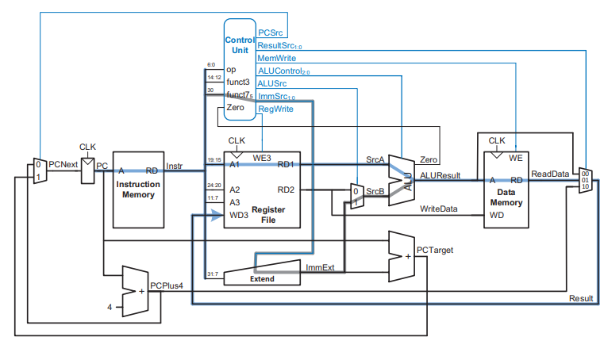
Risc-V Architecture :

Slide 3
Features added to risc-v :
A floating point register file is added in addition to the integer register file as well as fcsr (floating point control and status register) which is used to store the exception flags (NV, NX, OF, UF and DZ) and the rounding mode (frm) which in our design is set to 3’b0.
The invalid flag “NV” is raised when we have signaling NaN as an operand in all operations except sign injection operations, while it’s raised when we have quiet NaN in comparing operations (flt and fle).
The overflow flag “OF” is set when the exponent part exceeds its full range, while the underflow flag “UF” is set when the exponent part decreases less than its minimum range.
The inexact flag “NX” is set whenever one of the “OF” or “UF” flags or both are set.
The divide by zero flag “DZ” is always set to zero as division is not supported in this design.

Slide 4
Features added to risc-v :
A flag “f” is added from the control unit to the ALU and the register file to enable floating point operations.
A flag “flsw” is added from the control unit to the register file to enable floating point loading and store by reading from integer register file on an output port of the register file and reading from floating point register file on the other output port as well.
A flag “RegWritei” is added to enable writing in integer register file only, and another flag “RegReadi” is added to enable reading from integer register file only.
An input port “unsigned_conv” is added to the control unit to manage, when performing conversion operations, whether the conversion is signed or unsigned.
Rounding is performed on any ALU output whenever the “f” flag is set by using the RNE (round to nearest, ties to even) as the rounding mode which uses the “guard, round and sticky” (g, r and s) bits.

Slide 5
Round to nearest, ties to even rounding mode :
The guard and round bits are three external bits in the ALU used to hold the bits thrown away from the operand or ALU result’s significand part when shifting right.
On the other hand, the sticky bits is set to one whenever a bit of one is shifted to it even if it’s not the last bit shifted to it, while when no one has passed through it, it holds 0.
The g, r and s bits are used by checking if their weights (at the bits having a value of one) are less than half the weight of the last bit in the significand part to round down, their weights are more than half the weight of the last bit in the significand part to round up or their weights are equal to half the weight of the last bit in the significand part to round to the representation that has zero at the least significant bit in the significand part.

Slide 6
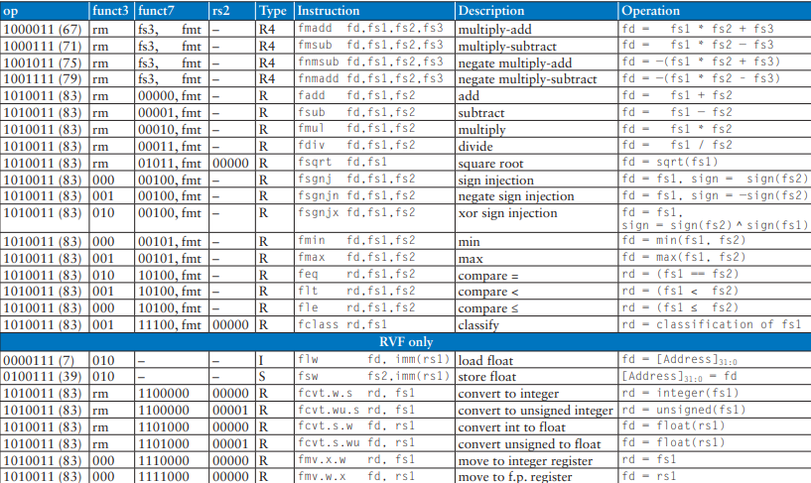
Floating-point operations supported:

Slide 7
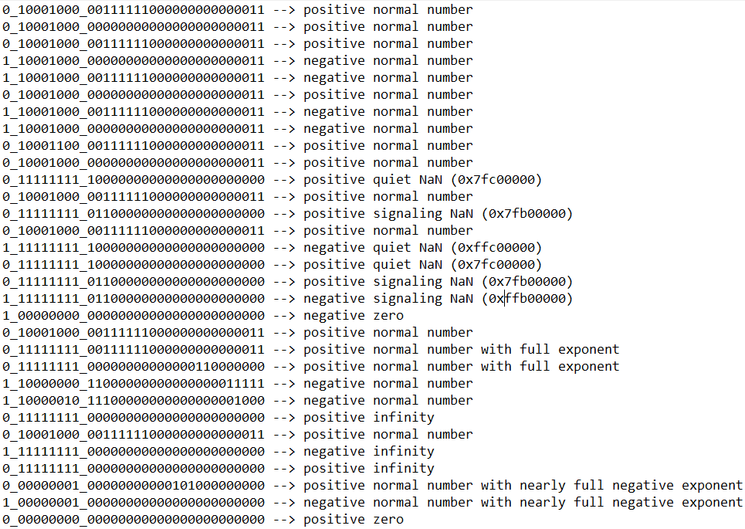
Floating point Data stored in data memory :

Slide 8
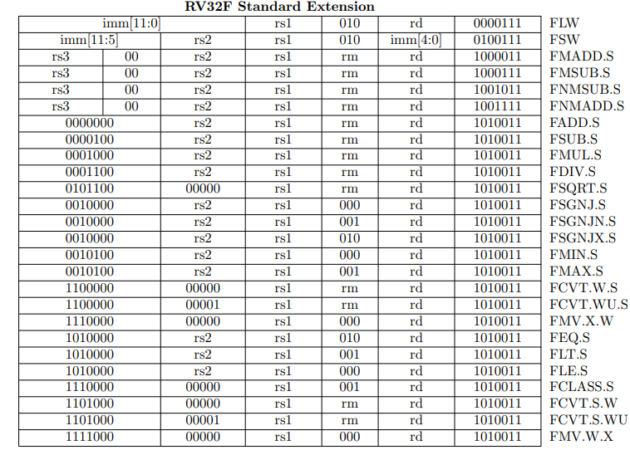
Floating point Instructions Formats :
F to int
F to int
Note: For the three instructions (fle, flt and feq), the result is 0 if either operand is NaN, while for the two instructions (fmax and fmin), if only one of the operands is NaN, the output will be the other operand, while if both operands are NaN, then the output will be a quiet NaN.

Slide 9
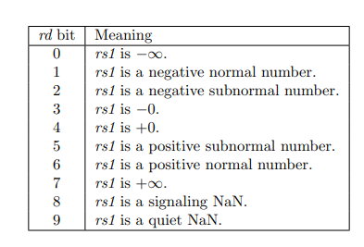
Fclass operation :
The FCLASS.S instruction examines the value in floating-point register fs1 and writes to integer register rd a 10-bit mask that indicates the class of the floating-point number. The corresponding bit in rd will be set if the property is true and clear otherwise. All other bits in rd are cleared. Note that exactly one bit in rd will be set.

Slide 10
Simulation & REsults
Run Modelsim

Slide 11
The End

