Slide 1
Operation Research for IT
Subject: Graphical method
Dr. Ahamed Abu Absaa
Student : Mohamed Abukhate,
Abdullah alda3or

Slide 2
1. Algorithm & Example
Algorithm
Graphical Method Steps (Rule)
Step-1:
Generate the mathematical model of the given LP problem.

Slide 3
Step-2:
a. Replace ≤ and ≥ sign to = in each constraint (inequality to equality). b. Find the two points of each line and draw it on graph. c. For inequality sign of each constraint, decide the area of
feasible solution.
(For ≤ constraint it is left side of the line and for ≥ constraint it is right side of the line. So for easy understanding, take any point of left side of line and if it satisfies the constraint then mark the left side area otherwise mark the right side area) d. Shade the common portion of the graph.

Slide 4
Step-3:
a. Decide the extreme points (corner points) of the feasible region. b. Calculate the objective function value at each extreme points. c. Find out min or max value (optimal value) of the objective function.

Slide 5
Example-1
1. Find solution using graphical method MAX z = 40x1 + 80x2 subject to 2x1 + 3x2 <= 48
x1 <= 15 x2 <= 10 and x1,x2 >= 0

Slide 6
Hint to draw constraints 1. To draw constraint 2x1+3x2≤48→(1) Treat it as 2x1+3x2=48 When x1=0 then x2=? ⇒2(0)+3x2=48 ⇒3x2=48 ⇒x2=48/3=16 When x2=0 then x1=? ⇒2x1+3(0)=48 ⇒2x1=48 ⇒x1= 48/2 =24
x1 | 0 | 24
x2 | 16 | 0

Slide 7
2. To draw constraint x1≤15→(2) Treat it as x1=15 Here line is parallel to Y-axis
x1 | 15 | 15
x2 | 0 | 1
3. To draw constraint x2≤10→(3) Treat it as x2=10 Here line is parallel to X-axis
x1 | 0 | 1
x2 | 10 | 10

Slide 8
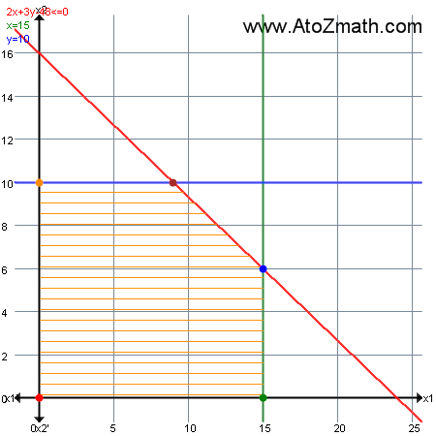

Slide 9
The value of the objective function at each of these extreme points is as follows:
Extreme Point Coordinates (x1,x2) | Lines through Extreme Point | Objective function value z=40x1+80x2
O(0,0) | 4→x1≥0 5→x2≥0 | 40(0)+80(0)=0
A(15,0) | 2→x1≤15 5→x2≥0 | 40(15)+80(0)=600
B(15,6) | 1→2x1+3x2≤48 2→x1≤15 | 40(15)+80(6)=1080
C(9,10) | 1→2x1+3x2≤48 3→x2≤10 | 40(9)+80(10)=1160
D(0,10) | 3→x2≤10 4→x1≥0 | 40(0)+80(10)=800
The maximum value of the objective function z=1160 occurs at the extreme point (9,10). Hence, the optimal solution to the given LP problem is : x1=9,x2=10 and max z=1160.

Slide 10
the code is in graphical method solution
clear all;
close all;
clc;
FOS= input(' Enter the value for FOS= ');
F= input('Enter Force= ');
L= input('Length= ');
E= input('Enter Youngs Modulus for Material= ');
sigma_y= input('Yield Stress of the Material= ');
def= input(' Maximum allowable deflection= ');

Slide 11
Count
a= input(' Minimum depth of the beam= ');
b= input(' Maximum depth of the beam= ');
darshan1= 6*F*(L)*FOS/sigma_y;
x1= a:0.001:b;
[r,c]=size(x1);
x2=x1;
for i=1:1:c
x2(1,i)=darshan1/x1(1,i)^2;
end
darshan2=4*F*(L^3)/E*def;
x3=x1;
for i=1:1:c
x3(1,i)=darshan2/x1(1,i)^3;
end
plot(x1,x2,x1,x3);

Slide 12
Or
clear all;
close all;
clc;
FOS= input(' Enter the value for FOS= ');
F= input('Enter Force= ');
L= input('Length= ');
E= input('Enter Youngs Modulus for Material= ');
sigma_y= input('Yield Stress of the Material= ');
def= input(' Maximum allowable deflection= ');
a= input(' Minimum depth of the beam= ');
b= input(' Maximum depth of the beam= ');
darshan1= 6*F*(L)*FOS/sigma_y;
darshan2=4*F*(L^3)/E*def;
x1= a:0.001:b;
[r,c]=size(x1);
x2=darshan1./x1.^2;
x3=darshan2./x1.^3;
plot(x1,x2,'r',x1,x3,'b');

