Slide 1

Sales Data Analysis - AdventureWorks Database
Exploratory Data Analysis with Python

Slide 2
Project Overview
- Analysis of AdventureWorks sales data
- Data extraction from SQL Server
- Data cleaning and preprocessing
- Exploratory data analysis
- Visualization of key metrics
Technologies used:
• Python (pyodbc, pandas, matplotlib, seaborn)
• SQL Server
• AdventureWorks2019 database

Slide 3
Data Extraction Code
Extracted 29225 sales records with 9 columns
Columns: SalesOrderID, OrderDate, CustomerID, SubTotal, TaxAmt, Freight, Territory, TotalSales, Year
import pyodbc
import pandas as pd
conn = pyodbc.connect(
r"DRIVER={ODBC Driver 18...};"
r"SERVER=localhost;"
r"DATABASE=AdventureWorks2019;"
r"Trusted_Connection=yes;"
r"Encrypt=no;"
)
query = """SELECT
soh.SalesOrderID,
soh.OrderDate,
soh.CustomerID,
soh.SubTotal,
soh.TaxAmt,
soh.Freight,
st.Name AS Territory
FROM Sales.SalesOrderHeader soh
LEFT JOIN Sales.SalesTerritory st
ON soh.TerritoryID = st.TerritoryID"""
df = pd.read_sql(query, conn)
conn.close()

Slide 4
Data Cleaning
Final dataset shape: (29225, 9)
Missing values handled: Territory (58)
Duplicates removed: Yes
# Check for missing values
print("Before drop ", df.isna().sum())
df.dropna(inplace=True)
# Check for duplicates
print("Number of duplicate rows:",
df.duplicated().sum())
df.drop_duplicates(inplace=True)

Slide 5
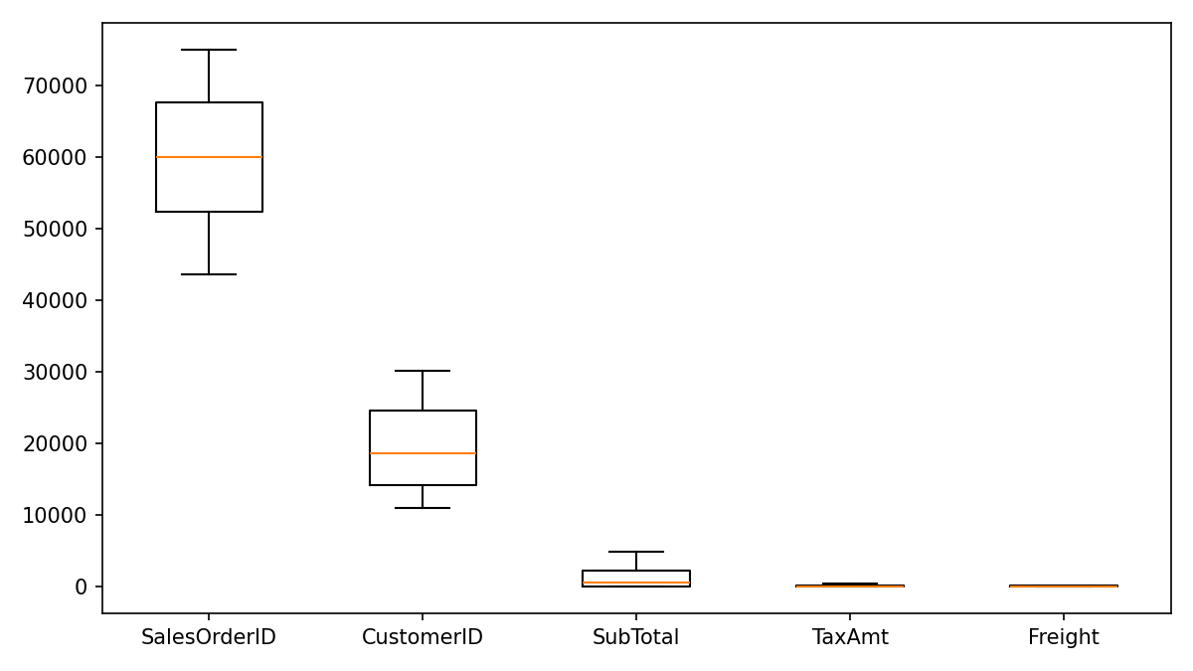
Outlier Detection

Slide 6
Outlier Removal
Shape after outlier removal: (29225, 9)
for col in numeric_cols:
Q1 = df[col].quantile(0.25)
Q3 = df[col].quantile(0.75)
IQR = Q3 - Q1
lower_bound = Q1 - 1.5 * IQR
upper_bound = Q3 + 1.5 * IQR
df = df[(df[col] >= lower_bound) &
(df[col] <= upper_bound)]

Slide 7
Feature Engineering
Created new features:
- TotalSales
- Year
# Create new features
df['TotalSales'] = (df['SubTotal'] +
df['TaxAmt'] +
df['Freight'])
df['Year'] = pd.to_datetime(
df['OrderDate']).dt.year

Slide 8
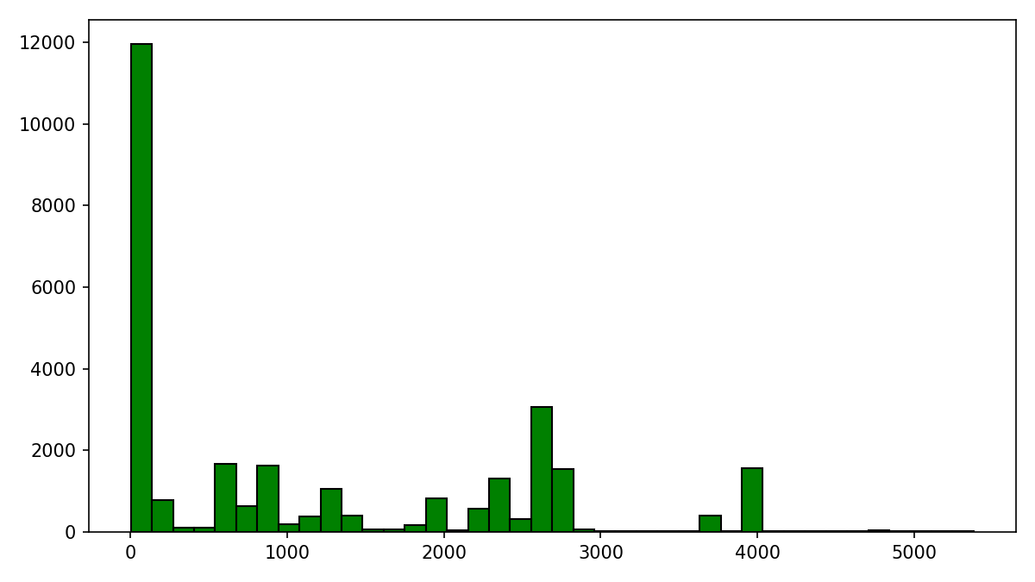
Total Sales Distribution

Slide 9
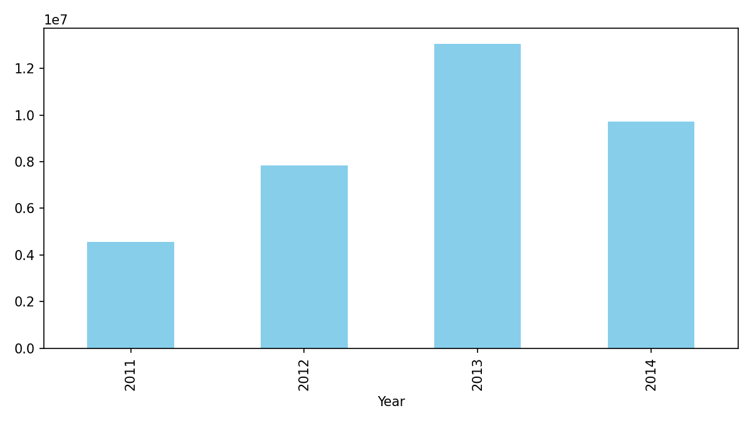
Sales by Year

Slide 10
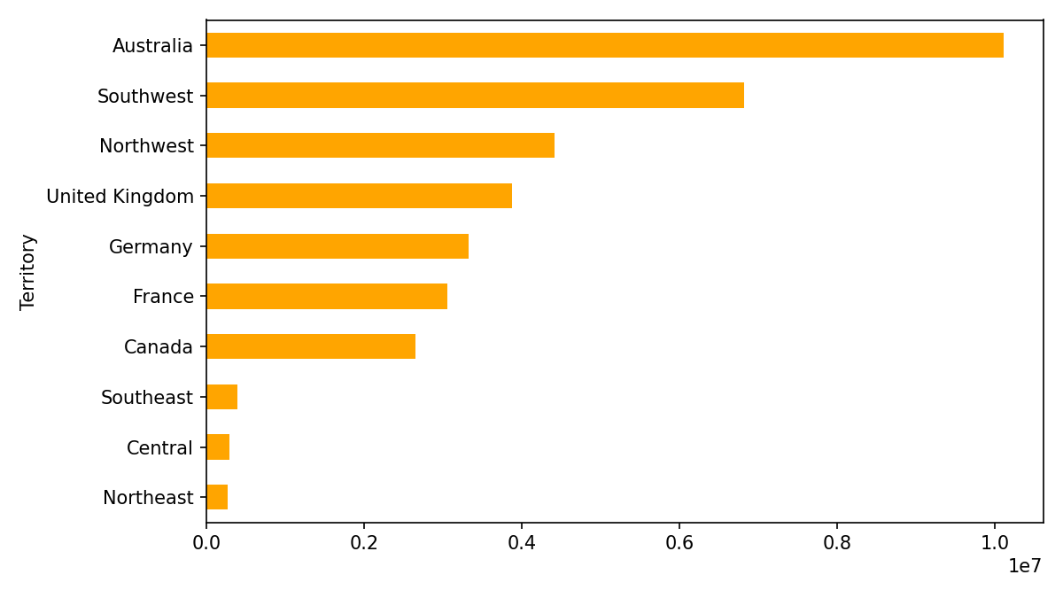
Sales by Territory

Slide 11
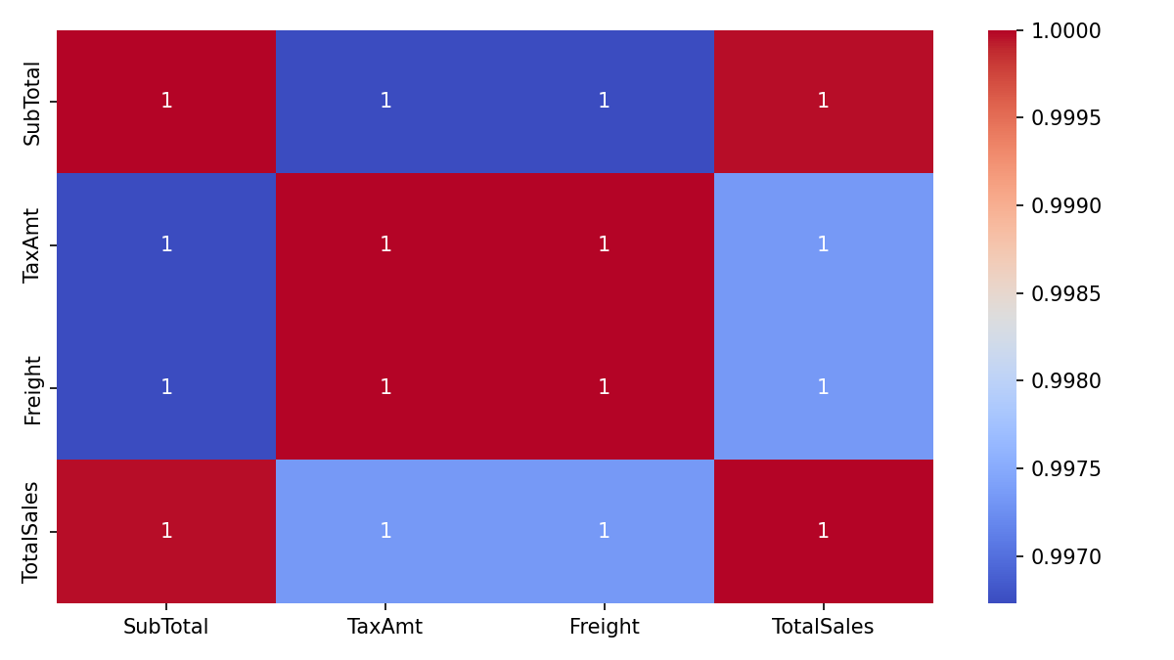
Feature Correlations

Slide 12

Key Findings
1. Sales Distribution: Most orders fall in lower range
2. Yearly Trends: Clear patterns by year
3. Top Territory: Australia
4. Correlations: Strong between SubTotal and TotalSales
5. Data Quality: Minimal missing data

Slide 13

Conclusion
Key insights:
- Identified sales patterns and distributions
- Cleaned and prepared data for analysis
Next steps:
- Customer segmentation
- Time series forecasting
- Profitability analysis

Slide 14

Thank You!
Questions?

