Slide 1
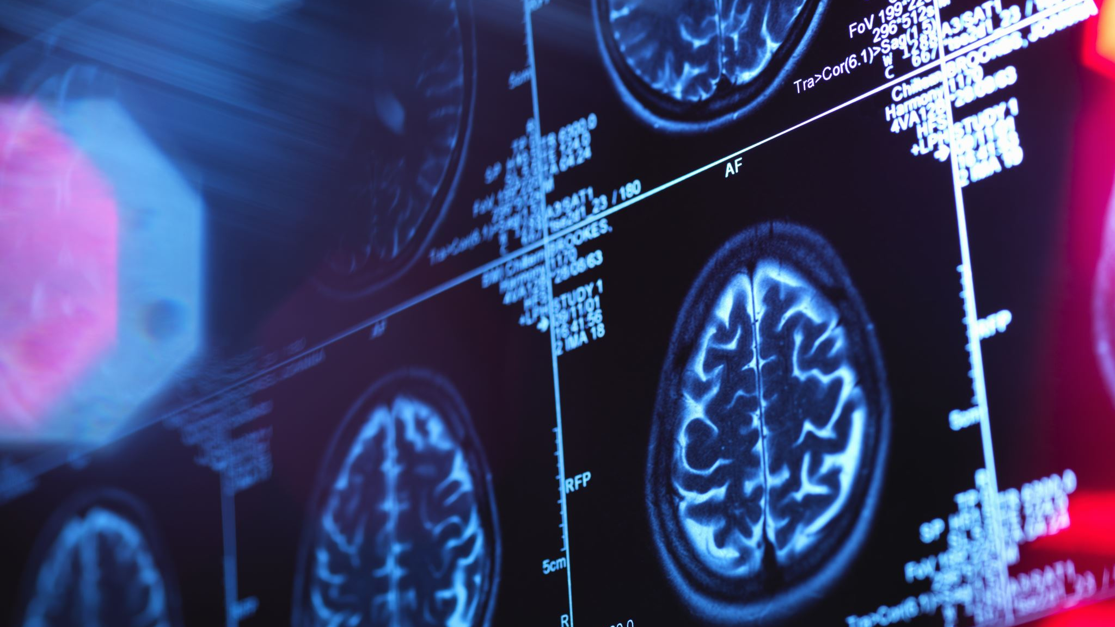
Convolutional Neural Networks for multi class Classification of Alzheimer’s Disease
Supervised By :-
Dr. Walid Hussein
Solution Proposed by :-
Mohamed Ashraf -161649 -AI
1

Slide 2

Introduction
Alzheimer’s disease (AD) is the cause of over 60% of dementia cases.
develop when nerve cells in the brain (called neurons) die or no longer function in a normal way
Early diagnosis of AD is essential for making treatment plans to slow down the progress of AD
The death of neurons causes abnormalities in memory, behaviour, and ability to think clearly
eventually impair an individual’s ability to perform even basic functions such as walking, speaking, and swallowing
2

Slide 3
Alzheimer’s Disease Stages
Asymptotic Stage.
Mild Cognitive Impairment Stage(MCI).
Dementia (disease) Stage.
3

Slide 4
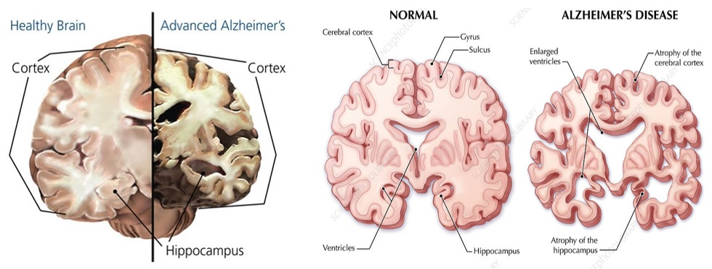
What happens to the brain?
The hippocampus abnormally shrinks in its size 2.2% to 5.9 % annually
4

Slide 5
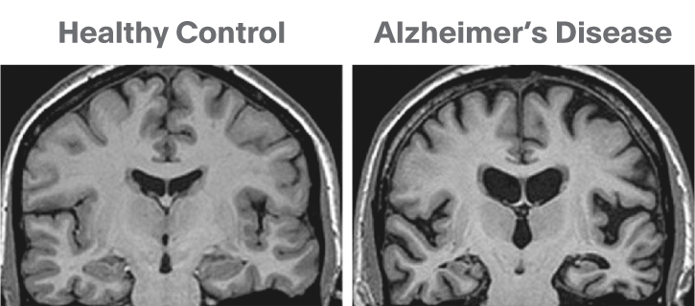
MRI Reflection
5

Slide 6
Motivation
The goal here is to use the deep learning techniques to develop such method. We will build a classifier whose task is to correctly classify what stage a patient at from an MRI scan of that patient’s
6

Slide 7
Solution methodology
Pass dataset to CNN and build model.
Start
Data
Collection
Preprocessing
CNN configuration
End
Pass dataset to Inception and build model.
Start
Data
Collection
Preprocessing
Inception
Configuration
End
7

Slide 8

Convolutional Neural Network Structure
8

Slide 9
The implementation CNN layers
Layers | Details
Input | input shape (176,176 ,3)
Conv2D | 16 filter, activation=Relu, padding='same'(1)
Conv2D | 16 filter, activation=Relu, padding='same'(1)
MaxPool2D
Conv2D | 32 filter, activation=Relu, padding='same'(1)
Conv2D | 32 filter, activation=Relu, padding='same'(1)
Batch Normalization
MaxPool2D
Conv2D | 64 filter, activation=Relu, padding='same'(1)
Conv2D | 64 filter, activation=Relu, padding='same'(1)
Batch Normalization
MaxPool2D
Conv2D | 128 filter, activation=Relu, padding='same'(1)
Conv2D | 128 filter, activation=Relu, padding='same'(1)
Batch Normalization
MaxPool2D
Dropout | Dropout rate 0.2
Flatten
Dense | Units =512, activation= Relu
Batch Normalization
Dropout | Dropout rate=0.7
Dense | Units =128, activation= Relu
Batch Normalization
Dropout | Dropout rate=0.5
Dense | Units =64, activation= Relu
Batch Normalization
Dropout | Dropout rate=0.3
Dense | Units = 4, activation= SoftMax
9

Slide 10
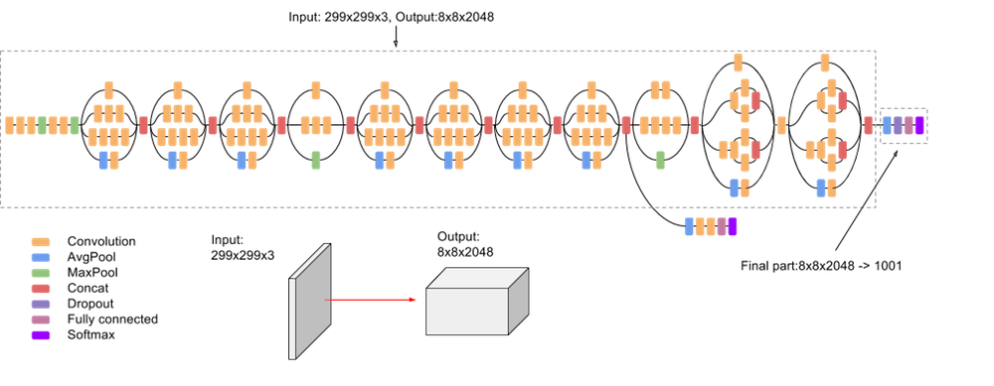
Inception Network Structure
10

Slide 11
Inception layers
Layers | Details
Input | Input shape=(176, 176, 3) , include top=False, weights=ImageNet
Dropout | Dropout rate=0.5
GlobalAveragePooling2
Flatten
Batch Normalization
Dense | Units =512, activation= relu
Batch Normalization
Dropout | Dropout rate=0.5
Dense | Units =265, activation= relu
Batch Normalization
Dropout | Dropout rate=0.5
Dense | Units =128, activation= relu
Batch Normalization
Dropout | Dropout rate=0.5
Dense | Units =64, activation= relu
Dropout | Dropout rate=0.5
Batch Normalization
Dense | Units = 4, activation='softmax'
11

Slide 12
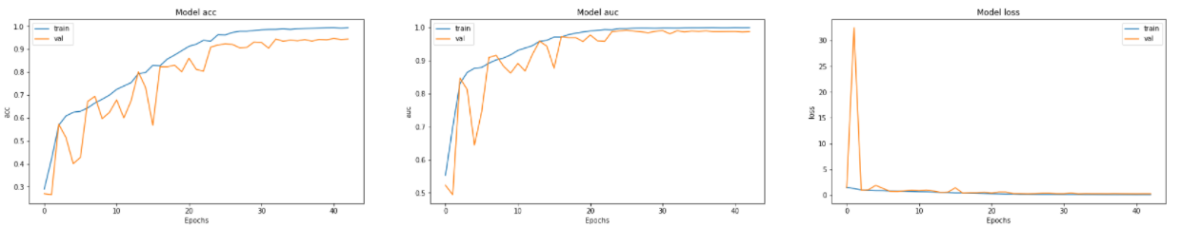
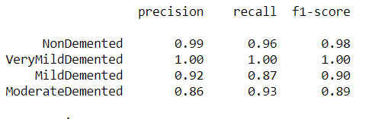
Result for the CNN model
12

Slide 13
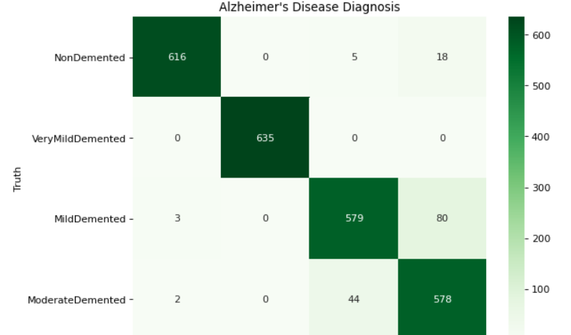
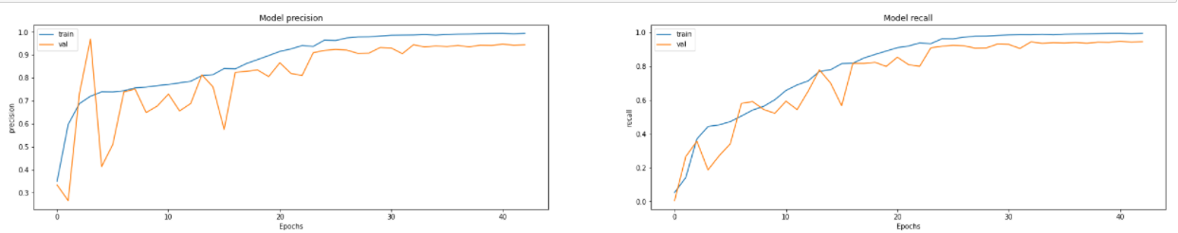
CNN Result
13

Slide 14
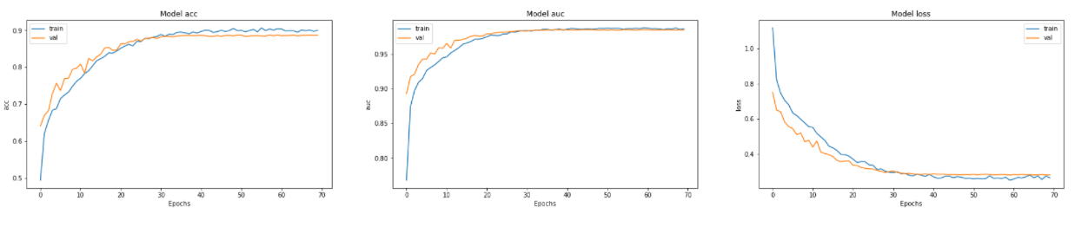
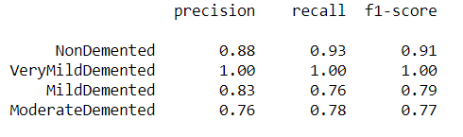
Result for the Inception model
14

Slide 15
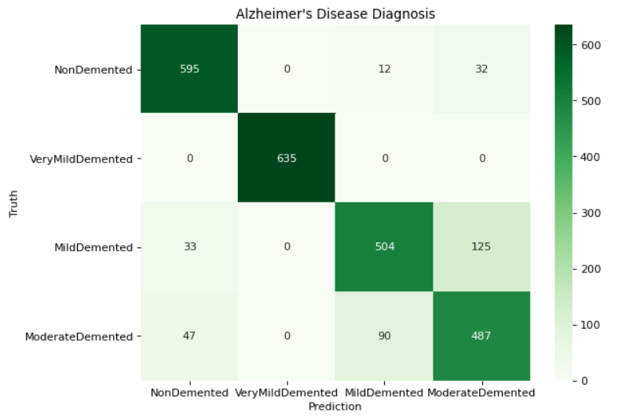
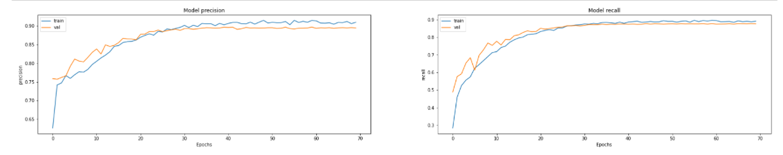
Result for the Inception model
15

Slide 16
The Data Set
Our data set is divided into three sets, training set ,test set and validation.
The training set contains 70%images, the validation 10% and testing contains 20% images.
Each set is divided into four classes, one for each AD stage and one for the non-demented (healthy) case.
16

