Slide 1
Class #1
Introduction to
MLOps & MLflow
In-depth: MLOps
SDD 2025/2026 — ISAE-SUPAERO

Slide 2
What is MLOps?

Slide 3
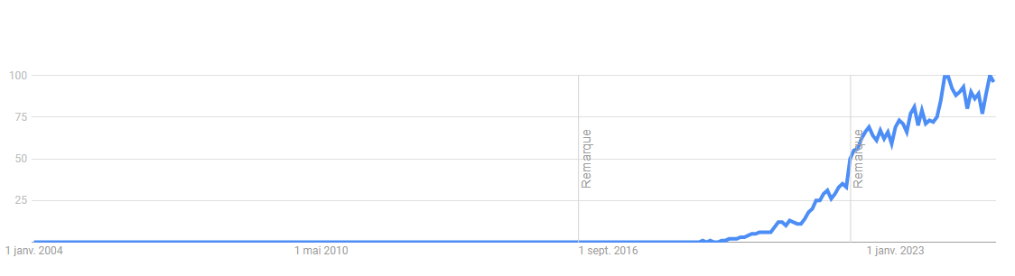
Why is MLOps Getting More Important?
The AI revolution is real
The benefits of AI/ML are well proven, especially with the boom of Generative AI. ChatGPT (Nov 2022) showed the world what AI can do.
Companies want to move AI from Proof of Concept to production. Only ~54% of ML projects make it past the POC stage.
MLOps bridges the production gap
MLOps provides the practices and tools to reliably deploy, monitor, and maintain ML models in production.
~54%
of ML projects never
make it to production
Google Trends
"MLOps" searches have
exploded since 2020,
peaking in 2024
Source: Google Trends

Slide 4
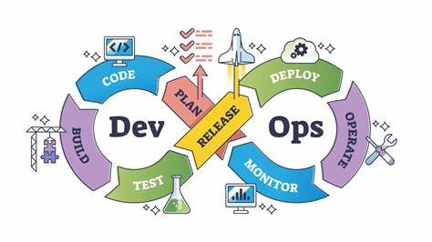
MLOps = DevOps applied to Machine Learning
MLOps stands for "Machine Learning Operations“ (2015)
MLOps empowers data scientists and app developers to help bring ML models to production. MLOps enables you to track / version / audit / certify / re-use every asset in your ML lifecycle and provides orchestration services to streamline managing this lifecycle
MLOps originates from DevOps (2007)
DevOps is a set of Best practices and technologies
to manage efficiently the lifecycle of the development of a Software
DevOps originates from Agile philosophy

Slide 5
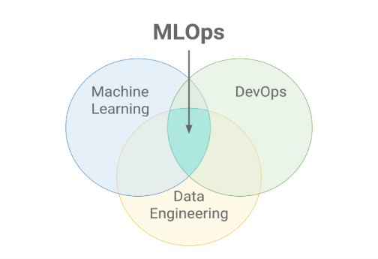
To put it straightforward
MLOps is a set of technologies and best practices that has 4 objectives:
1. Bring ML models to production, so the models can be used
2. Allow the maintenance of models in production
3. Monitor the lifecycle of a ML project
4. Automatize as many tasks as possible while achieving objectives #1 et #2

Slide 6
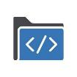
What does a typical ML project look like ?
Data
Collection
→
Exploratory
Analysis
→
Data Prep &
Feature Eng.
→
Model
Training
→
Model
Evaluation
→
Model
Inference
The ML project is source code
ml_project/
├── data/
│ ├── train/ # Training data
│ ├── test/ # Test data
│ └── raw/ # Unprocessed data
├── src/
│ ├── train.py # Training script
│ ├── inference.py # Predictions
│ ├── model.py # Model definition
│ └── preprocess.py
├── notebooks/
│ ├── eda.ipynb
│ └── model_training.ipynb
├── artifacts/
│ ├── model.pkl # Trained model
│ └── metrics.json
├── tests/
├── requirements.txt
├── config.yaml
└── README.md
Key questions
How do I track which hyperparameters gave the best results?
How do I share results with my team?
How do I deploy this model so users can access it?
How do I know if performance degrades over time?
How do I update the model without downtime?

Slide 7
Challenges when deploying ML models
Deploying a ML model = serving source code on a target server and running it
Challenge
Challenge
Environment mismatch
Continuous improvement
The target server likely has different specs: different Python version, different OS, missing libraries...
Once deployed, how do you keep improving the model? Switch algorithms? Update with new data?
Solution
Solution
Containerization (Docker) — Package code + dependencies in isolated containers
CI/CD pipelines — Continuous Integration & Continuous Deployment automate the update cycle
These are DevOps solutions adapted for ML — this is exactly what MLOps is about!

Slide 8

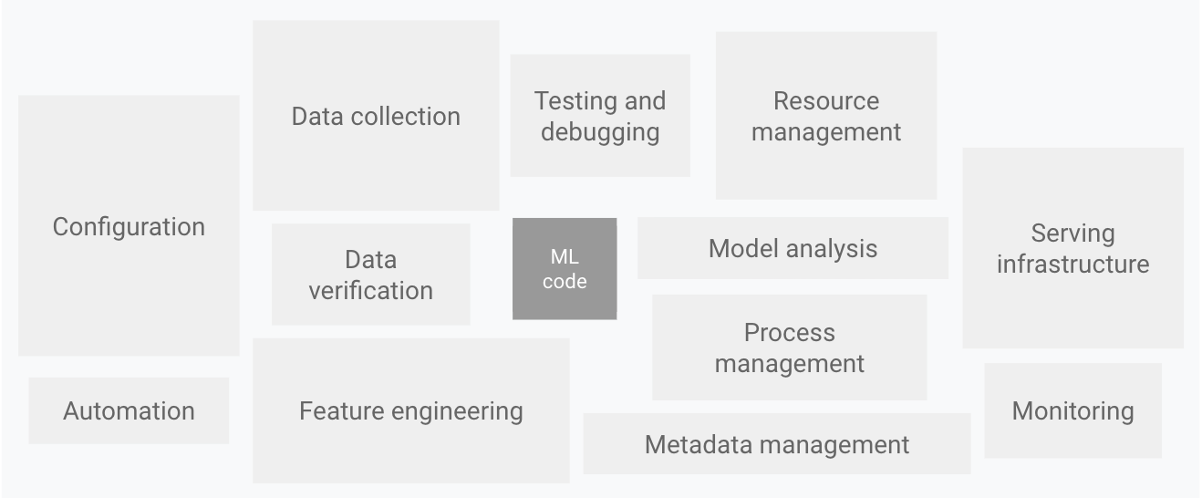
ML projects are complex – Far beyond just code
Google (2015)

Slide 9
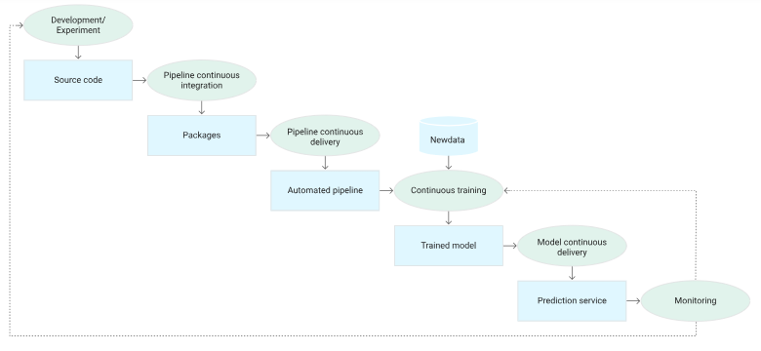
MLOps worfklow

Slide 10
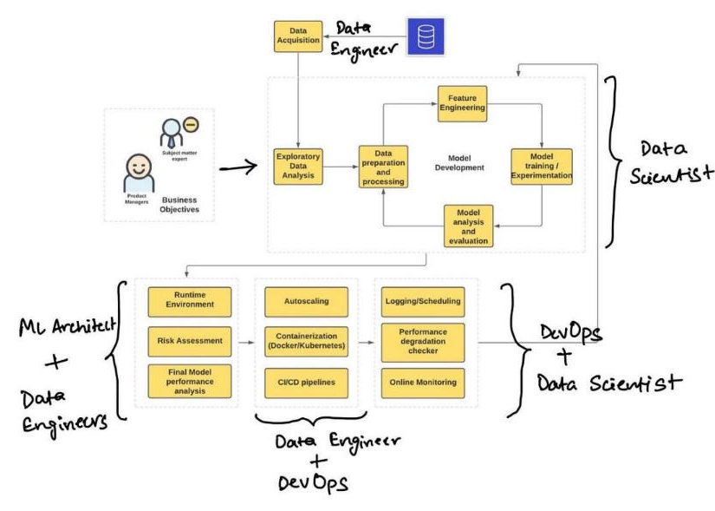
Deploying a ML project involves many data experts

Slide 11
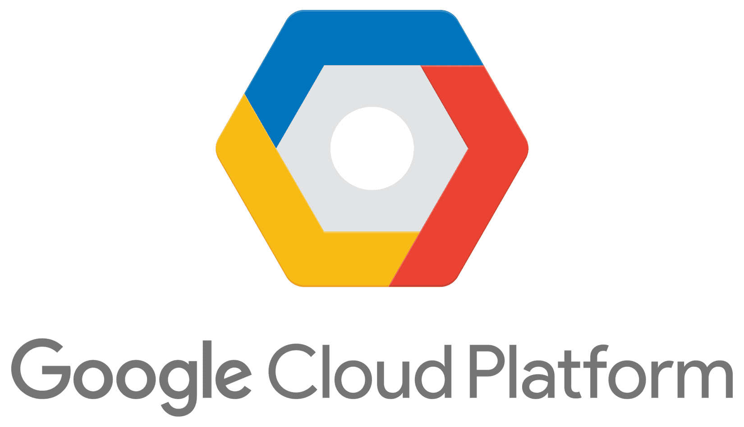

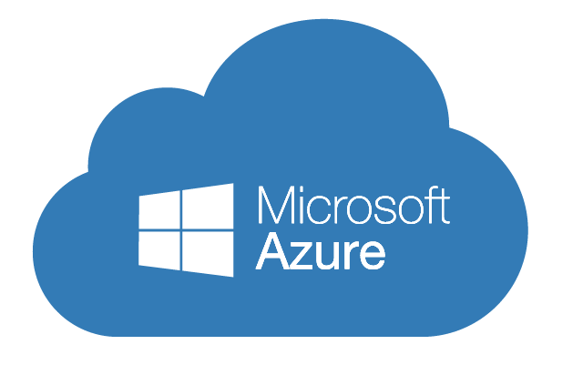
MLOps comes hand-in-hand with Cloud
Cloud = remote servers accessible through a network.
Public Cloud = servers accessible through the internet.
The Big 3 Cloud Providers
Cloud provides useful services for ML:
- Compute (GPU, RAM)
- Storage (e.g. for data)
- Managed ML services
- Foundation Models available as APIs

Slide 12
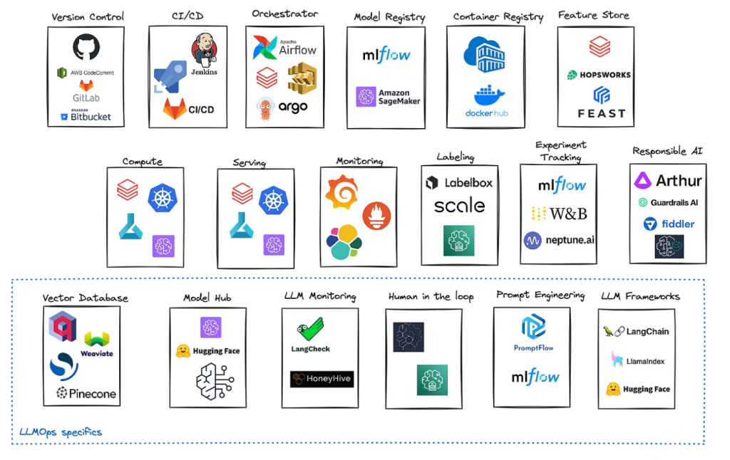
MLOps tools landscape

Slide 13


Slide 14



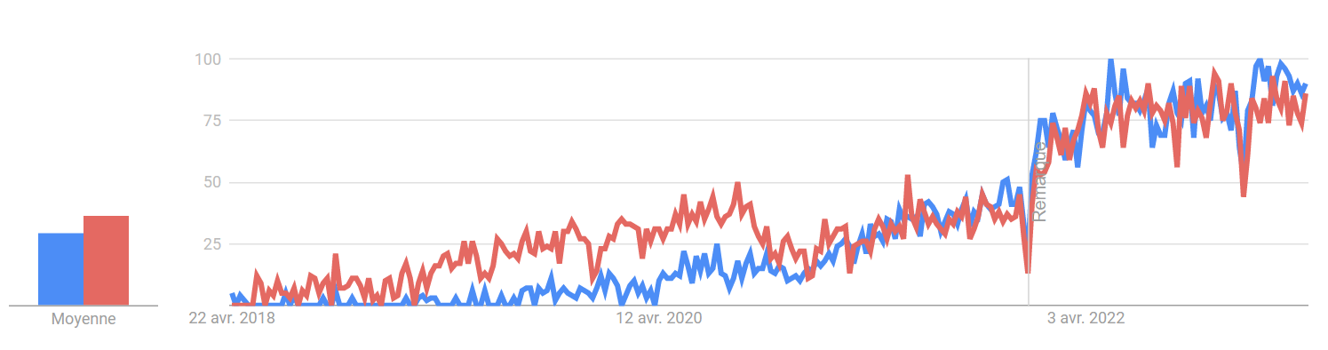
MLFlow follows the trend of increasing interest for MLOps
Source : Google Trends

Slide 15
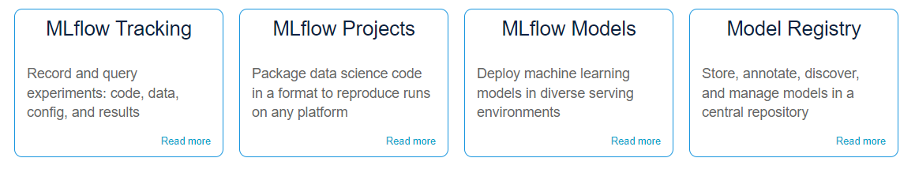
What is MLFlow ?
Open source platform developed by Databricks to manage ML models lifecycles. A comprehensive solution from experimentation to deployment.
The 4 main components of MLFlow:
Source : mlflow.org

Slide 16
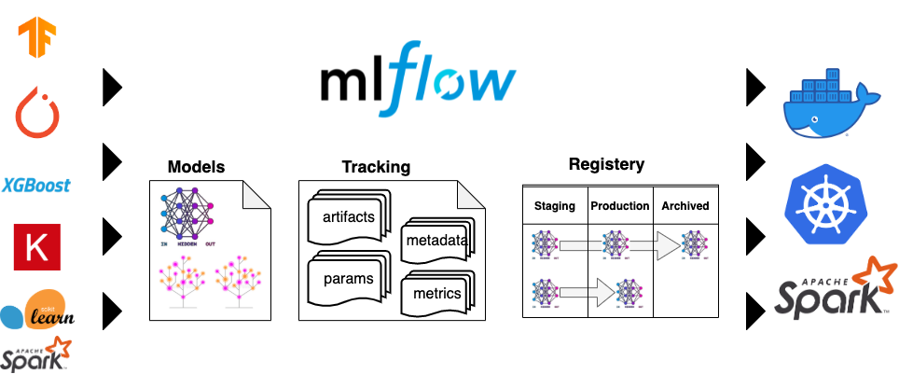

A universal solution
High compatibility with ML frameworks
High compatibility with deployment platforms

Slide 17
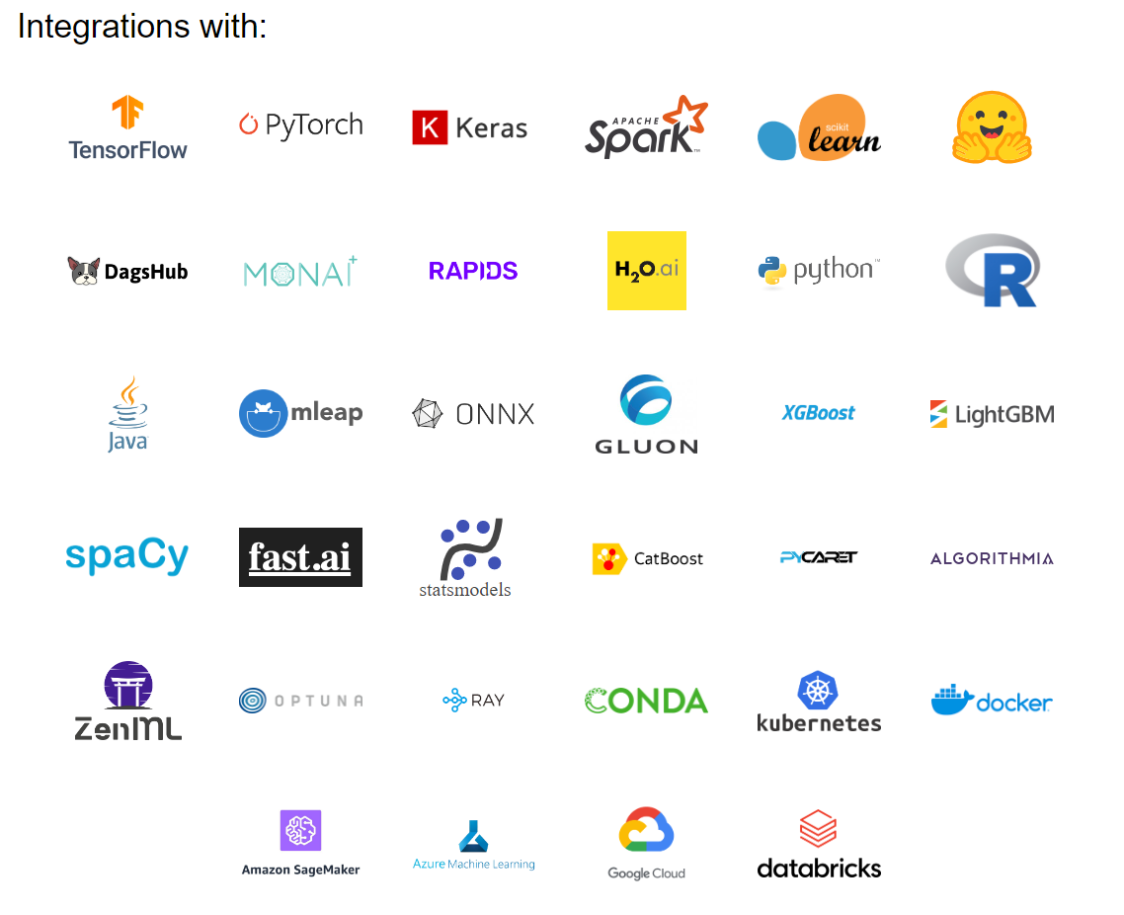
Other examples
Source : mlflow.org

Slide 18
When to use MLFlow ?
Solo projects (local)
1
When training one or more ML models on your own machine. MLflow is lightweight — track experiment results without heavy dependencies.
Team projects
2
Share hyperparameters, metrics, and KPIs on the same model across your team. Everyone sees the same experiment history.
Production pipelines (cloud / on-premise)
3
MLflow hosts and deploys models. Separating training and deployment pipelines improves maintenance, security, and reliability.

Slide 19
When to use MLFlow ?
Solo projects (local)
1
When training one or more ML models on your own machine. MLflow is lightweight — track experiment results without heavy dependencies.
Team projects
2
Share hyperparameters, metrics, and KPIs on the same model across your team. Everyone sees the same experiment history.
Production pipelines (cloud / on-premise)
3
MLflow hosts and deploys models. Separating training and deployment pipelines improves maintenance, security, and reliability.

Slide 20
Today’s Lab & Resources
Lab 01 — MLflow Experiment Tracking
Resources
~2h30 | German Credit Risk dataset
Papers:
Hidden Technical Debt in ML Systems (Google, 2015)
Build & Deploy GenAI/ML in the Enterprise (Google, 2024)
MLflow docs:
mlflow.org/docs
What you will learn:
Launch & connect to an MLflow tracking server
Log parameters, metrics, and artifacts
Compare runs using the MLflow UI
Automate hyperparameter search with Optuna
Register and version models in the Model Registry
Load a registered model for inference

Slide 21
Today’s Lab
Completed notebook must be sent to: jdiamant280@headmind.com
Let's get started!

