Slide 1

Telecom Analysis Project

Slide 2
Our Team
Momen Amr
Karim Diab
Islam Ashraf
Mohamed Sebeh
Samah Zain

Slide 3
Content
Introduction
Database Design
DWH Design
ETL Process
Analyzing data

Slide 4
Introduction

Slide 5
Introduction
This project aims to assist the company in preventing the decrease in the number of customers and providing ideas to increase their count.
By gaining insights into the factors driving churn, we acknowledge that the reasons for this phenomenon are diverse, ranging from dissatisfaction with services to competitive offerings from other providers.
Our objective is to furnish telecom companies with valuable insights to improve their overall performance.

Slide 6
Database Design

Slide 7
Database Design
Collecting the data
Understanding the data
Cleaning the data
Design entity relation diagram ( ERD )
Design the mapping
Creating tables in SQL
Transfer the data to SQL

Slide 8
NOTE:
When collecting data, the data must be appropriate for the project’s goal and must be from a reliable source. Therefore, data was selected from the Kaggle website.
You can explore it from this [link]

Slide 9
Cleaning the data

Slide 10
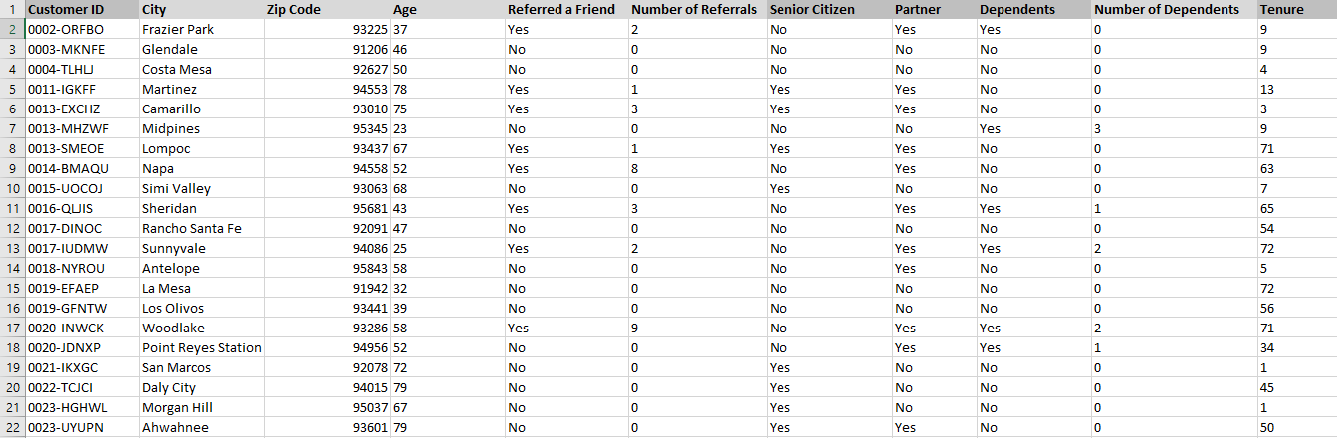
Cleaning the data
Data before cleaning:

Slide 11
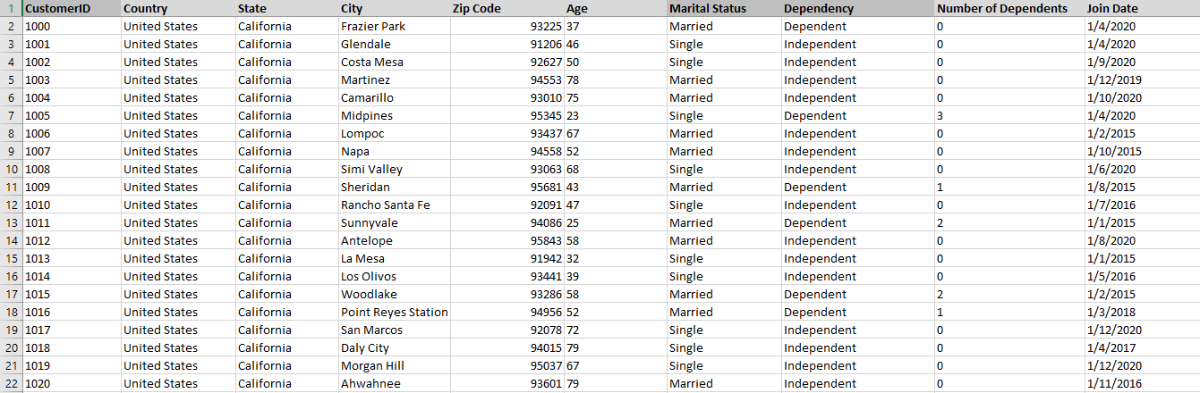
Cleaning the data
Data after cleaning:

Slide 12
Design entity relation diagram ( ERD )

Slide 13
Design entity relation diagram ( ERD )
Identify the entities
Identify the attributes
Identify the primary key
Identify the relationships :
Degree of relationship
Cardinality ratio
Participation

Slide 14
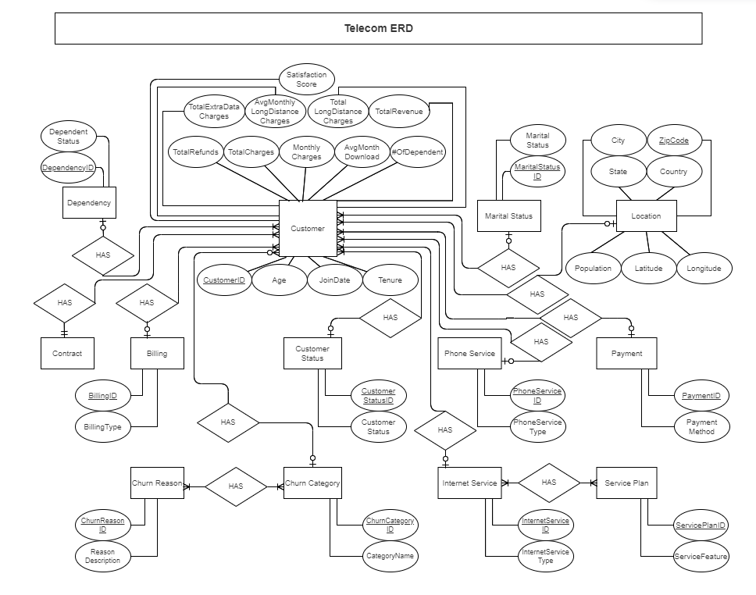
Design entity relation diagram ( ERD )

Slide 15
Design mapping

Slide 16
Design mapping
Mapping of regular entity
Mapping of relationships :
Binary ONE to MANY
Binary MANY to MANY

Slide 17
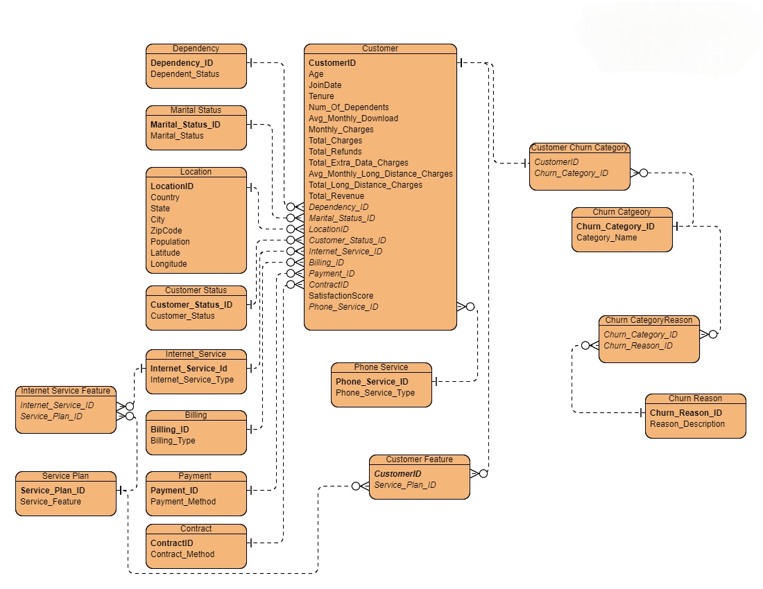
Design mapping

Slide 18
Creating tables in SQL

Slide 19
Creating tables in SQL
NOTE :
At this stage we convert what we did in mapping stage to actual tables in SQL server
taking into consideration the PK and FK constraint to adjust relationships between tables

Slide 20
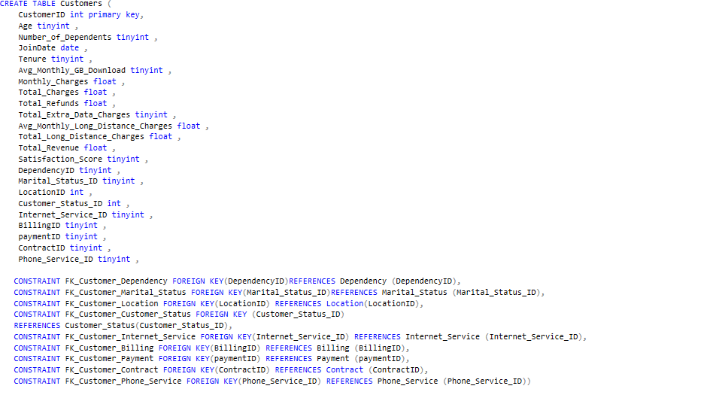
Creating tables in SQL
Example of Creating tables :

Slide 21
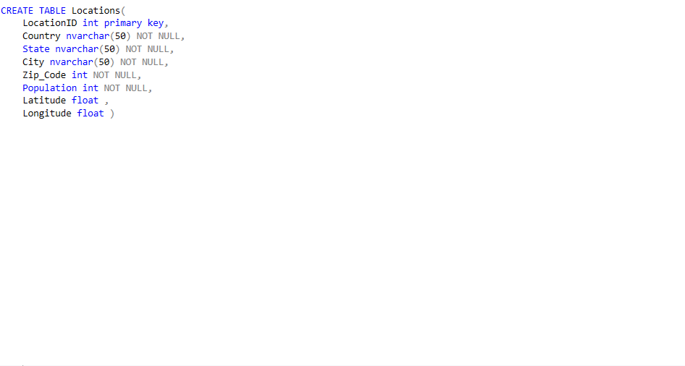
Creating tables in SQL
Another example of Creating tables :

Slide 22
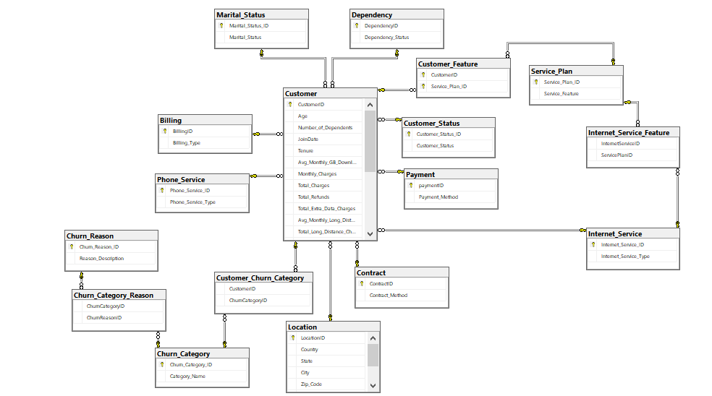
Creating tables in SQL
Database Diagram :

Slide 23
Transfer data to SQL

Slide 24
Transfer data to SQL
NOTE :
We can transfer data in two different ways either by importing excel files into SQL or by using SSIS to transfer the data from data source (excel files) to destination (Database).
But we preferred to transfer it using SSIS (Full load).

Slide 25
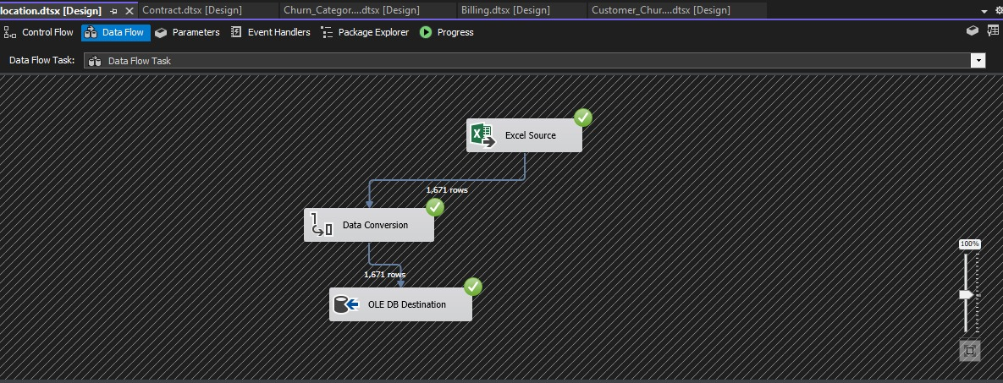
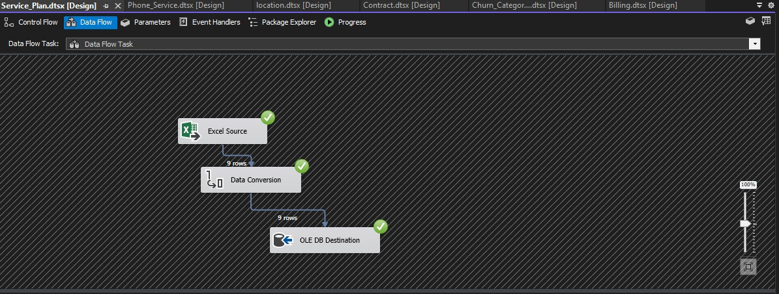
Transfer data to SQL
Example of transfer data :

Slide 26
DWH Design

Slide 27
DWH Design
The primary goal of a data warehouse is to provide a reliable, centralized repository of integrated data that can be easily accessed and analyzed to support strategic decision-making and business intelligence activities within an organization.
By understanding the business first and then converting normalized tables in a database into denormalized tables in a data warehouse through dimension tables and a fact table. To meet the business needs of analysis for a later period

Slide 28
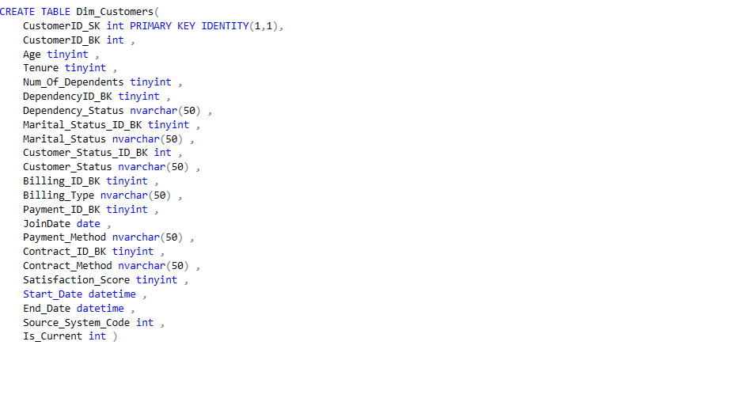
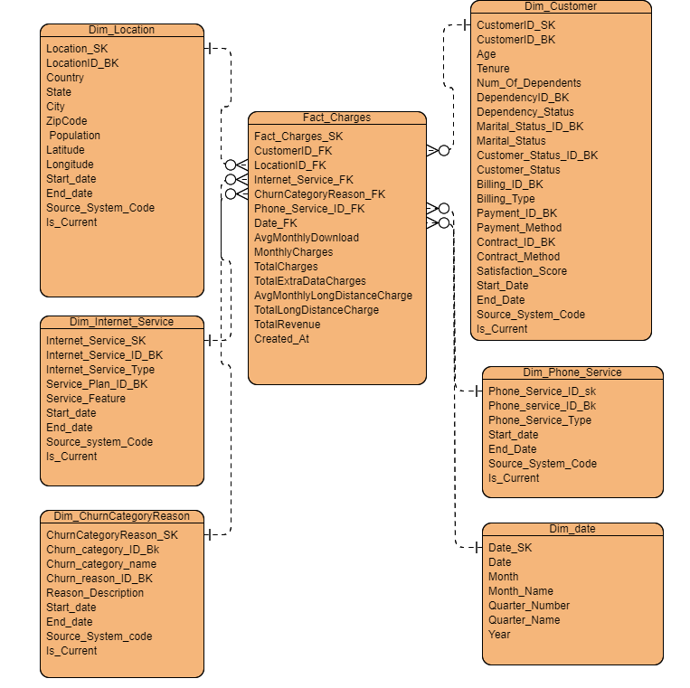
DWH Design
Identify dimension tables and fact table :

Slide 29
DWH Design
Example of creating tables :

Slide 30
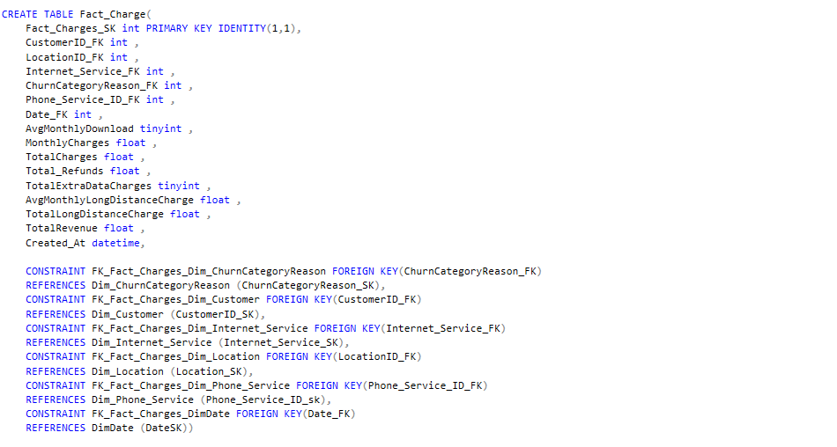
DWH Design
Another example of creating tables :

Slide 31
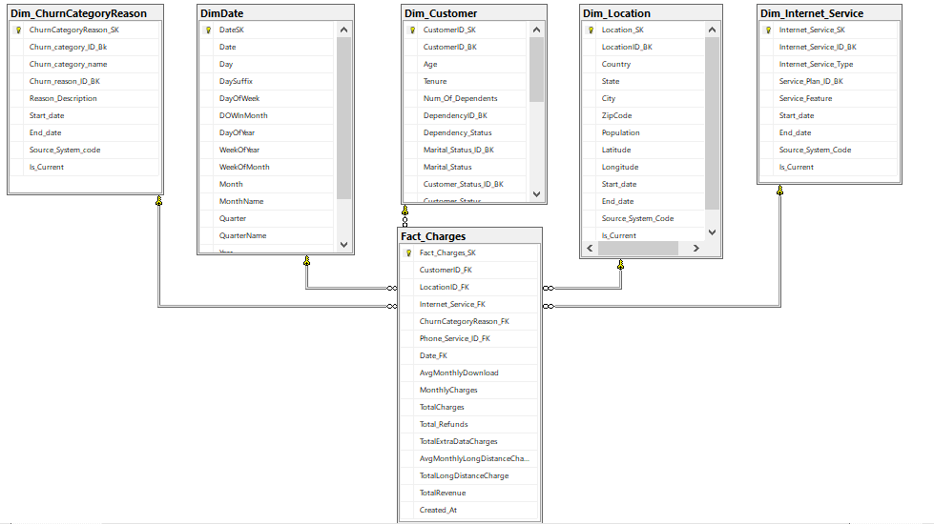
DWH Design
Data warehouse Diagram (Star Schema) :

Slide 32
ETL Process

Slide 33
ETL Process
Using SSIS to transfer data from database to data warehouse (Incremental Load) taking into consideration the slowly changing dimension and the look up.
Transfer The dimension tables first and then transfer the fact table.

Slide 34
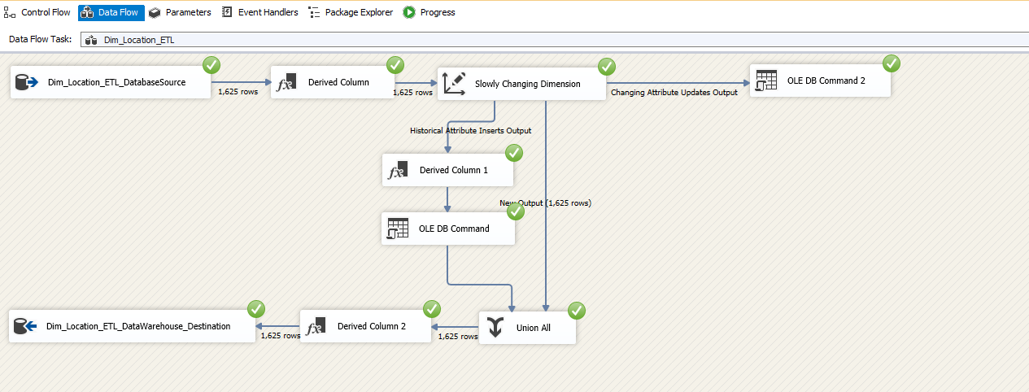
ETL Process
Example of transfer Dim Location table :

Slide 35
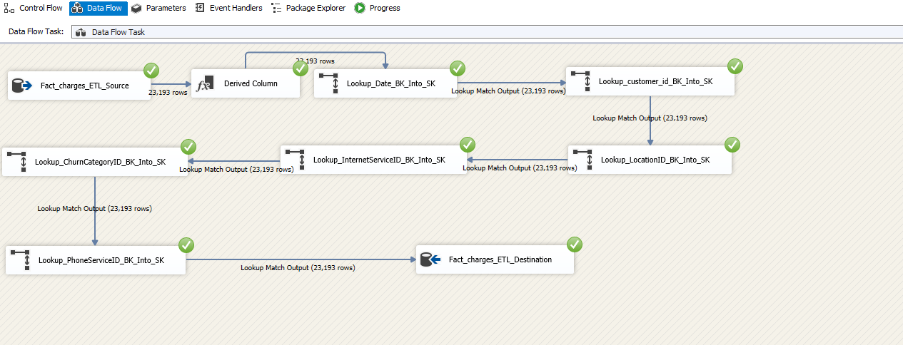
ETL Process
Another example of transfer Fact Charges table :

Slide 36
Analyzing data

Slide 37
Analyzing data
We can analyze data in multiple ways, such as:
SSAS and SSRS
visualization using Power BI
visualization using Tableau
visualization using Excel

Slide 38
SSAS and SSRS

Slide 39
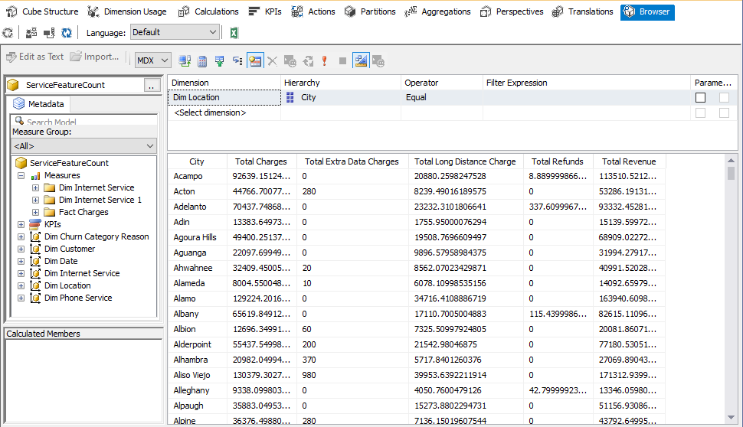
SSAS and SSRS
Example of City Revenue Cube:

Slide 40
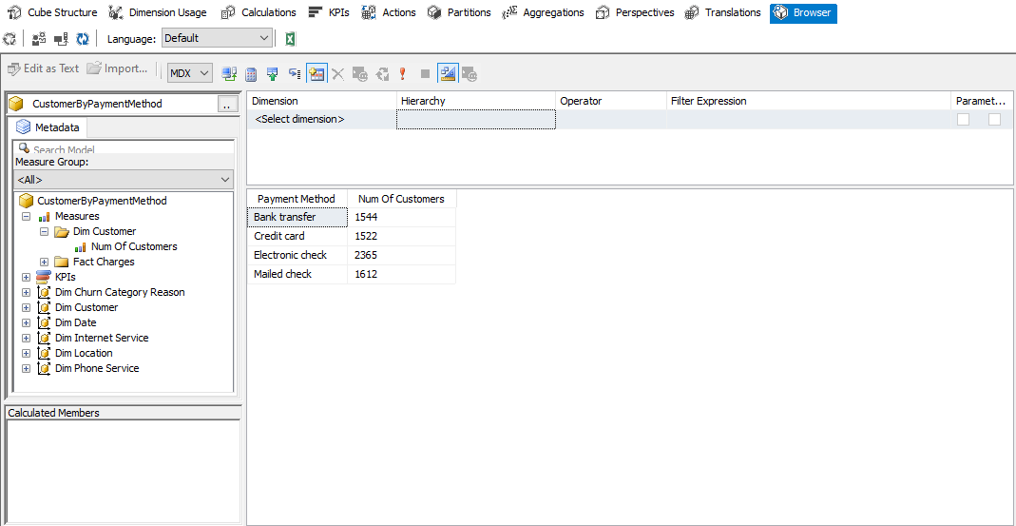
SSAS and SSRS
Another example of Customer by Payment Method Cube:

Slide 41
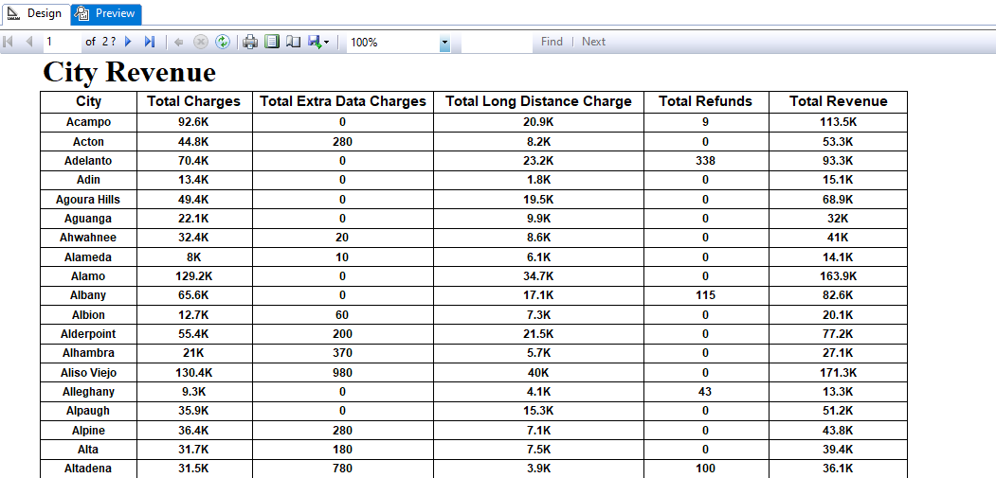
SSAS and SSRS
Example of City Revenue Report:

Slide 42
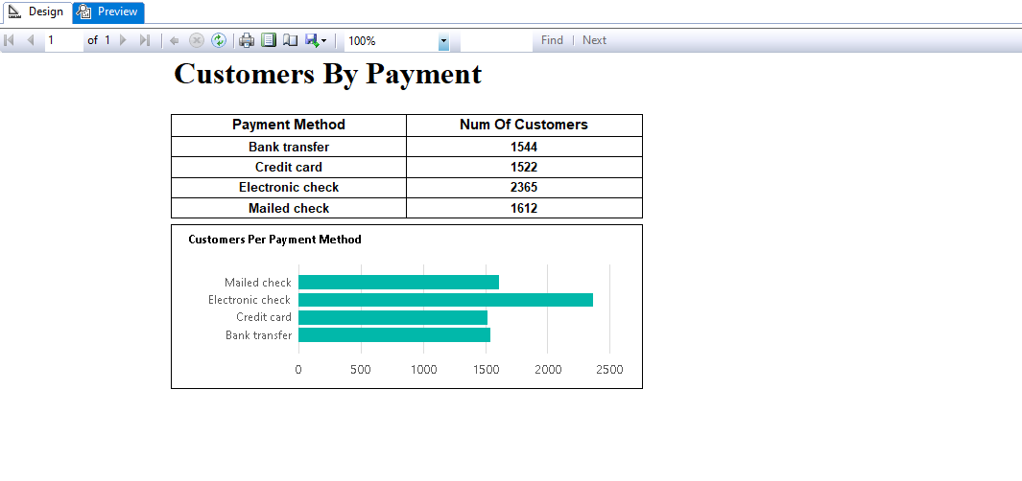
SSAS and SSRS
Example of Customer by Payment method Report:

Slide 43
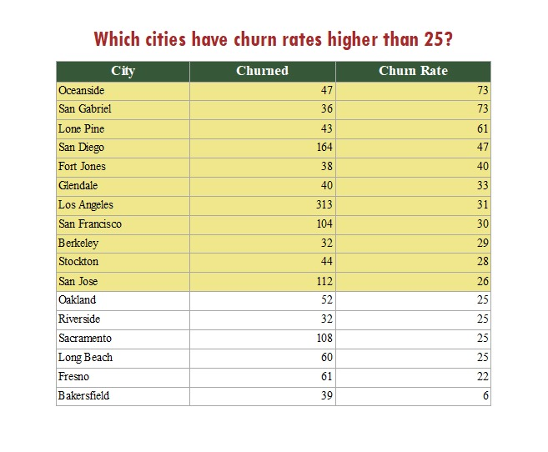
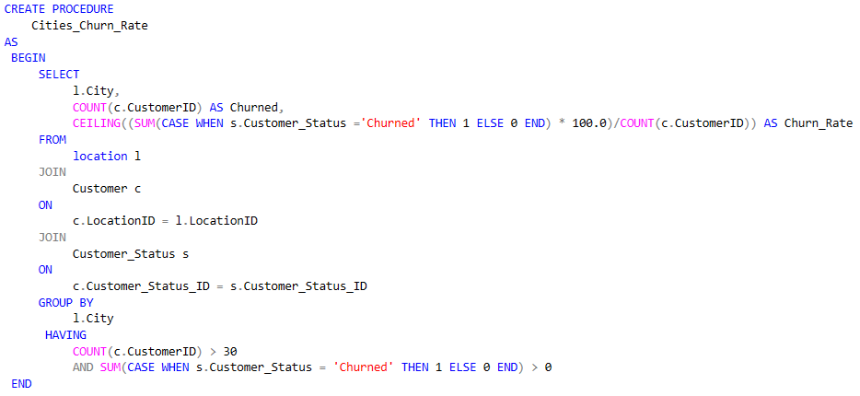
SSAS and SSRS
Example of Churn Rate Report:

Slide 44
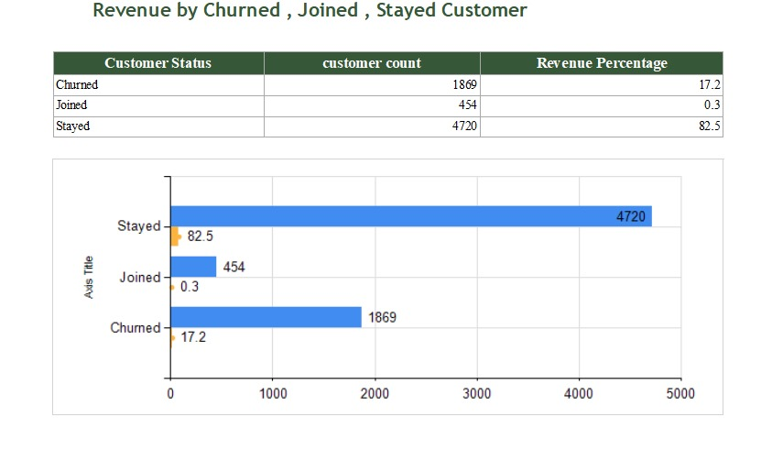
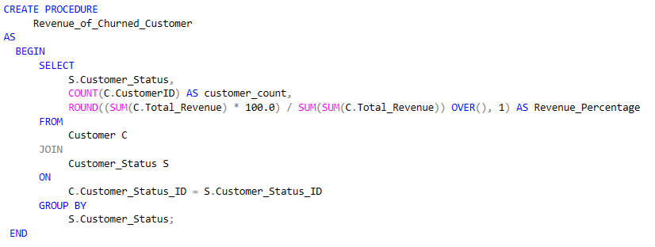
SSAS and SSRS
Example of Customer Status Revenue Report:

Slide 45
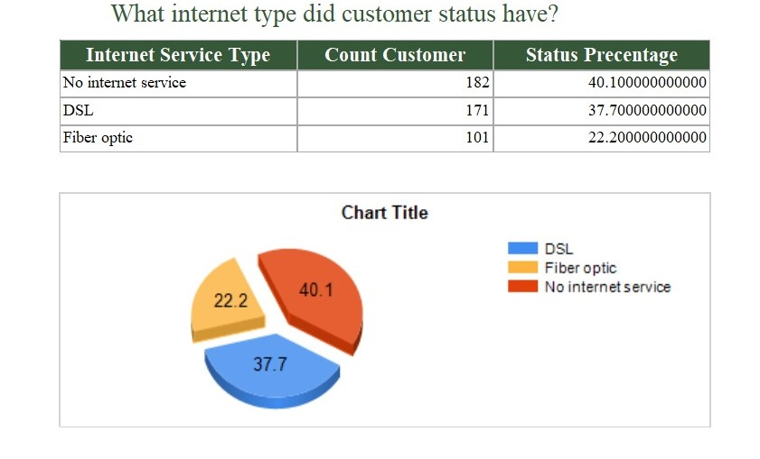
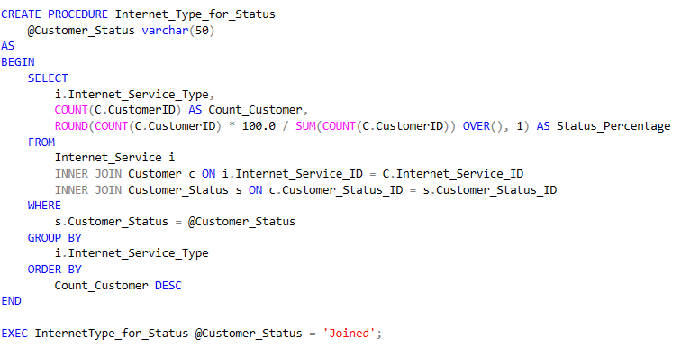
SSAS and SSRS
Example of Service type customer Report:

Slide 46
Visualization using Power BI

Slide 47
Visualization using Tableau

Slide 48
Visualization using Excel

Slide 49
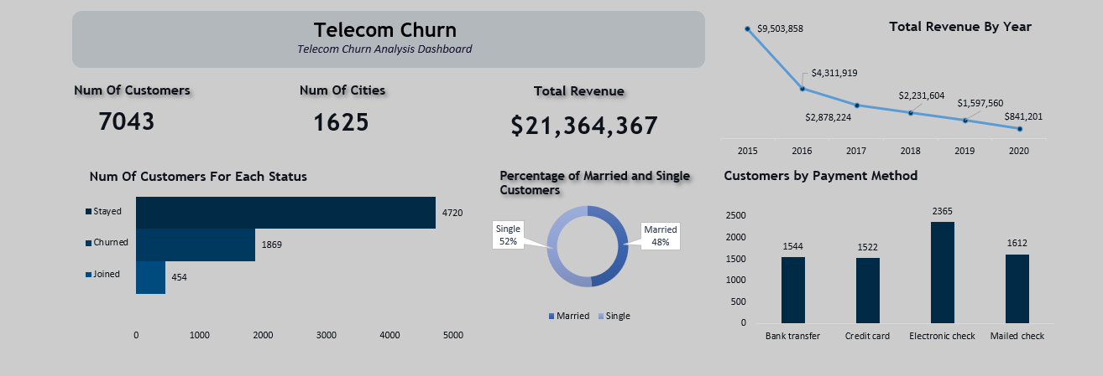
Visualization using Excel
Example of visualization using Excel:

Slide 50
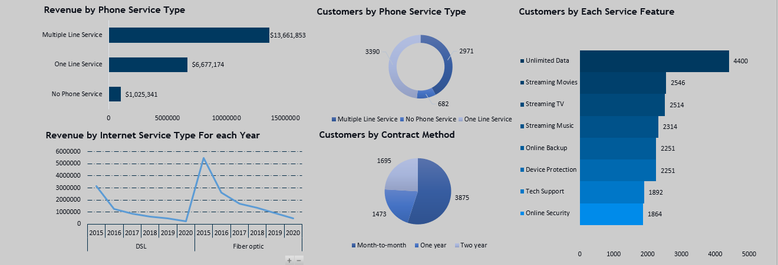
Visualization using Excel
Another example of visualization using Excel:

Slide 51
Recommended Actions

Slide 52
Recommended Actions
Churn category :
Number of churned customers for competitor churn category = 841 and
Number of churned customers for attitude churn category = 314
Action :
Study our competitors, examining the offers they present to determine if we offer similar types of these offers or not.
Introducing customer interaction training programs.

Slide 53
Recommended Actions
Satisfaction score :
The average satisfaction score = 3.24
Action :
Have customer service contact those with a satisfaction score below 3 to identify their issues and work to resolve them as quickly as possible.

Slide 54
Recommended Actions
Avg monthly download :
The average monthly download = 20.51 giga
Action :
Make good offers for ages between 20 to 30
Notifications regarding the sizes of completed downloads and the remaining

Slide 55
Recommended Actions
Revenue by billing type :
Revenue by paperless billing = 14 M and by paper billing = 7.4 M
Action :
launching an advertisement illustrating the disparity between paper billing and paperless billing, highlighting the convenience of paperless billing and the challenges associated with paper billing.
The employee explains the difference to the customer, elucidating the advantages of paperless billing, and assists them with the necessary procedures

Slide 56
Recommended Actions
Dependent and married customers :
Total married customers = 48.3% and total dependent customers = 29.96%
Action :
offer bonuses to anyone who refers someone, as this will drive growth and increase customer loyalty.

Slide 57
Recommended Actions
Revenue by contract method :
Revenue by two year contract = 8.5 M, by Month to Month contract = 6.9 M
and by one year = 6 M
Action :
Adding a six-month subscription option to our current plans. It would attract more customers seeking a balance of flexibility and value

Slide 58
Thank you

