Slide 1



CampusPay System
Graduation Project – 2024

Slide 2
Catalogue
Contents
01.
Introduction to CampusPay
And Problems & objectives
02.
Who are the users ? And what are the features of these users ?
03.
Technologies & the difference between campusPay and any other System ?
04.
System Analysis & design

Slide 3
01.
Introduction to CampusPay
And Problems & objectives

Slide 4
1
Introduction to CampusPay
- What is the Campus Pay ?
- CampusPay is a portable application dedicated to the Students of Fayoum University , which will be an integrated center for all financial services and payments related to the University of Fayoum , The CampusPay app will be equipped with a range of Features, including custom digital wallets for students, support for various payment methods to add money to wallets, and the ability to manage invoice payments and money transfers.
- CampusPay offers all the services of students specifically to the University of Fayoum, from the expenses of study and medical examinations to the payment of expenses for the ability’s exams, University City, registration of courses, and more .
- Campus Pay is not used by Students only but with other users and have different interfaces for each user

Slide 5
1
Problems
Problems :
1-Inconvenience: The traditional methods of bill payments and money transfers require students to visit different offices or locations on campus, which can be time-consuming and inconvenient.
5- Analysis and collection of information is a major challenge: The collection and analysis of information is an exceptional challenge, requiring considerable time and effort. This work can cause mistakes, leading to potential problems for individuals, especially students.
2- Lack of Real-time Information: Students often struggle to stay updated on their financial obligations, leading to missed payments, late fees, and penalties. The lack of real-time bill notifications and reminders makes it difficult for students to manage their expenses effectively.
6-The challenge for students when communicating with a moderator: communicating with moderator one of the most common problems as some students have a specific problem so they need to communicate with moderator so they don’t have any method to communicate with them , also moderator want to notify some students about specific thing so they don’t have a communication method with students
3- Lack of Security: Carrying cash or using physical payment methods puts students at risk of theft or loss. Additionally, the manual handling of cash and paper-based transactions increases the chances of errors and fraudulent activities.
4- The student's inability to afford university fees :
The student may have social difficulties and be unable to afford the costs of study

Slide 6
The Objectives of the system
1
1
Quick services : This app provides all services for Fayoum University students in a convenient manner. They can utilize their wallet to cover any expenses related to any college within the university.
2
convenience : the app offers a convenient solution by providing a user-friendly interface for students to manage bills and expenses directly from their mobile devices. This eliminates the need for physical visits to different campus offices, saving students time and effort.
3
Real-time Information: The app will provide students with real-time notifications and reminders for their financial obligations. They will receive timely updates on bill due dates, payment confirmations, and any changes or updates related to their financial transactions.
4
Donator: This feature assists any financially challenged student who is unable to cover university fees. This is also crucial and not present in other applications
5
Security: The app will provide a secure platform for financial transactions, reducing the risk of theft or loss associated with carrying cash or using physical payment methods. It will incorporate robust security measures to protect students' financial information and prevent fraudulent activities.
6
Dashboard: offer to the university clear visions of how many students paid and did not pay and the total amount they received, both from expenses, e-books, courses, and all other services
7
Chatting: The app also includes a chat to facilitate communication between students and the university.

Slide 7
02.
Who are the users ? &
what are the features of these users ?

Slide 8




2
Who are the users ?
Student
Administrator
Student is the person that use app for pay for a specific service , transfer money , make request financial aid or chat with moderator for specific problem
Administrators responsible for managing and organizing and maintains System where it work on managing accounts all users or managing services and other additional things
Moderator
Donator
is the person that work on solving all problems of students or donators or notify admin for specific problems in app , also it work on manage the social research requests and he can make a report from the dashboard to manager
Donators can see the social research requests
of students who are unable to pay university fees
then try helping them who cannot pay their
expenses of university

Slide 9




What are the features of each user ?
2
Student Features:
Moderator Features :
- View services & Pay for services
- Deposit Funds
- Review Balance & his transaction history
- Chat with Moderator
- Transfer Money for another student
- make a social research request
- add feedback
- make Report from the Dashboard
- chat with students for solving problems
- chat with Donators
- Chat with admins
- View Social research requests to accept or refuse requests and sending the accepted requests to donators
Admin Features :
Donators Features :
- Manage all accounts
- manage services
- Providing technical support
- show feedbacks for improving System
- managing & organizing main interface
- View accepted Social research requests
- Chat with Moderatos
- Transfer Money for specific request who are confirmed
- add feedback

Slide 10
03.
Technologies & the difference between CampusPay and any other System ?

Slide 11





3
The technologies used to develop CampusPay
UI&UX and Flutter
Dotnet software
Data Analysis
UI & UX techniques are utilized in the design system using the Figma platform, while Flutter is the technology used to convert the system into an application through coding.
Dotnet is software platform that provides a set of tools and libraries for building & running applications on Windows
Data analysis involves examining data to find insights and patterns, using techniques like python , excel , power bi to cleansing and interpretation to make informed decisions based on evidence.
Machine Learning
SQL server software
ML is a subset of artificial intelligence that focuses on developing algorithms and models that enable computers to learn from and make predictions or decisions based on data without explicit programming
(RDBMS) that supports a wide variety of transaction processing, business intelligence, and analytics applications in corporate IT environments.

Slide 12
3
the difference between CampusPay & any other System
CampusPay System
Other Systems
Target Audience: Specifically designed for students of Fayoum University.
Target Audience: Broad user base including individuals, businesses, and organizations across various industries
Purpose: Primarily focuses on facilitating payments related to tuition fees and student services within the university ecosystem
purpose: Offers a wide range of payment services, including peer-to-peer transactions, online shopping, bill payments, and more.
Scope: Limited to transactions and services directly associated with the university, providing a specialized solution for campus-related payments.
Scope: Covers a wide spectrum of transactions beyond specific institutional or industry boundaries, serving as a versatile solution for everyday financial activities.
Other systems help students in solving the technical problems only that related to the system
CampusPay Make students chat with their moderators of the fayoum university to solving any problems tecniqucal or non technical that related to the collage of the student

Slide 13
04.
System Analysis and design

Slide 14
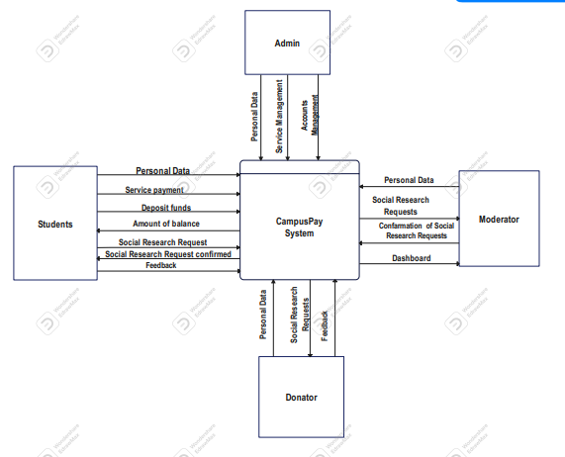
System Analysis and design : Context Diagram
4
Edit title
Edit title
Edit title

Slide 15
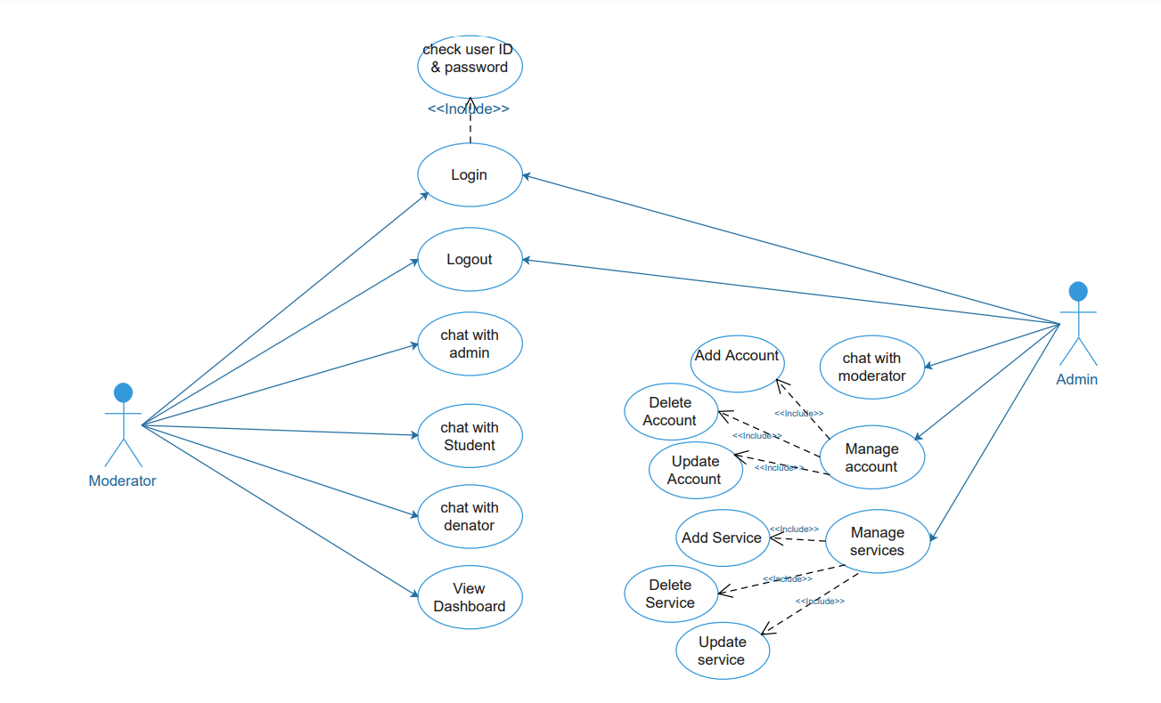
4
System Analysis and design : Use Case Diagram

Slide 16
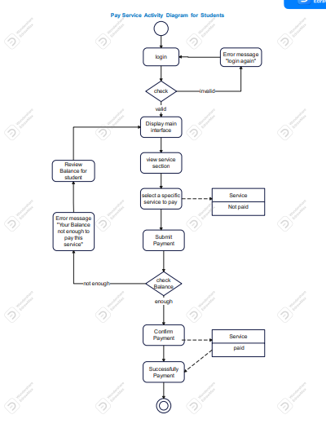
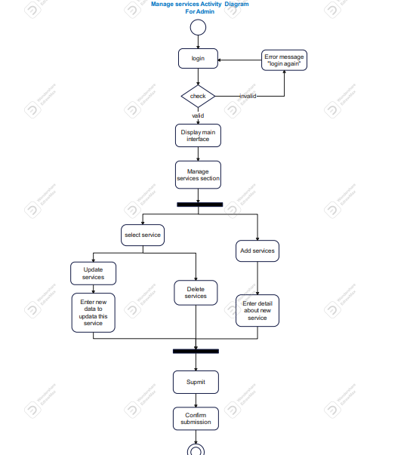
System Analysis and design : Activity Diagram-1
4

Slide 17
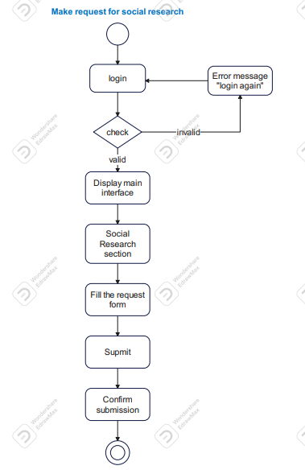
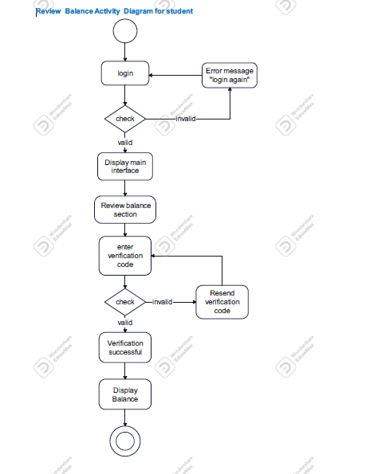
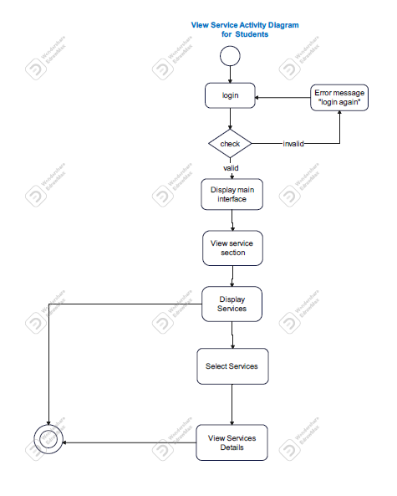
System Analysis and design : Activity Diagram-2
4

Slide 18
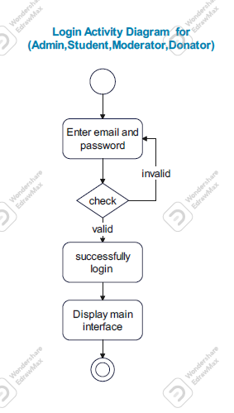
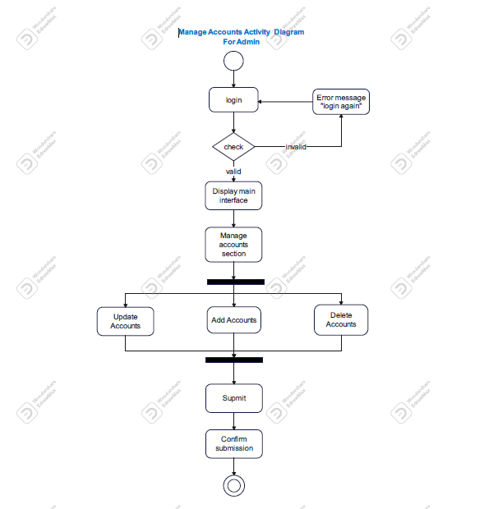
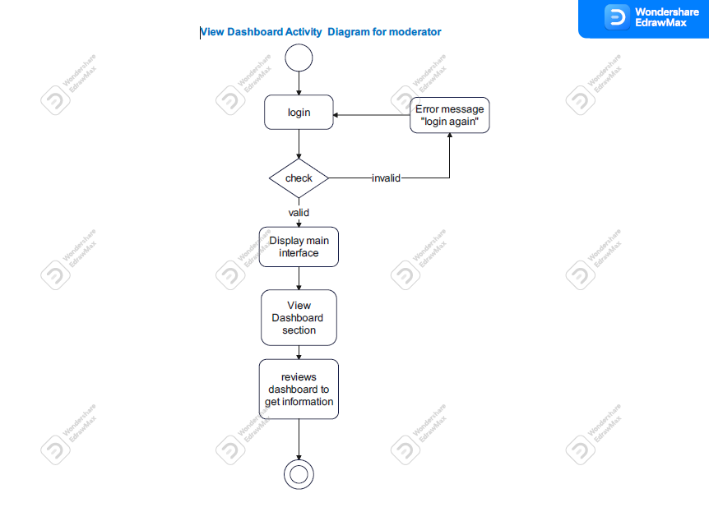
System Analysis and design : Activity Diagram-3
4

Slide 19
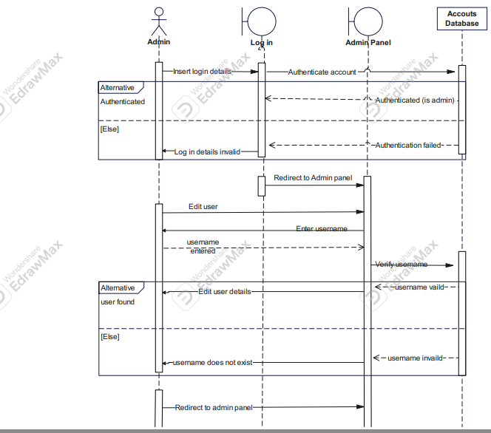
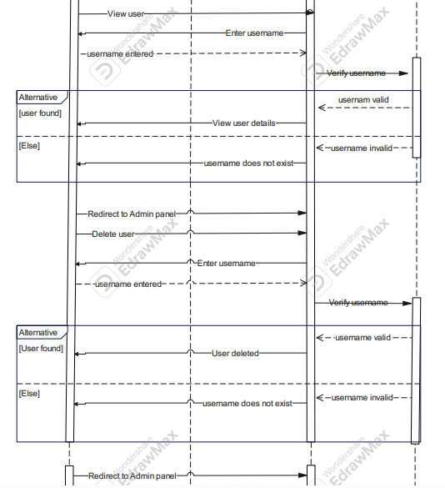
System Analysis and design : sequence Diagram-1
Admin: manage Accounts Sequence Diagram
4

Slide 20
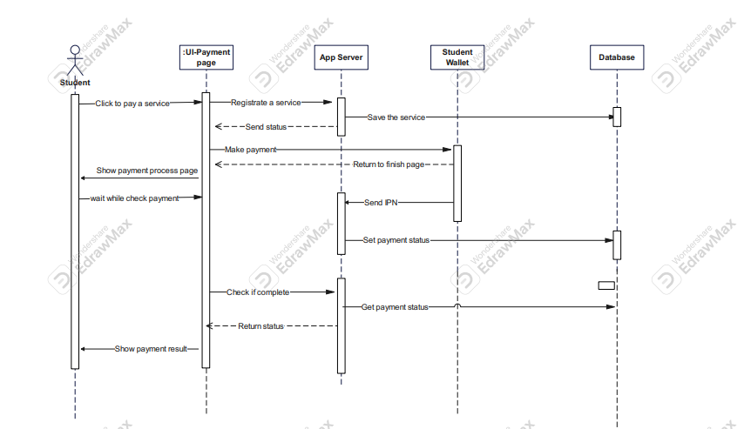
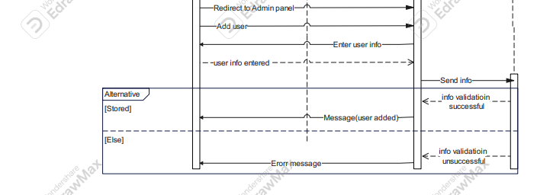
System Analysis and design : sequence Diagram-2
Student : Pay service Sequence Diagram
4

Slide 21
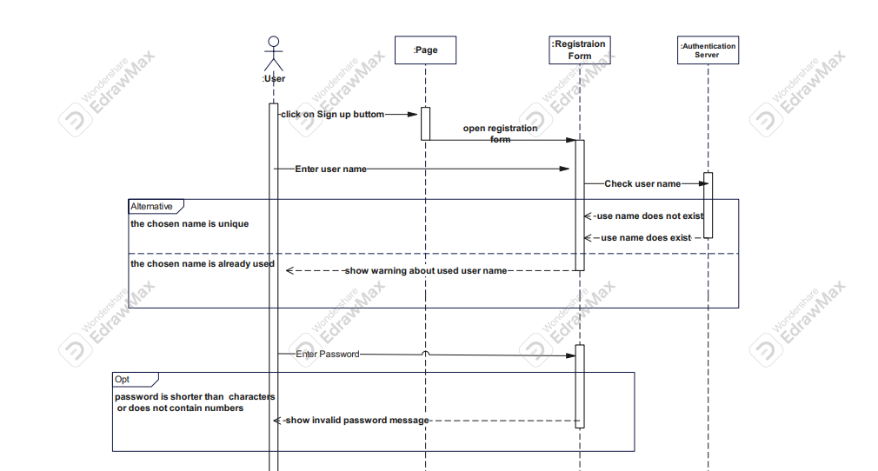
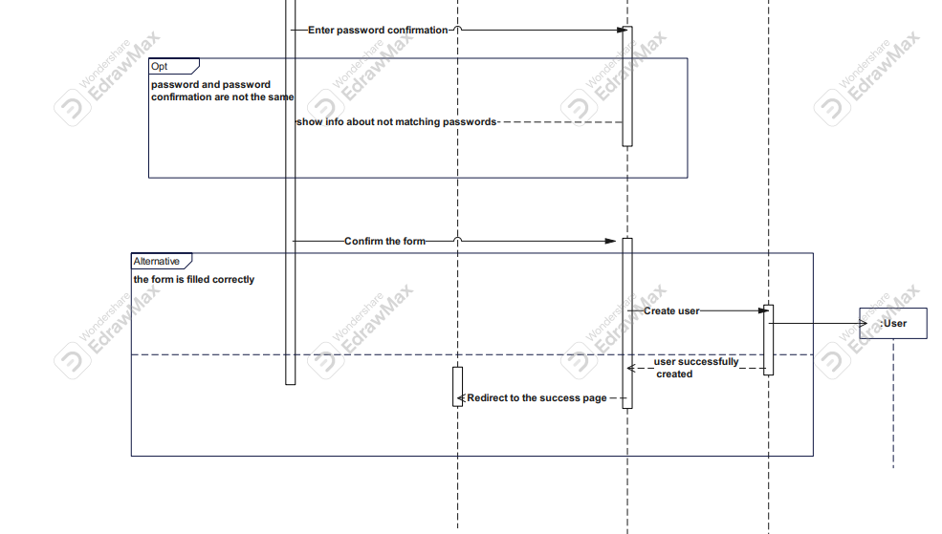
Users : login Sequence Diagram
System Analysis and design : sequence Diagram-3
4

Slide 22
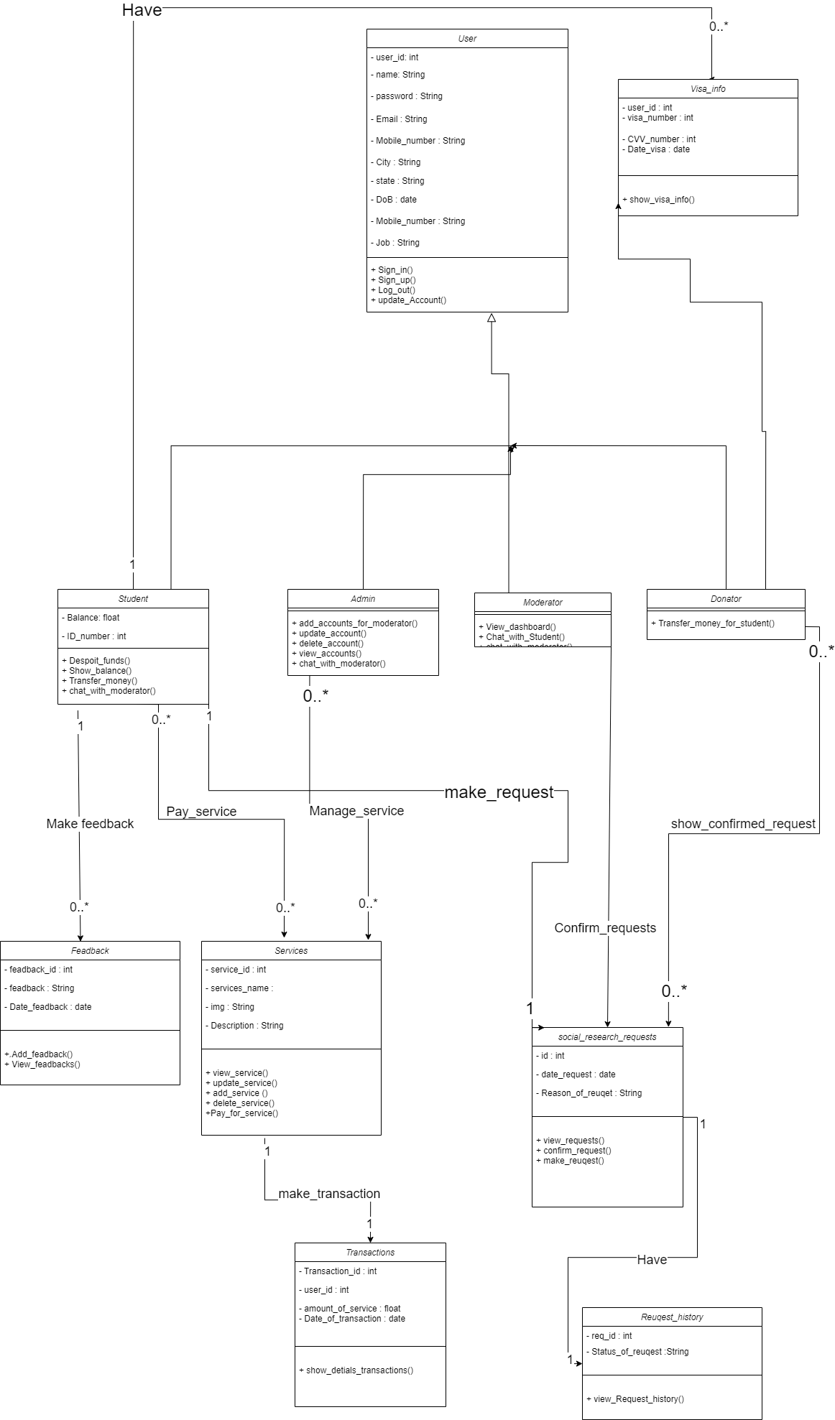
System Analysis and design : Class Diagram
4

Slide 23
Thank you for
watching and listening!
Team members
- mohamed ahmed saad ali
- Abdullah Salah Mohammed
- Abdullah Khaled Sayed
- Israa Arafa Ahmed Ahmed
- Abdul Rahman Muhammad Sayed
- Ahmed Ayman Salah
- Youssef Ali Saber Hussein

