Slide 1
Architecture used in the Paper
Our system uses grayscale images as input image having 28x28 sizes. The first layer in CCN applied 32 filters on input images, each image size is 3x3 producing 32 feature maps of size 26x26. The second layer is applying 64 filters, each of size 3x3 producing 64 feature maps of size 24x24. Max pooling layer is act as third layer which is used to down sampling the Input Images to 12x12 by using subsampling window of size 2x2. The layer 4 is fully connected layer having 128 neurons and uses softmax activation function for classification of images and produce the output image.

Slide 2


DataSet... (Arabic Handwritten Digits Databases)
Arabic handwritten digits datasets from (0–9) suitable for Arabic digit recognition research.
70.000 digits and 10 classes (0-9)
Devided into two sets
Training sets (60,000 digits) and (10 classes)
Test sets (10,000 digits) and (10 classes)

Slide 3
Implementation details
First we initialize image width and height 28X28
Then we load the data set, splitting it to train, validation and test set.
Reshaping the image to the size we initialized before
Then normalization
Make one-hot encoding to the target classes
Then entering the image to first convolution layer applying 32 filter 3X3 and using Relu activation then to the second convolution layer applying 64 filter 3X3 and using Relu activation, applying max pooling on it, flatten the output and pass it to first fully connected layer has 128 neuron using Relu activation, and output fully connected layer has 10 neurons using Softmax activation .
Model optimaizer is adam

Slide 4
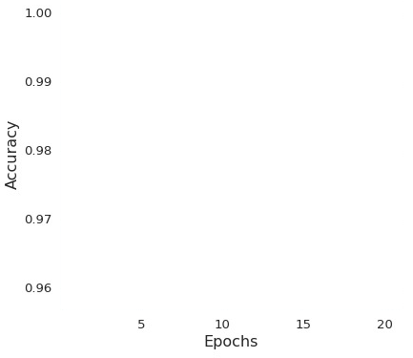
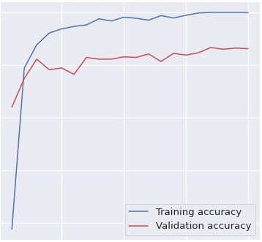
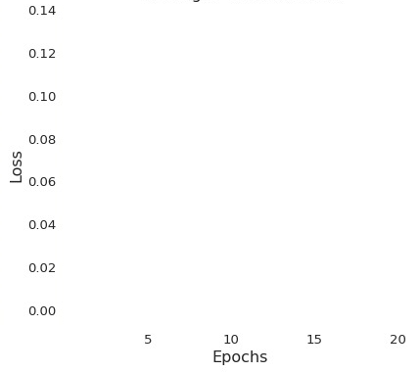
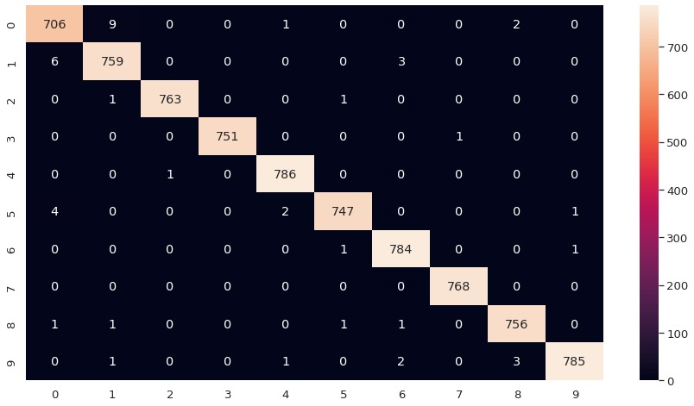
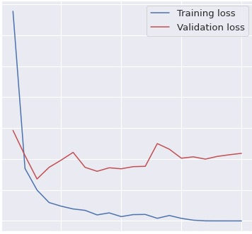
Results and visualizations
Training & Validation Accuracy
Training & Validation Loss
Confusion matrix
Model accuracy :
99.33333333333

