Slide 1

AP2 Project (MinMax Algorithm)
Elbachra Mohamed Amine
Khaldoune Anass

Slide 2

Project presentation
MINMAX
Connect4
CHESS
TICTACTOE
OTHELLO
NIMGAME
Graphical_tictactoe
Graphical_othello
Graphical_puissabce4
Graphical_chess
TWOPLAYERGAME
PROJET
PLAYER
ALPHABETA
ASK

Slide 3

Difficulties
evaluation function
AlphaBeta
Learning about Ttinker
some of the games rules

Slide 4
Researches
Rules
Tkinter
MinMax
AlphaBeta

Slide 5

Contribution to the work

Slide 6

ALPHABETA ALGORITHM

Slide 7
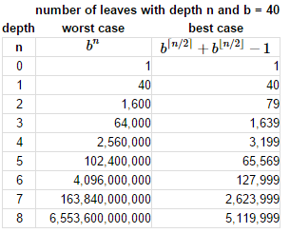

Slide 8
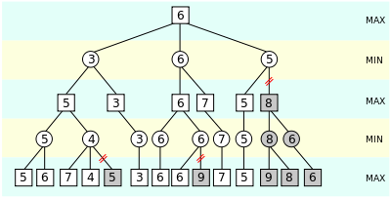

Slide 9
PROJECT DEMONSTRATION

Slide 10
Thanks!

