Slide 1


Gaussian Elimination
High-Performance Implementation
Mohamed Imad Eddine Ghodbane
May, 2024

Slide 2
CONTENT
01
PROJECT OVERVEW
02
PLUQ FACTORIZATION
03
MODULAR ARITHMETIC USING SIMD
04
SIMD IMPLEMENTATION OF PLUQ
05
CROUT METHOD
06
SIMD SCALAR PRODUCT
07
SIMD IMPLEMENTATION OF CROUT METHOD
08
RESULTS

Slide 3
PROJECT OVERVEW
PROJECT OVERVEW
Primary Objective
Develop a high-performance implementation of Gaussian elimination.
Focus on exact linear algebra over finite fields (𝐹𝑝=𝑍/𝑝𝑍) with a prime number stored on 30 bits.
Existing Libraries
FFLAS-FFPACK, Flint, NTL.
High performance for large matrices and small prime fields.
Areas for Improvement
Intermediate matrix dimensions (hundreds to thousands of elements).
Larger prime numbers.

Slide 4
PLUQ FACTORIZATION
Input
Matrix 𝐴 of size 𝑚×𝑛 with entries elements in the finite field 𝐹𝑝.
Output
LU decomposition of 𝐴, with permutation matrices 𝑃 and 𝑄.
Key Operations
Swap rows and columns based on pivot (pivot = 0).
Zero out elements below the pivot (Row Reduction).

Slide 5

PLUQ FACTORIZATION
Column Transposition
Let 𝐴 be a 3×3 matrix:
pivot = 0
Choose the next first non-zero entry in the row.
Perform column transposition to move the non-zero entry to the pivot position.

Slide 6


PLUQ FACTORIZATION
Column Transposition
pivot = 0
Choose the next first non-zero entry in the row.
Perform column transposition to move the non-zero entry to the pivot position.

Slide 7

PLUQ FACTORIZATION
Row Rotation
pivot row = [0, 0, 0]
Perform row rotation to move the zero row to the last row position.

Slide 8


PLUQ FACTORIZATION
Row Rotation
pivot row = [0, 0, 0]
Perform row rotation to move the zero row to the last row position.

Slide 9

PLUQ FACTORIZATION
Row Reduction
Compute the inverse of the pivot modulo 𝑝.
Multiply the pivot inverse by the elements of the pivot row.
Use the updated pivot row to eliminate the elements below the pivot in the current column.

Slide 10


PLUQ FACTORIZATION
Row Reduction
Compute the inverse of the pivot modulo 𝑝.
Multiply the pivot inverse by the elements of the pivot row.
Use the updated pivot row to eliminate the elements below the pivot in the current column.

Slide 11



PLUQ FACTORIZATION
Row Reduction
Compute the inverse of the pivot modulo 𝑝.
Multiply the pivot inverse by the elements of the pivot row.
Use the updated pivot row to eliminate the elements below the pivot in the current column.

Slide 12



PLUQ FACTORIZATION
Output

Slide 13
PLUQ FACTORIZATION
One Iteration
/*
Find Pivot
*/
// Row Reduction
for (int k = matrixRank + 1; k < m; k++) {
A->data[k * n + matrixRank] = mult(
A->data[k * n + matrixRank], inv, p);
for (int j = matrixRank + 1; j < n; j++)
A->data[k * n + j] = sub(
A->data[k * n + j],
mult(A->data[k * n + matrixRank],
A->data[matrixRank * n + j], p), p);
}

Slide 14
Modular Arithmetic Using SIMD
Subtraction
int sub(int a, int b, int p) {
int r = a - b;
return r < 0 ? r + p : r;
}
Multiplication
int mult(int a, int b, int p) {
long long r = (long long)a * b;
return r % p;
}

Slide 15
Modular Arithmetic Using SIMD
Subtraction
__m128i res = _mm_sub_epi32(a, b);
__m128i mask = _mm_cmplt_epi32(res,
_mm_setzero_si128());
__m128i ar = _mm_add_epi32(res, p);
res = _mm_blendv_epi8(res, ar, mask);
-
=

Slide 16
Modular Arithmetic Using SIMD
Subtraction
__m128i res = _mm_sub_epi32(a, b);
__m128i mask = _mm_cmplt_epi32(res,
_mm_setzero_si128());
__m128i ar = _mm_add_epi32(res, p);
res = _mm_blendv_epi8(res, ar, mask);
<?
=

Slide 17
Modular Arithmetic Using SIMD
Subtraction
__m128i res = _mm_sub_epi32(a, b);
__m128i mask = _mm_cmplt_epi32(res,
_mm_setzero_si128());
__m128i ar = _mm_add_epi32(res, p);
res = _mm_blendv_epi8(res, ar, mask);
+
=

Slide 18
Modular Arithmetic Using SIMD
Subtraction
__m128i res = _mm_sub_epi32(a, b);
__m128i mask = _mm_cmplt_epi32(res,
_mm_setzero_si128());
__m128i ar = _mm_add_epi32(res, p);
res = _mm_blendv_epi8(res, ar, mask);
?
=

Slide 19
Modular Arithmetic Using SIMD
Multiplication
int mult(int a, int b, int p) {
long long r = (long long)a * b;
return r % p;
}
There is no modulus operation in AVX2 !!
Solution: compute the remainder of the division by p.

Slide 20
Modular Arithmetic Using SIMD
Multiplication
__m256d h = _mm256_mul_pd(a, b);
__m256d d = _mm256_mul_pd(h, u);
__m256d c = _mm256_floor_pd(d);
__m256d e = _mm256_fnmadd_pd(c, p, h);
*
=

Slide 21
Modular Arithmetic Using SIMD
Multiplication
__m256d h = _mm256_mul_pd(a, b);
__m256d d = _mm256_mul_pd(h, u);
__m256d c = _mm256_floor_pd(d);
__m256d e = _mm256_fnmadd_pd(c, p, h);
*
=

Slide 22
Modular Arithmetic Using SIMD
Multiplication
__m256d h = _mm256_mul_pd(a, b);
__m256d d = _mm256_mul_pd(h, u);
__m256d c = _mm256_floor_pd(d);
__m256d e = _mm256_fnmadd_pd(c, p, h);
=

Slide 23
Modular Arithmetic Using SIMD
Multiplication
__m256d h = _mm256_mul_pd(a, b);
__m256d d = _mm256_mul_pd(h, u);
__m256d c = _mm256_floor_pd(d);
__m256d e = _mm256_fnmadd_pd(c, p, h);
-
=

Slide 24
Modular Arithmetic Using SIMD
Multiplication
__m256d mul_mod_p(__m256d a, __m256d b, __m256d u, __m256d p) {
__m256d h = _mm256_mul_pd(a, b);
__m256d d = _mm256_mul_pd(h, u);
__m256d c = _mm256_floor_pd(d);
__m256d e = _mm256_fnmadd_pd(c, p, h);
return e;
}
The Product exceeds the 52-bit length allocated for the mantissa in double floating-point representation. This can lead to a loss of precision in the final result !!

Slide 25
Modular Arithmetic Using SIMD
Multiplication
__m256d mul_mod_p(__m256d a, __m256d b, __m256d u, __m256d p) {
__m256d h = _mm256_mul_pd(a, b);
__m256d l = _mm256_fmsub_pd(x, y, h);
__m256d d = _mm256_mul_pd(h, u);
__m256d c = _mm256_floor_pd(d);
__m256d b = _mm256_fnmadd_pd(c, p, h);
__m256d e = _mm256_add_pd(b, l);
__m256d t = _mm256_sub_pd(e, p);
e = _mm256_blendv_pd(t, e, t);
t = _mm256_add_pd(e, p);
return _mm256_blendv_pd(e, t, e);
}

Slide 26
SIMD IMPLEMENTATION OF PLUQ
rows_elimination_avx2(int *A_data,int n, int matrixRank, int c,int p , __m256d vp, __m256d vu ,__m128i vp_128, int k) {
__m256d vc = _mm256_set1_pd(c);
__m256d tmp;
int i;
for (i = matrixRank + 1; i + 3 < n; i += 4) {
__m128i v1 = _mm_loadu_si128((__m128i *)&A_data[matrixRank*n+i]);
__m128i v2 = _mm_loadu_si128((__m128i *)&A_data[k*n+i]);
__m256d vDouble = _mm256_cvtepi32_pd(v1);
tmp = mul_mod_p(vc, vDouble, vu, vp);
__m128i resultInt = _mm256_cvttpd_epi32(tmp);
__m128i result = sub_avx2(v2, resultInt, vp_128);
_mm_storeu_si128((__m128i *)&A_data[k * n + i], result);
}
// loop handles elements that don't fit into chunks of 4
}

Slide 27
RESULTS
AVX2 vs Basic PLUQ
Sizes | 100 | 300 | 500 | 1000 | 1200
Basic (ms) | 0.69 | 18.70 | 86.57 | 694.06 | 1199.92
AVX2 (ms) | 0.15 | 3.90 | 17.80 | 139.98 | 242.56
Speedup | 4.60 | 4.79 | 4.86 | 4.95 | 4.95
PLUQ Speedups using AVX2 and 12 Bits Length Prime
AMD Ryzen™ 7 PRO 7840U w/ Radeon™ 780M Graphics × 16

Slide 28
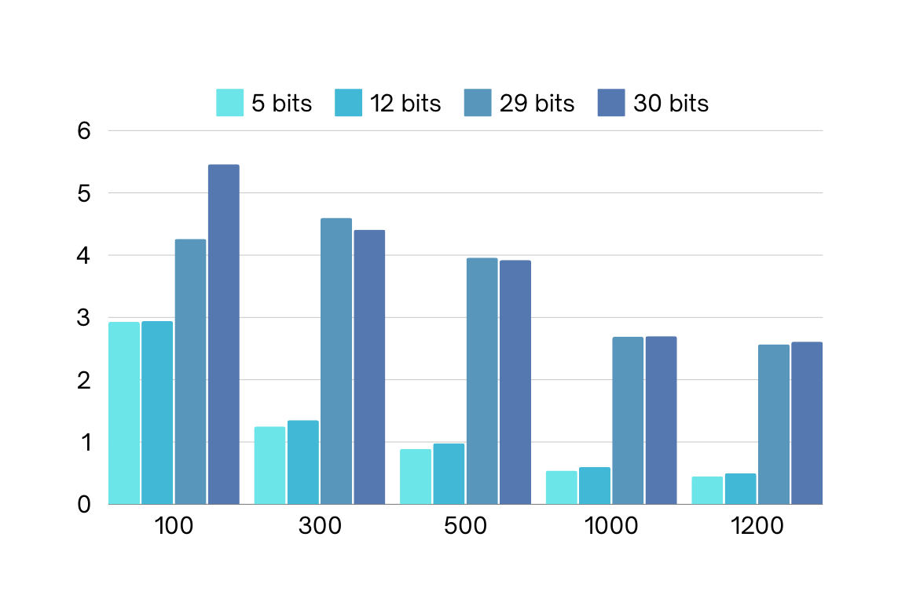
RESULTS
AVX2 vs FLINT
AMD Ryzen™ 7 PRO 7840U w/ Radeon™ 780M Graphics × 16

Slide 29



CROUT METHOD
Key Operation
Computes 𝑢𝑖𝑗​ and 𝑙𝑖𝑗​ using the multiplication equation 𝐴=𝐿𝑈 and the previously computed values of 𝐿 and 𝑈.

Slide 30





CROUT METHOD

Slide 31
SIMD SCALAR PRODUCT
Scalar Product
int sum = 0;
for (int i = 0; i < length; i++) {
sum += a[i] * b[i];
}
return sum % p;
Independence of Iterations
Each iteration of the loop computes a[i] * b[i] and adds it to sum.
The computation of a[i] * b[i] is independent of the previous iterations.

Slide 32
SIMD SCALAR PRODUCT
Scalar Product
*
+
=
=

Slide 33
RESULTS
AVX2 vs Basic Crout PLUQ
Sizes | 100 | 300 | 500 | 1000 | 1200
Basic (ms) | 0.71 | 19.00 | 87.40 | 697.97 | 1204.63
AVX2 (ms) | 0.11 | 2.37 | 12.97 | 135.07 | 246.83
Speedup | 6.45 | 8.01 | 6.73 | 5.16 | 4.86
Crout PLUQ Speedups using AVX2 and 12 Bits Length Prime
AMD Ryzen™ 7 PRO 7840U w/ Radeon™ 780M Graphics × 16

Slide 34
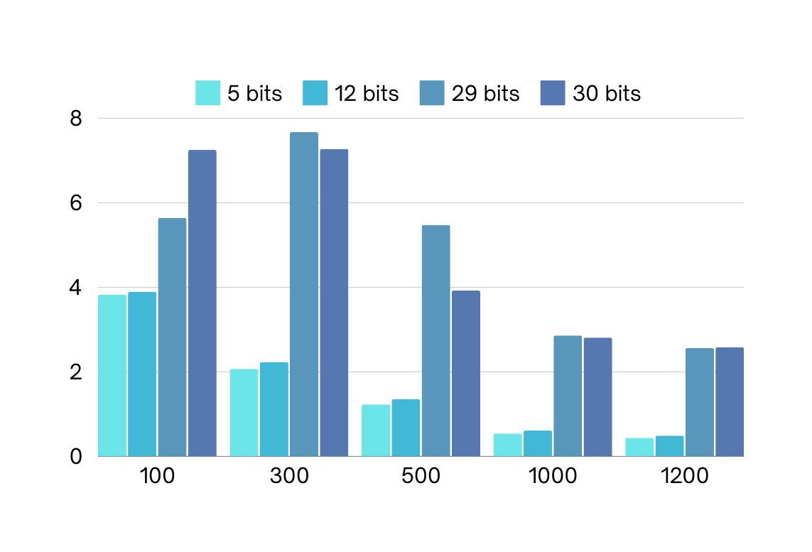
RESULTS
AVX2 vs FLINT
AMD Ryzen™ 7 PRO 7840U w/ Radeon™ 780M Graphics × 16

Slide 35
Thank You
Questions?

