Slide 1
Distributed and Object Databases
Lecture 1

Slide 2
Outline
Introduction
What is a distributed DBMS
Distributed DBMS Architecture
Background
Distributed Database Design
Database Integration
Semantic Data Control
Distributed Query Processing
Multidatabase query processing
Distributed Transaction Management
Data Replication
Parallel Database Systems
Distributed Object DBMS

Slide 3
Introduction
Distributed database system (DDBS) technology is the union of what appear to be two diametrically opposed approaches to data processing:
database system
computer network technologies

Slide 4
File Systems
program 1
File 1
data description 1
program 2
data description 2
File 2
program 3
data description 3
File 3

Slide 5
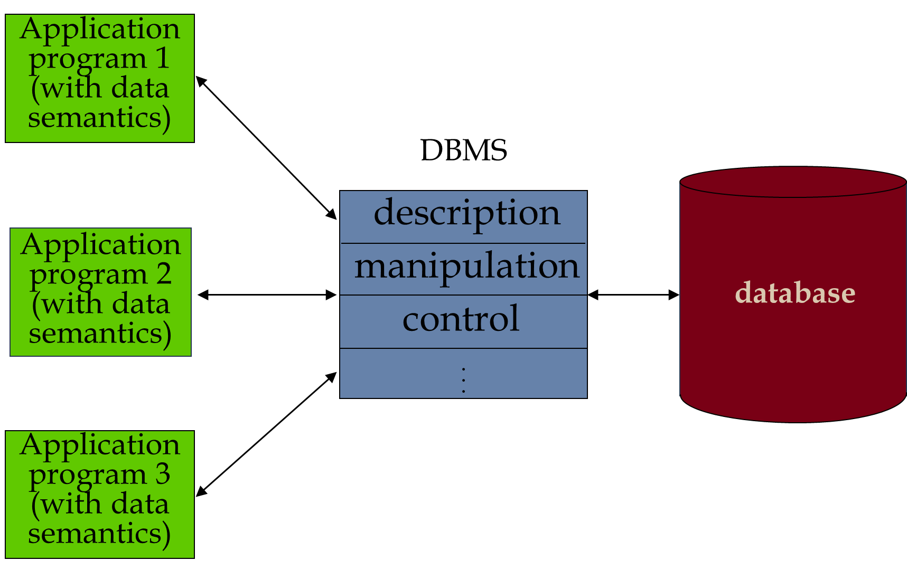
Database Management

Slide 6
Introduction
One of the major motivations behind the use of database systems is the desire to integrate the operational data of an enterprise and to provide centralized, thus controlled access to that data.
The technology of computer networks promotes a mode of work that goes against all centralization efforts.
It is possible to achieve integration without centralization, and that is exactly what the distributed database technology attempts to achieve

Slide 7
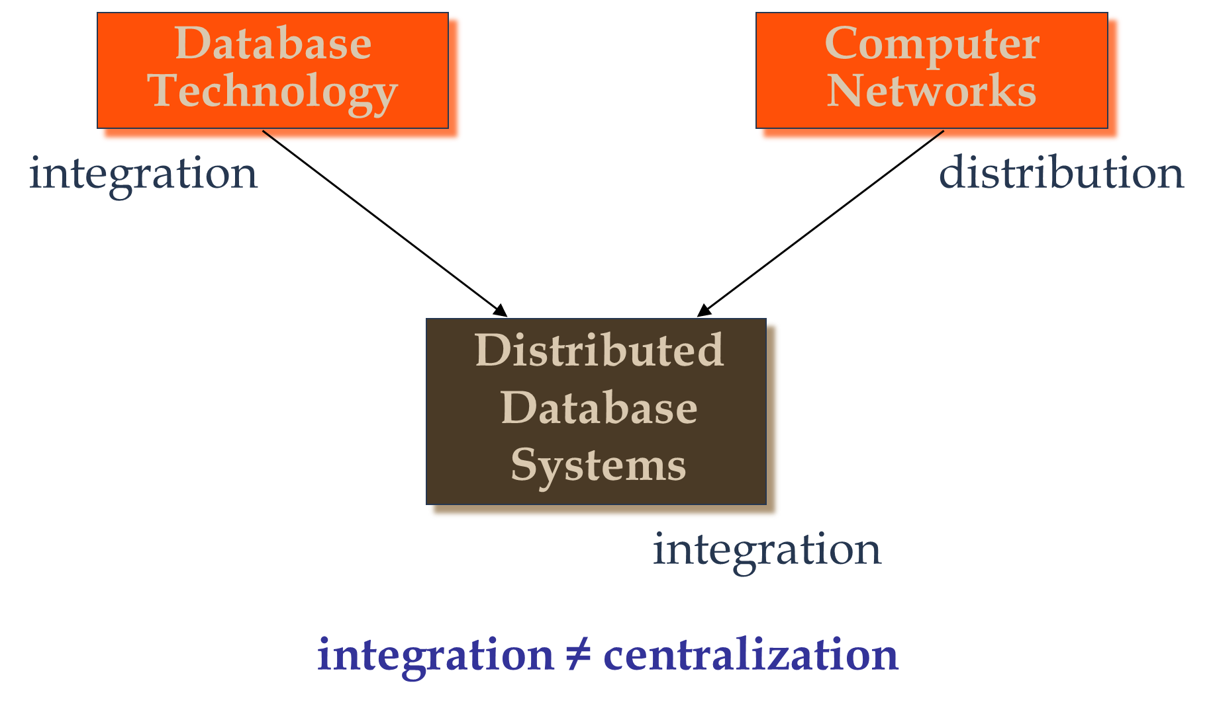
Motivation

Slide 8
Distributed computing system
A number of autonomous processing elements (not necessarily homogeneous) that are interconnected by a computer network and that cooperate in performing their assigned tasks.
The processing element is a computing device that can execute a program on its own.

Slide 9
What is being distributed?
There are four things that might be distributed:
Processing Logic.
Various functions of a computer system could be delegated to various pieces of hardware or software.
Data used by a number of applications may be distributed to a number of processing sites.
The Control of the execution of various tasks might be distributed instead of being performed by one computer system.

Slide 10
What is a Distributed Database System?
A distributed database (DDB) is a collection of multiple, logically interrelated databases distributed over a computer network.
A distributed database management system (D–DBMS) is the software that manages the DDB and provides an access mechanism that makes this distribution transparent to the users.
Distributed database system (DDBS) = DDB + D–DBMS

Slide 11
Why do we distribute at all?
distributed processing better corresponds to the organizational structure of today’s, widely distributed enterprises
more reliable
more responsive
many of the current applications of computer technology are inherently distributed, Web-based applications, electronic commerce business over the Internet, multimedia applications such as news-on-demand or medical imaging, manufacturing control systems are all examples of such applications.

Slide 12
What is a Distributed Database System?
distributed database is a collection of multiple, logically interrelated databases distributed over a computer network
A distributed database management system (D DBMS) is then defined as the software system that permits the management of the distributed database and makes the distribution transparent to the users.

Slide 13
What is not a DDBS?
A DDBS is not a “collection of files” that can be individually stored at each node of a computer network.
To form a DDBS, files should not only be logically related, but there should be structured among the files, and access should be via a common interface.

Slide 14
A timesharing computer system
A loosely or tightly coupled multiprocessor system
A database system which resides at one of the nodes of a network of computers - this is a centralized database on a network node
Note that physical distribution does not necessarily imply that the computer systems be geographically far apart.

Slide 15
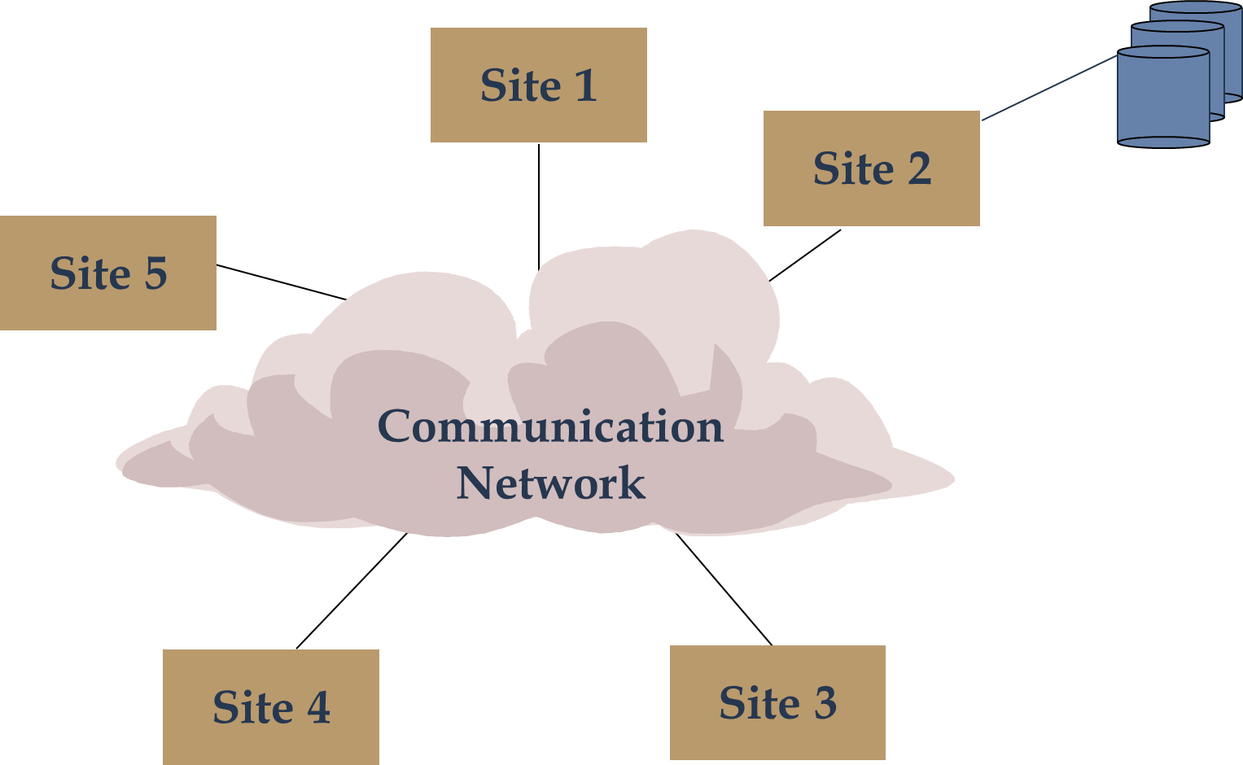
Central Database on a Network

Slide 16
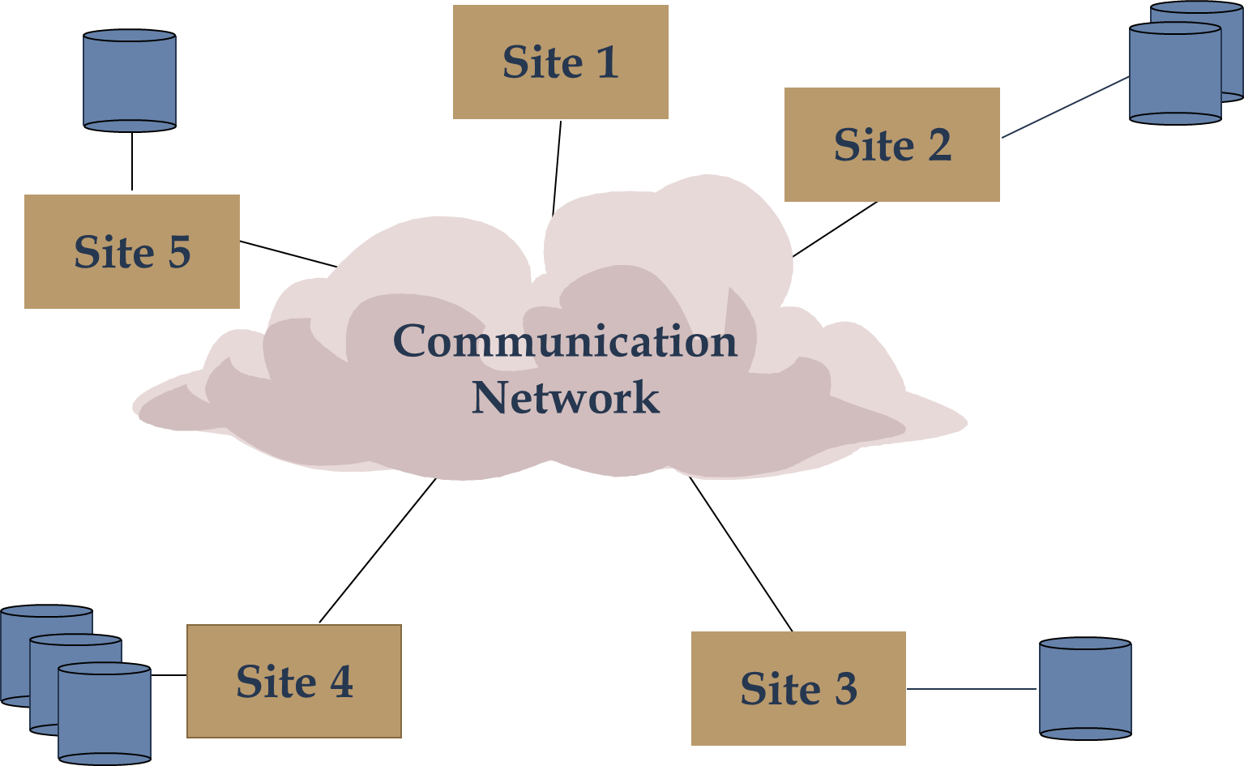
DDBS Environment

Slide 17
In distributed databases, data are “delivered” from the sites where they are stored to where the query is posed.
The alternative delivery modes are
pull-only : the transfer of data from servers to clients is initiated by a client pull
push-only : the transfer of data from servers to clients is initiated by a server push in the absence of any specific request from clients.
and hybrid.
Frequency
Periodic
Conditional
Ad-hoc or irregular
Communication Methods
Unicast
One-to-many
Note: not all combinations make sense

Slide 18
Transparency
Transparent Management of Distributed and Replicated Data refers to separation of the higher-level semantics of a system from lower-level implementation issues.
different types of transparencies:
Data Independence
Logical data independence
Physical data independence
Network Transparency
Location transparency
Fragmentation transparency
Replication Transparency
Fragmentation Transparency
horizontal fragmentation: sélection
vertical fragmentation: projection
hybrid
Notes:
•Replication Transparency. For performance, reliability, and availability reasons, it is usually desirable to be able to distribute data in a replicated fashion across the machines on a network. Such replication helps performance since diverse and conflicting user requirements can be more easily accommodated. the transparency issue is whether the users should be aware of the existence of copies or whether the system should handle the management of copies and the user should act as if there is a single copy of the data. it is desirable that replication transparency be provided as a standard feature of DBMSs.
•Fragmentation Transparency. it is commonly desirable to divide each database relation into smaller fragments and treat each fragment as a separate database object . There are two general types of fragmentation alternatives. In one case, called horizontal fragmentation, a relation is partitioned into a set of sub-relations each of which have a subset of the tuples (rows) of the original relation. The second alternative is vertical fragmentation where each sub-relation is defined on a subset of the attributes (columns) of the original relation.

Slide 19
the main advantages of DDBSs
Reliability Through Distributed Transactions.
Distributed DBMSs are intended to improve reliability since they have replicated components and, thereby eliminate single points of failure.
The failure of a single site, or the failure of a communication link which makes one or more sites unreachable, is not sufficient to bring down the entire system.
DBMS that provides full transaction support guarantees that concurrent execution of user transactions will not violate database consistency in the face of system failures as long as each transaction is correct

Slide 20
the main advantages of DDBSs
Reliability Through Distributed Transactions.
Replicated components and data should make distributed DBMS more reliable.
Distributed transactions provide
Concurrency transparency
Failure atomicity
Distributed transaction support requires implementation of
Distributed concurrency control protocols
Commit protocols
Data replication
Great for read-intensive workloads, problematic for updates
Replication protocols

Slide 21
the main advantages of DDBSs
Improved Performance.
is typically made based on two points.
First, a distributed DBMS fragments the conceptual database, enabling data to be stored in close proximity to its points of use (also called data localization).
The second case point is that the inherent parallelism of distributed systems may be exploited for inter-query and intra-query parallelism.
Inter-query parallelism results from the ability to execute multiple queries at the same time
intra-query parallelism is achieved by breaking up a single query into a number of subqueries each of which is executed at a different site, accessing a different part of the distributed database.

Slide 22
the main advantages of DDBSs
Easier System Expansion.
In a distributed environment, it is much easier to accommodate increasing database sizes.

Slide 23
Distributed DBMS Issues
Distributed Database Design
How to distribute the database
Replicated & non-replicated database distribution
A related problem in directory management
Query Processing
Convert user transactions to data manipulation instructions
Optimization problem
min{cost = data transmission + local processing}
General formulation is NP-hard

Slide 24
Distributed DBMS Issues
Concurrency Control
Synchronization of concurrent accesses
Consistency and isolation of transactions' effects
Deadlock management
Reliability
How to make the system resilient to failures
Atomicity and durability

Slide 25
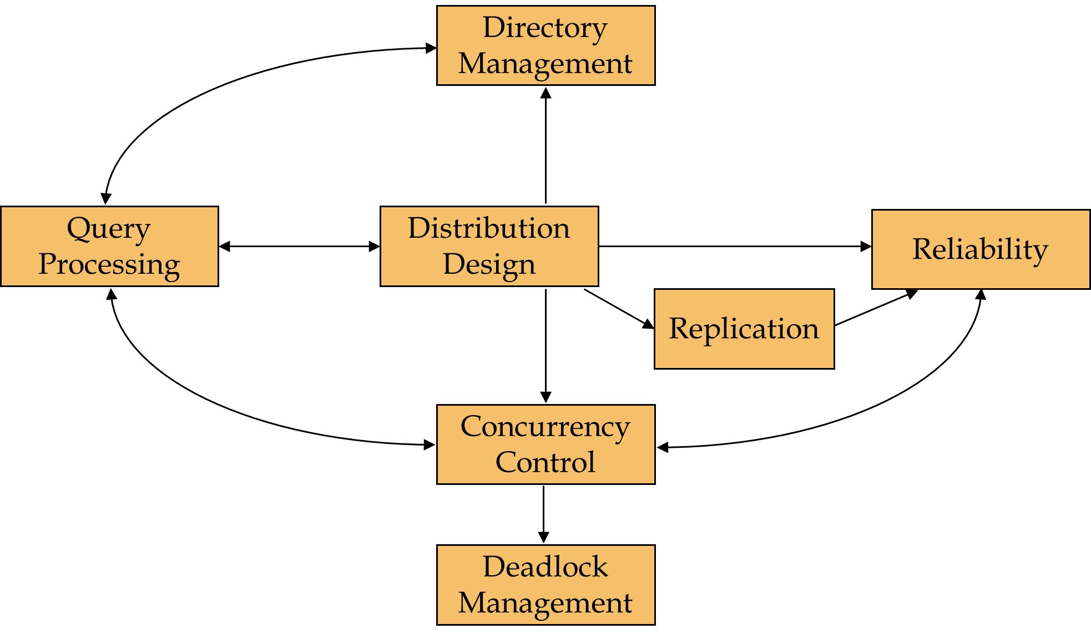
Relationship Between Issues

Slide 26
Distributed Database Design
How the database and the applications that run against it should be placed across the sites.
There are two basic alternatives to placing data:
partitioned (or non-replicated)
In the partitioned scheme the database is divided into a number of disjoint partitions each of which is placed at a different site.
Replicated
fully replicated (also called fully duplicated) where the entire database is stored at each site,
partially replicated (or partially duplicated) where each partition of the database is stored at more than one site, but not at all the sites.

Slide 27
Distributed Database Design
Distributed Directory Management
A directory contains information (such as descriptions and locations) about data items in the database.
A directory may be global to the entire DDBS or local to each site
it can be centralized at one site or distributed over several sites; there can be a single copy or multiple copies.

Slide 28
Distributed Database Design
Distributed Query Processing
Query processing deals with designing algorithms that analyze queries and convert them into a series of data manipulation operations.
The problem is how to decide on a strategy for executing each query over the network in the most cost-effective way.
The factors to be considered are the distribution of data, communication costs, and lack of sufficient locally-available information.

Slide 29
Distributed Database Design
Distributed Concurrency Control
Concurrency control involves the synchronization of accesses to the distributed database, such that the integrity of the database is maintained.
One not only has to worry about the integrity of a single database, but also about the consistency of multiple copies of the database.
Two fundamental approaches are used, locking, which is based on the mutual exclusion of accesses to data items, and timestamping, where the transaction executions are ordered based on timestamps.

Slide 30
Distributed Database Design
Distributed Deadlock Management
The competition among users for access to data can result in a deadlock if the synchronization mechanism is based on locking.

Slide 31
Distributed Database Design
Reliability of Distributed DBMS
It is important that mechanisms be provided to ensure the consistency of the database as well as to detect failures and recover from them.
The implication for DDBSs is that when a failure occurs and various sites become either inoperable or inaccessible, the databases at the operational sites remain consistent and up to date.
Furthermore, when the computer system or network recovers from the failure, the DDBSs should be able to recover and bring the databases at the failed sites up-to-date.

Slide 32
Distributed Database Design
Replication
it is necessary to implement protocols that ensure the consistency of the replicas
These protocols can be eager in that they force the updates to be applied to all the replicas before the transaction completes,
or they may be lazy so that the transaction updates one copy (called the master) from which updates are propagated to the others after the transaction completes.

Slide 33
Distributed DBMS Architecture
Defines the structure of the system
components identified
functions of each component defined
interrelationships and interactions between components defined
three “reference” architectures for a distributed DBMS
client/server systems
peer-to-peer distributed DBMS
multidatabase systems

Slide 34
Distributed DBMS Architecture
ANSI/SPARC Architecture
three views of data:
the external view, which is that of the end user, who might be a programmer;
the internal view, that of the system or machine;
the conceptual view, that of the enterprise.
For each of these views, an appropriate schema definition is required.

Slide 35
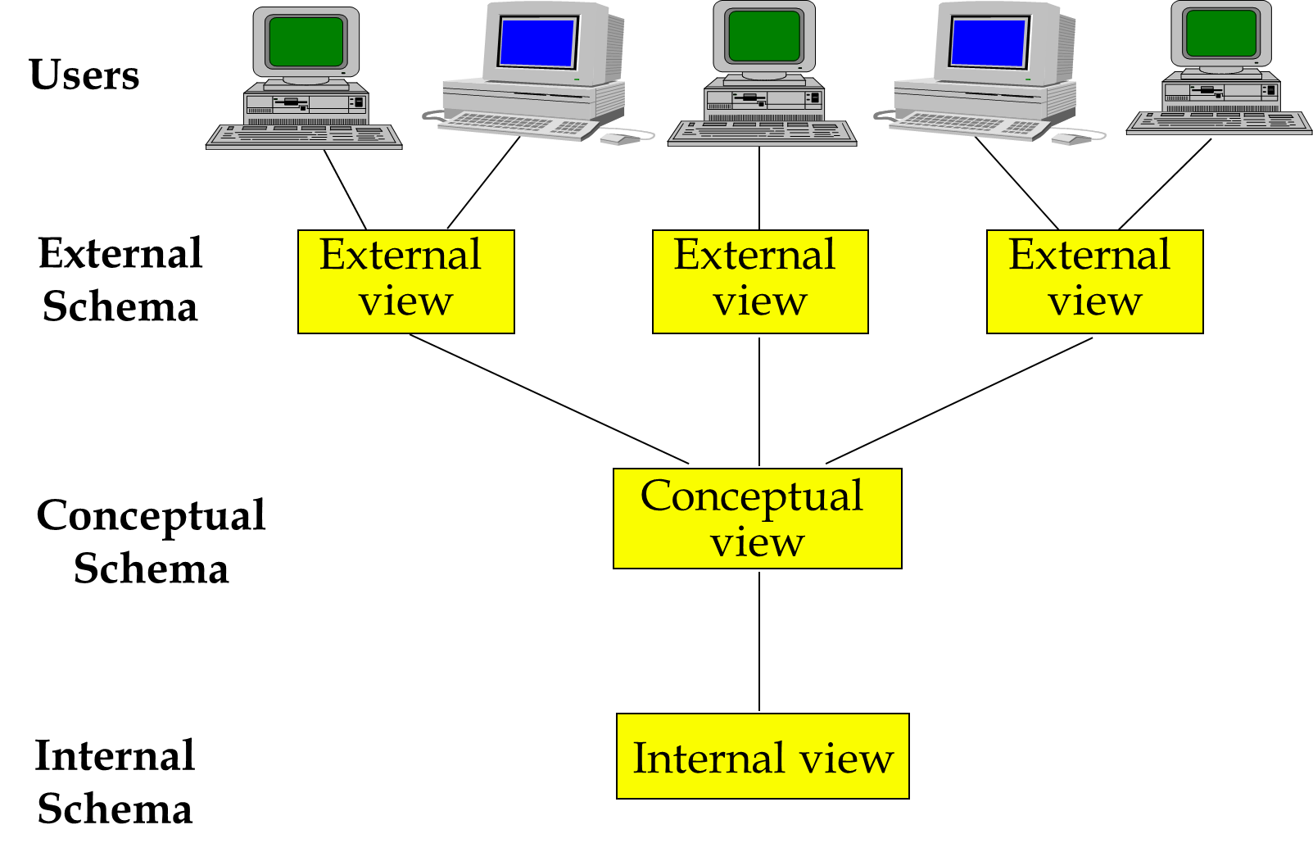
Distributed DBMS Architecture
The ANSI/SPARC Architecture

Slide 36
Distributed DBMS Architecture
A DBMS
reentrant program shared by multiple processes (transactions), that run database programs.
DBMS is interfaced with two other components:
the communication subsystem
permits interfacing the DBMS with other subsystems in order to communicate with applications
the operating system.
provides the interface between the DBMS and computer resources (processor, memory, disk drives, etc.).

Slide 37
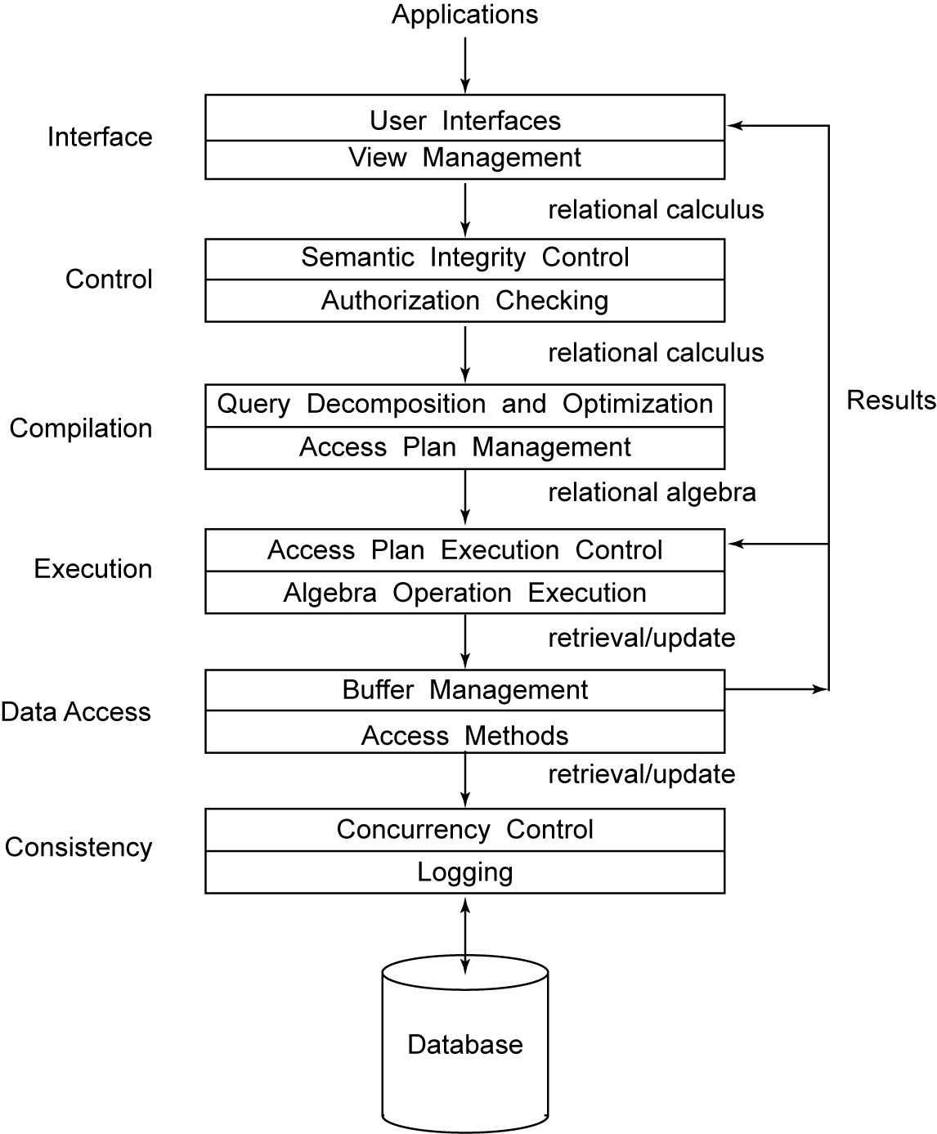
Distributed DBMS Architecture
DBMS Architecture

Slide 38
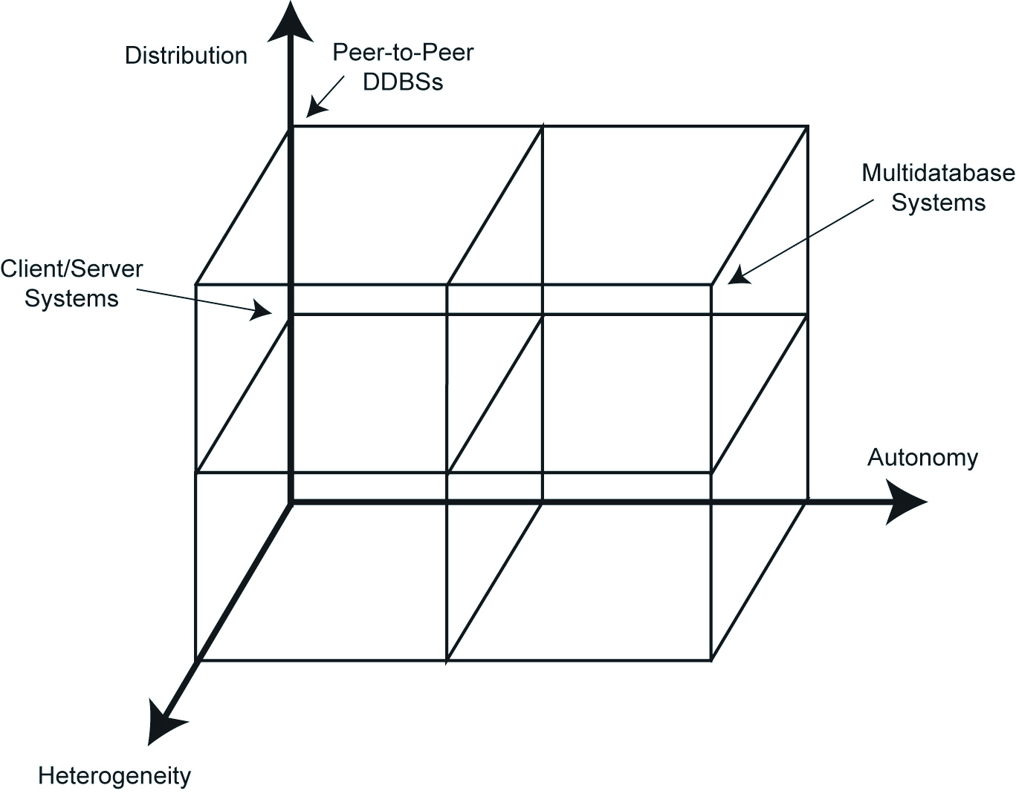
DBMS Implementation Alternatives

Slide 39
Distributed DBMS Architecture
Autonomy
indicates the degree to which individual DBMSs can operate independently
requirements of an autonomous system have been specified as
The local operations of the individual DBMSs are not affected by their participation in the distributed system.
The manner in which the individual DBMSs process queries and optimize them should not be affected by the execution of global queries that access multiple databases.
System consistency or operation should not be compromised when individual DBMSs join or leave the distributed system

Slide 40
Distributed DBMS Architecture
Autonomy
the dimensions of autonomy can be specified as
Design autonomy:
Individual DBMSs are free to use the data models and transaction management techniques that they prefer.
Communication autonomy:
Each of the individual DBMSs is free to make its own decision as to what type of information it wants to provide to the other DBMSs or to the software that controls their global execution.
Execution autonomy:
Each DBMS can execute the transactions that are submitted to it in any way that it wants to.

Slide 41
Distributed DBMS Architecture
Distribution
refers to the distribution (or decentralization) of control, the distribution dimension of the taxonomy deals with data.
non-distributed option
client/server distribution
peer-to-peer distribution

Slide 42
Distributed DBMS Architecture
Heterogeneity
may occur in various forms
hardware heterogeneity
differences in networking protocols
variations in data managers.
data models
query languages
transaction management protocols

Slide 43
Distributed DBMS Architecture
Peer-to-Peer Systems
there was no differentiation between the functionality of each site in the system
the physical data organization on each machine may be, and probably is, different
needs to be an individual internal schema definition at each site, which we call the local internal schema (LIS).
The enterprise view of the data is described by the global conceptual schema (GCS), which is global because it describes the logical structure of the data at all the sites.

Slide 44
Distributed DBMS Architecture
Peer-to-Peer Systems
To handle data fragmentation and replication, the logical organization of data at each site needs to be described. Therefore, there needs to be a third layer in the architecture, the local conceptual schema (LCS).
Finally, user applications and user access to the database is supported by external schemas (ESs), defined as being above the global conceptual schema.

Slide 45
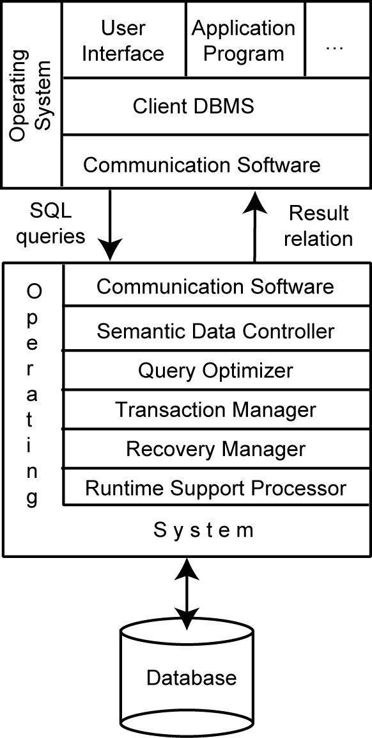
Distributed DBMS Architecture
Client/Server Reference Architecture

Slide 46
Advantages of Client-Server Architectures
More efficient division of labor
Horizontal and vertical scaling of resources
Better price/performance on client machines
Ability to use familiar tools on client machines
Client access to remote data (via standards)
Full DBMS functionality provided to client workstations
Overall better system price/performance

Slide 47
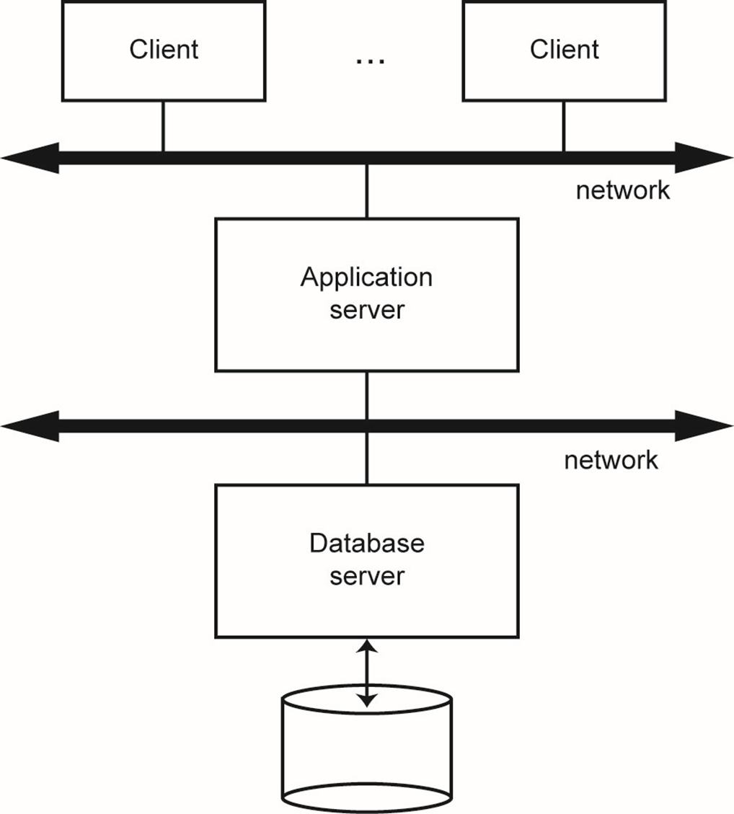
Database Server

Slide 48
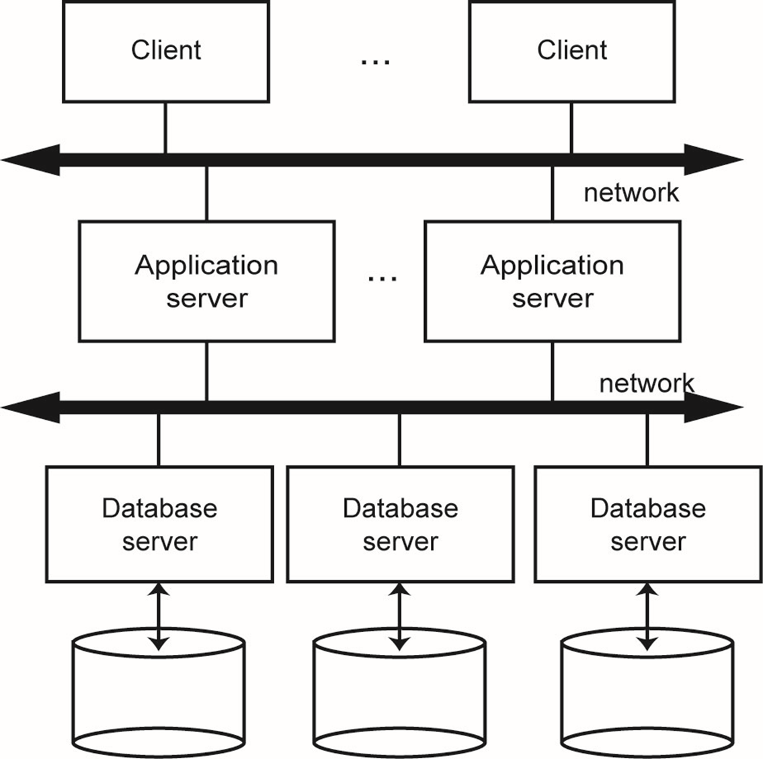
Distributed Database Servers

Slide 49
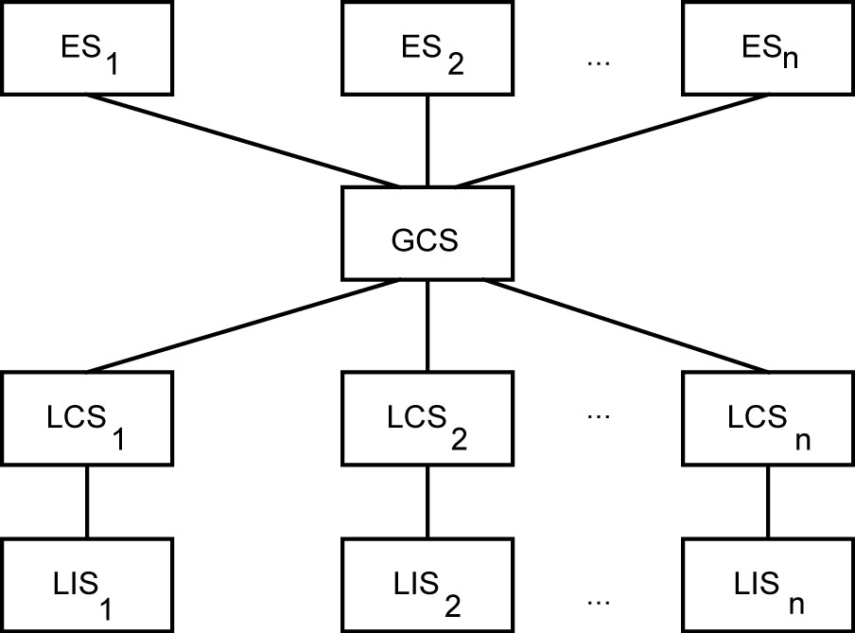
Datalogical Distributed DBMS Architecture
Distributed Database Reference Architecture

Slide 50
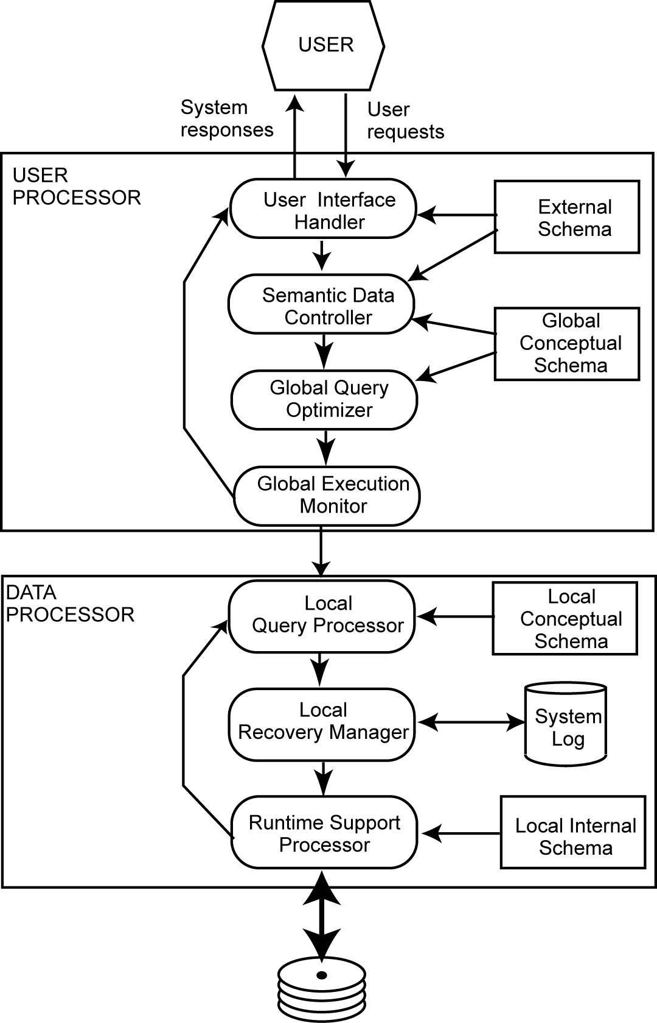
Peer-to-Peer Component Architecture
Distributed DBMS Components

Slide 51
Distributed DBMS Architecture
The first major component of a distributed DBMS, called the user processor, consists of four elements:
The user interface handler is responsible for interpreting user commands as they come in, and formatting the result data as it is sent to the user.
The semantic data controller uses the integrity constraints and authorizations that are defined as part of the global conceptual schema to check if the user query can be processed.

Slide 52
Distributed DBMS Architecture
The first major component of a distributed DBMS, called the user processor, consists of four elements:
The global query optimizer and decomposer determines an execution strategy to minimize a cost function, and translates the global queries into local ones using the global and local conceptual schemas as well as the global directory.
The distributed execution monitor (the distributed transaction manager) coordinates the distributed execution of the user request.

Slide 53
Distributed DBMS Architecture
The second major component of a distributed DBMS is the data processor and consists of three elements:
The local query optimizer, which actually acts as the access path selector, is responsible for choosing the best access path to access any data item.
The local recovery manager is responsible for making sure that the local database remains consistent even when failures occur.
The run-time support processor physically accesses the database according to the physical commands in the schedule generated by the query optimizer.
The run-time support processor is the interface to the operating system and contains the database buffer (or cache) manager, which is responsible for maintaining the main memory buffers and managing the data accesses.

Slide 54
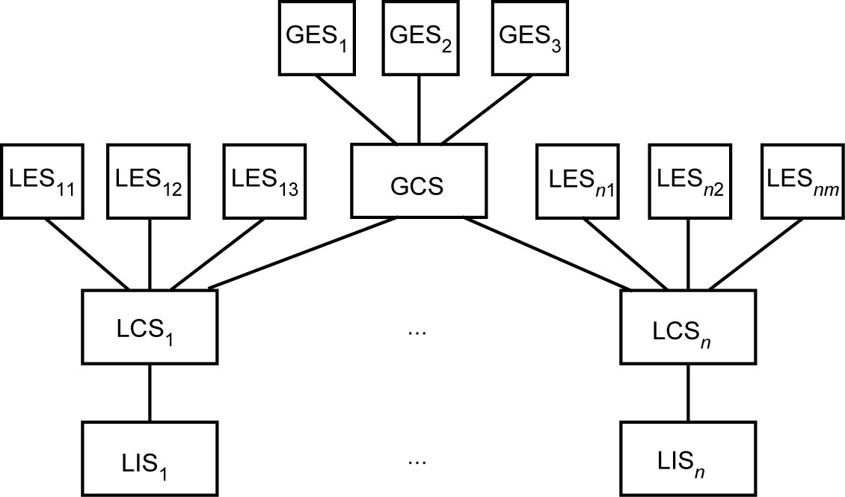
Distributed DBMS Architecture
MDBS Architecture with a GCS

Slide 55
Distributed DBMS Architecture
Multidatabase System Architecture
Multidatabase systems (MDBS) or data integration systems represent the case where individual DBMSs (whether distributed or not) are fully autonomous and have no concept of cooperation; they may not even “know” of each other’s existence or how to talk to each other.
The component-based architectural model of a multi-DBMS is significantly different from a distributed DBMS.
The fundamental difference is the existence of full-fledged DBMSs, each of which manages a different database.
The MDBS provides a layer of software that runs on top of these individual DBMSs and provides users with the facilities of accessing various databases

Slide 56
Distributed DBMS Architecture
Multidatabase System Architecture
The other fundamental difference relates to the definition of the global conceptual schema.
In the case of logically integrated distributed DBMSs, the global conceptual schema defines the conceptual view of the entire database.
while in the case of distributed multi-DBMSs, it represents only the collection of some of the local databases that each local DBMS wants to share. The individual DBMSs may choose to make some of their data available for access by others by defining an export schema

Slide 57
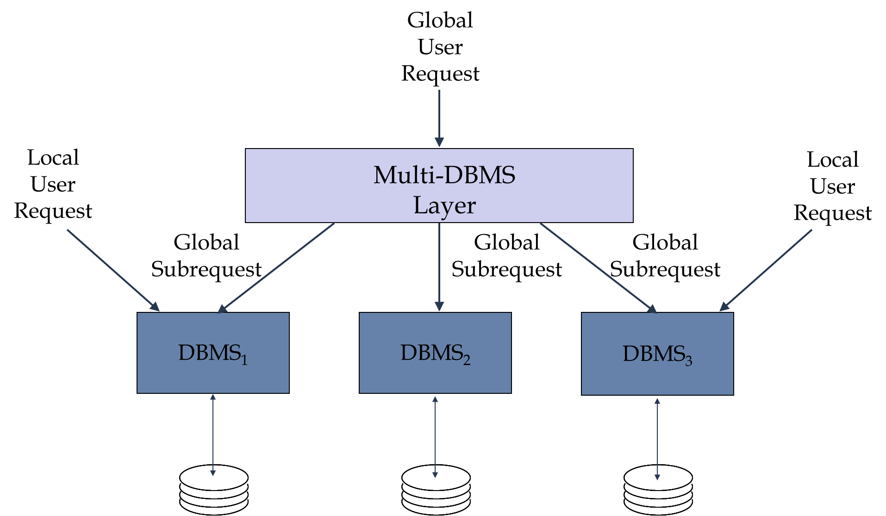
MDBS Components & Execution

