Slide 1
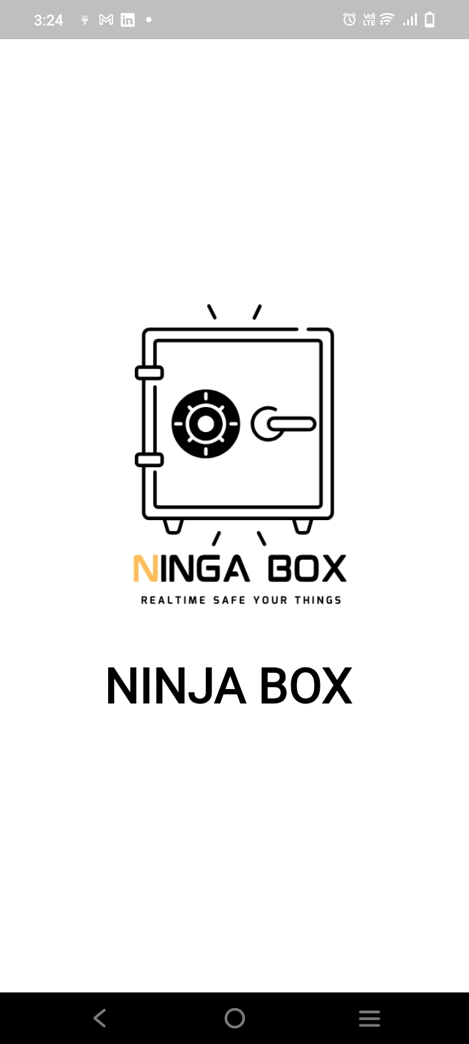
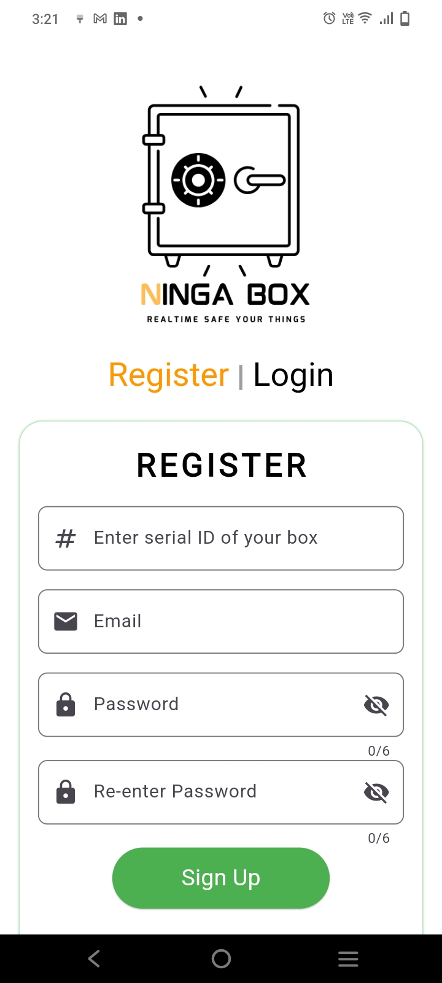
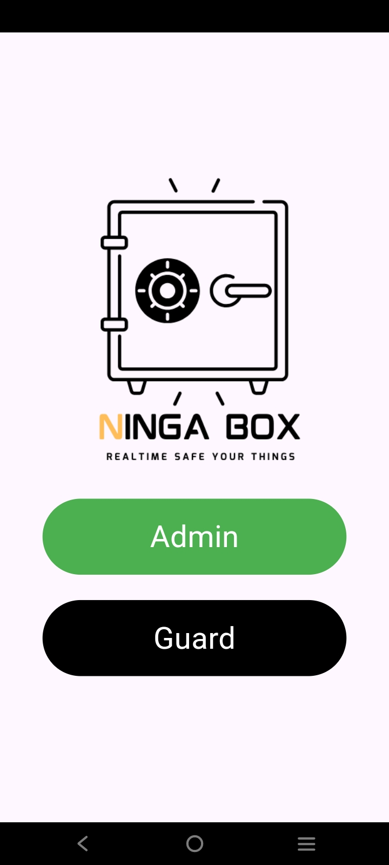
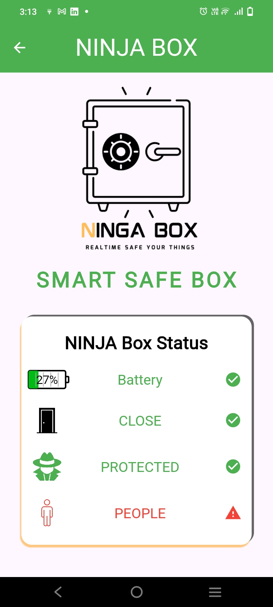
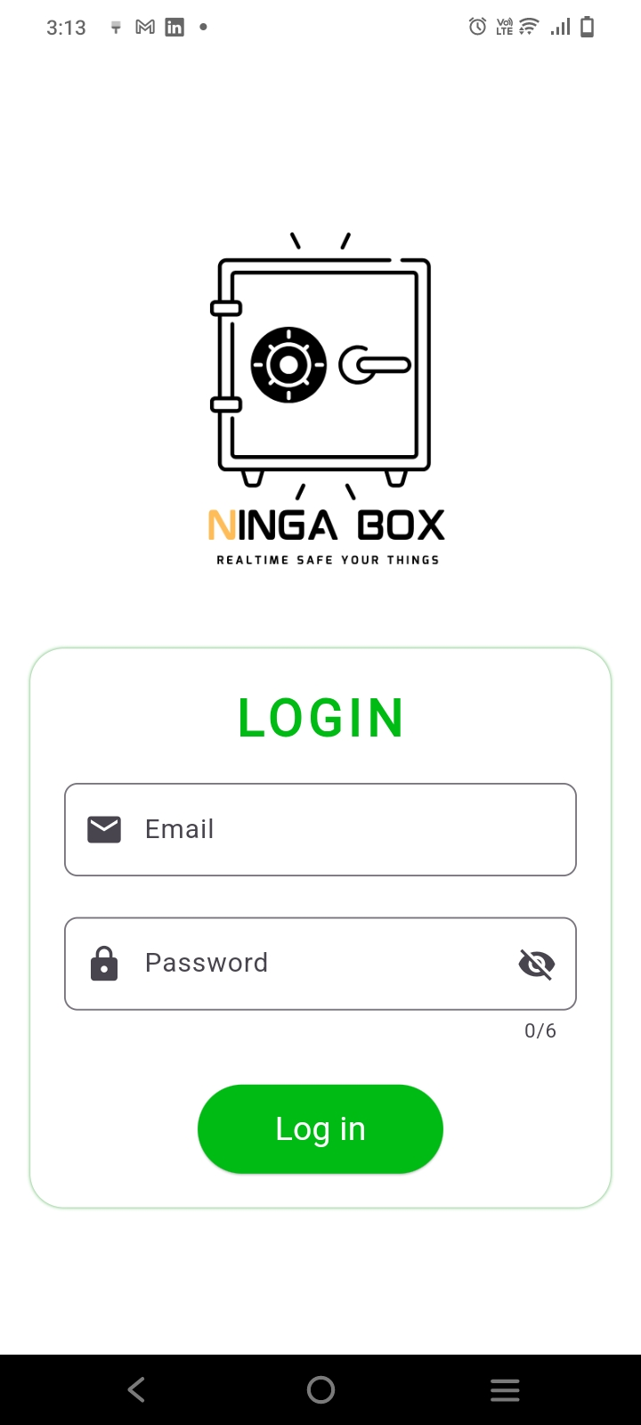
Ninja Box App
Splash Screen
Here admin or owner of the box can sign up to create account and he should prepare a serial number of his box to sign up by it.
On this page, you can choose your account type: normal guard or manager (admin).
Here guard login successfully, he can
Observing state of safe box.
On this page, guard can login.

Slide 2
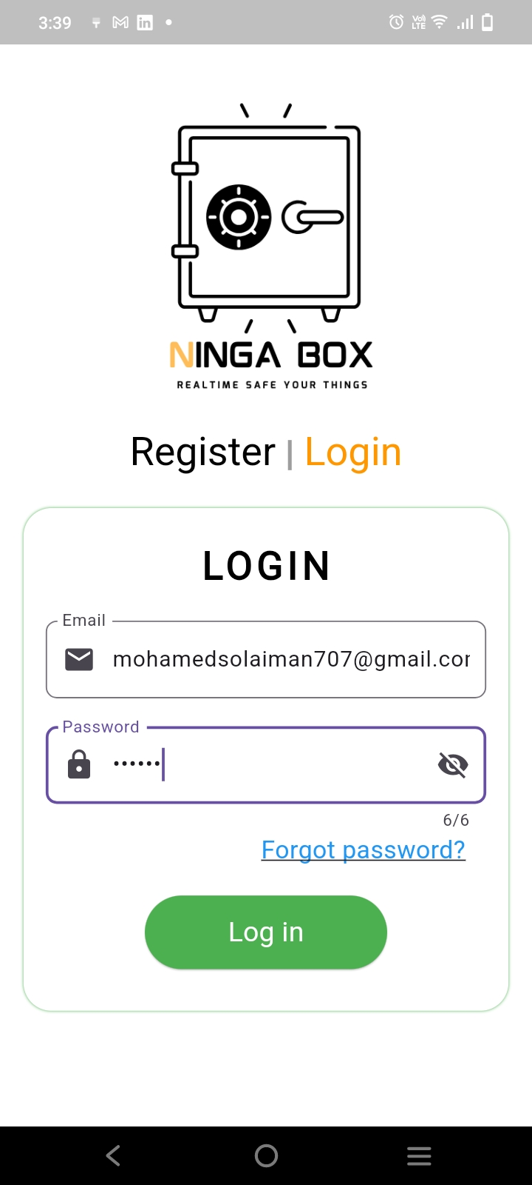
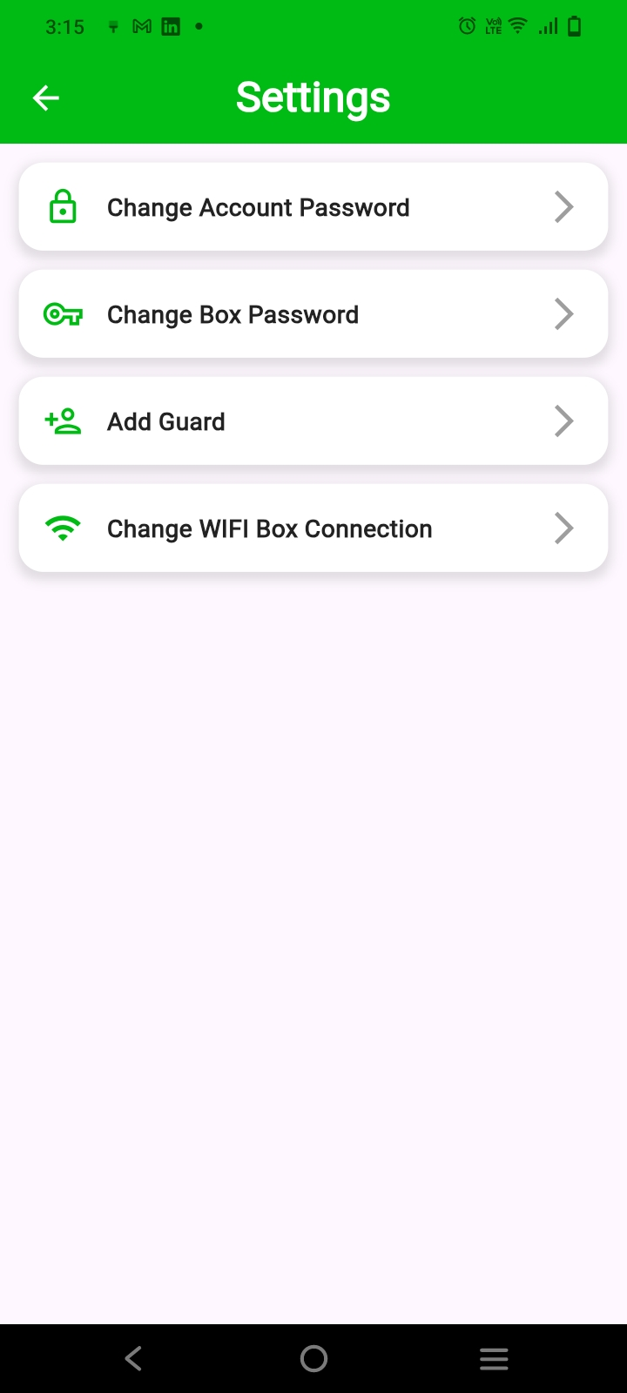
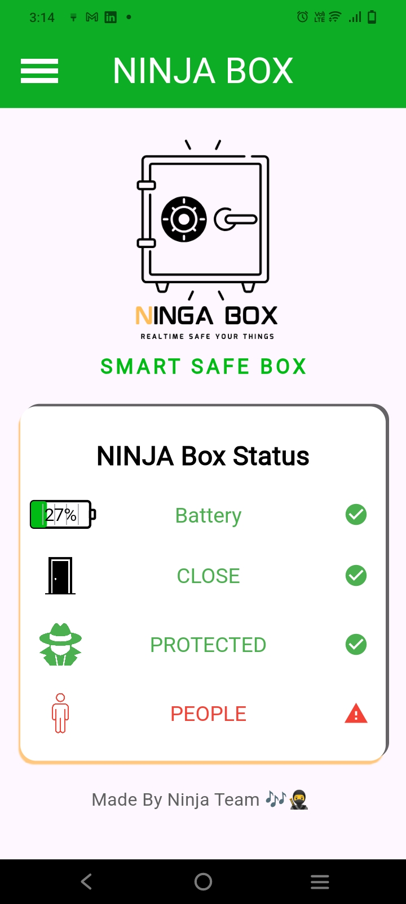
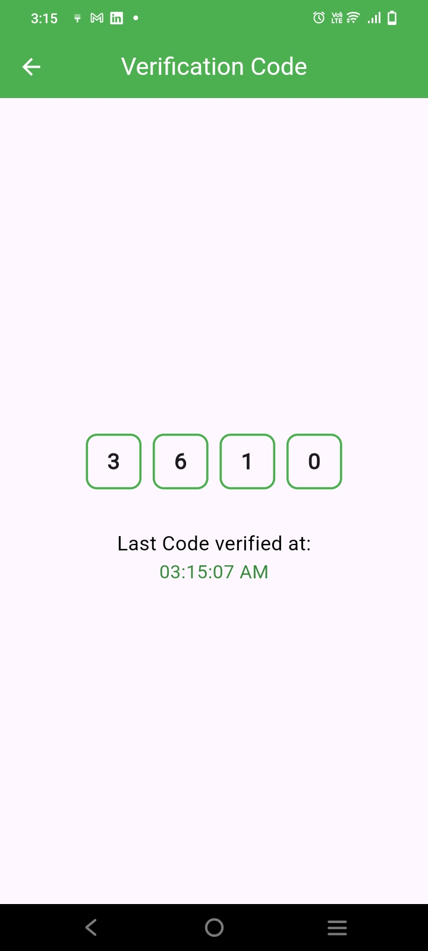
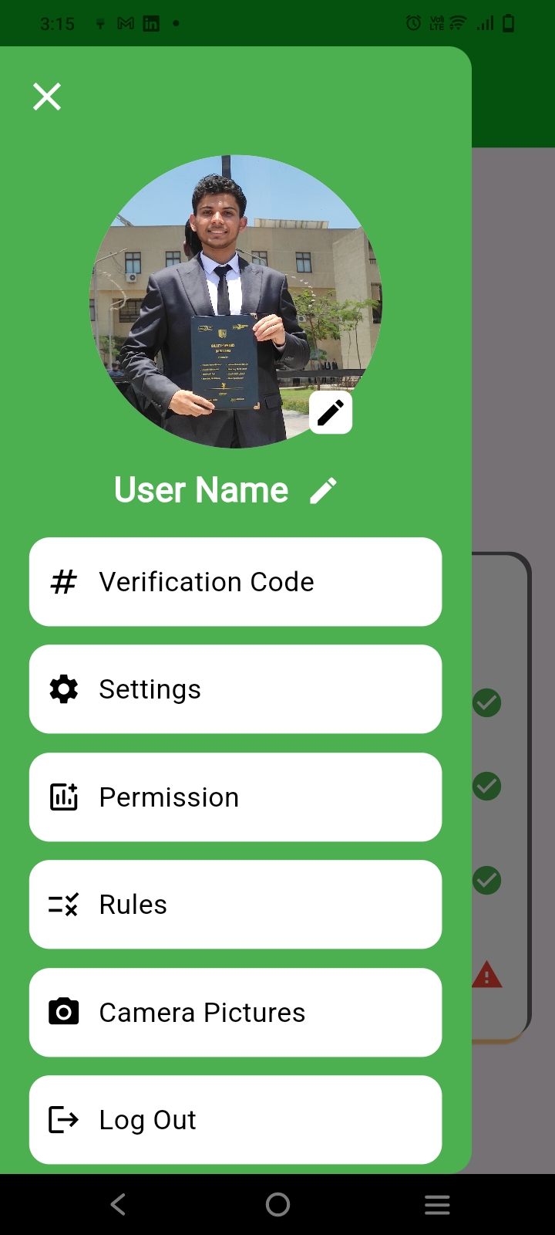
On this page, after you created an account, you can login as admin or owner, and if you forgot your password, dont worry, we add a features enable you to change your password.
On this page, we have many options and pages to manage, such as changing the account password, changing the box password, adding a guard, and changing the box's Wi-Fi connection.
Here the admin can
Monitor the state of
a box as shown in the
Picture.
On this page, the owner receive a verification code from
Firebase and this code
Upload from Keypads that exist in box to realtime database.
On this page, I built a
Drawer that contains
a profile image and name for owner
And he can change them.
Also can navigate to many
Pages as shown in the picture.

Slide 3
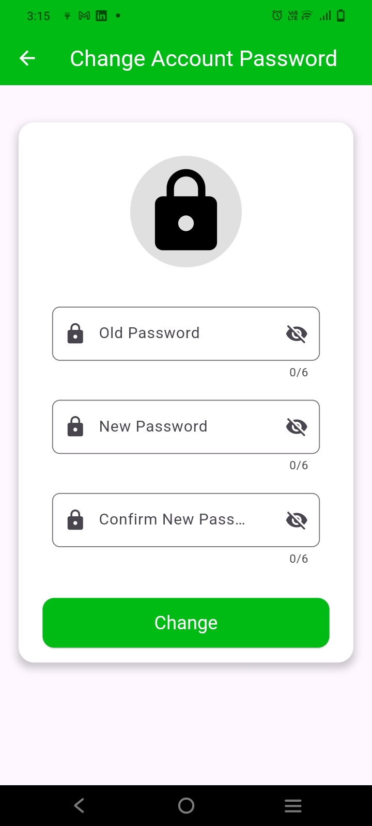
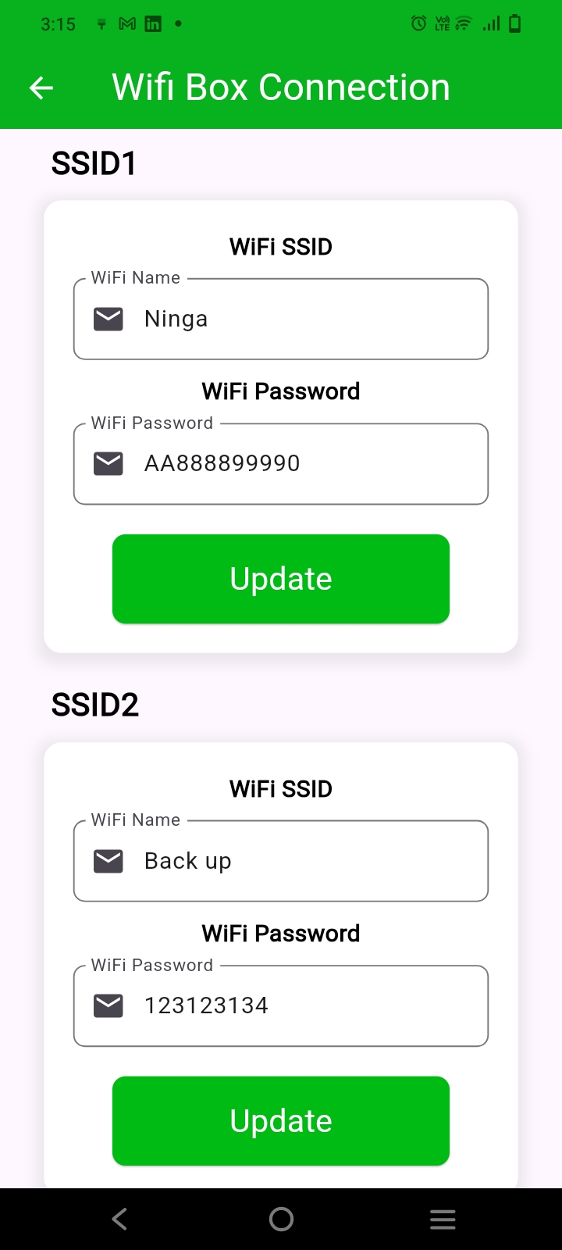
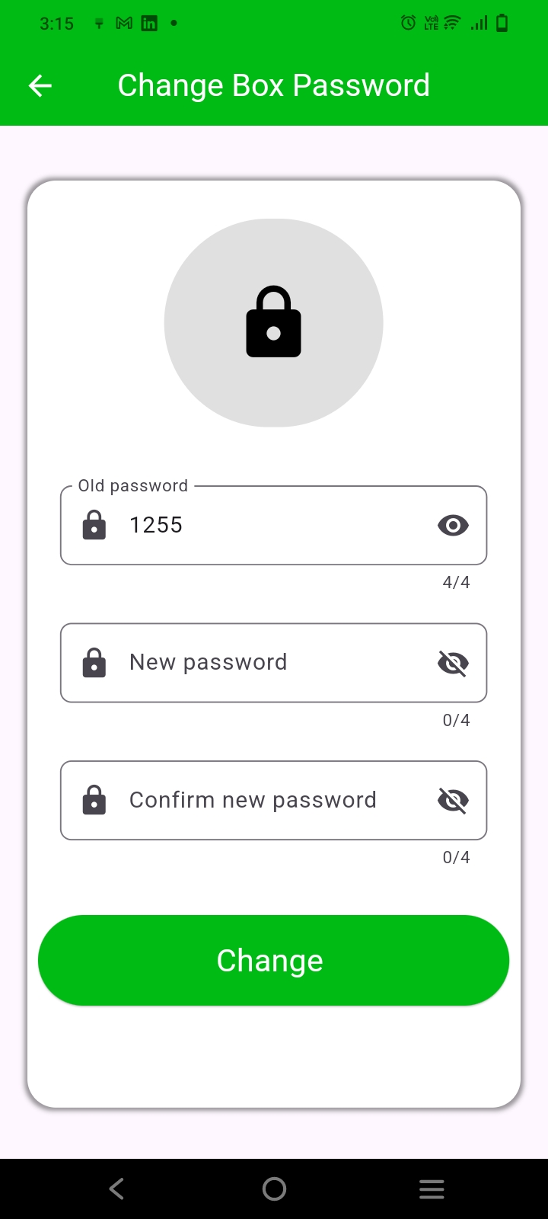
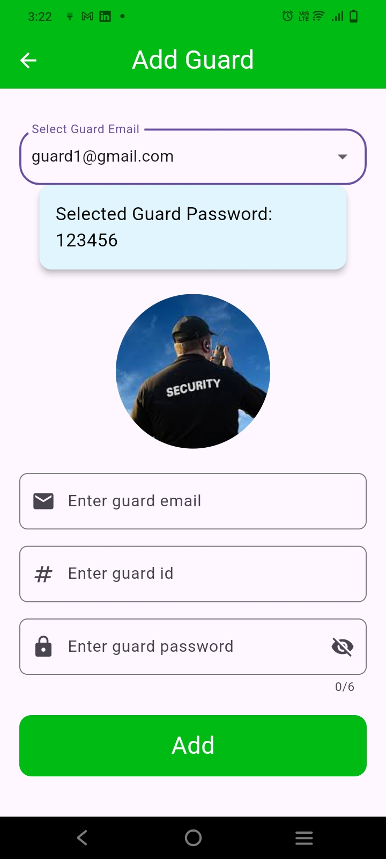
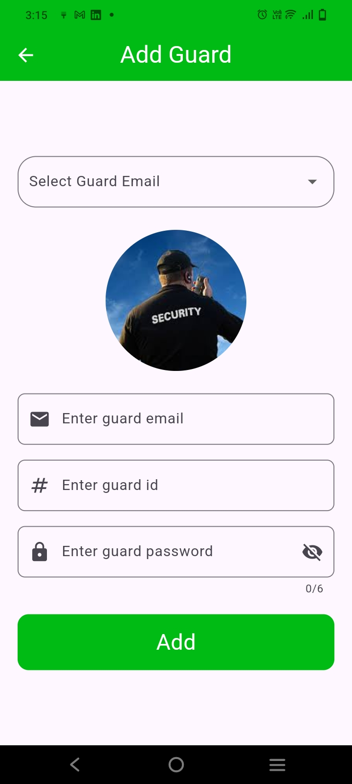
On this page, you can change an account password of owner.
On this page, admin
Can change WiFi name
And password ,then
This update listen in
firebase.
On this page, you can change the box main password if you have the permission
On those two pages, as admin you can Show all guards email and password, and you can create account for guard.

Slide 4
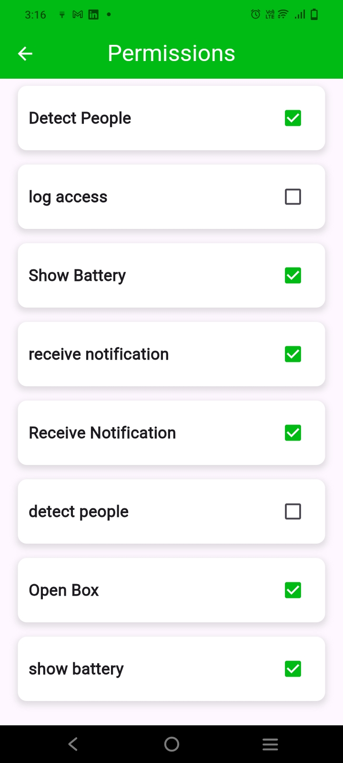
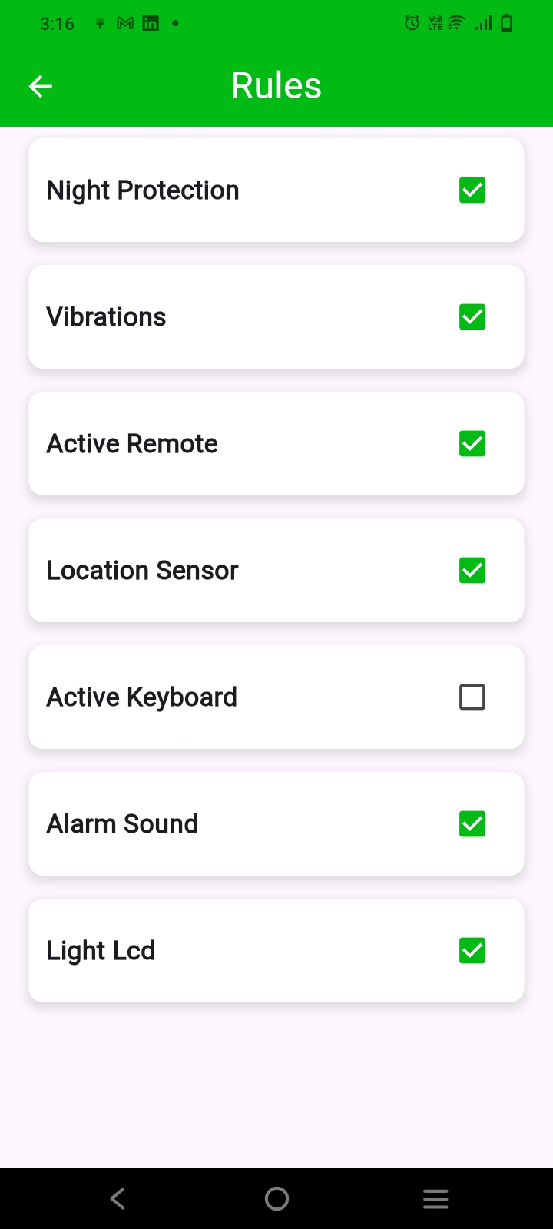
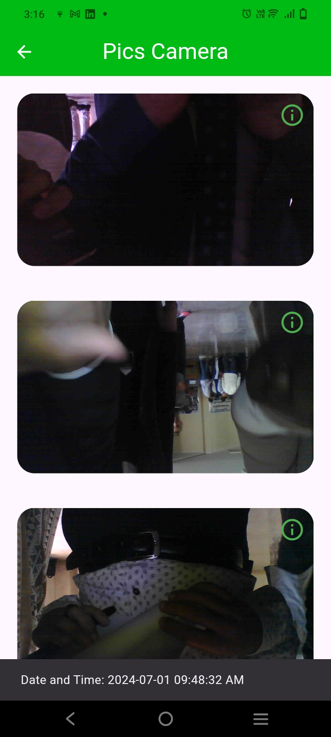
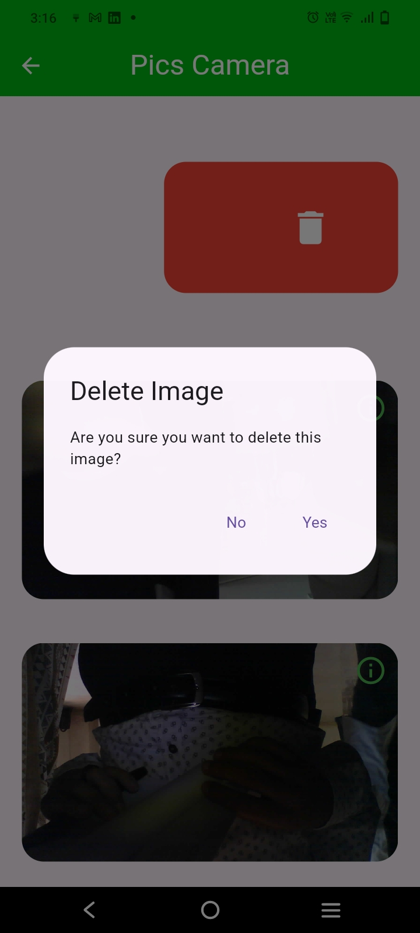
On this page, you can control permissions for guards, such as allowing them to, see the access log of the box, receive notifications from the box on the app, detect people, and view battery life.
Night Protection: Activates all protection functions to ensure no one is near the box.
2. Active Remote: Allows you to control and monitor the box remotely.
3. Location Sensor: Activates to ensure the box is in its designated place.
4. Active Keyboard: Controls the LCD and keypad; if deactivated, no data can be entered.
5. Alarm Sound: Stops or activates the alarm sound if something happens.
6. LCD Light: Turns the LCD lights on or off while keeping the keypad operational.
On this page, you can view, monitor photos taken
by the ESP32 camera and the time they were taken.
We also has ability to delete photos.

