Slide 1

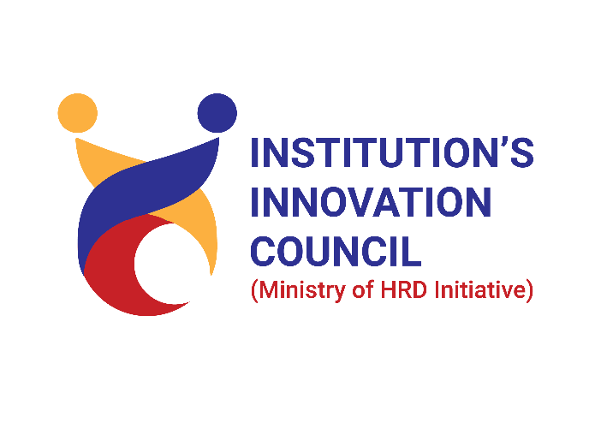
CS19641 – Professional Readiness For Innovation Employability and Entrepreneurship
DEPARTMENT OF COMPUTER SCIENCE AND ENGINEERING
Government Schemes Information Chatbot
Team Member 1 : Logeshwaran Elumalai
Team Member 2 : Madan A C
Team Member 3 : Mohamed Aadhil A
MENTOR : Dr. K. Ananthajothi

Slide 2
ABSTRACT
This abstract presents a novel chatbot designed to provide comprehensive information about Tamil Nadu government schemes, aiming to empower citizens and foster socio-economic development. The chatbot serves as a virtual assistant, offering easy access to a plethora of schemes across various sectors such as education, healthcare, agriculture, and employment. Through intuitive interaction, users can explore eligibility criteria, application procedures, and benefits associated with each scheme. It bridges the gap between government initiatives and citizen awareness, ensuring inclusivity and equitable access to opportunities. By simplifying complex information and offering personalized guidance, the chatbot strives to enhance transparency, accountability, and citizen engagement in governance. With its ability to disseminate timely and accurate information, the chatbot emerges as a catalyst for socio-economic transformation, fostering a culture of informed participation and collective progress.

Slide 3
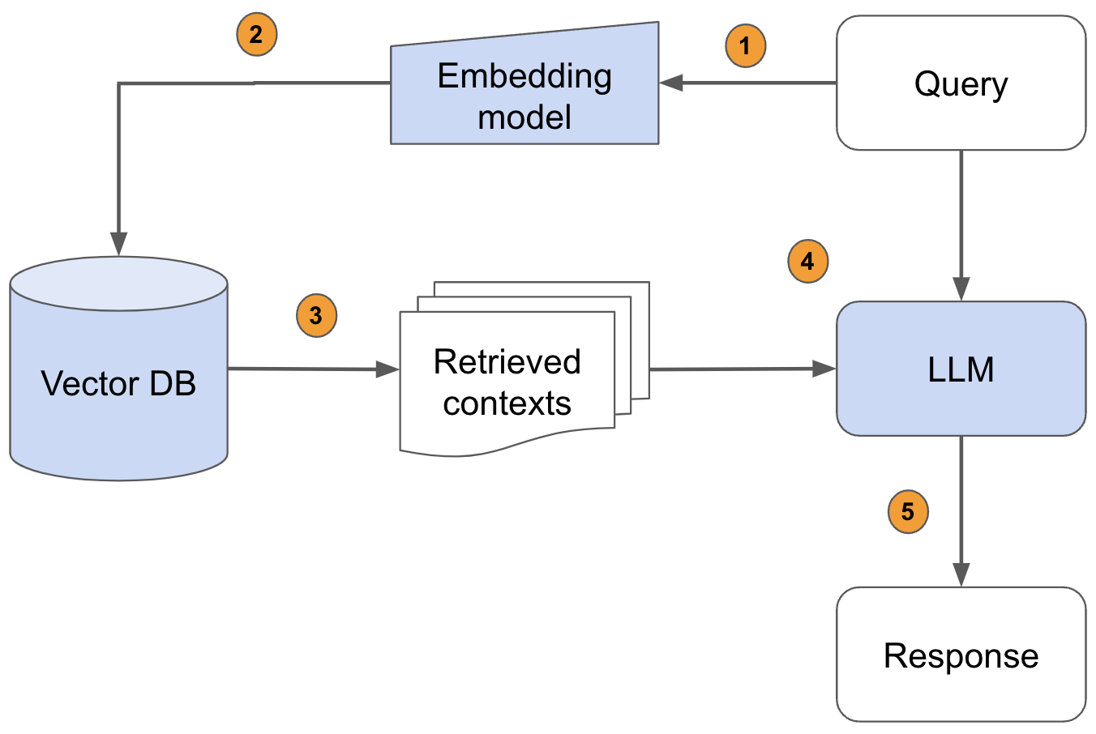
MODEL ARCHITECHTURE

Slide 4
TECHNOLOGY USED
In developing the RAG-based chatbot for Tamil Nadu government schemes, a sophisticated amalgamation of cutting-edge technologies was employed to ensure efficiency and effectiveness. Leveraging the Lang Chain framework, the development process was streamlined, allowing for seamless integration of various components. Initially, PDF documents containing detailed information about government schemes served as the foundation. These documents were processed using the Sentence Transformer model, which generated vector embeddings for each scheme, facilitating efficient storage and retrieval. The Pinecone vector database played a pivotal role in organizing and indexing these embeddings, enabling rapid access to relevant information. Augmented Gemini Pro pre-trained LLM (Large Language Model) served as the conversational engine, generating responses tailored to the retrieved scheme information. Through this interconnected ecosystem, users are provided with a user-friendly interface to inquire about eligibility criteria, application procedures, and benefits associated with each scheme. The chatbot's ability to understand user queries, retrieve pertinent information from the vector database, and generate coherent responses underscores its role as a valuable resource for citizens seeking guidance on government schemes.

Slide 5
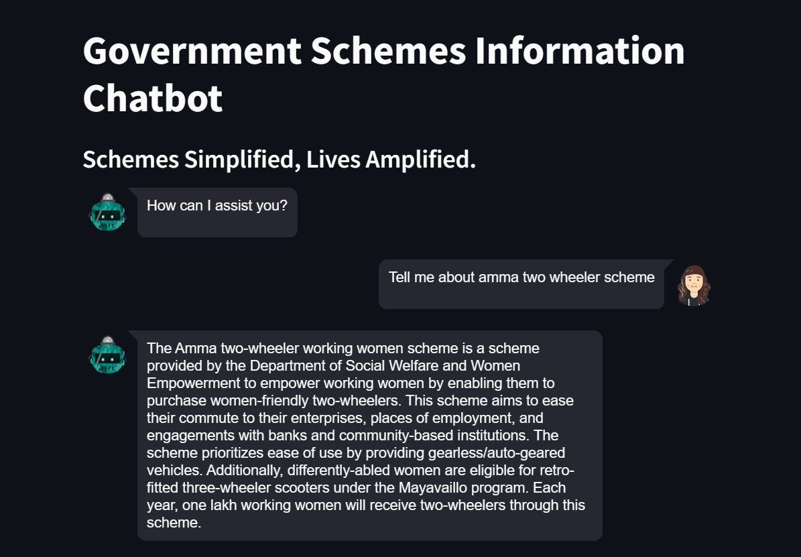
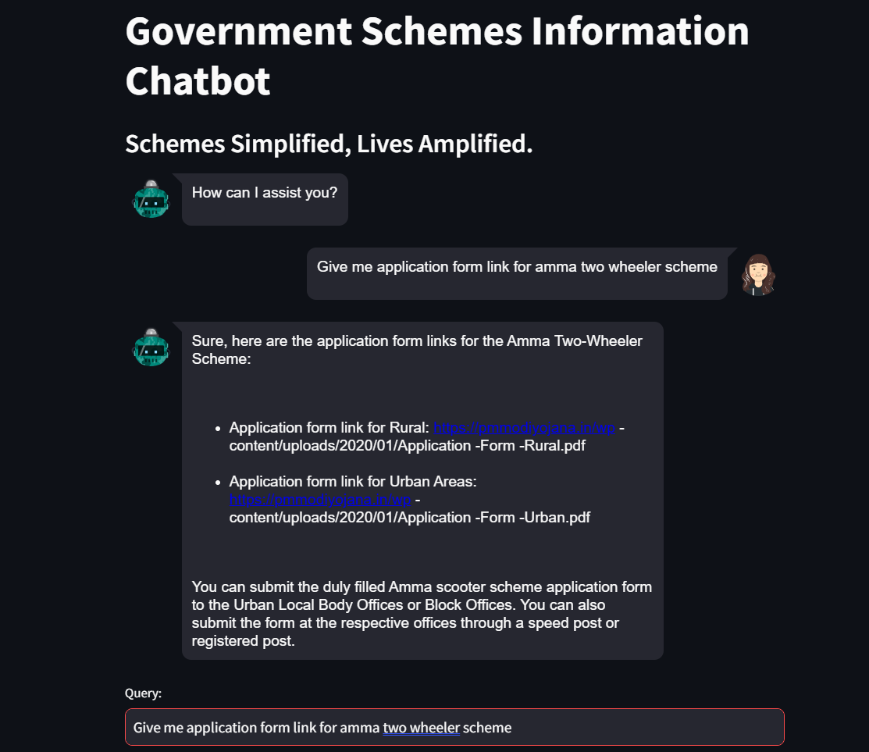
PROPOSED SOLUTION

Slide 6
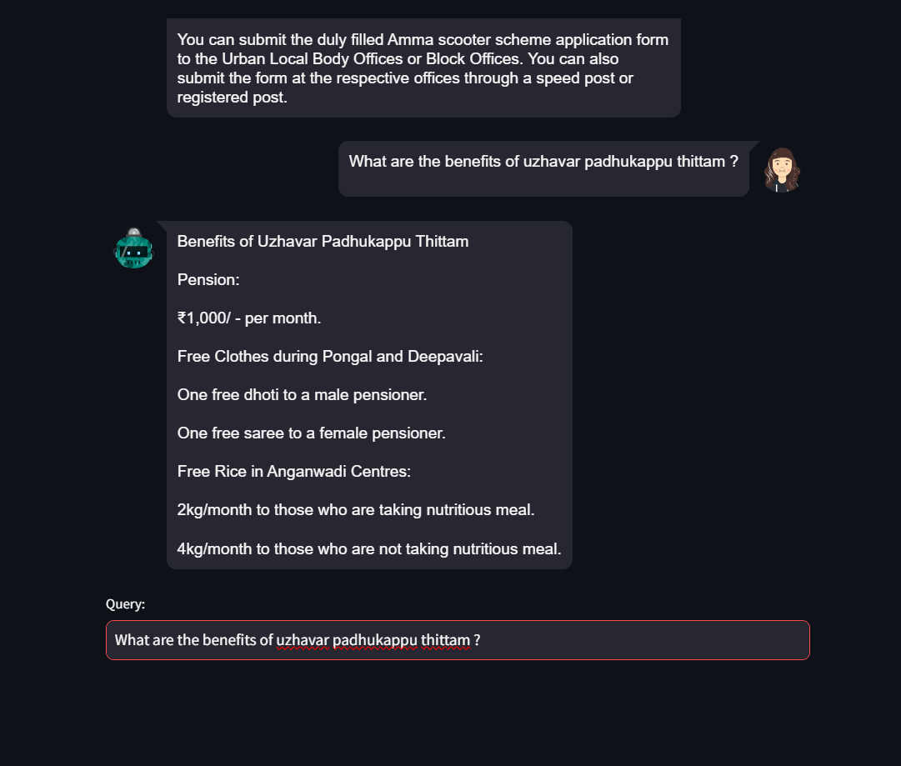
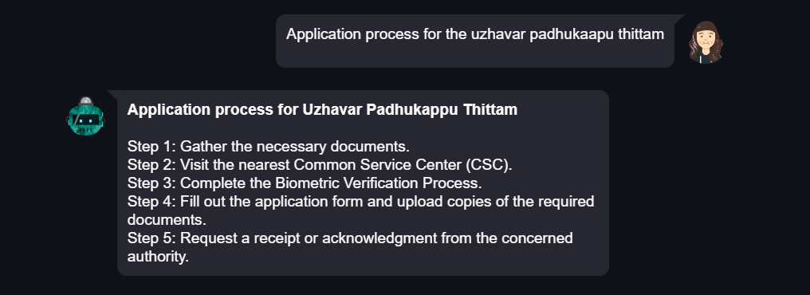

Slide 7
NOVELTY
The novelty of this project lies in its innovative approach to leveraging advanced technologies to enhance accessibility and usability of government schemes. By utilizing the Lang chain framework, the development process was streamlined, ensuring efficiency and scalability. The integration of PDF documents containing scheme information, coupled with the Sentence Transformer model, revolutionizes the storage and retrieval process through vector embeddings. The Pinecone vector database further amplifies efficiency by facilitating rapid access to relevant information. Augmented Gemini Pro pre-trained LLM marks a significant advancement in conversational AI, enabling the chatbot to generate contextually relevant responses. This seamless integration of disparate technologies creates a robust ecosystem where users can effortlessly navigate and engage with government schemes. The project's emphasis on user-friendliness, accuracy, and responsiveness reflects a paradigm shift in leveraging technology for public service delivery. Through this pioneering initiative, citizens of Tamil Nadu are empowered with a user-centric platform to access vital information and avail themselves of government benefits, fostering transparency, accountability, and inclusivity in governance.

Slide 8
SOCIAL RELEVANCE
1. Enhancing Citizen Engagement: This project promotes active citizen involvement by providing an accessible platform for understanding government schemes, empowering informed decision-making and societal participation.
2.Promoting Socio-Economic Inclusivity: Through widespread accessibility, it ensures that marginalized communities can access vital information, reducing socio-economic disparities and fostering equitable participation in public programs.
3. Facilitating Transparent Governance: By offering timely and accurate information about government initiatives, the project builds trust and accountability, essential for fostering transparent communication channels between the government and its citizens.
4. Empowering Socio-Economic Development: By equipping individuals with knowledge about available resources and support services, it catalyzes grassroots development, fostering prosperity and resilience across Tamil Nadu.

Slide 9
REFERENCES
https://python.langchain.com/v0.1/docs/use_cases/question_answering/
https://huggingface.co/sentence-transformers
https://docs.pinecone.io/home
https://www.anyscale.com/blog/a-comprehensive-guide-for-building-rag-based-llm-applications-part-1

Slide 10
THANK YOU

