Slide 1


Department of Computer Science and Engineering
CAMPUS CARPOOLING : OPTIMIZED RIDESHARING FOR STUDENTS
TEAM ID : B21A2425C05
LOGESHWARAN ELUMALAI (210701134)
MOHAMED AADHIL A (210701159)
MS. DHARSHINI B S
ASSISTANT PROFESSOR

Slide 2
Problem Statement and Motivation
Existing ridesharing platforms are generic and fail to meet the specific needs of college students, such as affordability especially, fixed routes, and predictable ride availability. These platforms often charge additional fees during peak hours and are prone to frequent ride cancellations, leaving students without reliable transportation options. They also lack customization for predefined routes commonly traveled by students, such as between home and college, resulting in inefficient ride matching and higher costs. This highlights the need for a ridesharing solution designed exclusively for students, offering reliable, cost-effective, and route-specific rides within a secure ecosystem. Such a solution would enhance accessibility and reliability for students, fostering a more connected campus community. By addressing these gaps, the platform could significantly improve the overall transportation experience for college students.

Slide 3
Objectives
Develop a campus ridesharing app that facilitates efficient ride matching and pricing for students commuting to college.
Integrate dynamic pricing based on real-time demand, distance, and traffic conditions, ensuring fair and transparent fares.
Use data preprocessing and feature engineering to simulate ridesharing scenarios and enhance the accuracy of ride matching algorithms.
Implement a hybrid ridesharing algorithm (HRA) to optimize ride matching between drivers and riders, improving overall ride efficiency.
Build the app as a Progressive Web App (PWA) for cross-platform compatibility, enabling offline functionality and faster user interactions.

Slide 4
Abstract
This project aims to develop a campus ridesharing platform that enhances commuting for students by offering an efficient, cost-effective, and environmentally friendly alternative to traditional transportation options. The app will integrate a Hybrid Ridesharing Algorithm (HRA) combining K-means clustering and genetic algorithms to optimize the matching of drivers and riders. Dynamic pricing will be implemented to adjust fare rates based on real-time factors like demand, distance, and traffic. Built as a Progressive Web App (PWA), it ensures seamless access across devices, even offline. The project addresses issues like ride cancellations and additional charges commonly seen in existing platforms, offering students a more reliable and transparent commuting option.

Slide 5
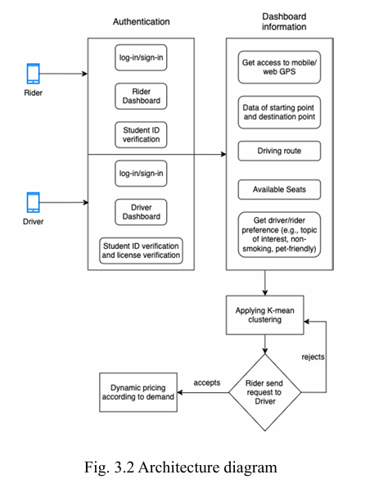
System Architecture

Slide 6
List of Modules
Responsive UI Design
Rider – Driver Registration
User Authentication
Synthetic Data Generation and Preprocessing For Hybrid Ridesharing Algorithm (HRA)
PWA (Progressive Web Application) Feature

Slide 7
Functional Description – Responsive UI
Ensures the app interface adapts seamlessly across various devices such as desktops, tablets, and mobile phones.
Utilizes React for building interactive UI components and Tailwind CSS for styling, enabling flexible layouts and responsiveness.
Uses utility-first CSS classes to make the UI elements responsive and easily customizable across different screen sizes.
Prioritizes user experience (UX) by optimizing navigation, interactivity, and accessibility on various devices.

Slide 8
Functional Description – Rider And Driver registration
Allows users (riders) to register for the ridesharing service by providing personal details such as name, contact number, email, and preferences.
Includes a validation process to ensure data accuracy and completeness during registration.
Allows users to create and manage their profiles.
Collects ride-specific preferences like preferred routes and times for efficient ride matching.

Slide 9
Functional Description – User Authentication
Provides secure login and registration functionalities, where users authenticate using College email and password.
Implements secure session management, including token-based authentication (e.g., JWT) to persist user login sessions across app usage.
Facilitates password recovery and account management to reset or update login credentials.
Ensures data security with proper encryption and secure handling of user credentials.

Slide 10
Functional Description – Synthetic Data Generation And Preprocessing For HRA
Generates synthetic data that simulates user behavior, vehicle availability, and traffic patterns for testing the Hybrid Ridesharing Algorithm.
Preprocesses the data by cleaning and transforming it to ensure consistency and compatibility with the algorithm's requirements.
Includes techniques like data cleaning, feature scaling, and transformation to make the data suitable for clustering and optimization tasks.
Provides the basis for testing the efficiency and accuracy of the HRA before implementing it with real data.

Slide 11
Functional Description – Initializing PWA features
The web application is being developed with the goal of converting it into a Progressive Web Application (PWA), which allows users to interact with the app even when offline.
manifest.json file has been initialized to define the app's name, icons, and other metadata required to make the app installable on users' devices.
service worker.js has been initialized as the foundation for enabling offline capabilities, caching assets, and handling background processes. However, full implementation of the service worker functionality is still pending.
The app will eventually offer a native-app-like experience, such as faster load times and the ability to function without an internet connection.

Slide 12

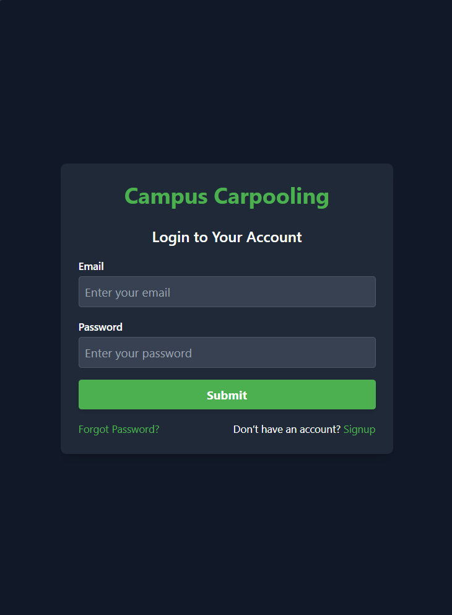

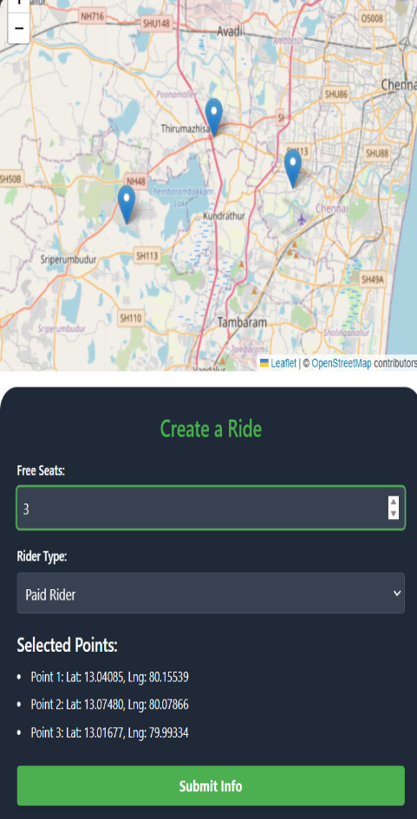
Implementation & Results of Modules
Splash Screen
Login Page
Home Page
Driver Dashboard

Slide 13
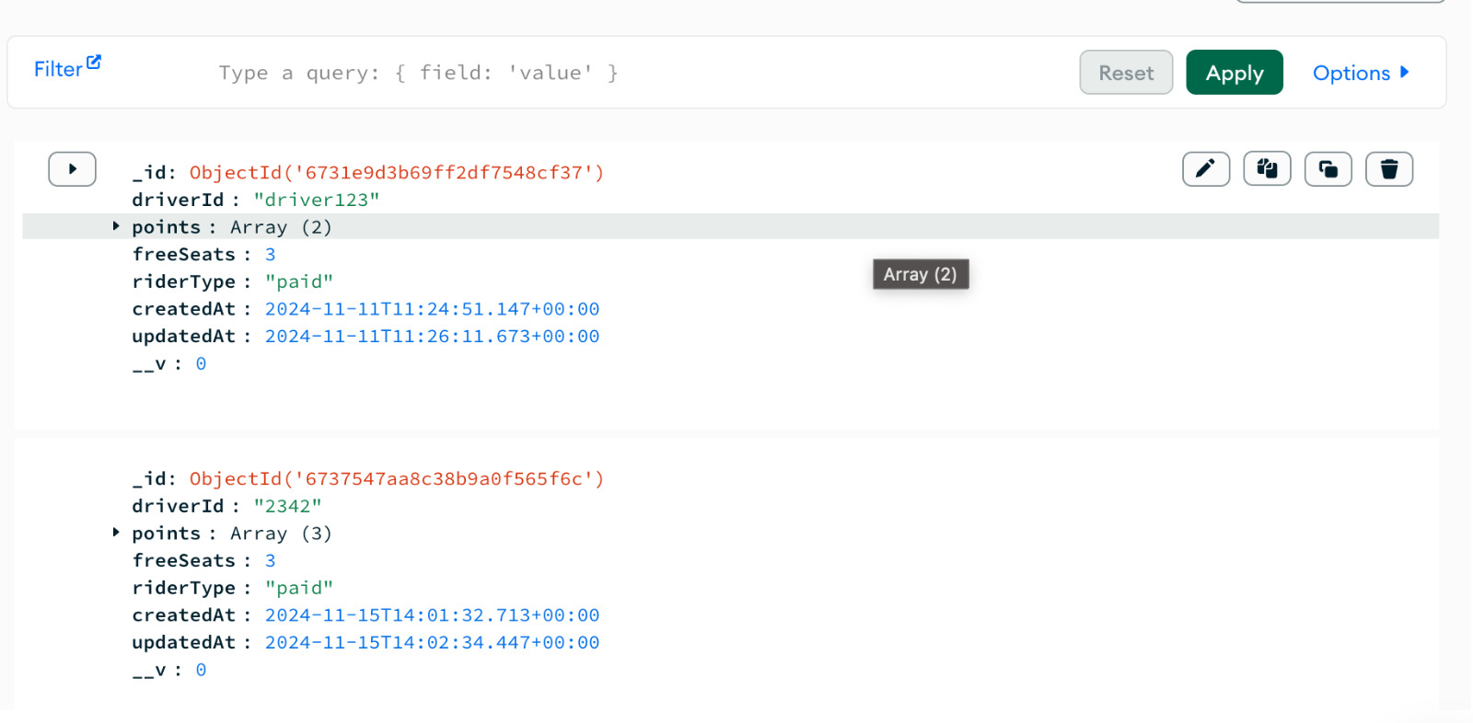
Implementation & Results of Modules
MongoDB For Storing Data

Slide 14
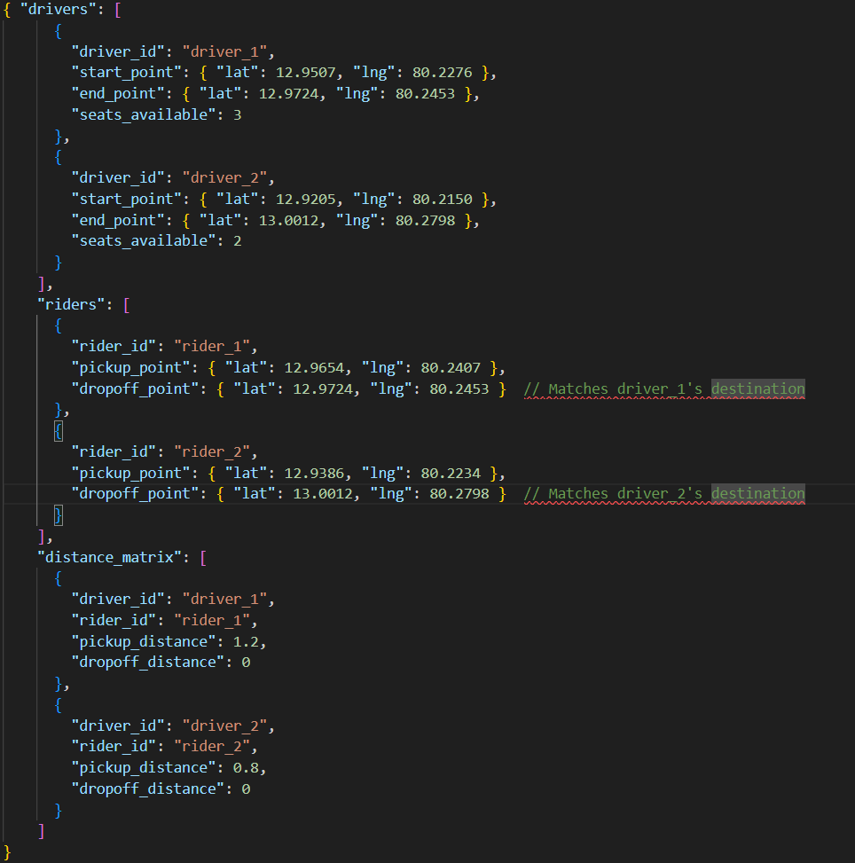
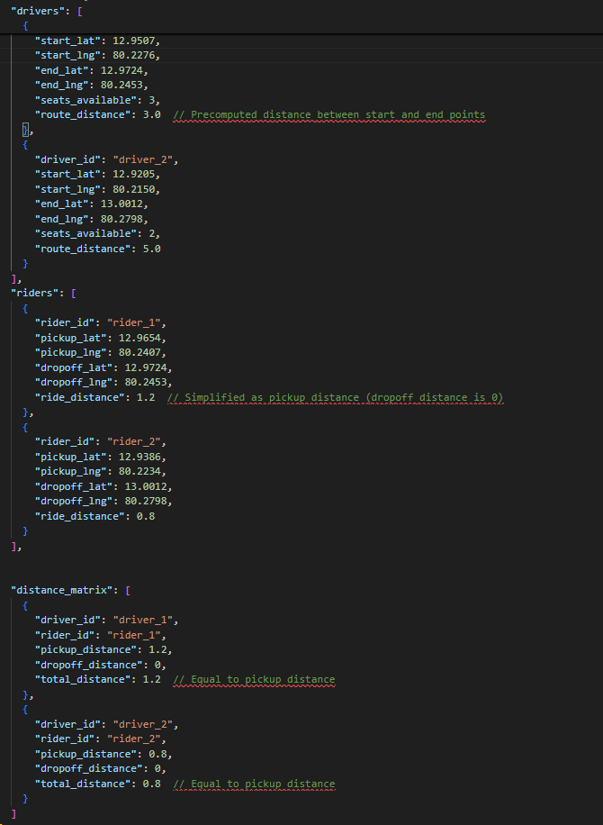
Implementation & Results of Modules

Slide 15
Conclusion & Work for Phase II
Phase 1 has laid a strong foundation for the development of the campus ridesharing application by focusing on key aspects such as responsive UI design, user authentication, and the initialization of the PWA feature. The user registration process for both riders and passengers has been successfully implemented, providing a seamless onboarding experience. Data preprocessing for the Hybrid Ridesharing Algorithm has been set up to enhance the matching process. While the PWA functionality has been initiated with the setup of essential files, it still requires further development for offline capabilities. Overall, Phase 1 ensures that the project is ready for the next phase of complex algorithm integration and further optimization.

Slide 16
Work for Phase II
Phase 2 will focus on implementing the Hybrid Ridesharing Algorithm to enhance ride matching and pricing strategies. The PWA feature will be completed, adding offline functionality and background sync. Performance optimization will be carried out to ensure smooth app operation during peak usage. Testing and debugging will address any issues with registration, authentication, and algorithms. By the end of Phase 2, the app will be ready for further feature development and refinement.

Slide 17
References
Anas, Mohd, C. Gunavathi, and G. Kirubasri. "Machine learning based personality classification for carpooling application." 2023 International Conference on Intelligent Systems for Communication, IoT and Security (ICISCoIS). IEEE, 2023.
Müller, Christian, et al. "Dynamic pricing for shared mobility systems based on idle time data." OR Spectrum 46.2 (2024): 411-444.
Seng, Kah Phooi, et al. "Ridesharing and crowdsourcing for smart cities: technologies, paradigms and use cases." IEEE Access 11 (2023): 18038-18081.
Kumar, P., Vinodh Kumar, S., Priya, L. (2023). Smart and Safety Traffic System for the Vehicles on the Road. In: Choudrie, J., Mahalle, P., Perumal, T., Joshi, A. (eds) IOT with Smart Systems. Smart Innovation, Systems and Technologies, vol 312. Springer, Singapore. https://doi.org/ 10.1007/978-981-19-3575-6_51.

Slide 18
Paper Publication Status
TITLE: Campus carpooling : optimized ridesharing for students using hybrid ridesharing algorithm.
AUTHORS: Ms. Dharshini B.S.
Logeshwaran Elumalai N (210701134)
Mohamed Aadhil A (210701159)
CONFERENCE:2nd INTERNATIONAL CONFERENCE ON EMERGING RESEARCH IN COMPUTATIONAL SCIENCE – 2024(ICERCS-2024)
MODE OF SUBMISSION: HYBRID MODE
STATUS: SUBMITTED AND WAITING FOR ACCEPTANCE

Slide 19
Thank You

