Slide 1


Sales Analysis
Prepared by:
Mohamed Abdel Tawwab Badr

Slide 2


Pipeline for my project
-Data Collection
-Exploratory Data Analysis (EDA)
-Data Cleaning & Preprocessing
-Data Visualization using power BI

Slide 3

Total Amount
44.69M
Count Of Product
22
.KPIs
Count of Boxes
7905
What are KPIs?
•Key Performance Indicators (KPIs) are measurable values that indicate how effectively an organization is achieving its strategic objectives.
•They provide clear insights into performance and help guide decision-making.

Slide 4
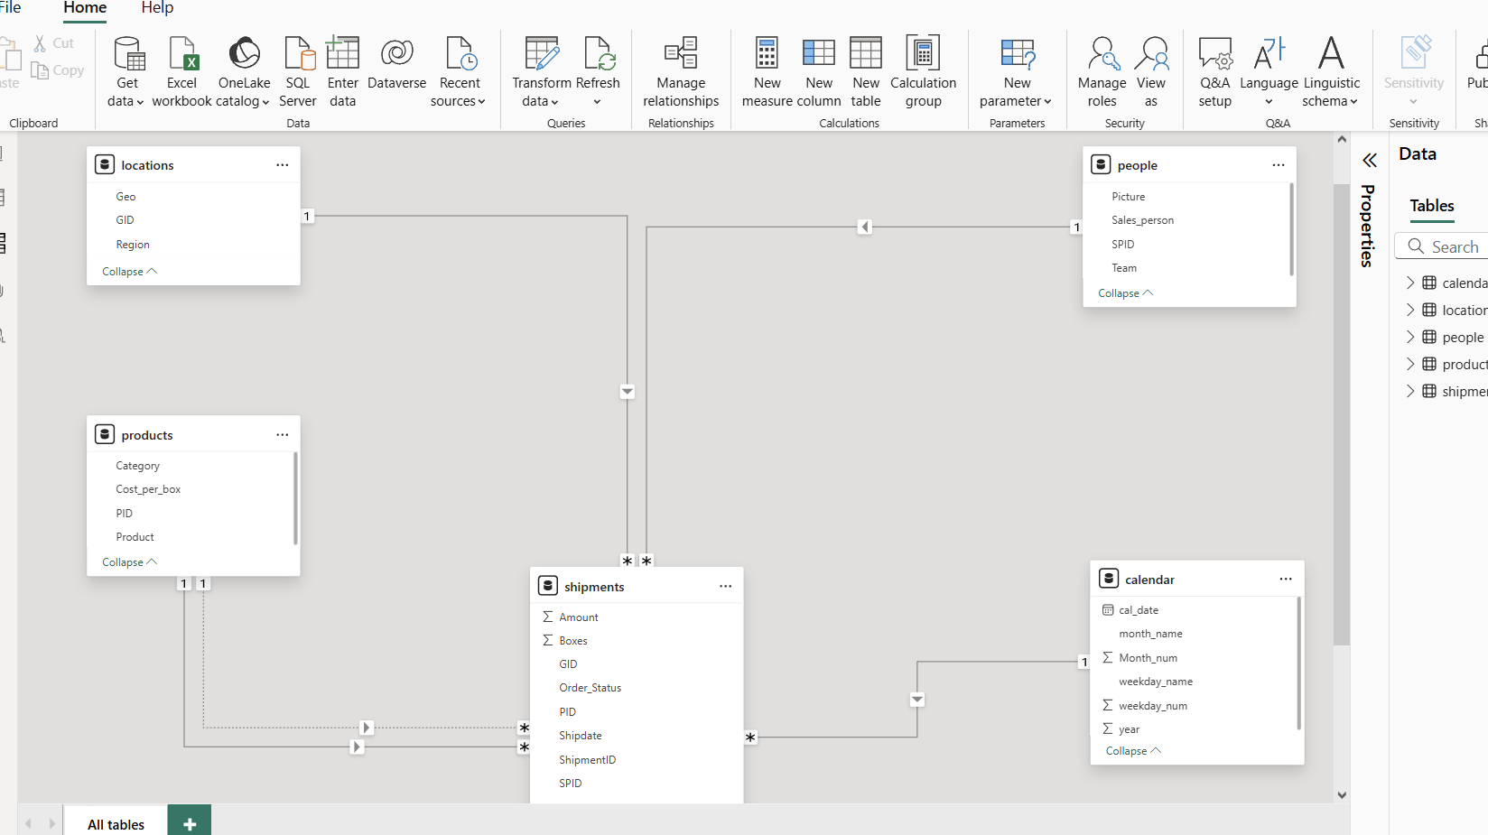

Data Model

Slide 5
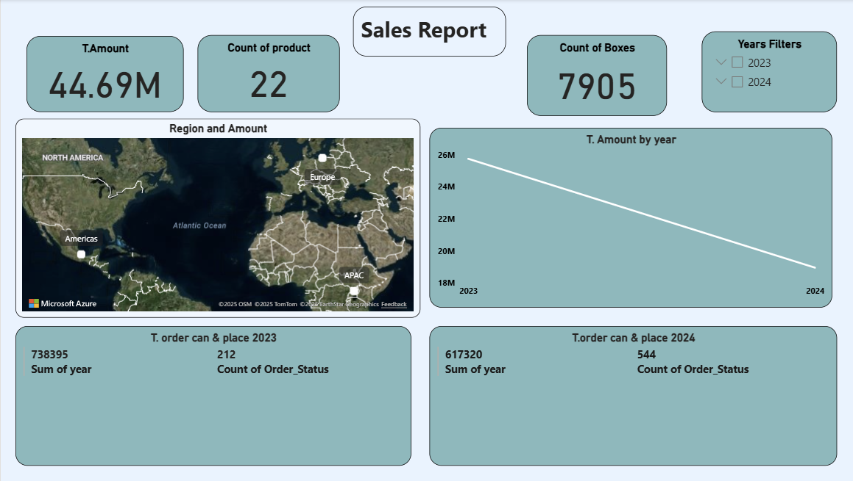

Slide 6
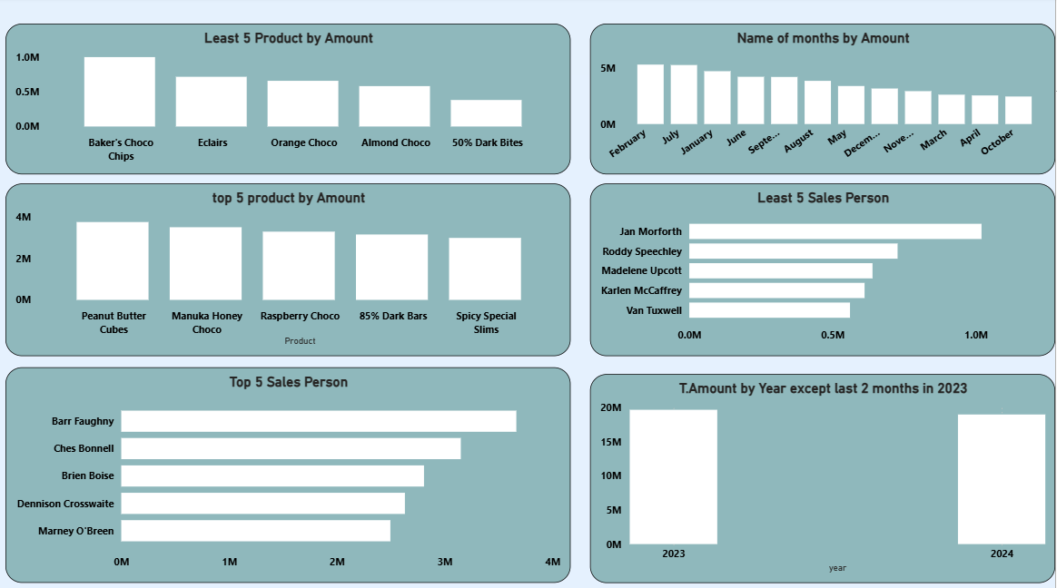

Slide 7
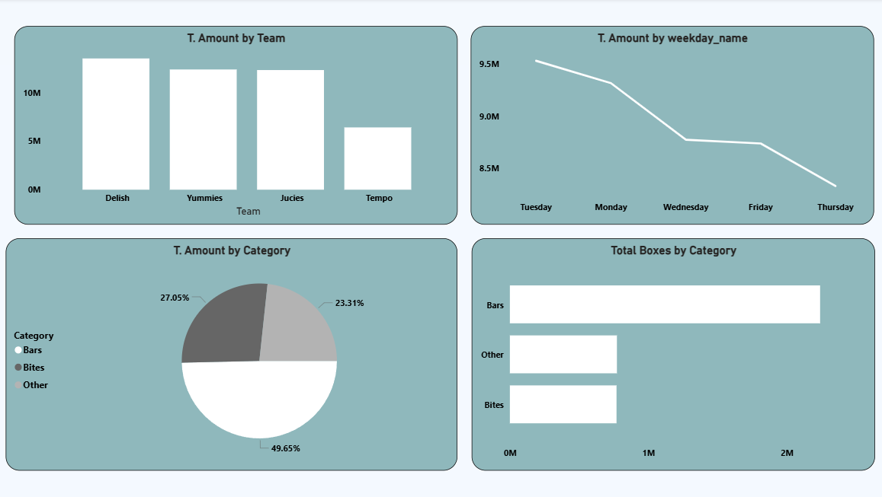

Slide 8
Notes
The drop from 2023 to 2024 is not a real problem it’s mainly because 2024 data is missing two months.
Lowest Sales
Team Tempo
Limited product knowledge
Low customer reach
Weak Effort
The company not paid salary
Team Not matching
Cancelations &Placed Possible Reasons
Lowest Sale Product
Almond Choco, 50% Dark Bites
Out of stock
Delivery delays
Extra costs
Payment issues
Better offer elsewhere
Taste not popular
Price is high
Few promotions
Not always available

Slide 9
Thank You
+201151658683
mo.abood.123.123@gmail.com

