Slide 1

TITLE
Analysis of Verified Skytrax Airline Reviews

Slide 2
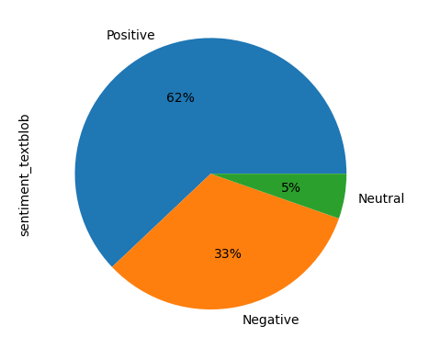
Sentiment Analysis
Based on the results of the sentiment analysis, it was found that over 60% of the reviews were classified as positive.
A pie chart was created to visualize the distribution of reviews, categorizing them into positive, negative, and neutral sentiments

Slide 3
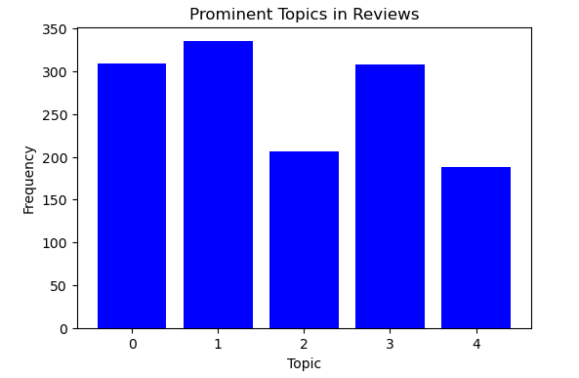
Topic Modeling
Topic 0: "flight", "ba", "good", "time", "crew", "service", "london", "cabin", "one", "staff"
Topic 1: "flight", "ba", "london", "service", "customer", "us", "get", "airport", "british", "hours“
Topic 2: "flight", "ba", "seat", "crew", "food", "good", "service", "seats", "time", "us“
Topic 3: "class", "flight", "ba", "business", "service", "food", "seat", "cabin", "seats", "time"
Topic 4: "ba", "flight", "staff", "london", "crew", "would", "seat", "service", "one", "british"

Slide 4
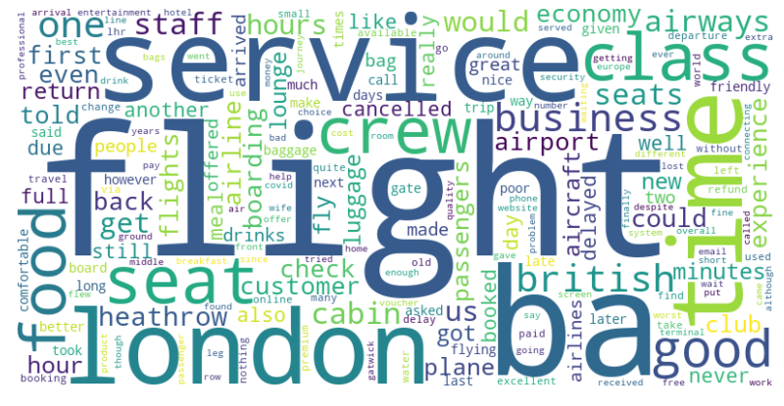
word cloud
Finaly To visualize the most frequent words used in the reviews, a word cloud was generated. The word cloud provides a visual representation of the words, with their size indicating their frequency of occurrence in the reviews.

Slide 5
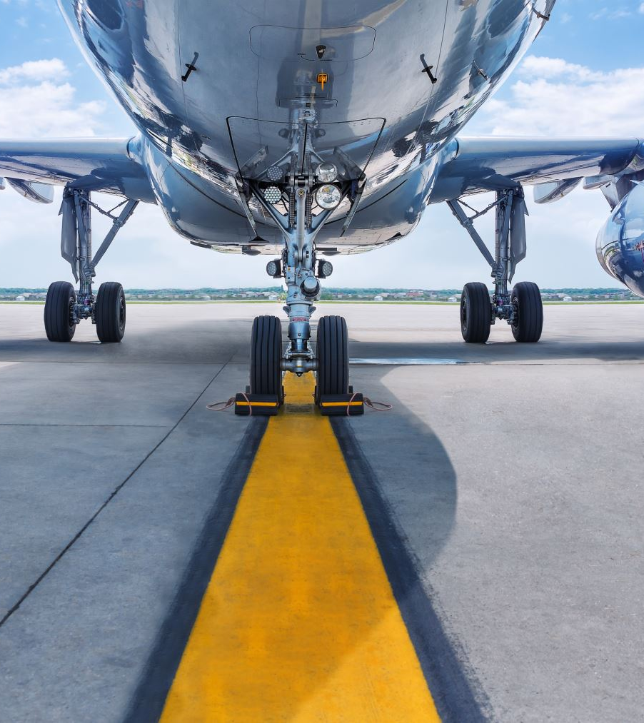
Conclusion
Based on the reviews, the primary areas of focus for reviewers at the airport were the quality of staff service, the waiting time for boarding or departure, the comfort of the seats, the food options, and to a lesser extent, the overall crowd or congestion.

