Slide 1

CUSTOMER ANALYTICS
BUSINESS ANALYTICS PROJECT
Customer Churn Analysis & Retention Solution
From customer data to better retention decisions
SIC 8 BD 801
Customer Churn Analysis & Retention Solution

Slide 2
Agenda
Team
Introduction
Problem Statement
Methodology
Tech Stack
Key Tasks
Results and Insights
Conclusion
Q&A
Notes:
Note:

Slide 3

Team Members
1
Mohamed Khaled
2
Ahmed Elbana
3
Mohamed Bedier
4
Ahmed Adel
5
Ahmed Mohamed
Samsung Innovation Campus

Slide 4
Introduction
Notes:
Note:

Slide 5

INTRODUCTION
Why churn matters
Customer churn means customers leaving the company. The earlier the signal is visible, the more time the business has to respond.
Customers leave. Business value leaves with them.
01
Revenue pressure
Losing customers can reduce recurring revenue and weaken the value of existing relationships.
02
Higher acquisition effort
Replacing lost customers requires new acquisition activity, time, and marketing effort.
03
Opportunity to act early
Identifying customers at risk creates an opportunity for proactive retention action before they leave.
Customer Churn Analysis & Retention Solution

Slide 6
Problem Statement
Notes:
Note:

Slide 7

The Business Challenge
Fragmented data across the customer journey
Customer information is often spread across different business activities, making it difficult to see the full picture of customer health.
Customer Profiles
Product Usage
Support & Experience
Offers & Retention
Demographics, geography, and account tenure. Who the customer is.
Activity levels, balances, and engagement frequency. How they use the service.
Ticket volume, resolution times, and service friction. How they feel.
Campaign history, discounts, and response rates. How we try to keep them.
Without a unified view, critical warning signs of churn are often missed until it is too late.
Customer Churn Analysis & Retention Solution

Slide 8

The Questions Leaders Need Answered
Framing the analysis to support practical business decisions
RISK ASSESSMENT
BEHAVIORAL PATTERNS
SERVICE EXPERIENCE
Which customers are more likely to churn in the next period?
What specific customer behaviors are most associated with churn?
Does customer support experience or ticket volume relate to churn?
PRODUCT ENGAGEMENT
OFFER EFFECTIVENESS
SEGMENT PRIORITY
How does product usage differ between retained and churned customers?
Are current offers helping with retention, or are they underutilized?
Which customer segments need immediate attention to prevent loss?
Customer Churn Analysis & Retention Solution

Slide 9
Methodology
Notes:
Note:

Slide 10

From Data to Decisions
Connecting customer activity to strategic business outcomes
Customer Data
Analysis
Business Insights
Better Retention Decisions
Unified view of profiles, usage, support, and offers.
Identifying patterns and behaviors linked to churn.
Translating data patterns into clear business signals.
Proactive outreach and targeted retention strategies.
Customer Churn Analysis & Retention Solution

Slide 11

A Simple, Repeatable Methodology
From raw data to actionable business decisions
01
02
03
04
05
Data Collection
Data Preparation
Customer Analysis
Business Insights
Decision Support
Gather information from relevant business sources and customer touchpoints.
Clean and organize information for consistent and reliable analysis.
Combine activity into a unified view to identify churn-related patterns.
Translate complex patterns into clear, actionable business findings.
Provide the evidence needed to support effective retention strategies.
Customer Churn Analysis & Retention Solution

Slide 12
Tech Stack
Notes:
Note:

Slide 13
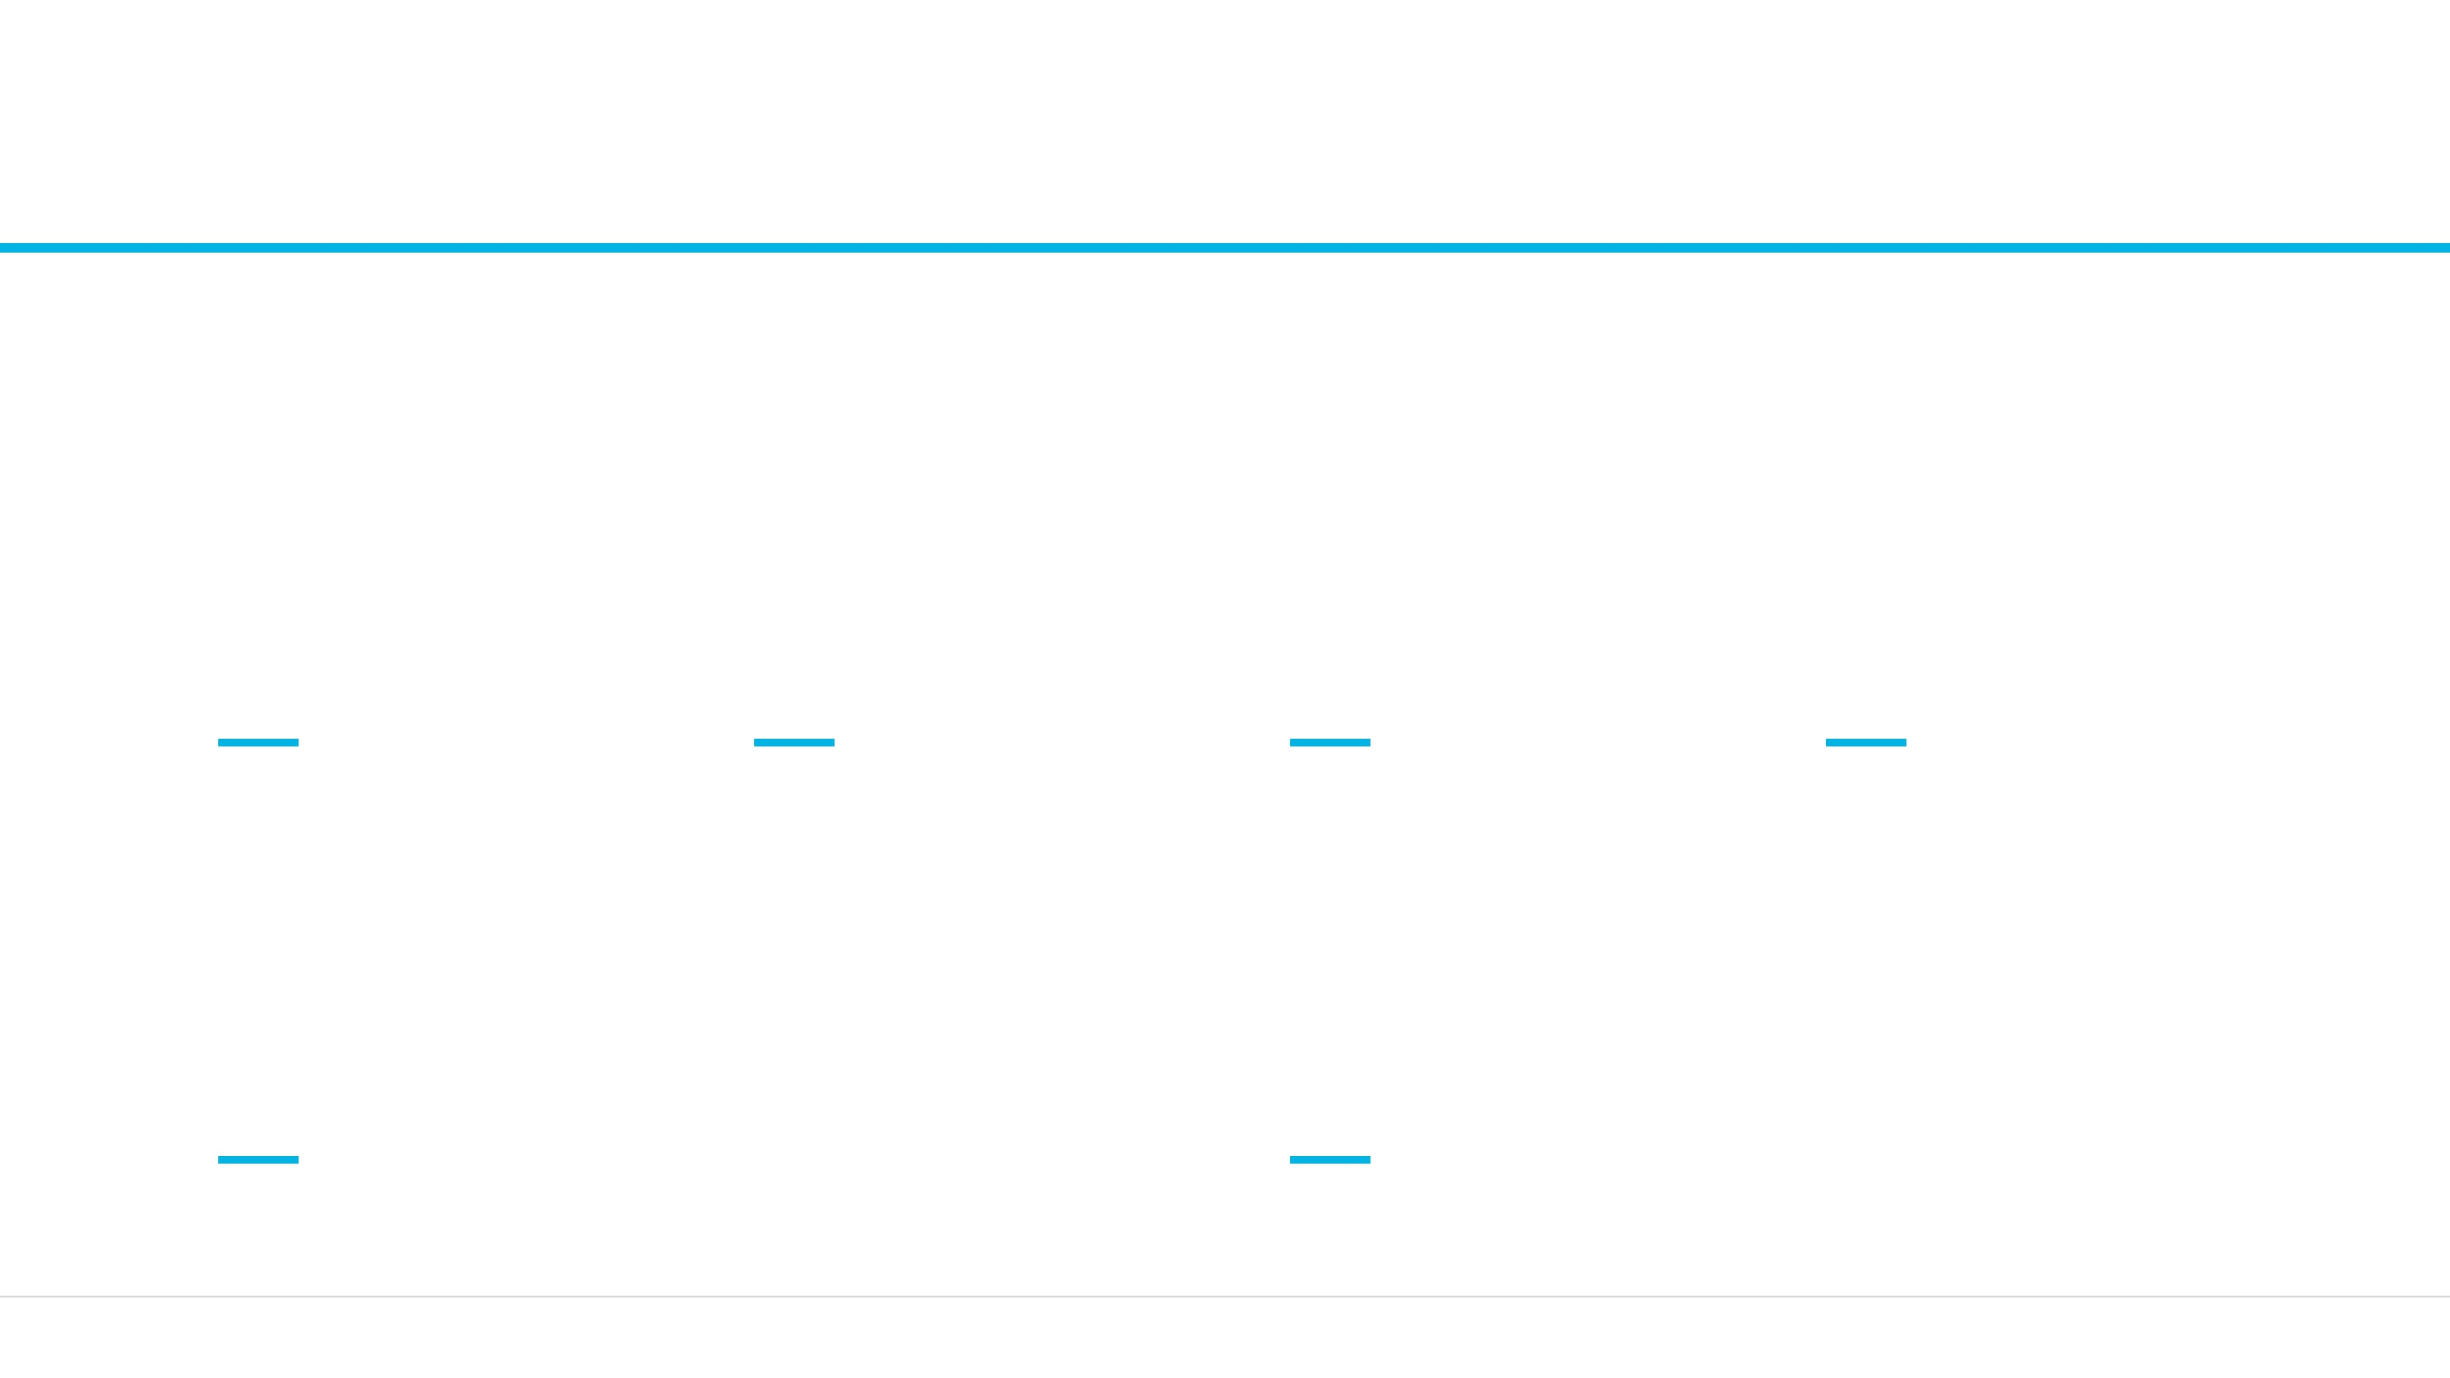
Technology Stack
Tools used to support the customer churn analysis
Data Integration
Data Processing
Data Storage & Management
Analytics & Visualization
Apache NiFi
Python · PySpark
Tableau
HDFS · Hive
Connects relevant data sources
Prepares and analyzes customer data
Turns findings into clear visual insights
Organizes data for reliable access
Project Environment
Customer Churn Analysis & Retention Solution
Jupyter Notebook
A connected toolkit for turning customer data into better retention decisions.
Supports exploration, analysis, and documentation
Customer Churn Analysis & Retention Solution

Slide 14
Key Tasks
Notes:
Note:

Slide 15
Key Tasks
Major project activities as business milestones
Data Preparation
Customer Profiling
Activity Analysis
Churn Analysis
Ensure customer and activity information is clean, consistent, and ready for analysis.
Understand characteristics: Age, Geography, and Tenure.
Analyze product usage and monthly balance trends.
Identify behaviors strongly associated with churn.
Standardize data formats across different business sources.
Understand financial profiles and product ownership patterns.
Review support tickets and offer interactions.
Segment customers based on retention risk levels.
Customer Churn Analysis & Retention Solution

Slide 16
Results and Insights
Notes:
Note:

Slide 17

What We Analyze About Each Customer
A multi-dimensional view of customer behavior and experience
CHARACTERISTICS
ENGAGEMENT
EXPERIENCE
Demographics
Product Usage
Support Interactions
Age, geography, and gender to identify segment-
Number of products owned and frequency of active
Volume of support tickets and resolution satisfaction.
specific trends.
use.
Offer Response
Financial Profile
Account Activity
History of accepting or ignoring retention offers.
Credit scores and estimated salary as indicators of
Login frequency and interaction with digital platforms.
stability.
Service Friction
Balance Trends
Identified pain points in the customer journey.
Relationship Tenure
Monthly balance levels and changes in spending
How long the customer has been with the company.
behavior.
Customer Churn Analysis & Retention Solution

Slide 18
Key Business Insights to Surface
Identifying actionable patterns for retention planning
High-Risk Segments
Focus Areas
Identify specific customer groups (by age, geography, or tenure) that show significantly higher churn exposure.
The analysis focuses on patterns that translate directly into business action, helping teams prioritize where to intervene.
Engagement Gaps
Compare product usage and balance trends between retained and churned customers to spot early warning signs.
Service Friction
Examine if high support ticket volume or specific service interactions are leading indicators of customer loss.
Offer Relevance
Evaluate which retention offers are actually working and which segments are not responding to current incentives.
Customer Churn Analysis & Retention Solution

Slide 19

Turning Insight Into Retention Action
Translating analysis into proactive business strategies
Proactive Outreach
Prioritize at-risk customers for direct engagement. Match the communication style and channel to the specific customer segment and behavior patterns identified.
Support Improvements
Identify friction points in the customer journey. Use churn signals to improve support follow-up and resource allocation where service issues are most likely to drive customer loss.
Targeted Offers
Move beyond broad discounting. Use insights to deliver relevant, timely offers that strengthen engagement for specific segments without eroding overall margin.
Continuous Monitoring
Establish a feedback loop to monitor the outcome of retention actions. Refine the analysis and outreach approach over time based on real-world customer responses.
Customer Churn Analysis & Retention Solution

Slide 20
Conclusion
Notes:
Note:

Slide 21

Business Value & Next Steps
Path Forward
01
Proactive Outreach
Prioritize at-risk customers for immediate engagement based on identified churn signals.
Strategic Value
02
Targeted Retention
Moving from reactive recovery to proactive retention through a unified view of customer health and focused business efforts.
Deploy specific offers and support improvements tailored to high-risk customer segments.
03
Continuous Monitoring
Establish a foundation for ongoing churn-risk measurement and campaign effectiveness tracking.
Customer Churn Analysis & Retention Solution

Slide 22


