Slide 1
Gamma case: PowerCO
Mohamed Ibrahim, PhD
14 July 2017, Munich

Slide 2
General Problem Formulation
9.91 % of PowerCo. customers churned by March 2016
We need to answer 2 main questions:
Why did they churn?
What to do about it?

Slide 3
Tasks assigned by PowerCo. To BCG
Leverage descriptive statistics and visualisation for extracting interesting insights from the provided data.
How is the problem framed?
What are the most explicative variables for churn?
Is there a link between channel sales and churn?
Is there a correlation between subscribed power and consumption?
Investigate ROC curve and Brier score.
Evaluate Effectiveness of 20% discount.
Output churn probability and churn decision using ML algorithm(s)
Future outlook.

Slide 4
Contents
Block diagram of the problem approach
Feature cleaning
Descriptive statistics
Model development
Discount effectiveness
Outlook

Slide 5
1. Block diagram of problem approach
Feature cleaning
Process raw data to better fit into the predictive model
Data exploration
Collect statistics and correlations of the data provided
Model development
Train multiple ML algorithms
Model evaluation
Evaluate the predictive model on test sets

Slide 6
2. Feature Cleaning

Slide 7
2. Feature cleaning: Breakdown of features
39 features provided
ML algorithms accept only numerical data, so we will need to take care of non-numerical features

Slide 8
2. Feature cleaning: Dates and price handling
Dates
Provided data includes dates about customer activity at some point of time.
Dates are converted into integer values which correspond to the number of days till the date of generating the data (1 January 2016)
Date_activ
‘2015-11-01‘
Date_activ
61
Price_p1_var1
0.168
0.168
0.168
0.168
0.168
0.168
0.171
0.167
0.167
0.167
0.167
0.167
Price
For each customer: 6 prices were provided for each month per year: 12 x 6 = 72 features! (more than double the rest of the features)
Predictive models work better with fewer number of features to avoid a problem called overfitting.
To solve this problem, the average price over the whole year is extracted. This is backed by the fact that the variance per feature per user over the months of the year is low.
This leads to only 6 features, which is a 91.6% reduction in features.
Price_p1_var1
0.1678

Slide 9
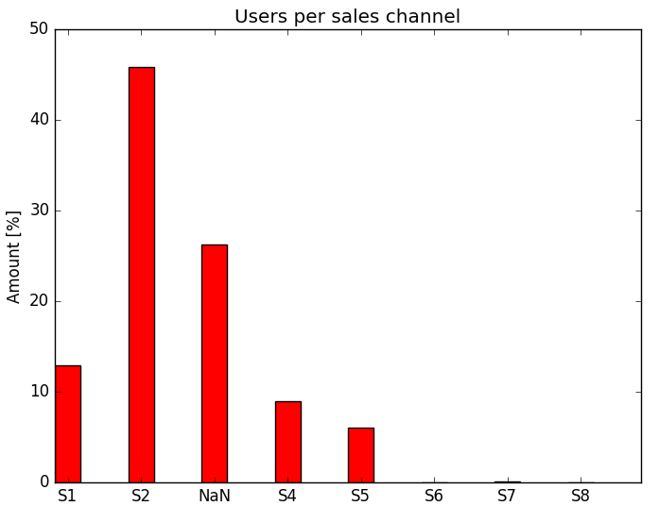
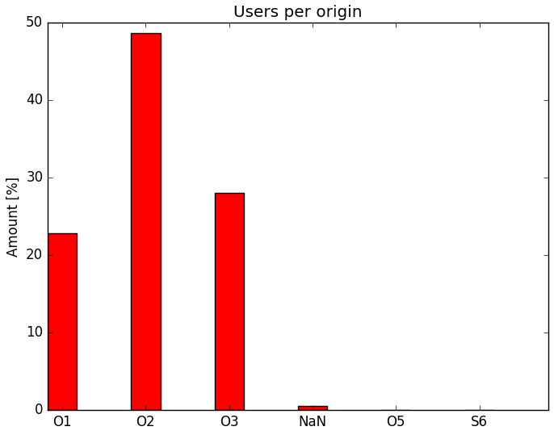
2. Feature cleaning: Categorial data handling
5 Categorial data: activity_new‚ campaign_disc_ele, channel_sales, has_gas, origin_up
campaign_disc_ele: The data is totally missing, so its eliminated
activity_new: We have 419 different categories and 60% of the information is missing, so it is difficult to get insights.
25% of sales channel is missing, instead of dropping it we use K-nn calssifier to calssify it. Accuracy of the test set is 80%.
Classified
Dropped
Dropped

Slide 10
3. Descriptive Statistics

Slide 11
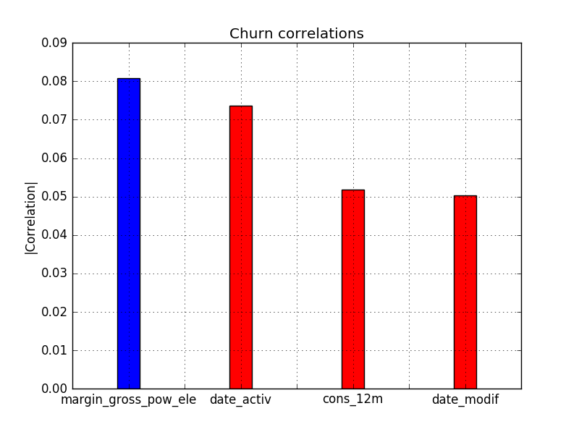
3. Descriptive statistics: Churn correlations
Churns from 2015 have been cross correlated with all the features.
A csv file containing the correlation coefficient to each feature is generated. (Correlations_churn.csv)
The figure shows the top 4 correlated features in terms of absolute value
Similar features are dropped: for e.g. Actual consumption and forecast.
Conclusions:
Customers with high margins tend to churn: Pricing
New users churn: Expectation
Low consumption customers churn: Large base price
Customers who modify contract churn: Expectation
Positive correlation
Negative correlation

Slide 12
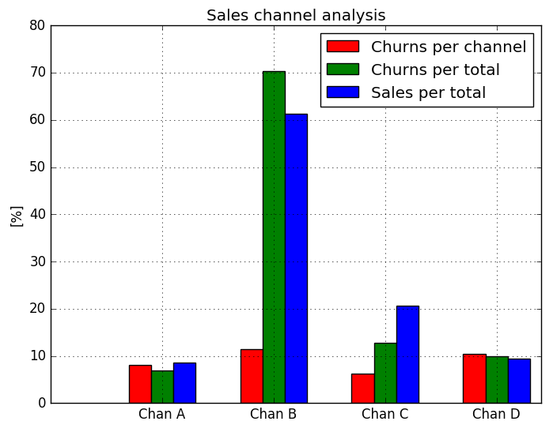
3. Descriptive statistics: Sales channel - Churn correlations
Sales channels are subdivided to top 4 in terms of churn contribution
As shown, our largest channel B exhibits worst churn rate of around 11%.
Our second largest sales channel Channel C gives the lowest churn rate.
Conclusions:
Channel B should be thoroughly investigated.
More sales force to sales channel C.
Fig. 4: Sales channel churn relationship

Slide 13
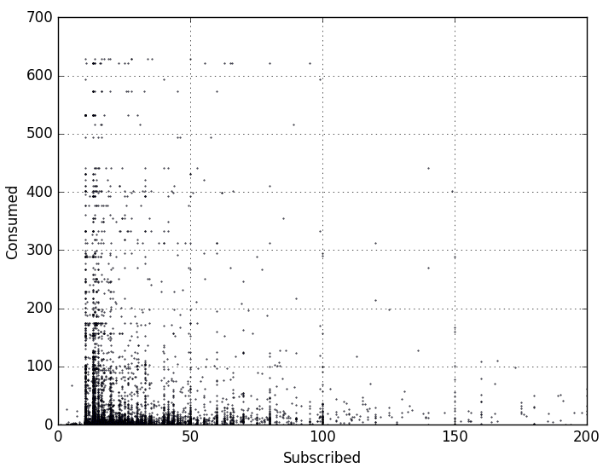
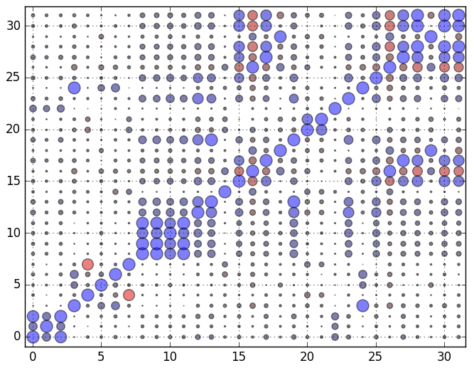
3. Descriptive statistics: Subscribed power- consumption correlations
Covariance matrix is computed for all features. (Correlations.csv)
Subscribed power and consumption exhibit a relatively low positive correlation: 0.102257
Feature ID
Scatter plot of subscribed vs consumed power
Feature covariance matrix
Feature ID

Slide 14
4. Model Development

Slide 15
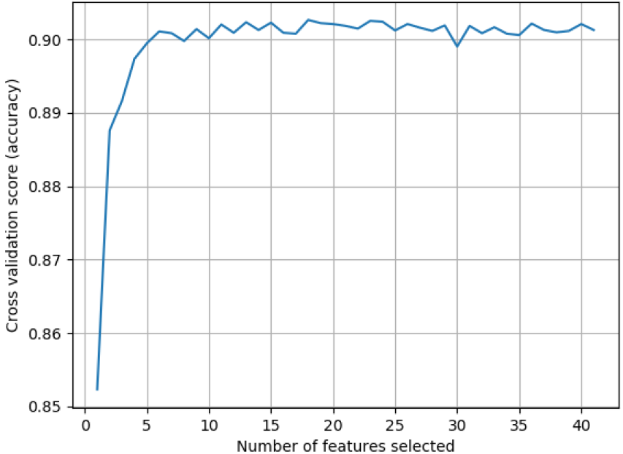
4. Model development: Feature importance
As a first step, we would like to understand how many features would the model need to predict customer churn.
Some features are highly correlated to each other. For e.g.: Actual consumption and forecast consumption.
The Recursive Feature Elimination with Cross Validation(RFECV) technique is used to:
Get a feeling how many features do we need.
Rank the features in terms of their importance
Curves show that starting around 10 features, the model can already exceed a 90% accuracy in churn detection.

Slide 16
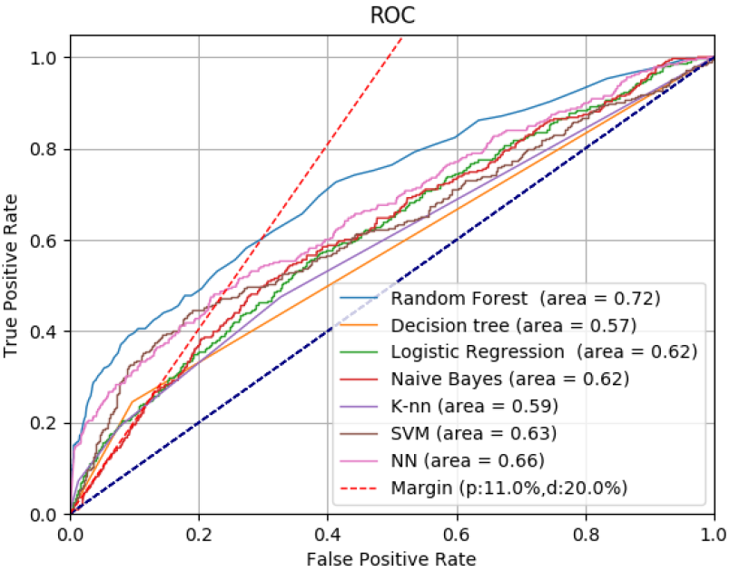
4. Model development: ROC
7 algorithms have bee trained on the training set.
Cross validation with a 20% test data size.
As shown, Random Forest, Neural Network, Logistic Regression, SVM have had the top ROC areas.
Algo | RF | NN | SVM | LR
Acc.[%] | 90.68 | 90.07 | 90.05 | 90.03
ROC | 0.72 | 0.66 | 0.63 | 0.62
Brier | 0.0931 | 0.0992 | 0.0994 | 0.0997
To increase sales the model must satisy this relationship

Slide 17
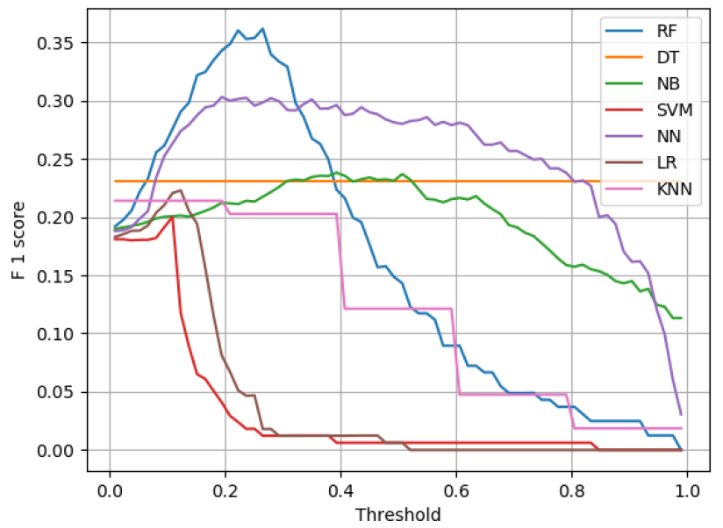
4. Model development: Choosing the threshold using F1 score
We need a threshold to decide whether the user should be labled as churn or not.
Since our parameter to estimate is skewed (most users do not churn), it would be useful to use a metric more suited to skewnwss rather than the accuracy of cross validation.
The F1 score is chosen, since it gives a metric proportional to the average of precision and recall.
The figure shows that Random Forest, with a threshold of 0.263, provides the best F1 score.
The Neural Network provides a model with less sensitivity to threshold choice.

Slide 18
4. Model development: Choosing the threshold using a business approach
Total users
Users willing to churn
Users willing to remain
Undetected users
Correctly Detected users
Falsely Detected users
Offered a Discount
Offered a Discount
Prob. to accepted the offer
Expected users =
U₁
+
U₂
+
U₃

Slide 19
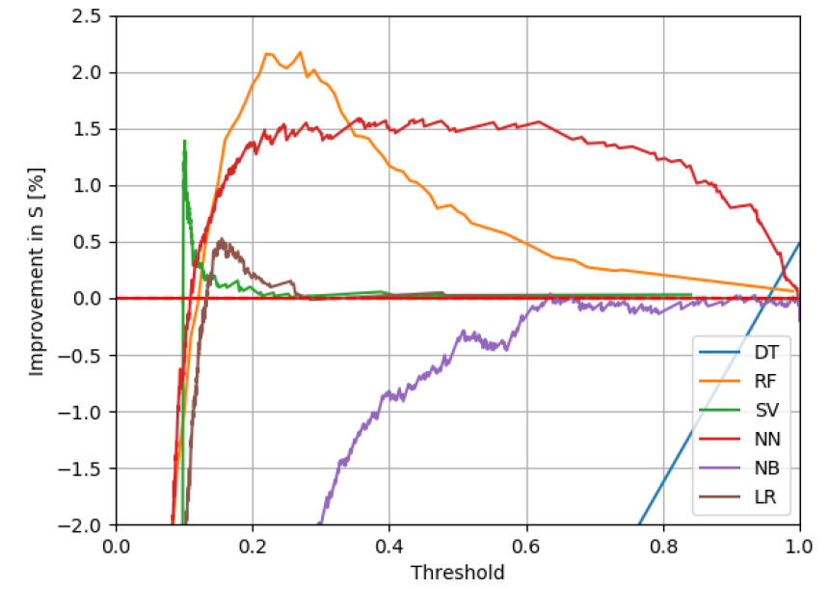
4. Model development: Choosing the threshold using a business approach
The figure shows the best threshold to choose in order to maximize the volume of customers we will have, compared to not reacting to the churn problem.
We assume 10% of the users intend to churn and that the 20% discount will be definately accepted.
Best threshold is 0.245 which is quite close to the previous approach.
Model Accuracy
Client‘s business performace
Users‘ reaction to discounts

Slide 20
5. Discount Effectiveness

Slide 21
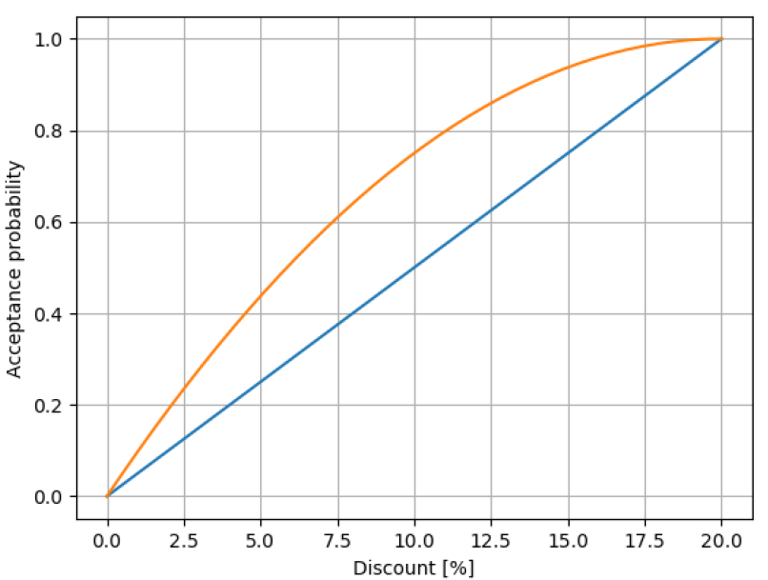
5. Discount effectiveness: User discount acceptance profile
Since 20% discount would hit the revenues hard, we seek a discounting strategy that would maximize our customer sales given a certain churn rate and user acceptance profile.
The figure shows different types of user acceptance profiles.
Linear acceptance profile simply states that the user will have a linear acceptance probability from 0 to 20%
Quadratic acceptance profile increases the probability of user acceptance given a discount offer.(Might be more realistic)

Slide 22
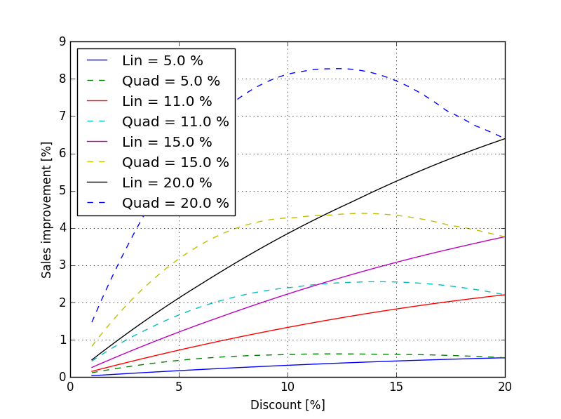
5. Discount effectiveness: Optimal discount
The figure shows the sales improvement vs discount offer, for 2 different acceptance profile and 3 different churn rates.
Conclusions:
Offering 20% discount might be too generous in case we have a quadtratic acceptance profile.
As churn rate increases, the effectiveness of the predictive model gets higher.

Slide 23
6. Outlook: Risk based pricing
Since the predictive models provide a continous score of churn per user, it would be imperative to provide a discount based on the churn score.
The strategy should take into account the margin per user and should target maximization of the profit (not just sales).
To do this more information is needed about the profit margin components of PowerCo. as well as user discount acceptance probability.
Discount offered
Margin
Churn score

Slide 24
Recommendations in a nutshell
Aspect | Recommendation
Pricing | Customers with high margins tend to churn. Low consumption customers churn. Investigate special price plans for low consumption.
Contract Expectation | New users and customers who recently modified their contract churn. Make clear indication of contract pricing and conditions.
Sales channel | Our largest sales channel is performing poorly. More sales force to our second largest sales channel.
Subscribed – consumed power | There is a slight positive correlation. If subscribed power incurs more fixed prices, might be useful to reconsider the plans.
Model | We use a Random Forest classifier with 200 trees and a threshold of 0.263.
20% Discount | With the provided model and 10% churn rate, we expect a 2.1% improvement in Sales Volume compared to not using the model.
Optimal discount | Given a certain user discount acceptance profile, we can find a discount which would maximize out sales volume. For a quadratic user acceptance a 12.5% discount would provide a 2.7% improvement in sales.

Slide 25
Thank you

Slide 27
Appendix: Selected model details
Aspect | Value
Algorithm name | Random Forest
Number of trees | 200
Criterion | ‚Entropy‘
Verification method | K-fold cross validation
Number of features | Top 32 features
Train - Test size | 80-20
Threshold | 0.263
Mean Accuracy | 90.68%
ROC area | 0.72
Brier score | 0.0931
F1 score | 0.355
Missing values | Numeric: mean, Categorial: Classification
Feature scaling | Zero mean unit variance

Slide 28
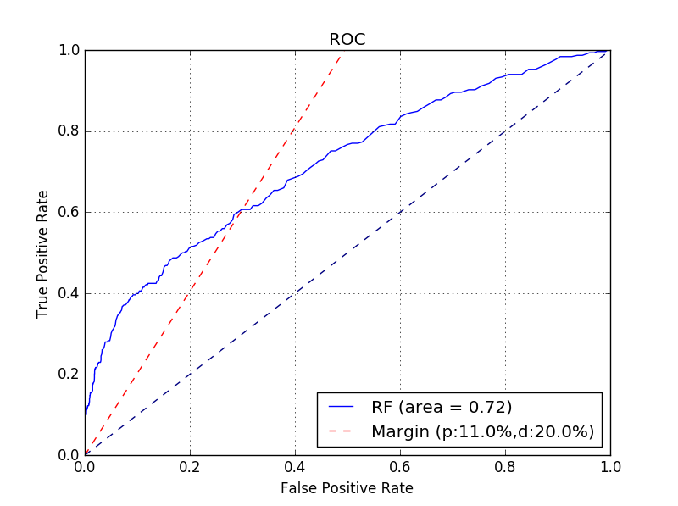
Appendix: Model Performance ROC

Slide 29
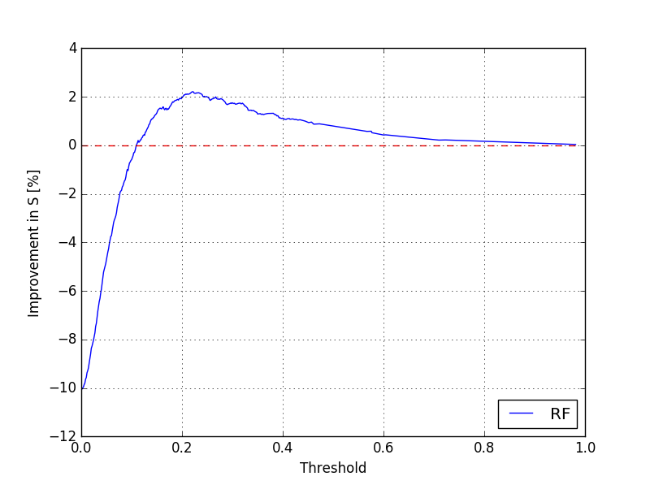
Appendix: Model Performance improvement in sales

Slide 30
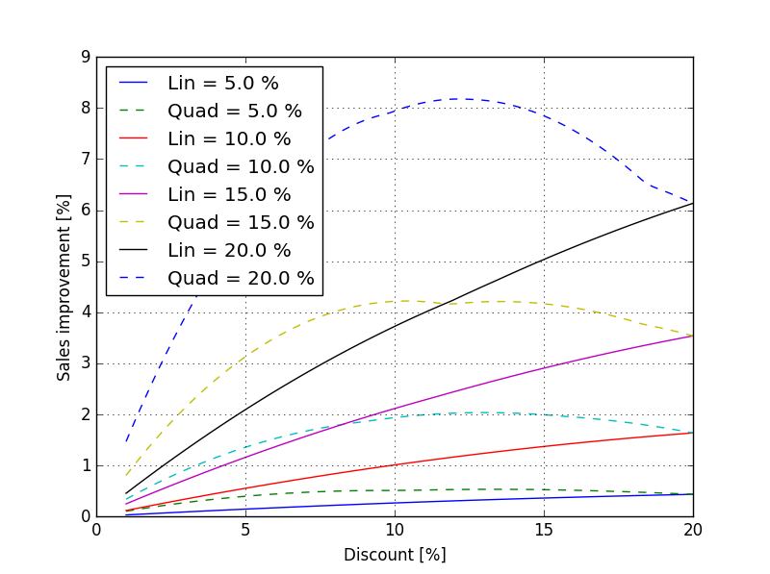
Appendix: Model Performance sales improvement

