Slide 1

Kickoff
Where To Go?
Before taking any steps towards adopting a new technology or following a trend, it is crucial to prioritize the foundation. In our innovation lab, we believe in treating technologies as tools rather than as ends in themselves. Technology is something anyone can learn or practice.

Slide 2
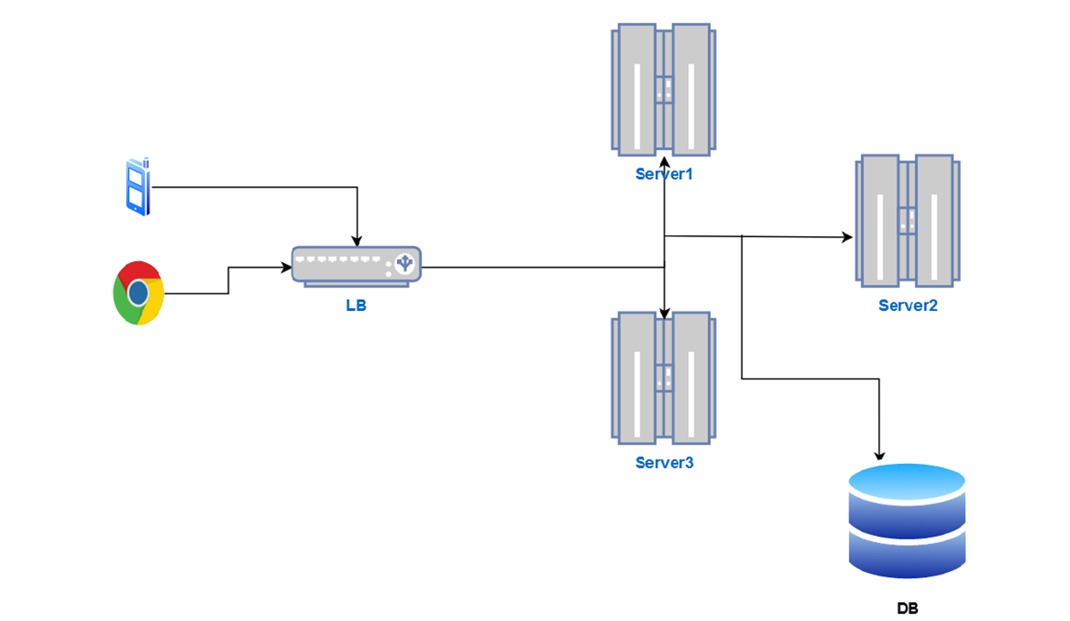
Our Goal
Transient from Layerd to

Slide 3
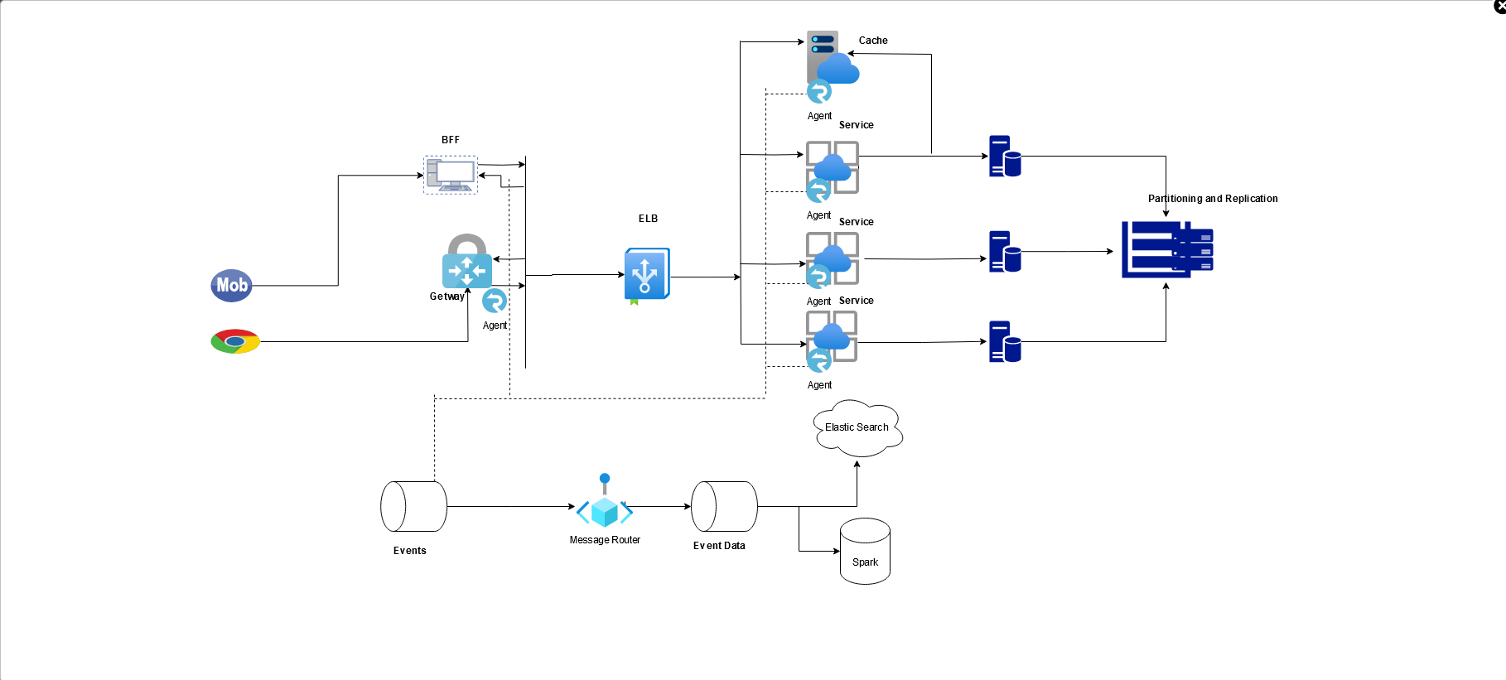
Target

Slide 4
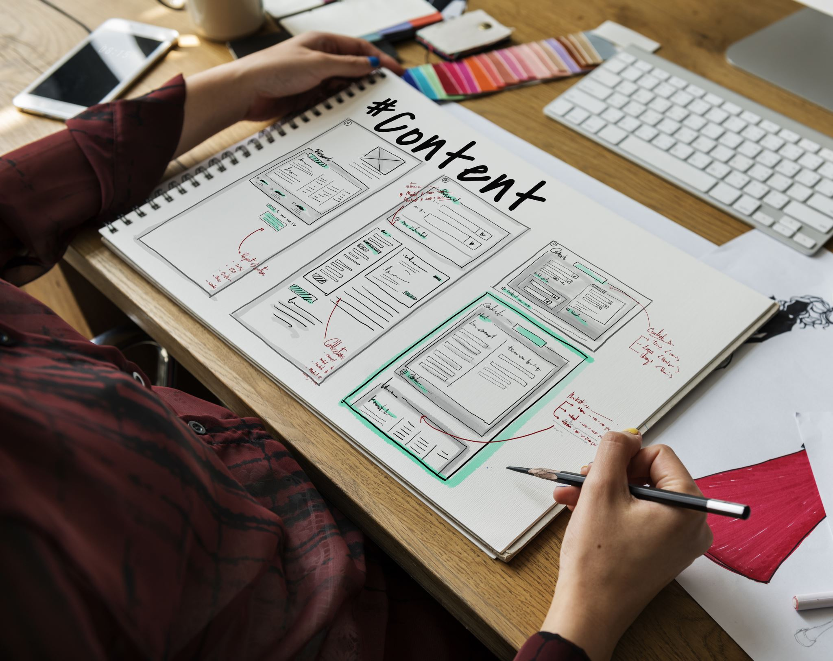
To do List
OOP
SOLID
Refactoring
Defensive Programming

Slide 5

OOP
We strive to incorporate object-oriented programming (OOP) principles into our mindset, as we aspire to think in an OOP through declare it’s concepts :
Abstraction
Inheritance
Encapsulation
Polymorphism

Slide 6
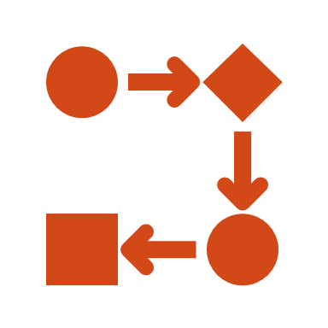
SOLID
We don't need to reinvent the wheel. Instead, let's focus on discussing one of the most important aspects of the software industry. Over the decades, it has been found that a solid foundation is the key solution to most of the software design problems in our industry. Therefore, it is crucial to have a thorough discussion on this matter.

Slide 7

Refactoring
Because of almost time we work on code our eyes doesn't see it before , so we need to have some rules and tips to put all of us on the most efficient way to dealing easily with use cases ,if it new requirement or refactoring a piece of code, we will try introduce
Some most common design patterns will help
Refactoring tips

Slide 8

Defensive Programming
is an approach in software development that focuses on anticipating and handling potential issues and errors. It aims to create robust and resilient code that can withstand unexpected situations and prevent failures

Slide 9

Next?
we will start from OOP Principal
In the next session corresponding to
23-04-2024

Slide 10

Thank you
All thanks and appreciation to the team members, especially those in charge of its management Eng Ashraf ,Mohamed fayed, Islam hamed, Mohamed Abotir

