Slide 1
OOP

Slide 2
Agenda
What is OOP
Why OOP ?
Concepts
approaches

Slide 3
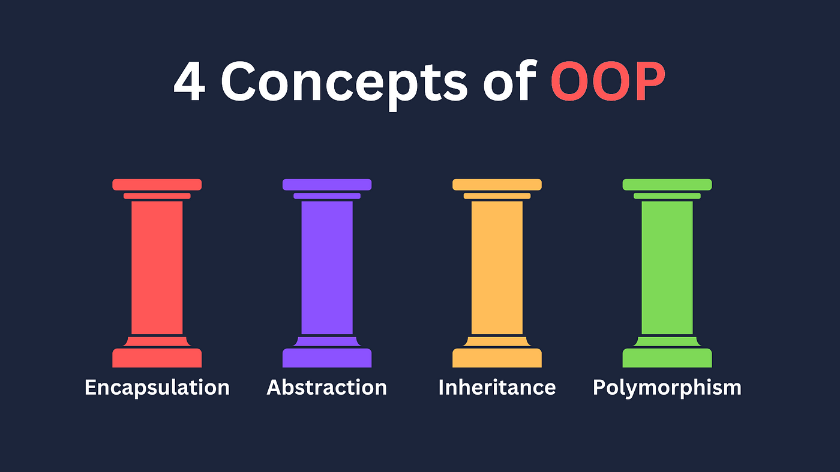
What is OOP?

Slide 4
OOP
Object-Oriented Programming (OOP) is a programming paradigm that organizes code around objects, which are instances of classes.
Key Characteristics :
Encapsulation
Inheritance
Polymorphism
Abstraction

Slide 5
Why OOP?
The way you Do!

Slide 6
OOP
Benefits
Modularity: Code is divided into self-contained objects, leading to easier maintenance and reusability
Code Organization: OOP promotes a structured approach to programming, making it easier to understand and work with.
Code Reusability: Inheritance allows the reuse of code by creating derived classes from existing ones.
Challenges
Modeling vs Reusability : we should balance between both
Purposeful gestures
Maintain good posture
Control your expressions

