Slide 1
CHATLONG
Providing Empathetic, Context-Aware Support for Arabic-Speaking Communities
Team
رواد المستقبل

Slide 2
Why ChatLong?

Slide 3



Language Barrier in Mental Health Resources
Shortage of Accessible Mental Health Services
Problem
Inconsistency in Support Quality
Lack of Immediate Emotional Support

Slide 4
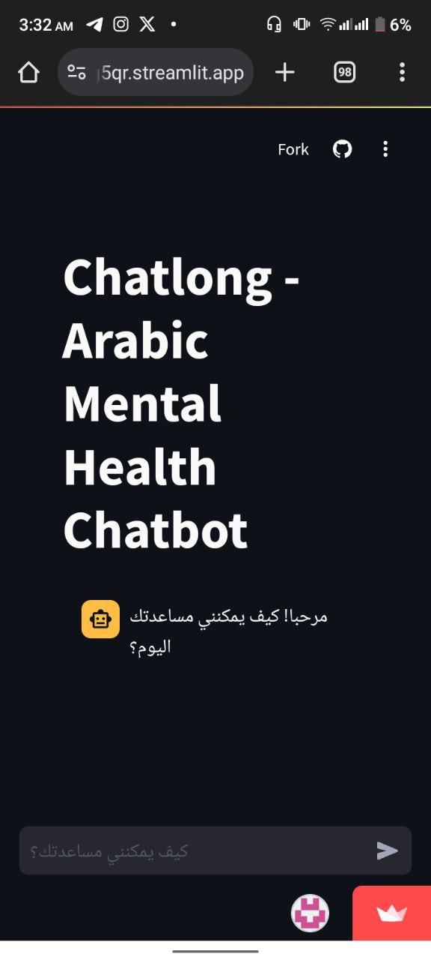
Overview
An intelligent chatbot designed to provide empathetic, supportive conversations in Arabic.
Bridging the mental health support gap with culturally relevant solutions.

Slide 5
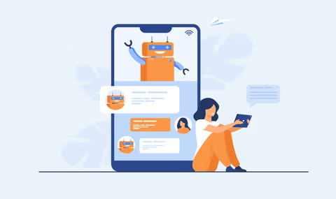
What Makes Chatlong Unique?
Chatlong is the first Arabic-language mental health chatbot that combines empathy and cultural sensitivity, powered by the fine-tuned Meta-LLaMA-3 model.
Unique Features:
Tailored for Arabic mental health support.
Empathy-driven responses that respect cultural nuances.
Accessible and secure platform.

Slide 6
Project Architecture
Data Preparation
Model fine-tuning
Sentiment analysis
Chat interface

Slide 7
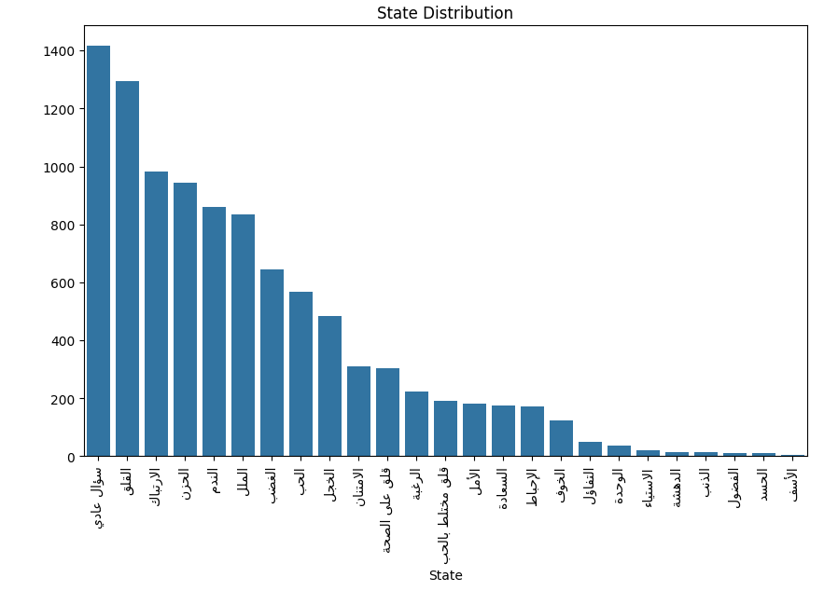
1. Data Preparation
Data Source: "arabictherapydataset" from Hugging Face. Shape: 11227 rows × 3 columns
Data Cleaning: The dataset is cleaned to remove punctuations, diacritics, and stop words. Arabic text is normalized and tokenized for effective model training.
Data Analysis and Visualization: Analyze the distribution of patterns across different sentiments and visualize this distribution using bar charts.

Slide 8
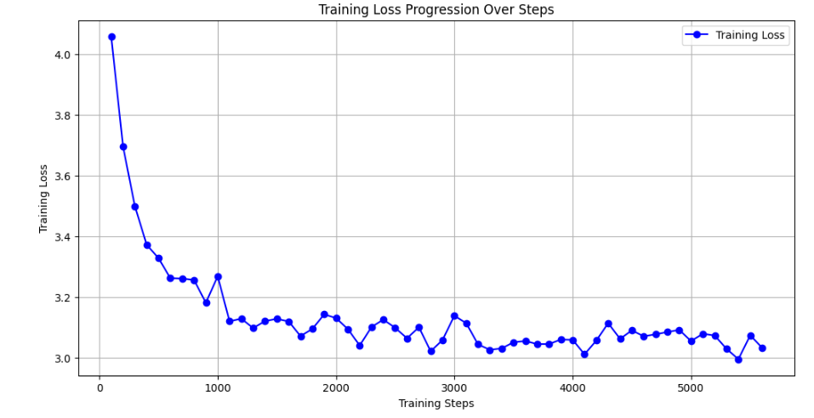
2. Model Fine-tuning
The Meta-Llama-3-8B-Instruct model is fine-tuned using LoRA (Low-Rank Adaptation) to adapt it to the Arabic mental health dataset.
Evaluation Loss: The model achieved an evaluation loss of 2.016 at the end of training.

Slide 9
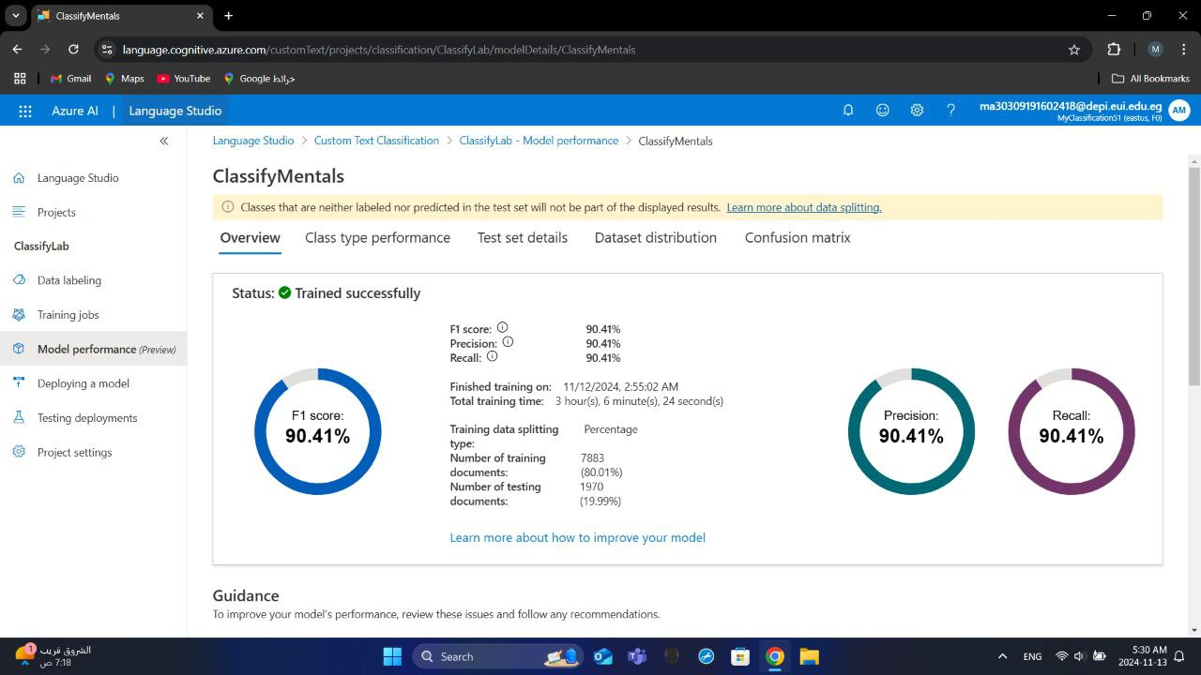
3. Sentiment analysis
Azure Cognitive Services: Uses the Azure Text Analytics client to classify user queries.
Sentiment Classification: Sends user questions to the classification API endpoint and retrieves the predicted category and confidence score.
Contextualization: Incorporates the sentiment classification information into the chatbot's prompt, enabling it to generate more tailored responses.
Prompt Engineering: A detailed system prompt establishes the chatbot's persona as a supportive and empathetic AI assistant.

Slide 10
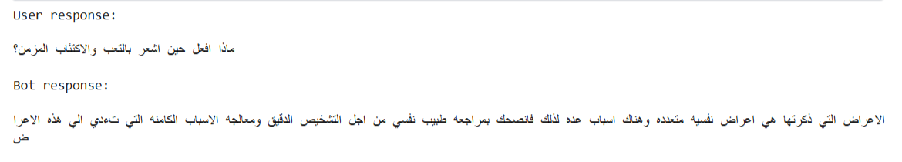
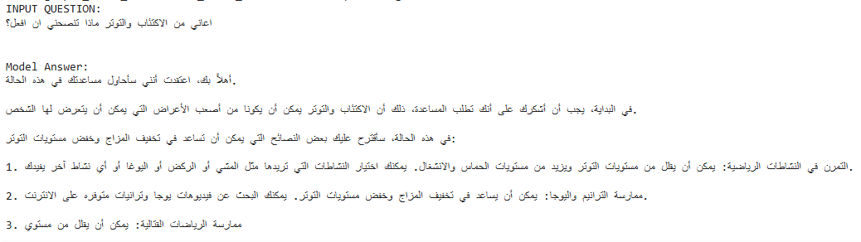
4. Chat inference

Slide 11
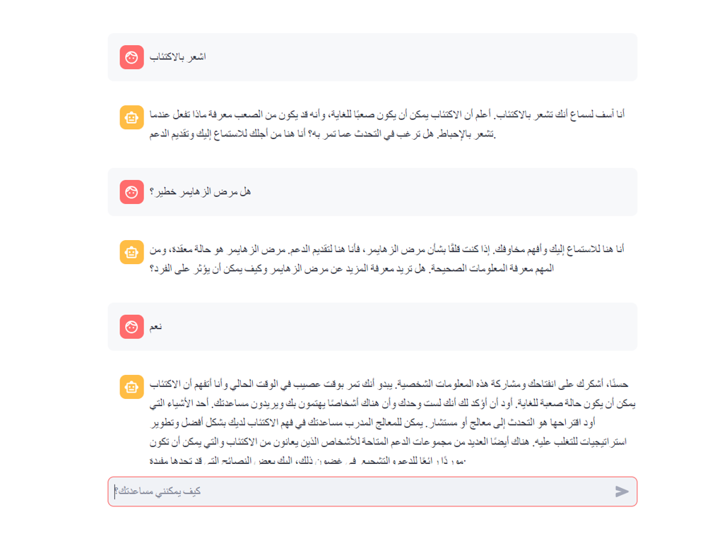
How Users Interact with Chatlong?
Onboarding: Users can start conversations instantly.
Features:
Empathetic chat responses based on sentiment.
Access to mental health resources.
Contextual memory for better response continuity.

Slide 12
Who Is Chatlong For?
Target Users: Arabic-speaking individuals seeking private, supportive mental health discussions.
Core features
Empathetic responses
sentiment-based interactions
context awareness
privacy

Slide 13
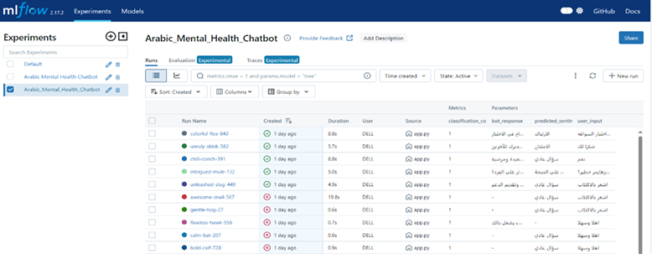
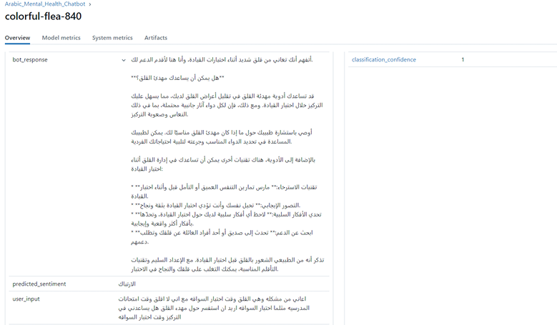
Results & Evaluation
Empathetic Conversations: Effectively provides supportive and context-aware responses.
Relevance and Responsiveness: Adapts based on sentiment and user engagement.
Continuous Improvement: Ongoing MLflow tracking for quality control.

Slide 14
Programming Languages + Frameworks
Programming Languages:
Python is used for data preprocessing, NLP model development, and integration with Azure.
Frameworks and Tools :
Transformers: For loading and fine-tuning the language model (Meta-Llama-3-8B-Instruct).
Azure Text Analytics API: For sentiment analysis.
Streamlit: For creating the user interface.
MLflow: For model tracking and management.
Other relevant libraries: (e.g., PyArabic, NLTK, scikit-learn)
Supporting Technologies:
Hugging Face Hub: For accessing pre-trained models and datasets.
Azure Cloud: For hosting the Text Analytics API.

Slide 15
What’s Next for Chatlong?
Expand Data Source: Increase the diversity and scope of training data to improve the chatbot's knowledge and adaptability.
Incorporate More Therapeutic Techniques: Integrate techniques from different therapy models (e.g., Cognitive Behavioral Therapy) to provide more targeted guidance.
Personalization: Allow users to set goals and track progress, providing a more personalized experience.
Multilingual Support: Add support for other languages to reach broader populations.

Slide 16
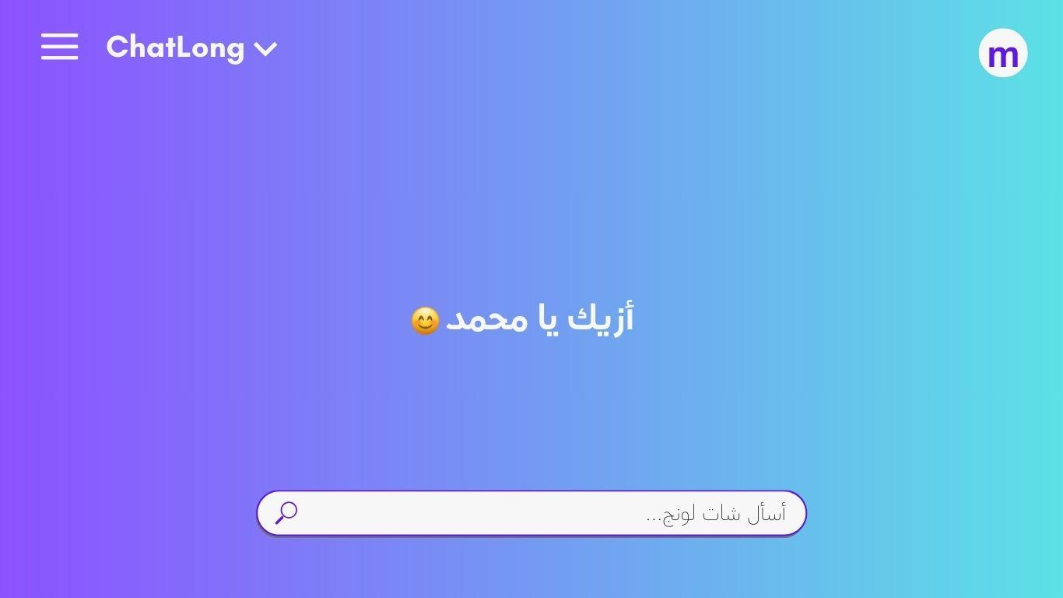
Chatlong: A New Approach to Mental Health Support
Chatlong bridges the gap in mental health resources for Arabic speakers, providing an empathetic, accessible, and culturally relevant tool.

Slide 17
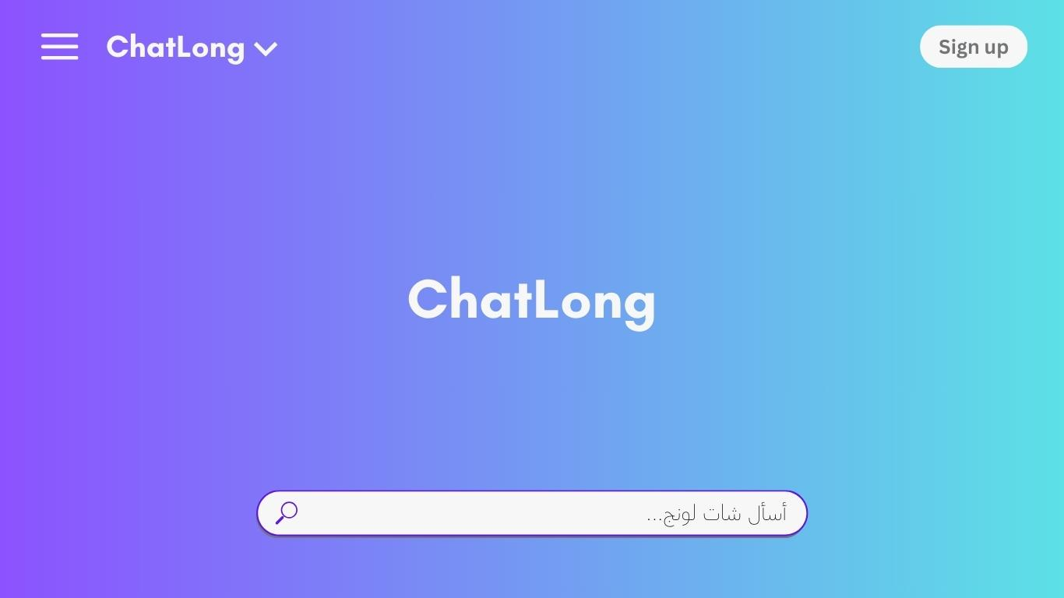

Slide 18


Slide 19
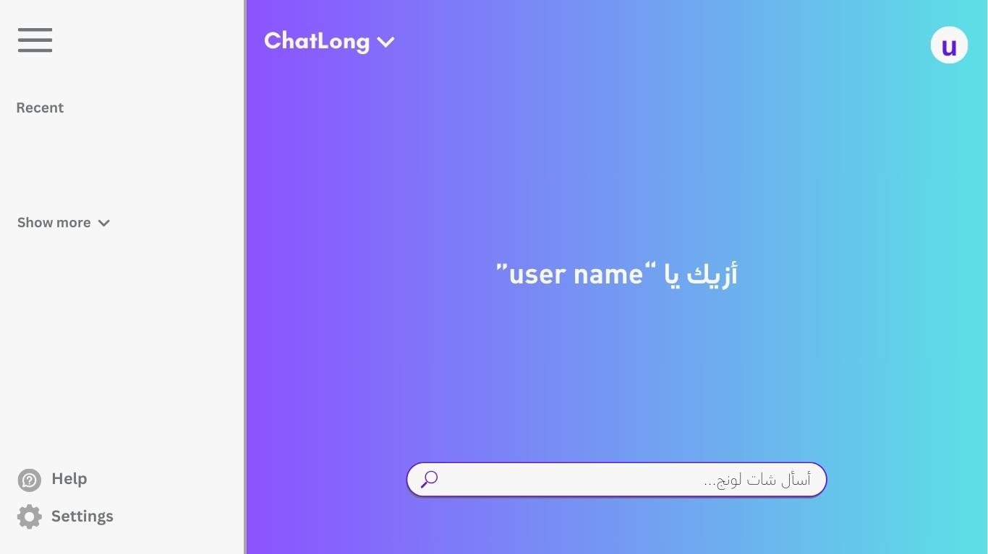

Slide 20
Thank you!
Any questions?

Slide 21
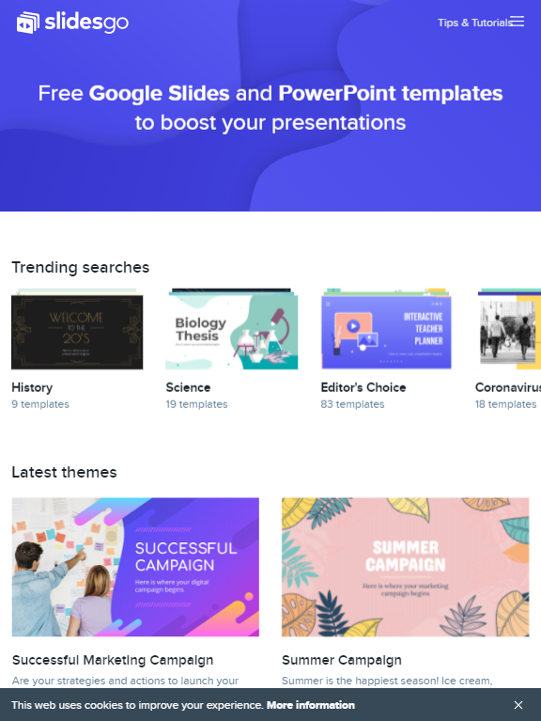

Slide 22
