Slide 1
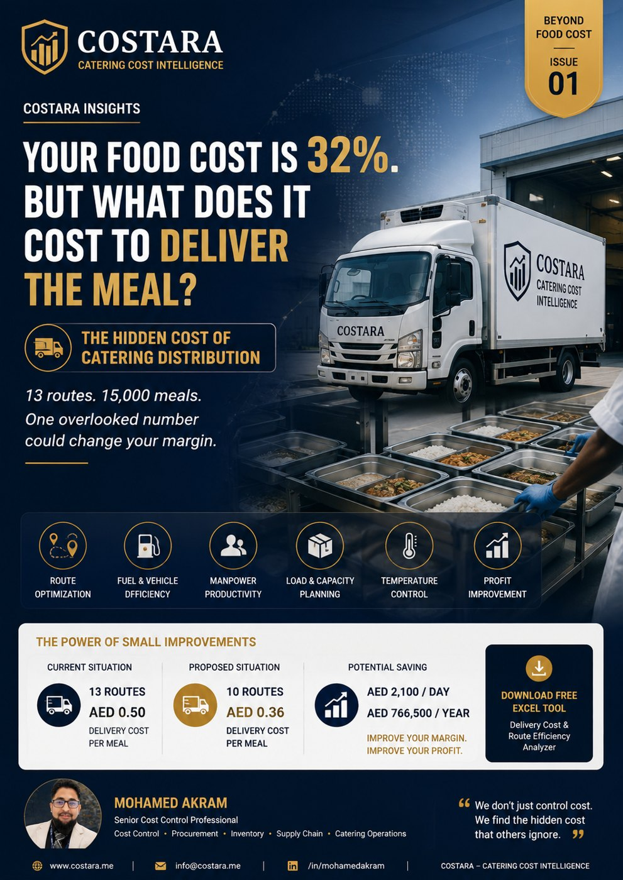

Slide 2
The Hidden Cost of Catering Distribution
Your food cost may be under control — but is your delivery model eating your profit?
• Measure cost per delivered meal, not only food cost.
• Review routes, vehicle utilization, manpower, waiting time and failed deliveries.
• Small route improvements can protect monthly net profit.

Slide 3
Practical Management Question
Where is the real cost driver, and which department can control it before it becomes a monthly variance?
Measure the process, calculate the impact, then convert the result into an action plan.

Slide 4
Need help identifying cost leakage?
Costara Advisory supports catering, restaurants, cafés, central kitchens and food production operations with practical cost, inventory, audit, menu costing, procurement, logistics and supply chain reviews.
Consulting fees apply based on scope and operational size.

