Slide 1
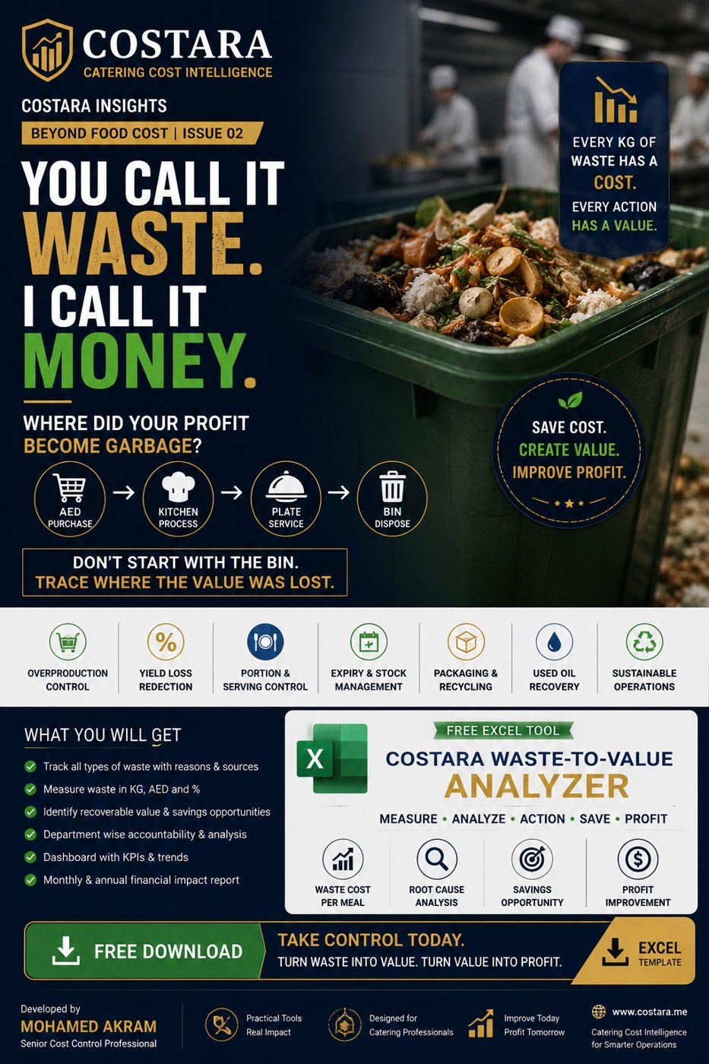

Slide 2
Waste-to-Value: Where Profit Becomes Garbage
Do not start with the bin. Trace where the value was lost.
• Separate preventable waste, yield loss, surplus, used oil, packaging and disposal.
• Measure waste cost per meal and annualize the opportunity.
• Turn root-cause analysis into action, not just waste recording.

Slide 3
Practical Management Question
Where is the real cost driver, and which department can control it before it becomes a monthly variance?
Measure the process, calculate the impact, then convert the result into an action plan.

Slide 4
Need help identifying cost leakage?
Costara Advisory supports catering, restaurants, cafés, central kitchens and food production operations with practical cost, inventory, audit, menu costing, procurement, logistics and supply chain reviews.
Consulting fees apply based on scope and operational size.

