Slide 1
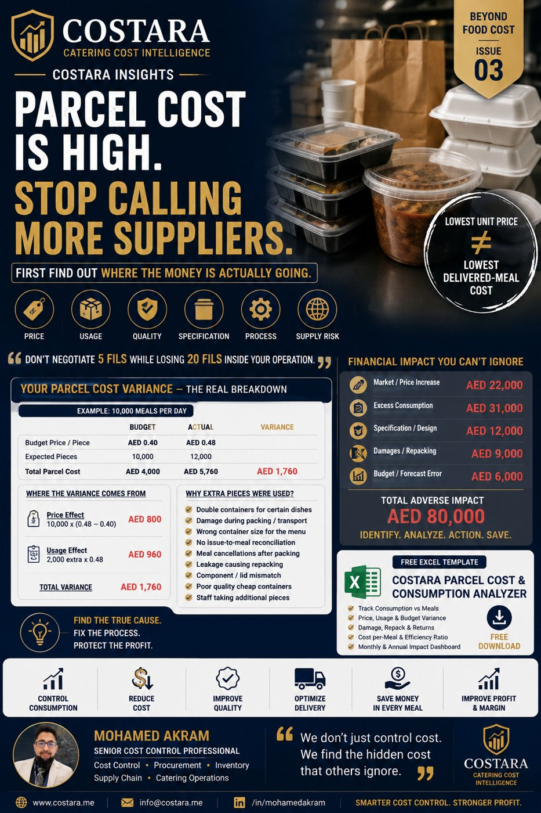

Slide 2
Parcel Cost Is High. Stop Calling More Suppliers.
Lowest unit price is not always the lowest delivered-meal cost.
• Break variance into price, usage, quality, specification, process and supply risk.
• Track pieces consumed per meal and lid/container mismatches.
• Fix operational leakage before negotiating only a few fils.

Slide 3
Practical Management Question
Where is the real cost driver, and which department can control it before it becomes a monthly variance?
Measure the process, calculate the impact, then convert the result into an action plan.

Slide 4
Need help identifying cost leakage?
Costara Advisory supports catering, restaurants, cafés, central kitchens and food production operations with practical cost, inventory, audit, menu costing, procurement, logistics and supply chain reviews.
Consulting fees apply based on scope and operational size.

