Slide 1
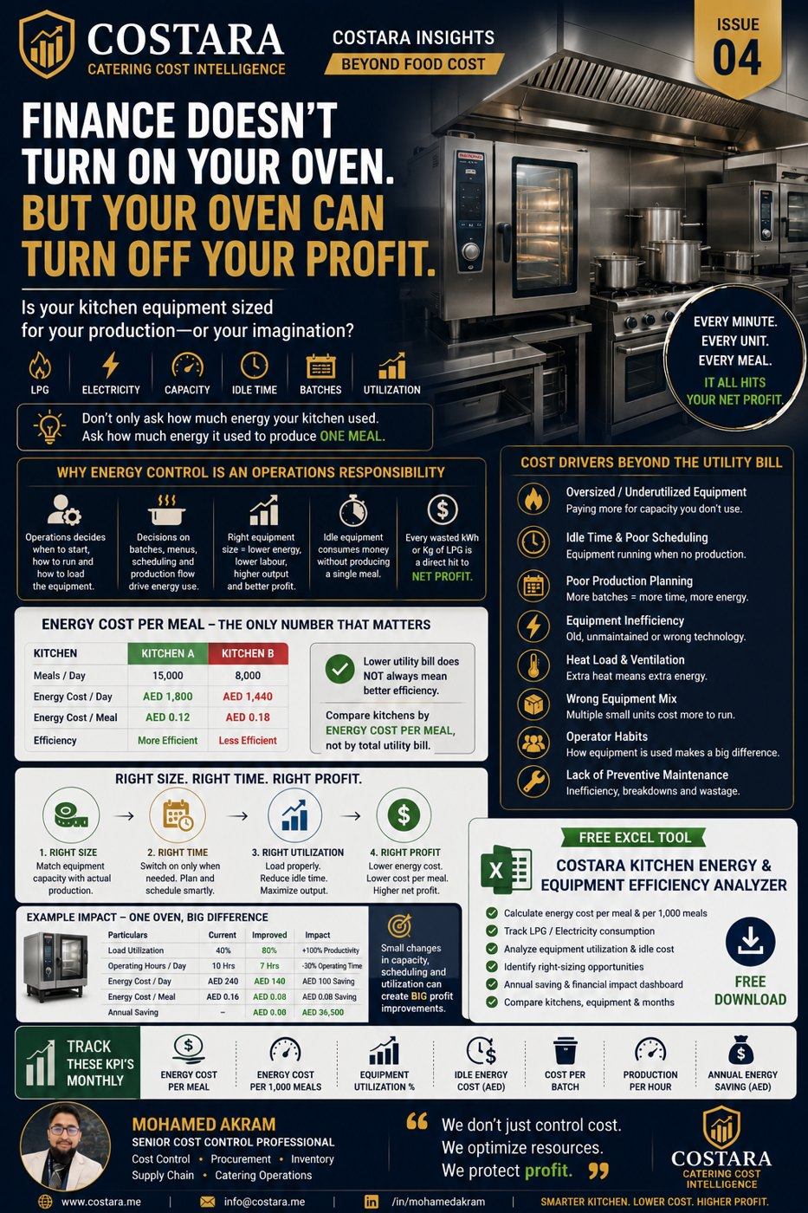

Slide 2
Kitchen Energy & Equipment Efficiency
Finance does not turn on your oven — but your oven can turn off your profit.
• Measure LPG/electricity cost per meal and per 1,000 meals.
• Match equipment capacity to real production volume.
• Reduce idle time, poor scheduling and inefficient batch planning.

Slide 3
Practical Management Question
Where is the real cost driver, and which department can control it before it becomes a monthly variance?
Measure the process, calculate the impact, then convert the result into an action plan.

Slide 4
Need help identifying cost leakage?
Costara Advisory supports catering, restaurants, cafés, central kitchens and food production operations with practical cost, inventory, audit, menu costing, procurement, logistics and supply chain reviews.
Consulting fees apply based on scope and operational size.

