Slide 1
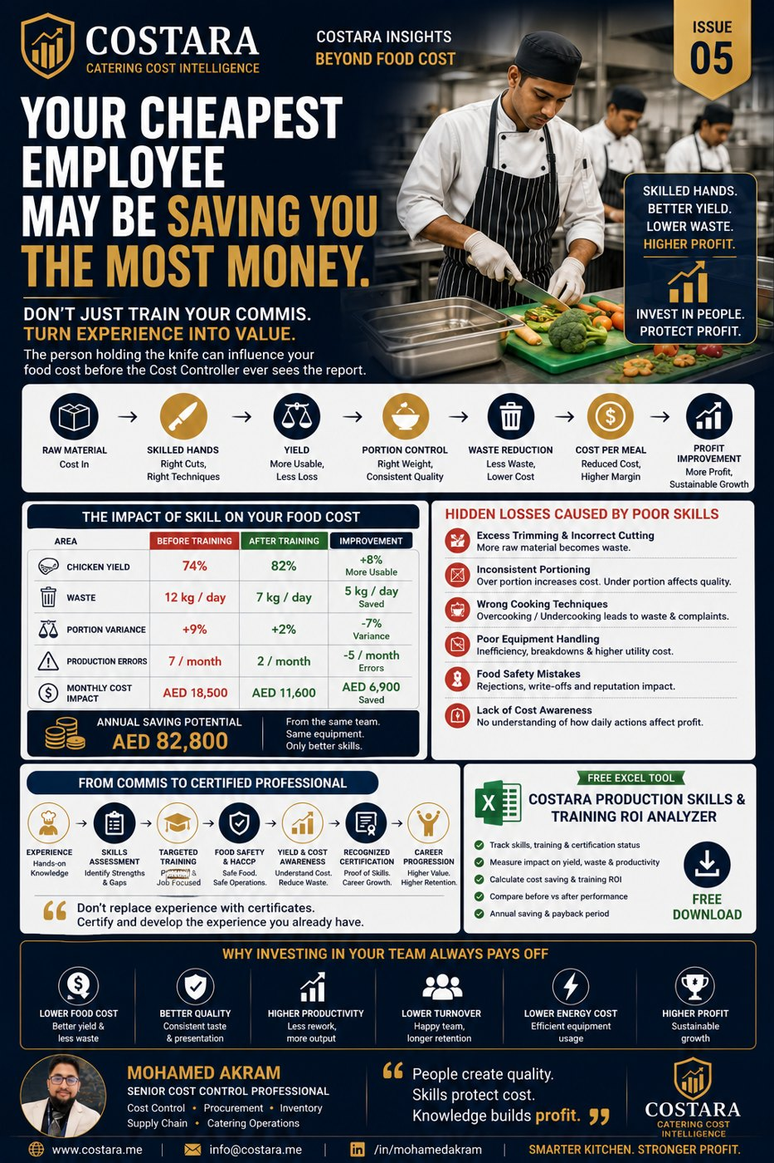

Slide 2
Train the Team. Protect the Cost.
The person holding the knife can influence food cost before the report is generated.
• Develop Commis I and II through yield, portion, waste and food safety training.
• Convert experience into measurable skill and certification.
• Measure before-and-after yield, waste, errors and ROI.

Slide 3
Practical Management Question
Where is the real cost driver, and which department can control it before it becomes a monthly variance?
Measure the process, calculate the impact, then convert the result into an action plan.

Slide 4
Need help identifying cost leakage?
Costara Advisory supports catering, restaurants, cafés, central kitchens and food production operations with practical cost, inventory, audit, menu costing, procurement, logistics and supply chain reviews.
Consulting fees apply based on scope and operational size.

