Slide 1
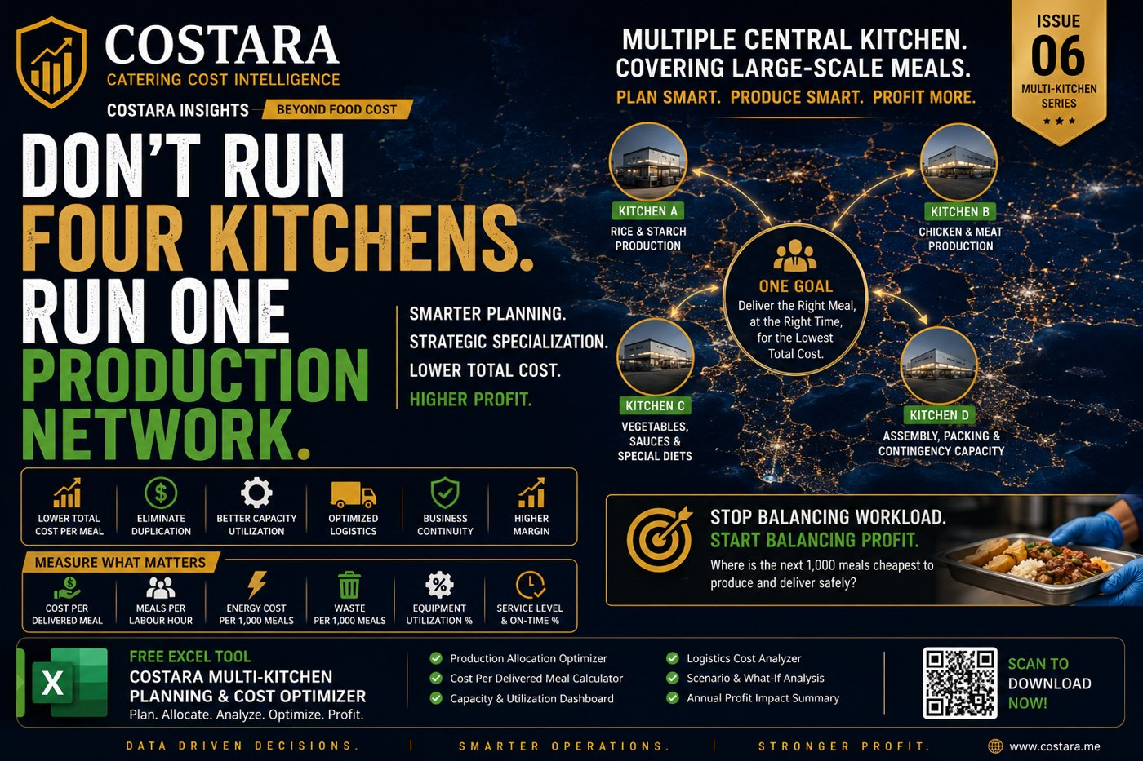

Slide 2
Do Not Run Four Kitchens. Run One Production Network.
The cheapest kitchen is the one that delivers safely, on time, at the lowest total cost.
• Plan by demand, capacity, equipment, specialization and logistics.
• Compare cost per delivered meal across kitchens.
• Balance profit, not only workload.

Slide 3
Practical Management Question
Where is the real cost driver, and which department can control it before it becomes a monthly variance?
Measure the process, calculate the impact, then convert the result into an action plan.

Slide 4
Need help identifying cost leakage?
Costara Advisory supports catering, restaurants, cafés, central kitchens and food production operations with practical cost, inventory, audit, menu costing, procurement, logistics and supply chain reviews.
Consulting fees apply based on scope and operational size.

