Slide 1
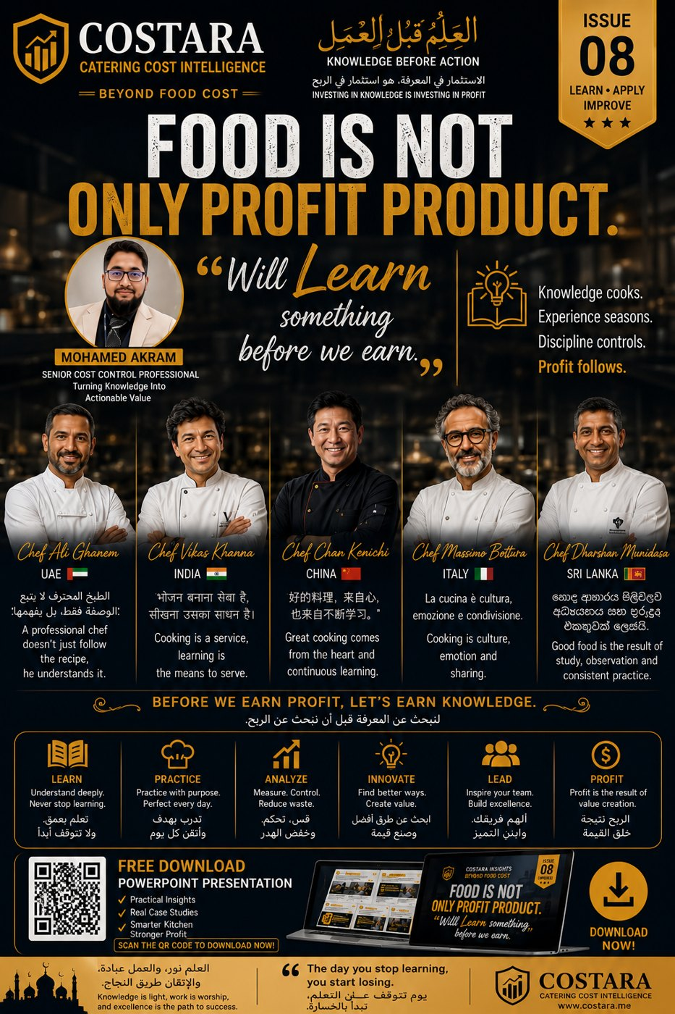

Slide 2
Food Is Not Only Profit Product
Learn something before we earn.
• Food profit starts from knowledge, discipline and repeated learning.
• Skills, observation and continuous improvement protect the kitchen.
• Profit follows when teams learn, practice, analyze, innovate and lead.

Slide 3
Practical Management Question
Where is the real cost driver, and which department can control it before it becomes a monthly variance?
Measure the process, calculate the impact, then convert the result into an action plan.

Slide 4
Need help identifying cost leakage?
Costara Advisory supports catering, restaurants, cafés, central kitchens and food production operations with practical cost, inventory, audit, menu costing, procurement, logistics and supply chain reviews.
Consulting fees apply based on scope and operational size.

