Slide 1
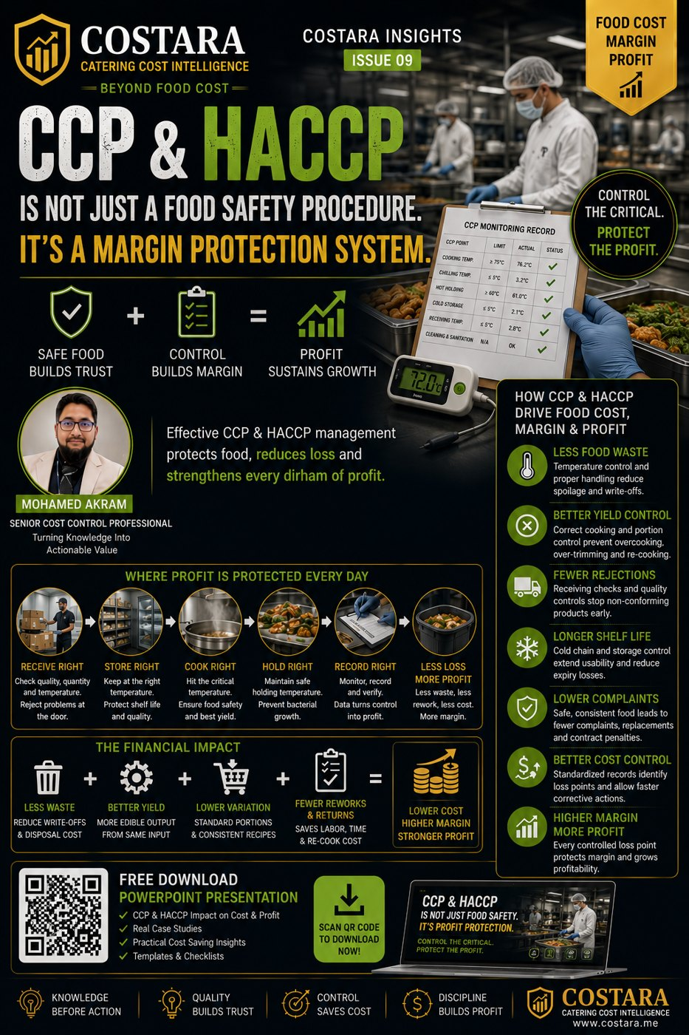

Slide 2
CCP & HACCP: Margin Protection System
CCP & HACCP is not only food safety — it is profit protection.
• Temperature control reduces spoilage, rejection and write-offs.
• Correct cooking and holding protect yield and quality.
• Records reveal recurring loss points that affect cost, complaints and margin.

Slide 3
Practical Management Question
Where is the real cost driver, and which department can control it before it becomes a monthly variance?
Measure the process, calculate the impact, then convert the result into an action plan.

Slide 4
Need help identifying cost leakage?
Costara Advisory supports catering, restaurants, cafés, central kitchens and food production operations with practical cost, inventory, audit, menu costing, procurement, logistics and supply chain reviews.
Consulting fees apply based on scope and operational size.

