Slide 1
Reconstruction of Cardiac Ultrasound Images Using Phased Array Transducer Techniques
Task 2 Imaging

Slide 2
TABLE OF CONTENTS
01
Transducer Configuration
02
03
Transmit apodization
Transmit Delays
04
05
RF Signal Simulation
Pressure Field Simulation
06
07
09
08
I/Q Demodulation
Beamforming:
Image Compounding
Time-Gain Compensation (TGC)

Slide 3
INTRODUCTION
We simulate ultrasound signals to generate an UltraSound image of the heart.

Slide 4
01
Transducer Configuration
64-element phased array with a 2.7 MHz center frequency.

Slide 5
02
Transmit apodization
using a cosine function to smooth the beam profile

Slide 6
03
Transmit Delays

Slide 7
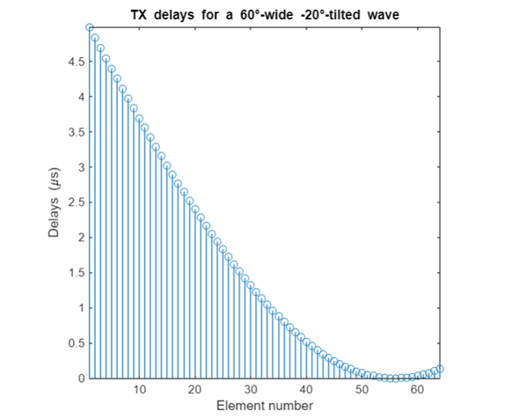
Seven diverging waves are transmitted at tilt angles ranging from -20° to +20°.

Slide 8
04
Pressure Field Simulation

Slide 9
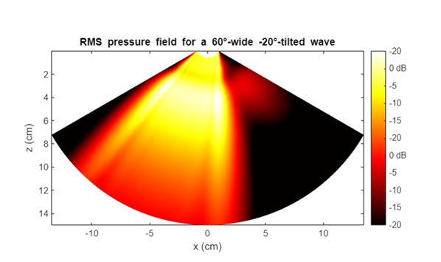
Pressure field is visualized to validate the 60-degree diverging wave steered at -20

Slide 10
05
RF Signal Simulation

Slide 11
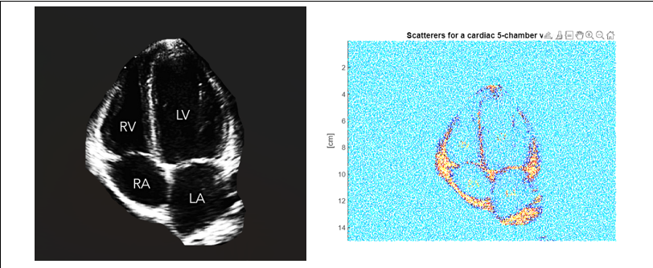
Scatterers representing heart structures are generated.

Slide 12
06
I/Q Demodulation

Slide 13
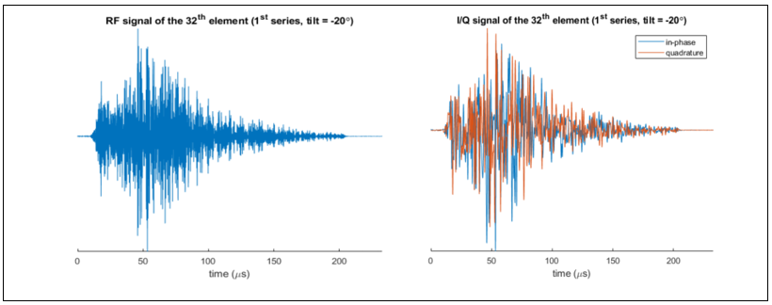
RF signals are converted into in-phase (I) and quadrature (Q) components

Slide 14
07
Beamforming
Delay-and-sum (DAS) beamforming is applied to focus the received signals onto a 256 × 128 polar grid.

Slide 15
08
Time-Gain Compensation (TGC)
The beamformed I/Q signals were time-gain compensated to equalize amplitudes across depths

Slide 16
09
Image Compounding

Slide 17
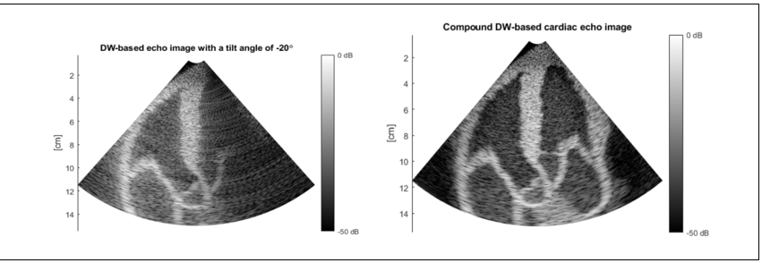
Individual images from all seven tilts were compounded by summing their beamformed signals

Slide 18
THANK YOU

