Slide 1
Expert Systems
Chapter 1
Week 1

Slide 2
Introduction
So far we have think a lot about how we can represent knowledge, but not so much about how we can use it to solve real practical problems.
During the 20th Century, a number of definitions of artificial intelligence (AI) were proposed.
One of the earliest popular definitions of AI was, and still is: “making computers think like people”.

Slide 3
The Turing Test
Alan Turing’s famous Turing Test .
wrote a seminal paper in which he proposed a fair and reasonable test to identify what is an intelligent computer system
Turing Test in which a human would try to determine if the “person” they were talking to via a remote keyboard was a human or computer program. Passing such a test is considered to be strong AI.

Slide 4
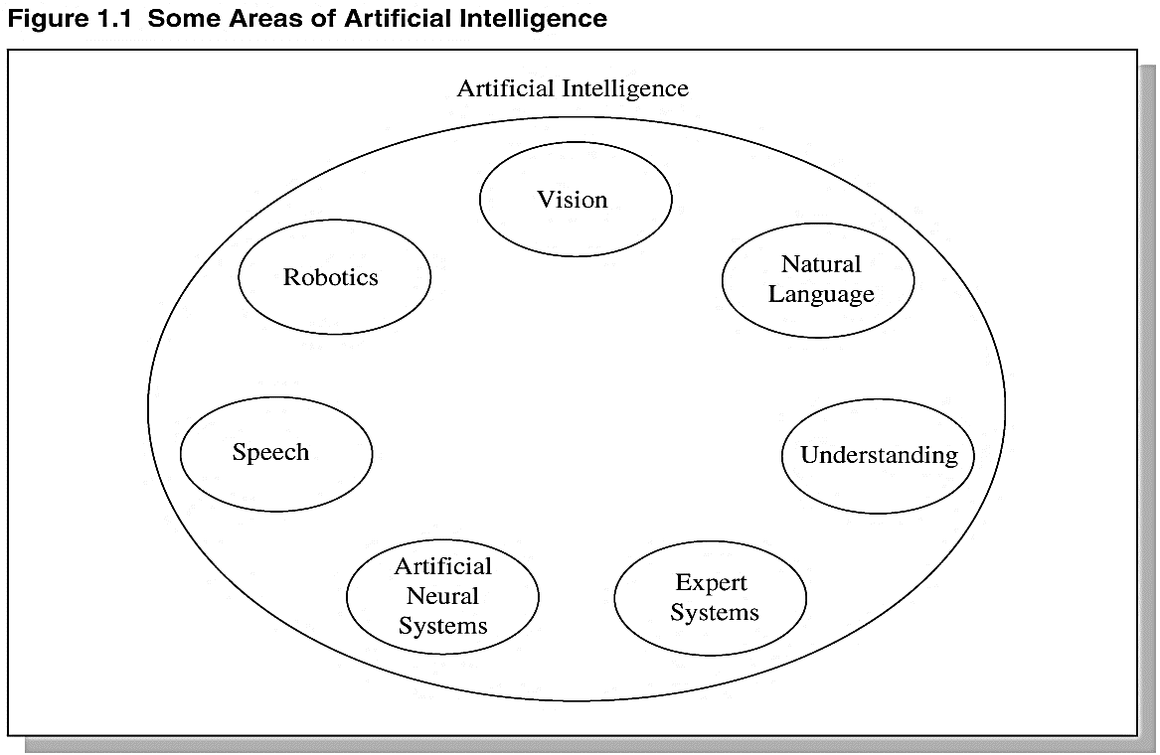
AI and General Problem Solving

Slide 5
'Search' as a General Problem Solving

Slide 6
'Search' as a General Problem Solving
a breadth-first search.
depth-first search .

Slide 7
'Search' as a General Problem Solving
Heuristic Search
best-first search
this uses a combination of
breadth-first and depth-first.

Slide 8
Expert System
An Expert System is a system that employs human knowledge captured in a computer to solve problems that ordinarily require human expertise.
It is imitate the expert’s reasoning processes to solve specific problems.
A computer-based information system that uses expert knowledge.
It may play the role of an assistant to a human decision maker.

Slide 9
What the Expert can do
1- Recognizing and formulating the problem
2- Solving the problem quickly and properly
3- Explaining the solution
4- Learning from experience
5- Reconstructing the knowledge
6- Breaking rules
7- Awareness of limitation

Slide 10
Expert systems are different from other programs
simulates human reasoning.
Reasons with knowledge.
It deals with subjects that requires amount of human expertise.
Uses methods that are heuristic (plausible) as well as algorithmic (certain).
retains flexibility
It must be capable of explaining and justifying solutions

Slide 11
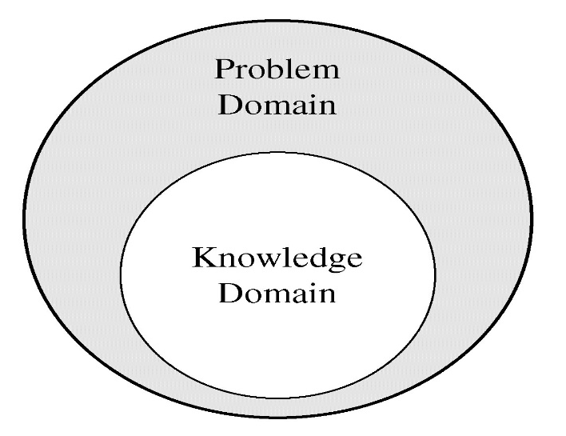
An expert systems differ from other kinds of artificial intelligence programs
An expert’s knowledge is specific to one problem domain .
The expert’s knowledge about solving specific problems is called the knowledge domain.
The problem domain is always
a superset of the knowledge domain.
Requires amount of human expertise.

Slide 12
Expert systems areas
Expert systems are used in the many areas, in which we single out the following classes:
Interpretation.
Prediction.
Diagnostics.
Designing.
Planning.

Slide 13
Expert systems areas
Expert systems are used in the many areas, in which we single out the following classes:
Monitoring.
Remount.
Education.
Management Systems.

Slide 14
Typical Tasks for Expert Systems involve
Diagnosis ( such as equipment faults or human diseases)
Structural analysis of complex objects (such as chemical compounds)
Configuration of complex objects (such as computer systems)
The interpretation of data (such as sonar signals)
Planning sequences of actions (such as might be performed by robots).

Slide 15
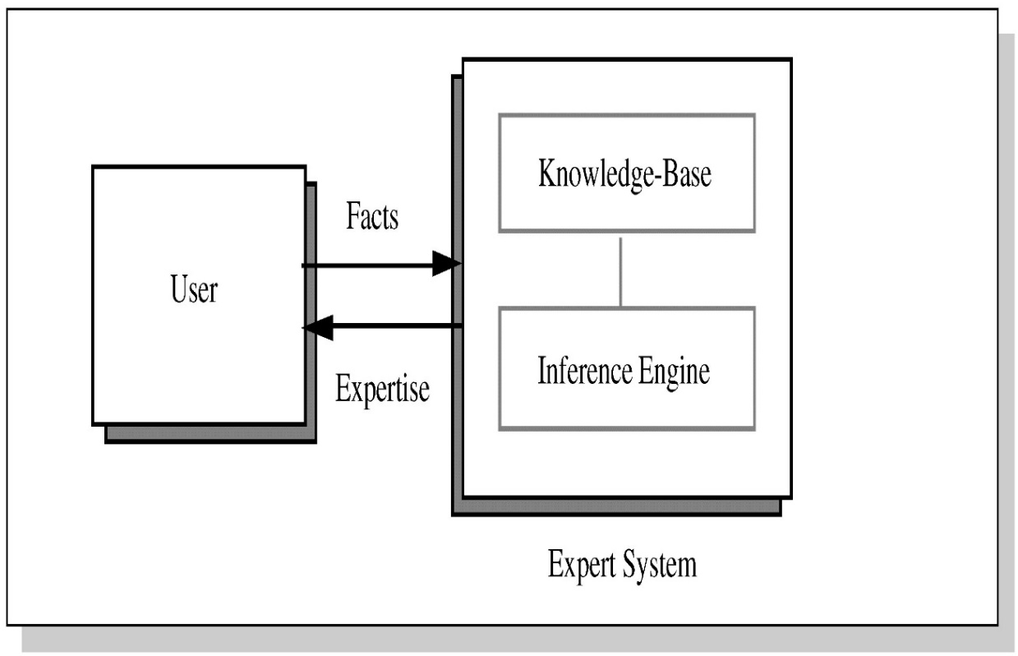
Fundamental Topics in Expert Systems

Slide 16
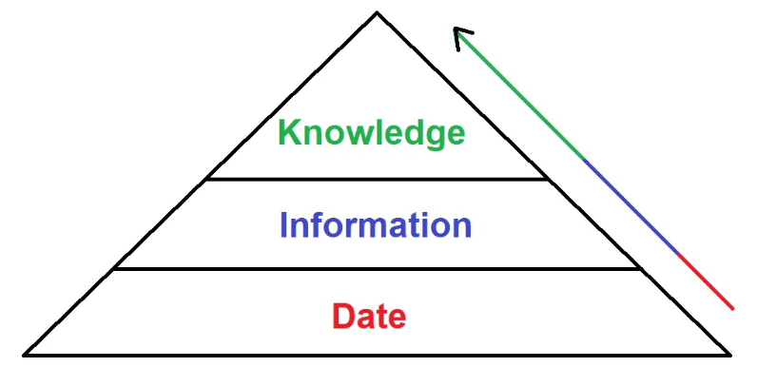
Fundamental Topics in Expert Systems
Data.
Information
Knowledge

Slide 17
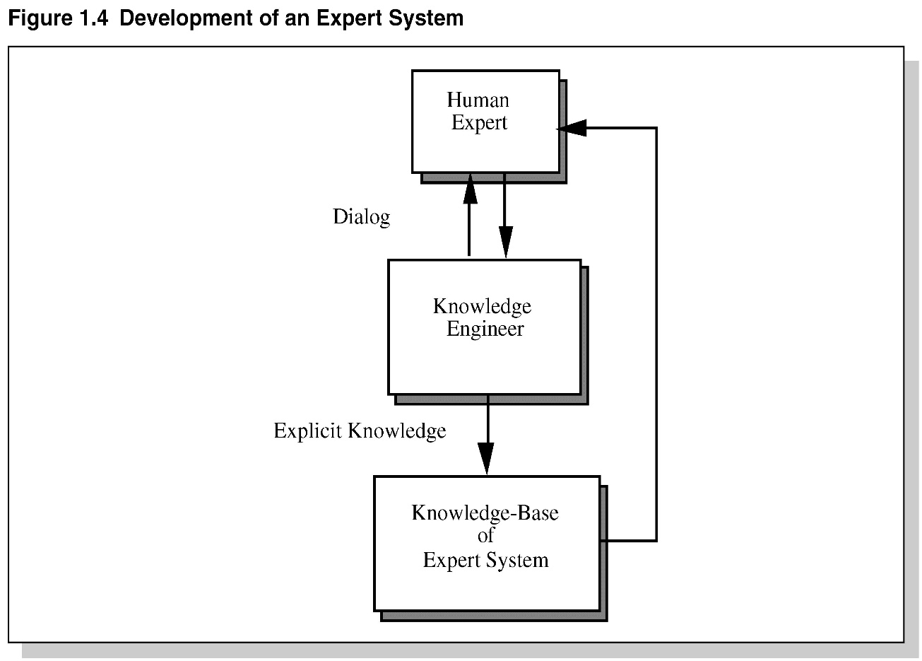
Fundamental Topics in Expert Systems

Slide 18
Limitations of Expert System
Unable to make a creative response in an extraordinary situation
Errors in the knowledge base can lead to wrong decision
The maintenance cost of an expert system is too expensive
Each problem is different therefore the solution from a human expert can also be different and more creative

Slide 19
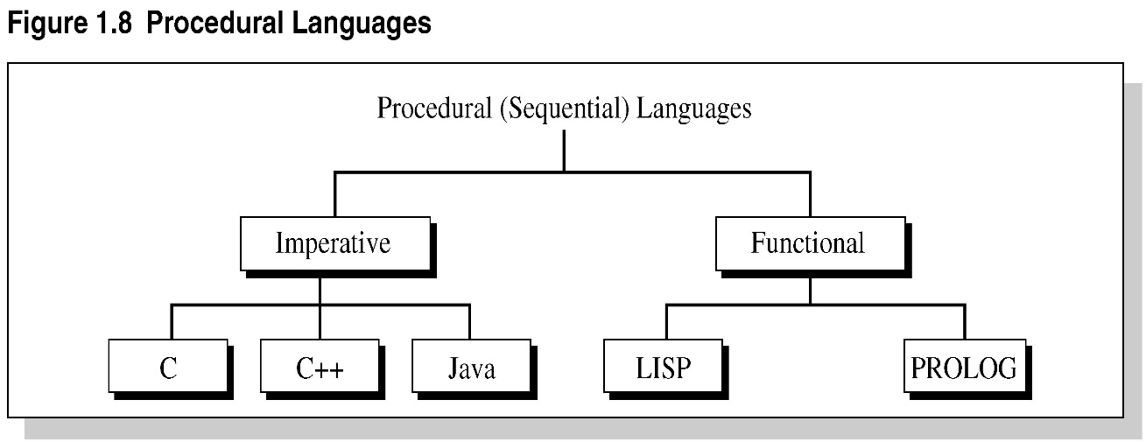
Procedural Languages

Slide 20
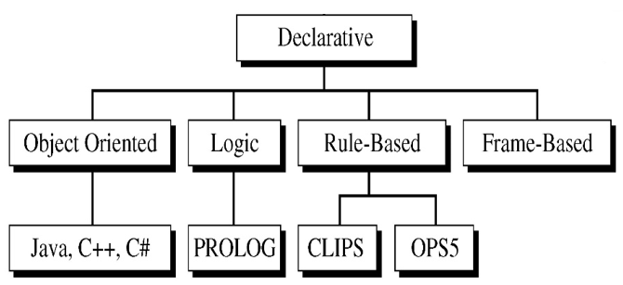
Procedural Languages

Slide 21
Examples of Expert Systems
MYCIN.
DENDRAL.
PXDES.
CaDet.

