Slide 1
Spring Integration - Part1
- Mohamed Ali

Slide 2
Spring Framework - Background
The key themes of the Spring Framework is inversion of control, handles responsibilities on behalf of the components that are managed within its context (eg: dependency injection).
Extend to aspect-oriented programming, its a cross cutting concerns modularizing them into reusable aspects (post and pre processing).
The Spring framework and portfolio provide a comprehensive programming model for building enterprise applications
The spring framework is based on well established best practices, such as programming to interfaces, favoring composition over inheritance and simplified abstraction.
It results a system that is easier to test, understand, maintain, and extend and also increases the level of testability and portability.

Slide 3
Spring Integration - Overview
Spring Integration is a simple model for building enterprise integration solutions to maintain separation of concern in essential.
It enables lightweight messaging within Spring-based applications and supports integration with external systems via declarative adapters on higher level of abstraction (remoting, messaging, and scheduling).
It supports message-driven architectures, routing and transformation of messages (different transform and different data format)
As an extension, it provide wide variety of configuration options ( annotation, XML with namespace support element and course direct use if spring integration API)

Slide 4
Goals and Principles
Goals
Provide a simple model for implementing complex enterprise integration solutions.
Facilitate asynchronous, message-driven behavior within a Spring-based application.
Promote intuitive, incremental adoption for existing Spring users.
Principles
Components should be loosely coupled for modularity and testability.
The framework should enforce separation of concerns between business logic and integration logic.

Slide 5
SI Layers & Components
It’s a layered architecture between vertical perspective and horizontal perspective and the layer promote loose coupled.
Vertical perspective – Separation of concern and interface based concern.
Horizontal perspective – Message driven architecture.
It follows abstract “pipes-and-filter” model. The “filter” component is capable of producing and/or consuming messages and the “pipes” are transport the messages between the filters.
Also it is encapsulated in a layer through interfaces

Slide 6
Main Components
Message
Message Channel
Message Endpoint
Message Endpoints
Transformer
Filter
Router
Splitter
Aggregator
Service Activator
Channel Adaptor

Slide 7
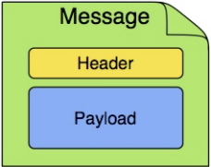

Message
Generic wrapper of any java objects consists of payload and header.
Payload can be any type and header contain common information like id, timestamp, correlation id and return address. Used to pass value to and from the connected transport.
Message Channel
It represents the "pipe" of a pipes-and-filters architecture and follow either point-to-point or publish/subscribe semantics (i.e.) one consumer to receive message or multiple consumer to broadcast.
Producers send Messages to a channel, and consumers receive Messages from a channel.
SI has pollable channel to buffering the messages in queue, it helps to controlling the inbound messages and avoid the overloading a consumer.
If configure the consumer as poller, it can only capable to receive messages.

Slide 8
Message Endpoint
Message endpoint represents the "filter" of a pipes-and-filters architecture.
It’s a thin but dedicated layer that translates inbound requests into service layer invocations.
It translates service layer return values into outbound replies
Message Endpoints
Message Endpoints are responsible for connecting the various messaging components to channels.
Its primary role is to connect application code to the messaging framework and to do so in a non-persistent manner.
Message Endpoints are mapped to Message Channels
Transformer
Message transformer is responsible for converting the message content or structure and return the modified message content like XML Document to java.lang.String .
Filter
Determines whether a Message should be passed to an output channel at all. It contain simple test method to check payload content type, value and header, etc. and send to the output channel if accepted or else message dropped.
It user as conjunction with Publish Subscriber channel, where narrow down the message sets to process by some criteria.
It not generic use of "filter" within the Pipes-and-Filters architectural pattern with endpoint. It something to selectively narrow down the message between two channels.

Slide 9
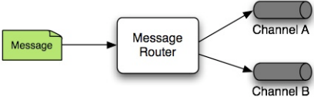
Router
Basically it decide what the channel or channels should receive the message next, based on some criteria with Message's content and/or metadata available in the Message Headers.
Dynamic alternative to a statically configured output channel (Service Activator or other endpoint with sending reply)
Splitter
A Splitter is another type of Message Endpoint whose responsibility is to accept a Message from its input channel, split that Message into multiple Messages, and then send each of those to its output channel
It is used dividing a "composite" payload object into a group of Messages containing the sub-divided payloads.
Aggregator
It is opposite to splitter and also a message type endpoint, which receives multiple messages and combine them into a single message.
Aggregator little complex to maintain object state (messages to be aggregate) to complete the grouping. It has facility to set timeout it needed, whether to send partial results upon timeout, and the discard channel
SI provides a CorrelationStrategy, a ReleaseStrategy and configurable settings for: timeout.

Slide 10
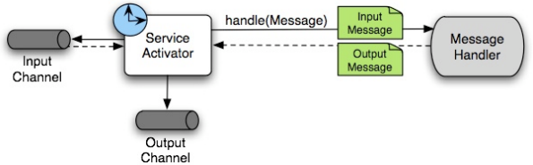
Service Activator
Service activator is a generic endpoint to connecting a service instance to messaging system.
It is mandatory to mention input channel, service method to invoke with return value and optional to give output message channel to send.
If output channel is mention, then the return value after processing or sending to message service reply to output channel. Else channel specified return address from reply message.

Slide 11
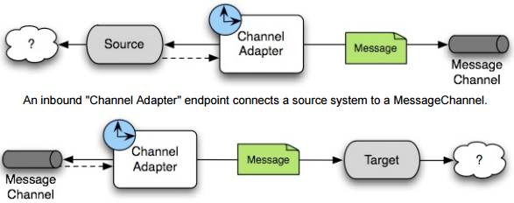
Channel Adaptor
A Channel Adapter is an endpoint that connects a Message Channel to some other system or transport. Channel Adapters may be either inbound or outbound.
It will do some mapping between the Message and whatever object or resource is received-from or sent-to the other system (File, HTTP Request, JMS Message, etc).
Depending on the transport, the Channel Adapter may also populate or extract Message header values channel. Else channel specified return address from reply message.

Slide 12
Configuration
Configure SI either XML namespace support or annotation based Java object
Some Annotation Definition
@EnableIntegration
@MessageGateway
@IntegrationComponentScan
@EnablePublisher
@GlobalChannelInterceptor
ConsumerEndpointFactoryBean @Bean
MessageHandler @Bean

Slide 13
Some XML declaration Tags
<beans xmlns="http://www.springframework.org/schema/beans"
xmlns:xsi="http://www.w3.org/2001/XMLSchema-instance"
xmlns:int=http://www.springframework.org/schema/integration
http://www.springframework.org/schema/integration/spring-integration.xsd >
<int:channel >
<int:gateway>
<int:splitter>
<int:router>
<int:service-activator>
<int:aggregator>

Slide 14
General Recommendation
Use plain old java objects (POJOs) whenever possible
Expose only the framework in your code when absolutely necessary
Don’t explicitly set ApplicationContext, if your component is ApplicationContextAware. Defer such uses until later in the context lifecycle.
If you InitilizilingBean in component, don’t send any messages in initialization method. It may get fail due to application context not initiated.
If you want to send message in statup, use ApplicationListener & ContextRefreshedEvent to send messages or impliment SmartLifeCyle in your bean and override start method and send the message.

Slide 15
References
http://docs.spring.io/spring-integration/reference/htmlsingle/

