Slide 1
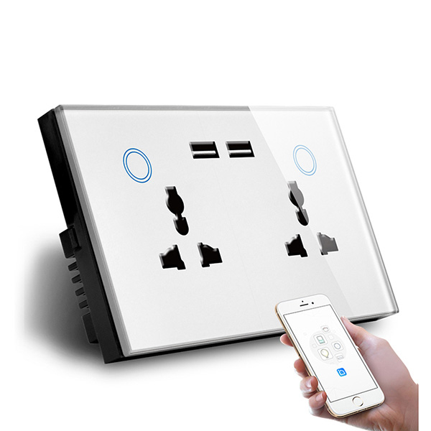
Smart Socket Presentation
University : System analysis, design and validation
Prepared by: Mohamed Nael El Kahlout — 2041091006
Palestine Technical College
Notes:
Instructor notes: Formal academic tone, include references to control systems and testing.

Slide 2
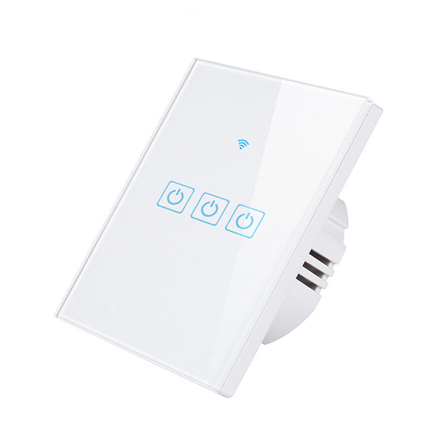
Abstract
A remote-controlled smart socket with Manual and Automatic modes based on DHT22 temperature sensor.
Designed to enhance user safety, save energy, and reduce fire risk during extreme seasons.
Realtime synchronization via Firebase Realtime Database for monitoring and control.
Notes:
Introduce the lecture and objectives.

Slide 3
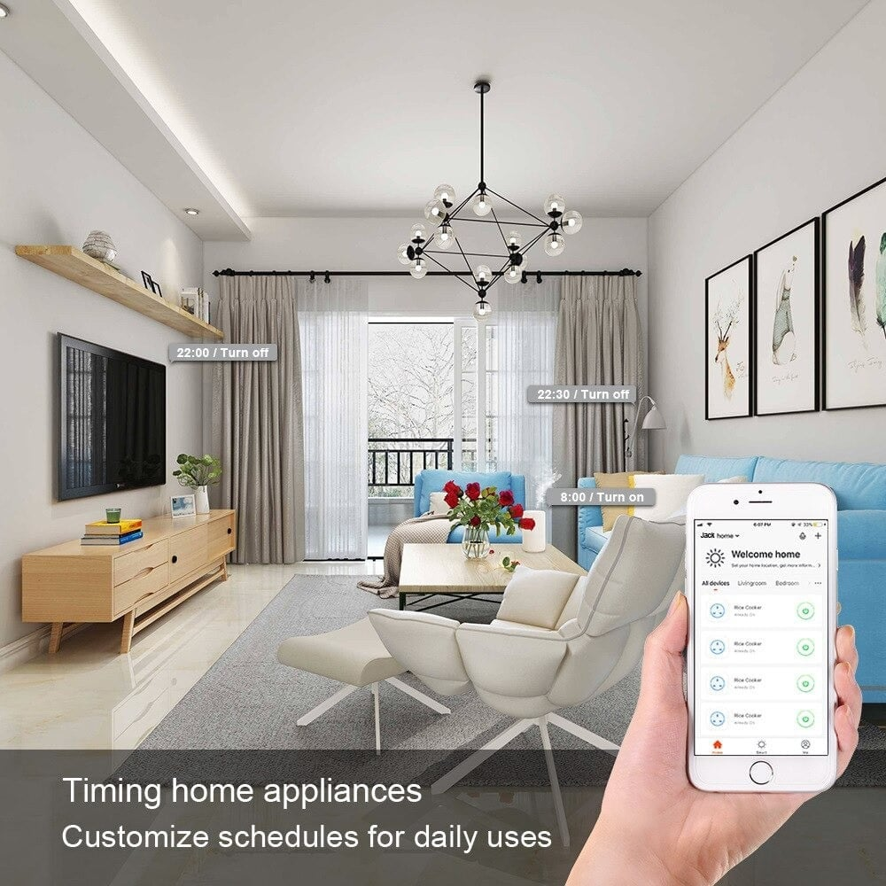
Learning Outcomes
Understand sensor-based control logic and system design.
Learn how to integrate ESP32 with Firebase for realtime data exchange.
Apply best practices for reducing network traffic and ensuring safety.
Notes:
State these outcomes at lecture start.

Slide 4
Problem Statement
Unsupervised heating/cooling devices can cause health risks and fire hazards.
Inefficient energy consumption without remote monitoring and control.
A need for a simple, low-cost protective system for household appliances.
Notes:
Give examples and motivate the problem.

Slide 5
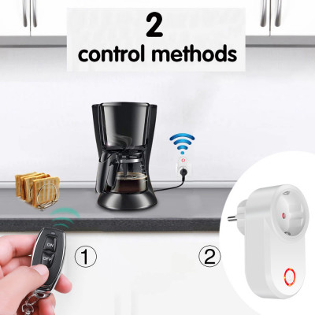
Significance & Motivation
Protect children and elderly from extreme temperature exposure.
Reduce electricity bills by avoiding unnecessary operation of appliances.
Lower fire risk from unattended heaters and improve appliance lifetime.
Enable preventive maintenance through logs and anomaly detection.
Notes:
Provide realistic use-cases and data when available.

Slide 6
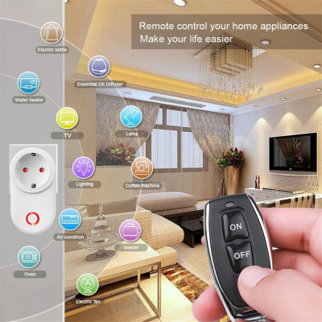
System Objectives & Requirements
Remote ON/OFF control of an electrical outlet.
Two operation modes: Manual and Automatic with user-selectable thresholds.
Realtime data storage on Firebase and a web dashboard for control.
Safety measures: debounce, polarity detection, and failure handling.
Notes:
Discuss functional and non-functional requirements.

Slide 7
Hardware Components
ESP32 microcontroller (Wi-Fi capable).
DHT22 temperature/humidity sensor.
Relay module for switching the load.
Power supply and safety components (fuse, grounding).
Notes:
Show Wokwi schematic during demo.

Slide 8
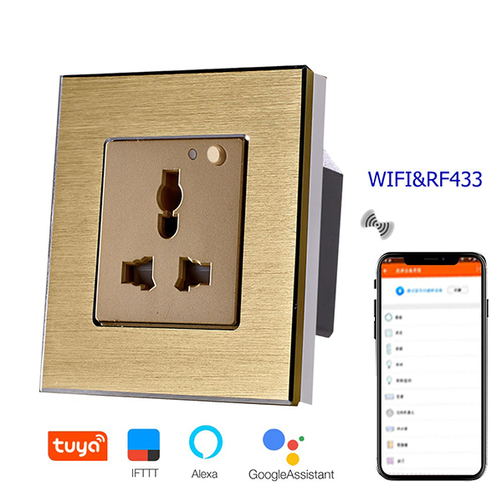
Software Architecture & Flow
Connect to Wi-Fi, then GET socket1.json from Firebase to read mode and thresholds.
Manual mode: apply status field from DB (on/off).
Auto mode: read DHT22 and compare CurrentTemp to min/max to decide relay state.
PUT updates to DB only when state changes; send temp only on significant change (Δ >= 0.2°C).
Notes:
Sketch flowchart live on board.

Slide 9
Sensor Logic
Condition: if minTemp < currentTemp < maxTemp → Relay = ON
Else → Relay = OFF
Recommend hysteresis to avoid rapid toggling around thresholds.
Current default values from project export: {
"currentTemp": 25.6,
"maxTemp": 30,
"minTemp": 20,
"mode": "manual",
"status": "off"
}
Notes:
Explain safety margins.

Slide 10
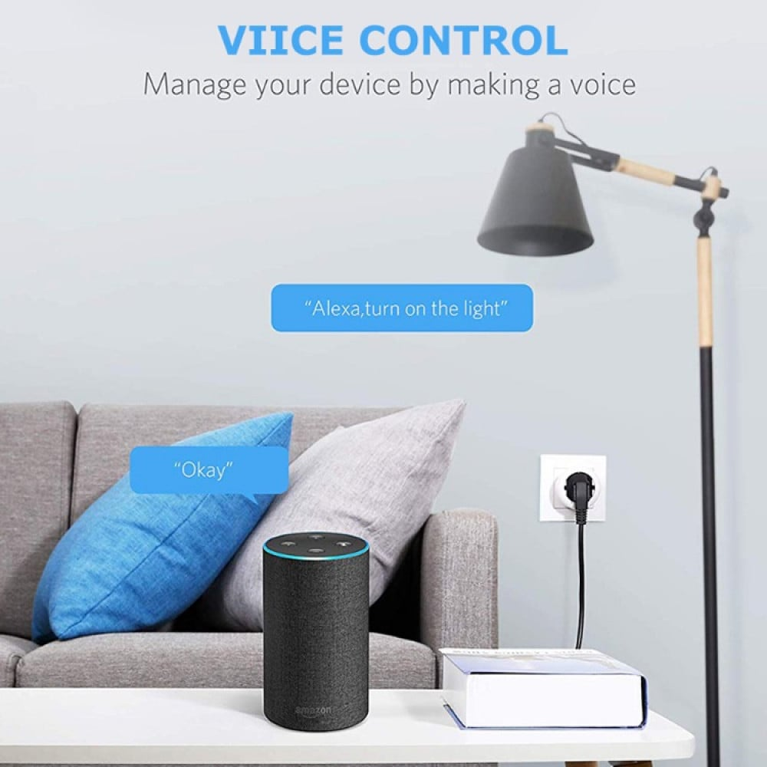
Protective Use-Cases (Summer/Winter)
Summer: prevent overcooling and health issues from excessive AC operation.
Winter: avoid prolonged exposure to cold for infants by automating heaters appropriately.
Reduce circuit overload by avoiding simultaneous heavy-load devices.
Mitigate risks of fire or gas-related incidents with unattended heaters.
Notes:
Give case studies or scenarios.

Slide 11
Algorithm (Pseudo-code)
loop():
data = HTTP GET (Firebase/socket1.json)
if data.mode == "manual":
if data.status == "on": setRelayStateIfChanged("on")
else: setRelayStateIfChanged("off")
else: # auto
temp = dht.readTemperature()
if minTemp < temp < maxTemp: setRelayStateIfChanged("on")
else: setRelayStateIfChanged("off")
send currentTemp to DB only if |temp - lastSent| >= 0.2

Slide 12
Code Highlights
httpGETRequest(url) and httpPUTRequest(url, payload) — HTTP helpers for Firebase
setRelayStateIfChanged("on"/"off") — writes to relay, updates DB on change
Automatic decision in loop(): temp -> compare with min/max -> apply relay
Reduce DB writes by sending temp only on meaningful change (Δ >= 0.2°C)

Slide 13
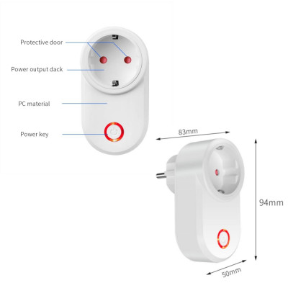
Validation & Testing
Simulate on Wokwi and monitor Serial output for DHT readings and relay state.
Test transitions (Manual <-> Auto) and threshold changes from dashboard.
Test behavior on sensor failure and network loss scenarios.
Notes:
Propose a simple test plan.

Slide 14
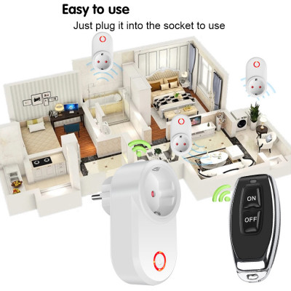
Limitations & Future Work
HTTP-based polling could be replaced with MQTT for efficiency.
Implement authentication and secure rules on Firebase.
Add current sensing, power metering, and notification channels (SMS/Email).
Notes:
Discuss research directions.

Slide 15
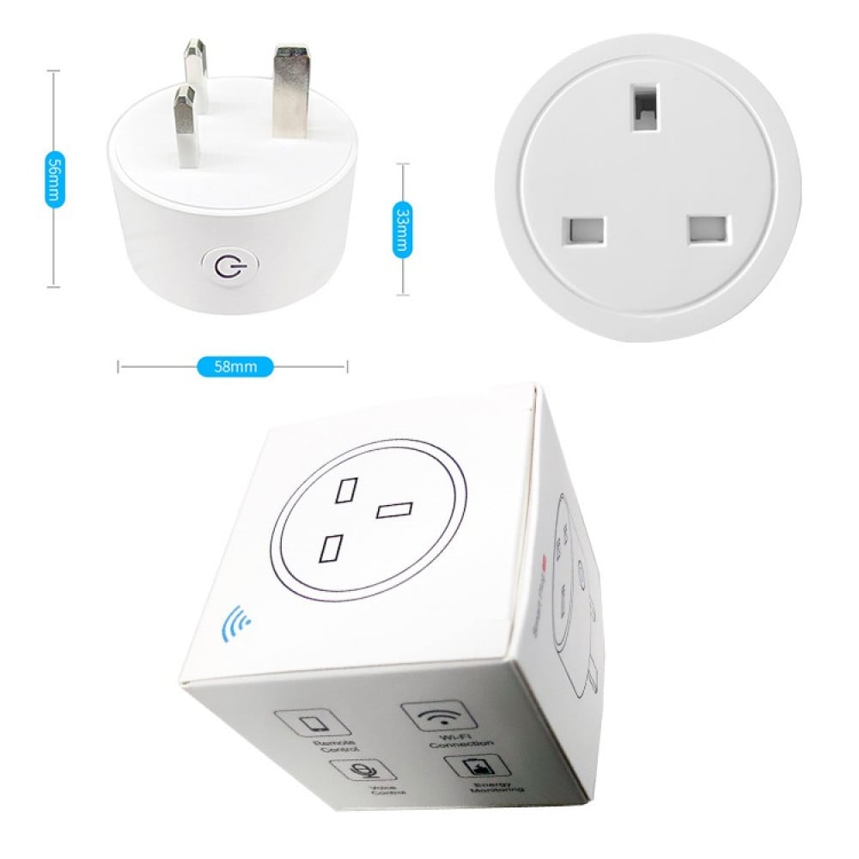
Project Files & Delivery
Included: sketch.ino, diagram.json (Wokwi), index.html (dashboard), README
Deliverable: PPTX (this lecture), demo video, project archive (Drive links)
Notes:
Explain where to find files for graders.

Slide 16
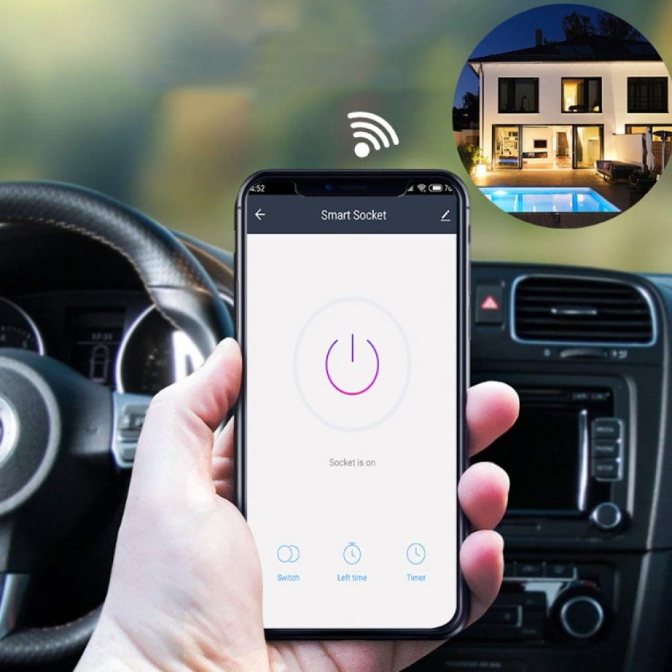
Conclusion & Questions
A practical, extendable system aimed at safety and energy efficiency.
Open for questions and discussion about control strategies and enhancements.
Notes:
End lecture and invite questions.

