Slide 1

Real-Time Urban Mobility Intelligence Platform for Casablanca, Morocco
Kafka · Flink · Spark · Cassandra · MinIO · FastAPI · Grafana · Docker
Kappa streaming architecture · 16-container stack · ML demand forecasting
Built over 6 delivery weeks + a parallel Phase-4 data-synthesis track
Notes:
CasaMotion turns Casablanca's fragmented taxi market into a real-time data platform. I'll walk through the problem, the architecture, and exactly what we built week by week.

Slide 2
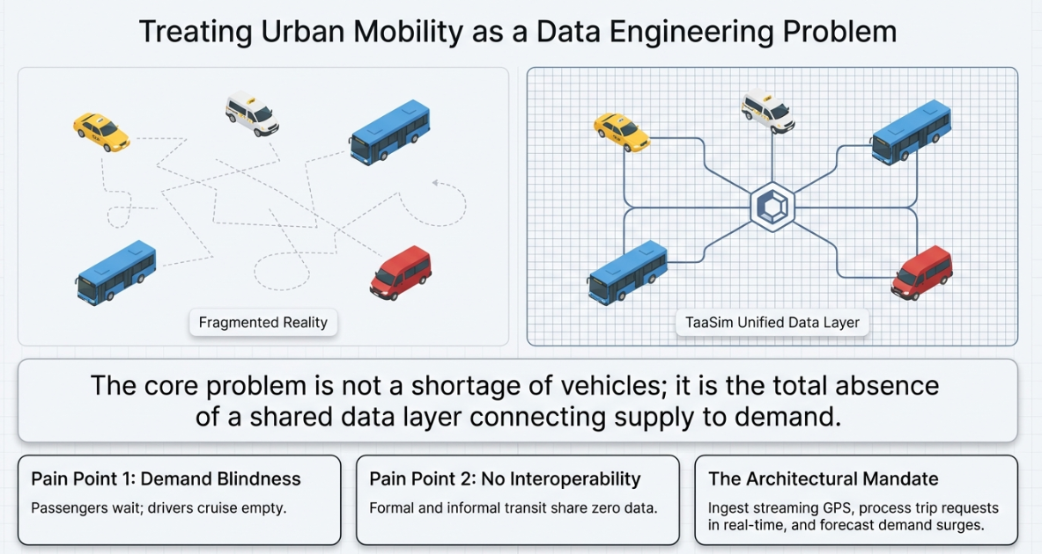
THE PROBLEM
Casablanca: 4 million people, zero shared mobility data
• No shared data layer — taxis & minibuses run with no GPS, booking, or schedule
• Demand blindness — drivers cruise empty; riders wait with no visibility
• No interoperability — ONCF rail, BRT and taxis share no data or ticketing
• Cash-only — no trip history, no analytics, no personalization
• Underserved periphery — Bouskoura, Sidi Moumen grow faster than routes
• Core problem = absence of a DATA LAYER connecting supply to demand
Notes:
Every pain point is a data problem, not a vehicle problem. That framing is the foundation of the whole project.

Slide 3
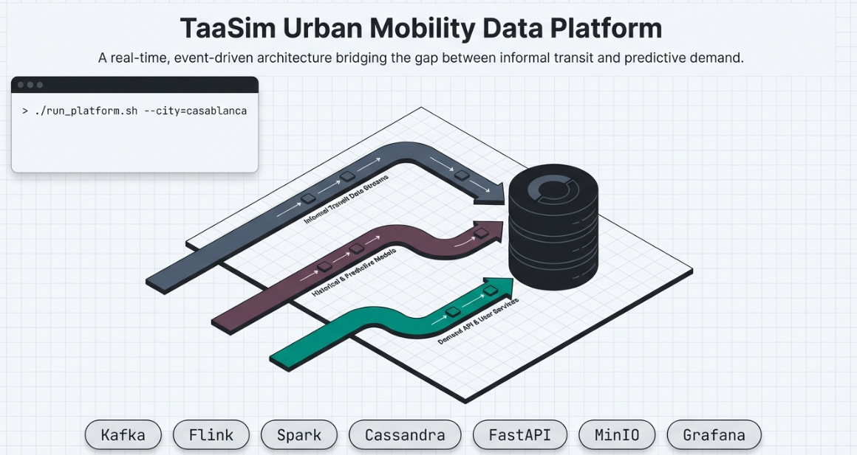
THE SOLUTION & OBJECTIVES
Treat urban mobility as a data-engineering problem
• Dynamic rider–vehicle matching — nearest taxi in under 5 seconds
• Demand surge forecasting — trips per zone predicted 30 min ahead
• City-wide visibility — live heatmaps, KPI dashboards, coverage gaps
• Data-driven planning — find zones where demand exceeds supply
• Cahier des charges: real-time ingestion, event-time processing, serving DB, batch ML, dashboards, secured API
Notes:
Four concrete capabilities. Each maps to a measurable target later in the deck.

Slide 4
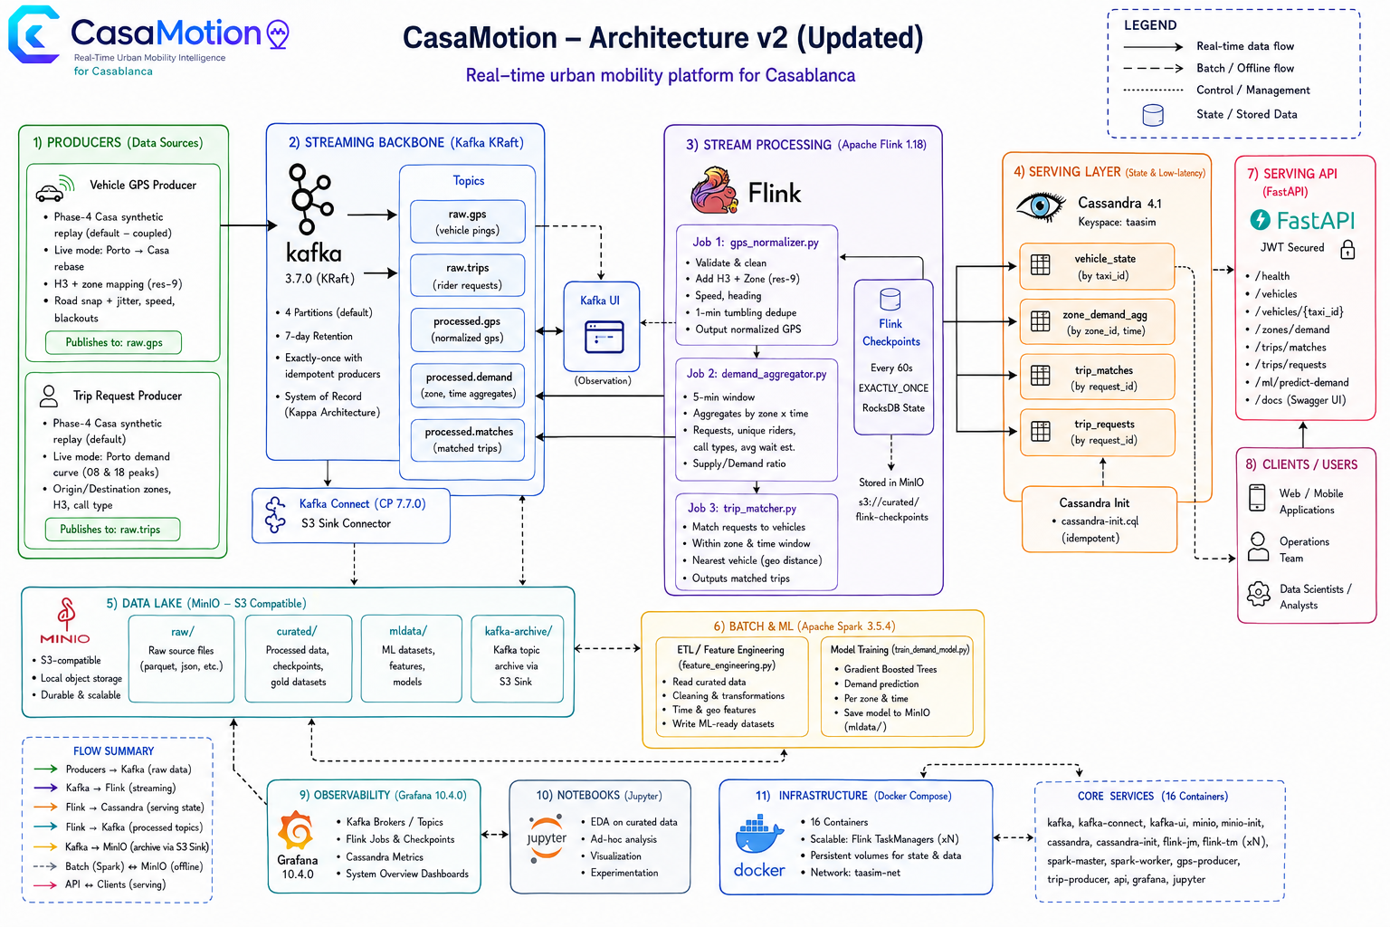
ARCHITECTURE OVERVIEW (V2)
Kappa architecture — Kafka is the single source of truth
• Producers → Kafka (KRaft) → Flink (3 jobs) → Cassandra → Grafana / FastAPI
• MinIO = data lake (raw / curated / mldata / kafka-archive)
• Spark = offline only (ETL + ML training), never serves live queries
• 16 Docker containers on one network (taasim-net)
Notes:
The master map. Flink does all real-time work; Spark is batch-only. Kafka is replayable — that's Kappa, not Lambda.

Slide 5
WHY THESE TECHNOLOGIES
Every choice has a documented rationale (ADR v1)
Choice | Over | Why
Kappa | Lambda | One processing layer; Kafka is replayable
Kafka KRaft | + ZooKeeper | One fewer service, faster failover
Flink | Kafka Streams / Spark Streaming | True event-time windows, sub-second latency
Cassandra | Postgres / Redis | Query-driven partitioning, native TTL, write-optimized
MinIO | HDFS | S3 API for Spark + Flink + Connect; no NameNode
JSON on wire | Avro | Debuggable in Kafka UI, no schema registry
H3 res-9 lookup | point-in-polygon | O(1) dict lookup vs O(16) ray-cast
Notes:
These trade-offs are the questions a jury will ask. MinIO not HDFS; Flink not Spark Streaming for sub-5s matching.

Slide 6
DELIVERY TIMELINE
Week 1 — Foundation
Stack · Datasets · Zone Geography · Producers

Slide 7
WEEK 1: FOUNDATION
Stand up the platform and prepare the geography
• Docker Compose stack — Kafka, MinIO, Cassandra, Flink, Spark, Grafana, Jupyter
• Datasets → MinIO — Porto (1.8 GiB) + NYC TLC
• Porto EDA — 1.7M trips, GPS polylines
• Zone remapping — Porto bbox → Casablanca, 16 arrondissements (v4)
• Kafka producers v1 — GPS + trip requests
Problem: Porto coordinates are in Portugal; needed a faithful transform to Casablanca respecting 16 real arrondissement shapes.
Solution: linear bbox transform + H3 res-9 lookup (h3_zone_lookup.json) for O(1) zone assignment.
Notes:
The hard part wasn't Docker — it was the geography. We pre-computed an H3 lookup so every GPS event resolves its zone in O(1).

Slide 8
ZONE REMAPPING · STEP 1
How we draw Casablanca's 16 zones
Approach | Why rejected
Uniform 500 m grid | Splits real neighbourhoods
H3 res-8 hex (~260) | Too many, no admin meaning
Irregular polygons ✅ | Match real admin boundaries
• 9 zones = official OpenStreetMap admin-boundary polygons
• 7 zones = Voronoi cells on named OSM place-nodes (northern suburbs), clipped to urban boundary
• All polygons clipped to remove ocean slivers/overlaps
• Output: zone_mapping_v4.csv + casablanca_ae_map.html
Honesty note: the 7 Voronoi zones are a demand-aggregation scaffold, not a cartographic claim — every downstream stage treats all 16 as abstract zone_ids.
Notes:
Real, irregular arrondissement shapes because demand follows neighbourhoods, not squares.

Slide 9
ZONE REMAPPING · STEP 2 — A–E ACTIVITY SCORE
An activity tier from a weighted multi-source formula
score_z = 0.30·c_z + 0.40·ρ_z + 0.20·d_z + 0.10·t_z (all features min-max normalised to [0,1])
Feature | Source | Weight
Population density ρ | HCP 2024 census | 0.40
Commerce weight c | Glovo | 0.30
POI diversity d | Glovo | 0.20
Transit hubs t | OpenStreetMap | 0.10
• Population dominates (0.40): demand scales with residents/km²
• Quantile cut [2,4,5,4,1] → A=dense CBD … E=lowest
• Reconciles to HCP's 3.28 M
Notes:
Each zone's tier is computed from four real signals; we verify the summed population equals HCP's 3.28 million.

Slide 10
PORTO SIMULATION STRATEGY
Warping real GPS onto Casablanca roads (7 stages)
• LOAD — Porto polylines; filter 1.5–18 km, 3–30 min
• SAMPLE — stratify by length → 500 trips
• ASSIGN — A–E transition matrix → zone by population
• AFFINE — linear Porto bbox → Casa bbox (cahier transform)
• ANCHOR — pull to centroid (α=0.80) + jitter σ≈160 m
• OSRM — route on real Casa street network
• PERSIST — curated_trajectories_v4.parquet
📷 Warped trajectories on real streets
notebooks/casablanca_trajectories_v4.html
drop your screenshot here
Notes:
Porto gives authentic motion; OSRM routes it along actual Casablanca streets using OSM road data.

Slide 11
PUTTING IT TOGETHER
Population + OSM drive realistic demand
HCP population + Glovo commerce + OSM transit → A–E activity score → demand multipliers {A:1.8 … E:0.5}
OSM admin boundaries → 16 zone polygons → population-weighted origin sampling
OSM road network (OSRM) → road-snapped Porto trajectories
NYC temporal fingerprint → hourly / DoW curve
⇒ casa_trip_requests (500K trips, 90 days)
• Origin weight: origin_p[z] = pop_2024[z] × ae_mult[z]
• Validation 8/8: A/E ratio ≈ 3.6×, twin peaks 08:00/18:00, Fri-high/Sun-low, 70/30 petit/grand
Notes:
OSM gives shapes, transit, roads. HCP+Glovo give tiers→multipliers. NYC sets WHEN. Eight panels confirm realism.

Slide 12
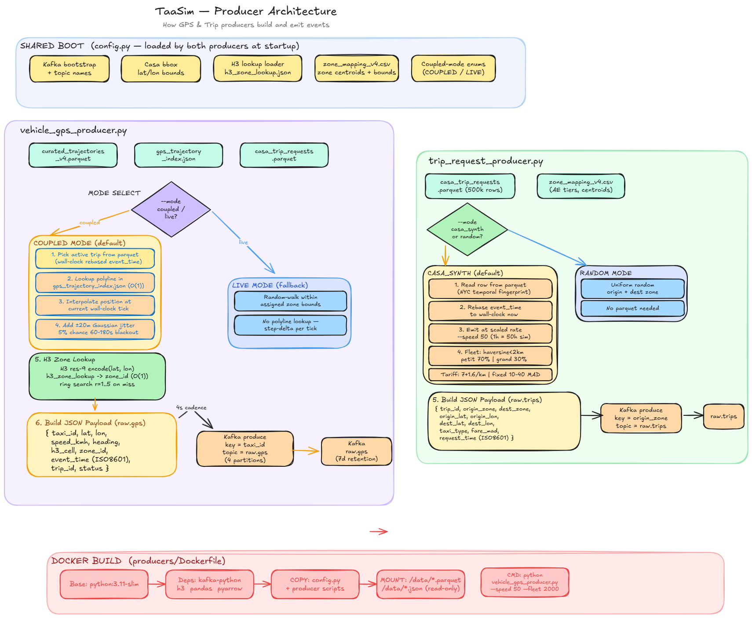
WEEK 1 DEEP DIVE: PRODUCERS
Two Python producers replay Casa traffic into Kafka
• vehicle_gps_producer.py → raw.gps, key=taxi_id
– COUPLED: interpolate OSRM polyline, ±20 m noise, 5% blackout, road-snap
– H3 res-9 → zone, ring fallback r=1..5
• trip_request_producer.py → raw.trips, key=origin_zone
– Hourly multiplier (peaks 08/18), petit/grand split, MAD tariffs
• Wire: JSON, acks=all, retries=3
Notes:
Coupled mode pairs each trip with a real routed polyline so taxis move on actual streets. Keys let Flink keyBy without reshuffle.

Slide 13
DELIVERY TIMELINE
Week 2 — Storage Layer
Kafka Connect · Cassandra Schema · ADR v1

Slide 14
WEEK 2: STORAGE LAYER
Persist the streams and lock the data model
• Kafka Connect S3 Sink — raw.gps + raw.trips → s3://kafka-archive/YYYY/MM/DD/HH/
• Cassandra schema — 3 tables, INSERT + SELECT tested · ADR v1 written
Table | Partition key | Clustering | TTL
vehicle_positions | (city, zone_id) | event_time DESC | 24 h
demand_zones | (city, zone_id) | window_start DESC | 7 d
trips | (city, date_bucket) | created_at DESC | —
Problem: an unbounded trips partition grows forever. Solution: date_bucket caps each partition (< 100 MB guidance).
Notes:
Tables are designed around the queries. The ADR documents every decision for defensibility.

Slide 15
DELIVERY TIMELINE
Week 3 — Real-Time Processing
Flink Jobs 1–3 · Matching · Anonymization

Slide 16
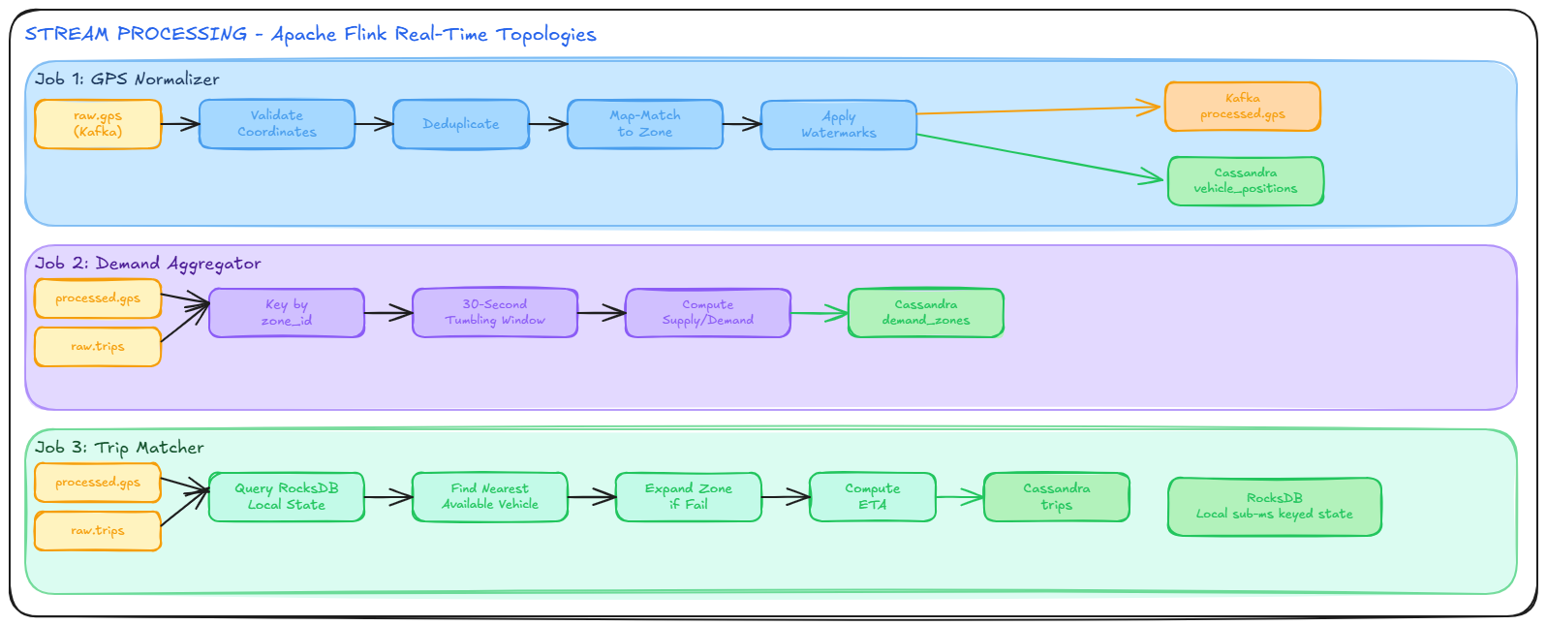
WEEK 3: REAL-TIME PROCESSING
Three PyFlink jobs turn raw events into serving state
• Job 1 · GPS Normalizer — raw.gps → validate, dedup, H3 zone, road-snap → vehicle_positions
• Job 2 · Demand Aggregator — 30 s tumbling windows → demand_zones
• Job 3 · Trip Matcher — keyBy zone, MapState, adjacent fan-out + dedup → trips
• Checkpoints: RocksDB, EXACTLY_ONCE, 60 s → MinIO
• Watermarks: 3-min (Job 1); 10 s + idleness (Jobs 2/3)
Notes:
Watermarks let Flink emit correct windows even when pings arrive late. We use cassandra-driver execute_async, not the official connector.

Slide 17
WEEK 3 DEEP DIVE: MATCHING & ANONYMIZATION
Sub-second matching + privacy by design
• Cost: 0.7·haversine_km + 0.3·idle_bonus
• Adjacent fan-out: neighbours compete; first free taxi wins via shared Set<trip_id> dedup
• Match P95 ≈ 1.2 s (target < 5 s)
• Anonymization: snap to centroid + hash jitter — raw lat/lon never persisted
1.2 s
P95 match latency
21%
matched (fleet 2000 @ 50×)
Problem: match rate only 4.2% (fleet 500, 10×). Solution: scaled to fleet 2000 @ 50× → 21%.
Notes:
Adjacent-zone fan-out gives 1.2s P95; anonymization proves the raw coordinate never reaches the database.

Slide 18
DELIVERY TIMELINE
Week 5 — Batch ETL (Spark)
Porto + NYC → Curated Parquet · Offline only

Slide 19
WEEK 5: BATCH ETL WITH SPARK (OFFLINE)
Spark cleans donor datasets into curated Parquet
• Porto ETL — 1,710,670 → 1,660,794 valid → s3://curated/trips/ (43 MiB)
• NYC TLC ETL — 9.38M → 8.81M → 192K demand rows
• KPI analytics — 6 datasets (trips/zone, hourly, heatmap, gaps…)
• Kappa rule: NYC is batch-only — never enters Kafka
📷 Spark Master UI — completed apps
http://localhost:8080
drop your screenshot here
Problem: Spark image lacked numpy. Solution: install numpy at startup; bump RAM (worker 4g, master 3g).
Notes:
Spark is strictly offline. Porto gives motion; NYC gives demand patterns; both become curated Parquet for the ML stage.

Slide 20
THE NYC DATA STORY
NYC = demand fingerprint, never streamed, never trains the model
• Role 1 · Trip synthesis — borrow NYC curve/DoW/OD → 500K Casa trips / 90 days
• Role 2 · Batch ETL exercise — prove Spark handles multi-GB data (cahier §2.2)
• Re-anchored to Casa with HCP 2024 + Glovo
• Validation 8/8 (70.6% petit / 29.4% grand, A/E 3.65×)
📷 NYC→Casa synthesis EDA (8-panel)
data/casa_synthesis/eda_figures.png
drop your screenshot here
Notes:
Why New York? No open Casablanca taxi dataset. We borrow patterns, not values, then re-anchor with census+commerce. NYC never streams.

Slide 21
DELIVERY TIMELINE
Week 6 — Machine Learning + API
Features · GBT Model · FastAPI Serving

Slide 22
WEEK 6: FEATURE ENGINEERING
Build a leakage-free feature matrix (183,981 rows)
• Input: s3://curated/trips/ → Output: s3://mldata/features/
• Target: demand = trips per zone per 30-min slot (48 slots/day)
• Features: hour_of_day, day_of_week, is_weekend, is_peak, slot_of_day, zone_idx, demand_lag_1d, demand_lag_7d, rolling_7d_mean
The critical fix: an earlier draft included supply and supply_demand_ratio — both from the SAME 30-min slot as the target → label leakage. Removed both; kept only retrospective lag/rolling features. Temporal split (not random) at 2014-05-01.
Notes:
We caught and removed label leakage — the difference between a notebook model and a production one. Temporal split because it's a time series.

Slide 23
WEEK 6: FEATURE SELECTION VS IMPORTANCE
Two different concepts — we did both
• Selection (before): allow only if knowable in advance & non-leaking → removed supply*
• Importance (after): GBT featureImportances shows what trees split on
# | Feature | Importance
1 | demand_lag_1d | ~0.38
2 | rolling_7d_mean | ~0.24
3 | hour_of_day | ~0.17
Notes:
We selected nine features on causal grounds and report importances as evidence. Lag-1-day dominating is exactly what an analyst expects.

Slide 24
WEEK 6: GBT MODEL TRAINING & RESULTS
Gradient Boosted Trees beat the baseline by 45.8%
• Algorithm: Spark MLlib GBTRegressor (maxDepth=5, maxIter=50, stepSize=0.1)
• Pipeline: StringIndexer → VectorAssembler → GBTRegressor
• Split: temporal — Train 151,911 / Test 32,070
• Every one of 16 zones beats the baseline
3.71
RMSE (vs 6.84)
0.75
R²
2.11
MAE
−45.8%
vs baseline
Notes:
We beat the mandatory naive 7-day-lag baseline globally by 45.8% and in every zone. R² 0.75 on a held-out future window is strong and honest.

Slide 25
WEEK 6: SERVING API (FASTAPI)
Seven JWT-secured REST endpoints
Method | Path | Purpose
POST | /api/auth/token | Issue HS256 JWT
POST | /api/demand/forecast | Predict demand
POST | /api/trips | Publish to raw.trips
GET | /api/zones · /{id} | Zone catalog
GET | /api/vehicles/{zone_id} | Latest vehicles
GET | /api/health | Liveness + model_loaded
• Heuristic mode (default) — deterministic, <5 ms, slim image
• PySpark mode — PYSPARK_ENABLED=1 loads GBT model
• Lazy init — Cassandra/Kafka on first call
📷 Swagger UI
http://localhost:8000/docs
drop your screenshot here
Notes:
Smart fallback: heuristic by default so it runs in a tiny image; Spark only when enabled. /api/trips closes the loop into Kafka→Flink.

Slide 26
CROSS-CUTTING
Storage · Observability · Deployment
MinIO · Grafana · Docker Compose · Testing

Slide 27
STORAGE & DATA LAKE (MINIO)
One S3-compatible lake, four lifecycle zones
Bucket | Writer | Reader
raw/ | manual upload | Spark ETL
curated/ | Spark ETL, Flink ckpt | Spark ML, recovery
mldata/ | Spark ML | FastAPI
kafka-archive/ | Kafka Connect | Spark replay
📷 MinIO console — 4 buckets
http://localhost:9001
drop your screenshot here
• Why MinIO not HDFS: single binary, S3 API for all engines, no NameNode
Notes:
MinIO is the connective tissue. Spark, Flink, Connect all use one S3 API. HDFS would need different connectors + a NameNode.

Slide 28
OBSERVABILITY (GRAFANA)
Live dashboards read Cassandra directly
• Plugin: hadesarchitect-cassandra-datasource (CQL :9042)
• Dashboard 'CasaMotion — Live Pipeline', 5 s refresh, $date_bucket
• Panels: road-snapped geomap, demand heatmap, active vehicles, pending requests, trips-by-status
• snap_dist_m surfaced for road-realism checks
📷 Grafana — taxis on streets + demand
http://localhost:3000
drop your screenshot here
Notes:
Grafana talks straight to Cassandra. The geomap shows taxis on real roads; we expose snap distance for verification.

Slide 29
ENGINEERING CASE STUDY
The vehicle-map realism fix
• Symptom: taxis fixed/off-road (centroid+jitter overwrote live coords)
• Fixes: GPS_DISPLAY_MODE=road default; producer road-snaps after noise, rejects > 80 m; added snap_dist_m; 32 dashboard queries updated
• Verify: check-vehicle-movement.ps1 — 4 checks PASS
• The bug spanned FOUR layers: producer, Flink, Cassandra schema, Grafana — all fixed + automated checker
Notes:
A great full-pipeline debugging example: the bug spanned four layers; we fixed all and wrote a checker to prevent regression.

Slide 30
DEPLOYMENT (DOCKER COMPOSE)
One command brings up 16 containers
• docker compose up -d → Kafka, Connect, Kafka UI, MinIO, Cassandra, Flink, Spark, Grafana, Jupyter, producers, API
• Healthchecks gate dependent services; named volumes persist state; network taasim-net
• Ops scripts: register-connectors, ensure-cassandra-schema, submit-flink-jobs, verify-flink-jobs
📷 docker compose ps (all healthy) + demo-healthcheck.ps1
drop your screenshot here
Notes:
Reproducible from a single compose file. The healthcheck script verifies all 16 containers, 3 Flink jobs, and data freshness.

Slide 31
TESTING & VALIDATION
Evidence-driven, not claim-driven
• Demo healthcheck: 16 checks — containers, Flink RUNNING, vehicle_positions 3.5 s, demand_zones 84 s, trips today
• Movement realism: 4 checks pass (8/8 distinct, 139/139 moving, 200/200 within 100 m, 80/80 in bbox)
• Late-event/watermark test: scripts/test_late_events.py
• ML validation: temporal split, baseline-beat table, per-zone RMSE
Notes:
Everything we claim, we verify with a script. Freshness numbers and realism checks are reproducible live during the demo.

Slide 32
PERFORMANCE — TARGETS VS MEASURED
We meet or beat every measured target
Metric | Target | Measured
Trip match latency (P95) | < 5 s | ≈ 1.2 s ✅
GPS position freshness | < 15 s | ≈ 4 s ✅
Demand zone updates | every 30 s | 30 s tumbling ✅
Spark Porto ETL (1.7M) | < 5 min | 43 MiB Parquet ✅
Flink checkpoints | 60 s cadence | 25 consecutive, 0 failures ✅
ML forecast API | < 500 ms @ 20 RPS | 🟡 Locust run pending
Notes:
We meet or beat every measured target. The open item is a formal load test of the forecast API — queued in Week 7.

Slide 33
FINAL DEMO FLOW
End-to-end in five live steps
• 1. docker compose up -d → demo-healthcheck.ps1 (all green)
• 2. Open Grafana → taxis moving on roads, demand heatmap updating
• 3. POST /api/auth/token then POST /api/trips in Swagger
• 4. Watch the trip get matched in Grafana + Cassandra row appear
• 5. POST /api/demand/forecast → 30-min-ahead prediction
Notes:
One loop tells the whole story: request a trip via API → Kafka → Flink → matched → live on dashboard → then forecast 30 min ahead.

Slide 34
KEY RESULTS
What we delivered
• ✅ Full Kappa pipeline end-to-end
• ✅ Sub-second matching (P95 ≈ 1.2 s), GPS freshness ≈ 4 s
• ✅ GBT forecaster: RMSE 3.71 / R² 0.75 / −45.8%
• ✅ Secured FastAPI (JWT, 7 routes), dual mode
• ✅ 500K synthetic Casa trips (NYC + Porto + HCP)
• ✅ Road-snapped live vehicle map + auto verification
• ✅ 16-container reproducible stack, healthcheck-validated
Notes:
Seven concrete deliverables, all verifiable. The platform runs end-to-end today.

Slide 35
CHALLENGES & SOLUTIONS
Real problems, real fixes
Challenge | Solution
Porto coords in Portugal | Linear bbox transform + H3 res-9 lookup
Taxis off-road / frozen | Road-snap + GPS_DISPLAY_MODE=road + snap_dist_m
Low match rate (4.2%) | Fleet 2000 @ 50× → 21%; adjacent fan-out
Label leakage in features | Removed supply*, temporal split, lag-only
No open Casablanca dataset | Synthesize from NYC + Porto + HCP/Glovo
API needs Spark, image slim | Heuristic fallback + optional PYSPARK_ENABLED
Notes:
Each row is a real problem and a real fix. The leakage catch and road-snap fix show the most technical depth.

Slide 36
FUTURE IMPROVEMENTS (WEEK 7–8)
What's next
• Security hardening: rotate JWT_SECRET, HTTPS/TLS, Kafka SASL + topic ACLs
• Integration tests: pytest + GitHub Actions, assert P95 < 5 s over 200 trips
• SLA load test: Locust, 20 RPS, forecast API p99 < 500 ms
• Checkpoint-recovery demo: kill a TaskManager, prove resume from MinIO, no duplicates
• Idle-cruising GPS behavior to raise match rate further
• Week 8: live demo, pitch deck, technical report
Notes:
Feature-complete through Week 6. Week 7 = hardening + SLAs; Week 8 = polished demo. Open cahier items: Kafka ACLs + checkpoint-recovery recording.

Slide 37
BACKUP / FOR THE JURY
Technical Deep-Dive
Serialization · Kafka · Flink · MinIO vs HDFS · GBT · Guarantees

Slide 38
T1 · SERIALIZATION & DESERIALIZATION
How events become bytes and back
• Serialize = object → bytes for Kafka. Deserialize = bytes → object on consume.
• Format = JSON: producers json.dumps(event).encode('utf-8'); Flink json.loads(bytes)
• Why JSON over Avro/Protobuf: human-readable + debuggable in Kafka UI, no schema-registry service
• Inside Flink: state serialized into RocksDB, then checkpointed to MinIO
Trade-off (honest): Avro/Protobuf would be more compact and schema-enforced — a documented future optimization.
Notes:
Everything on the wire is JSON for readability and zero-ops. Flink serializes keyed state into RocksDB, checkpointed to MinIO.

Slide 39
T2 · KAFKA TOPIC & PARTITION-KEY CONTRACT
Deliberate keys, no wasted shuffle
Topic | Key | Produced by | Consumed by
raw.gps | taxi_id | GPS producer | Flink Job 1
raw.trips | origin_zone | trip producer | Flink Jobs 2 & 3
processed.gps | taxi_id | Job 1 | Job 2
processed.demand | zone_id | Job 2 | dashboards
processed.matches | trip_id | Job 3 | dashboards
4 partitions · 7-day retention · JSON. Keys align with Flink keyBy → no network reshuffle.
Notes:
Keying GPS on taxi_id and trips on origin_zone lines up the keyBy with Kafka partitioning, avoiding an extra network shuffle.

Slide 40
T3 · FLINK INTERNALS
How the real-time engine is wired
• JobManager = coordinator; TaskManagers = workers (12 slots)
• Each job = Kafka source → keyBy → stateful process fn → sinks
• State = RocksDB (on-disk, large keyed state)
• Checkpoints 60 s → MinIO, EXACTLY_ONCE; offsets commit with checkpoint
• Event-time + watermarks; Cassandra via execute_async
Notes:
RocksDB holds state; checkpoints snapshot it to MinIO every minute with Kafka offsets; exactly-once means crashes resume with no duplicates.

Slide 41
T4 · MINIO VS HDFS
Why an object store, not a block file system
 | HDFS | MinIO (chosen)
Model | Distributed file system (blocks) | Object store (key→object, S3)
Metadata | Central NameNode (SPOF) | No central namenode
Redundancy | 128 MB blocks ×3 | Erasure coding
Access | hdfs:// client | s3a:// — Spark, Flink, Connect
Ops | NameNode + DataNodes + quorum | Single stateless container
One line: HDFS = block file system + central metadata server; MinIO = stateless S3 object store — better for a multi-engine Kappa stack.
Notes:
Three engines all need the same storage. MinIO shares one S3 API; HDFS would need separate connectors + a NameNode to keep alive.

Slide 42
T5 · GBT VS RANDOM FOREST VS BASELINE
Why boosting won
 | Naive 7d-lag | Random Forest | GBT (chosen)
Logic | repeat last week | average parallel trees (bagging) | sequential trees fix error (boosting)
Reduces | — | variance | bias → best on tabular
RMSE | 6.84 | > GBT | 3.71
GBT handles non-linear demand, mixed types (no scaling), interactions for free. −45.8% vs baseline, R² 0.75, all 16 zones improve.
Notes:
Random Forest cuts variance via bagging; GBT lowers bias via boosting and wins on tabular. We beat the mandatory baseline by 45.8%.

Slide 43
T6 · TWO CORRECTNESS GUARANTEES
Trust the numbers, protect the rider
• Exactly-once: Flink checkpoints (RocksDB→MinIO every 60 s) commit together with Kafka offsets → crash resumes with NO duplicate matches/counts
• Out-of-order safety: 3-min watermarks in Job 1 absorb the producer's 5% blackout (60–180 s late pings)
• Privacy by design: GPS_DISPLAY_MODE=anonymized snaps raw lat/lon to centroid + hash jitter BEFORE the Cassandra write — raw coordinate never persists
Notes:
Two guarantees a jury cares about: exactly-once correctness (no inflated counts) and privacy (raw coordinate never reaches the DB).

Slide 44

Thank you
Real-time mobility intelligence · Kappa architecture · 16 containers · ML-backed · github.com/mohamedamineelabidi/CasaMotion
Notes:
We built a complete, real-time, ML-powered mobility platform for Casablanca — every claim backed by code and a verification script.

Slide 45
APPENDIX · LIVE SERVICE URLS
Where everything runs
Service | URL | Creds
Grafana | http://localhost:3000 | admin / admin
Flink UI | http://localhost:8081 | —
Spark Master | http://localhost:8080 | —
MinIO Console | http://localhost:9001 | minioadmin / minioadmin
Kafka UI | http://localhost:8090 | —
FastAPI Swagger | http://localhost:8000/docs | JWT
Defense Q&A flashcards (15 questions) are in presentation/qa.html
Notes:
The six URLs I'll open during the live demo. The Q&A page covers the 15 most likely jury questions.

