Slide 1

FNB/First rand case study
Group 10

Slide 2
Minimum | 0,0%
Maximum | 99,0%
Average | 61,7%
Standard Deviation | 22,1%
The analysis of how the average PD compares to the overall actual default rate will give insight into how accurate the model used is. The average PD = 61.7% and the overall actual default rate = 48.94%. The average PD being higher than the actual default rate is indicative of that the model used overestimates the likelihood of default amongst the customers, as the actual data suggests that customers tend to default less than predicted
Data analysis
The Histogram's shape of the data is negatively skewed, with data leaning towards the larger percentiles. This comes to show that majority of the customers have a higher PD and therefore have a higher chance of defaulting on their payments.
Default rate
Actual default rate: 0,489434
Default rate: 48,94%

Slide 3

Statistic Name | Statisitc | Comments
Min | 0 | This data's minimum number is zero
Max | 999
Average | 19,32759 | This number may be affected by the presence of many zeros
Median | 2 | This is indicative that this data lies mostly in the first few numbers since the middle most number is 2
Mode | 1 | This is indicative that this data lies mostly in the first few numbers since the number that appears the most is 1
% observations where zero | 21,3% | 21.3% of entries in this data are zeros and this definetly has an impact on the data's average
Average excluding zeros | 24,54356 | The average changes and goes up without the influence of zeros

Slide 4
Statistic Name | Statisitc
Min | -91919
Max | 12772
Average | 2567,518177
Median | 2076
Mode | 0
% observations where zero | 0,28%
Average excluding special code | 2823,707773
Min w/o special code | 0
Upon observing the histogram, the data in the histogram is positively skewed, meaning that the majority of data points are concentrated on the lower end of the distribution, with a tail extending towards the higher end. In other words, there are fewer occurrences of extremely high values, and the bulk of the data tends to cluster towards the lower values.
Min | 0
1st Quartile (25%) | 861
2nd Quartile (50%) | 2076
3rd Quartile (75%) | 4053
Max | 12772

Slide 5
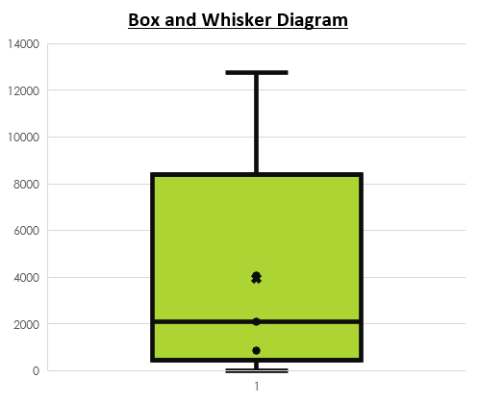
Row Labels | Count of cust_no | Sum of default_ind | default rate
above average | 3872 | 1412 | 36,5%
below average | 6113 | 3475 | 56,8%
Grand Total | 9985 | 4887 | 48,9%
Customers with a feature 5 value that is below average seem to have a higher default rate than customers with a feature 5 value that is above average, this seems to be a promising differentiator between good risk and bad risk customers but further evaluation will give accurate answers and differentiate better.
Row Labels | Sum of default_ind | Count of cust_no | default rate
1st quartile | 1606 | 2495 | 64,4%
2nd quartile | 1364 | 2497 | 54,6%
3rd quartile | 1080 | 2495 | 43,3%
4th quartile | 837 | 2498 | 33,5%
Grand Total | 4887 | 9985 | 48,9%
The default rate decreases as the feature 5 value gets bigger and bigger, meaning the higher the feature 5 value is for a customer, than the less likely they are to default, as the default rate decreases as the quartile goes higher. Customers in the 4th quartile have a low default rate and customers in the 1st quartile have a high default rate. This is a good differentiator between good and bad risk customers.

