Slide 1
NetGuard: A Scalable Framework for Detecting DDoS Attacks Using Cloud data Analysis
Batch No: 10
TEAM MEMBERS | REGISTER NUMBER
S.VISHWA | 820322205060
G.ALFRED EDISON | 820322205301
M.HARIN | 820322205302
A.MOHAMED ASHAR | 820322205303
Guided by
Dr K . ARUNA - ASSOCIATE PROFESSOR / IT

Slide 2
Problem Statement
Cloud storage systems often lack strong encryption, making sensitive files vulnerable to unauthorized access and cyber threats. Protecting stored data with secure encryption is essential for modern cloud applications.
Without OTP-based email verification, cloud systems may allow fake or duplicate registrations, reducing system reliability.
Many systems do not implement strict owner-based approval mechanisms, leading to unauthorized file sharing and potential data leakage.
Traditional platforms fail to detect and notify users about incorrect key attempts or suspicious activities, increasing security risks.

Slide 3
Objective
The project aims to provide a secure cloud-based file storage and access system using encryption and authentication mechanisms. It ensures that only authorized users can retrieve and open stored files.
By implementing an access key verification process, the system enhances data confidentiality and prevents unauthorized access. This ensures that sensitive information remains protected from malicious users.
The project integrates user authentication and login mechanisms to validate identities before granting file access. This improves security and prevents unauthorized file downloads or modifications.
A DDoS attack detection system is incorporated to identify and mitigate multiple incorrect access attempts. This feature helps prevent cyber threats and enhances system reliability.

Slide 4
Literature review
S.No | Title | Author | Merits | Demerits
1. | Comprehensive Analysis of DDoS Anomaly Detection in Software-Defined Networks | Abdinasir Hirsi | Enhanced detection accuracy | Increased communication load during detection
2. | Design a Robust DDoS Attack Detection and Mitigation Scheme in SDN-Edge-IoT by Leveraging Machine Learning | Habtamu Molla Belachew | Machine learning models enhance threat identification | Difficult to implement and maintain.
3. | A Hybrid Machine Learning - Fuzzy Cognitive Map Approach for Fast, Reliable DDoS Attack Detection | Prathibha Keshavamurthy | Hybrid approach enhances system robustness | Needs substantial labeled data for effective learning

Slide 5
S.No | Title | Author | Merits | Demerits
4. | User Terminals as Attackers: An Open Dataset Analysis of DDoS Attacks in 5G Networks | Maria Christopoulou | Freely available for further study and model training. | May not reflect the full spectrum of attack tactics.
5. | An Explanatory Machine Learning Method for the Identification of DDoS Attacks in SDN Architectures | Himmat Rathore | Reduces manual intervention in attack detection and response | Risk of misclassifying normal traffic as an attack

Slide 6
Proposed system
The project proposes a method to detect and prevent DDoS attacks in cloud storage using federated learning. This approach allows multiple cloud nodes to train a detection model without sharing raw data, ensuring privacy and security. By analyzing network traffic patterns, the system can identify and mitigate potential DDoS threats.
To enhance security, a face biometric-based authentication system is implemented. This ensures that only the authorized data owner can access cloud files. The authentication process verifies the user's identity through facial recognition, preventing unauthorized access and securing sensitive information.
An alert system is integrated to notify the data owner of any unauthorized access attempts. If an unknown user tries to access the files, the system triggers an alert and allows the owner to block the unauthorized ID. This approach improves cloud security by preventing data breaches and unauthorized access.

Slide 7
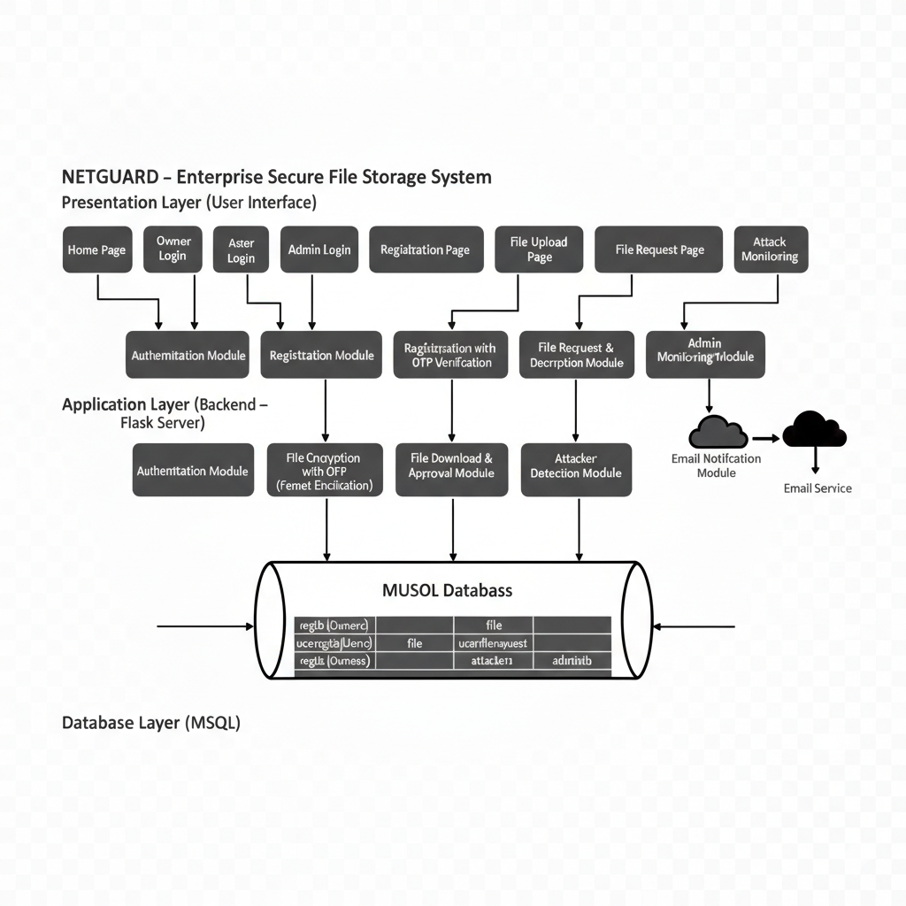
database

Slide 8
Work done far
So far, the project has completed the study of DDoS attacks and their impact on network security. Relevant datasets were identified, and network traffic data was collected for analysis.
Data preprocessing and feature extraction were performed to prepare meaningful traffic attributes for learning. The Random Forest model was selected and trained using the processed dataset.
A basic detection workflow was implemented to classify traffic as normal or DDoS. Initial testing shows promising accuracy, and alert generation for detected attacks has been designed.

Slide 9
Work Yet to Be Done
The remaining work includes fine-tuning the Random Forest model to further improve detection accuracy and reduce false positives. Additional features may be analyzed to enhance classification performance.
Real-time traffic monitoring and full alert integration need to be implemented and tested. Finally, extensive evaluation using multiple datasets and performance metrics will be conducted to validate system reliability.

Slide 10

Execution of First Module

Slide 11
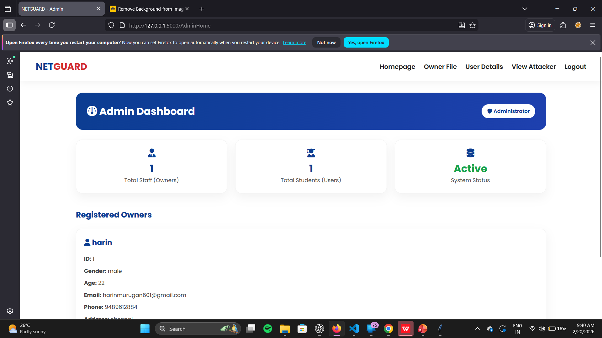

Slide 12
Expected Outcome
The system accurately detects DDoS attacks using Random Forest, distinguishing malicious traffic from legitimate network behavior effectively.
It reduces false positives and enables real-time monitoring, allowing timely response and mitigation of potential service disruptions.
Overall, the project enhances network security, improves service availability, and strengthens resilience against evolving cyber threats.

Slide 13
Conclusion
This project successfully demonstrates the effectiveness of a approach for detecting Distributed Denial of Service (DDoS) attacks using the Random Forest algorithm. By analyzing network traffic features and learning patterns from historical data, the system is able to accurately distinguish between normal and malicious traffic.
The proposed workflow, which includes data collection, preprocessing, feature engineering, model training, and real-time detection, ensures reliable performance and timely alert generation. The reduction in false positives and improved detection accuracy highlight the advantage over traditional rule-based methods.

Slide 14
References
Hirsi, Abdinasir, et al. "Comprehensive Analysis of DDoS Anomaly Detection in Software-Defined Networks." IEEE Access (2025).
Belachew, Habtamu Molla, et al. "Design a Robust DDoS Attack Detection and Mitigation Scheme in SDN-Edge-IoT by Leveraging Machine Learning." IEEE Access (2025).
Keshavamurthy, Prathibha, and Sarvesh Kulkarni. "A Hybrid Machine Learning-Fuzzy Cognitive Map Approach for Fast, Reliable DDoS Attack Detection." 2024 8th Cyber Security in Networking Conference (CSNet). IEEE, 2024.
Christopoulou, Maria, et al. "User Terminals as Attackers: An Open Dataset Analysis of DDoS Attacks in 5G Networks." 2024 IEEE Conference on Standards for Communications and Networking (CSCN). IEEE, 2024.
Rathore, Himmat, and Renu Ratnawat. "An Explanatory Machine Learning Method for the Identification of DDoS Attacks in SDN Architectures." 2024 4th Asian Conference on Innovation in Technology (ASIANCON). IEEE, 2024.

