Slide 1
FOTA
Automotive FOTA Graduation Project
Presented to
x
Presented by
Mohamed Ashraf

Slide 2
FOTA
FOTA technology has emerged as a crucial component in the automotive industry, empowering manufacturers to remotely update and manage the software in vehicles. It enables automakers to provide software enhancements, bug fixes, security updates, and new features to vehicles post-purchase, ensuring continuous improvement throughout their lifecycle.
FOTA's efficiency reduces costs associated with recalls, as some software-related safety issues can be addressed remotely. Real-time diagnostics and data collection enable proactive issue identification, while cybersecurity updates safeguard against potential cyber threats. Moreover, FOTA facilitates the integration of connected and autonomous technologies, ensuring they remain up-to-date and operate safely. However, proper security measures must be prioritized to protect against potential vulnerabilities and cyberattacks in this interconnected automotive landscape.
In the absence of FOTA (Firmware Over-the-Air) technology, both clients (customers) and OEMs (Original Equipment Manufacturers) face mutual losses that impact their operations and overall experience.
The lack of efficient remote updates results in safety and security risks for both parties, leaving vehicles vulnerable to potential cyberattacks and other security breaches. Additionally, the absence of FOTA leads to higher recall expenses as physical recalls become necessary, putting a strain on OEMs' financial resources and inconveniencing clients.
Both clients and OEMs are deprived of the benefits of timely software enhancements and new features, which could have otherwise improved customer satisfaction and driving experiences.
Embracing FOTA can effectively address these mutual losses, ensuring secure and seamless firmware updates, bolstering safety measures, and enhancing overall efficiency for clients and OEMs alike.
Clients
OEM
Time
Money
Effort
Safety and
Security Risks
Time
Money
Reputation
Higher
Recall Expenses
Unnecessary
overhead
Ven Diagram #Figure 1

Slide 3
FOTA Key Benefits
FOTA (Firmware Over-the-Air) technology brings significant benefits to the automotive industry, revolutionizing the way vehicles are managed and updated. One key advantage is the cost-effectiveness it offers. By deploying software updates remotely, FOTA reduces the expenses associated with physical recalls and service center visits, saving valuable time and resources for both manufacturers and customers.
The improved user experience is another standout benefit of FOTA in the automotive sector. Manufacturers can continuously enhance in-car systems and features through software updates. This allows for the introduction of new functionalities and optimizations, ensuring that customers always have access to the latest innovations and improvements in their vehicles.
FOTA's impact on safety and security is paramount. The ability to remotely deliver critical security patches and firmware updates strengthens the resilience of connected car systems against potential cyber threats. This proactive approach helps safeguard vehicles and their occupants, making driving a safer experience.
Real-time diagnostics and data collection capabilities facilitated by FOTA provide valuable insights for automakers. By analyzing vehicle performance data, manufacturers can identify potential issues and make informed decisions for product development and quality improvements.
Another advantage of FOTA is its contribution to extending the lifecycle of vehicles. Through continuous software updates, automakers can keep their vehicles relevant and competitive in the market, reducing the need for customers to replace their cars frequently.
FOTA also ensures adaptability to emerging regulations. Manufacturers can swiftly deploy software updates to meet new emissions standards, safety regulations, and other legal obligations, ensuring compliance without significant delays or costly hardware modifications.
Moreover, FOTA enables agile innovation and customization in the automotive industry. Manufacturers can respond quickly to market demands and customer preferences by introducing personalized updates through software, catering to individual needs and creating a more tailored driving experience for customers.
With remote troubleshooting and support capabilities, FOTA streamlines customer service. Automakers can diagnose and resolve software-related issues remotely, reducing the need for physical service center visits and enhancing overall customer satisfaction.

Slide 4
Problem Attraction
Vehicles now require +150 ECU's
Complexity of vehicles software.
Bugs & features are more even to appear
FOTA is a nascent technology for automotive applications. Its use was pioneered for supporting firmware updates for Electric vehicles, Autonomous vehicles and high end luxury cars in last couple of years. However, FOTA has a much larger potential due to increasing complexity of the new models of vehicles. According some research reports, there will be 203 million vehicles on road which can receive FOTA, by year 2022. The savings in servicing cost using FOTA can amount up to $30 billion as the time and manpower employed in the workshop for software-only updates will be saved. Also, increased customer satisfaction because of small downtime of vehicle will be an added benefit.
Ford recalls more than 430,000y vehicles due to software defects
`Quote`

Slide 5

FOTA In Business
LONDON--(BUSINESS WIRE)--The automotive over-the-air updates market is set to grow by 92.29 million units accelerating at a CAGR of almost 54%, during the period spanning over 2020-2024. One of the key factors driving growth is the reduced vehicle recalls. Improvements in terms of performance and software have reduced the number of vehicle recalls over recent years. The rising focus on intelligent transportation systems is a significant trend that will further stimulate market growth. The rising consumer focus on safety has increased the adoption of connected technology solutions in automobiles.
The SOTA segment was leading the segment in 2019. SOTA enables the map updates to be transferred over the air directly from the cloud, thus making it a secure, fast, and simple process. The technology is widely adopted by prominent automakers such as BMW, General Motors, Ford, Toyota Motor, Chrysler, Renault, Nissan, Scania, and Volvo. These factors are driving the growth of the segment.
The rising adoption of numerous in-vehicle systems such as ADAS, infotainment, and telematics systems has increased the complexity in automotive software architecture. This is compelling software developers to create defect-free and efficient software for automotive applications.
Automotive Over-The-Air Updates Market Size to Grow by 92.29 Million Units During 2020-2024 | Technavio

Slide 6
FOTA Components
Firmware Creation
Storage
Distribution
Security
Error Handling
Bandwidth
User Control
Firmware Creation: Development and testing of updated firmware with bug fixes, improvements, and new features.
Storage: Securely storing firmware updates in a centralized repository or cloud-based storage.
Distribution: Delivering firmware updates wirelessly to target vehicles via cellular networks or Wi-Fi.
Security: Verifying the authenticity and integrity of firmware updates to prevent security risks and cyberattacks.
Error Handling: Implementing mechanisms to recover from failed updates and rollback to the previous version if necessary.
Bandwidth Optimization: Minimizing data size by using delta updates to conserve bandwidth during firmware distribution.
User Control and Consent: Allowing users to schedule updates, set preferences, and opt-out of specific updates if desired.

Slide 7
Components Explained
The typical FOTA (Firmware Over-the-Air) process for the automotive industry involves a series of well-defined steps to deliver software updates wirelessly to vehicles. It begins with the creation and thorough testing of updated firmware. Automotive manufacturers develop firmware versions that include bug fixes, security patches, performance enhancements, and new features. This firmware is rigorously validated to meet safety and quality standards.
Once the updated firmware is ready, it is securely stored in a centralized repository or cloud-based storage system. Manufacturers maintain this database to efficiently manage different firmware versions and updates. The storage is carefully protected to prevent unauthorized access and tampering, ensuring the integrity of the firmware.
When the FOTA process is initiated, notifications are sent to the target vehicles, alerting users about the availability of the new software update. These notifications can be displayed on the vehicle's infotainment system or sent to the user's smartphone through a connected app. Some FOTA implementations allow users to have control over the update process, prompting them to give consent for the update to proceed or schedule the update at a convenient time.
To ensure the security and authenticity of the firmware, it is encrypted and digitally signed before being transferred to the target vehicles. This prevents unauthorized modifications and ensures that only authenticated firmware updates are accepted by the vehicle's systems.
The over-the-air delivery of the updated firmware takes place using various wireless communication technologies, such as cellular networks (3G, 4G, 5G), Wi-Fi, or Bluetooth. For successful updates, vehicles need to be within network coverage.
During the update process, the FOTA system performs error handling and verification. If any errors occur during the update, the system attempts to recover or rollback to the previous firmware version to avoid device malfunction.
Once the update is successfully installed, the FOTA system sends a confirmation message to the manufacturer, indicating the completion of the update process. Users may also receive notifications confirming the successful update on their vehicle's display or smartphone app.
Post-update, manufacturers may collect data to monitor the performance of the new firmware version and gather user feedback. This data helps manufacturers evaluate the effectiveness of the update and identify any potential issues that need further improvement.

Slide 8
Benefits Of FOTA

Slide 9
FOTA Security
Security in automotive FOTA (Firmware Over-the-Air) is of paramount importance due to the critical nature of the software updates being delivered to vehicles. FOTA security measures are designed to protect against potential cyber threats and ensure the authenticity, integrity, and confidentiality of firmware updates.
Authentication and authorization are crucial components of FOTA security. Before installing any firmware update, the vehicle's systems must verify the authenticity of the update source and ensure that it comes from a trusted and authorized entity. This process includes cryptographic verification using digital signatures to confirm that the firmware has not been tampered with during transit.
Encryption plays a vital role in FOTA security. FOTA updates are encrypted to protect the data from interception or manipulation during transmission. Encryption ensures that only authorized recipients can access and understand the update contents, safeguarding the information from unauthorized access.
Secure boot and update mechanisms are commonly implemented in automotive FOTA systems. Secure boot ensures that the vehicle's software is booted from a known, trusted source, preventing unauthorized or malicious software from executing during startup. Similarly, the FOTA update process is designed to be secure, preventing unauthorized modifications to the firmware during the update installation.
Secure communication is essential to protect the FOTA update process. Automotive manufacturers rely on secure protocols and encrypted channels, such as HTTPS or Secure Sockets Layer (SSL), to safeguard data transmission during the over-the-air update delivery.
FOTA systems use error-checking and verification mechanisms during the update process. If any errors are detected during the update installation, the system can attempt to recover or roll back to the previous version to prevent issues with the vehicle's functionality and ensure the integrity of the update.
The storage of firmware updates must be highly secure to prevent unauthorized access or tampering. Manufacturers utilize robust access controls and encryption techniques to protect the firmware repository or cloud-based storage, preventing any compromise to the update files.
Continuous monitoring and response mechanisms are essential to detect and respond to any security incidents or attempted breaches in real-time. Timely detection and response can mitigate potential risks and ensure the integrity of the update process.

Slide 10
Most Used Security Algorithms
RSA (Rivest-Shamir-Adleman): RSA is a widely used asymmetric encryption algorithm. It is used in FOTA to digitally sign firmware updates, ensuring their authenticity and integrity during transmission and installation.
AES (Advanced Encryption Standard): AES is a symmetric encryption algorithm used to encrypt the firmware updates. It ensures that the updates are transmitted securely over the air and can only be decrypted by authorized recipients.
SHA-256 (Secure Hash Algorithm 256-bit): SHA-256 is a cryptographic hash function used to create digital signatures for firmware updates. It provides a unique hash value that verifies the authenticity and integrity of the update.
ECC (Elliptic Curve Cryptography): ECC is an alternative to RSA for asymmetric encryption. It offers the same level of security with shorter key lengths, making it suitable for resource-constrained automotive systems.
X.509 Certificates: X.509 certificates are used to authenticate the identity of the firmware update server and ensure that updates come from trusted sources.
TLS/SSL (Transport Layer Security/Secure Sockets Layer): TLS/SSL protocols are employed to establish secure communication channels between the update server and vehicles, preventing unauthorized interception or tampering of firmware updates during transmission.
OTA Rollback Protection: Mechanisms are implemented to prevent malicious attackers from rolling back firmware to older, vulnerable versions. These mechanisms may involve cryptographic checks and secure storage of the update history.
Secure Boot and Secure Flashing: Secure boot mechanisms ensure that only authenticated and signed firmware can be loaded during the boot process. Secure flashing ensures that firmware updates are installed securely without the risk of tampering.
Digital Signatures and Certificate Validation: Digital signatures are used to verify the authenticity of firmware updates, and certificate validation ensures the trustworthiness of the certificates used in the FOTA process.
Public Key Infrastructure (PKI): PKI is a framework that provides the necessary infrastructure for managing digital certificates and public-private key pairs, which are crucial for secure FOTA.

Slide 12
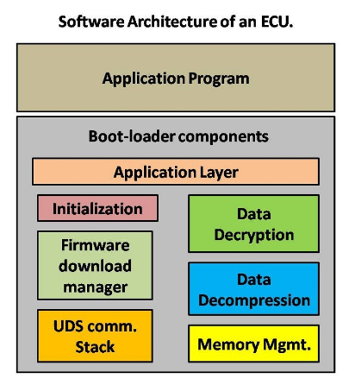

Slide 13
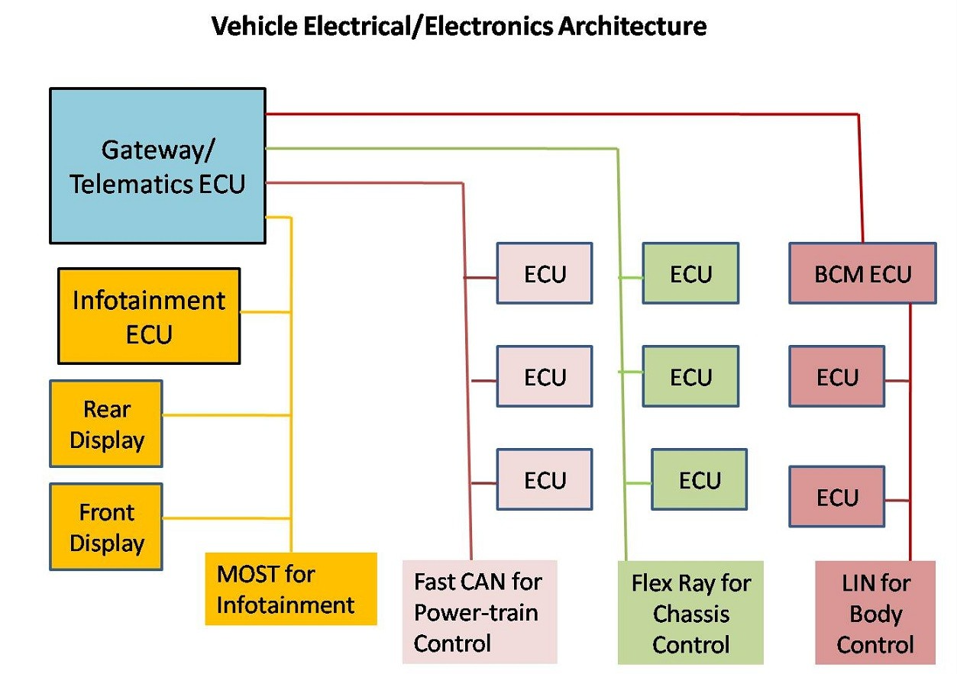

Slide 14
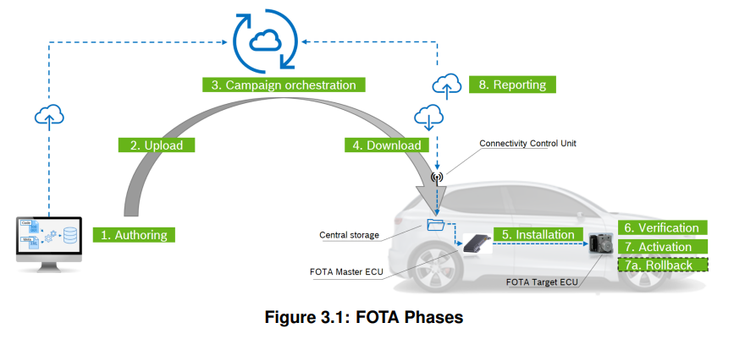

Slide 15
