Slide 1
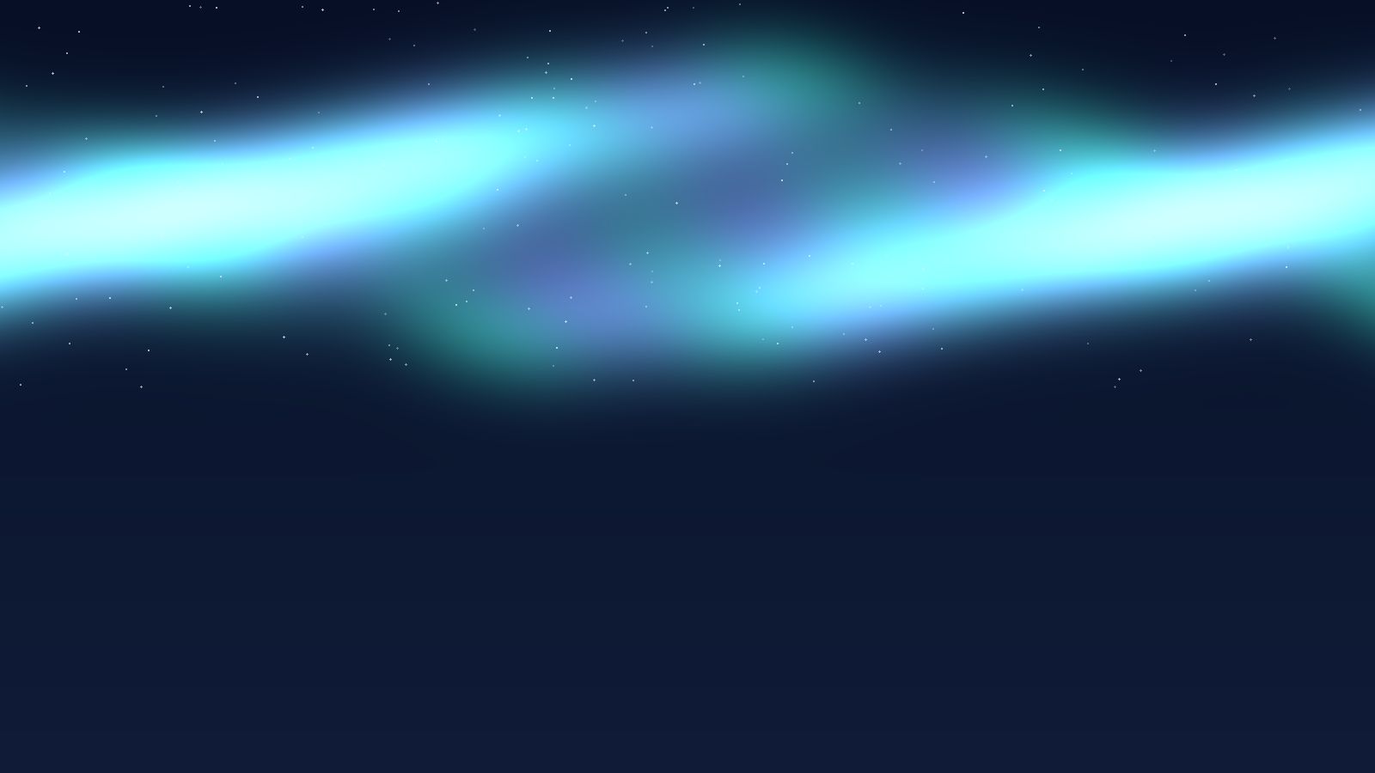


UNIVERSIDAD AUTÓNOMA DE NUEVO LEÓN
FACULTAD DE CIENCIAS FÍSICO MATEMÁTICAS
DOCTORADO EN INGENIERÍA FÍSICA
Geomagnetic Activity and Reported Aurora Sightings
2024 annual analysis • NASA DONKI support • October 2026 case study
Mohamed Ayas Mohamed Kasim
MATRICULA: 2322294
Noviembre, 2026

Slide 2
Why study geomagnetic activity and auroras?
PROJECT INTRODUCTION
THREE COMPLEMENTARY SOURCES
Space weather links disturbances in Earth’s magnetic environment with visible auroral activity.
GFZ
Planetary Kp index
We use reproducible Python processing and interactive Power BI analysis to investigate whether stronger geomagnetic activity accompanies more reported aurora sightings.
Aurorasaurus
Citizen-reported sightings
NASA DONKI
Geomagnetic storm events
Main period: January–December 2024
SCIENTIFIC COMPUTING • UANL / FCFM
02
Notes:
About 45 seconds. Explain correlation is a statistical association, not proof of causation, and that reports depend on observer coverage.

Slide 3
Theory 1 • Earth’s geomagnetic field
GEOPHYSICAL BACKGROUND
Earth’s magnetic field is generated mainly by motion of conductive fluid in the outer core.
Solar wind →
The magnetosphere interacts with the solar wind. During disturbances, energy and particles can be transferred into the near-Earth environment.
Kp is a planetary, three-hour index of geomagnetic disturbance (0–9).
Illustrative magnetosphere (not to scale)
SCIENTIFIC COMPUTING • UANL / FCFM
03
Notes:
About 55 seconds. Key concepts: geodynamo, magnetic shielding, solar wind interaction; Kp is global disturbance index rather than a direct aurora detector.

Slide 4
Theory 2 • How auroras form
01
02
03
04
Solar wind
→
Magnetic coupling
→
Atmospheric excitation
→
Visible light
Charged particles and magnetic energy reach Earth’s magnetosphere.
Energy enters the magnetosphere and drives particle acceleration.
Energetic electrons collide with oxygen and nitrogen.
Atoms and molecules emit light, forming auroral displays.
Important: a high Kp increases auroral potential but does not guarantee a sighting at a given location.
SCIENTIFIC COMPUTING • UANL / FCFM
04
Notes:
About 65 seconds. Explain green light often oxygen emissions; colors vary with altitude and emitting species. High Kp expands potential visibility, but weather, latitude, daylight and observers matter.

Slide 5
Research question, data and design
SCIENTIFIC QUESTION
Are days with higher geomagnetic Kp associated with more reported aurora sightings?
GFZ KP
AURORASAURUS
NASA DONKI
2024 · 2,928 intervals
2024 · 11,465 reports
2024 · 20 events
Three-hour activity measurements
Citizen-reported observation records
Independent storm event inventory
Daily matching for correlation; NASA storm-start dates for an independent group comparison.
SCIENTIFIC COMPUTING • UANL / FCFM
05
Notes:
About 50 seconds. Explain the daily joining logic and distinguish 20 NASA events from 97 GFZ three-hour intervals.

Slide 6
Scientific computing workflow • Python to Power BI
01
02
03
04
05
APIs & archive
→
Python
→
Validation
→
Files
→
Power BI
GFZ / NASA / Zenodo
requests + pandas
UTC, gaps, duplicates
JSON / CSV / Parquet
date model + DAX
GFZ is public; NASA DONKI uses an API key stored in an environment variable (not committed to GitHub).
SCIENTIFIC COMPUTING • UANL / FCFM
06
Notes:
About 70 seconds. Note Python scripts are reusable, date dimension avoids double counting, project uses public GFZ API and authenticated NASA DONKI with no secrets in repository.

Slide 7
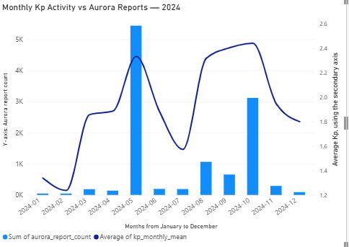
2024 annual findings • What the data show
KP OBSERVATIONS
AURORA REPORTS
MEAN KP
STORM INTERVALS
2,928
11,465
1.92
97
366 days × 8 intervals
Citizen observations
Planetary Kp index
Three-hour intervals, Kp ≥ 5
MONTHLY PATTERN
Aurora reports peak in May and rise again in October 2024.
The monthly chart is descriptive. The daily scatterplot provides the stronger association test.
SCIENTIFIC COMPUTING • UANL / FCFM
07
Notes:
About 70 seconds. Read numbers, explain month scale versus daily association. May and October stand out. Note reporting biases.

Slide 8
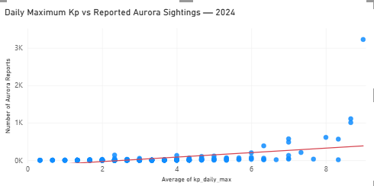
Main finding • Higher Kp, more reported auroras
DAILY CORRELATION
+0.4498
Pearson r
+0.6181
Spearman ρ
Positive association; not proof of causation.
08
SCIENTIFIC COMPUTING • UANL / FCFM
Notes:
About 80 seconds. Define axes, trend line, discuss outliers: a high count during an extreme Kp event strongly affects Pearson; Spearman complements it. Report counts reflect citizen observing, not total physical occurrences.

Slide 9
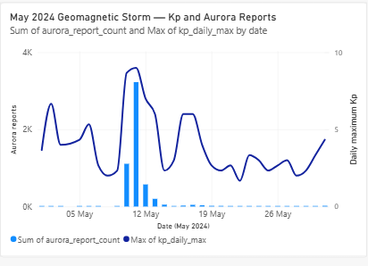
May 2024 case study • A major geomagnetic storm
EVENT-LEVEL EVIDENCE
10–11 May 2024
A pronounced Kp rise coincides with a surge in aurora reports.
Dual axes: daily Kp (line) and reported sightings (bars).
SCIENTIFIC COMPUTING • UANL / FCFM
09
Notes:
About 65 seconds. May case study shows agreement in timing; NASA satellite image can be mentioned as supplementary independent observation if available, but these bars are citizen reports, not satellite-confirmed sightings.

Slide 10
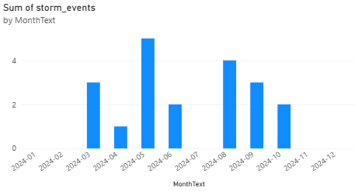
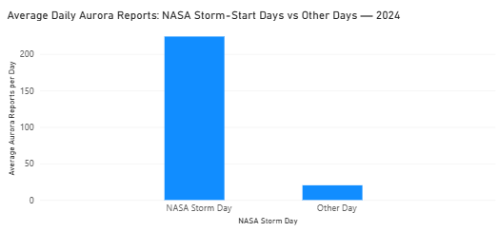
NASA DONKI • Independent storm-event support
NASA STORM EVENTS
MONTHS WITH EVENTS
MAX REPORTED KP
20
7
9.0
2024 DONKI records
Recorded in 7 months
Highest DONKI Kp
NASA storm-start days show higher average aurora report counts; event counts ≠ three-hour storm intervals.
SCIENTIFIC COMPUTING • UANL / FCFM
10
Notes:
About 70 seconds. One chart counts NASA DONKI GST event starts by month; other compares average reports per storm-start day vs other days. Mention 20 unique events, 7 months. The two sources are independently collected but use related space-weather quantities.

Slide 11
Secondary case study • October 2026
REPRODUCIBILITY ACROSS PERIODS
The same Python → Power BI approach was first applied to October 2026.
3-HOUR KP VALUES
MEAN KP
MAXIMUM KP
STORM-LEVEL INTERVALS
248
1.93
7.333
7
October 1–31, 2026
October 1–31, 2026
10 October 2026
October 1–31, 2026
October 10 was the most disturbed day in the analyzed month. This is a separate study period, not part of the 2024 correlation.
11
SCIENTIFIC COMPUTING • UANL / FCFM
Notes:
About 50 seconds. Point out that this supplementary case demonstrates pipeline transferability, and must not be combined chronologically with the 2024 aurora observations.

Slide 12
Conclusions and reproducibility
MAIN TAKEAWAYS
LIMITATIONS
01
2024 daily maximum Kp and aurora report counts show a positive association.
Citizen reporting depends on darkness, weather, geographic coverage and observer participation.
02
The May 2024 disturbance illustrates a strong event-level rise in reporting.
REPRODUCE
Python scripts + source data + Power BI + documentation
03
NASA DONKI independently documents storm-event timing; October 2026 shows workflow reuse.
github.com/mohamedayas16/
Semester_2_CS_2026
GFZ · Aurorasaurus/Zenodo · NASA DONKI
SCIENTIFIC COMPUTING • UANL / FCFM
12
Notes:
About 70 seconds. Finish with clear claim and limitations. Explain no direct causality or full visibility inference. Invite questions about data source, API key security, statistical correlation, and aggregation.

Slide 13
Thank You !
MOHAMED AYAS MOHAMED KASIM
github.com/mohamedayas16/Semester_2_CS_2026

