Slide 1
CEREBRO / SMART INTAKE + BUSINESS-AWARE AI
From rough input to a business decision
Simple input
Smart intake
Model-ready data
Decision output
Four AI microservices with extraction, validation, model selection, and explainable outputs.

Slide 2
THE PLATFORM
Cerebro is a decision-support workflow
The user sees a clear business task. Technical details remain available when needed.
01
02
03
04
Simple input
Smart intake
Validated model
Business output
Paste a brief, posting, facts, or upload history
Extract facts, normalize values, flag missing information
Use the compatible model or statistical method
Explain the signal, assumptions, and next action
Ports preserved: gateway 8900 · fraud 8901 · hiring 8902 · demand 8903 · product 8904 · frontend 8905

Slide 3
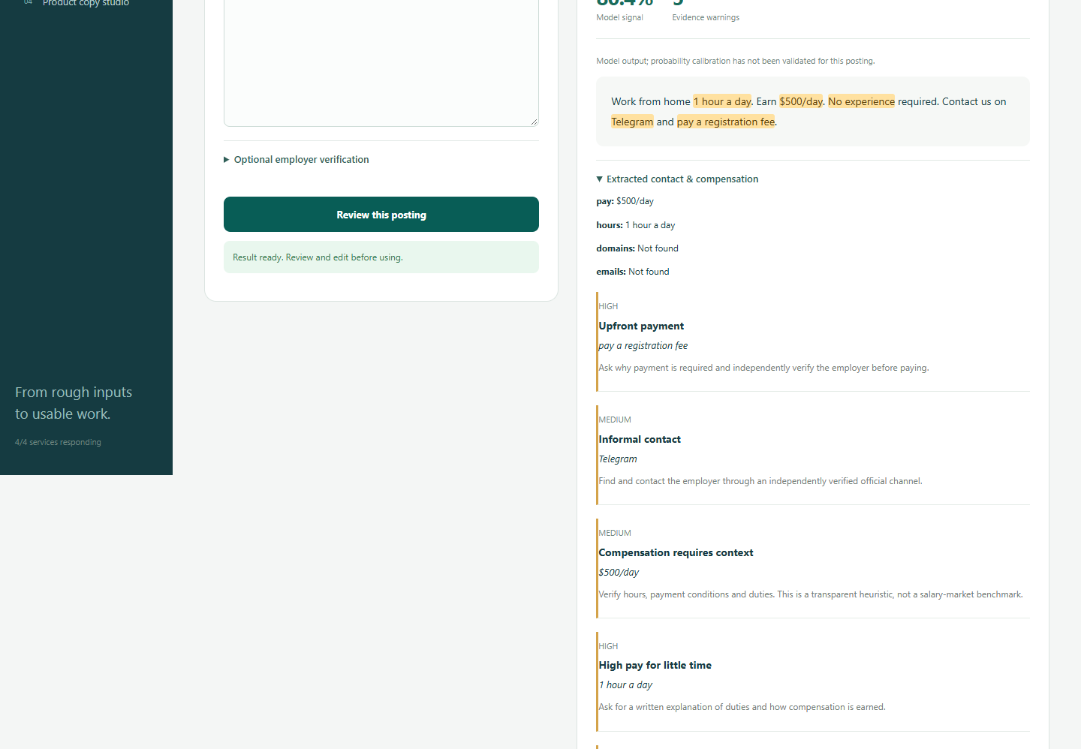
FRAUD REVIEW
A job warning with evidence, not a verdict
The workflow combines the saved classifier with deterministic combination rules and verification actions.
What changed
• Paste one posting
• Extract pay, contact, domains, and requests
• Highlight exact evidence
• Separate model signal from advisory level
• Recommend independent verification
No rule match never lowers the model signal.

Slide 4
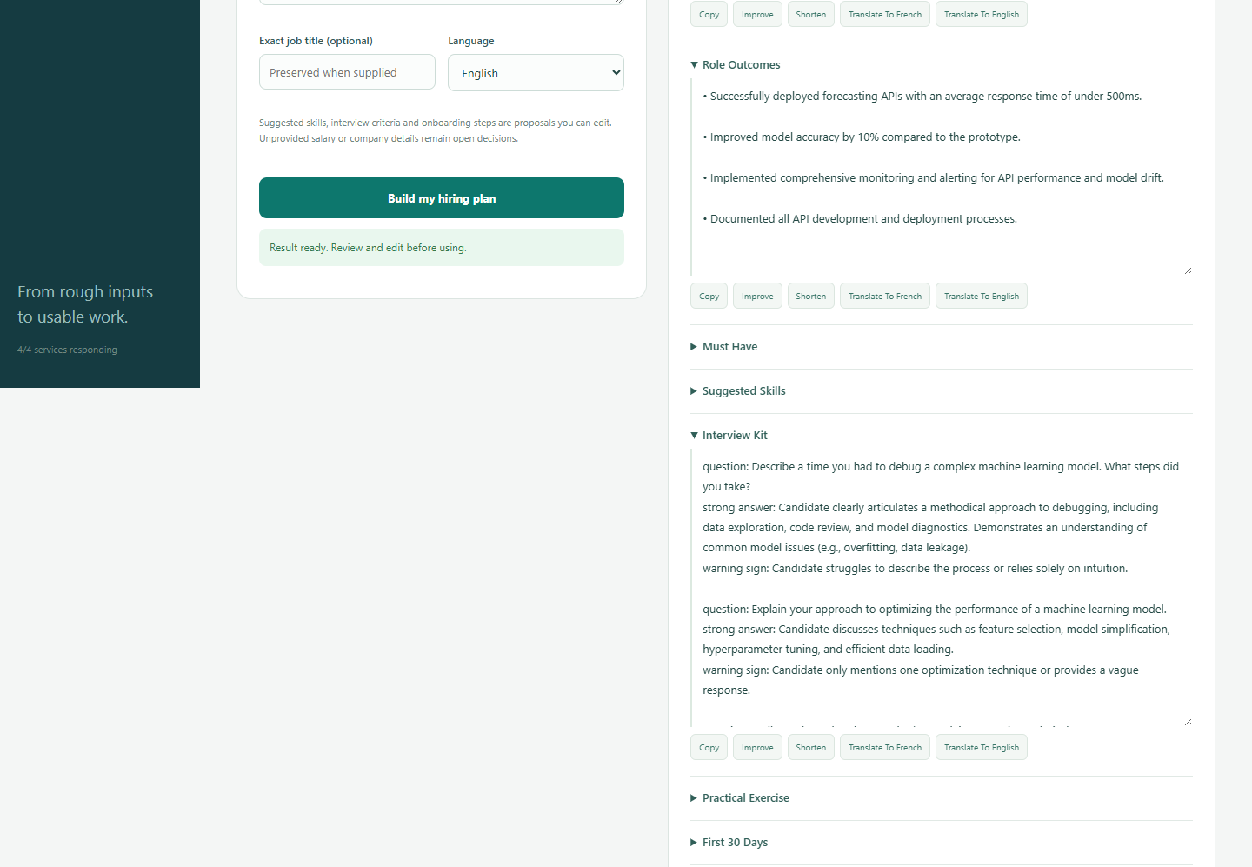
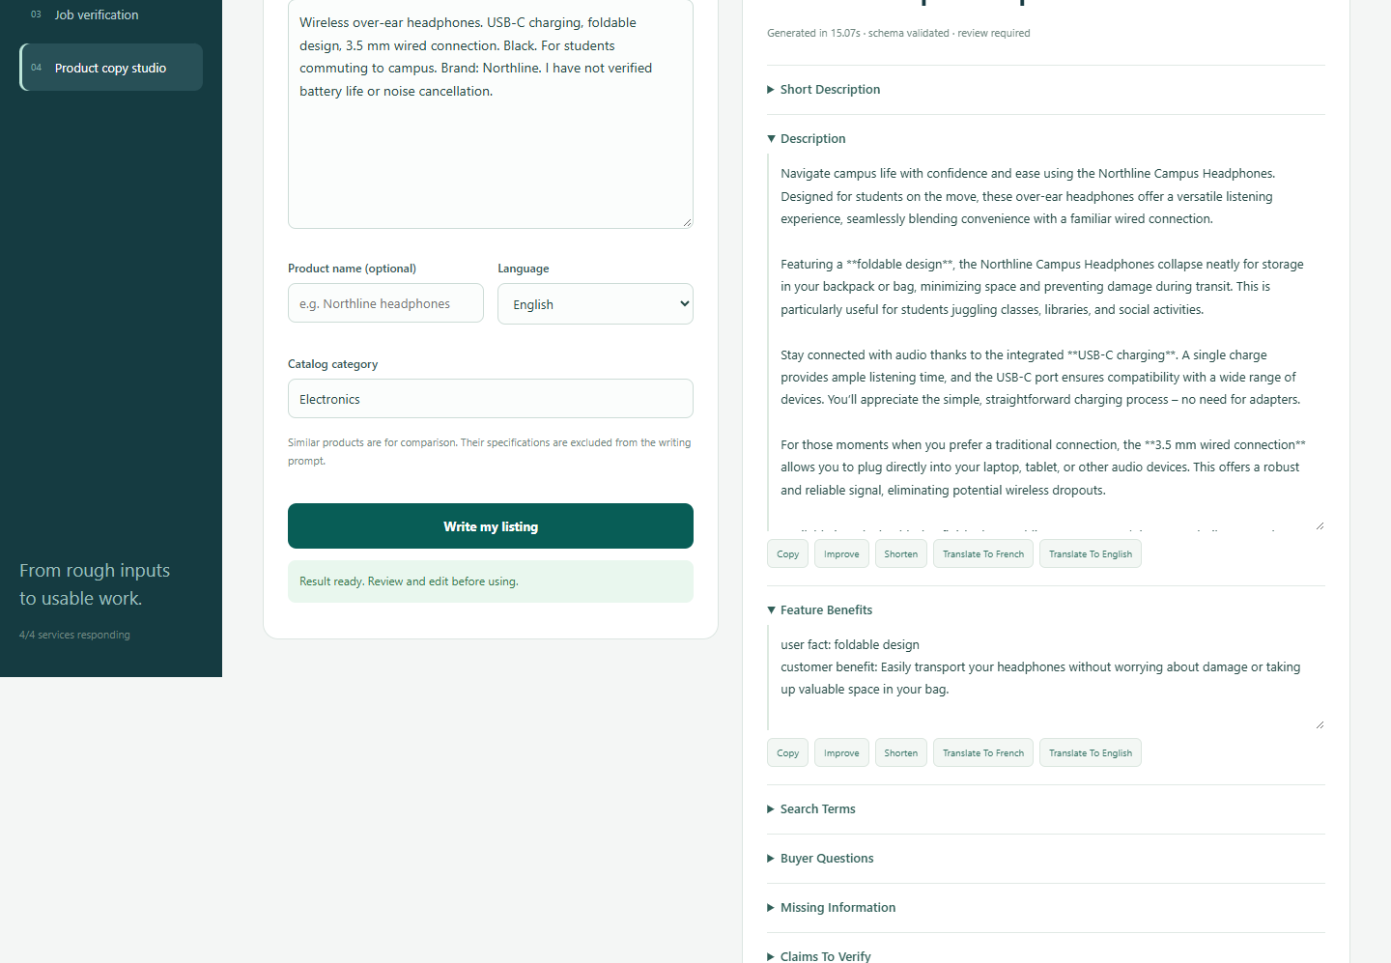
HIRING + PRODUCT
Generation starts from facts
Gemma 3 4B adds structure and useful recommendations while preserving supplied facts.
Rough brief → outcomes, interview kit, exercise, onboarding, and publishable copy
Verified facts → benefits, buyer questions, missing information, and grounded references

Slide 5
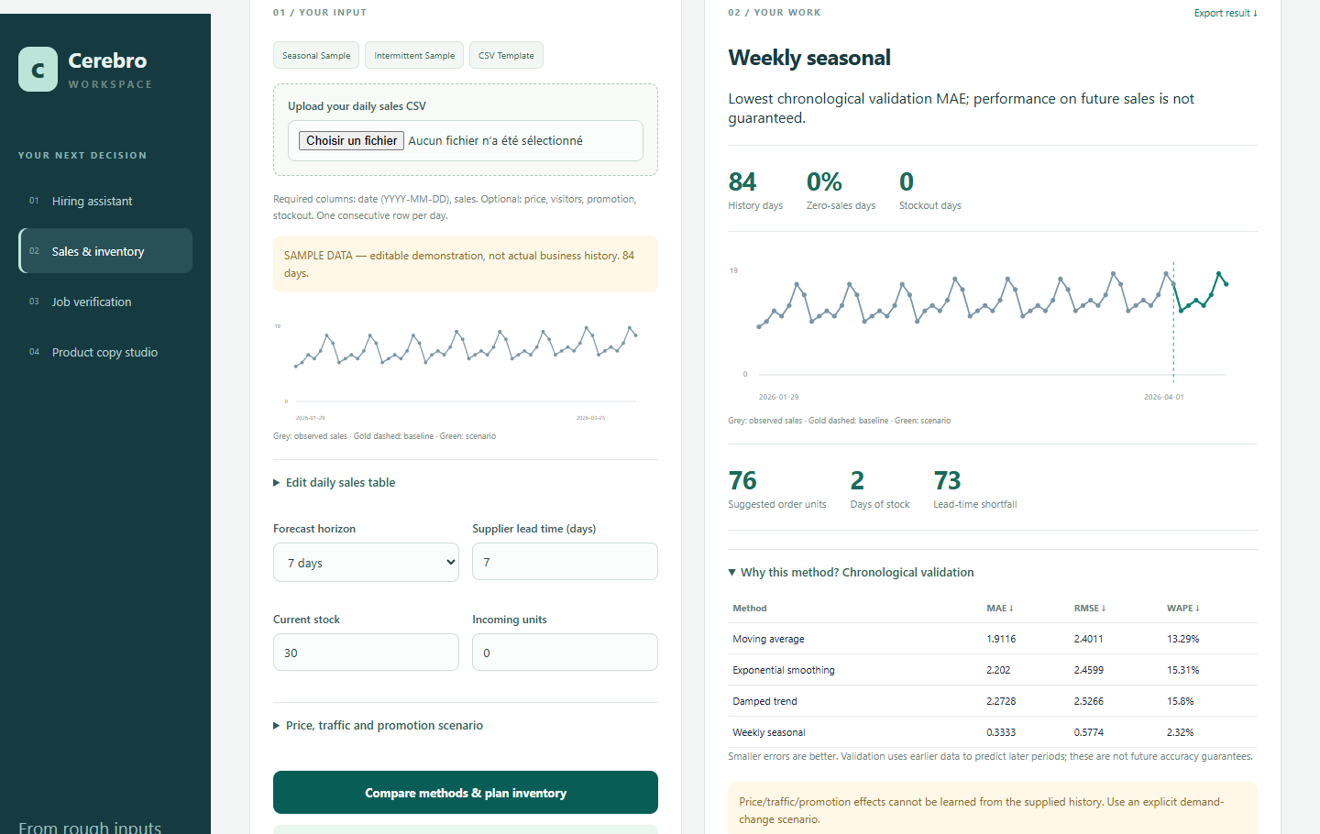
DEMAND FORECASTING
A product-aware inventory decision
User histories use compatible statistical methods. M5 series keep the validated M5 model. No-history products receive scenario planning, not fake forecasts.
Output
Named product
Data readiness
Chronological validation
Method comparison
Lead-time demand
Safety stock assumptions
Recommended order
Stockout warnings

Slide 6
BEFORE / AFTER
The upgrade changes what the user can trust
The platform now exposes the preparation and assumptions needed for responsible decisions.
BEFORE
AFTER
Raw sales rows
Generic forecast
Random catalog similarity
One fraud score
Job-description paraphrase
Named product and history
Readiness and validation
Catalog abstention
Evidence and next checks
Complete hiring package
The platform supports a decision while showing what it knows, what it assumes, and what remains missing.

