Slide 1
Module 4: Introducing Forecasting
AWS Academy Machine Learning Foundations
Notes:
Welcome to Module 4: Introduction to Forecasting.

Slide 2

Module overview
Sections
Forecasting overview
Processing time series data
Using Amazon SageMaker Canvas to create a forecast model
Module wrap-up
Simulation
Creating a Forecast Model with Amazon SageMaker Canvas
Knowledge check
Notes:
This module includes the following sections:
Forecasting overview
Processing time series data
Using Amazon SageMaker Canvas to create a forecast model
Module wrap-up
The module also includes a simulation where you will learn how to use Amazon SageMaker Canvas to work with time series data.
Finally, you will be asked to complete a knowledge check that will test your understanding of key concepts covered in this module.

Slide 3
Module objectives
At the end of this module, you should be able to:
Describe the business problems solved by using machine learning forecasting.
Describe the challenges of working with time series data.
List the steps that are required to generate a forecast by using Amazon SageMaker Canvas.
Use Amazon SageMaker Canvas to make an in-app prediction.
Notes:
After completing this module, you should be able to do the following:
Describe the business problems solved by using machine learning forecasting.
Describe the challenges of working with time series data.
List the steps that are required to generate a forecast by using Amazon SageMaker Canvas.
Use Amazon SageMaker Canvas to make an in-app prediction.

Slide 4
Section 1: Forecasting overview
Module 4: Introducing Forecasting
Notes:
Introducing Section 1: Forecasting overview.
You start with a review of what forecasting means and learn about some use cases for forecasting.

Slide 5
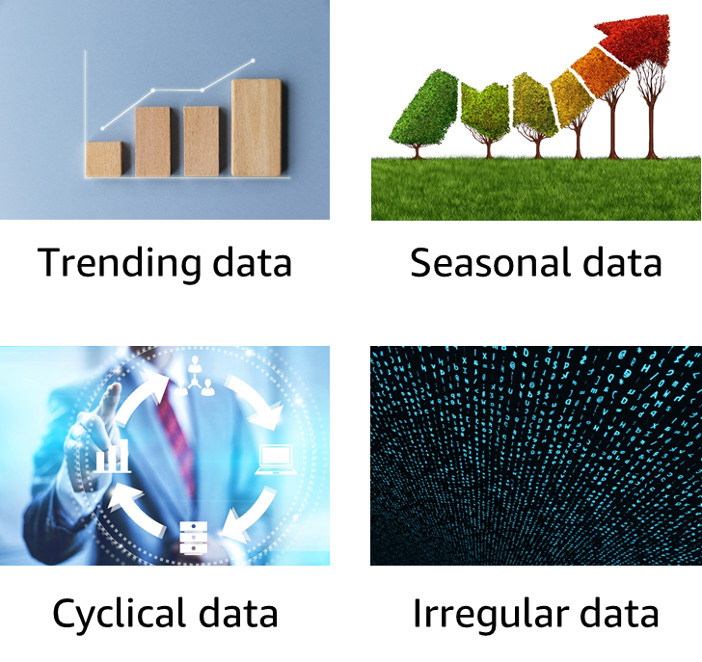
Overview of forecasting
Predicting future values that are based on historical data
Can be either univariate or multivariate
Common patterns –
Trends: Patterns that increase, decrease, or are stagnant
Seasonal: Pattern that is based on seasons
Cyclical: Other repeating patterns
Irregular: Patterns that might appear to be random
Notes:
Forecasting is an important area of machine learning. It is important because so many opportunities for predicting future outcomes are based on historical data. Many of these opportunities involve a time component. Although the time component adds more information, it also makes time series problems more difficult to handle than other types of predictions.
You can think of time series data as falling into two broad categories. The first type is univariate, which means that it has only one variable. The second type is multivariate, which means that it has more than one variable. In addition to these two categories, most time series datasets also follow one of the following patterns:
Trend – A pattern that shows the values as they increase, decrease, or stay the same over time
Seasonal – A repeating pattern that is based on the seasons in a year
Cyclical – Some other form of a repeating pattern
Irregular – Changes in the data over time that appear to be random or that have no discernable pattern

Slide 6


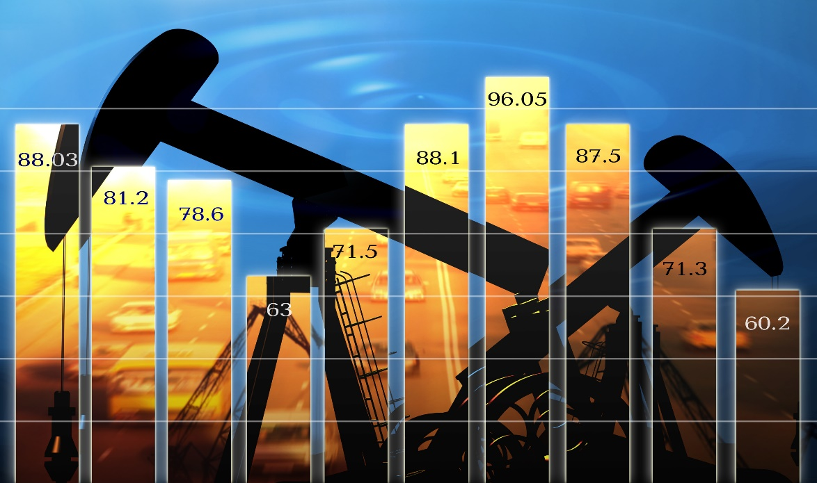

Forecasting use cases
Sales and demand forecasts
Inventory projections
Energy consumption
Weather forecasts
Notes:
You can use forecasting for a range of domains. Some of the more common applications include:
Marketing applications, such as sales forecasting or demand projections.
Inventory management systems to anticipate required inventory levels. Often, this type of forecast includes information about delivery times.
Energy consumption to determine when and where energy is needed.
Weather forecasting systems for governments, and commercial applications such as agriculture.

Slide 7
Section 2: Processing time series data
Module 4: Introducing Forecasting
Notes:
Introducing Section 2: Processing time series data.
Working with time series data presents several unique challenges, which you will now review.

Slide 8
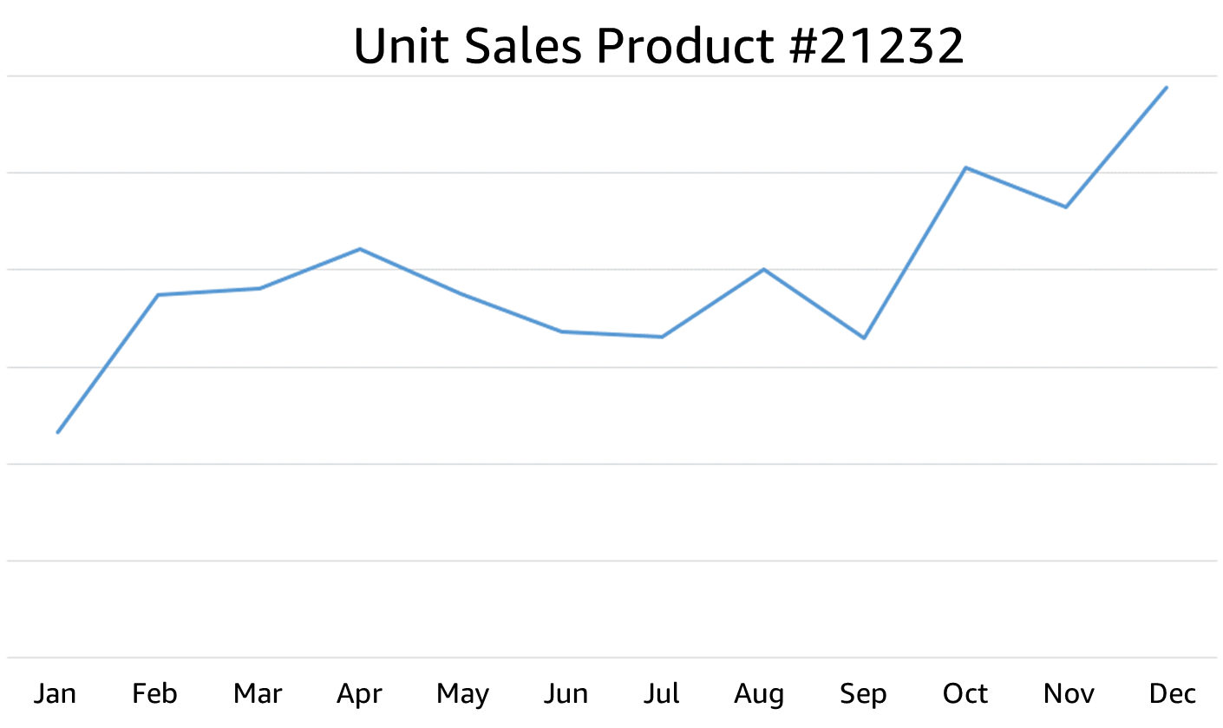
Time series data
Time series data
is captured in
sequence over time
Related data informs the time series data—for example, price or promotions
Metadata might also be needed to explain predictions—for example, brand name or category
Notes:
Time series data is captured in chronological sequence over a defined period of time. Introducing time into a machine learning model has a positive impact because the model can derive meaning from change in the data points over time. Time series data tends to be correlated, which means that a dependency exists between data points.
Because you have a regression problem—and because regression assumes independence of data points—you must develop a method for handling data dependence. The purpose of this method is to increase the validity of the predictions.
In addition to the time series data, you can add related data to augment a forecasting model. For example, for a prediction about retail sales, you might include information about the product being sold (such as item identification or sales price). This information is in addition to the number of units that are sold per time period.
The third type of data is metadata about the dataset. For example, for a retail dataset, you might want to include metadata to group results, like a brand name. Another example of metadata could be including a genre for music or videos.

Slide 9
Time and date challenges
Incomplete and varying timestamps
yyyy-mm-dd HH:MM:SS
Includes time
yyyy-dd-mm
Year, day, month
yyyy-mm-dd
Year, month, day
yyyy-mm
No day
ss:s
Seconds
mm-dd
No year
UTC, local, and time zones:
Is the time in UTC format?
2020-06-02T13:15:30Z
Notes:
The more data that you have, the better. A challenge that you can expect with multiple data sources is the timestamp of the data. You find differences in the timestamp format, along with other challenges, such as incomplete data. You might be able to infer missing data in some cases. For example, imagine that you have some data that contains both the month and the day, but no year. Suppose that the data appears to sequence through the month numbers in the database, and repeats after 12. In that case, you can add the year if you know when the data started. You can infer future years, based on the order of the data.
Much data is stored in Universal Coordinated Time (UTC) format, but not all data is in UTC. You should check whether the timestamp is local or universal time. With ML in general, it is good practice to standardize timestamps to UTC for consistency across time zones.
Sometimes the timestamp doesn’t represent the time that you think it does. For example, suppose you have a database of cars that were serviced at a garage. Does the timestamp indicate the time that the car arrived, was completed, or was picked up? Or does it indicate when the final entry was entered into the system?
If you try to model hourly caloric intake of patients, but you have only daily data, then you must adjust your target timescale.
You might not have a timestamp present in your data. You might have other ways to extrapolate a time series, depending on the data and domain. For example, you might have wavelength measurements or vectors in an image.
Daylight savings time is different around the world. Because of daylight savings, some times occur twice a year in their time zones.

Slide 10
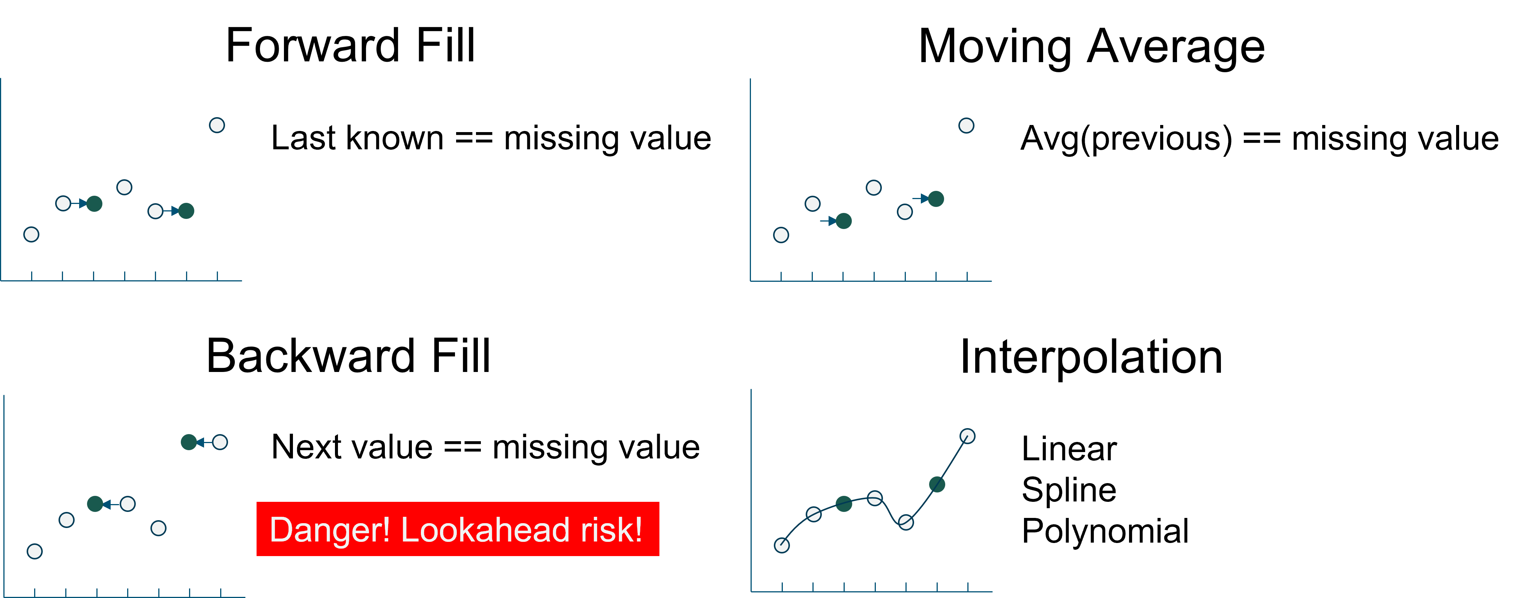
Time series handling: Missing data
Note: Zero is sometimes the perfect fill value
Notes:
A common occurrence in real-world forecasting problems is missing values in the raw data. Missing values makes it harder for a model to generate a forecast. The primary example in retail is an out-of-stock situation in demand forecasting. If an item goes out of stock, the sales for the day will zero. If the forecast is generated based on those zero sales values, the forecast will be incorrect.
Missing values can be marked as missing for various reasons. Missing values can occur because of no transaction, or possibly because of measurement errors. Maybe a service that monitored certain data was not working correctly, or the measurement could not occur correctly.
The missing data can be calculated in several ways:
Forward fill – Uses the last known value for the missing value.
Moving average – Uses the average of the last known values to calculate the missing value.
Backward fill – Uses the next known value after the missing value. Be aware that it is a potential danger to use the future to calculate the past, which is bad in forecasting. This practice is known as lookahead, and it should be avoided.
Interpolation – Essentially uses an equation to calculate the missing value.
You also have the choice to use a zero fill. This choice is often used in retail, a domain where missing sales data shouldn’t be calculated. The missing data represents no orders on that day. It would be wise to investigate why, but you don’t want to fill in the missing value in this case.

Slide 11
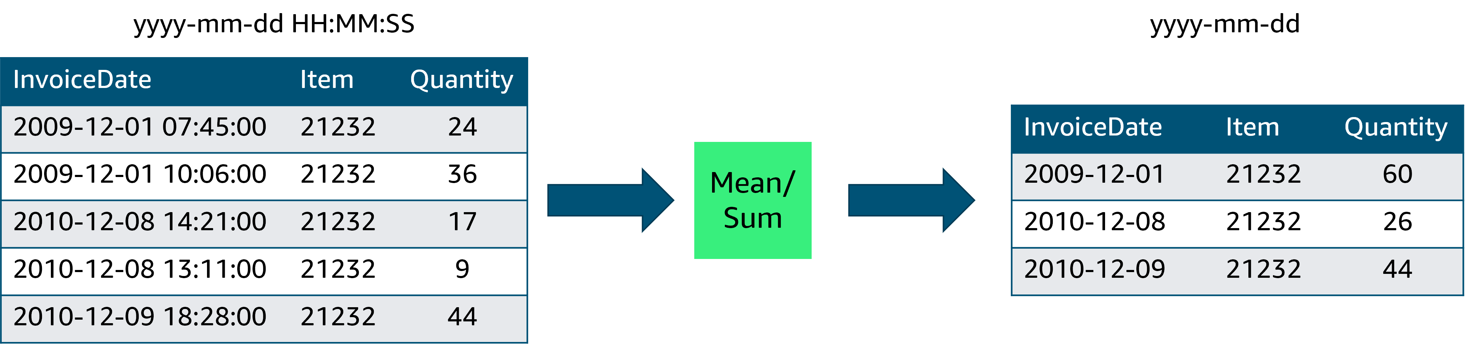
Time series handling: Downsampling
Notes:
You might obtain data at different frequencies. For example, you might have sales data that includes the exact timestamp that the sale was recorded. However, the inventory data might contain only the year, month, and day of the inventory level. When you have data that is at a different frequency than other datasets, or isn’t compatible with your question, you might need to downsample.
Downsample means moving from a more finely grained time to a less finely grained time. This example converts an hourly dataset to a daily dataset.
When you downsample, you must decide how to combine the values. In the case of sales data, summing the quantity makes the most sense. If the data is temperature, you might want to find the average. Understanding your data helps you decide what the best course of action is.

Slide 12
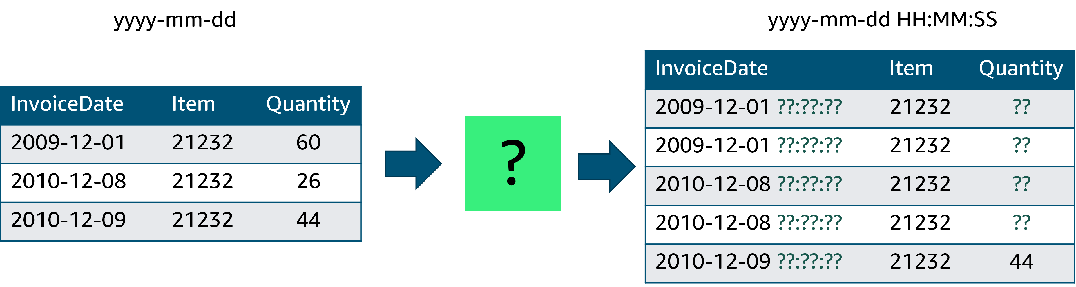
Time series handling: Upsampling
Reasons to upsample:
Match different time series
Irregular time series
Knowledge of domain
Notes:
The inverse of downsampling is upsampling. The problem with upsampling is that it’s difficult to achieve in most cases. Suppose that you wanted to upsample your sales data from daily sales to hourly sales. Unless you have some other data source to reference, you wouldn’t be able to change from daily to hourly sales. In some cases, you must use additional data or knowledge. For example, if you must match the frequency of another time series, you might have an irregular time series or specific domain knowledge that could help. In those cases, you must be careful of how you convert the data. For the retail example, the best that you can do is create a single order for the day at a specified hour. For temperature, you can copy the daily temperature into each of the hourly slots, or use some formula to calculate a curve.

Slide 13
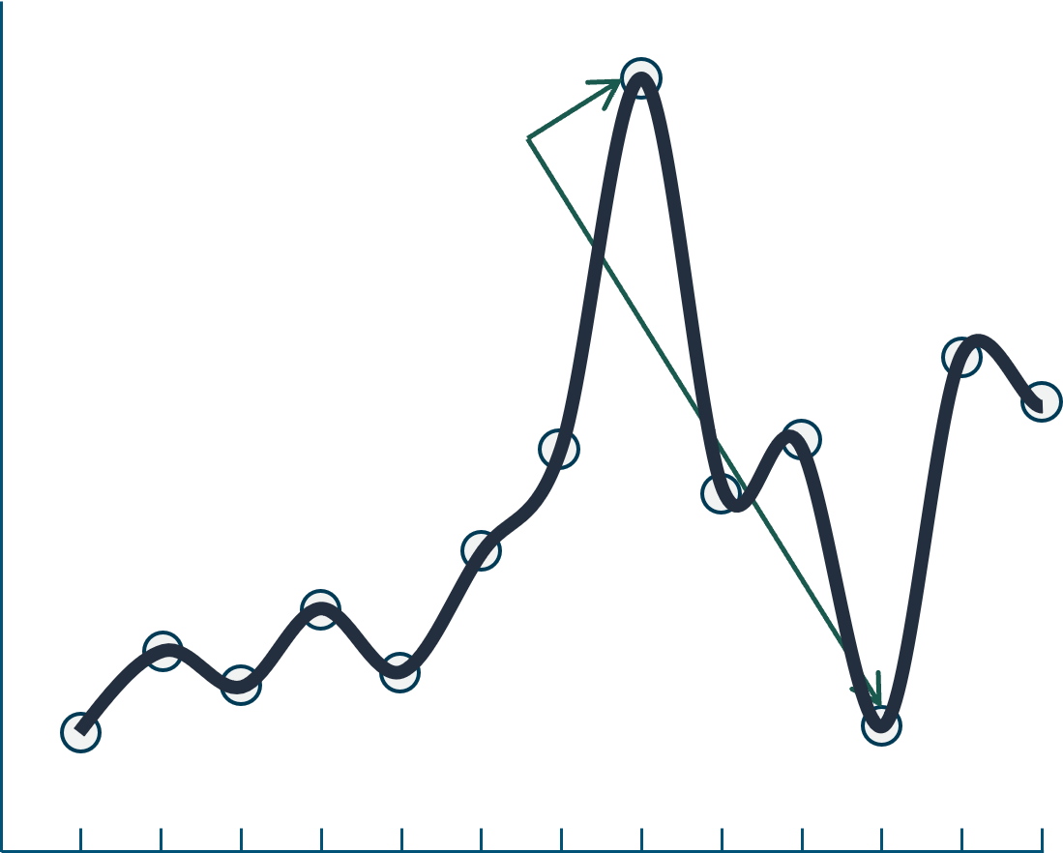
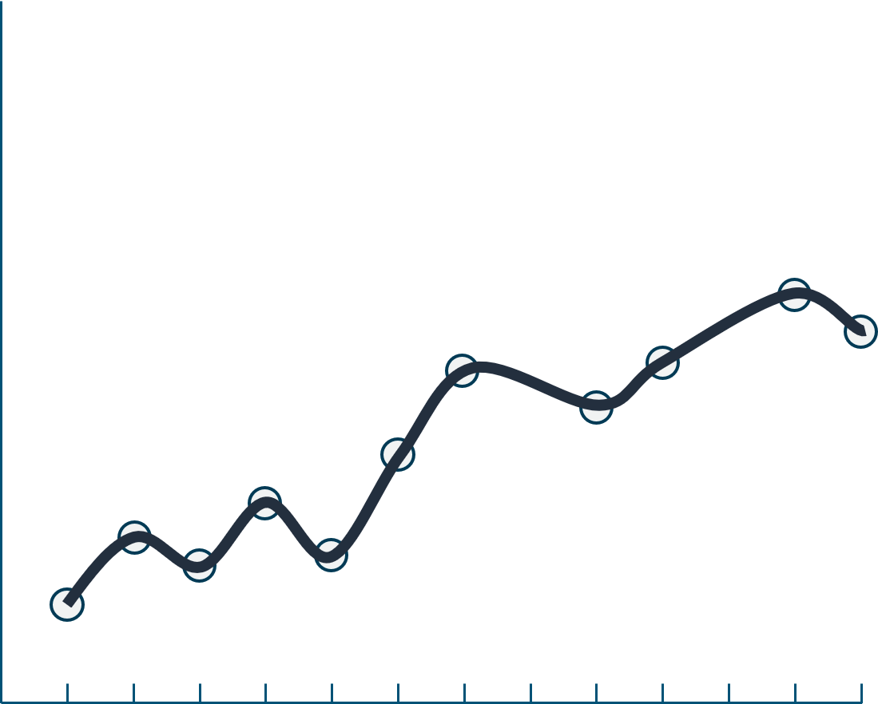
Time series handling: Smoothing data
outliers
Smoothing function
Why are you smoothing?
Data preparation
Visualization
How does smoothing affect your outcome?
Cleaner data to model
Model compatibility
Production improvements
Notes:
Outliers can be a problem in data science. The same is true of time series data.
If you examine sales data and you see an order with an unusually large quantity of items, you might not want to include that order in your forecast calculations. The order size might never be repeated. Removing these outliers and anomalies is known as smoothing.
Smoothing your data can help you deal with outliers and other anomalies. You might consider smoothing for the following reasons.
Data preparation – Removing error values and outliers
Visualization – Reducing noise in a plot
Understand why you are smoothing the data and the impact that it might have. You might want the outcome to be reduced noise and to create a better model. However, it’s equally important to consider these questions: Could your smoothing compromise the model? Does the model expect noisy data? Can you also smooth the data in production?

Slide 14
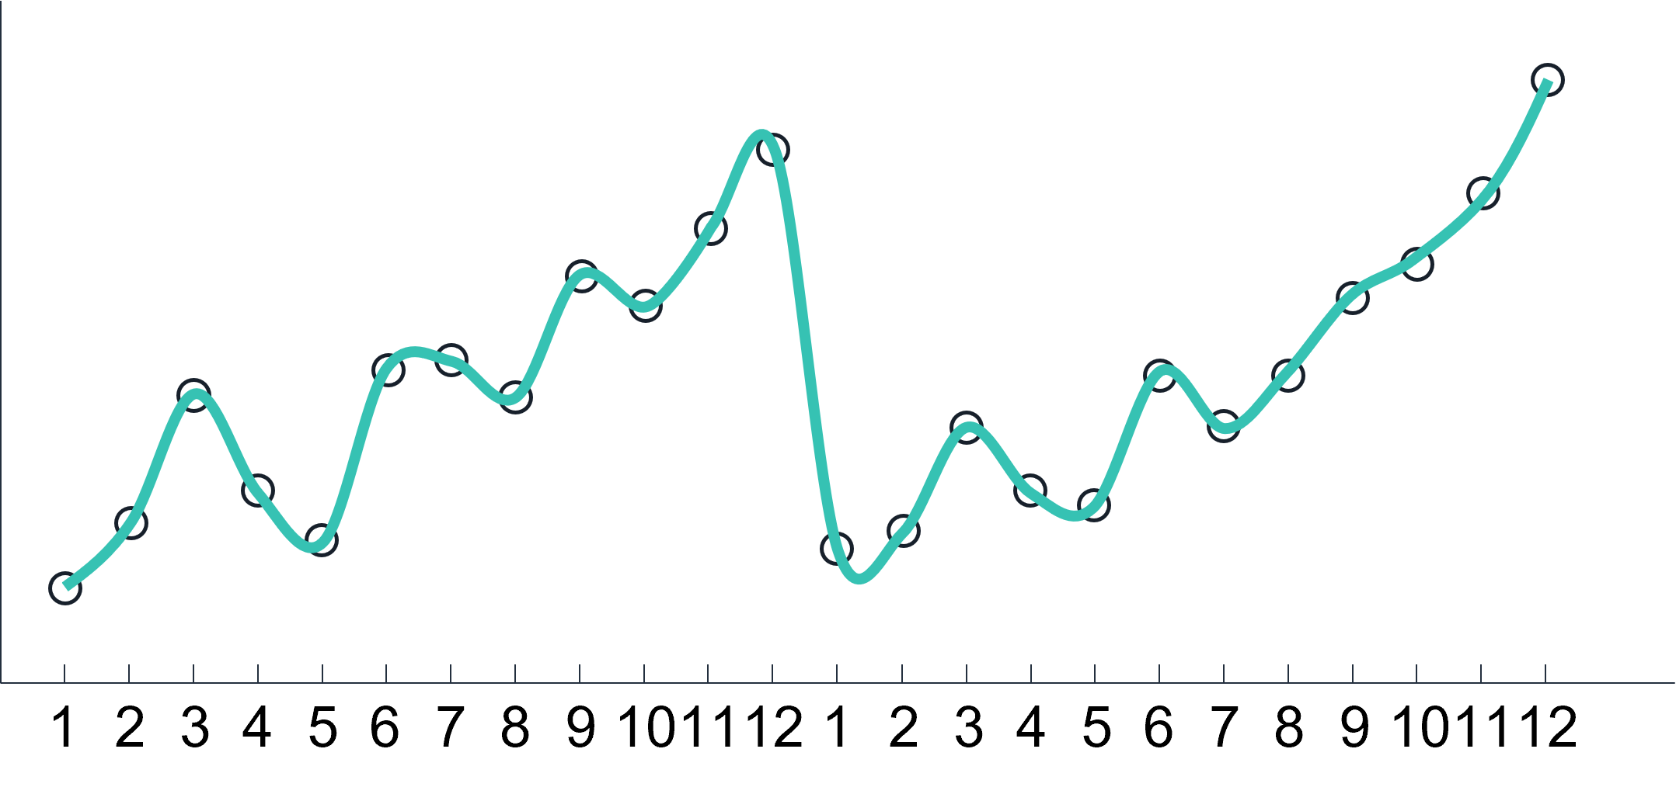
Seasonality
Seasonality frequency
Hourly, daily, quarterly, yearly
Spring, summer, fall, winter
Major holiday sales, winter holiday season
Incorporating holidays
Notes:
Seasonality in data is any kind of repeating observation where the frequency of the observation is stable. For example, in sales you typically see higher sales at the end of a quarter, and into Q4. Consumer retail exhibits this pattern even more in Q4. Be aware that data can have multiple types of seasonality in the same dataset.
Many times, you might want to incorporate seasonality information into your forecast. Localized holidays are a good example for sales.

Slide 15
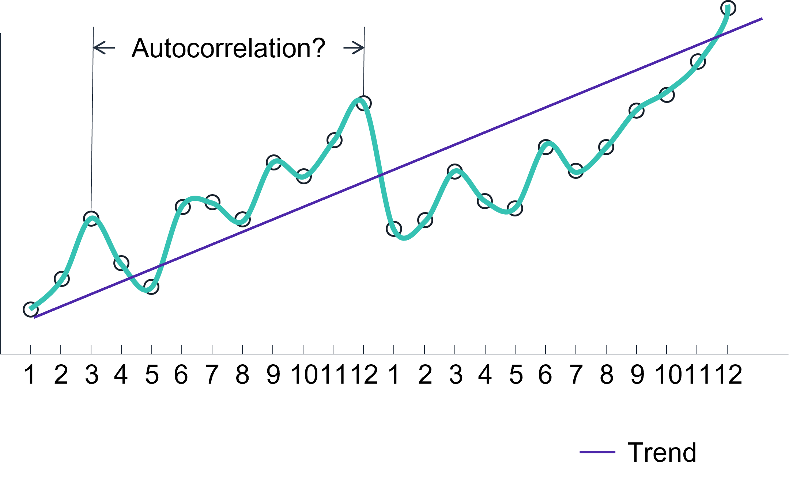
Stationarity, trends, and autocorrelation
Stationarity
How stable is the system?
Does the past inform the future?
Trends
Correlation issues
Autocorrelation
How points in time are linearly related
Influences algorithm choice
Notes:
It is important to know how stable a system is. The level of stability, or stationarity, can tell you how much you should expect the system’s past behavior to inform future behavior. A system with low stability is not good for predicting the future. A stationary time series has constant statistical properties over time, which is important for forecasting.
Often, you will want to determine the trend for a time series. However, adjusting the series for the trend can make it difficult to compare the series with another series that was also adjusted for trend. The trends might dominate the values in the series, which can lead you to overestimate of the correlation between the two series. This phenomenon was shown in the previous topic.
Autocorrelation is one of the special problems that you face with time series data. As you saw in other machine learning problems, the goal of building an ML model is to separate the signal from the noise. Autocorrelation is a form of noise because separate observations are not independent of each other.
A time series with autocorrelation might overstate the accuracy of the model that is produced. Some of the algorithms that you see in this module can help correct for autocorrelation.
Correlations do not mean causation.
Be careful when you interpret your own data, and be cautious about correlations—you don’t want to act on correlations that have no real-world meaning. As an experiment, say that you generate two random time series datasets of numbers between 0 and 1. You will find that they have low correlation. However, if you introduce the same slope to both sets of data, you will see a strong correlation.
These factors, along with seasonality, can influence the model that you select to produce your forecast. Some algorithms handle seasonality and autocorrelation, but others do not.

Slide 16
Using pandas for time series data
Time-aware index
dataframe['2010-01-04’]
dataframe['2010-02':'2010-03’]
dataframe['weekday_name'] = dataframe.index.weekday_name
GroupBy and resampling operations
dataframe.groupby('StockCode')
dataframe.groupby('StockCode').resample('D').sum()
Autocorrelation
dataframe['Quantity'].autocorr()
Notes:
The pandas library was developed with financial data analysis in mind. As such, it is good at handling time series data.
You can set the index of your pandas DataFrame to be a datetime, which gives you the ability to use the date and time to select your data. You can use ranges that contain partial dates. You can also extract date parts, such as year, month, weekday_name, and more.
For grouping and resampling tasks, pandas has built-in functions to do both.
Finally, pandas can give you insights into autocorrelation.
For more information about pandas and time series data, see “Time Series/Date Functionality” in the pandas documentation at https://pandas.pydata.org/pandas-docs/stable/user_guide/timeseries.html.

Slide 17
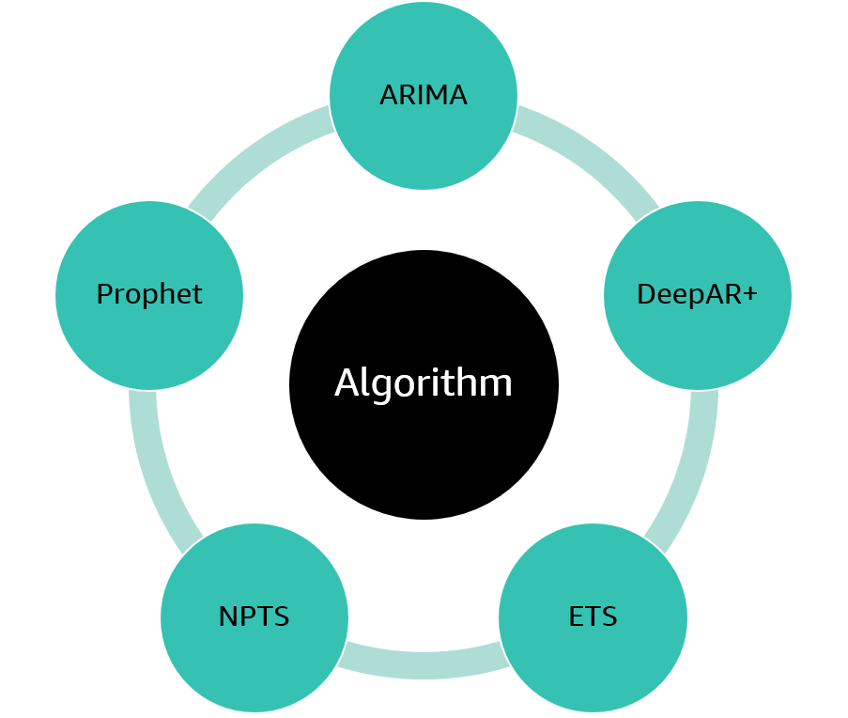
Time series algorithms
Autoregressive Integrated Moving Average (ARIMA)
DeepAR+
Exponential Smoothing (ETS)
Non-Parametric Time Series (NPTS)
Prophet
Notes:
One of the tasks in building a forecasting application is to choose an appropriate algorithm. The type of dataset that you are using and the features of that dataset should determine your choice of algorithm.

Slide 18

Section 2 key takeaways
Time series data is sequenced
Time challenges –
Different formats
Missing data
Seasonality
Correlations
The pandas library offers support for time series data
Notes:
Some key takeaways from this section of the module include:
Time series data is sequenced data that includes a time element, which makes it different from regular datasets
Some of the time challenges include –
Handling different time formats
Handling missing data through down sampling, up sampling and smoothing
Handling seasonality, such as weekdays and yearly cycles
Avoiding bad correlations
The pandas library offers support for time series data through functions that deal with time

Slide 19
Section 3: Using Amazon SageMaker Canvas to create a forecast model
Module 4: Introducing Forecasting
Notes:
Introducing Section 3: Using Amazon SageMaker Canvas to create a forecast model

Slide 20





Amazon SageMaker Canvas
A no-code visual interface for building ML models
Create and import SageMaker Canvas datasets
Prepare data with Amazon SageMaker Data Wrangler
Choose ready-to-use models or build custom models
Deploy models and integrate with ML operations
SageMaker Canvas features
Notes:
If you have ML users who want to create ML models but have limited coding and cloud infrastructure provisioning experience, you can use Amazon SageMaker Canvas. It contains ready-to-use models that you can immediately use to make predictions. Alternatively, you can build your own custom ML model or chat with popular large language models.
SageMaker Canvas gives you the ability to train and deploy custom ML models and generate predictions without the need to write any code. It is a managed service that provisions needed AWS resources on your behalf. SageMaker Canvas contains several features to assist your ML workflow, such as importing and preparing datasets, training ML models, and deploying ML models to make predictions.
You can import and create SageMaker Canvas datasets. For custom models, you can create datasets for tabular and image data. For ready-to-use models, you can use tabular and image datasets as well as document datasets.
If you're importing datasets larger than 5 GB or you need advanced transformations, use Amazon SageMaker Data Wrangler. With SageMaker Data Wrangler in SageMaker Canvas, you can create a data flow and use various data preparation techniques, such as applying advanced transforms or joining datasets. You can import data into SageMaker Canvas from the following data sources depending on the type of model you want to build.
Local files on your computer
Amazon Simple Storage Service (Amazon S3) buckets
Amazon Redshift provisioned clusters (not Amazon Redshift Serverless)
AWS Glue Data Catalog through Amazon Athena
Amazon Aurora
Amazon Relational Database Service (Amazon RDS)
Salesforce Data Cloud
Snowflake
Databricks, SQLServer, MariaDB, and other databases that use Java Database Connectivity (JDBC) connectors
More than 40 external software as a service (SaaS) platforms, such as SAP OData
From within SageMaker Canvas, you can choose a ready-to-use model or use the My Models option to train a custom model for your imported dataset. When you build your own model, SageMaker Canvas uses the information in the dataset to build up to 250 models and chooses the one that performs the best.
The ML Operations feature provides model deployment capability and helps you to integrate your model with the machine learning operations (MLOps) processes in your organization.

Slide 21
SageMaker Canvas custom model types
What is the predicted price of a 2000 square foot house?
Yes or no?
Is the user a platinum, gold, or silver user?
Numeric prediction
Categorical prediction
(Two categories)
Categorical prediction
(Three or more categories)
Will the company be able to fulfill shoe orders next quarter?
Is this image an eggplant, a tomato, or a zucchini?
Is this text positive, neutral, or negative?
Time series forecasting
Image prediction
Text prediction
Notes:
When you begin building a model, SageMaker Canvas automatically recommends one or more model types depending on the data in your dataset. Model types fall into one of the following categories.
Numeric prediction is known as regression in machine learning. Use the numeric prediction model type when you want to make predictions for numeric data. For example, you might want to predict the price of houses based on features such as the house’s square footage.
Categorical prediction is known as classification in machine learning. The classification known as two category prediction (also known as binary classification in machine learning) is used when you have two categories that you want to predict for your data. For example, you might want to determine whether a customer is likely to churn or not.
Three plus category prediction (also known as multi-class classification in machine learning) is used when you have three or more categories that you want to predict for your data. For example, you might want to predict a customer's loan status based on features such as previous payments or if a customer will fall into a specific user category.
Time series forecasting should be used when you want to make predictions over a period of time. For example, you might want to predict the number of items you’ll sell in the next quarter.
Image prediction (also known as single-label image classification in machine learning), should be used when you want to assign labels to images. For example, you might want to classify different types of manufacturing defects in images of your product or classify images of vegetables.
Text prediction (also known as multi-class text classification in machine learning) should be used when you want to assign labels to passages of text. For example, you might have a dataset of customer reviews for a product, and you want to determine whether customers liked or disliked the product. You might have your model predict whether a given passage of text is positive, negative, or neutral.
In this section, you will learn how to use SageMaker Canvas to create a time series forecasting ML model without having to write any code or provision your own resource environments.

Slide 22
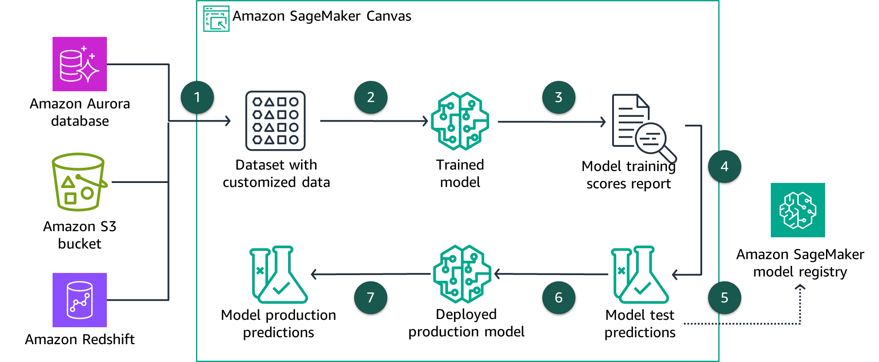
Building a custom forecasting model
Notes:
If you want a model that is customized to your use case and trained with your data, you can create a new model. By training a custom model on your data, you are able to capture characteristics and trends that are specific and most representative of your data. For example, you might want to create a custom time series forecasting model that you train on inventory data from your warehouse to manage your logistics operations.
You can get predictions customized to your data by implementing the following steps:
Import customized data from your data sources. Example data sources include Amazon Aurora, Amazon S3, and Amazon Redshift. You can optionally clean, format, and merge data from different data sources if required. To make a time series forecast, your dataset must have a timestamp column, a target column that has the values that you are using to forecast future values, and an item ID column that contains unique identifiers for each item in your dataset.
Build a predictive model by training the model on the customized data. You can choose to do a quick build or a standard build. A quick build will usually take 2–15 minutes and is reasonably accurate. Alternatively, a standard build duration takes 2–4 hours but is the most accurate of the two options.
Evaluate the model’s training performance and accuracy scores supplied by SageMaker Canvas. For example, for tabular time series models, you can evaluate scores such as Average Weighted Quantile Loss, Mean Absolute Percent Error, Weighted Absolute Percent Error, Root Mean Square Error, and Mean Absolute Scaled Error.
If you are satisfied with the model’s scores, you can test the model by making batch or single predictions on a deployed test version of the model.
When you are satisfied with the prediction tests, you can optionally register the model. A new version of the model will be available in Amazon SageMaker model registry.
Your model is now ready for use by applications, and you can deploy the model to a production environment to provide forecast predictions. The deployment configuration requires the model version, a deployment name, and the type and number of Amazon Elastic Compute Cloud (Amazon EC2) instances to use. The deployed model will have a URL to invoke the model for a prediction.
You can also use SageMaker Canvas to test single predictions on your production model. This can provide you with latency and prediction results to help ensure your model is working well.
This process can be automated with Amazon SageMaker Canvas automations.

Slide 23
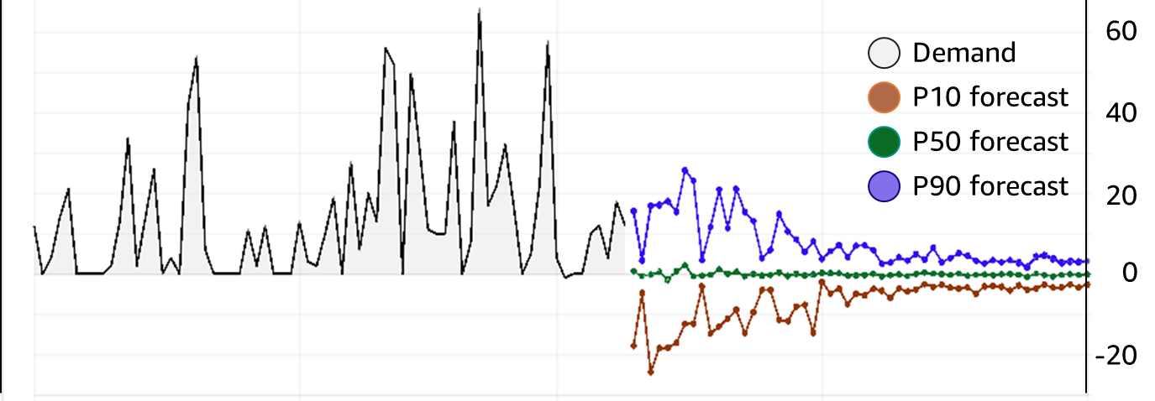
Model evaluation metric: wQL
Quantiles are determined for 10, 50, and 90 percent quantiles.
wQL is the average error for each quantile in a set.
wQL works best for models with greater variability in the errors.
Notes:
Average Weighted Quantile Loss (wQL) evaluates the forecast as a whole by averaging the accuracy at specific distribution points called quantiles for P10, P50, and P90 quantiles. A lower value indicates a more accurate model. When Amazon SageMaker Canvas creates a forecast, it provides probabilistic predictions at three distinct quantiles: 10 percent, 50 percent, and 90 percent. These prediction quantiles show you how much uncertainty is associated with each forecast.
A P10 quantile predicts that, 10 percent of the time, the true value will be less than the predicted value. For example, suppose that you are a retailer. You want to forecast product demand for winter gloves that sell well only during the fall and winter. Say that you don’t have sufficient storage space and the cost of invested capital is high or that the price of being overstocked on winter gloves concerns you. Then, you might use the P10 quantile to order a relatively low number of winter gloves. You know that the P10 forecast overestimates the demand for your winter gloves only 10 percent of the time, so you will be sold out of your winter gloves 90 percent of the time.
A P50 quantile predicts that 50 percent of the time, the true value will be less than the predicted value. Continuing the winter gloves example, say you know that there will be a moderate amount of demand for the gloves, and you aren’t concerned about being overstocked. Then, you might choose to use the P50 quantile to order gloves.
A P90 quantile predicts that 90 percent of the time, the true value will be less than the predicted value. Suppose you determine that being understocked on gloves will result in large amounts of lost revenue: for example, the cost of not selling gloves is extremely high or the cost of invested capital is low. In this case, you might choose to use the P90 quantile to order gloves.

Slide 24

Model forecasting example
A web retailer of shoes wants to predict how often it will be unable to fill orders for AnyCompany brand shoes.
SageMaker Canvas predicts a demand of 1,000 pairs per month:
P10: Ten percent of the time, fewer than 880 pairs will be ordered.
P50: Fifty percent of the time, fewer than 1,050 pairs will be ordered.
P90: Ninety percent of the time, fewer than 1,200 pairs will be ordered.
Notes:
This example shows how a web retailer might use the accuracy metrics to evaluate a forecast. The retailer wants to predict the demand for sales of a particular brand of shoes. They input the sales records for this brand into SageMaker Canvas to create a prediction.
The prediction provides a forecasted demand of 1,000 pairs with the P10, P50, and P90 values. The wQuantileLoss values indicate that 10 percent of the time (P10), fewer than 880 pairs will be sold. Next, 50 percent of the time (P50), fewer than 1,050 pairs will be sold. Finally, 90 percent of the time (P90), fewer than 1,200 pairs will be sold. The retailer can then use these values to determine which level of inventory to hold. The determination is based on their assessment of the risk that they can’t fulfill orders or that they have excess inventory.

Slide 25
Model evaluation metric: RMSE
Root mean square error (RMSE) is the root square of prediction errors.
The RMSE is the difference between the actual target value and the predicted value.
Test | Actual Result | Prediction | Difference | Difference Squared
1 | 2 | 4 | 2 | 4
2 | 4 | 8 | 4 | 16
3 | 8 | 13 | 5 | 25
4 | 5 | 9 | 4 | 16
RMSE = root (( sum of squared differences) / number of predictions)
= root ((4 + 16 + 25 + 16) / 4)
= root (61 / 4) = root (15.25 ) = 3.905
Notes:
The Root Mean Square Error (RMSE) is another method for evaluating the reliability of your forecasts. Like wQuantileLoss, RMSE calculates how far off the forecasted values were from the actual test data.
The RMSE finds the difference between the actual target value in the dataset and the forecasted value for that time period, and it then squares the differences. The example shows how to calculate RMSE. The RMSE value represents the standard deviation of the prediction errors. This test is good for forecast validity when the errors are mostly of the same size (that is, there aren’t many outliers). Lower RMSE metrics indicate that the model’s forecasts are more reliable.

Slide 26
Other evaluation metrics for forecasting models
MAPE
WAPE
MASE
Column impact
Notes:
In addition to RMSE and wQL, SageMaker Canvas provides three more evaluation metrics. You can also view the column impact that your input data makes on the predictions.
Mean Absolute Percent Error (MAPE) is the percentage error (percent difference of the mean forecasted and actual value) averaged over all time points. A lower value indicates a more accurate model with MAPE equals zero as a perfect model with no errors.
Weighted Absolute Percent Error (WAPE) measures the overall deviation of forecasted values from observed values and is defined by the sum of the absolute error normalized by the sum of the absolute target. A lower value indicates a more accurate model with MAPE equals zero as a perfect model with no errors.
Mean Absolute Scaled Error (MASE) is the mean of the absolute error of the forecast normalized by the mean absolute error of a simple baseline forecasting method. A lower value indicates a more accurate model with MASE less than one as a model estimated to be better than the baseline. On the other hand, a MASE of greater than one as a model is estimated to be worse than the baseline.
Column impact helps you better understand how the attributes in your dataset impact the forecasts for specific time series. SageMaker Canvas quantifies the relative impact of each attribute to determine whether they increase or decrease the model's forecast. Column impact can be compared on a relative scale where a larger value has a larger impact on the forecast.

Slide 27
Python example of invoking a time series model
import boto3
import pandas as pd
csv_path = './real-time-payload.csv'
data = pd.read_csv(csv_path)
client = boto3.client("runtime.sagemaker")
body = data.to_csv(index=False).encode("utf-8")
response = client.invoke_endpoint(
EndpointName = "endpoint_name",
ContentType = "text/csv",
Body=body,
Accept = "application/json"
)
Notes:
You can use your SageMaker Canvas models that you've deployed to a SageMaker endpoint in production with your applications. To get a forecast, invoke the endpoint programmatically by calling the runtime SageMaker client.invoke_endpoint function with the endpoint name and data to make the prediction.

Slide 28



Additional options for forecasting insights
Group column
Holiday schedule
What-if scenario
Group the forecast by each value in the column.
Add holiday schedules to improve sales forecasting.
Change values in the data to see how it affects the forecast.
Notes:
SageMaker Canvas provides you the capability to refine your forecasting insights with group columns, holiday schedules, or what-if scenarios.
You can specify a column in your dataset as a Group column. SageMaker Canvas groups the forecast by each value in the column. For example, you can group the forecast on columns containing price data or unique item identifiers. By grouping a forecast by a column, you can make more specific forecasts. For example, if you group a forecast on a column containing item identifiers, you can see the forecast for each item.
Holidays might impact the overall sales of items. For example, in the US, the number of items sold in both November and December might differ greatly from the number of items sold in January. If you use the data from November and December to forecast the sales in January, your results might be inaccurate. Using a holiday schedule prevents you from getting inaccurate results. You can use a holiday schedule for 251 countries.
For a forecast on a single item in your dataset, you can use what-if scenarios. A what-if scenario gives you the ability to change values in your data and change the forecast. For example, you can answer the following questions by using a what-if scenario: What if I lowered prices? How would that affect the number of items sold?

Slide 29
Updating your model
First build
Version 1
Second build
Version 2
Third build
Version 3
Notes:
In SageMaker Canvas, you can update the models that you’ve built by adding model versions.
Each model that you build has a version number. The first model is version 1 or V1. You can use model versions to see changes in prediction accuracy when you update your data or choose a different build type.
When viewing your model, SageMaker Canvas shows you the model history so that you can compare all of the model versions that you built. You can also delete versions that are no longer useful to you. By creating multiple model versions and evaluating their accuracy, you can iteratively improve your model performance.
Before you can add a new version, you must successfully build at least one model version. To add a model version, you can either clone an existing version or create a new version.
For example, if you build a model successfully for the first time by using the quick build option, the version number would be version 1. If you then choose the standard build option, SageMaker clones your model, and the new version would be version 2.

Slide 30
Section 3 key takeaways
Amazon SageMaker Canvas is a no-code visual interface for building ML models.
SageMaker Canvas provides ready-to-use models and the capability to build your own customized models, such as forecasting models.
SageMaker Canvas provides evaluation metrics to evaluate your built model.
You can test your model in SageMaker Canvas test and production environments managed on your behalf.
SageMaker Canvas provides you the capability to refine your forecasting insights with group columns, holiday schedules, or what-if scenarios.
Invoke your production model by deploying it to an Amazon SageMaker endpoint.

Slide 31


Module 4 – Simulation: Creating a Forecast with Amazon SageMaker Canvas
Notes:
You will now complete the module 4 simulation: Creating a Forecast with Amazon SageMaker Canvas.

Slide 32
Module wrap-up
Module 4: Introducing Forecasting
Notes:
It’s now time to review the module and wrap up with a knowledge check.

Slide 33
Module summary
In summary, in this module you learned how to:
Describe the business problems solved by using machine learning forecasting.
Describe the challenges of working with time series data.
List the steps that are required to generate a forecast by using Amazon SageMaker Canvas.
Use Amazon SageMaker Canvas to make an in-app prediction.

Slide 34
Complete the knowledge check
Notes:
It is now time to complete the knowledge check for this module.

Slide 35
Additional resources
Amazon SageMaker Canvas documentation
Amazon SageMaker Canvas product page
Notes:
If you want to learn more about the topics that are covered in this module, you might find the following additional resources helpful:
For Amazon SageMaker Canvas documentation, see “SageMaker Canvas” in the SageMaker Developer Guide at https://docs.aws.amazon.com/sagemaker/latest/dg/canvas.html.
For the Amazon SageMaker Canvas product page, see “Amazon SageMaker Canvas” at https://aws.amazon.com/sagemaker/canvas/.

Slide 36
Thank you
Corrections, feedback, or other questions?
Contact us at https://support.aws.amazon.com/#/contacts/aws-academy.
Notes:
Thank you for completing this module.

Slide 37
Image source files for development use only.

Slide 38




Overview of forecasting
Predicting future values that are based on historical data
Can be either univariate or multivariate
Common patterns –
Trends: Patterns that increase, decrease, or are stagnant
Seasonal: Pattern that is based on seasons
Cyclical: Other repeating patterns
Irregular: Patterns that might appear to be random
Trending data
Seasonal data
Cyclical data
Irregular data
Notes:
Forecasting is an important area of machine learning. It is important because so many opportunities for predicting future outcomes are based on historical data. Many of these opportunities involve a time component. Although the time component adds more information, it also makes time series problems more difficult to handle than other types of predictions.
You can think of time series data as falling into two broad categories. The first type is univariate, which means that it has only one variable. The second type is multivariate, which means that it has more than one variable. In addition to these two categories, most time series datasets also follow one of the following patterns:
Trend – A pattern that shows the values as they increase, decrease, or stay the same over time
Seasonal – A repeating pattern that is based on the seasons in a year
Cyclical – Some other form of a repeating pattern
Irregular – Changes in the data over time that appear to be random or that have no discernable pattern

Slide 39
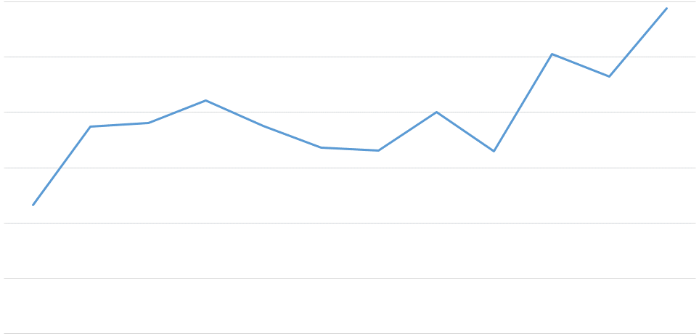
Time series data
Unit Sales Product #21232
Time series data
is captured in
sequence over time
Related data informs the time series data—for example, price or promotions
Metadata might also be needed to explain predictions—for example, brand name or category
Jan
Feb
Mar
Apr
May
Jun
Jul
Aug
Sep
Oct
Nov
Dec
Notes:
Time series data is captured in chronological sequence over a defined period of time. Introducing time into a machine learning model has a positive impact because the model can derive meaning from change in the data points over time. Time series data tends to be correlated, which means that a dependency exists between data points.
Because you have a regression problem—and because regression assumes independence of data points—you must develop a method for handling data dependence. The purpose of this method is to increase the validity of the predictions.
In addition to the time series data, you can add related data to augment a forecasting model. For example, for a prediction about retail sales, you might include information about the product being sold (such as item identification or sales price). This information is in addition to the number of units that are sold per time period.
The third type of data is metadata about the dataset. For example, for a retail dataset, you might want to include metadata to group results, like a brand name. Another example of metadata could be including a genre for music or videos.

Slide 40
Time series handling: Missing data
Forward Fill
Moving Average
Last known == missing value
Avg(previous) == missing value
Backward Fill
Interpolation
Next value == missing value
Linear
Spline
Polynomial
Danger! Lookahead risk!
Note: Zero is sometimes the perfect fill value
Notes:
~alt text/group3: Plots for the different fill techniques. More details in notes.
A common occurrence in real-world forecasting problems is missing values in the raw data. Missing values makes it harder for a model to generate a forecast. The primary example in retail is an out-of-stock situation in demand forecasting. If an item goes out of stock, the sales for the day will zero. If the forecast is generated based on those zero sales values, the forecast will be incorrect.
Missing values can be marked as missing for various reasons. Missing values can occur because of no transaction, or possibly because of measurement errors. Maybe a service that monitored certain data was not working correctly, or the measurement could not occur correctly.
The missing data can be calculated in several ways:
Forward fill – Uses the last known value for the missing value.
Moving average – Uses the average of the last known values to calculate the missing value.
Backward fill – Uses the next known value after the missing value. Be aware that it is a potential danger to use the future to calculate the past, which is bad in forecasting. This practice is known as lookahead, and it should be avoided.
Interpolation – Essentially uses an equation to calculate the missing value.
You also have the choice to use a zero fill. This choice is often used in retail, a domain where missing sales data shouldn’t be calculated. The missing data represents no orders on that day. It would be wise to investigate why, but you don’t want to fill in the missing value in this case.

Slide 41
Time series handling: Downsampling
yyyy-mm-dd HH:MM:SS
yyyy-mm-dd
InvoiceDate | Item | Quantity
2009-12-01 07:45:00 | 21232 | 24
2009-12-01 10:06:00 | 21232 | 36
2010-12-08 14:21:00 | 21232 | 17
2010-12-08 13:11:00 | 21232 | 9
2010-12-09 18:28:00 | 21232 | 44
InvoiceDate | Item | Quantity
2009-12-01 | 21232 | 60
2010-12-08 | 21232 | 26
2010-12-09 | 21232 | 44
Mean/
Sum
Notes:
~alt text/full image/can’t be grouped: [please provide alt text; and long description in notes if necessary]
You might obtain data at different frequencies. For example, you might have sales data that includes the exact timestamp that the sale was recorded. However, the inventory data might contain only the year, month, and day of the inventory level. When you have data that is at a different frequency than other datasets, or isn’t compatible with your question, you might need to downsample.
Downsample means moving from a more finely grained time to a less finely grained time. This example converts an hourly dataset to a daily dataset.
When you downsample, you must decide how to combine the values. In the case of sales data, summing the quantity makes the most sense. If the data is temperature, you might want to find the average. Understanding your data helps you decide what the best course of action is.

Slide 42
Time series handling: Upsampling
yyyy-mm-dd
yyyy-mm-dd HH:MM:SS
InvoiceDate | Item | Quantity
2009-12-01 ??:??:?? | 21232 | ??
2009-12-01 ??:??:?? | 21232 | ??
2010-12-08 ??:??:?? | 21232 | ??
2010-12-08 ??:??:?? | 21232 | ??
2010-12-09 ??:??:?? | 21232 | 44
InvoiceDate | Item | Quantity
2009-12-01 | 21232 | 60
2010-12-08 | 21232 | 26
2010-12-09 | 21232 | 44
?
Reasons to upsample:
Match different time series
Irregular time series
Knowledge of domain
Notes:
~alt text/full image/can’t be grouped: [please provide alt text; and long description in notes if necessary]
The inverse of downsampling is upsampling. The problem with upsampling is that it’s difficult to achieve in most cases. Suppose that you wanted to upsample your sales data from daily sales to hourly sales. Unless you have some other data source to reference, you wouldn’t be able to change from daily to hourly sales. In some cases, you must use additional data or knowledge. For example, if you must match the frequency of another time series, you might have an irregular time series or specific domain knowledge that could help. In those cases, you must be careful of how you convert the data. For the retail example, the best that you can do is create a single order for the day at a specified hour. For temperature, you can copy the daily temperature into each of the hourly slots, or use some formula to calculate a curve.

Slide 43
Time series handling: Smoothing data
outliers
Smoothing function
Why are you smoothing?
Data preparation
Visualization
How does smoothing affect your outcome?
Cleaner data to model
Model compatibility
Production improvements
Notes:
~alt text/group3: Line plot with outliers.
~alt text/group5: Line plot after smoothing function applied.
Outliers can be a problem in data science. The same is true of time series data.
If you examine sales data and you see an order with an unusually large quantity of items, you might not want to include that order in your forecast calculations. The order size might never be repeated. Removing these outliers and anomalies is known as smoothing.
Smoothing your data can help you deal with outliers and other anomalies. You might consider smoothing for the following reasons.
Data preparation – Removing error values and outliers
Visualization – Reducing noise in a plot
Understand why you are smoothing the data and the impact that it might have. You might want the outcome to be reduced noise and to create a better model. However, it’s equally important to consider these questions: Could your smoothing compromise the model? Does the model expect noisy data? Can you also smooth the data in production?

Slide 44
Seasonality
Seasonality frequency
Hourly, daily, quarterly, yearly
Spring, summer, fall, winter
Major holiday sales, winter holiday season
Incorporating holidays
1
2
3
4
5
6
7
8
9
10
11
12
1
2
3
4
5
6
7
8
9
10
11
12
Notes:
~alt text/group89: Line plot for 24 values that rise and fall along the y axis.
Seasonality in data is any kind of repeating observation where the frequency of the observation is stable. For example, in sales you typically see higher sales at the end of a quarter, and into Q4. Consumer retail exhibits this pattern even more in Q4. Be aware that data can have multiple types of seasonality in the same dataset.
Many times, you might want to incorporate seasonality information into your forecast. Localized holidays are a good example for sales.

Slide 45
Stationarity, trends, and autocorrelation
Stationarity
How stable is the system?
Does the past inform the future?
Trends
Correlation issues
Autocorrelation
How points in time are linearly related
Influences algorithm choice
Autocorrelation?
1
2
3
4
5
6
7
8
9
10
11
12
1
2
3
4
5
6
7
8
9
10
11
12
Trend
Notes:
~alt text/group7: Graph showing increasing trend over 2 years of unlabeled data.
It is important to know how stable a system is. The level of stability, or stationarity, can tell you how much you should expect the system’s past behavior to inform future behavior. A system with low stability is not good for predicting the future.
Often, you will want to determine the trend for a time series. However, adjusting the series for the trend can make it difficult to compare the series with another series that was also adjusted for trend. The trends might dominate the values in the series, which can lead you to overestimate of the correlation between the two series. This phenomenon was shown in the previous topic. For a detailed explanation of reasons for this occurrence, see “Avoiding Commons Mistakes with Time Series Analysis” at https://www.svds.com/tbt-avoiding-common-mistakes-time-series-analysis/.
Autocorrelation is one of the special problems that you face with time series data. As you saw in other machine learning problems, the goal of building an ML model is to separate the signal from the noise. Autocorrelation is a form of noise because separate observations are not independent of each other.
A time series with autocorrelation might overstate the accuracy of the model that is produced. Some of the algorithms that you see in this module can help correct for autocorrelation.
These factors, along with seasonality, can influence the model that you select to produce your forecast. Some algorithms handle seasonality and autocorrelation, but others do not.

Slide 46
Time series algorithms
Autoregressive Integrated Moving Average (ARIMA)
DeepAR+
Exponential Smoothing (ETS)
Non-Parametric Time Series (NPTS)
Prophet
Algorithm
ARIMA
DeepAR+
ETS
NPTS
Prophet
Notes:
One of the tasks in building a forecasting application is to choose an appropriate algorithm. The type of dataset that you are using and the features of that dataset should determine your choice of algorithm.
Amazon Forecast supports these five algorithms.
Autoregressive Integrated Moving Average (ARIMA) – This algorithm removes autocorrelations, which might influence the pattern of observations.
DeepAR+ – A supervised learning algorithm for forecasting one-dimensional time series. It uses a recurrent neural network to train a model over multiple time series.
Exponential Smoothing (ETS): This algorithm is useful for datasets with seasonality. It uses a weighted average for all observations. The weights are decreased over time.
Non-Parametric Time Series (NPTS) – Predictions are based on sampling from past observations. Specialized versions are available for seasonal and climatological datasets.
Prophet – A Bayesian time series model. It’s useful for datasets that span a long time period, have missing data, or have large outliers.

Slide 47
Amazon Forecast workflow
Deploy model
New data, retraining
Business problem
Generate forecasts
Problem formulation
Tune model
Yes
Meets business goal?
Collect and label data
Evaluate data
Feature engineering
Select and train model
Evaluate model
No
Import, evaluate, and clean your data
Train a predictor
Notes:
~alt text/group4: Amazon Forecast flowchart. Sections described in notes.
When you generate forecasts, you can apply the machine learning development pipeline that you use throughout this course.
Import your data – You must import as much data as you have—both historical data and related data. You should do some basic evaluation and feature engineering before you use the data to train a model.
Train a predictor – To train a predictor, you must choose an algorithm. If you are not sure which algorithm is best for your data, you can let Amazon Forecast choose by selecting AutoML as your algorithm. You also must select a domain for your data, but if you’re not sure which domain fits best, you can select a custom domain. Domains have specific types of data that they require. For more information, see Predefined Dataset Domains and Dataset Types in the Amazon Forecast documentation.
Generate forecasts – As soon as you have a trained model, you can use the model to make a forecast by using an input dataset group. After you generate a forecast, you can query the forecast, or you can export it to an Amazon Simple Storage Service (Amazon S3) bucket. You also have the option to encrypt the data in the forecast before you export it.

Slide 48
Supported domains
Retail
Inventory planning
Amazon EC2 capacity
Work force
Web traffic
Metrics
Custom
Amazon Forecast
Training data
Domain-specific schema
Predictor
Forecast
Notes:
~alt text/group50: Training data flowing to Amazon Forecast.
When you work with Amazon Forecast, you should select the appropriate domain. You can select from the following list:
Retail – Product demand
Inventory planning – Raw materials requirements
EC2 capacity – Capacity demand for Amazon Elastic Compute Cloud (Amazon EC2)
Work force – Workload projections
Web traffic – Projected traffic to one or more websites
Metrics – Projecting metrics such as revenue, sales, or cash flow
Custom – Projections for a domain that you can’t map to one of the previous domains
By selecting a domain, you improve the efficiency of the predictor. Each domain has specific types of data that you supply when you build the predictor. For example, the Retail domain expects item identifiers, a timestamp for the observation, the number of sales for that item, and the specified timestamp.
For more information on the supported domains, see the topic “Predefined Dataset Domains and Dataset Types” at https://docs.aws.amazon.com/forecast/latest/dg/howitworks-domains-ds-types.html.

Slide 49








Amazon Forecast overview
AWS Management
Console
Historical data
Amazon Forecast
Predictors
Related data
CSV file
Notes:
~alt text/group4: Amazon Forecast flowchart. Steps described in notes.
The overall process for working with Amazon Forecast is to import historical and related data. Amazon Forecast inspects the data, identifies key data, and selects an appropriate algorithm. It uses the algorithm to train and optimize a custom model and produce a predictor. You create forecasts by applying the predictor to your dataset. Then, you can either retrieve these forecasts in the AWS console, or export the forecasts as comma-delimited files. You can also use an application programming interface (API) and command line interface (CLI) commands to create and retrieve forecasts.

Slide 50
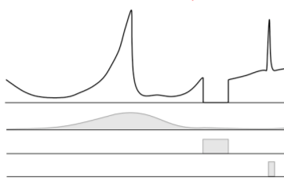
Retail forecasting example
Time series data
Transactional sales data
Timestamp, item, quantity
Metadata
Category, item color
Item, metadata
Related data
Time series
In-stock data
Promotion data
Timestamp, item, price
Notes:
~alt text/group6: Arrows show time series data, metadata, and related data as elements of retail forecasting.
The following example shows the data that you need for a retail demand forecast.
For the time series, you must provide:
Timestamp – The time at which the transaction took place, ideally in UTC format
Item – The item ID of the item
Quantity – How many items were sold
The metadata for the item might include category or item color, for example. The link back to the time series data includes only the item ID, because the metadata for the item doesn’t typically change.
The sales price or other promotion data are examples of related data that can create a more useful forecast. To link this back to the item, you must include the timestamp and item ID.

Slide 51
Selecting an Amazon Forecast algorithm
You can select from the following list of algorithms:
ARIMA
DeepAR+
ETS
NPTS
Prophet
Predictor
Algorithm
Model
Notes:
Amazon Forecast predictors use an algorithm to train a model. They then use the model to make a forecast by using an input dataset group. To help you get started, Amazon Forecast provides the following predefined algorithms:
ARIMA
DeepAR+
ETS
NPTS
Prophet
You can also use the AutoML feature, which tries all the algorithms to see which one is the best at predicting data.
For more information about Amazon Forecast algorithms, see “Amazon Forecast Algorithms” in the AWS documentation at https://docs.aws.amazon.com/forecast/latest/dg/aws-forecast-choosing-recipes.html.

Slide 52
Evaluating your forecast: Back testing
Predictor accuracy metrics are based on back testing.
Forecast horizon
Start date
End date
Training
Testing
Time
Back test window offset
Backtest window 1
Training
Testing
Backtest window 2
Training
Testing
Backtest window 3
Training
Testing
Notes:
~alt text/group6: Time series data used to train a model that is then tested.
When you prepare data for training in machine learning, you typically hold back data to use when you validate and score the model. The data that you hold back is usually a random sample of your available data. With time series data, you must process your data differently because of a correlation between time.
When you import your data, Amazon Forecast breaks it into training and test datasets, which the diagram shows. The training data is used to train the model, which is then tested against the data that was held back. You can specify multiple back test windows, which will split the data multiple times, train the model, and use metrics to determine which model gives the best results. The default back test window is 1.
You can change how Amazon Forecast splits the data by setting the BackTestWindowOffset parameter when you create the predictor. If you don’t set this value, the algorithms use default values.
After you have trained a model, you will need to measure its accuracy, which you will learn about next.

Slide 53
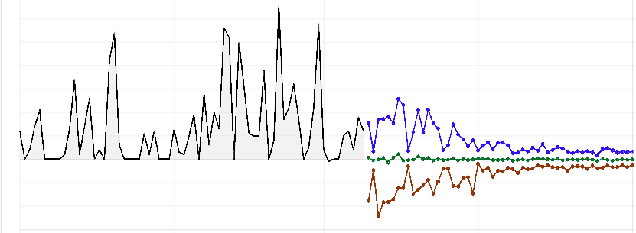
Evaluation metrics: wQuantileLoss
Quantiles determined for 10%, 50%, and 90% quantiles
wQuantileLoss is the average error for each quantile in a set –
Works best for models with greater variability in the errors
60
Demand
P10 forecast
40
P50 forecast
P90 forecast
20
0
-20
Notes:
~alt text/group7: Line graphs of data and forecasts from wQuantileLoss for three quantiles.
The first Amazon Forecast evaluation metric is the weighted quantile loss (wQuantileLoss). When Amazon Forecast creates a forecast, it provides probabilistic predictions at three distinct quantiles—10 percent, 50 percent, and 90 percent. These prediction quantiles show you how much uncertainty is associated with each forecast.
A P10 quantile predicts that, 10 percent of the time, the true value will be less than the predicted value. For example, suppose that you are a retailer. You want to forecast product demand for winter gloves that sell well only during the fall and winter. Say that you don’t have sufficient storage space and the cost of invested capital is high, or that the price of being overstocked on winter gloves concerns you. Then, you might use the P10 quantile to order a relatively low number of winter gloves. You know that the P10 forecast overestimates the demand for your winter gloves only 10 percent of the time, so you will be sold out of your winter gloves for 90 percent of the time.
A P50 quantile predicts that 50 percent of the time, the true value will be less than the predicted value. Continuing the winter gloves example, say you know that there will be a moderate amount of demand for the gloves, and you aren’t concerned about being overstocked. Then, you might choose to use the P50 quantile to order gloves.
A P90 quantile predicts that 90 percent of the time, the true value will be less than the predicted value. Suppose you determine that being understocked on gloves will result in large amounts of lost revenue—for example, the cost of not selling gloves is extremely high or the cost of invested capital is low. In this case, you might choose to use the P90 quantile to order gloves.
Amazon Forecast also calculates the associated loss (error) at each quantile. Weighted quantile loss (wQuantileLoss) calculates how far off the forecast a certain quantile is from actual demand in either direction. Lower wQuantileLoss metrics mean that the model’s forecasts are more reliable.

Slide 54
Root mean square error (RMSE)
RMSE is the square of the errors.
Test | Actual result | Prediction | Deltas
1 | 2 | 4 | 2
2 | 4 | 8 | 4
3 | 8 | 12 | 4
4 | 16 | 28 | 12
 |  | RMSE | 6.708204
Error is the difference between the actual
target value and the forecasted value
Works best for a model where most errors are of similar size
Notes:
The root mean square error (RMSE) is another method for evaluating the reliability of your forecasts. Like wQuantileLoss, RMSE calculates how far off the forecasted values were from the actual test data.
The RMSE finds the difference between the actual target value in the dataset and the forecasted value for that time period, and it then squares the differences. The example shows how to calculate RMSE. The RMSE value represents the standard deviation of the prediction errors. This test is good for forecast validity when the errors are mostly of the same size (that is, there aren’t many outliers). Lower RMSE metrics indicate that the model’s forecasts are more reliable.

Slide 55


Model accuracy example
Web retailer of shoes wants to predict how often it will be unable to fill orders for AnyCompany brand shoes.
Amazon Forecast predicts demand of 1,000 pairs per month
P10: 10% of the time, fewer than 880 pairs will be ordered
P50: 50% of the time, fewer than 1,050 pairs will be ordered
P90: 90% of the time, fewer than 1,200 pairs will be ordered
P10 = 880
P50 = 1050
P90 = 1200
Forecast = 1000
Notes:
This example shows how a web retailer might use the accuracy metrics to evaluate a forecast. The retailer wants to predict the demand for sales of a particular brand of shoes. They input the sales records for this brand into Amazon Forecast to create a predictor.
The predictor provides a forecasted demand of 1,000 pairs with the P10, P50, and P90 values. The wQuantileLoss values indicate that 10 percent of the time (P10), fewer than 880 pairs will be sold. Next, 50 percent of the time (P50), fewer than 1,050 pairs will be sold. Finally, 90 percent of the time (P90), fewer than 1,200 pairs will be sold. The retailer can then use these values to determine which level of inventory to hold. The determination is based on their assessment of the risk that they can’t fulfill orders, or have excess inventory.

Slide 56








SOURCE: Building a custom forecasting model
Amazon SageMaker Canvas
1
2
3
Amazon Aurora
database
Dataset with customized data
Trained model
Model training scores report
4
Amazon S3
bucket
Amazon SageMaker model registry
7
6
5
Model production predictions
Deployed production model
Model test predictions
Amazon Redshift

