Slide 1
Module 7: Introducing Generative AI
AWS Academy Machine Learning Foundations
Notes:
Welcome to Module 7: Introduction to Generative AI.

Slide 2

Module overview
Sections
  What is generative AI?
  How does generative AI work?
  AWS generative AI offerings
  Amazon Q Developer
Demonstrations
  Explore an FM and Use Prompt Engineering in a Notebook
  Creating a Linear Regression Model Using Amazon Q Developer
Knowledge check
Notes:
This module introduces generative AI. The following topics are covered in this module:
What is generative AI?
How does generative AI work?
AWS generative AI offerings
Amazon Q Developer
You will be asked to complete a knowledge check that will test your understanding of key concepts covered in this module.

Slide 3
Module objectives
At the end of this module, you should be able to do the following:
  Define generative artificial intelligence (AI).
  Differentiate between traditional machine learning (ML) and generative AI.
  Use a foundation model (FM) in a Jupyter notebook to generate an image from text.
  Identify the benefits of Amazon Q Developer.
  Explain how Amazon Q Developer works with Amazon SageMaker to speed up development of your ML application.
Notes:
At the end of this module, you should be able to do the following:
Define generative artificial intelligence (AI).
Differentiate between traditional machine learning (ML) and generative AI.
Use a foundation model (FM) in a Jupyter notebook to generate an image from text.
Identify the benefits of Amazon Q Developer.
Explain how Amazon Q Developer works with Amazon SageMaker to speed up development of your ML application.

Slide 4
Section 1: What is generative AI?
Module 7: Introducing Generative AI
Notes:
Introducing Section 1: What is generative AI?

Slide 5
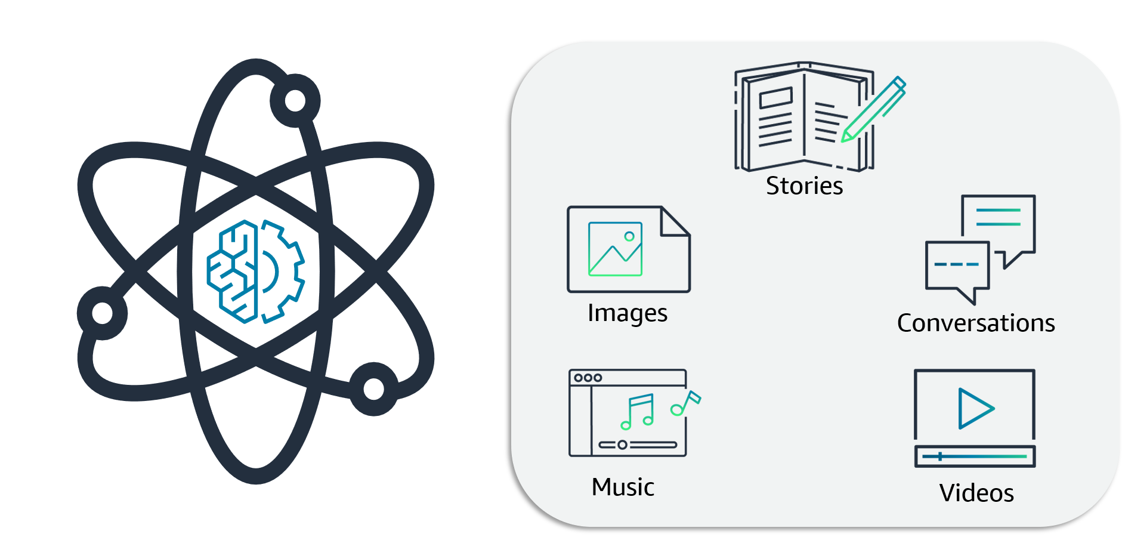
Generative AI definition
Notes:
Generative AI is a type of artificial intelligence that can create new content and ideas, including conversations, stories, images, videos, and music. AI generators are powered by pretrained machine learning models called foundation models (FMs). These models are capable of producing content, so you don’t have to. This AI-generated content can be edited, so you can make the necessary modifications that meet your needs.

Slide 6
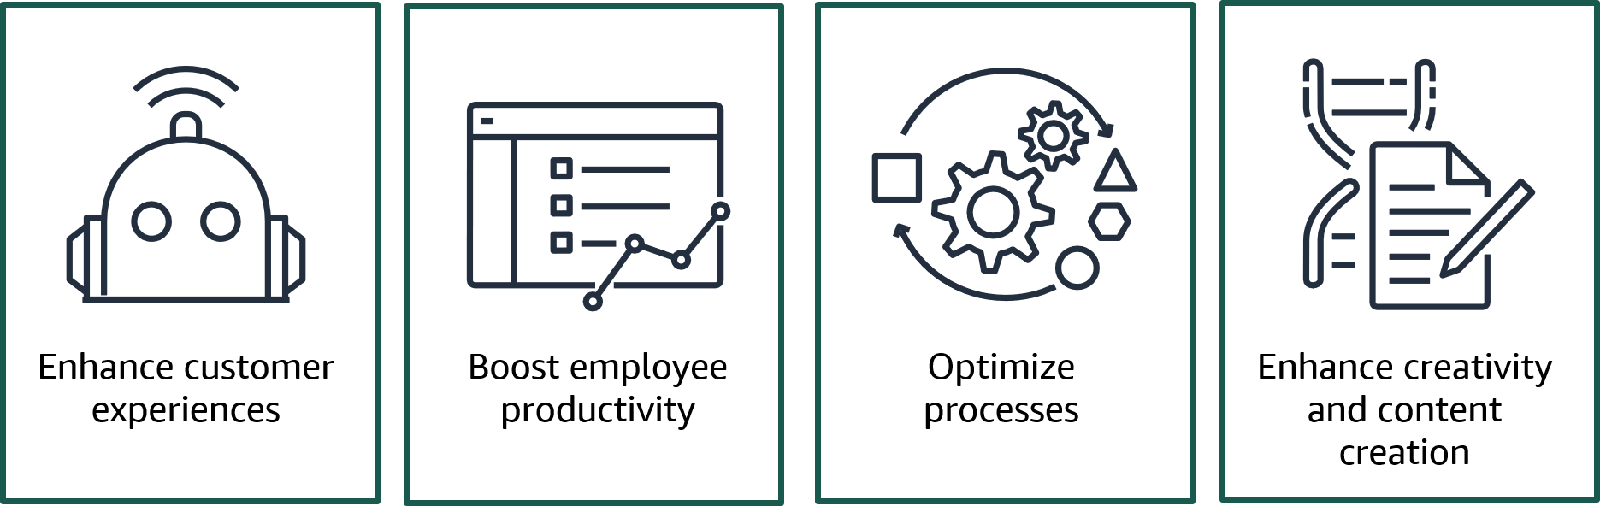
Generative AI use cases
Notes:
Generative AI can be applied for a broad range of use cases.
Enhance customer experiences: Chatbots and virtual assistants can enhance customer service experiences by streamlining customer self-service and reducing operational costs. Generative AI can also help with summarizing and analyzing customer conversations and creating better personalized customer experiences.
Boost employee productivity: Generative AI can help boost employee productivity by accelerating application development, automating report generation, and improving content searches through a conversational interface.
Optimize processes: Business operations can be optimized by using intelligent document processing that extracts and summarizes data through generative AI-powered questions and answers. Generative AI can also help improve supply chain logistics and augment data by generating synthetic data to train ML models.
Enhance creativity and content creation: AI-generated media can enhance creativity and content creation. Marketing content created using generative AI, such as blog posts or social media updates, can save time and resources. Sales content, guidance, and enablement can also be generated to match a prospect’s profile and behavior, thereby improving response rates. Product developers can use generative AI to generate multiple design prototypes based on certain inputs and constraints, which speeds up the ideation phase.

Slide 7

Section 1 key takeaways
Generative AI is a type of artificial intelligence that can create new content and ideas, including conversations, stories, images, videos, and music.
Generative AI is powered by large models called FMs.
Generative AI can be applied for a broad range of purposes.
Notes:
Some key takeaways from this section of the module include the following:
Generative AI is a type of artificial intelligence that can create new content and ideas, including conversations, stories, images, videos, and music.
Generative AI is powered by large models called FMs.
Generative AI can be applied for a broad range of purposes.

Slide 8
Section 2: How does generative AI work?
Module 7: Introducing Generative AI
Notes:
Introducing Section 2: How does generative AI work?

Slide 9
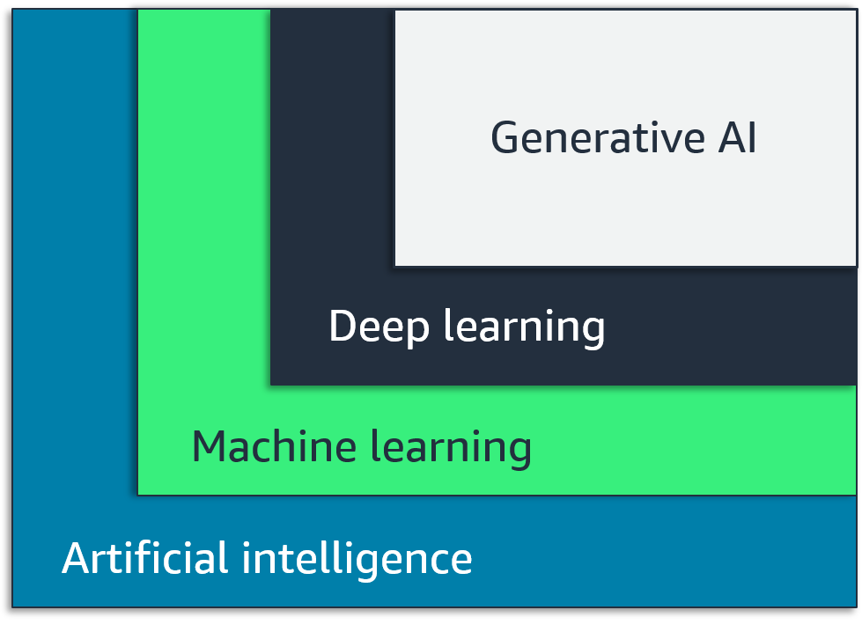
Artificial intelligence, machine learning, deep learning, and generative AI
Notes:
This graphic is an introduction to machine learning (ML), and it shows where generative AI fits in with the larger picture of artificial intelligence (AI).
Generative AI is a subset of machine learning. Generative AI is powered by models called foundation models that make use of deep learning techniques such as neural networks.

Slide 10
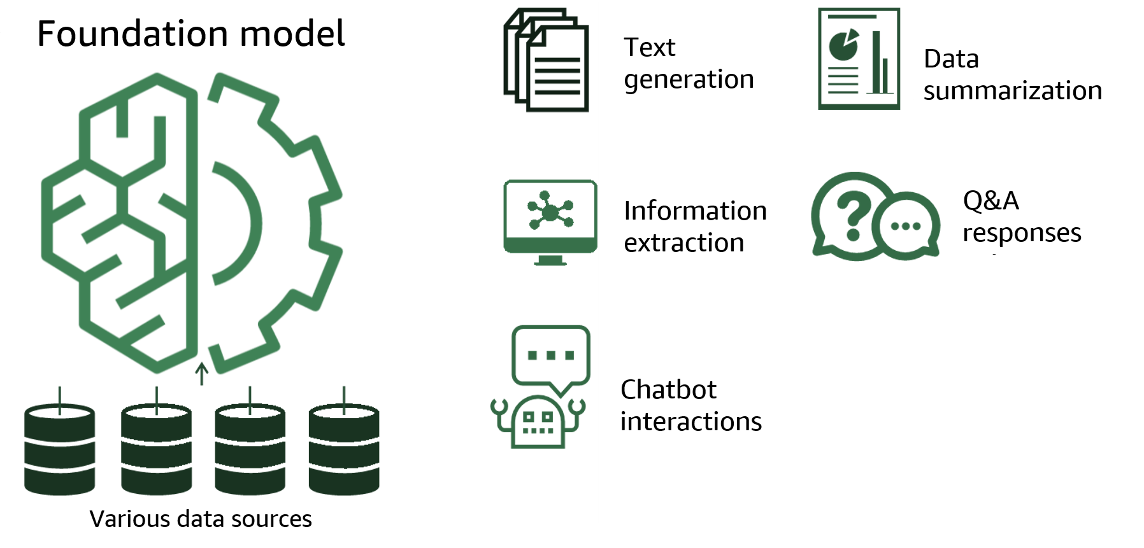
What are FMs?
Notes:
At the core of every AI generator is a foundation model. Foundation models are a class of powerful machine learning models that are differentiated by their ability to be pretrained on vast amounts of data to perform a wide range of downstream tasks. These tasks include text generation, data summarization, information extraction, question and answer responses, and chatbot interactions. They can also generate images, music, videos, or code. In contrast, traditional ML models are trained to perform a specific task from a data set.

Slide 11
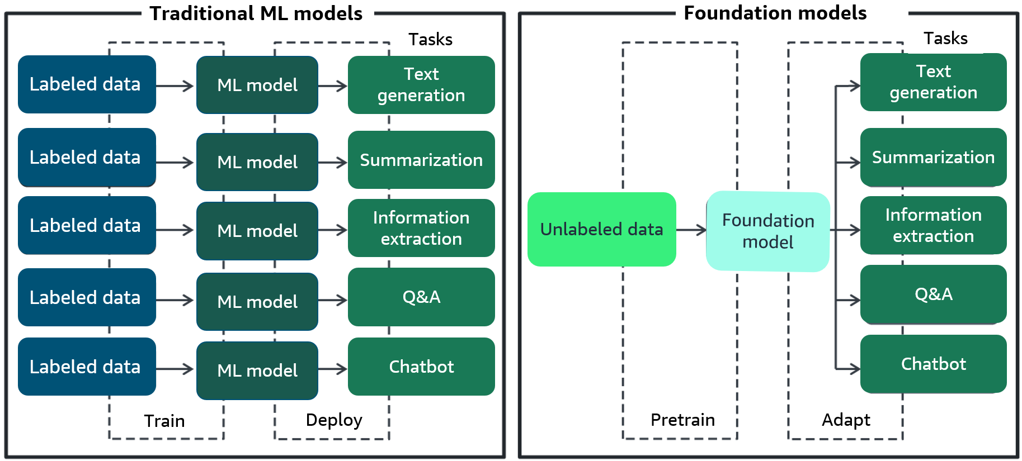
Comparison of traditional and foundation models
Notes:
Let’s review some key differences between traditional machine learning models and foundation models.
Traditional ML models are typically siloed to perform specific tasks, like analyzing text for sentiment, classifying images, and forecasting trends. To accomplish each task, customers need to gather labeled data, train a model, and deploy that model.
The size and general-purpose nature of foundation models make them very different from traditional ML models.
With foundation models, instead of gathering labeled data and training multiple models, you use the same pretrained foundation model to adapt several tasks. Foundation models can also be customized to perform domain-specific functions that are differentiating to their businesses. This uses only a small fraction of the data and compute required to train a model from scratch.

Slide 12










What tasks can foundation models do?
Text
generation
Q&A
Sentiment analysis
Text summarization
Search
Code generation
Image generation
Image classification
Video generation
Audio generation
Notes:
There are multiple tasks that FMs can perform. A few examples include language processing, visual comprehension, and code generation. An example of an FM that can perform language processing on natural language tasks is Amazon Titan. And Stable Diffusion is an example of an FM that can perform visual comprehension tasks.
For more information about what FMs can do and examples of other FMs, see What are Foundation Models? at https://aws.amazon.com/what-is/foundation-models/.

Slide 13
What are LLMs?
Large language models (LLMs):
  Trained on trillions of words
  Able to understand, learn, and generate text
  Adaptable to various tasks like text generation, summarization, or sentiment analysis
  Able to perform domain-specific functions
Notes:
A subset of FMs, called large language models (LLMs), are trained on trillions of words across many natural language tasks.
These LLMs can understand, learn, and generate text that’s nearly indistinguishable from text produced by humans.
With LLMs, instead of gathering labeled data for each model and training multiple models, customers can use the same pretrained LLM to adapt various tasks such as text generation, summarization, or sentiment analysis. LLMs can be customized to add domain-specific knowledge such as internal documents for a particular business.

Slide 14
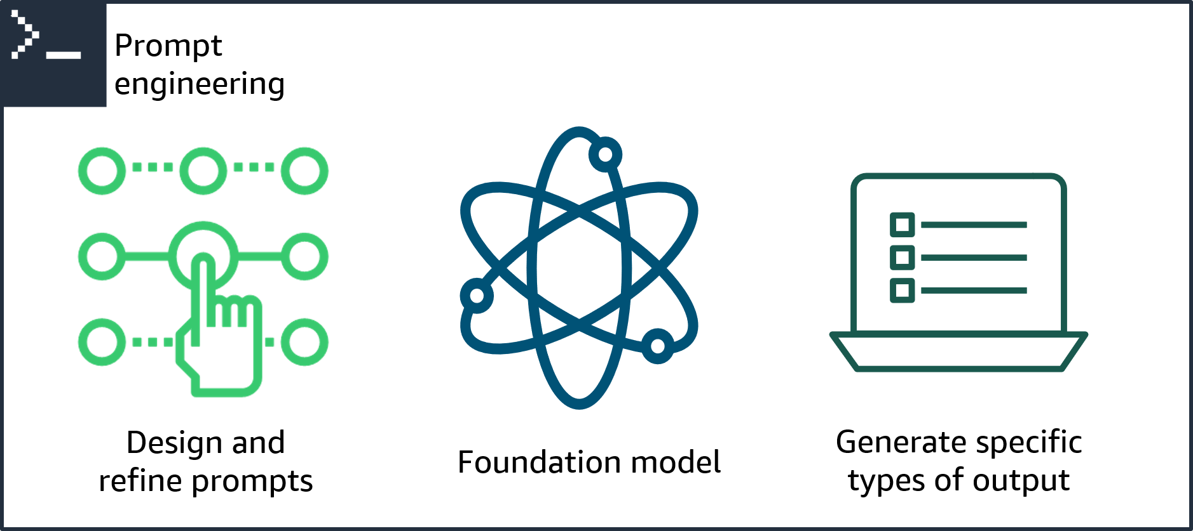
What is prompt engineering?
Notes:
Generative AI architectures use prompt engineering to initiate an action from a foundation model. Prompt engineering is the process of designing and refining the prompts or input stimuli for a language model to generate specific types of output. Prompt engineering involves selecting appropriate keywords, providing context, and shaping the input in a way that encourages the model to produce the desired response. It is a vital technique to actively shape the behavior and output of foundation models.

Slide 15
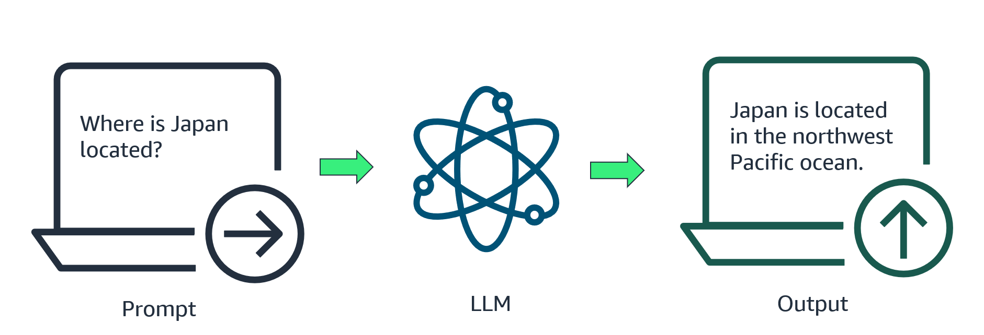
Example of a prompt
Notes:
A prompt is the text that you input into the model. The model then generates a response to the prompt. This is known as inference. The result of the inference is displayed as the output. In this example, your prompt is, “Where is Japan located?” The model’s inference on the prompt returns an output that says, “Japan is located in the northwest Pacific Ocean.”

Slide 16




Structure of a prompt
Instructions: Summarize the following restaurant review.
Instruction
Restaurant: Luigi’s; Location: Naples, Italy; Specialty: Pasta
Prompt
Context
Review: We ordered the tagliatelle and mozzarella caprese. The tagliatelle were a work of art—the pasta was just right and the tomato sauce with fresh basil was perfect. The caprese was OK but nothing out of the ordinary. Service was slow at first but overall it was fine. Other than that, Luigi’s was a great experience!
Input
Summary: Luigi’s is a great Italian restaurant with delicious pasta and good service.
Output
Notes:
The structure of a prompt depends on the task that you want the model to perform.
A prompt is composed of the following:
Instructions: This is a task for the large language model to do. It provides a task description or instruction for how the model will perform.
Context: This is external information to guide the model.
Input data: This is the input for which you want a response.
The model will then generate an output.
Output: This is the output type or format.
If the model does not give you the output that you want, you need to alter the prompt or provide the model with examples of the tasks in the prompt. This is called prompt engineering.

Slide 17

Demonstration: Explore an FM and Use Prompt Engineering in a Notebook
Explore what an FM can do.
Use and modify prompt engineering to generate an image from text.
The recorded demo is included in your online course.
Notes:
This demonstration explores foundation models in Amazon SageMaker Studio. This demonstration also highlights how to use generative AI to create images from text prompts.

Slide 18
Section 2 key takeaways
Foundation models (FMs) are pretrained on vast amount of data and perform many tasks.
Some examples of tasks that an FM can do are language processing, visual comprehension, and code generation.
A subset of FMs, large language models (LLMs), are trained on trillions of words across many natural-language tasks.
Prompt engineering is the process of designing and refining the prompts or input stimuli for a language model to generate specific types of output.
Notes:
Some key takeaways from this section of the module include the following:
Foundation models (FMs) are pretrained on vast amount of data and perform many tasks.
Some examples of tasks that an FM can do are language processing, visual comprehension, and code generation.
A subset of FMs, large language models (LLMs), are trained on trillions of words across many natural-language tasks.
Prompt engineering is the process of designing and refining the prompts or input stimuli for a language model to generate specific types of output.

Slide 19
Section 3: AWS generative AI offerings
Module 7: Introducing Generative AI
Notes:
Introducing Section 3: AWS generative AI offerings

Slide 20
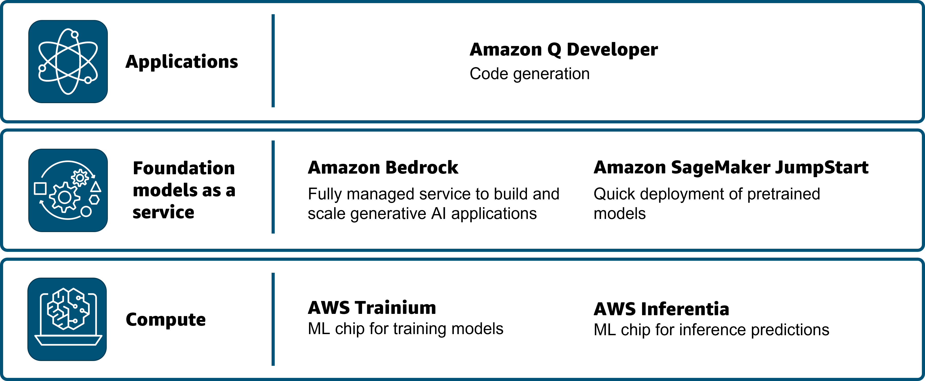
AWS generative AI offerings
Notes:
AWS offers several generative AI offerings, including the following:
Amazon Q Developer is a coding companion that integrates with your integrated development environment (IDE).
Amazon Bedrock is a fully managed service that makes FMs from AWS and leading AI startups available through an API. This means that you can choose from various FMs to find the model that's best suited for your use case. Amazon Bedrock helps developers create generative AI applications that can deliver up-to-date answers based on proprietary knowledge sources.
Amazon SageMaker JumpStart helps you quickly get started with ML. It provides a set of solutions for the most common use cases that can be deployed readily in just a few steps. The solutions are fully customizable and showcase the use of AWS CloudFormation templates and reference architectures so you can accelerate your ML journey.
AWS Trainium is the second-generation ML accelerator that AWS purpose built for deep learning training of over 100 billion parameter models.
AWS Inferentia is a custom ML chip designed by AWS that you can use for high-performance inference predictions. To use the chips, set up an Amazon Elastic Compute Cloud (Amazon EC2) instance and use the AWS Neuron SDK to invoke the Inferentia or Trainium chip.
For more information on other generative AI offerings at AWS, see the Additional resources slide of this module.

Slide 21
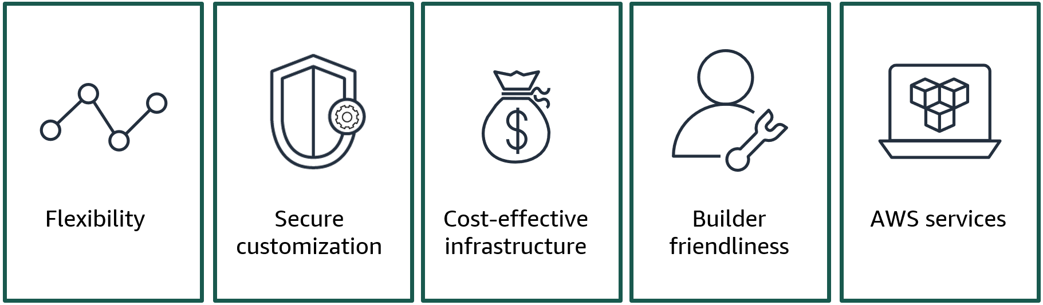
Benefits of using AWS for generative AI
Notes:
There are several benefits of using AWS for your generative AI needs.
AWS offers flexibility. Customers need a straightforward way to find and access high-performing FMs that are best suited for their business. AWS offers a wide selection of FMs built by Amazon and top AI startups, including AI21 Labs, Anthropic, and Stability AI.
Another benefit is secure customization. Customers want to build differentiated applications using their own data. They need their data to stay completely protected, secure, and private. Using Amazon Bedrock, customers can fine tune models for a particular task without having to annotate large volumes of data (as few as 20 examples is enough). No customer data is used to train the underlying models. All data is encrypted and stays within the customer's virtual private cloud (VPC).
Customers want to fully use FMs in a high-performing and cost-effective infrastructure purpose-built for ML. AWS offers the best price performance for generative AI with infrastructure powered by AWS designed ML chips and NVIDIA GPUs. With AWS, customers can cost-effectively scale infrastructure to train and run FMs containing hundreds of billions of parameters.
AWS offerings are builder friendly. Customers want to quickly integrate and deploy FMs into their applications and workloads running on AWS. Using AWS generative AI capabilities, customers don't need to send their data to the model. Instead, they can bring the model to their data using familiar controls and integrations and services such as Amazon SageMaker and Amazon Simple Storage Service (Amazon S3).
AWS services offer customers generative AI solutions to help improve productivity while seamlessly interacting with applications and systems. With generative AI built in, services such as Amazon Q Developer can help customers improve productivity. Customers can also deploy generative AI solutions, such as call summarization and question answering, that combine AWS AI services with leading FMs.

Slide 22
Section 3 key takeaways
AWS offers several generative AI offerings: Amazon Bedrock, AWS Inferentia, AWS Trainium, and Amazon SageMaker JumpStart.
There are several benefits of using AWS services to build your generative AI application.
Notes:
AWS offers several generative AI offerings: Amazon Bedrock, AWS Inferentia, AWS Trainium, and Amazon SageMaker JumpStart.

Slide 23
Section 4: Amazon Q Developer
Module 7: Introducing Generative AI
Notes:
Introducing Section 4: Amazon Q Developer

Slide 24

Amazon Q Developer
Generative AI-powered coding assistant
Designed for developers and IT professionals
Generates code and helps you understand, build, extend, and operate AWS applications
Scan code for security vulnerabilities
Secure and private by design
Amazon Q Developer
Notes:
To alleviate some of the challenges with writing code, AWS introduced Amazon Q Developer. Amazon Q Developer is a coding assistant that those without extensive experience can use. It is trained on years of high-quality AWS examples and documentation. It can also be trained on your company’s code and systems. Amazon Q Developer can chat about code, provide in-line code completions, generate new code, and scan your code for security vulnerabilities. It can also make code upgrades and improvements, such as language updates, debugging, and optimizations. With Amazon Q Developer, you can describe the application you want to create in natural language, and Amazon Q Developer will generate and suggest code for the application. You can build applications without needing to write all code yourself. The no-code approach of Amazon Q Developer can be particularly useful for creating simple web applications, automating business processes, or building prototypes and proofs of concept.
For more information, see “Getting Started” in the AWS Amazon Q Developer User Guide on the content resources page of your online course.

Slide 25









Amazon Q Developer supports you across the software development lifecycle (SDLC)
Plan
Create
Test and secure
Operate
Maintain and modernize
Ask questions and get referenceable and contextual guidance.
Explain code with conversational coding.
Receive in-line code recommendations for multiple languages.
Implement features through comments or code prompts.
Chat in your integrated development environment (IDE).
Generate unit tests.
Scan project code for security vulnerabilities and get remediation suggestions.
Troubleshoot errors.
Troubleshoot network connectivity with VPC Reachability Analyzer.
Modernize code with Amazon Q Developer Agent for code transformation.
Notes:
Amazon Q supports developers across the software development lifecycle (SDLC) phases in several ways.
Plan: You can use Amazon Q in the AWS Management Console to ask questions, receive best practices and recommendations, optimize Amazon Elastic Cloud Compute (EC2) instances, and learn more about the Well-Architected Framework. In the integrated development environment (IDE), Amazon Q can help you understand your code base and get up to speed on projects.
Create: Amazon Q helps improve development productivity through in-line code recommendations directly in your IDE or command line interface (CLI), using natural language to generate new features. You can ask Amazon Q questions without leaving the IDE. The in-line code recommendations are available for multiple coding languages. For more information, see “Supported languages for Amazon Q Developer in the IDE” at https://docs.aws.amazon.com/amazonq/latest/qdeveloper-ug/q-language-ide-support.html.
Test and secure: Amazon Q helps you confirm that your code is working and secure through unit test assistance. It helps you to find and fix security vulnerabilities earlier in the development cycle.
Operate: Amazon Q can help troubleshoot errors, for example, in AWS Lambda, Amazon EC2, and Amazon Elastic Container Service (Amazon ECS). You can analyze your VPC reachability and get better debug and optimization tips.
Maintain and modernize: Amazon Q Developer Agent for code transformation helps you maintain and modernize code by upgrading projects to more up-to-date language versions.
For more information, see “Accelerate your Software Development Lifecycle with Amazon Q” in the AWS DevOps Blog at https://aws.amazon.com/blogs/devops/accelerate-your-software-development-lifecycle-with-amazon-q/.

Slide 26
Demonstration: Creating a Linear Regression Model Using Amazon Q Developer
This demo illustrates how Amazon Q Developer can accelerate coding tasks in ML applications.
The recorded demo is included in your online course.
Notes:
This demonstration highlights how Amazon Q Developer increases developer productivity by suggesting code comments and suggestions in Jupyter notebooks.

Slide 27
Section 4 key takeaways
Amazon Q Developer is a generative AI tool that will integrate with your IDE and help you develop your application faster using a large language model (LLM).
Amazon Q Developer scans code for security vulnerabilities
Amazon Q Developer supports developers across the SDLC.
Notes:
Amazon Q Developer is a generative AI tool that will help you develop your application faster.
Amazon Q Developer also has a security scanner that helps mitigate security vulnerabilities, thus safeguarding the integrity of the codebase.
Amazon Q Developer supports developers across the software development life cycle (SDLC).

Slide 28
Module wrap-up
Module 7: Introducing Generative AI

Slide 29
Module takeaways
Generative AI is a type of artificial intelligence that can create new content and ideas, including conversations, stories, images, videos, and music.
Generative AI is powered by large models called FMs.
Foundation models (FMs) are pretrained on vast amount of data and perform many tasks.
Prompt engineering is the process of designing and refining the prompts or input stimuli for a language model to generate specific types of output.
AWS offers several generative AI offerings: Amazon Bedrock, AWS Inferentia, AWS Trainium, and Amazon SageMaker JumpStart.
Amazon Q Developer is a generative AI tool that will integrate with your IDE and help you develop your application faster
Notes:
Some key takeaways from this section of the module include:
Generative AI is a type of artificial intelligence that can create new content and ideas, including conversations, stories, images, videos, and music.
Generative AI is powered by large models called FMs.
Foundation models (FMs) are pretrained on vast amount of data and perform many tasks.
Prompt engineering is the process of designing and refining the prompts or input stimuli for a language model to generate specific types of output.
AWS offers several generative AI offerings: Amazon Bedrock, AWS Inferentia, AWS Trainium, and Amazon SageMaker JumpStart.
Amazon Q Developer is a generative AI tool that will integrate with your IDE and help you develop your application faster.

Slide 30
Module summary
In summary this module, you learnt how to:
  Define generative artificial intelligence (AI).
  Differentiate between traditional machine learning (ML) and generative AI.
  Use a foundation model (FM) in a Jupyter notebook to generate an image from text.
  Identify the benefits of Amazon Q Developer.
  Explain how Amazon Q Developer works with Amazon SageMaker to speed up development of your ML application.
Notes:
In summary, in this you learnt how to:
Define generative artificial intelligence (AI).
Differentiate between traditional machine learning (ML) and generative AI.
Use a foundation model (FM) in a Jupyter notebook to generate an image from text.
Identify the benefits of Amazon Q Developer.
Explain how Amazon Q Developer works with Amazon SageMaker to speed up development of your ML application.

Slide 31
Complete the knowledge check
Notes:
It is now time to complete the knowledge check for this module.

Slide 32
Additional resources
Amazon Q Devloper
Amazon Bedrock
Amazon SageMaker JumpStart
AWS Inferentia
AWS Trainium
Notes:
For information about generative AI, see the following:
Amazon Q Developer at https://aws.amazon.com/q/developer/
Amazon Bedrock at https://aws.amazon.com/bedrock
Amazon SageMaker JumpStart at https://aws.amazon.com/pm/sagemaker
AWS Inferentia at https://aws.amazon.com/machine-learning/inferentia
AWS Trainium at https://aws.amazon.com/machine-learning/trainium

Slide 33
Thank you
Corrections, feedback, or other questions?
Contact us at https://support.aws.amazon.com/#/contacts/aws-academy.
Notes:
Thank you for completing this module.

Slide 34







Generative AI definition
Stories
Images
Conversations
Music
Videos
Notes:
Generative AI is a type of artificial intelligence that can create new content and ideas, including conversations, stories, images, videos, and music. AI generators are powered by pretrained machine learning models called foundation models (FMs). These models are capable of producing content, so you don’t have to. This AI-generated content can be edited, so you can make the necessary modifications that meet your needs.

Slide 35




Generative AI use cases
Enhance customer experiences
Boost employee productivity
Optimize processes
Enhance creativity and content creation
Notes:
Generative AI can be applied for a broad range of use cases.
Enhance customer experiences: Chatbots and virtual assistants can enhance customer service experiences by streamlining customer self-service and reducing operational costs. Generative AI can also help with summarizing and analyzing customer conversations and creating better personalized customer experiences.
Boost employee productivity: Generative AI can help boost employee productivity by accelerating application development, automating report generation, and improving content searches through a conversational interface.
Optimize processes: Business operations can be optimized by using intelligent document processing that extracts and summarizes data through generative AI-powered questions and answers. Generative AI can also help improve supply chain logistics and augment data by generating synthetic data to train ML models.
Enhance creativity and content creation: AI-generated media can enhance creativity and content creation. Marketing content created using generative AI, such as blog posts or social media updates, can save time and resources. Sales content, guidance, and enablement can also be generated to match a prospect’s profile and behavior, thereby improving response rates. Product developers can use generative AI to generate multiple design prototypes based on certain inputs and constraints, which speeds up the ideation phase.

Slide 36





Benefits of using AWS for generative AI
Flexibility
Secure customization
Cost-effective infrastructure
Builder friendliness
AWS services
Notes:
There are several benefits of using AWS for your generative AI needs.
AWS offers flexibility. Customers need a straightforward way to find and access high-performing FMs that are best suited for their business. AWS offers a wide selection of FMs built by Amazon and top AI startups, including AI21 Labs, Anthropic, and Stability AI.
Another benefit is secure customization. Customers want to build differentiated applications using their own data. They need their data to stay completely protected, secure, and private. Using Amazon Bedrock, customers can fine tune models for a particular task without having to annotate large volumes of data (as few as 20 examples is enough). No customer data is used to train the underlying models. All data is encrypted and stays within the customer's virtual private cloud (VPC).
Customers want to fully use FMs in a high-performing and cost-effective infrastructure purpose-built for ML. AWS offers the best price performance for generative AI with infrastructure powered by AWS designed ML chips and NVIDIA GPUs. With AWS, customers can cost-effectively scale infrastructure to train and run FMs containing hundreds of billions of parameters.
AWS offerings are builder friendly. Customers want to quickly integrate and deploy FMs into their applications and workloads running on AWS. Using AWS generative AI capabilities, customers don't need to send their data to the model. Instead, they can bring the model to their data using familiar controls and integrations and services such as Amazon SageMaker and Amazon Simple Storage Service (Amazon S3).
AWS services offer customers generative AI solutions to help improve productivity while seamlessly interacting with applications and systems. With generative AI built in, services such as Amazon Q Developer can help customers improve productivity. Customers can also deploy generative AI solutions, such as call summarization and question answering, that combine AWS AI services with leading FMs.

Slide 37
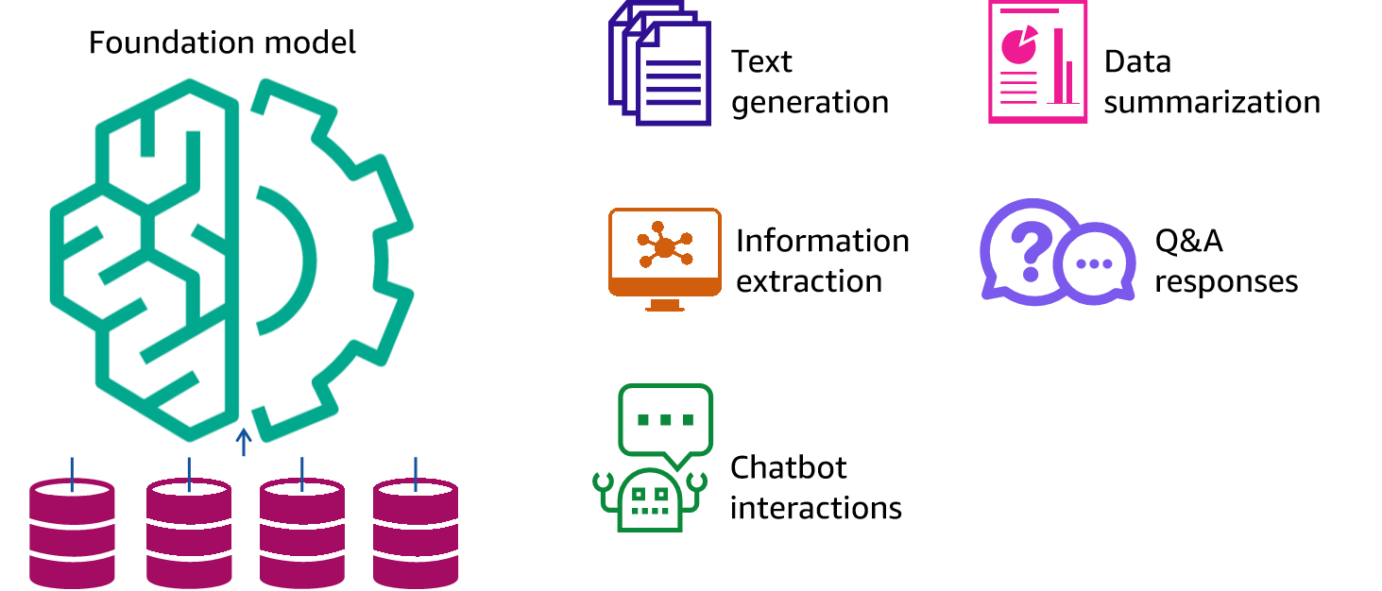
What are FMs?
Foundation model
Text generation
Data summarization
Information extraction
Q&A responses
Chatbot interactions
Various data sources
Notes:
At the core of every AI generator is a foundation model. Foundation models are a class of powerful machine learning models that are differentiated by their ability to be pretrained on vast amounts of data to perform a wide range of downstream tasks. These tasks include text generation, data summarization, information extraction, question and answer responses, and chatbot interactions. They can also generate images, music, videos, or code. In contrast, traditional ML models are trained to perform a specific task from a data set.

Slide 38
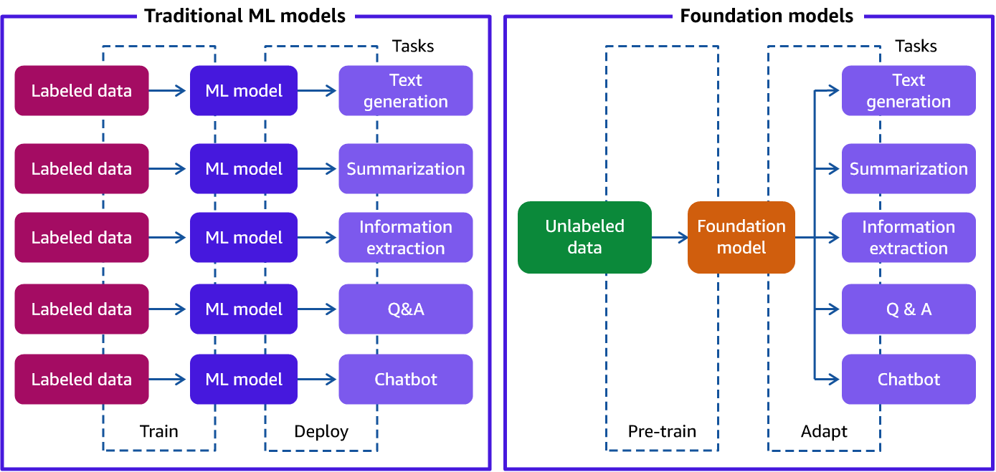
Comparison of traditional and foundation models
Traditional ML models
Foundation models
Tasks
Tasks
Labeled data
ML model
Text generation
Text generation
Labeled data
ML model
Summarization
Summarization
Labeled data
ML model
Information extraction
Unlabeled data
Foundation model
Information extraction
Labeled data
ML model
Q&A
Q&A
Labeled data
ML model
Chatbot
Chatbot
Train
Deploy
Pretrain
Adapt
Notes:
Let’s review some key differences between traditional machine learning models and foundation models.
Traditional ML models are typically siloed to perform specific tasks, like analyzing text for sentiment, classifying images, and forecasting trends. To accomplish each task, customers need to gather labeled data, train a model, and deploy that model.
The size and general-purpose nature of foundation models make them very different from traditional ML models.
With foundation models, instead of gathering labeled data and training multiple models, you use the same pretrained foundation model to adapt several tasks. Foundation models can also be customized to perform domain-specific functions that are differentiating to their businesses. This uses only a small fraction of the data and compute required to train a model from scratch.

Slide 39



Foundation model types
Text-to-text
Text-to-embeddings
Multimodal
Notes:
When you build your application, it’s important to choose the right type of foundation model. Review each model type to learn more about different types of foundation models.
Text-to-text: Text-to-text foundation models (FMs) are built for natural language processing tasks that are developed by the ML research community, startups, and established companies. Many organizations have had a chance to experiment with generative large language models (LLMs) that can do things like summarize text, extract information, respond to questions, and create content. These models take a user’s input text and extend it with new, generated text (for example, sentence auto-completion).
Text-to-embeddings: Text-to-embeddings FMs are another type of LLM that can compare pieces of text (inputs), like what a user types into a search bar with indexed data, and makes a connection between the two. Amazon’s product search uses this type of LLM to compare a user’s ask with catalog data and present the user with more accurate and relevant results.
Multimodal: Multimodal FMs can understand and generate different formats, such as text and images. An example of this is Stable Diffusion.

Slide 40




What is prompt engineering?
Prompt engineering
Design and refine prompts
Generate specific types of output
Foundation model
Notes:
Generative AI architectures use prompt engineering to initiate an action from a foundation model. Prompt engineering is the process of designing and refining the prompts or input stimuli for a language model to generate specific types of output. Prompt engineering involves selecting appropriate keywords, providing context, and shaping the input in a way that encourages the model to produce the desired response. It is a vital technique to actively shape the behavior and output of foundation models.

Slide 41


Example of a prompt
Japan is located in the northwest Pacific ocean.
Where is Japan located?
Prompt
LLM
Output
Notes:
A prompt is the text that you input into the model. The model then generates a response to the prompt. This is known as inference. The result of the inference is displayed as the output. In this example, your prompt is, “Where is Japan located?” The model’s inference on the prompt returns an output that says, “Japan is located in the northwest Pacific Ocean.”

Slide 42
Prompt engineering refinement
Output indicator
Instructions
Context
Input data
Notes:
A prompt's form depends on the task you are giving to a model.
Instructions:
This is a task for the large language model to do. It provides a task description or instruction for how the model should perform.
Context:
This is external information to guide the model.
Input data:
This is the input for which you want a response.
Output indicator:
This is the output type or format.

Slide 43



AWS generative AI offerings
Amazon Q Developer
Applications
Code generation
Foundation models as a service
Amazon Bedrock
Amazon SageMaker JumpStart
Fully managed service to build and scale generative AI applications
Quick deployment of pretrained models
AWS Trainium
AWS Inferentia
Compute
ML chip for training models
ML chip for inference predictions
Notes:
AWS offers several generative AI offerings, including the following:
Amazon Q Developer is a coding companion that integrates with your integrated development environment (IDE).
Amazon Bedrock is a fully managed service that makes FMs from AWS and leading AI startups available through an API. This means that you can choose from various FMs to find the model that's best suited for your use case. Amazon Bedrock helps developers create generative AI applications that can deliver up-to-date answers based on proprietary knowledge sources.
Amazon SageMaker JumpStart helps you quickly get started with ML. It provides a set of solutions for the most common use cases that can be deployed readily in just a few steps. The solutions are fully customizable and showcase the use of AWS CloudFormation templates and reference architectures so you can accelerate your ML journey.
AWS Trainium is the second-generation ML accelerator that AWS purpose built for deep learning training of over 100 billion parameter models.
AWS Inferentia is a custom ML chip designed by AWS that you can use for high-performance inference predictions. To use the chips, set up an Amazon Elastic Compute Cloud (Amazon EC2) instance and use the AWS Neuron SDK to invoke the Inferentia or Trainium chip.
For more information on other generative AI offerings at AWS, see the Additional resources slide of this module.

