Slide 1
Exploratory Data Analysis of Academic Performance
Mathematics vs Portuguese (Cortez & Silva, 2008)

Slide 2
1) Title
Title: Exploratory Data Analysis of Academic Performance
Focus: Mathematics vs Portuguese (two independent student cohorts)
Scope: Descriptive EDA only (no prediction, no causality)
Key message: This talk summarizes exploratory insights on final grades (G3) across two subjects.

Slide 3
2) Context & Motivation
Academic performance is multidimensional (school context, behaviors, support, study habits)
EDA helps:
  understand distributions and heterogeneity
  identify potential descriptive associations
  guide future (careful) analyses
Key message: EDA provides a structured “map” of the data before any modeling decisions.

Slide 4
3) Dataset Description
Source: Cortez & Silva (2008) student performance dataset
Two datasets (independent):
  Mathematics: 395 students
  Portuguese: 649 students
Target variable: Final grade G3 (0–20)
Variables: demographics, family context, study habits, behaviors, school support
Key message: Two separate cohorts allow comparisons by subject, but not within-student changes.

Slide 5
4) Methodology (EDA Only)
Data preparation:
  recoding categorical variables, creating descriptive indices (e.g., alcohol index)
Descriptive statistics:
  means/medians, dispersion, pass rates
Exploratory association tools:
  histograms/boxplots/scatterplots
  Spearman correlations (robust to non-normality / ordinal variables)
Multivariate overview:
  PCA on standardized numeric variables
Key message: All results are descriptive; no predictive modeling and no causal claims.

Slide 6
5) Exploratory Hypotheses (Guiding Questions)
H1: G3 distributions differ between Mathematics and Portuguese
H2: Higher absences are descriptively associated with lower G3
H3: Behavioral variables (e.g., alcohol, going out) show descriptive associations with G3
H4: Associations may differ across context (school) and/or sex
Key message: Hypotheses are used as a reading grid, not as confirmatory tests.

Slide 7
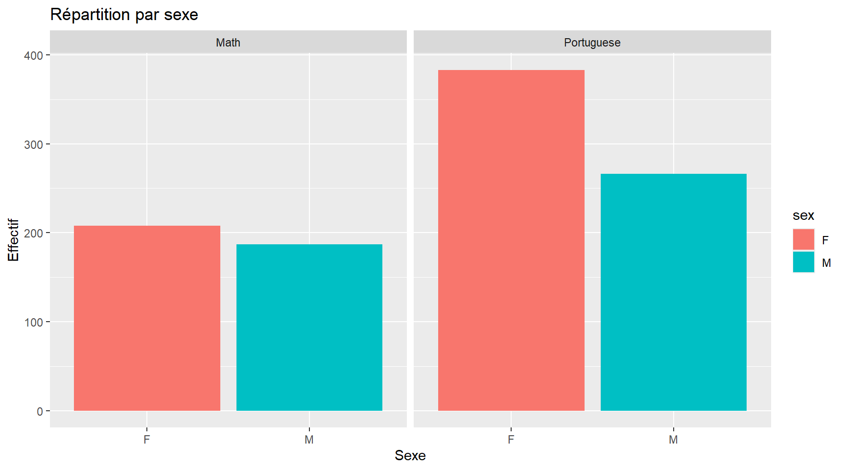
6) Demographic Profile (Age & Sex)
Age is concentrated around mid-teen values (typical secondary school range)
Sex distribution is broadly comparable across subjects, but differs by cohort

Slide 8
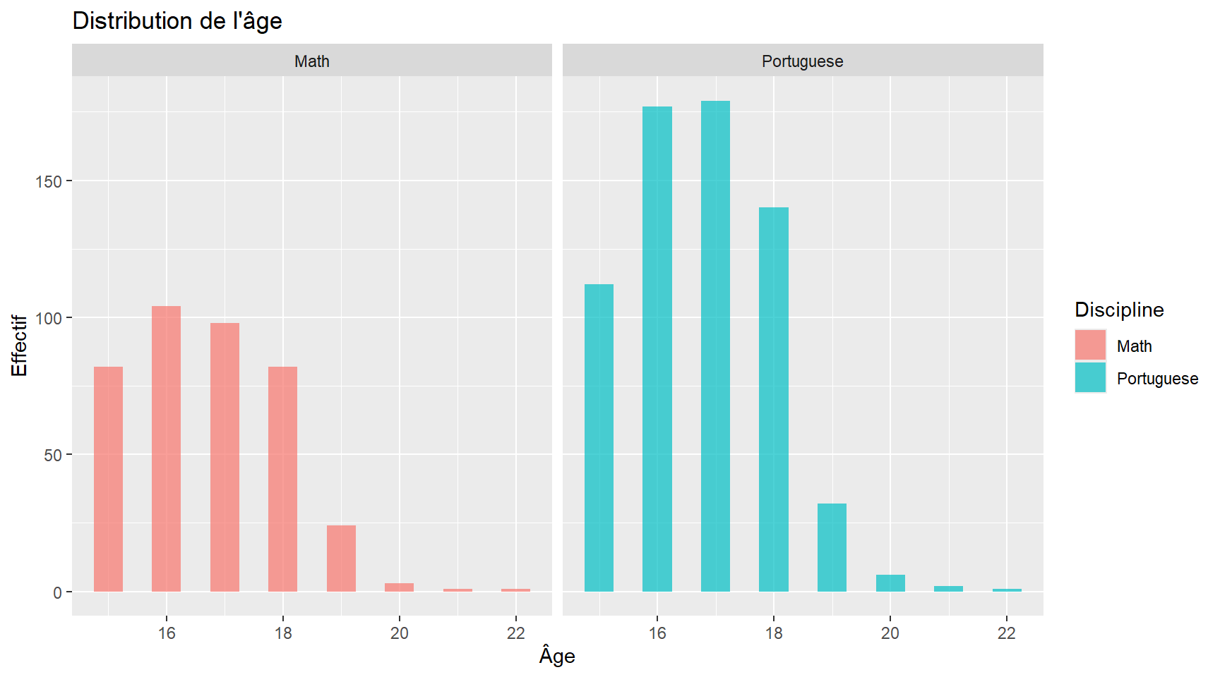

Slide 9
Key message: Demographics provide essential context for interpreting grade differences.

Slide 10
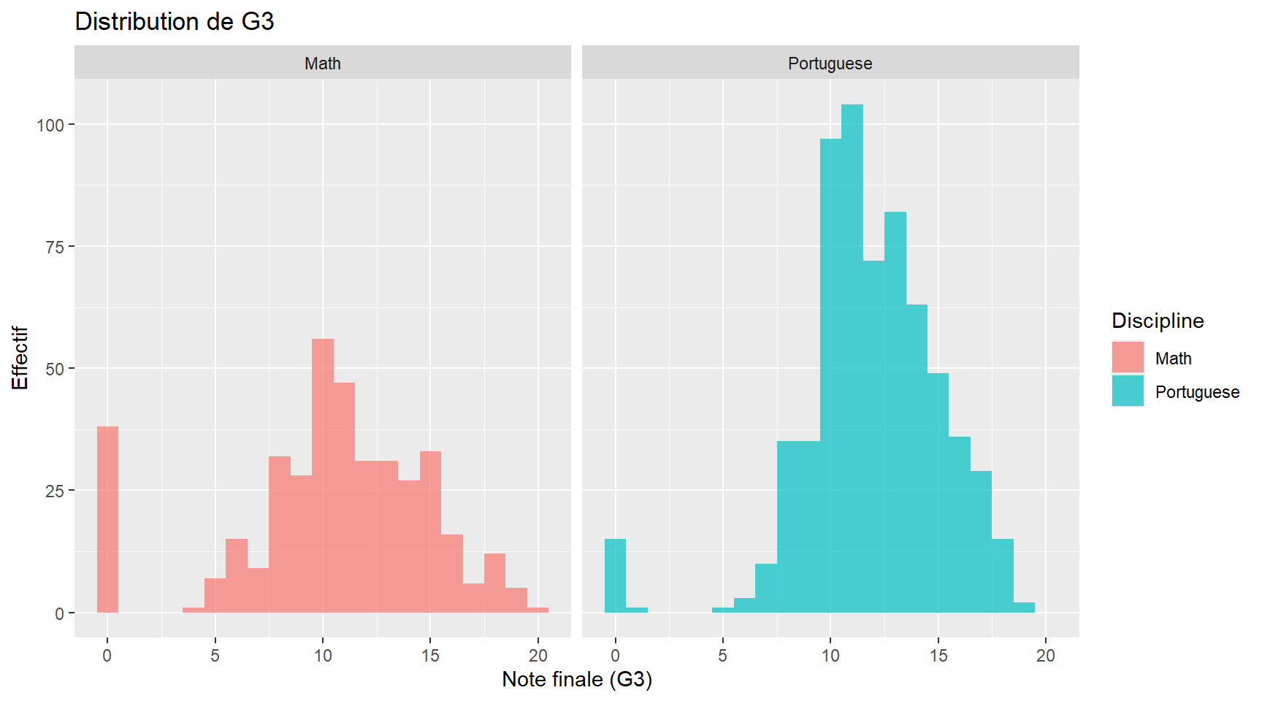
7) Distribution of Final Grades (G3)
Compare shape, spread, and central tendency of G3 by subject
Look for skewness, ceiling effects, and variability differences

Slide 11
Key message: Portuguese shows a higher central tendency and lower dispersion than Mathematics.

Slide 12
8) Quantitative Comparison (Math vs Portuguese)
Subject | n | Mean G3 | Median G3 | Pass rate (G3≥10)
Mathematics | 395 | 10.42 | 11 | 67.1%
Portuguese | 649 | 11.91 | 12 | 84.6%
Summary (G3):

Slide 13
Differences (Mathematics − Portuguese):
  Mean difference: -1.49
  Median difference: -1
  Effect size (Cohen’s d): ≈ -0.39
Key message: The average Portuguese G3 is higher; the standardized difference is small-to-moderate.

Slide 14
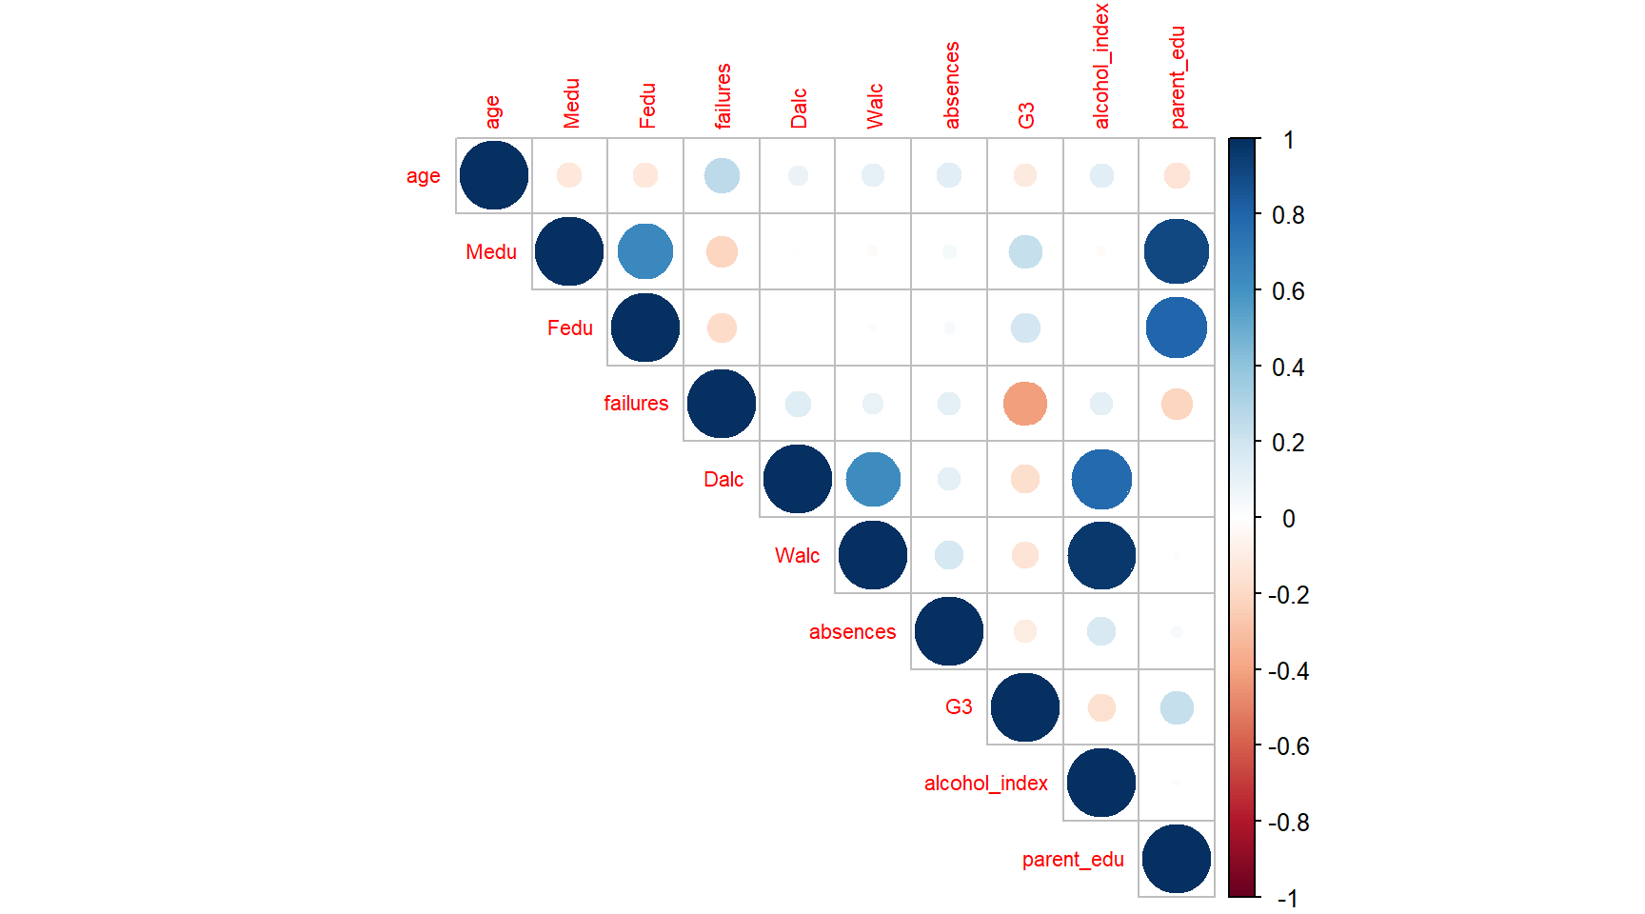
9) Variables Most Associated with G3 (Spearman)
Correlation matrix overview:

Slide 15
Variable | Spearman rho with G3
failures | -0.41
parent_edu | +0.24
alcohol_index | -0.17
absences | -0.11
Top descriptive associations with G3 (Spearman, approximate):

Slide 16
Interpretation (descriptive):
  Negative rho → higher values tend to coincide with lower G3
  Positive rho → higher values tend to coincide with higher G3
Key message: Prior failures and parental education show strong descriptive links with final grades.

Slide 17
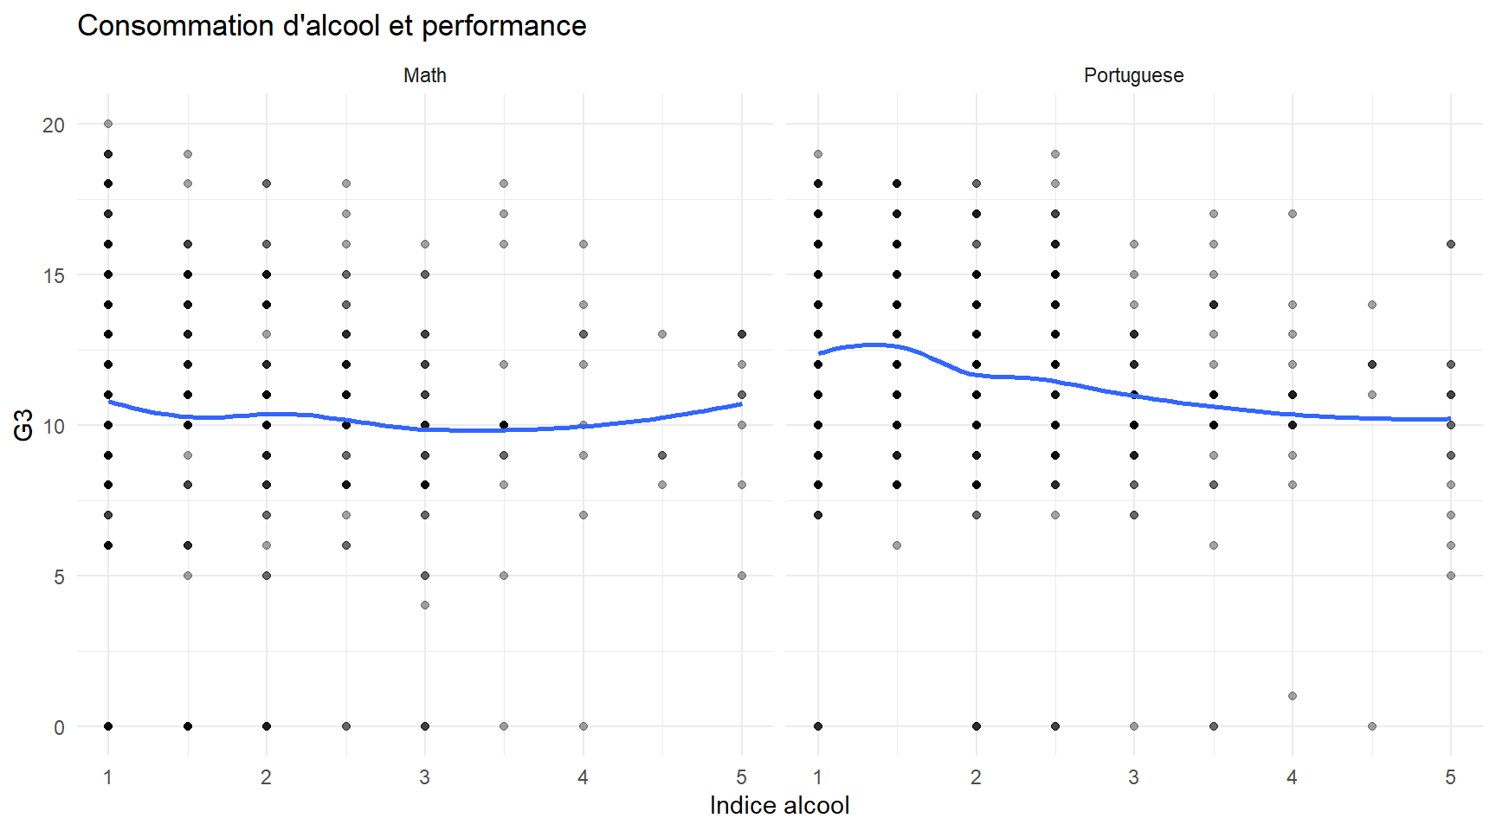
10) Focus Example: Alcohol vs Performance
Exploratory question: does alcohol consumption co-vary with G3?
Use a simple scatter + smooth trend (no causal interpretation)

Slide 18
Key message: The alcohol–G3 relationship is weak-to-moderate and should be read as descriptive only.

Slide 19
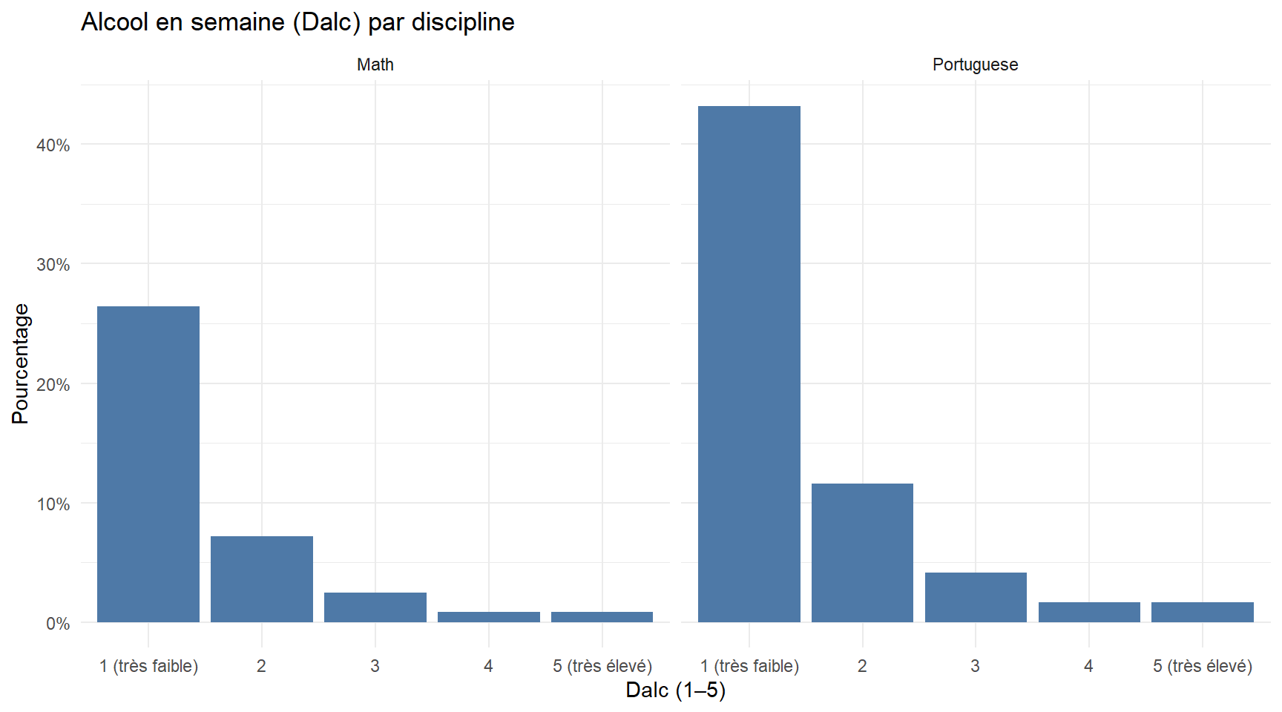
11) Additional Descriptive Focus: Weekday Alcohol & Absences
Weekday alcohol consumption (Dalc) is ordinal (1–5) and differs in distribution across cohorts
Study time vs absences helps describe how engagement and attendance co-vary (still descriptive)

Slide 20
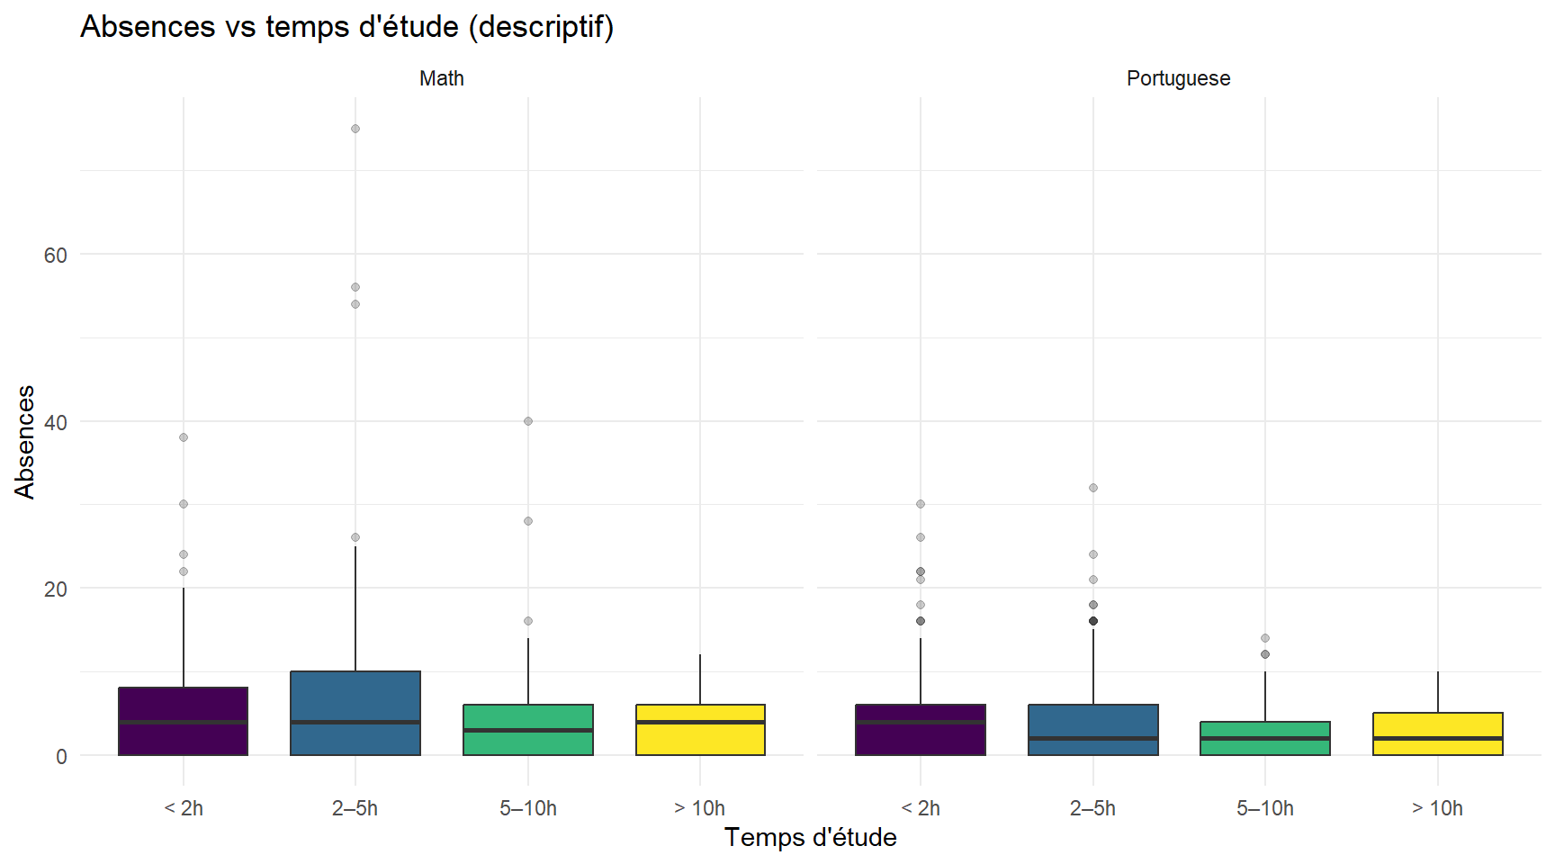

Slide 21
Key message: Attendance patterns and weekday alcohol levels provide concrete descriptive contrasts between subjects.

Slide 22
12) Discussion & Methodological Limitations
Two independent cohorts (Math vs Portuguese): comparisons are between groups
Many variables are ordinal; numeric conversions are for exploration only
Correlations and trends:
  can be sensitive to confounding and non-linearities
  should not be interpreted as causal effects
Multiple comparisons: treat p-values (if shown) as exploratory
Key message: The analysis highlights patterns, but does not establish causes.

Slide 23
13) Conclusion & Key Takeaways
Portuguese shows higher G3 central tendency and pass rate than Mathematics
Strongest descriptive associations with G3 include:
  prior failures (negative)
  parental education (positive)
  some behavioral indicators (weak-to-moderate)
Results remain consistent with EDA scope (no modeling, no causality)
Key message: Differences across subjects exist and are interpretable at a descriptive level.

Slide 24
14) Perspectives (Future Exploratory Work)
Stratified EDA:
  by school and sex to assess heterogeneity
Robustness checks:
  compare Spearman vs Kendall
  sensitivity to outliers (winsorization)
Missing data:
  patterns, potential bias in descriptive summaries
Optional (still non-ML): richer descriptive visualizations (interaction plots, small multiples)
Key message: Next steps can deepen the descriptive story without moving into prediction or causality.

