Slide 1
Neural Network
Task (1) “Penguins”

Slide 2
Visualizations:

Slide 3
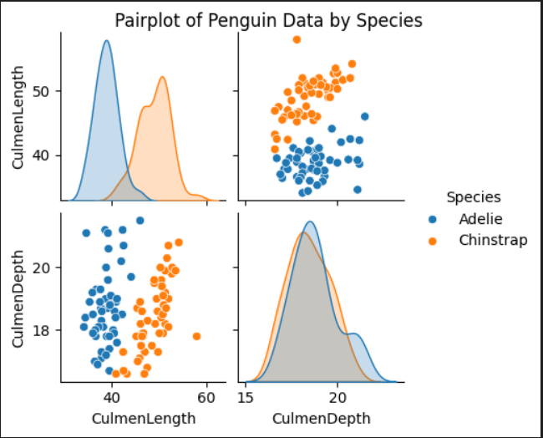
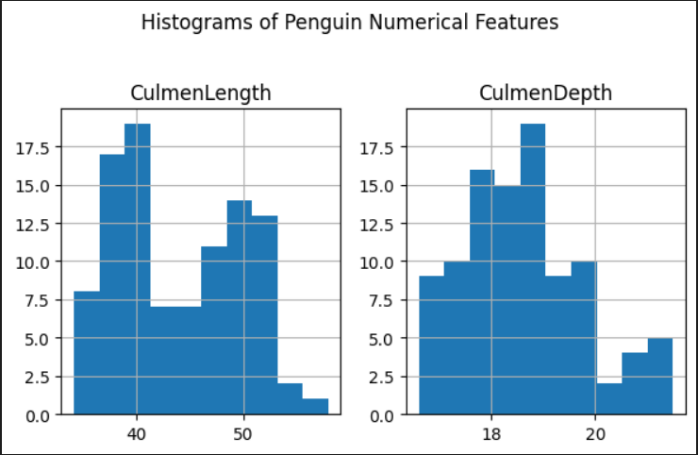
1.1 (CulmenDepth-CulmenLength)->(Adelie-Chinstrap):

Slide 4
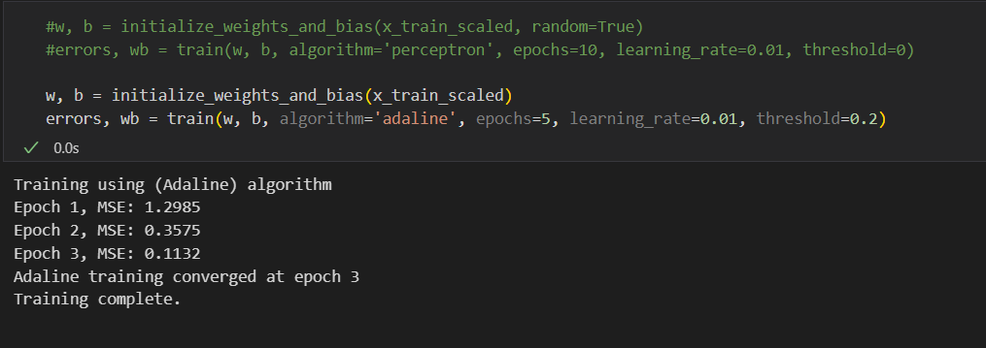
a. Adaline:

Slide 5
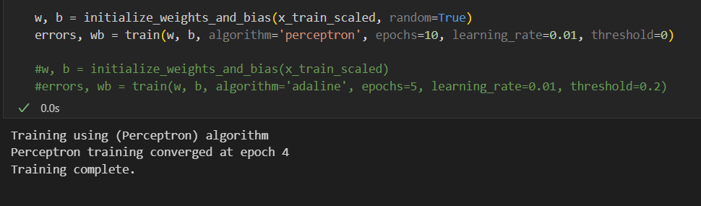
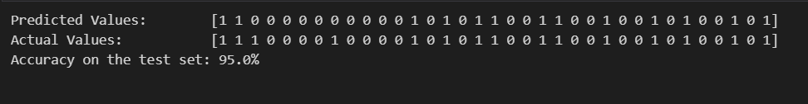
b. Perceptron:

Slide 6
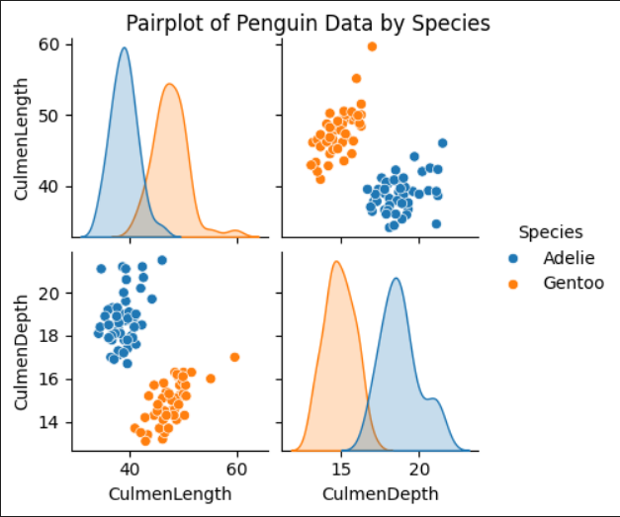
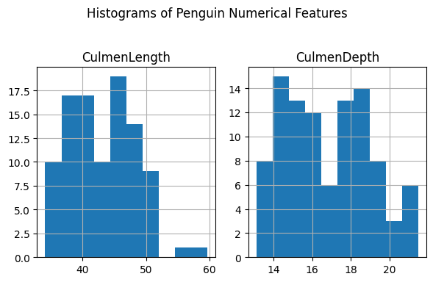
1.2 (CulmenDepth-CulmenLength)->(Adelie-Gentoo):

Slide 7
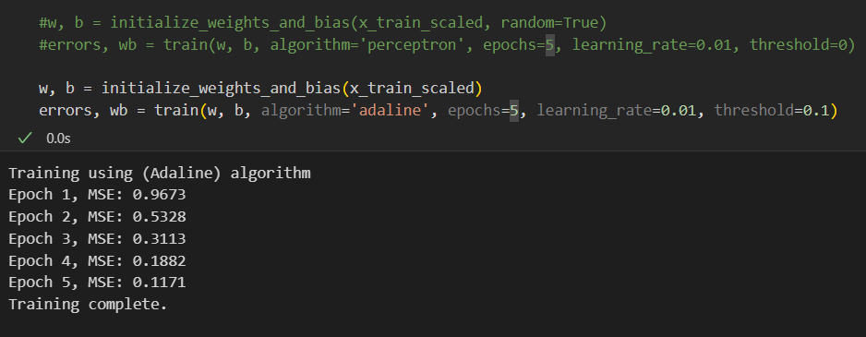
a. Adaline:

Slide 8
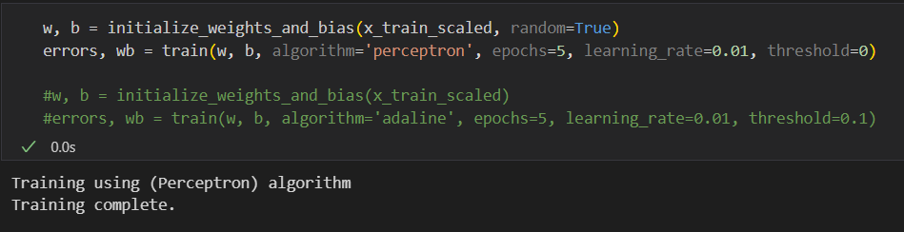

b. Perceptron:

Slide 9
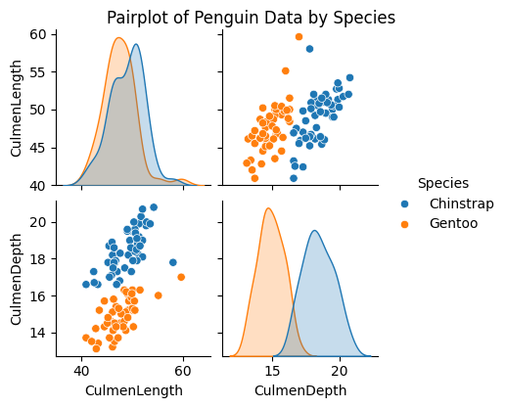
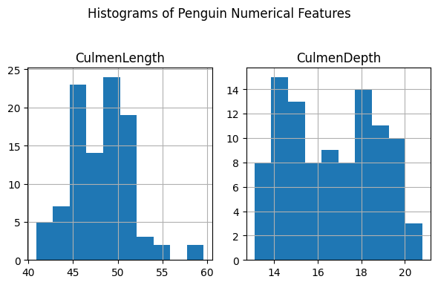
1.3 (CulmenDepth-CulmenLength)->(Chinstrap-Gentoo):

Slide 10
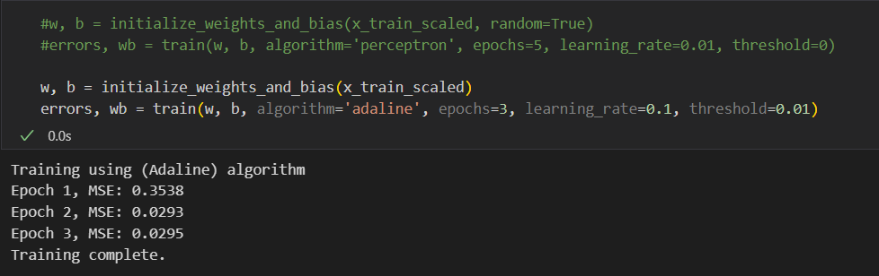
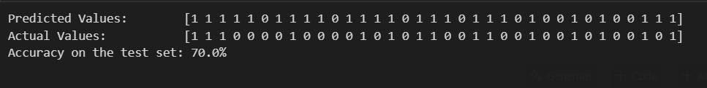
a. Adaline:

Slide 11
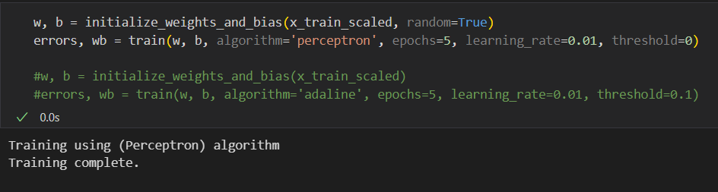
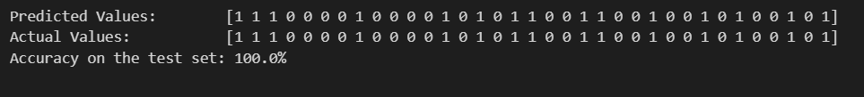
b. Perceptron:

Slide 12
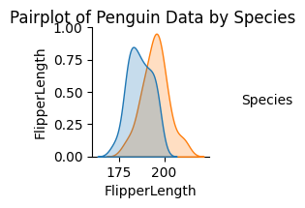
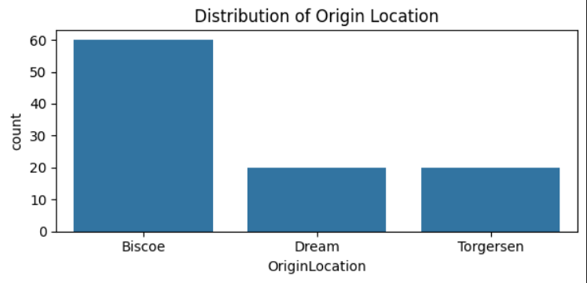
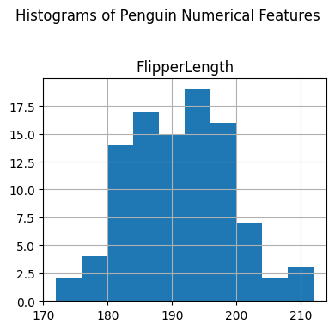
2.1 (FlipperLength-OriginLocation)->(Adelie-Chinstrap):

Slide 13
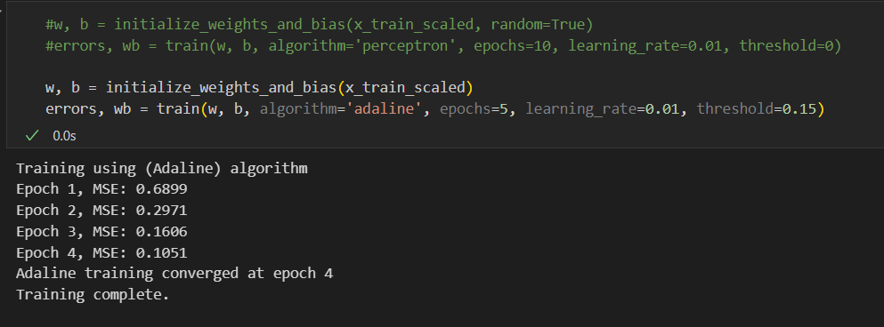
a. Adaline:

Slide 14
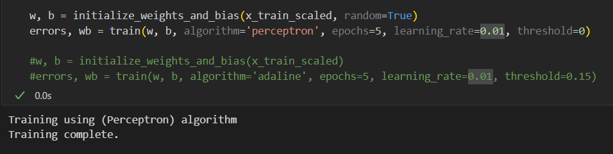

b. Perceptron:

Slide 15
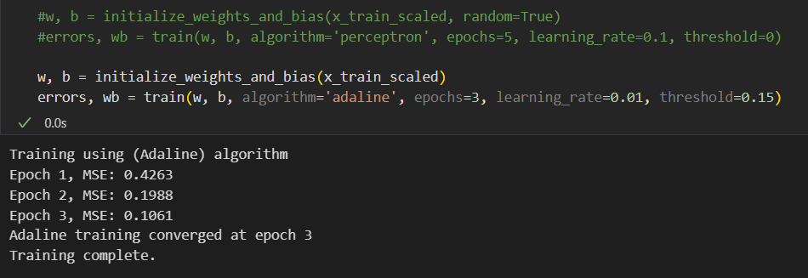
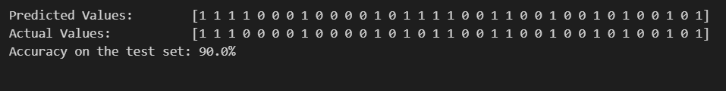
2.2 (FlipperLength-OriginLocation)->(Adelie-Gentoo): a. Adaline:

Slide 16
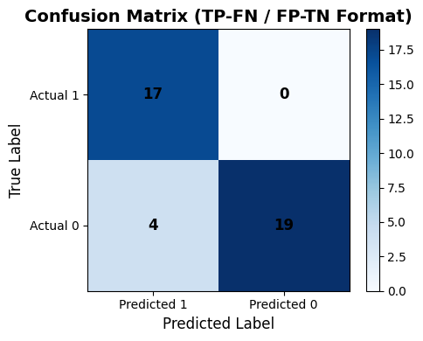
Adaline Conf_Matrix:

Slide 17
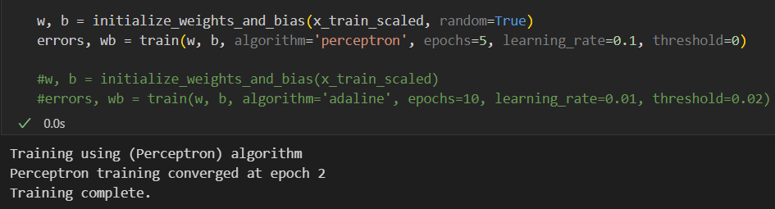
b. Perceptron:

Slide 18
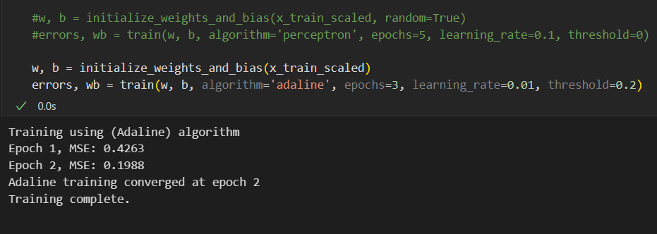
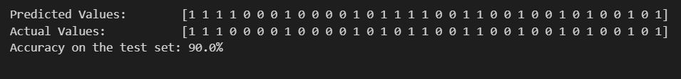
2.3 (FlipperLength-OriginLocation)->(Adelie-Gentoo): a. Adaline:

Slide 19
Adaline Conf_Matrix:

Slide 20
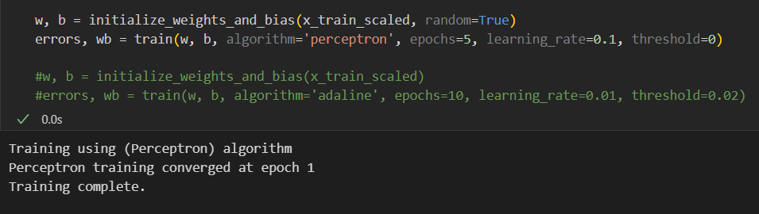
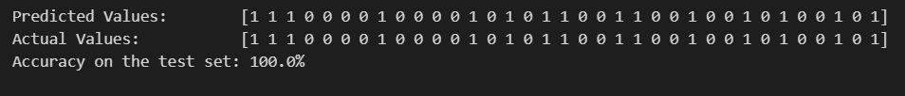
b. Perceptron:

Slide 21
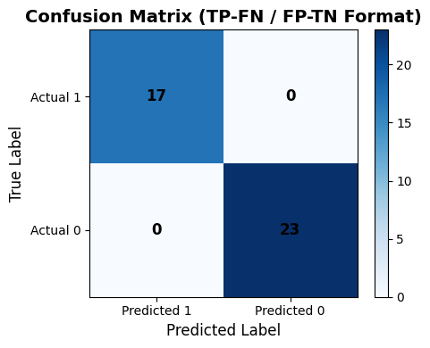
Perceptron Conf_Matrix:

Slide 22
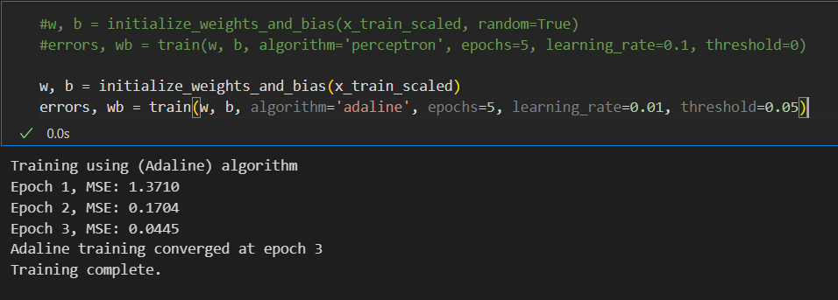
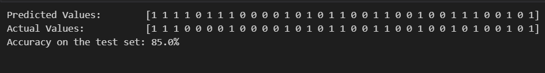
3. (FlipperLength-BodyMass)->(Gentoo-Adelie): a. Adaline:

Slide 23
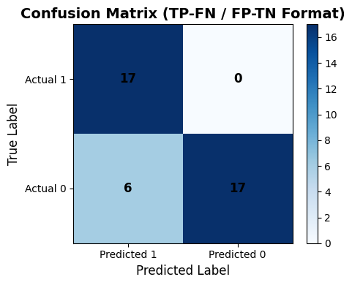
b. Adaline Conf_matrix:

Slide 24
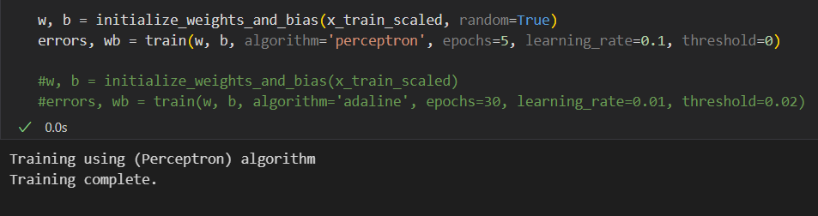
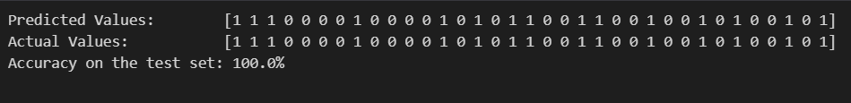
b. Perceptron:

Slide 25
b. Perceptron Conf_matrix:

Slide 26
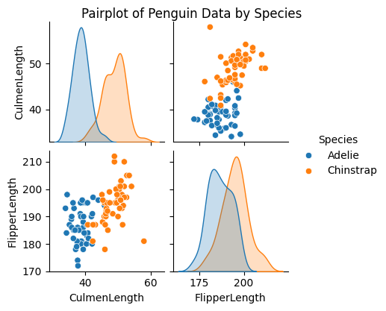
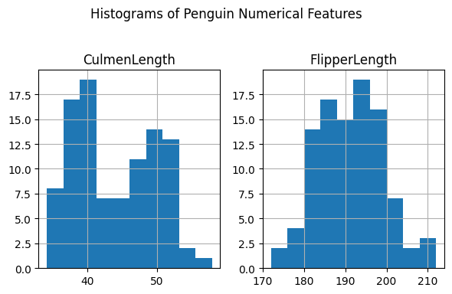
4. (CulmenLength-FlipperLength)->(Chinstrap-Adelie):

Slide 27
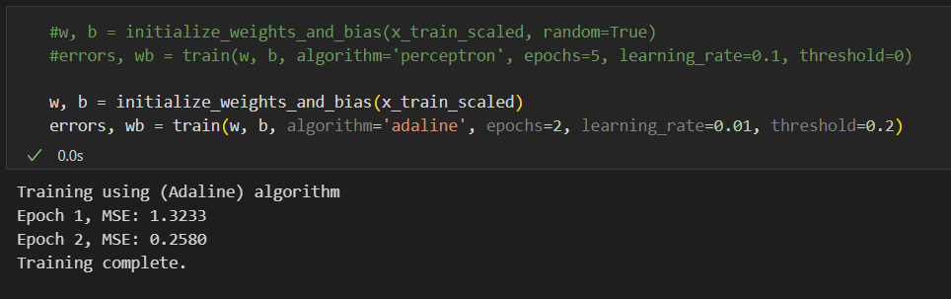
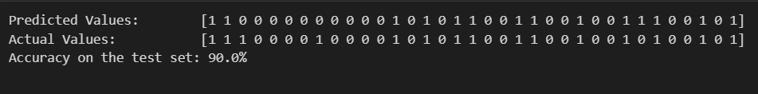
a. Adaline:

Slide 28
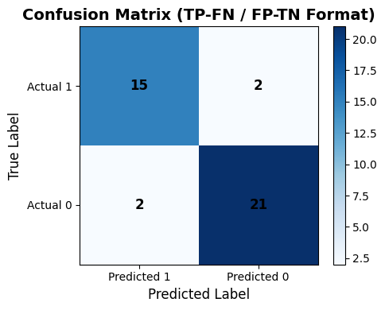
Adaline Conf_Matrix:

Slide 29
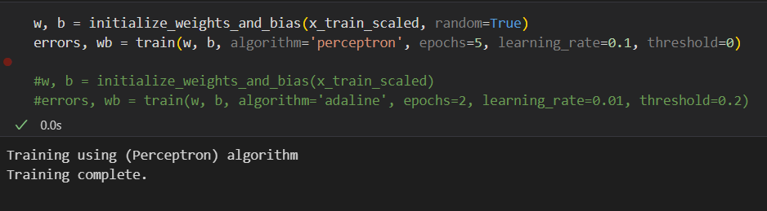
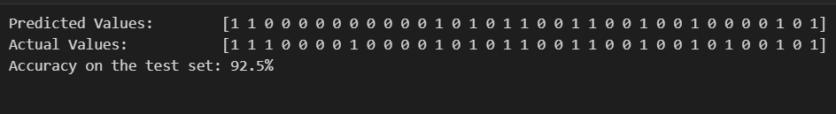
b. Perceptron:

Slide 30
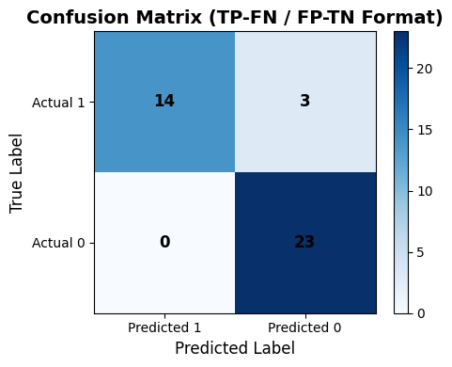
Perceptron Conf_Matrix:

