Slide 1
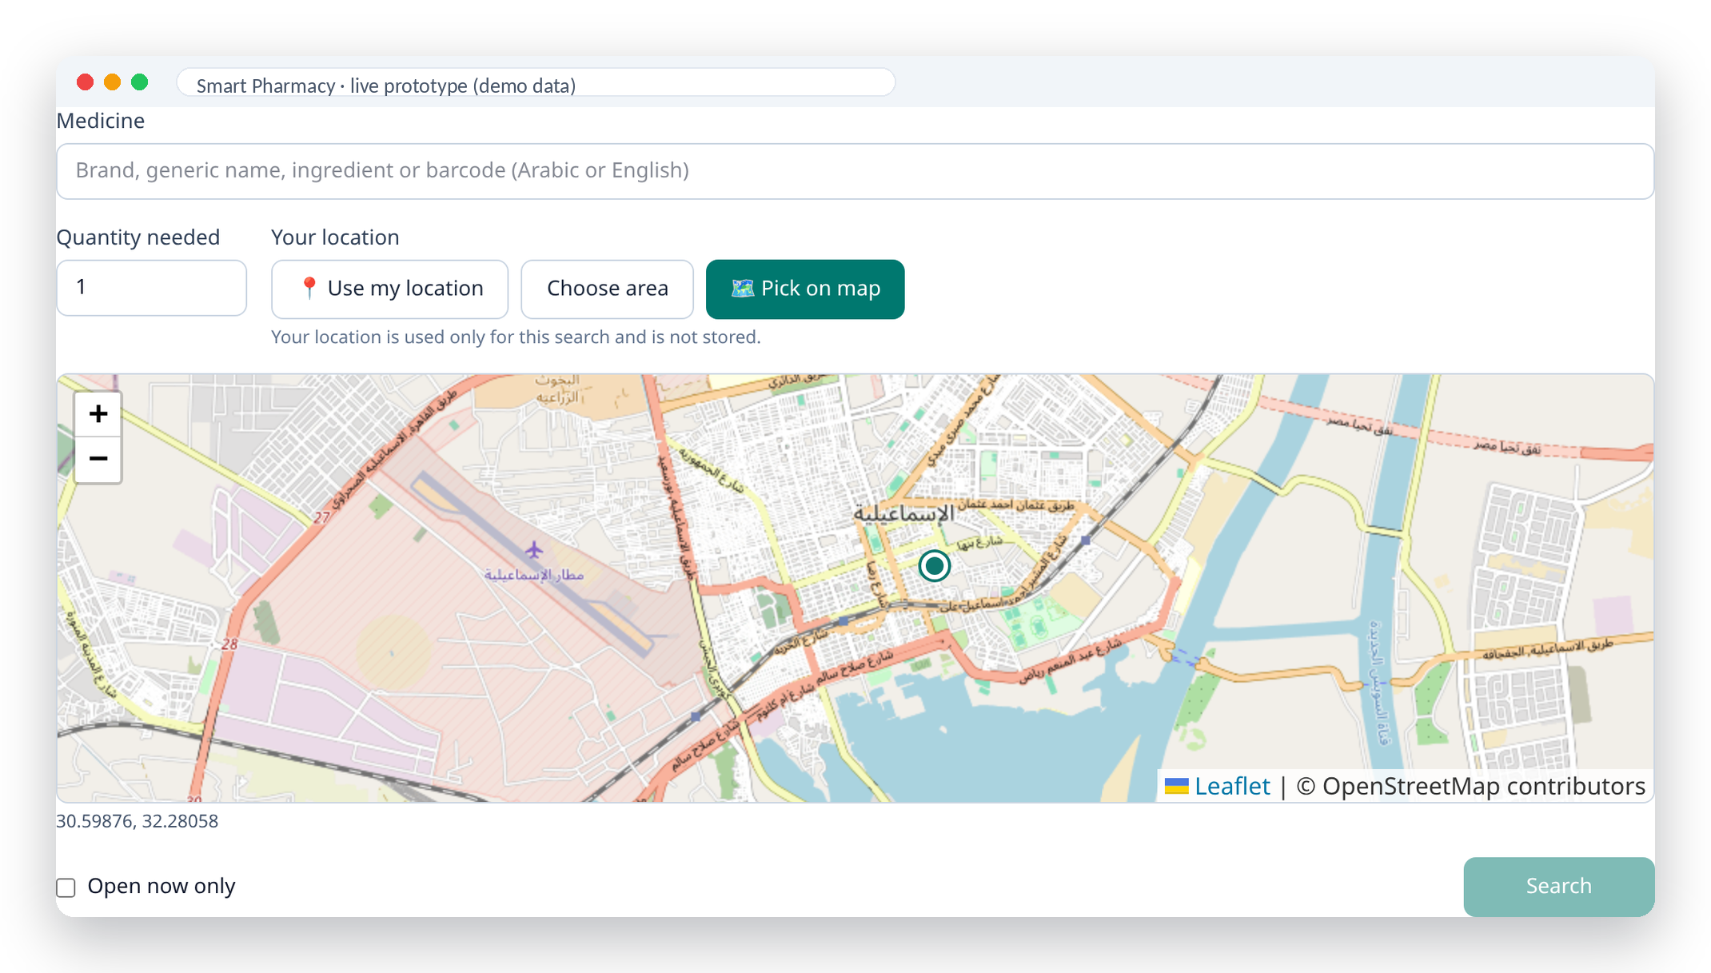
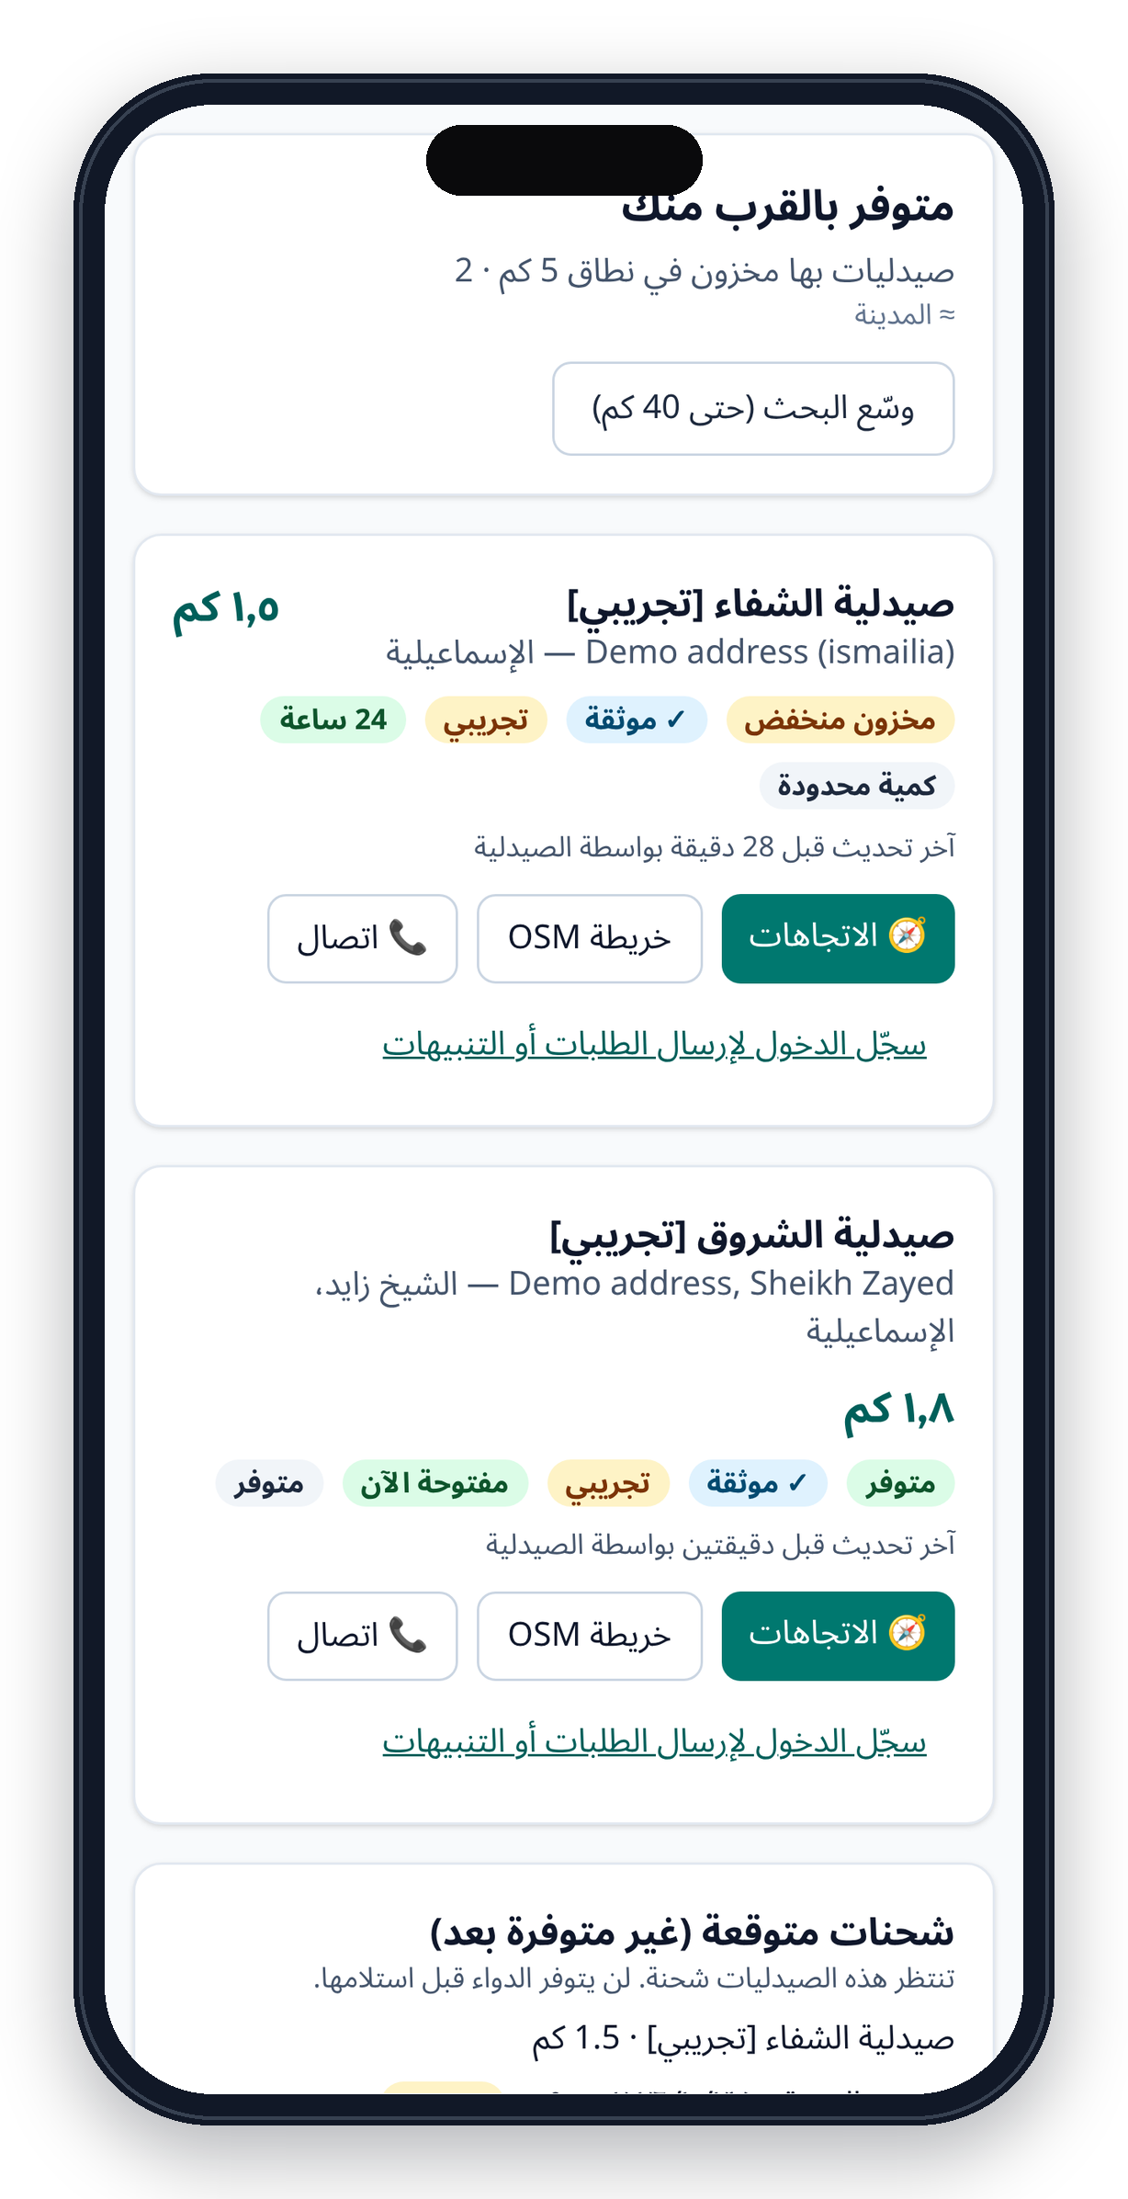
HACKATHON PITCH · 2026
Smart Pharmacy
الصيدلية الذكية
Find the nearest pharmacy that actually has your medicine — verified, fresh, in Arabic & English.
Patients
Pharmacies
Warehouses
Live prototype · demo data · Ismailia, Egypt
Ahmed Alsaholy · Ahmed Shahen · Khaled Zakarya · Mohamed Ekramy · Fayez Mohamed
Notes:
Hi — we're team Smart Pharmacy. In Egypt, when a medicine goes missing, patients don't know which pharmacy still has it. We built a working platform that shows the nearest verified pharmacy with fresh stock, and connects pharmacies and warehouses so that stock data stays honest. Everything you'll see is a live prototype running on clearly labelled demo data.

Slide 2
THE PROBLEM
When a medicine disappears, patients go pharmacy to pharmacy
ILLUSTRATIVE SCENARIO
Patients
Um Ahmed, 58, lives in Ismailia and takes Concor 5 mg for her blood pressure.
Her pharmacy is out. She calls six pharmacies, visits three — and still can't tell who has it, or when the next delivery arrives.
Lost time and money; some turn to black-market packs of unknown origin [11].
Pharmacists
About 30% of their time goes to checking stock and calling suppliers by hand [12].
Warehouses
Concor, Augmentin, Brufen and Cataflam were all reported short in 2024 [5][11].
No live view of where demand is — orders arrive by phone, shortages are spotted late.
~1,000
30M+
11M
of 17,000 registered medicines hit by shortages (Jul 2024) [5]
Egyptians with hypertension depend on chronic medicines [5]
people live with diabetes and need insulin and tablets every month [11]
Smart Pharmacy · الصيدلية الذكية
Sources: [5] [11] [12]
2
Notes:
This is a real pattern: in 2024 around a thousand medicines were reported short, including Concor, Augmentin, Brufen and Cataflam. Patients lose time and some buy from the black market. Pharmacists spend about 30% of their day chasing stock. Warehouses can't see demand.

Slide 3
THE PROBLEM IN NUMBERS
Shortages come and go — and nobody shares one live picture
Reported number of medicines in shortage — Egypt
20–40%
of trade names were short in mid-2024, while 15–20% of active-ingredient demand went unmet [7].
300
branded drugs had no available alternative in March 2025 [8].
40% → <5%
shortage share by late 2025 — yet insulin, cardiac and oncology medicines still go missing [9][10].
Patients need to know where the last boxes are — today.
* Branded trade names (FEI Pharmaceutical Chamber). Counts come from different bodies and definitions — that inconsistency is part of the problem [5][6][8][9].
Smart Pharmacy · الصيدلية الذكية
Sources: [5]–[10]
3
Notes:
Look at the numbers: depending on who counts, Egypt had between 200 and almost 1,500 medicines in shortage in the last two years. Even the official figures disagree — because nobody has a shared, live view of stock. Supply recovered by late 2025, but critical medicines still disappear.

Slide 4
ROOT CAUSE
95,000 pharmacies. Zero shared stock visibility.
95,000
≤ 2
Today: every link is a phone call
community pharmacies — one of the highest densities in the world [2]
pharmacies per pharmacist by law → mostly independent shops, no chain-wide inventory [13]
Rx ?
Rx ?
Patient
Warehouses
Rx ?
7,000+
~30%
Rx ?
products from ~3,000 suppliers, still ordered largely by phone [12]
of a pharmacist's time spent checking stock and prices manually [12]
Rx ?
No live stock · no delivery ETAs · no trust signal
Smart Pharmacy · الصيدلية الذكية
Sources: [2] [12] [13]
4
Notes:
Why does this happen? Egypt has around 95,000 pharmacies, mostly independent because the law limits ownership to two per pharmacist. There's no shared inventory system: stock lives in notebooks, isolated POS systems and phone calls to thousands of suppliers.

Slide 5
OPPORTUNITY
A large, fast-growing and digital-ready market
Egypt pharma market (EGP bn)
Registered pharmacists
109.5M
people in Egypt (CAPMAS, Sep 2026) [1]
96.3M
internet users · 81.9% penetration (Jan 2025) [14]
92.6M
mobile-internet subscriptions (Dec 2025) [15]
~4B
+43% in 2024 · +37% in 2025 — Egyptian Drug Authority [3][4]
4.4× in 20 years — Pharmacists Syndicate records [2]
medicine packs sold in 2025 (EDA) [4]
Smart Pharmacy · الصيدلية الذكية
Sources: [1]–[4] [14] [15]
5
Notes:
The market is big and growing: EGP 422 billion in 2025 according to the Egyptian Drug Authority, with 313,000 pharmacists. And Egyptians are online: 96 million internet users, mostly on mobile — so a mobile-first, Arabic-first service can reach them.

Slide 6
OUR SOLUTION
One verified network for medicine availability
Smart Pharmacy connects patients, pharmacies and warehouses around one question: who has this exact medicine, right now, near me?
For patients
For pharmacies
For warehouses
Search by brand, generic, ingredient or barcode — Arabic or English
Inventory with batches, expiry and low-stock alerts
Accept or partially fill orders with automatic allocation
Nearest verified pharmacies with fresh stock, 5 → 10 → 20 → 40 km
Every unit change recorded in an auditable ledger
Shipments, delivery dates and delays — with reasons
Directions, call, ask to confirm or hold — or get an alert
Order from warehouses; track incoming stock and ETAs
Resolve discrepancies; see real demand signals
Trust layer: admin-verified pharmacies · freshness labels · auditable stock ledger · privacy by design
Smart Pharmacy · الصيدلية الذكية
6
Notes:
Our solution is one network for three users. Patients search and find verified stock nearby. Pharmacies manage inventory with a tamper-proof ledger and order from warehouses. Warehouses fulfil orders, schedule deliveries and see real demand. A trust layer makes sure what patients see is verified and fresh.

Slide 7
HOW IT WORKS
From search to pickup — and from warehouse to shelf
1
Search
2
Locate
3
Rank
4
Act
Exact product: brand, generic, ingredient or barcode — Arabic or English
GPS (with consent), city / district, or a pin on the map
Verified & fresh stock first; expand 5 → 10 → 20 → 40 km
Directions, call, confirm or hold — or set an alert
Progressive radius search
Supply loop keeps stock honest
40 km
Stops at the first ring with verified, fresh stock.
Patients can expand anytime — up to 40 km (configurable).
One indexed query; results in milliseconds.
Pharmacy orders
Warehouse confirms & allocates
Shipment + ETA (delays flagged)
20 km
10 km
5 km
Patients see it instantly
Ledger updates stock
Pharmacy receives & verifies
Orders and dispatches never inflate pharmacy stock — only a verified receipt does.
Smart Pharmacy · الصيدلية الذكية
7
Notes:
A patient searches the exact product, shares a location or picks an area, and we rank verified, fresh stock first — starting at 5 km and expanding only if needed. Behind the scenes, the supply loop keeps data honest: orders and shipments never inflate stock; only a verified receipt updates the ledger, and patients see it immediately.

Slide 8
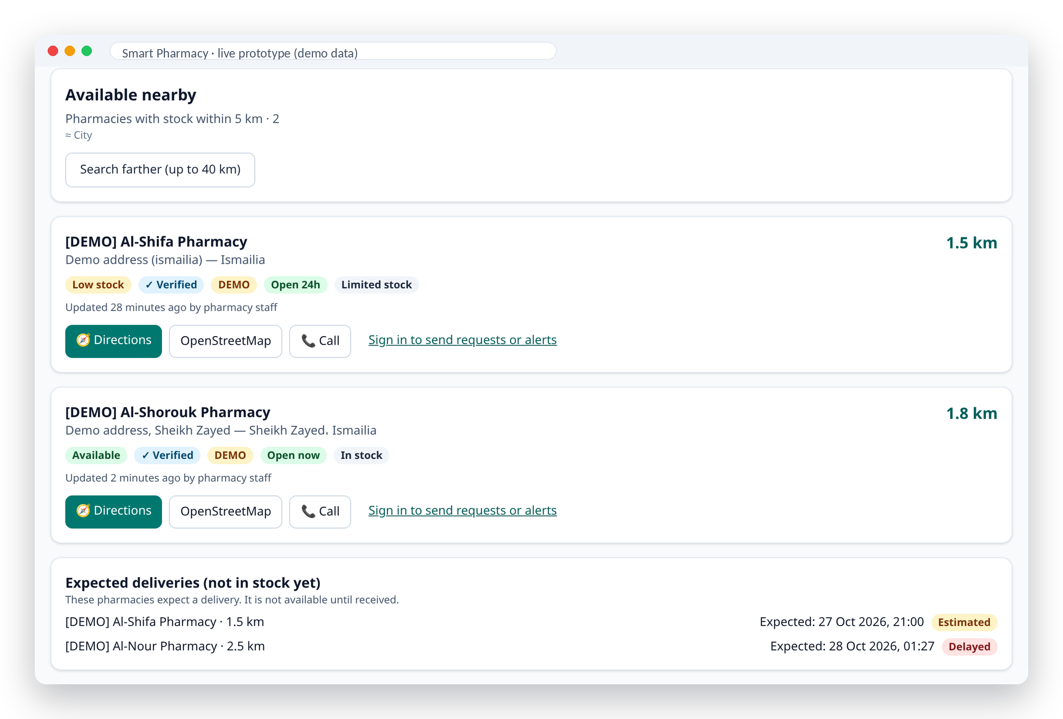
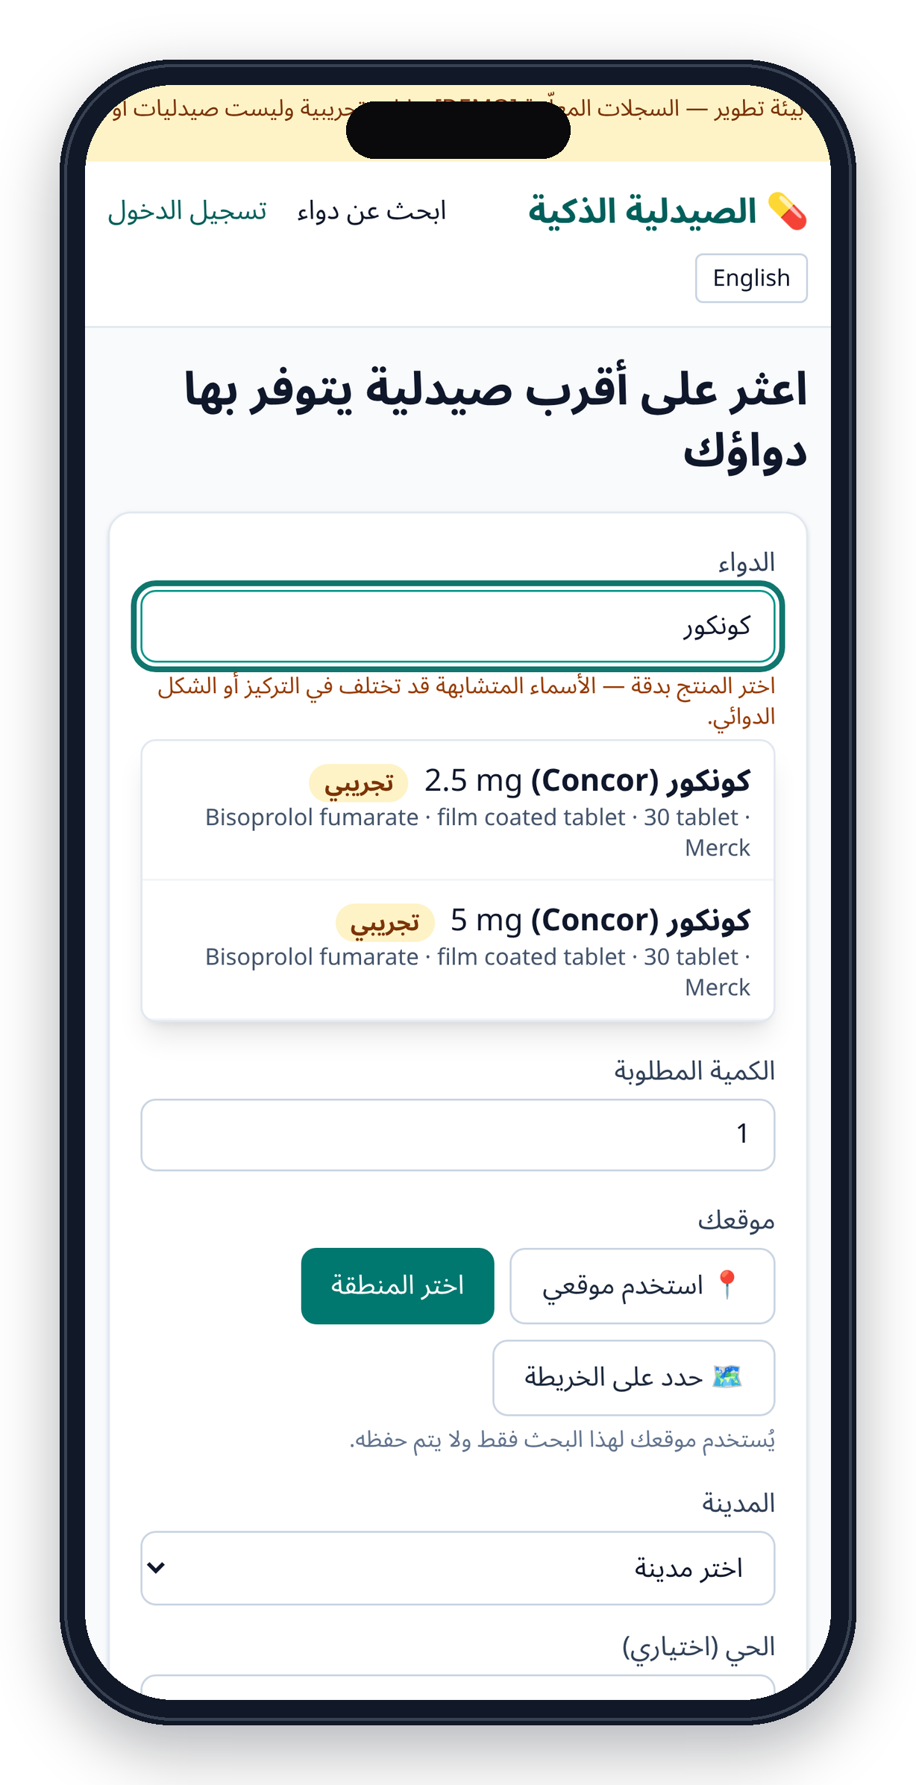
PRODUCT · PATIENTS
Patient finder — exact product, nearest verified stock
Distance · verified · open now · freshness — expected deliveries are kept separate, never counted as stock
Exact-product picker (5 mg ≠ 2.5 mg) · Arabic-first, right-to-left, no account needed
Smart Pharmacy · الصيدلية الذكية
8
Notes:
Here's the real app. The picker forces an exact choice — Concor 5 mg is never confused with 2.5 mg. Results show distance, a verified badge, opening status and how fresh the stock data is. Expected deliveries appear separately, so we never promise stock that isn't on the shelf.

Slide 9
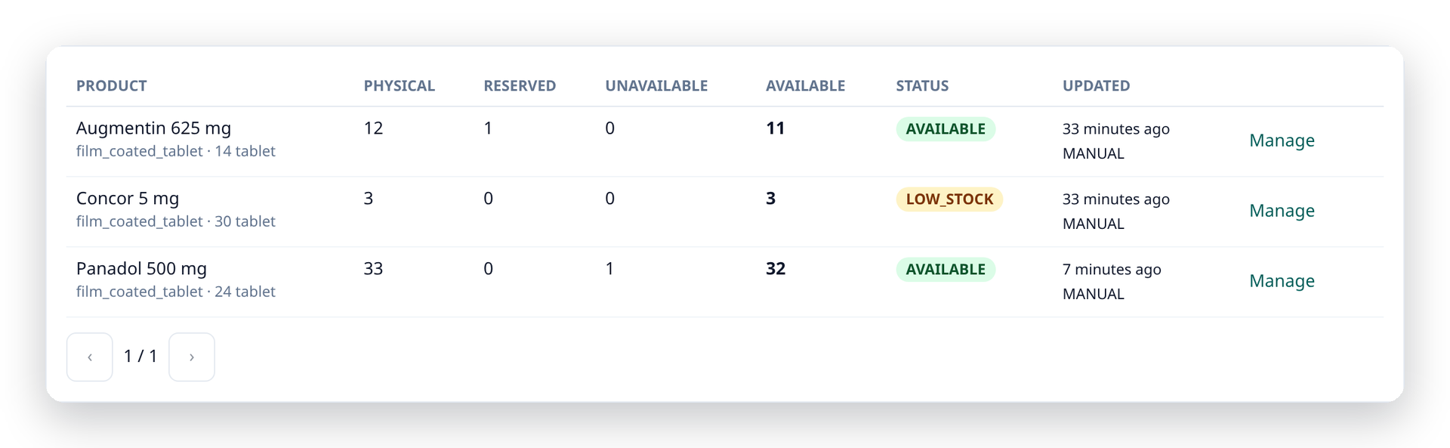
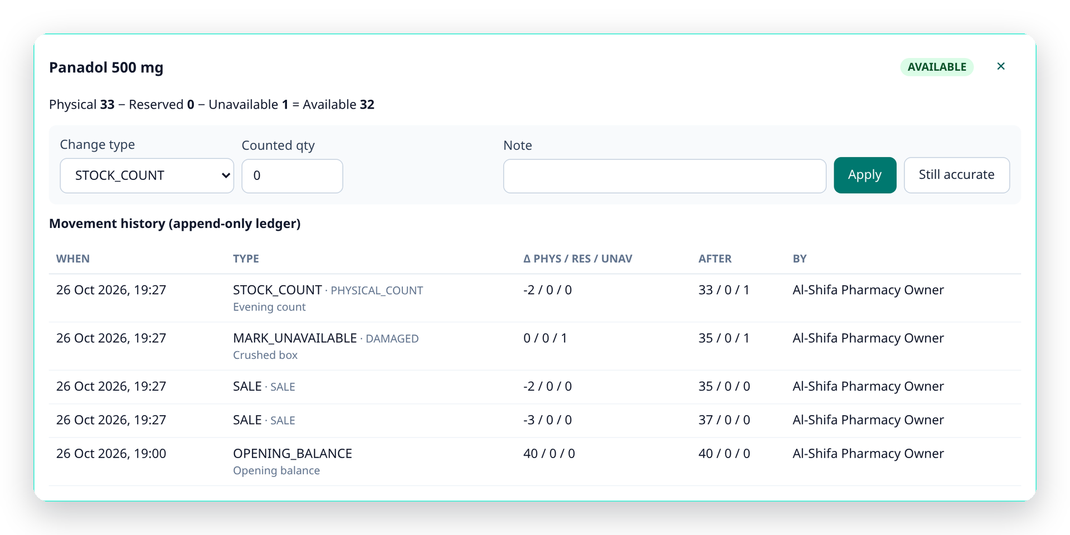
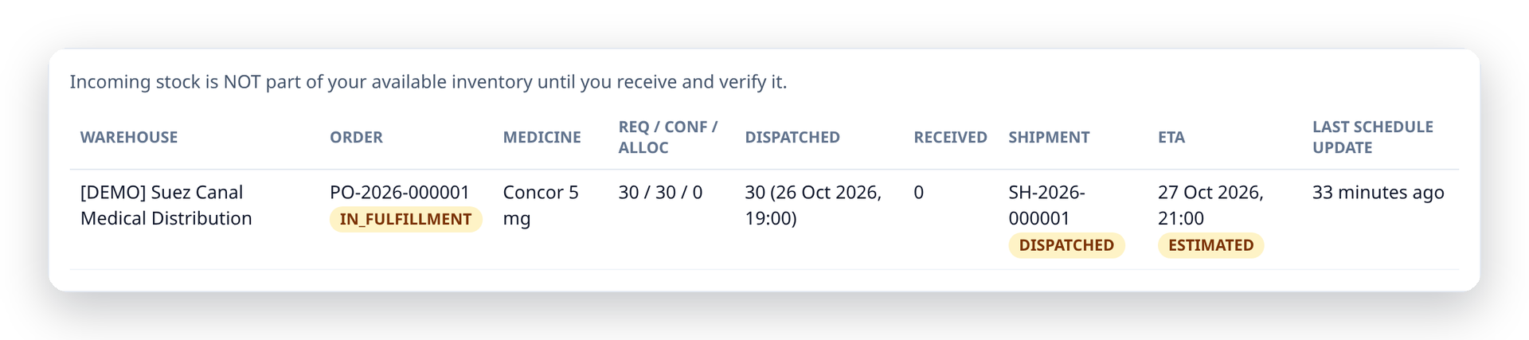
PRODUCT · PHARMACIES
Pharmacy workspace — inventory you can trust
Available = Physical − Reserved − Unavailable
Low-stock & expiry alerts · CSV import · barcode lookup
Incoming stock tracked from order to verified receipt — separate from shelf stock
Never negative — enforced by the database. Every change is an append-only ledger entry.
Patient confirmation requests and holds with pickup codes
Smart Pharmacy · الصيدلية الذكية
9
Notes:
For pharmacies: a clean inventory with clear availability, an incoming-stock view that tracks every order until verified receipt, and a ledger where every unit change is recorded. Available stock can never go negative — the database enforces it.

Slide 10
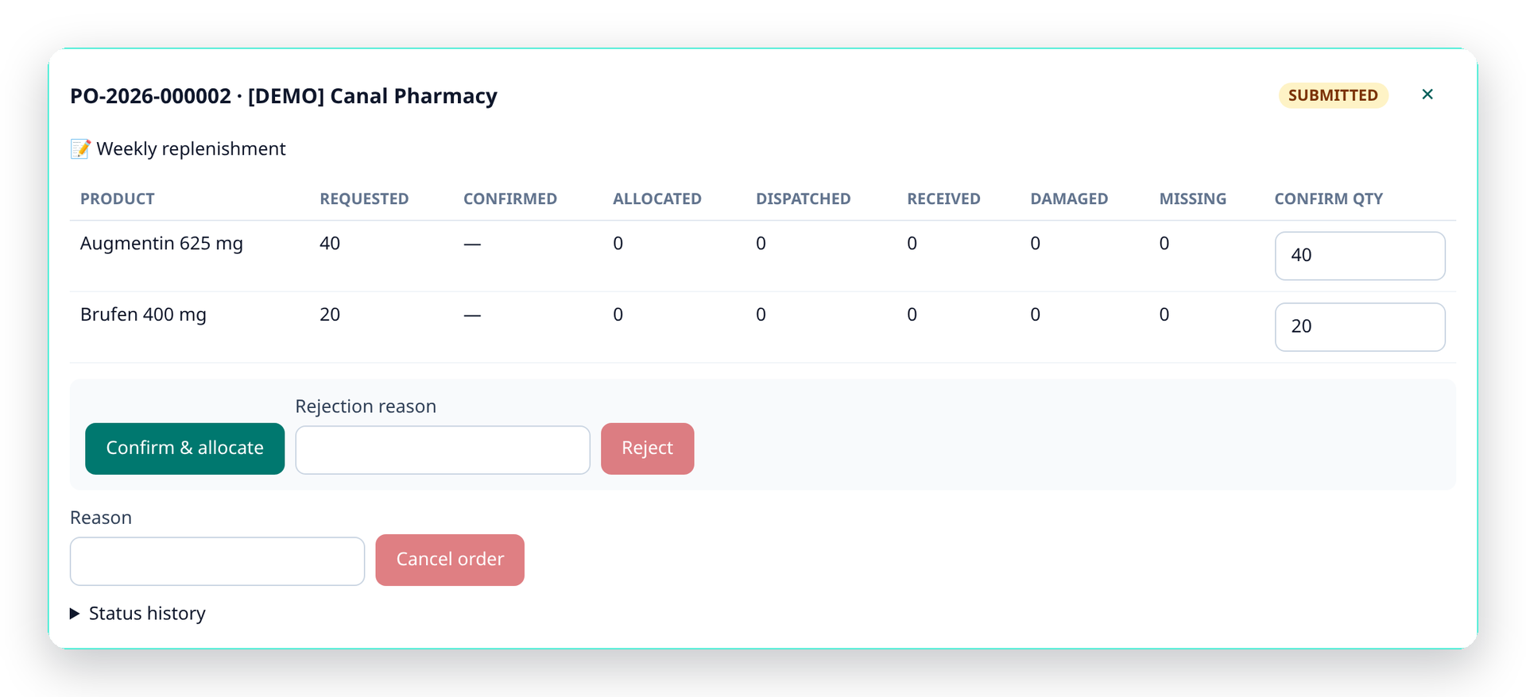
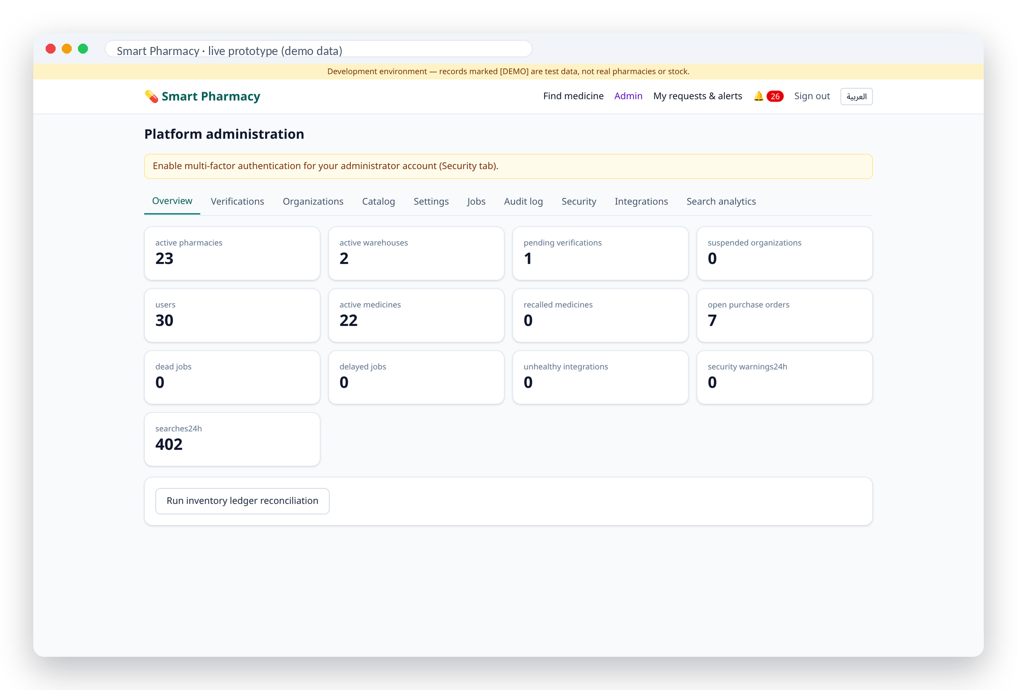
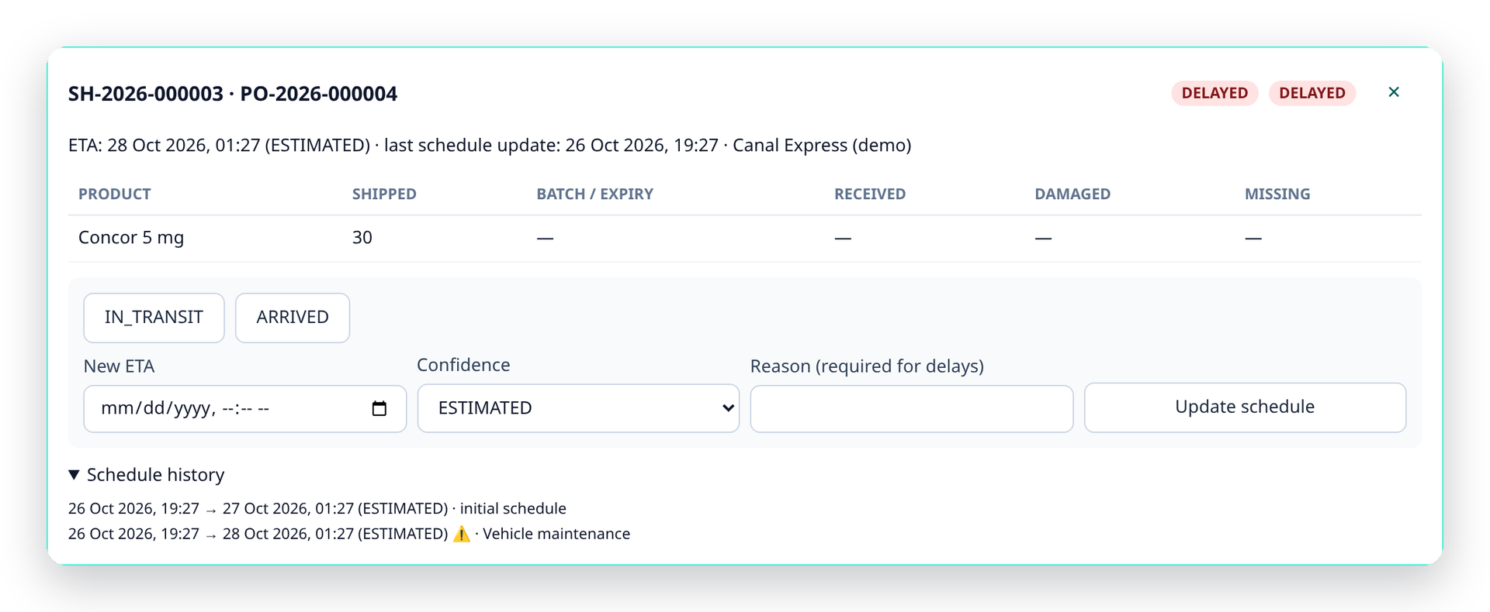
PRODUCT · WAREHOUSES & ADMIN
Warehouse operations and platform trust controls
Confirming an order reserves stock instantly — no overselling
Delays require a reason; pharmacies are notified automatically
Admins verify every pharmacy before patients can see it
Smart Pharmacy · الصيدلية الذكية
10
Notes:
Warehouses confirm orders — fully or partially — and the stock is reserved immediately, so it can't be sold twice. Shipments carry delivery dates with a confidence level, and delays need a reason. Admins verify every pharmacy and see platform health, jobs and audit logs.

Slide 11
TRUST BY DESIGN
What patients see is verified, fresh — and provable
Freshness windows (configurable)
What patients see
Guarantees
Update source
Confirmed
Outdated after
Available
Available stock can't go negative (DB-enforced)
Pharmacy POS integration
2 h
24 h
Low stock
Append-only ledger: every unit traceable
Staff update · barcode · delivery receipt
12 h
72 h
Recently reported — unconfirmed
Duplicate-safe orders & syncs
CSV import
24 h
7 days
Fewer units than requested
Pharmacies can't touch each other's data
Outdated — call first
Admin MFA, audit logs, rate limits
A failing or silent integration is automatically downgraded — it can never look fresh.
Expected delivery — not in stock
Location used once, never stored
Ranking rule: a closer but unconfirmed listing never outranks a farther verified and recently updated one.
Smart Pharmacy · الصيدلية الذكية
Sources: [18]
11
Notes:
Trust is the core. Every listing carries a freshness label based on its source: integrations are fresh for 2 hours, staff updates for 12. Outdated data is labelled and pushed down. The database guarantees stock can't go negative, every change is in an append-only ledger, and a closer unconfirmed listing never beats a verified one.

Slide 12
DATA FROM THE PROTOTYPE
Every search becomes a signal
Simulated traffic: 402 patient searches across 24 demo pharmacies in Ismailia governorate — demo data, shown to illustrate the analytics, not market results.
Search outcomes
Where stock was found
Freshness of listings
Insight: all 22 unmet searches were for Mixtard 30 100 IU/mL — stocked only at a warehouse. That is the demand signal suppliers and authorities need, captured without storing personal data.
Smart Pharmacy · الصيدلية الذكية
Sources: [18] — live query of the prototype database
12
Notes:
These charts come straight from our prototype's database. We simulated 400 patient searches on demo data. Most found stock within 5 km; outlying towns needed the wider rings. The interesting part: every unmet search was for insulin, which only a warehouse had. That's a demand signal — anonymous — that warehouses and authorities can act on.

Slide 13
PROOF IT WORKS
A working prototype — measured, not mocked
Finder response time (ms)
67/67
20/20
95
automated tests passing
end-to-end acceptance steps
documented REST API endpoints
0
0
AR · EN
stock-ledger mismatches
known dependency vulnerabilities
full right-to-left support
Automated tests by area
Synthetic load: 3,000 pharmacies · 90,000 stock lines · 2-vCPU sandbox · 109 requests/s at 10 concurrent users.
Smart Pharmacy · الصيدلية الذكية
Sources: [18]
13
Notes:
This isn't a mockup. 67 automated tests pass, including a 20-step end-to-end acceptance test covering admin, pharmacy, warehouse and patient. Search answers in 15 milliseconds at the median on 3,000 synthetic pharmacies, and the stock ledger reconciles with zero mismatches.

Slide 14
COMPETITION
Where we fit — and why we're different
What only we combine
Smart Pharmacy
1
Live, verified multi-pharmacy availability with freshness labels
EDA 'Availability' reports
patients + pharmacies + warehouses, live
2
Progressive 5 → 40 km search; Arabic-first; works without an account or GPS
Pharmacy chain apps
Ordering & delivery ←→ Live availability & supply
3
Warehouse → pharmacy loop: incoming stock visible, receipts update stock
4
Auditable stock ledger — no overselling, every unit traceable
Chefaa
Pharmacy Marts
Vezeeta
Yodawy
iSupply
5
Anonymous demand signals (unmet searches) for suppliers & regulators
Patient-facing ←→ Pharmacy & supply-facing (B2B)
Positioning based on public company descriptions (2023–2026); competitors may offer features not shown — not a feature audit.
Smart Pharmacy · الصيدلية الذكية
Sources: [12] [16] [17]
14
Notes:
Existing players are strong at what they do: Chefaa, Yodawy and Vezeeta focus on ordering and delivery; Pharmacy Marts and iSupply digitise pharmacy procurement; the Drug Authority collects shortage reports. We sit across these: live, verified availability for patients, connected to the pharmacy and warehouse supply loop.

Slide 15
BUSINESS MODEL & GO-TO-MARKET
Free for patients. Valuable for the supply chain.
Pharmacy Pro (SaaS)
Go-to-market
Free listing & stock updates; Pro adds ledger analytics, POS integration, team accounts and alerts.
1
Pilot · Ismailia
1.5M people [1] · 5–10 pharmacies + 1 warehouse · 8 weeks
Warehouse plan
2
Suez Canal cities
Order & shipment management for distributors + a small fee per fulfilled order.
Port Said · Suez · Ismailia governorate towns
Demand insights
3
Greater Cairo
Aggregated, anonymised shortage & demand signals for distributors, manufacturers and authorities.
Partner with national distributors and pharmacy groups
Proposed model — to be validated during the pilot.
Pilot KPIs
Search success rate · time-to-medicine · % fresh listings · request response time · shortage signal lead time
Patients always free · no selling of personal data
Smart Pharmacy · الصيدلية الذكية
Sources: [1]
15
Notes:
Patients will always use it for free. Revenue comes from pharmacies upgrading to Pro features, warehouses using order and shipment management, and anonymised demand insights. We'll validate this in an 8-week pilot in Ismailia with 5 to 10 pharmacies and one warehouse, then expand along the Suez Canal and to Cairo.

Slide 16
ROADMAP
Built in this hackathon — ready for a pilot
✓
Done · MVP
2
Next 3 months
3
6–12 months
Patient finder (AR / EN, RTL)
Ismailia pilot with real pharmacies
Demand forecasting & reorder suggestions
Inventory ledger, CSV & barcode
SMS / WhatsApp availability alerts
Insurance & e-prescription partners
Orders, shipments & receiving
Password reset & e-mail verification
Expansion to Greater Cairo
Admin verification & audit logs
POS connectors
Open API for health authorities
67 automated tests passing
Verified catalog import (EDA data)
Supplier performance scorecards
Smart Pharmacy · الصيدلية الذكية
16
Notes:
We've built the core this hackathon. Next: a real pilot in Ismailia, SMS and WhatsApp alerts, POS connectors and a verified catalog from Drug Authority data. Then forecasting, insurance partners and expansion to Cairo.

Slide 17
TEAM
The team behind Smart Pharmacy
AA
AS
KZ
ME
FM
Ahmed Alsaholy
Ahmed Shahen
Khaled Zakarya
Mohamed Ekramy
Fayez Mohamed
BUILT WITH
NestJS
PostgreSQL + PostGIS
Next.js
React
TypeScript
Tailwind CSS
Thank you — let's make every medicine findable. شكرًا
Smart Pharmacy · الصيدلية الذكية
17
Notes:
We're a team of five: Ahmed Alsaholy, Ahmed Shahen, Khaled Zakarya, Mohamed Ekramy and Fayez Mohamed. Thank you — we'd love your questions, and we'd love to pilot this with real pharmacies.

Slide 18
SOURCES
Data sources
[1] CAPMAS population clock via EgyptToday (19 Sep 2026): 109.5M residents; Ismailia 1.5M
https://www.egypttoday.com/Article/1/149579/Egypt%E2%80%99s-domestic-population-reaches-109-5-Million-CAPMAS
[2] Egyptian Pharmacists Syndicate records, in Expl. Res. Clin. Soc. Pharmacy (2023): 95,000 pharmacies; 313k pharmacists
https://www.sciencedirect.com/science/article/pii/S2667276623001658
[3] Egyptian Drug Authority via Daily News Egypt (3 Jun 2025): market EGP 216bn (2023) → 309bn (2024)
https://www.dailynewsegypt.com/2025/06/03/egypts-pharmaceutical-market-hits-egp-309bn-in-2024-marking-43-growth/
[4] Egyptian Drug Authority via Arab Finance (Jul 2026): EGP 422bn in 2025 (+37%), ~4bn packs
https://www.arabfinance.com/en/news/newdetails/exploring-egypt-rising-pharmaceutical-industry
[5] Middle East Monitor (30 Jul 2024): ~1,000 of 17,000 registered drugs short; Concor, Brufen, Cataflam; 30M+ hypertensive
https://www.middleeastmonitor.com/20240730-egyptians-face-illness-amid-a-serious-scarcity-of-medicines/
[6] Ahram Online (20 Aug 2024): shortages fell from ~1,000 to ~500 medicine types
https://english.ahram.org.eg/NewsContentP/1/530363/Egypt/Egypt-drug-shortage-crisis-Major-relief-around-the.aspx
[7] Business Monthly (23 Oct 2024): 800+ types short (FEI memo); 20–40% of trade names (CICMS)
https://businessmonthlyeg.com/pharmaceutical-shortages-worsen-in-egypt-how-government-and-pharmacists-respond/
[8] Zawia3 (25 Apr 2025): 1,471 branded drugs unavailable, 300 without alternatives (FEI Pharma Chamber, Mar 2025)
https://zawia3.com/en/psychiatric-medications/
[9] EnterpriseAM (3 Sep 2025): ~200 missing medicines in 2025; chronic & life-saving gaps persist
https://enterpriseam.com/egypt/2025/09/03/pharma-firms-push-for-price-hikes-as-shortages-and-black-market-resurface/
[10] Al Majalla (9 Dec 2025): shortages cut from 40% to under 5% of total supply
https://en.majalla.com/node/328622/business-economy/egypt%E2%80%99s-drug-price-increases-help-companies-not-patients
[11] The National (15 Feb 2024): Augmentin & chronic-drug shortages; ~11M with diabetes; black-market risk
https://www.thenationalnews.com/mena/egypt/2024/02/15/medicine-shortages-cairo-diabetes-drugs/
[12] Wamda (19 Mar 2024): ~30% of pharmacists' time on manual stock checks; 7,000+ products, 3,000 suppliers
https://www.wamda.com/2024/03/egypt-pharmacy-marts-secures-bridge-round-acasia-ventures
[13] Mada Masr (9 Mar 2021): law allows a pharmacist to own no more than two pharmacies
https://www.madamasr.com/en/2021/03/09/feature/economy/the-rise-and-fall-of-egypts-top-pharmaceutical-chain/
[14] Naos Solutions – Egyptians & Digital 2025 (DataReportal data): 96.3M internet users, 81.9%
https://naos-solutions.com/egyptians-and-digital-2025-report/
[15] IDSC via Zawya (20 Apr 2026): 92.6M mobile-internet subscriptions (Dec 2025)
https://www.zawya.com/en/business/technology-and-telecom/egypts-mobile-internet-users-hit-926mln-in-december-2025-idsc-hwrcfjnz
[16] Ahram Online: Egyptian Drug Authority 'Availability' service for reporting missing medicines
https://english.ahram.org.eg/UI/Front/Inner.aspx?NewsContentID=527162
[17] Competitor profiles – AccretiveEdge (Aug 2025: Yodawy, Chefaa, Vezeeta); Tracxn (Pharmacy Marts, iSupply)
https://accretiveedge.com/articles/healthtech-startups-middle-east/
[18] Smart Pharmacy prototype – team measurements, Oct 2026 (tests, latency on synthetic data, demo analytics)
Internal: docs/10-testing-and-quality.md and live demo database
Market figures as reported by the cited sources (retrieved Oct 2026). Screens and demo analytics use clearly labelled demo data from the prototype; performance figures are team measurements on synthetic data.
Smart Pharmacy · الصيدلية الذكية
18
Notes:
All market figures come from the sources listed here, with links. Prototype numbers are our own measurements, and every screen uses clearly labelled demo data.

