Slide 1

UART in STM32F10x
Sepehr Naimi
www.NicerLand.com

Slide 2
Topics
Communication Theory
Introduction to USART
STM32 USART Registers
STM32 USART Programming

Slide 3

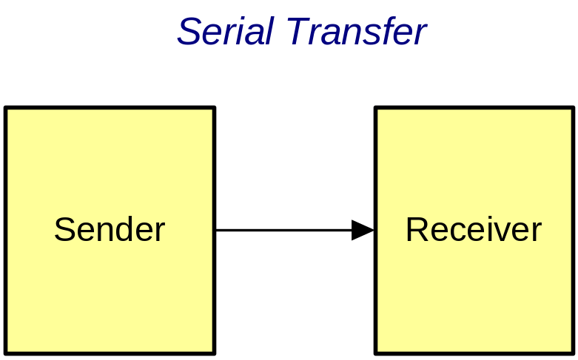
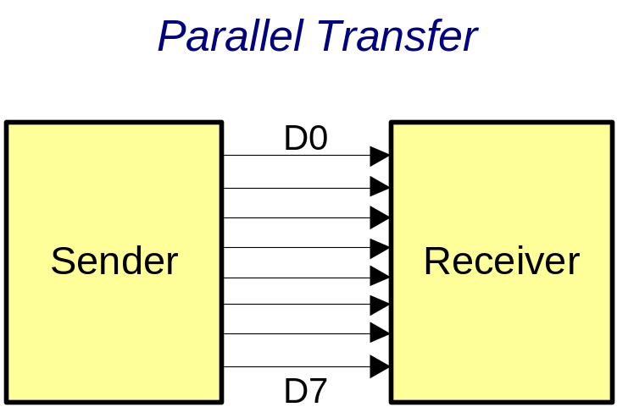
Serial vs. Parallel

Slide 4
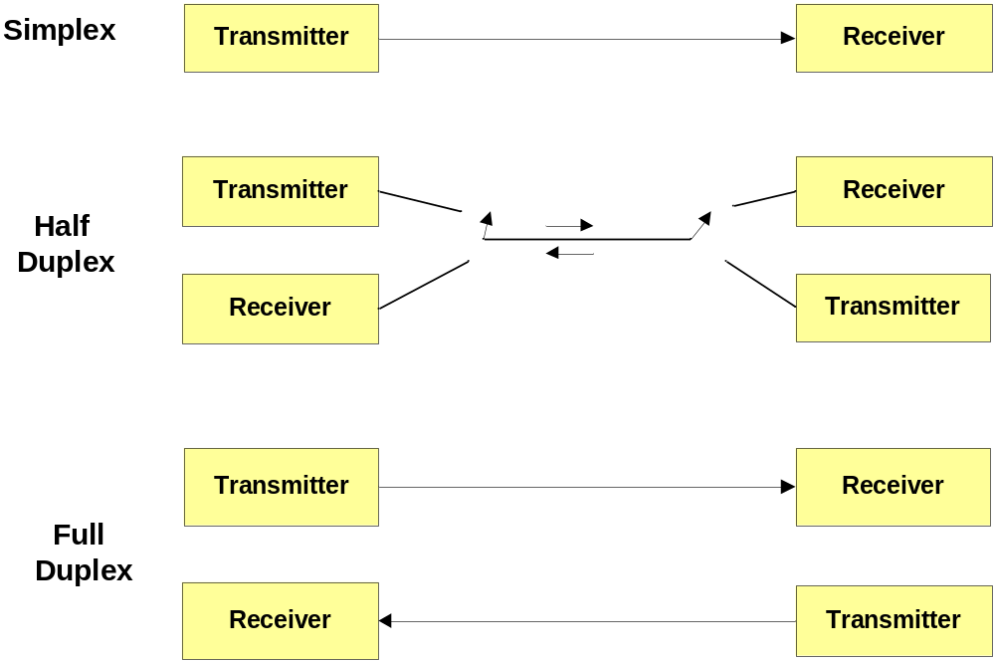
Direction

Slide 5
Synchronous vs. Asynchronous
Synchronous
Asynchronous
  No clock
data
data
data
data
clk
clk

Slide 6
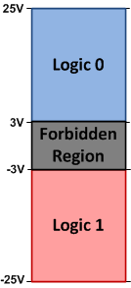
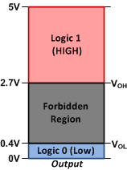
Line coding
Representing 1 and 0 using signals
  Level line coding
    TTL
    CMOS
    RS232
TTL
RS232

Slide 7
Introduction to USART Protocol

Slide 8
USART vs. UART
USART: Universal synchronous and asynchronous Receiver-transmitter
  Support both synchronous and asynchronous communications
UART: Universal asynchronous Receiver-transmitter

Slide 9
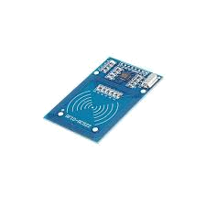
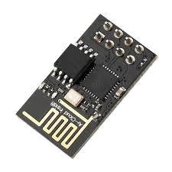
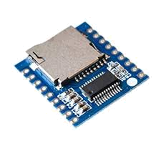
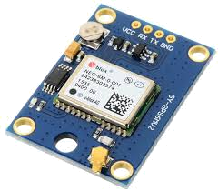
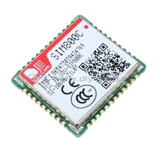
UART
Now, UART is widely used to communicate different devices with MCUs
SMS/GPRS
Wireless
RFID Card Reader
Voice Player
GPS

Slide 10
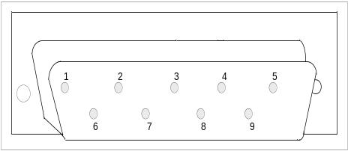
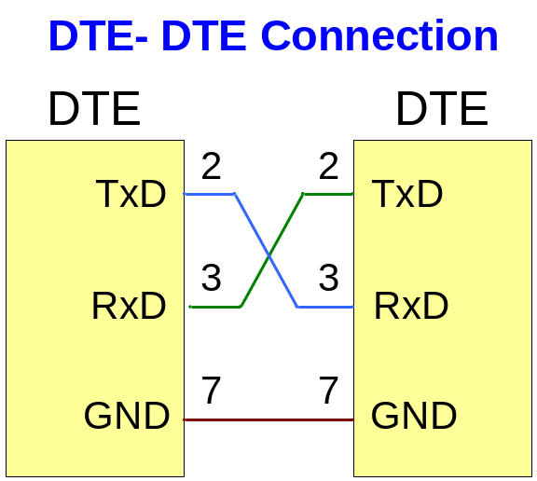
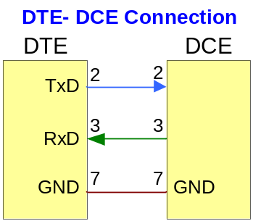
USART Pins
DCD (Data Carrier Detect)
RXD (Received Data)
TXD (Transmitted Data)
DTR (Data Terminal Ready)
GND (Signal Ground)
DSR (Data set ready)
RTS (Request to send)
CTS (Clear to send)
RI (Ring Indicator)

Slide 11
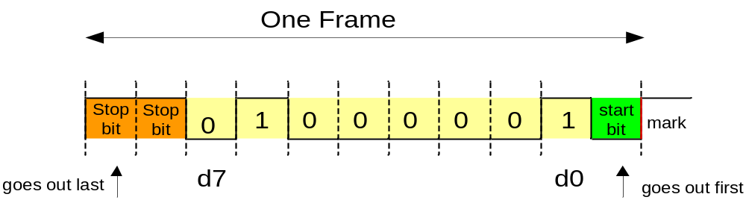
Sending data
Start bit (0)
Data
Parity bit (optional)
Stop bit (1)
The line becomes high for 1 or 2 bits to make sure that the start bit makes a falling edge
The receiver uses the falling edge to be synched with the sender
Then data is sent
The line is high when no data is sent
The transmitter sends a 0 bit as a start bit

Slide 12
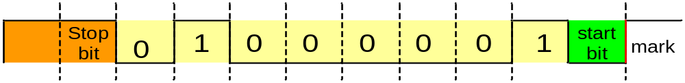
Speed (Baud rate)
Sample rate = send rate
Sample rate faster than sending
0
1
0
0
0
0
0
1
0
0
0
0
0
0
1
1

Slide 13
USART in STM32F10x

Slide 14
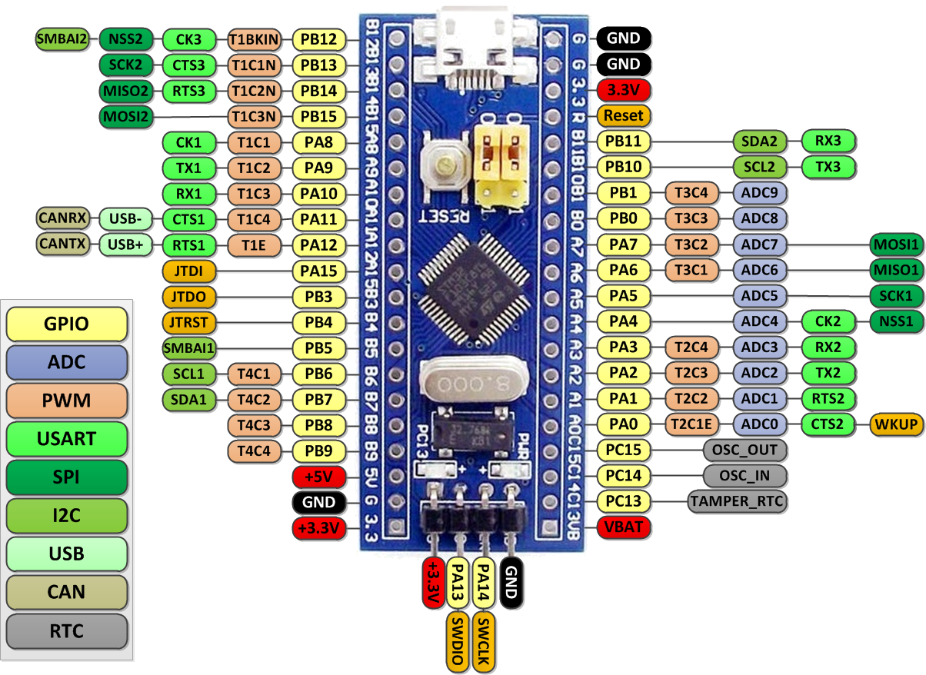
USART Pins in the Blue Pill
USART3
USART3
USART1
USART2

Slide 15
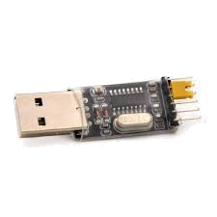
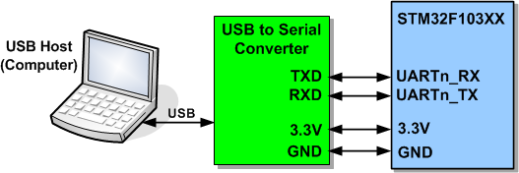
Connecting the Blue Pill to the PC using USART

Slide 16
USART Registers

Slide 17
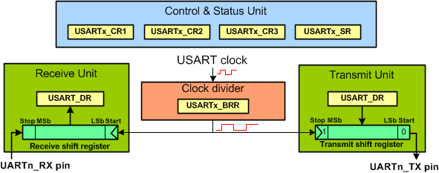
USART Registers

Slide 18
Configuring the USART

Slide 19
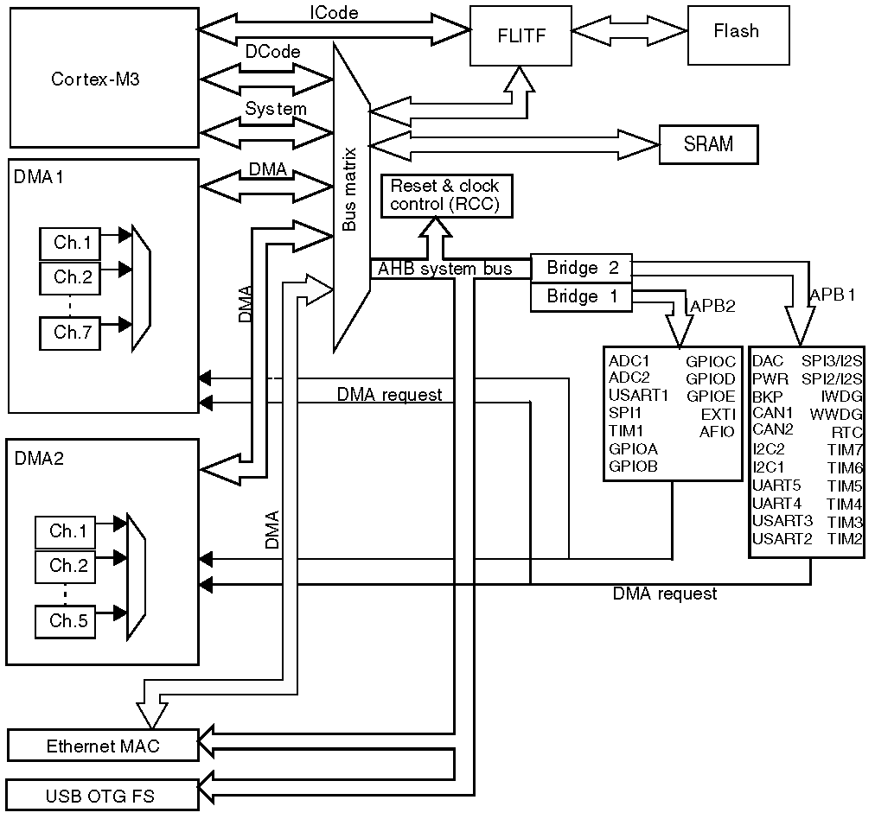
APB1, APB2, and AHB

Slide 20
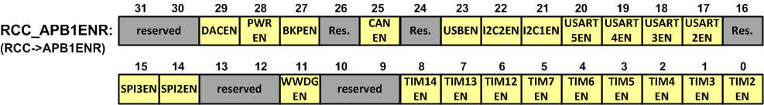
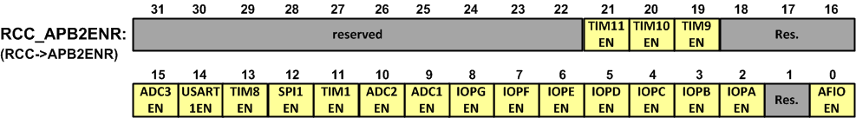
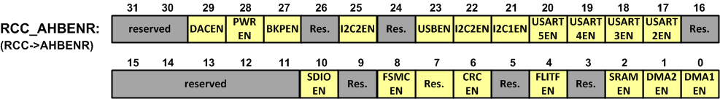
Enabling Clocks
Label | Description | Label | Description
IOPx | I/O port x clock enable | ADCnEN | ADCn clock enable
USARTnEN | USARTn clock enable | DACnEN | DACn clock enable
USBEN | USB clock enable | TIMnEN | TIMn timer clock enable
CANEN | CAN clock enable | SPInEN | SPI n clock enable
PWREN | Power interface clock enable | BKPEN | Backup interface clock enable
WWDG | Window watchdog clock enable | SDIOEN | SDIO clock enable
DMAnEN | DMAn clock enable | FSMCEN | FSMC clock enable
CRCEN | CRC clock enable | I2CnEN | I2Cn clock enable
Note: (0: clock disabled, 1: clock enabled)

Slide 21
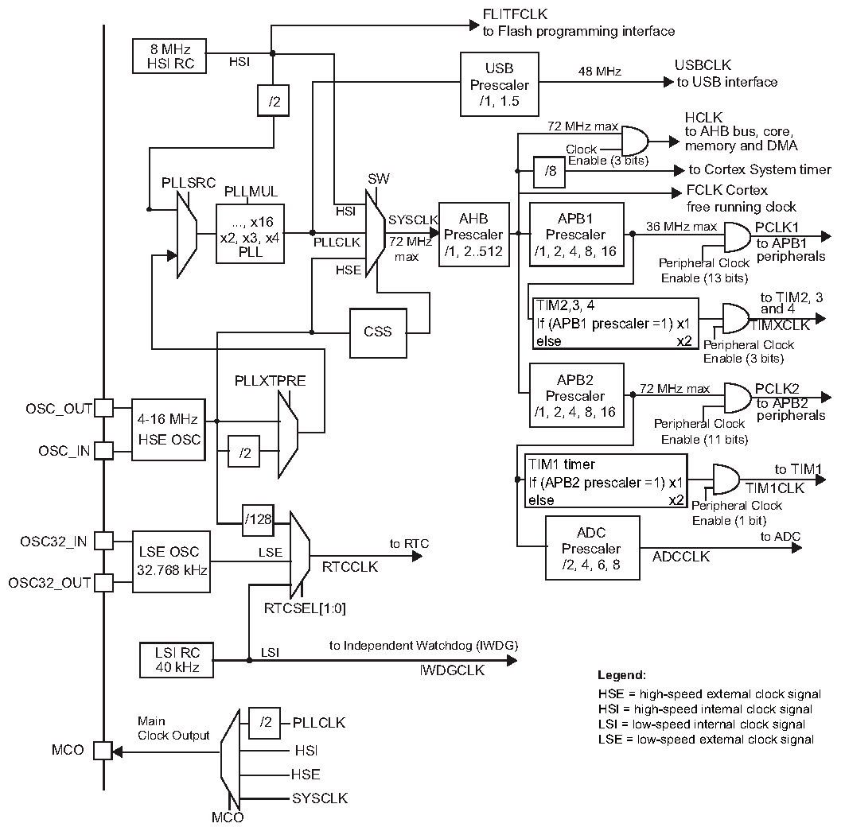
STM32F10X Clock
F_{PCLK1} is 36MHz by default
USART1
USART2
USART3
F_{PCLK2} is 72MHz by default

Slide 22
Baud rate
Baud rate = F_{PCLKx} / BRR

Slide 23
Example: Find BRR for USART1 with baud rate of 57600
Solution:
USART1 is connected to APB1 bus and F_{PLK1} is 36MHz by default.
BRR = F_{PLK1}/Baud rate = 36M/57600 = 625

Slide 24
Control Register 1 (CR1)
Field | Bit | Description
UE | D13 | 0 = USART prescaler and outputs disabled. 1 = USART enabled
M | D12 | Data format mode bit. We must use this to select 8-bit data frame size 0 = select 8-bit data frame and one start bit 1 = Select 9-bit data frame and one start bit
WAKE | D11 | Wake-up condition bit. See the user manual 0 = Idle line wakeup 1 = Address mark wake-up
PCE | D10 | Parity Control Enable bit. This will insert a parity bit right after the MSB bit. 0 = no parity bit 1 = parity bit
PS | D9 | Parity select (used only if PE is one.) 0 = even parity bit 1 = odd parity bit
PEIE | D8 | PE interrupt enable 0 = disabled 1 = A USART interrupt is generated whenever the PE flag of USART_SR is set.
TXEIE | D7 | TXE interrupt enable 0 = disabled 1 = A USART interrupt is generated whenever the TXE flag of USART_SR is set.
TCIE | D6 | Transmission complete interrupt enable 0 = disabled 1 = A USART interrupt is generated whenever the TC flag of USART_SR is set.
RXNEIE | D5 | RXNE interrupt enable 0 = disabled 1 = A USART interrupt is generated whenever ORE or RXNE are set.
IDLEIE | D4 | Idle interrupt enable 0 = disabled 1 = A USART interrupt is generated whenever the IDLE bit of USART_SR is set.
TE | D3 | Transmitter enable (The bit enables the USART transmitter) 0 = transmitter is disabled 1 = transmitter is enabled
RE | D2 | Receiver enable (The bit enables the USART receiver) 0 = disable the receiver 1 = enable the receiver
RWU | D1 | Receiver wakeup 0 = Receiver in active mode 1 = Receiver in mute mode (See the user manual for more information)
SBK | D0 | Send break (0 = do not send, 1 = send break character) See the user manual.

Slide 25
Control Register 2 (CR2)
Field | Bit | Description
STOP | D12,D13 | Number of stop bits 0 = 1 stop bit 1 = 0.5 stop bit 2 = 2 stop bits 3 = 1.5 stop bits

Slide 26
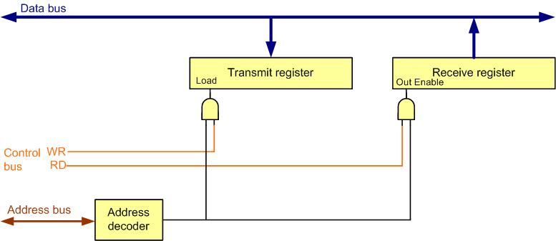
Data Register (DR)

Slide 27
Status Register (SR)
Field | Bit | Description
CTS | D9 | When the CTS pin is changed the flag is set by hardware. For more information see the user manual.
LBD | D8 | LIB break detection flag (See the user manual)
TXE | D7 | Transmit data register Empty 0 = Data is not transferred to the shift register yet. 1 = The Data Register is empty and ready for the next byte.
TC | D6 | Transmit Complete flag (The flag is set by hardware. To clear the flag, you can write a zero to it. If you read the USART_SR and then write to the USART_DR register, the flag will be automatically cleared.) 0 = Transmission is in progress (shift register is occupied) 1 = Transmission complete (both shift register and Data Register are empty)
RXNE | D5 | Receive Data Register not empty flag. This indicates a byte has been received and is sitting in USART Data Register and ready to be picked up. 0 = No data is available in USART Data Register. 1 = Data is available in USART Data Register and ready to be picked up.
IDLE | D4 | Idle line detected. See the user manual.
ORE | D3 | Overrun error (The flag is set by hardware, if a new byte of data is received while RXNE is set.) 0 = No overrun 1 = Overrun error
NF | D2 | Noise error Flag bit (The bit is set by hardware, if noise is detected on the received frame.) 0 = No noise 1 = Noise error
FE | D1 | Framing Error bit (The bit is set by hardware, if de-synchronization, noise or a break character is detected.) 0 = No framing error 1 = Framing error
PF | D0 | Parity flag error bit (The bit is set by hardware, if the received data has a parity error.) 0 = No parity error 1 = Parity error

Slide 28
Example: Sending “Hi\n\r” through USART1 with baud rate of 9600bps
#include "stm32f10x.h"
void delay_ms(uint16_t t);
void usart1_sendByte(unsigned char c);
int main()
{
RCC->APB2ENR |= 0xFC | (1<<14); //enable GPIO & USART1 clocks
//USART1 init.
GPIOA->ODR |= (1<<10); //pull-up PA10
GPIOA->CRH = 0x444448B4; /* RX1=input with pull-up, TX1=alt. func. output */
USART1->CR1 = 0x200C;
USART1->BRR = 7500; // 72MHz/9600bps = 7500
while(1)
{
usart1_sendByte('H');
usart1_sendByte('i');
usart1_sendByte('\n'); //go to new line
usart1_sendByte('\r'); //carrier return
delay_ms(1000); //wait 1 second
}
}
void usart1_sendByte(unsigned char c)
{
USART1->DR = c;
while((USART1->SR&(1<<6)) == 0); //wait until the TC flag is set
}
void delay_ms(uint16_t t)
{
volatile unsigned long l = 0;
for(uint16_t i = 0; i < t; i++)
for(l = 0; l < 6000; l++)
{
}
}

Slide 29
Example: Receiving data through USART2 and sending back with baud rate of 9600bps
#include "stm32f10x.h"
void usart2_sendByte(unsigned char c);
uint8_t usart2_recByte(void);
int main()
{
RCC->APB1ENR |= (1<<17); //enable usart2 clock
RCC->APB2ENR |= 0xFC; //enable GPIO clocks
//USART2 init.
GPIOA->CRL = 0x44448B44; //RX2=in, TX2=alt. func. Output
GPIOA->ODR |= (1<<3); // pull-up PA3(RX2)
USART2->CR1 = 0x200C;
USART2->BRR = 3750; //36MHz/9600 = 3750
while(1)
{
uint8_t receivedByte = usart2_recByte();
usart2_sendByte(receivedByte);
}
}
uint8_t usart2_recByte()
{
while((USART2->SR&(1<<5)) == 0); //wait until the RXNE flag is set
return USART2->DR;
}
void usart2_sendByte(unsigned char c)
{
USART2->DR = c;
while((USART2->SR&(1<<6)) == 0); //wait until the TC flag is set
}

Slide 30
Example: Receive a byte serially via USART1. If the received data is “H”, make PC13 high; If the received data is “L”, make PC13 low.
#include "stm32f10x.h"
uint8_t usart1_recByte(void);
int main()
{
RCC->APB2ENR |= 0xFC | (1<<14); /* enable GPIO and usart1 clocks */
/* USART1 init. */
GPIOA->ODR |= (1<<10); /* pull-up PA10 */
GPIOA->CRH = 0x444448B4; /* RX1=input with pull-up, TX1=alt. func output */
USART1->CR1 = 0x200C;
USART1->BRR = 7500; /* 72MHz/9600bps = 7500 */
GPIOC->CRH = 0x44344444;
while(1) {
uint8_t c = usart1_recByte();
switch(c) {
case 'H':
case 'h': GPIOC->ODR |= (1<<13); break; /* PC13 = high */
case 'L':
case 'l': GPIOC->ODR &= ~(1<<13); break; /* PC13 = low */
}
}
}
uint8_t usart1_recByte()
{
while((USART1->SR&(1<<5)) == 0); /* wait until the RXNE flag is set */
return USART1->DR;
}

