Slide 1
Timer

Slide 2
Introduction to Timers and Counters

Slide 3
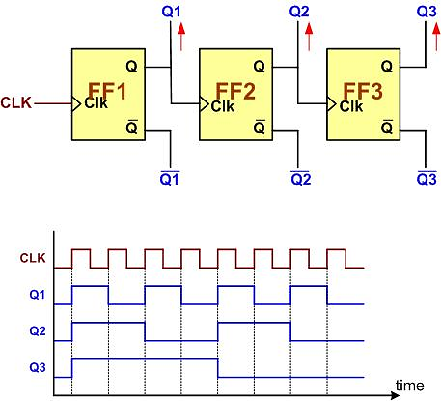
Creating Counters using Flip Flops

Slide 4


8-bit counter Stages
Up-counter
Down counter

Slide 5

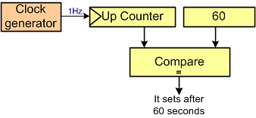

Some Counter Usages
Event Counter
Timer
Measuring the time between 2 events

Slide 6
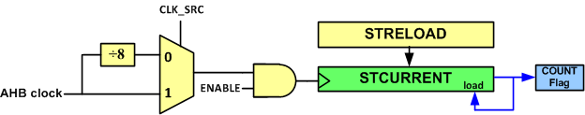
System Tick Timer
Available in all Cortex-M MCUs
It is a 24-bit down counter. It counts down from an initial value to 0.
Used to initiate an action on a periodic basis
  OS ticks
SysTick->LOAD
SysTick->VAL

Slide 7

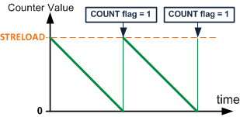
System Tick Counting

Slide 8

STCTRL (System Tick Control) Register
Name | bit | Description
ENABLE | 0 | 0: The counter is disabled, 1: enables SysTick to begin counting down
TICKINT | 1 | Interrupt Enable 0: Interrupt generation is disabled. 1: when SysTick counts to 0 an interrupt is generated
CLKSOURCE | 2 | Clock Source 0: AHB clock divided by 8 1: AHB clock
COUNTFLAG | 16 | Count flag 0: The SysTick has not counted down to zero since the last time this bit was read 1: The SysTick has counted down to zero Note: This flag is cleared by reading the STRCTRL or writing to STCURRENT.

Slide 9
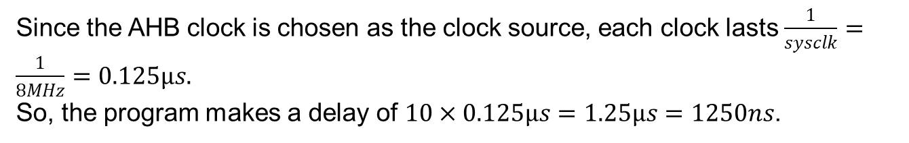
Example: Assuming system clock = 8 MHz, calculate the delay which is made by the following function.
void delay() {
SysTick->LOAD = 9;
SysTick->CTRL = 5; /*Enable the timer and choose system clock as the clock source */
while((SysTick->CTRL &0x10000) == 0) /*wait until the Count flag is set */
{ }
SysTick->CTRL = 0; /*Stop the timer (Enable = 0) */

Slide 10
Example
In an ARM microcontroller a clock with frequency of clk is fed to the sysTick timer. Calculate the delay which is made by the timer if the STRELOAD register is loaded with N.
Solution:
The timer is initialized with N. So, it goes through N+1 stages.
Since the system clock is chosen as the clock source, each clock lasts 1 / clk
So, the program makes a delay of (N + 1) × (1 / clk) = (N + 1) / clk.

Slide 11
Example: Using the System Tick timer, write a function that makes a delay of 1 ms. Assume APB clock = 72 MHz.
Solution:
delay = (N + 1) / clk ➔ (N + 1) = delay × clk = 0.001 sec × 72 MHz = 72,000 ➔ N = 72,000 – 1 = 71999
void delay1ms(void)
{
SysTick->LOAD = 71999;
SysTick->CTRL = 0x5; /* Enable the timer and choose sysclk as the clock source */
while((SysTick->CTRL & 0x10000) == 0) /* wait until the COUNT flag is set */
{ }
SysTick->CTRL = 0; /* Stop the timer (Enable = 0) */
}

Slide 12
STM32 Timers

Slide 13



STM32 Timers
ARR (Auto-Reload Register)
CNT (Counter)
Note:
In STM32 microcontrollers, all the timer registers begin with TIMx. So, for simplicity, just consider the letters which come after TIM. For example, consider TIMx_CNT as CNT (Counter).

Slide 14
TIMx_CR1 (Control Register)
CMS (Center-aligned Mode Selection)
DIR (Direction)
CEN (Counter Enable)
  0: counter disabled
  1: count
OPM (One Pulse Mode)
  0: the counter counts continuously
  1: the counter stops at the next update event.
CMS | DIR | Counting mode
00 | 0 | Counting up
00 | 1 | Counting down
01 | X | Count up and down
10 | X | Count up and down
11 | X | Count up and down

Slide 15
Example: Find the TIMx_CR1 value to: (a) count up continuously (b) count down continuously (c) stop counting.
TIMx_CR1: | CKD | ARPE | CMS | DIR | OPM | URS | UDIS | CEN
 | 0 | 0 | 00 | 0 | 0 | 0 | 0 | 1
TIMx_CR1: | CKD | ARPE | CMS | DIR | OPM | URS | UDIS | CEN
 | 0 | 0 | 00 | 1 | 0 | 0 | 0 | 1
TIMx_CR1: | CKD | ARPE | CMS | DIR | OPM | URS | UDIS | CEN
 | 0 | 0 | 00 | 0 | 0 | 0 | 0 | 0

Slide 16
TIMx_SR (Status Register)

Slide 17
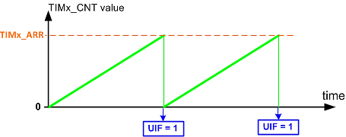
Counting Up

Slide 18
Example
Assume TIM2_ARR = 5 and TIM2_CNT is counting up. (a) Explain when the UIF flag is raised. (b) How many clocks does it take until the UIF flag rises?
(b) When the counter starts counting, it goes through 6 states (ARR+1 states) until the flag rises.

Slide 19
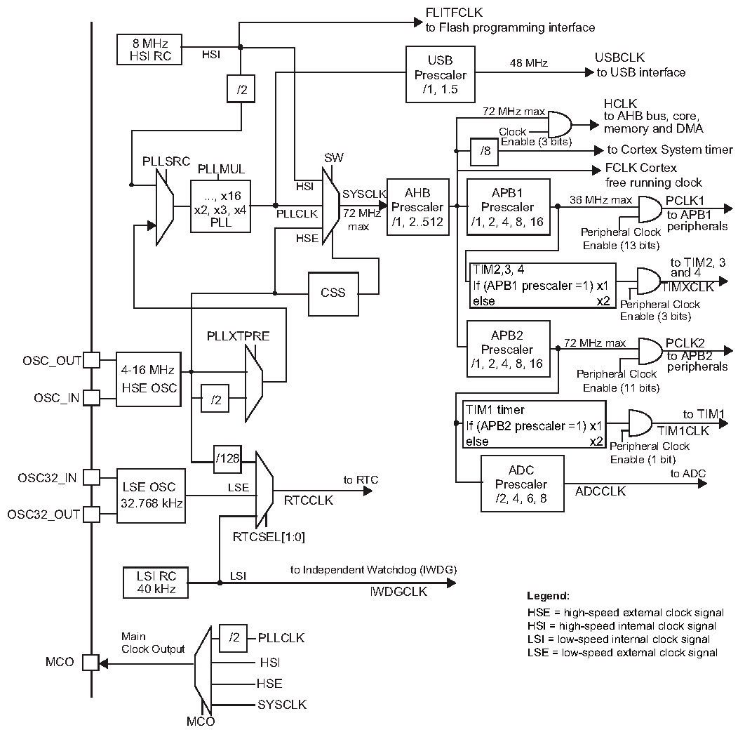
STM32F10X Clock
TIM2, 3, and 4
TIM1

Slide 20
By default, the CPU clock frequency is 72MHz; the APB1 clock is set to 36MHz, and APB2 is 72MHz. Calculate the frequency of the clock that is fed to the timers.
Since the CPU clock is 72MHz and APB1 clock is 36MHz, the prescaler for APB1 is set to 2 (other than 1). So the APB2 clock is multiplied by 2 and fed to the timers which are connected to APB1 bus. 36MHz × 2 = 72MHz.
APB2 clock has the same frequency as the CPU. So, its prescaler is set to 1 and the timer clocks are the same as the APB2 clock. According to Figure 8-8, TIM1 and TIM8 are connected to APB2. So, a clock with frequency of 72MHz are fed to the timers.
So, the clocks for all timers are 72MHz by default, unless we change the APB prescalers.

Slide 21
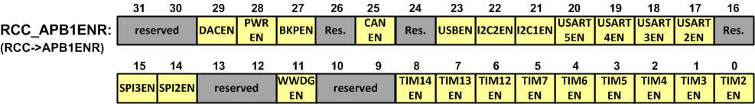
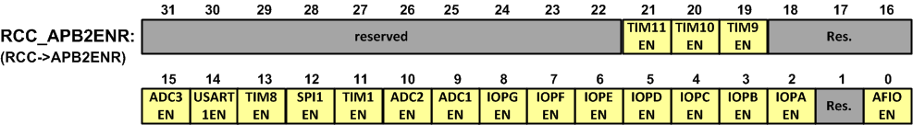
Enabling Clocks
Label | Description | Label | Description
IOPx | I/O port x clock enable | ADCnEN | ADCn clock enable
USARTnEN | USARTn clock enable | DACnEN | DACn clock enable
USBEN | USB clock enable | TIMnEN | TIMn timer clock enable
CANEN | CAN clock enable | SPInEN | SPI n clock enable
PWREN | Power interface clock enable | BKPEN | Backup interface clock enable
WWDG | Window watchdog clock enable | SDIOEN | SDIO clock enable
DMAnEN | DMAn clock enable | FSMCEN | FSMC clock enable
CRCEN | CRC clock enable | I2CnEN | I2Cn clock enable
Note: (0: clock disabled, 1: clock enabled)

Slide 22
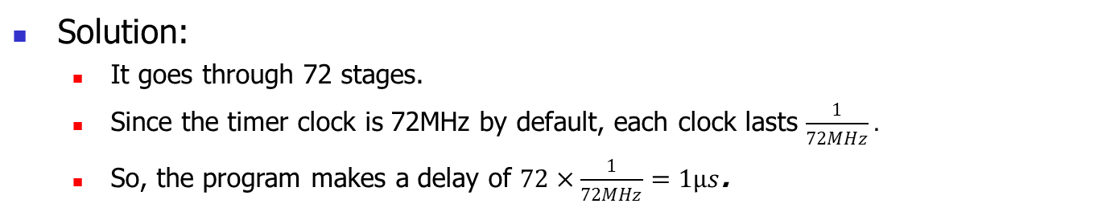
Example: Calculate the delay which is made by the following function.
void delay()
{
RCC->APB1ENR |= (1<<0); /* enable TIM2 clock */
TIM2->ARR = 71;
TIM2->SR = 0; /* clear the UIF flag */
TIM2->CR1 = 1; /* up counting */
while((TIM2->SR & 1) == 0); /* wait until the UIF flag is set */
TIM2->CR1 = 0; /*stop counting */
}

Slide 23
Example: Using TIM2 make a delay of 50µs. The clock frequencies are set by default.
Solution:
Delay = ARR+1 /72MHz ➔ ARR+1 = delay × 72MHz = 50 µs × 72MHz = 3600 ➔ ARR = 3600 – 1 = 3599.
void delay()
{
RCC->APB1ENR |= (1<<0); /* enable TIM2 clock */
TIM2->ARR = 3599;
TIM2->CR1 = 1; /* up counting */
while((TIM2->SR & 1) == 0); /* wait until the UIF flag is set */
TIM2->CR1 = 0; /*stop counting */
TIM2->SR = 0; /* clear the UIF flag */
}

Slide 24
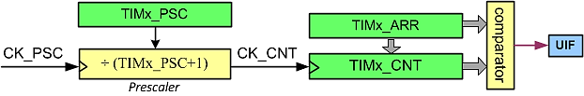
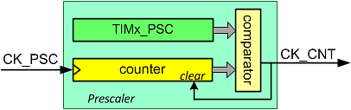
Prescaler
Prescaler is a 16-bit up-counter and a comparator

Slide 25
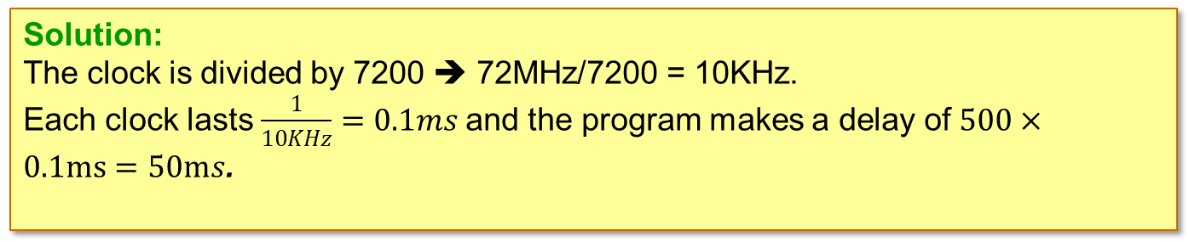
Example: Calculate the delay which is made by the following function.
void delay() {
RCC->APB1ENR |= (1<<0); /* enable TIM2 clock */
TIM2->PSC = 7200-1; /* PSC = 7199 */
TIM2->ARR = 500-1;
TIM2->SR = 0; /* clear the UIF flag */
TIM2->CR1 = 1; /* up counting */
while((TIM2->SR & 1) == 0); /* wait until the UIF flag is set */
TIM2->CR1 = 0; /*stop counting */
}

Slide 26
Example: Using TIM2 write a program that toggles PC13, every second.
#include <stm32f10x.h>
void delay(void);
int main( ) {
RCC->APB2ENR |= 0xFC; /* enable GPIO clocks */
RCC->APB1ENR |= (1<<0); /* enable TIM2 clock */
GPIOC->CRH = 0x44344444; /* PC13 as output */
while(1) {
GPIOC->ODR ^= (1<<13); /* toggle PC13 */
delay();
}
}
void delay() {
TIM2->PSC = 7200-1; /* PSC = 7199 */
TIM2->ARR = 10000-1;
TIM2->SR = 0; /* clear the UIF flag */
TIM2->CR1 = 1; /* up counting */
while((TIM2->SR & 1) == 0); /* wait until the UIF flag is set */
TIM2->CR1 = 0; /*stop counting */
}

Slide 27
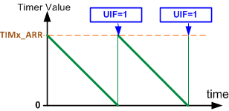
Down Counting

Slide 28
Example: Calculate the delay which is made by the following function.
void delay()
{
RCC->APB1ENR |= (1<<0); /* enable TIM2 clock */
TIM2->ARR = 999;
TIM2->CR1 = 1; /* up counting */
while((TIM2->SR & 1) == 0); /* wait until the UIF flag is set */
TIM2->CR1 = 0; /*stop counting */
TIM2->SR = 0; /* clear the UIF flag */
}
Solution:
It takes 1000 clocks to rise the flag.
Each clock lasts 1/72MHz
Delay = 1000×1/72MHz = 1/72K = 13.8µs.

Slide 29
Output Compare

Slide 30
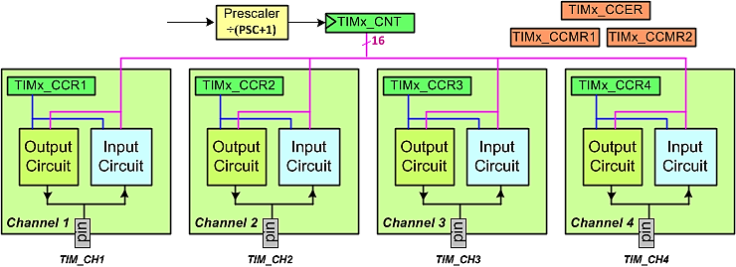
The Channels of TIMx

Slide 31
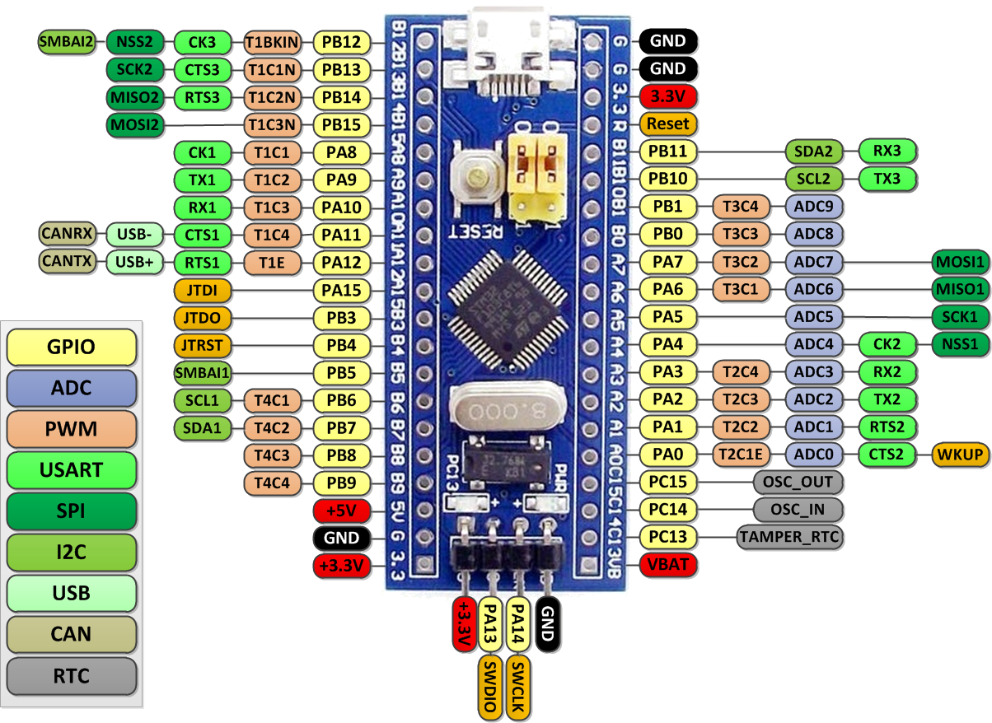
USART Pins in the Blue Pill
TIM1
TIM3
TIM2
TIM4

Slide 32
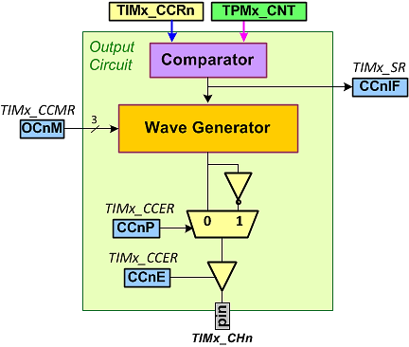
Output Circuit

Slide 33
CCER (Compare/Capture Enable Reg.)
CCnP (Compare/Capture n output Polarity)
  0: Active high (directly)
  1: Active low (inverted)
CCnE (Compare/Capture n output Enable
  0: the output is disabled.
  1: the output is enabled

Slide 34
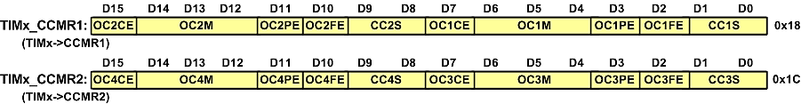
CCMR1 and CCMR2
OCnM | Mode | Description
000 | Frozen | Compare match has no effect on the GPIO pin
001 | Active on match | When CNT=CCRn, the wave generator makes its output high and the GPIO pin (TIMx_CHn) becomes active.
010 | Inactive on match | When CNT=CCRn, the wave generator makes its output low and the GPIO pin (TIMx_CHn) changes to inactive level.
011 | Toggle on match | When CNT=CCRn, it toggles the GPIO pin (TIMx_CHn).
100 | Force inactive | It forces the GPIO pin to inactive level without considering the values of the TIMx_CNT and TIMx_CCRn registers.
101 | Force active | It forces the GPIO pin to active level without considering the values of the TIMx_CNT and TIMx_CCRn registers.
110 | PWM 1 | It is discussed in the PWM chapter.
111 | PWM 2 | It is discussed in the PWM chapter.
CCnS (Compare/Capture n Selection):
  00: Compare (output)
  : Capture (input)
OCnM (Output Compare n Mode)

Slide 35
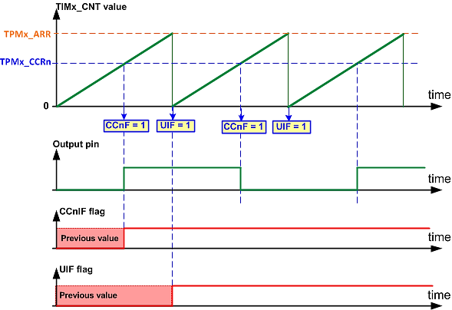
Toggle mode (OCnM = 011)

Slide 36
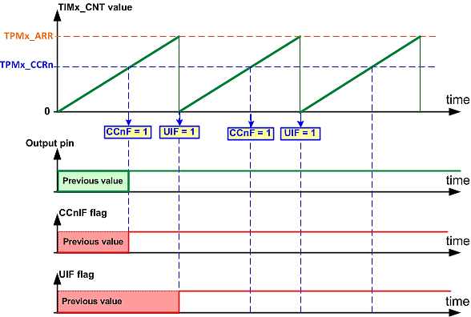
Set Mode (OCnM = 001)

Slide 37
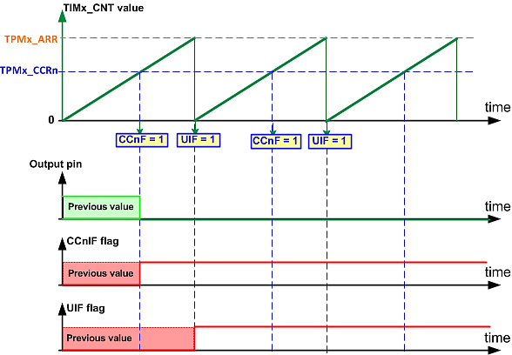
Clear Mode (OCnM =010)

Slide 38
Example: Find the CCMR value to: (a) Set high channel 2 on compare match, (b) toggle channel 2 on compare match, (c) toggle channel 3 on compare match
OCnM | Mode
000 | Frozen
001 | Active on match
010 | Inactive on match
011 | Toggle on match
100 | Force inactive
101 | Force active
110 | PWM 1
111 | PWM 2
(a)
TIMx_CCMR1: | OC2CE | OC2M | OC2PE | OC2FE | CC2S | OC1CE | OC1M | OC1PE | OC1FE | CC1S
 | 0 | 001 | 0 | 0 | 00 | 0 | 000 | 0 | 0 | 00
TIMx->CCMR1 = 0x1000;
(b)
TIMx_CCMR1: | OC2CE | OC2M | OC2PE | OC2FE | CC2S | OC1CE | OC1M | OC1PE | OC1FE | CC1S
 | 0 | 011 | 0 | 0 | 00 | 0 | 000 | 0 | 0 | 00
TIMx->CCMR1 = 0x3000;
(c)
TIMx_CCMR2: | OC4CE | OC4M | OC4PE | OC4FE | CC4S | OC3CE | OC3M | OC3PE | OC3FE | CC3S
 | 0 | 000 | 0 | 0 | 00 | 0 | 011 | 0 | 0 | 00
TIMx->CCMR2 = 0x0030;

Slide 39
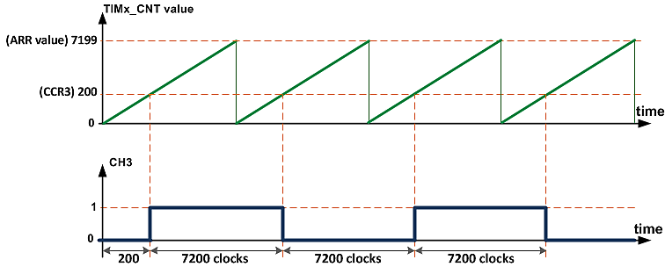
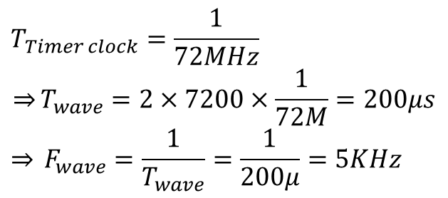
Example: Draw the wave generated by the following program. Calculate the frequency of the generated wave.
#include <stm32f10x.h>
int main( ) {
RCC->APB2ENR |= 0xFC; /* enable GPIO clocks */
RCC->APB1ENR |= (1<<0); /* enable TIM2 clock */
GPIOA->CRL = 0x44444B44; /* PA2: alternate func. output */
TIM2->CCR3 = 200;
TIM2->CCER = 0x1 << 8; /* CC3P = 0, CC3E = 1 */
TIM2->CCMR2 = 0x0030; /* toggle channel 3 */
TIM2->ARR = 10000-1;
TIM2->CR1 = 1; /* start counting up */
while(1) { }
}

Slide 40
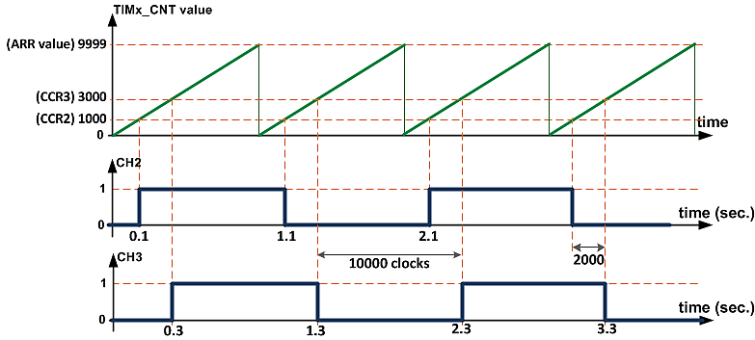
Example: Draw the waves generated by the following program.
#include <stm32f10x.h>
int main( ) {
RCC->APB2ENR |= 0xFC; /* enable GPIO clocks */
RCC->APB1ENR |= (1<<0); /* enable TIM2 clock */
GPIOA->CRL = 0x44444BB4; /* PA2(CH3), PA1(CH2): alternate func. output */
TIM2->CCR2 = 1000;
TIM2->CCR3 = 3000;
TIM2->CCER = (0x1<<8)|(0x1<<4); /*CC3P = 0, CC3E = 1, CC2E = 1 */
TIM2->CCMR1 = 0x3000; /* toggle ch.2 */
TIM2->CCMR2 = 0x0030; /* toggle ch. 3 */
TIM2->PSC = 7200-1;
TIM2->ARR = 10000-1;
TIM2->CR1 = 1;
while(1) { }
}

Slide 41
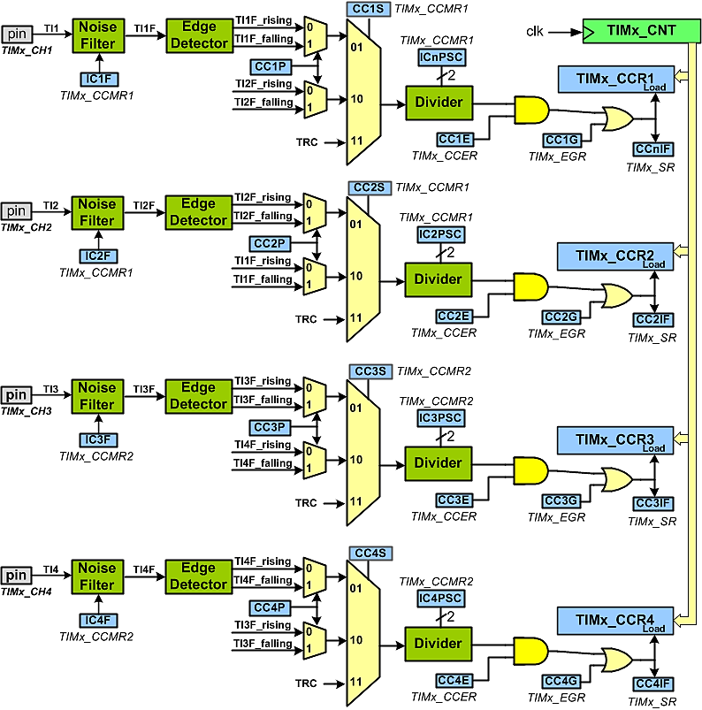

Slide 42
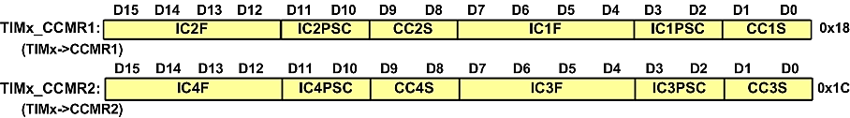
CCMR1 and CCMR2
CCnS (Compare/Capture n Selection)
ICnPSC (Input Capture Prescaler)
ICnF (Input Capture Filter)
CC1S | Mode
00 | Output Compare mode
01 | Input from TIMx_CH1
10 | Input from TIMx_CH2
11 | Input from TRC
CC2S | Mode
00 | Output Compare mode
01 | Input from TIMx_CH2
10 | Input from TIMx_CH1
11 | Input from TRC
ICnF | N | Fsampling | ICnF | N | Fsampling | ICnF | N | Fsampling | ICnF | N | Fsampling
0000 | 1 | f_{DTS} | 0100 | 6 | f_{DTS}/2 | 1000 | 6 | f_{DTS}/8 | 1100 | 8 | f_{DTS}/16
0001 | 2 | f_{CK_INT} | 0101 | 8 | f_{DTS}/2 | 1001 | 8 | f_{DTS}/8 | 1101 | 5 | f_{DTS}/32
0010 | 4 | f_{CK_INT} | 0110 | 6 | f_{DTS}/4 | 1010 | 5 | f_{DTS}/16 | 1110 | 6 | f_{DTS}/32
0011 | 8 | f_{CK_INT} | 0111 | 8 | f_{DTS}/4 | 1011 | 6 | f_{DTS}/16 | 1111 | 8 | f_{DTS}/32
CC3S | Mode
00 | Output Compare mode
01 | Input from TIMx_CH3
10 | Input from TIMx_CH4
11 | Input from TRC
CC4S | Mode
00 | Output Compare mode
01 | Input from TIMx_CH4
10 | Input from TIMx_CH3
11 | Input from TRC

Slide 43
CCnE (Compare/Capture n Enable)
  0: disable
  1: enable

Slide 44
TIM_SR (Status Register)
CCnIF (Capture/Compare n Input Flag)
  0: No capture occurred,
  1: capture occurred
CCnOF (Capture/Compare n Over-capture flag)
  0: No over-capture,
  1: over-capture detected)

Slide 45
Example
Find the CCMR1 and CCER values to configure channel 1 for capturing pin TIMx_CH1 on rising edge, and no division. The noise filter should accept signals after 4 timer clocks.
Solution:
TIMx_CCMR1: | IC2F | IC2PSC | CC2S | IC1F | IC1PSC | CC1S
 | 0000 | 00 | 00 | 0010 | 00 | 01
TIMx->CCMR1=0x0021;
TIMx_CCER | Res. | CC4P | CC4E | Res. | CC3P | CC3E | Res. | CC2P | CC2E | Res. | CC1P | CC1E
 | 00 | 0 | 0 | 00 | 0 | 0 | 00 | 0 | 0 | 00 | 0 | 1
TIMx->CCER=0x0001;

Slide 46
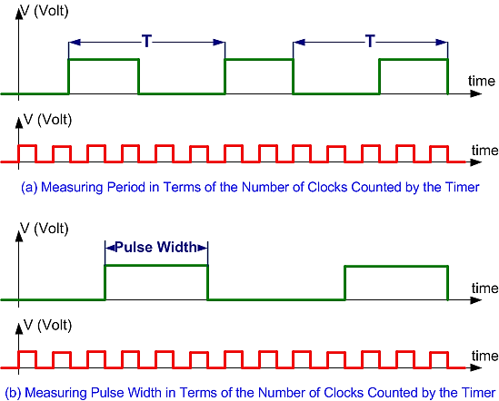
Measuring Period and Pulse width

Slide 47
Example: The program measures the frequency of the wave and reports through usart1
#include <stm32f10x.h>
#include <stdio.h>
void usart1_init(void);
void usart1_sendByte(unsigned char c);
void usart1_sendInt(unsigned int i);
void usart1_sendStr(char *str);
int main( ) {
RCC->APB2ENR |= (0xFC| (1<<14)); /* enable GPIO clocks and USART1 clock */
RCC->APB1ENR |= (1<<0); /* enable TIM2 clock */
GPIOA->CRL = 0x44444844; /* PA2(CH3): input pull-up */
GPIOA->ODR |= (1<<2);
TIM2->CCMR2 = 0x001; /* Pin TIM2_CH3 as input for channel 3 */
TIM2->CCER = 0x1 << 8; /*CC3P = 0 (rising), CC3E = 1 */
TIM2->PSC = 7200-1;
TIM2->ARR = 50000-1;
TIM2->CR1 = 1; /* start counting up */
usart1_init( );
uint16_t t = 0, t0 = 0;
while(1) {
while((TIM2->SR &(1<<3)) == 0); /* wait until the CC3IF flag sets */
t = TIM2->CCR3; /* read the captured value */
usart1_sendInt(t - t0); /* send the difference */
usart1_sendStr(“\n\r”); /* go to new line */
t0 = t;
}
}
void usart1_init( ) {
GPIOA->ODR |= (1<<10); //pull-up PA10
GPIOA->CRH = 0x444448B4; // RX1=input with pull-up, TX1=alt. func output
USART1->CR1 = 0x200C;
USART1->BRR = 7500; // 72MHz/9600bps = 7500
}
void usart1_sendByte(unsigned char c) {
while((USART1->SR&(1<<6)) == 0); //wait until the TC flag is set
USART1->DR = c;
}
/* the function sends a zero ending string through USART1 */
void usart1_sendStr(char *str) {
while(*str != 0) {
usart1_sendByte(*str);
str++;
}
}
/* The function sends a number through USART1 */
void usart1_sendInt(unsigned int i) {
char str[10];
sprintf(str,"%d",i);
usart1_sendStr(str);
}

Slide 48
Using Timer as a Counter

Slide 49
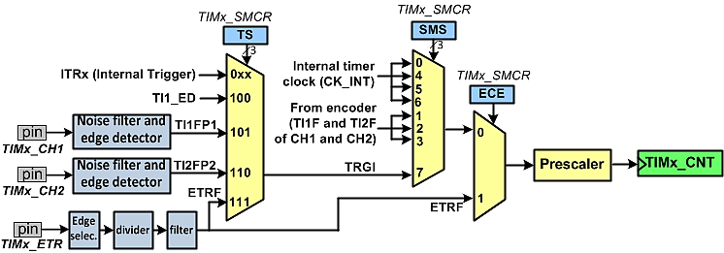
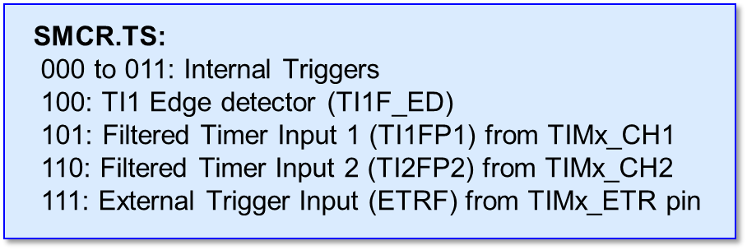
Timers Clock Sources
SMS | Mode | Description
0 | Timer mode | clocked by the internal clock
1 | Encoder mode 1 | counter counts up/down on TI2FP1 edge depending on TI1FP2 level.
2 | Encoder mode 2 | counter counts up/down on TI1FP2 edge depending on TI2FP1 level.
3 | Encoder mode 3 | counter counts up/down on both TI1FP2 and TI2FP2 edges depending on the level of the other.
4 | Reset mode | The counter is reset and the registers are updated on each rising edge of TRGI signal. (See the manual.)
5 | Gated mode | As long as the TRGI signal is high, the timer counts. The timer stops counting when the TRGI signal is low.
6 | Trigger mode | at the rising edge of the TRGI signal, it starts counting.
7 | External clock mode 1 | Counts the rising edges of TRGI signal.
SMCR (Slave Mode Control Register)

Slide 50
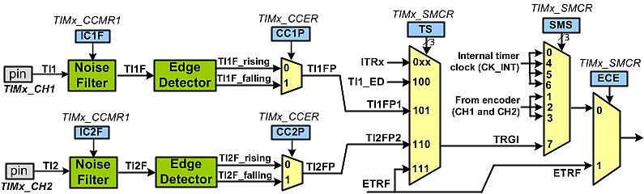
TIMx_CH1 and TIMx_CH2 External Clock Circuit

Slide 51
Example: Find the SMCR value to choose (a) TIMx_CH1 (b) TIMx_CH2 as the clock source for the counter.
(a)
TIMx_SMCR | ETP | ECE | ETPS | ETF | MSM | TS | Res. | SMS
 | 0 | 0 | 00 | 0000 | 0 | 101 | 0 | 111
TIMx_SMCR = 0x57;
(b)
TIMx_SMCR | ETP | ECE | ETPS | ETF | MSM | TS | Res. | SMS
 | 0 | 0 | 00 | 0000 | 0 | 110 | 0 | 111
TIMx_SMCR = 0x67;

Slide 52
Example: Write a program that counts the input pulses of TIMx_CH2 on rising edge and sends the value of counter through USART1.
int main( ) {
RCC->APB2ENR |= (0xFC| (1<<14)); // enable GPIO clocks and USART1 clock
RCC->APB1ENR |= (1<<0); /* enable TIM2 clock */
usart1_init(); /* initialize the usart1 */
GPIOA->CRL = 0x44444484; /* PA1(CH2): input pull-up */
GPIOA->ODR |= (1<<1);
TIM2->CCMR1 = 0x0000; /* no filter */
TIM2->CCER = 0; /* CC2P = 0 (rising) */
TIM2->SMCR = 0x67; /* TIM2_CH2 as clock source */
TIM2->ARR = 50000-1; /* count from 0 to 49999 then roll over to 0 */
TIM2->CR1 = 1; /* start counting up */
while(1) {
usart1_sendInt(TIM2->CNT); /* send the counter value through serial */
usart1_sendStr("\n\r"); /* go to new line */
delay_ms(100);
}
}

Slide 53
Example: A clock pulse is fed into pin TIM2_CH1(PA0). Write a program that toggles PC13 every 100 pulses.
#include <stm32f10x.h>
int main( ) {
RCC->APB2ENR |= 0xFC; /* enable GPIO clocks and USART1 clock */
RCC->APB1ENR |= (1<<0); /* enable TIM2 clock */
GPIOA->CRL = 0x44444448; /* PA0(CH1): input pull-up */
GPIOA->ODR |= (1<<0);
GPIOC->CRH = 0x44344444; /* PC13 as output */
TIM2->CCMR1 = 0x0000; /* no filter */
TIM2->CCER = 0x1 << 1; /* CC0P = 1 (falling) */
TIM2->SMCR = 0x57; /* TIM2_CH1 as clock source */
TIM2->ARR = 100-1;
TIM2->CR1 = 1;
while(1) {
if((TIM2->SR&1) != 0) {
TIM2->SR = 0;
GPIOC->ODR ^= (1<<13);
}
}
}

Slide 54
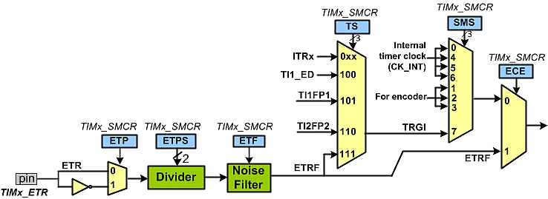
ETR (External clock) input Block

