Slide 1

Interrupt in STM32F10x ARM
Sepehr Naimi
www.NicerLand.com

Slide 2
Topics
Polling Vs. interrupt
Interrupt (Exception) in ARM
Steps in executing an interrupt
Context switching
SysTick Timer
External Interrupts
USART Interrupts
Timer Interrupts
Priority

Slide 3
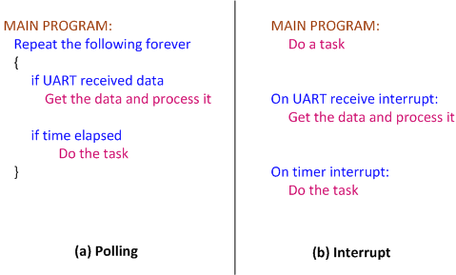
Polling Vs. Interrupt
Polling
  Ties down the CPU
Interrupt
  Efficient CPU use
  Has priority
  Can be masked

Slide 4
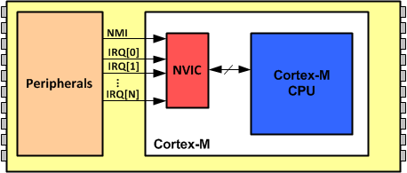
Interrupt in Cortex-M
NVIC (Nested Vector Interrupt Controller)

Slide 5
Interrupt Vector
Int. Number | Interrupt | Memory Location
 | Stack Pointer initial value | 0x00000000
1 | Reset | 0x00000004
2 | NMI | 0x00000008
3 | Hard Fault | 0x0000000C
4 | Memory Management Fault | 0x00000010
5 | Bus Fault | 0x00000014
6 | Usage Fault (undefined instructions, divide by zero, unaligned memory access, ...) | 0x00000018
7 | Reserved | 0x0000001C
8 | Reserved | 0x00000020
9 | Reserved | 0x00000024
10 | Reserved | 0x00000028
11 | SVCall | 0x0000002C
12 | Debug Monitor | 0x00000030
13 | Reserved | 0x00000034
14 | PendSV | 0x00000038
15 | SysTick | 0x0000003C
16 | IRQ for peripherals | 0x00000040
17 | IRQ for peripherals | 0x00000044
… | … | …
255 | IRQ for peripherals | 0x000003FC

Slide 6

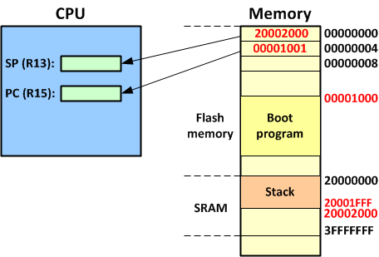
Reset (INT 01)

Slide 7
Non-maskable Interrupt (INT 02)
Cannot be masked by software

Slide 8
Faults (INTs 03 to 06)
Faults are invoked when there are conditions that the CPU is unable to handle
  Hard Fault (INT 3)
  Memory Management Fault (INT 4)
    E.g. attempting to write into a read-only memory
  Bus Fault (INT 5)
    E.g. trying to access memory address location that has not been mapped to anything
  Usage Fault (INT 6)
    divide-by-zero, unaligned memory access, undefined instruction, and so on

Slide 9
SVC (INT 11)
SVC (Supervisor call)
  Software interrupt
  Whenever the SVC instruction is executed, the interrupt is invoked
  Widely used by the operating system to call the OS kernel functions and services that can be provided only by the privileged access mode of the OS

Slide 10
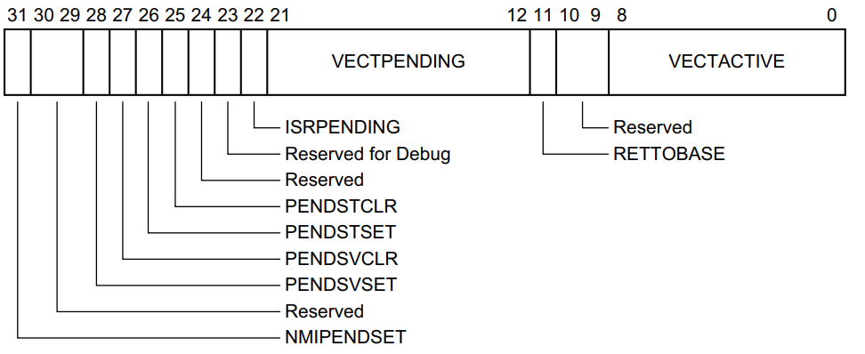
PendSV (INT 14)
PendSV (Penable Service call)
  Setting the PENDSVSET bit of the ICSR register generates the interrupt
  It is served when no other interrupt is executing
  In OS, it can be used for context switching
ICSR:

Slide 11
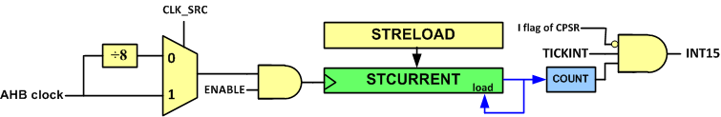

SysTick Interrupt (INT 15)
In OS systems, it is used to generate clock ticks at regular intervals
If TICINT=1, when COUNTFLAG is set, it generates an interrupt.

Slide 12
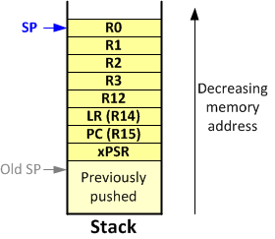
Processing Interrupts in Cortex-M
CPSR, PC, LR, R12, R3, R2, R1, and R0 are pushed
CPU goes into the Handler Mode
LR is loaded with a number with bit 31-5 all 1s
PC is loaded with the contents of memory INT# * 4
The ISR is executed
When the return instruction is executed the value of LR shows it is in the Handler Mode. So, the registers are popped off the stack.

Slide 13
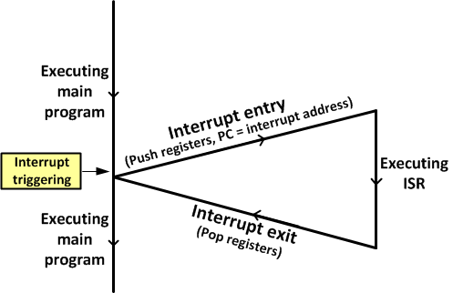
Processing Interrupts in Cortex-M (Cont.)

Slide 14
Interrupt vs. subroutine call
BL
Interrupt
jumps to any location
BL is used by the programmer in the sequence of instruction
cannot be masked
Saves only PC
CPU mode remains unchanged
On return, restores PC
Jumps to a fixed location
hardware interrupt can come in at any time
Can be masked (disabled)
Saves CPSR, PC, LR, R12, R3, R2, R1, and R0.
CPU goes to Handler mode
On return, restores CPSR, R15, R14, R12, R3–R0.

Slide 15
Toggling PC13 using the SysTick Interrupt
#include <stm32f10x.h>
void SysTick_Handler()
{
GPIOC->ODR ^= (1<<13); /* toggle PC13 */
}
int main()
{
RCC->APB2ENR = 0xFC; /* enable GPIO clocks */
GPIOC->CRH = 0x44344444; /* PC13 as output */
SysTick->LOAD = 9000000-1; /* STRELOAD = 72,000,000/8 -1 */
SysTick->CTRL = 0x03; /* Clock = AHB clock/8, int. enable, Enable = 1 */
while(1)
{
}
}

Slide 16
Peripheral Interrupts (INTs 15 to 255)
They are generated as a result of an event in the peripheral devices such as timer timeout or UART receiving or sending
Each manufacturer implements the peripheral interrupts as they please

Slide 17
Peripheral Interrupts in STM32F10x
INT# | IRQ# | Vector location | Acronym | Device
1-15 | None | 0000 0000 to 0000 003C |  | CPU Exception (set by ARM) See Table 12-1.
16 | 0 | 0000 0040 | WWDG | Window Watchdog interrupt
17 | 1 | 0000 0044 | PVD | PVD through EXTI line detection interrupt
18 | 2 | 0000 0048 | TAMPER | Tamper interrupt
19 | 3 | 0000 004C | RTC | RTC global interrupt
20 | 4 | 0000 0050 | FLASH | Flash global interrupt
21 | 5 | 0000 0054 | RCC | RCC global interrupt
22 | 6 | 0000 0058 | EXTI0 | EXTI line 0 interrupt
23 | 7 | 0000 005C | EXTI1 | EXTI line 1 interrupt
24 | 8 | 0000 0060 | EXTI2 | EXTI line 2 interrupt
25 | 9 | 0000 0064 | EXTI3 | EXTI line 3 interrupt
26 | 10 | 0000 0068 | EXTI4 | EXTI line 4 interrupt
27 | 11 | 0000 006C | DMA1_Channel1 | DMA1 Channel1 global interrupt
28 | 12 | 0000 0070 | DMA1_Channel2 | DMA1 Channel2 global interrupt
29 | 13 | 0000 0074 | DMA1_Channel3 | DMA1 Channel3 global interrupt
30 | 14 | 0000 0078 | DMA1_Channel4 | DMA1 Channel4 global interrupt
31 | 15 | 0000 007C | DMA1_Channel5 | DMA1 Channel5 global interrupt
32 | 16 | 0000 0080 | DMA1_Channel6 | DMA1 Channel6 global interrupt
33 | 17 | 0000 0084 | DMA1_Channel7 | DMA1 Channel7 global interrupt
34 | 18 | 0000 0088 | ADC1_2 | ADC1 and ADC2 global interrupt
35 | 19 | 0000 008C | CAN1_TX | CAN1 TX interrupts
36 | 20 | 0000 0090 | CAN1_RX0 | CAN1 RX0 interrupts
37 | 21 | 0000 0094 | CAN1_RX1 | CAN1 RX1 interrupt
38 | 22 | 0000 0098 | CAN1_SCE | CAN1 SCE interrupt
39 | 23 | 0000 009C | EXTI9_5 | EXTI Line[5:9] interrupts
40 | 24 | 0000 00A0 | TIM1_BRK | TIM1 Break interrupt
41 | 25 | 0000 00A4 | TIM1_UP | TIM1 Update interrupt
42 | 26 | 0000 00A8 | TIM1_TRG_COM | TIM1 Trigger and Commutation interrupts
43 | 27 | 0000 00AC | TIM1_CC | TIM1 Capture Compare interrupt
44 | 28 | 0000 00B0 | TIM2 | TIM2 global interrupt
45 | 29 | 0000 00B4 | TIM3 | TIM3 global interrupt
46 | 30 | 0000 00B8 | TIM4 | TIM4 global interrupt
47 | 31 | 0000-00BC | I2C1_EV | I2C1 event interrupt
48 | 32 | 0000-00C0 | I2C1_ER | I2C1 error interrupt
49 | 33 | 0000-00C4 | I2C2_EV | I2C2 event interrupt
50 | 34 | 0000-00C8 | I2C2_ER | I2C2 error interrupt
51 | 35 | 0000-00CC | SPI1 | SPI1 global interrupt
52 | 36 | 0000-00D0 | SPI2 | SPI2 global interrupt
53 | 37 | 0000-00D4 | USART1 | USART1 global interrupt
54 | 38 | 0000-00D8 | USART2 | USART2 global interrupt
55 | 39 | 0000-00DC | USART3 | USART3 global interrupt
56 | 40 | 0000-00E0 | EXTI15-10 | EXTI Line[15:10] interrupts
57 | 41 | 0000-00E4 | RTCAlarm | RTC alarm through EXTI line interrupt
58 | 42 | 0000-00E8 | USBWakeup | USB wakeup from suspend through EXTI line interrupt
59 | 43 | 0000-00EC | TIM8_BRK | TIM8 Break interrupt
60 | 44 | 0000-00F0 | TIM8_UP | TIM8 Update interrupt
61 | 45 | 0000-00F4 | TIM8_TRG_COM | TIM8 Trigger and Commutation interrupts
62 | 46 | 0000-00F8 | TIM8_CC | TIM8 Capture Compare interrupt
63 | 47 | 0000-00FC | ADC3 | ADC3 global interrupt
64 | 48 | 0000-0100 | FSMC | FSMC global interrupt
65 | 49 | 0000-0104 | SDIO | SDIO global interrupt
66 | 50 | 0000-0108 | TIM5 | TIM5 global interrupt
67 | 51 | 0000-010C | SPI3 | SPI3 global interrupt
68 | 52 | 0000-0110 | UART4 | UART4 global interrupt
69 | 53 | 0000-0114 | UART5 | UART5 global interrupt
70 | 54 | 0000-0118 | TIM6 | TIM6 global interrupt
71 | 55 | 0000-011C | TIM7 | TIM7 global interrupt
72 | 56 | 0000-0120 | DMA2_Channel1 | DMA2 Channel1 global interrupt
73 | 57 | 0000-0124 | DMA2_Channel2 | DMA2 Channel2 global interrupt
74 | 58 | 0000-0128 | DMA2_Channel3 | DMA2 Channel3 global interrupt
75 | 59 | 0000-012C | DMA2_Channel4_5 | DMA2 Channel4 and DMA2 Channel5 global interrupts

Slide 18
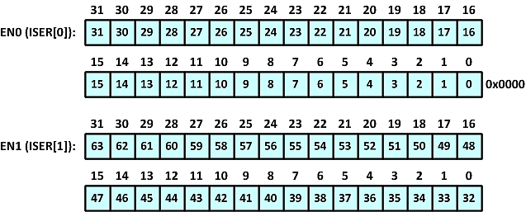
Enabling Peripheral Interrupts in Cortex-M
Using the ISER register:
Using the function:
NVIC->ISER[0] = 1<<7; /* enable IRQ7 (bit 7 of ISER[0]) */
void NVIC_EnableIRQ(IRQn_Type IRQn);
NVIC_EnableIRQ(EXTI1_IRQn);

Slide 19


Disabling Peripheral Interrupts in Cortex-M
NVIC->ICER[1] = 1<<5; /*disable bit 37 (bit 5 of ICER[1]) */
void NVIC_DisableIRQ(IRQn_Type IRQn);
NVIC_DisableIRQ(UART0_IRQn);

Slide 20
The I flag of xPSR
All the interrupts (except NMI) will be disabled if the flag is set.
In Assembly CPSID and CPSIE are used to disable and enable
In C:
  __enable_irq(); /* Enable interrupt Globally */
  __disable_irq(); /* Disable interrupt Globally */

Slide 21
External Interrupt

Slide 22
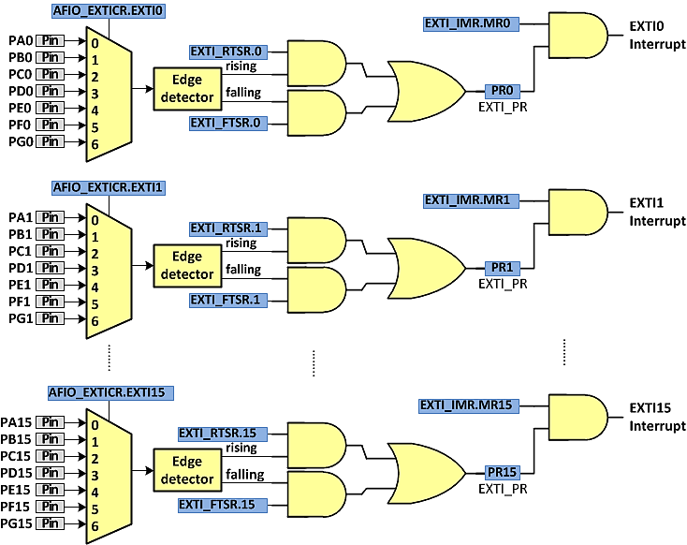
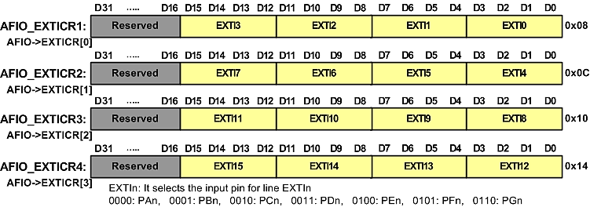
External Interrupt (EXTI) Circuit
AFIO_EXTICRx (External Interrupt Configuration Register x)
PR (Pending Register)
RTSR (Rising Trigger Selection Register)
IMR (Interrupt Mask Register)
FTSR (Falling Trigger Selection Register)

Slide 23
Example: The program toggles PC13 on each falling edge of PB4
#include <stm32f10x.h>
void EXTI4_IRQHandler() /* interrupt handler for EXTI4 */
{
EXTI->PR = (1<<4); /* clear the Pending flag */
GPIOC->ODR ^= 1<<13; /* toggle PC13 */
}
int main( ) {
RCC->APB2ENR |= (0xFC | 1); /* Enable clocks for GPIO ports and AFIO */
GPIOB->CRL = 0x44484444; /* PB4 as input */
GPIOB->ODR |= (1<<4); /* pull-up PB4 */
GPIOC->CRH = 0x44344444; /* PC13 as output */
AFIO->EXTICR[1] = 1<<0; /* EXTI4 = 1 (selects PB4 for line 4) */
EXTI->FTSR = (1<<4); /* int. on falling edge */
EXTI->IMR = (1<<4); /* enable interrupt EXTI4 */
NVIC_EnableIRQ(EXTI4_IRQn); /* enable the EXTI4 interrupt */
while(1) { }
}
To clear the PR flag write 1 to the bit

Slide 24
USART Interrupt

Slide 25
Enabling USART Interrupts
Field | Bit | Description
PEIE | D8 | PE interrupt enable 0 = disabled 1 = A USART interrupt is generated whenever the PE flag of USART_SR is set.
TXEIE | D7 | TXE interrupt enable 0 = disabled 1 = A USART interrupt is generated whenever the TXE flag of USART_SR is set.
TCIE | D6 | Transmission complete interrupt enable 0 = disabled 1 = A USART interrupt is generated whenever the TC flag of USART_SR is set.
RXNEIE | D5 | RXNE interrupt enable 0 = disabled 1 = A USART interrupt is generated whenever ORE or RXNE are set.
USART1->CR1 = 0x2024; /* enable receive and receive interrupt*/
NVIC_Enable_IRQ(USART1_IRQ); /* enable USART1 interrupt */

Slide 26
Example: get a character via USART1. If it is L make PC13 low. If it is H make PC13 high.
#include "stm32f10x.h"
void USART1_IRQHandler() /* USART1 interrupt routine */
{
uint8_t c = USART1->DR; /* get received data */
if((c == 'H')||(c == 'h'))
GPIOC->ODR |= (1<<13); /* make PC13 high */
else
if((c == 'L')||(c == 'l'))
GPIOC->ODR &= ~(1<<13); /* make PC13 low */
}
int main( ) {
RCC->APB2ENR |= 0xFC|(1<<14); /* enable GPIO and usart1 clocks */
GPIOC->CRH = 0x44344444; /* PC13 as output */
/* USART1 init. */
GPIOA->ODR |= (1<<10); /* pull-up PA10 */
GPIOA->CRH = 0x444448B4; /* RX1=input with pull-up, TX1=alt. func output */
USART1->CR1 = 0x2024; /* receive int. enable, receive enable */
USART1->BRR = 7500; /* 72MHz/9600bps = 7500 */
NVIC_EnableIRQ(USART1_IRQn); /* USART1 IRQ enable */
while(1) { }
}

Slide 27
Example: send the state of PB5 via USART1. If PB5 is Low, send L. Otherwise, send H.
#include "stm32f10x.h"
void USART1_IRQHandler( ) { /* USART1 interrupt routine */
if((GPIOB->IDR & (1<<5)) != 0) /* is PB5 high? */
USART1->DR = 'H'; /* send 'H' */
else
USART1->DR = 'L'; /* send 'L' */
}
int main( ) {
RCC->APB2ENR |= 0xFC|(1<<14); /* enable GPIO and usart1 clocks */
GPIOB->CRL = 0x44844444; /* PB5 as input */
GPIOB->ODR |= (1<<5); /* pull-up PB5 */
/* USART1 init. */
GPIOA->ODR |= (1<<10); /* pull-up PA10 */
GPIOA->CRH = 0x444448B4; /* RX1=input with pull-up, TX1=alt. func output */
USART1->CR1 = 0x2048; /* TC int. enable, transmit enable */
USART1->BRR = 7500; /* 72MHz/9600bps = 7500 */
NVIC_EnableIRQ(USART1_IRQn); /* USART1 IRQ enable */
while(1) { }
}

Slide 28
Timer Interrupt

Slide 29
Enabling Timer Interrupts
DMA Interrupt Enable Register (DIER)
Field | Bit | Description
UIE | D0 | Update interrupt enable (0: disabled, 1: enabled) If UIE=1, whenever UIF is set an interrupt is generated.
CCnIE | D1-D4 | Capture/Compare n Interrupt Enable (0: disabled, 1: enabled) If the bit is set, an interrupt is generated when the CCnIF flag is set.
TIE | D6 | Trigger Interrupt Enable (0: disabled, 1: enabled)
UDE | D8 | Update DMA request Enable
CCnDE | D9-D12 | Capture/Compare n DMA request Enable (0: disabled, 1: enabled)
TDE | D14 | Trigger DMA request Enable

Slide 30
Example: Toggle PC13 every second using the TIM interrupt.
#include <stm32f10x.h>
void TIM2_IRQHandler( ) {
TIM2->SR = 0; /* clear UIF flag */
GPIOC->ODR ^= (1<<13); /* toggle PC13 */
}
int main( ) {
RCC->APB2ENR |= 0xFC; /* enable GPIO clocks */
RCC->APB1ENR |= (1<<0); /* enable TIM2 clock */
GPIOC->CRH = 0x44344444; /* PC13 as output */
TIM2->PSC = 7200-1; /* PSC = 7199 */
TIM2->ARR = 10000-1;
TIM2->SR = 0; /* clear the UIF flag */
TIM2->CR1 = 1; /* up counting */
TIM2->DIER = (1<<0); /* enable UIE interrupt */
NVIC_EnableIRQ(TIM2_IRQn); /* enable TIM2 interrupt */
while(1) { }
}

Slide 31
Interrupt Priority

Slide 32
Interrupt Priority
Int. # | Interrupt | Priority Level
 | Stack Pointer initial value
1 | Reset | -3 Highest
2 | NMI | -2
3 | Hard Fault | -1
4 | Memory Management Fault | Programmable
5 | Bus Fault | Programmable
6 | Usage Fault (undefined instructions, divide by zero, unaligned memory access, ....) | Programmable
7 | Reserved | Programmable
8 | Reserved | Programmable
9 | Reserved | Programmable
10 | Reserved | Programmable
11 | SVCall | Programmable
12 | Debug Monitor | Programmable
13 | Reserved | Programmable
14 | PendSV | Programmable
15 | SysTick | Programmable
16 | IRQ for peripherals | Programmable
17 | IRQ for peripherals | Programmable
… | … | Programmable
255 | IRQ for peripherals | Programmable

Slide 33
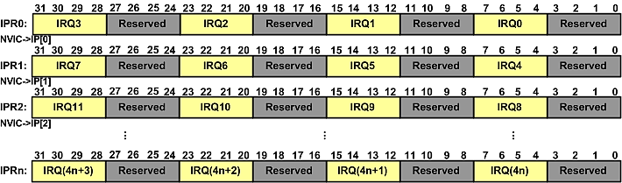
Interrupt Priority Register (IPR)
NVIC->IP[IRQn/4] |= PRIO << (8 * (IRQn % 4) + 6);
NVIC->IP[11] |= 2 << (8 + 6);
NVIC_SetPriority (TIM3_IRQn, 2);

Slide 34
Thread Mode vs. Handler Mode
On reset, the CPU goes to Thread mode.
The applications run in Thread mode.
The Interrupt routines are executed in Handler mode.
The Thread and Handler modes can have separate stacks.

