Slide 1
ADC and DAC Programming

Slide 2
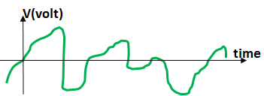

Analog vs. Digital Signals

Slide 3
DAC
Vout
4
3
2
V_{REF}
1
Step size =
0
input
Num of steps
00
01
10
11
V_{OUT} = num × step size
DAC
Binary number (input)
n
V_{OUT}
Vref

Slide 4
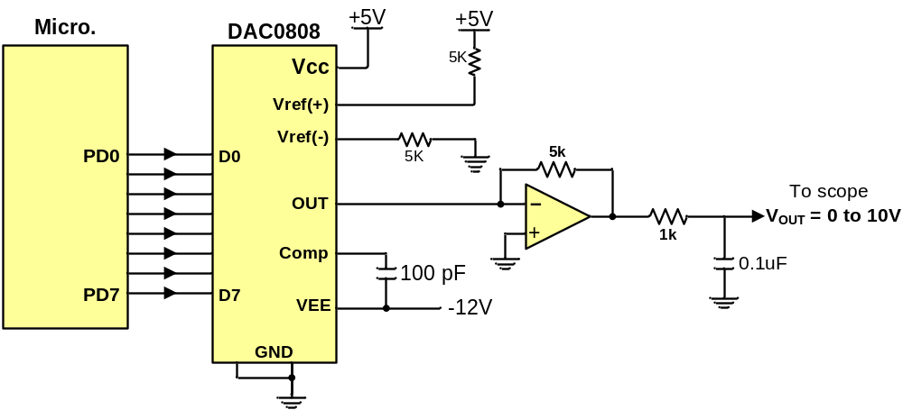
Connecting a DAC to the microcontroller

Slide 5
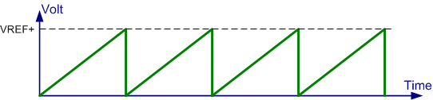
Generating a stair-step wave using DAC
#include <stm32f10x.h>
void delay_us(uint16_t t);
int main( ) {
RCC->APB2ENR |= 0xFC; /* enable clocks for GPIOs */
GPIOA->CRL = 0x33333333; /* PA0-PA7 as outputs */
int8_t n = 0;
while(1) {
GPIOA->ODR = n; /* copy n into PORTA to be converted */
n ++; /* increment n */
delay_us(10);
}
}
void delay_us(uint16_t t) {
for(int i = 0; i < t; i++)
{
for(volatile uint16_t a = 0; a < 6; a++)
{}
}
}

Slide 6
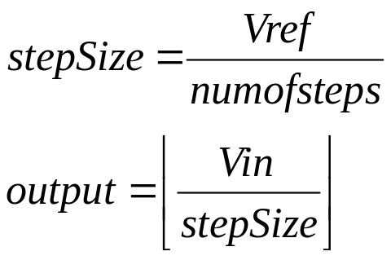
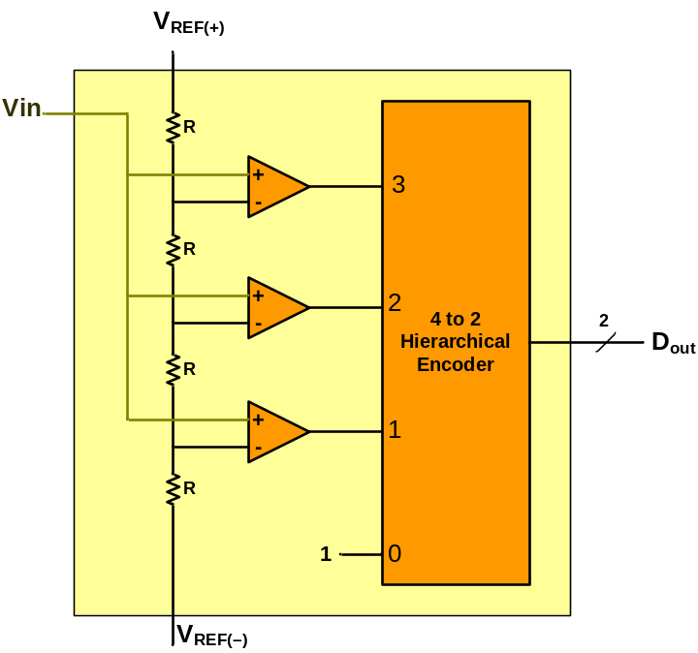
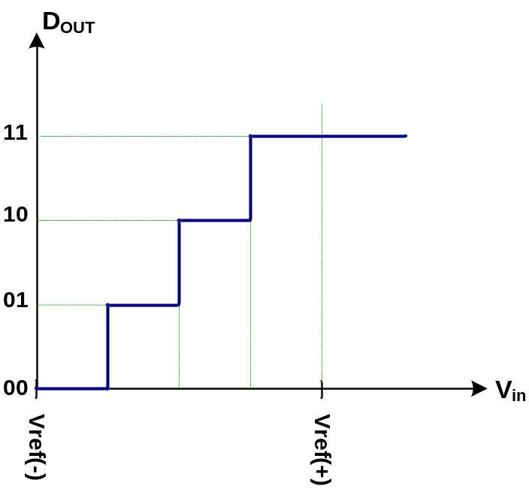
ADC
ADC
n
V_{in}
Output
(binary number)
Vref

Slide 7
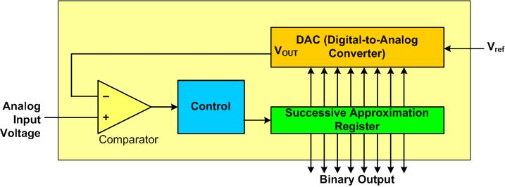
Successive Approximation ADC

Slide 8
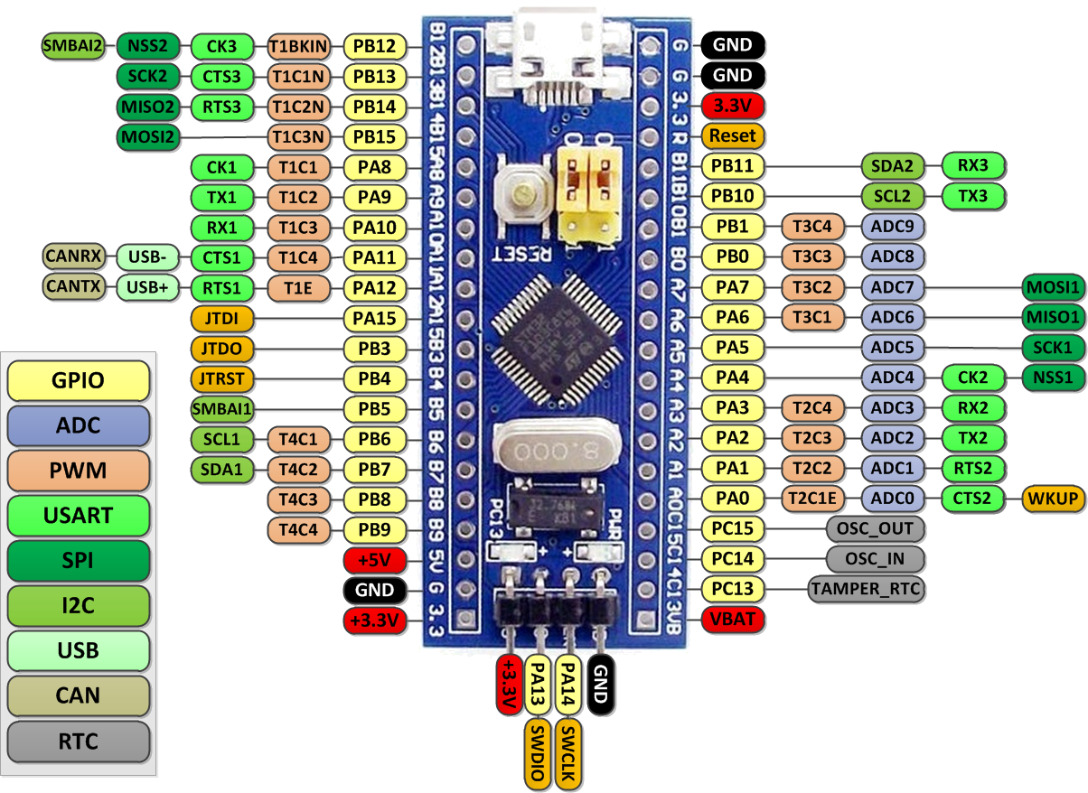
ADC pins

Slide 9
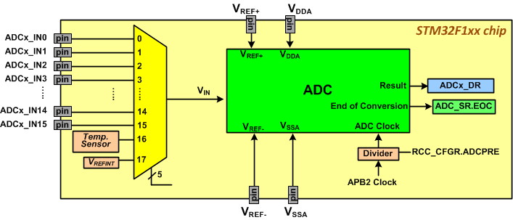
Simplified Block Diagram of ADC in STM32F1

Slide 10
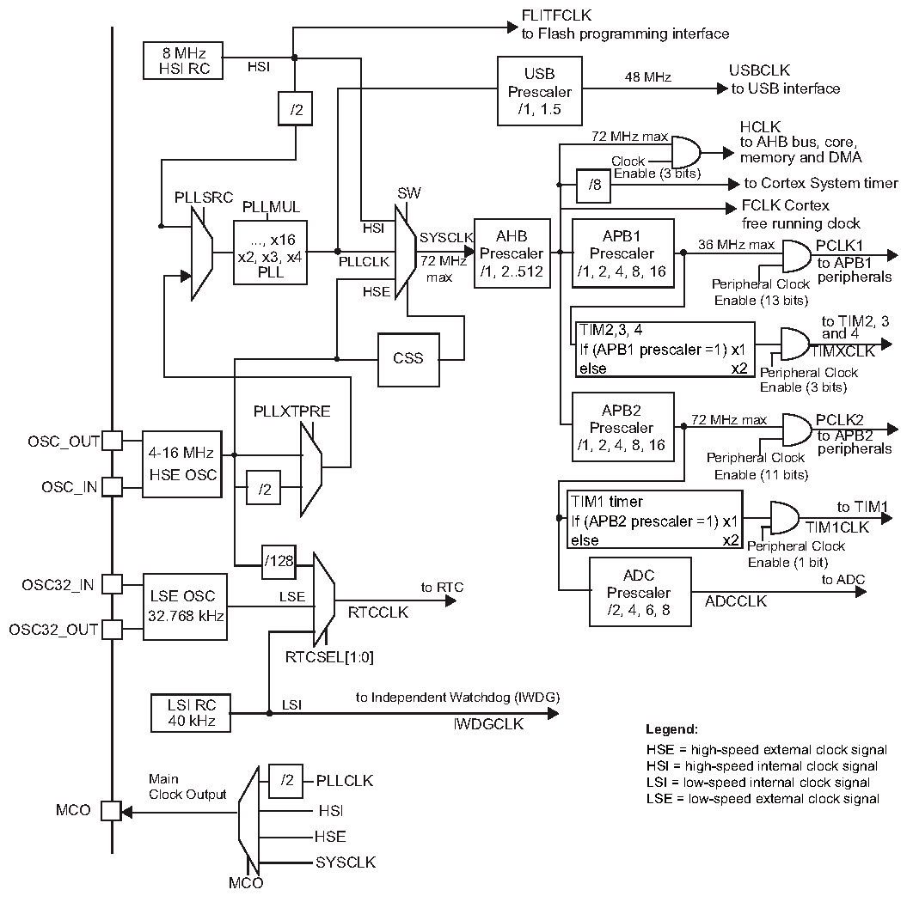
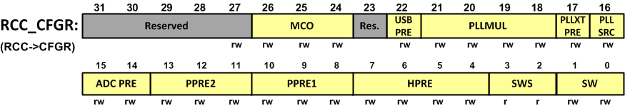
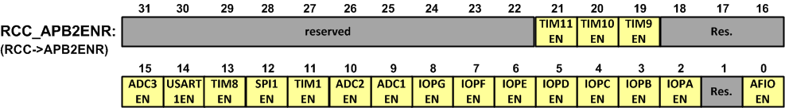
ADC Clock
ADCPRE value | ADC Clock Frequency
00 | PCLK2 (APB2 clock) divided by 2
01 | PCLK2 (APB2 clock) divided by 4
10 | PCLK2 (APB2 clock) divided by 6
11 | PCLK2 (APB2 clock) divided by 8
ADC

Slide 11
ADC Data Register

Slide 12
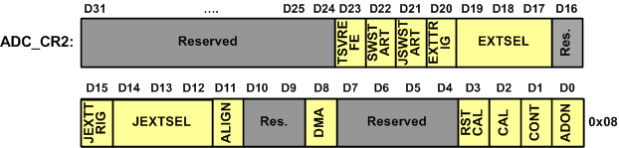
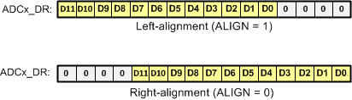
ADC_CR2 (Control Register)
Field | Description
ALIGN | Data alignment (0: right alignment, 1: left alignment)
DMA | Direct Memory Access (0: disabled, 1: enabled)
CAL | ADC Calibration To calibrate the ADC, set to bit to 1. The bit clears by hardware, when the calibration finishes.
CONT | Continuous (0: single conversion, 1: continuous conversion)
ADCON | ADC ON/OFF (0: ADC OFF, 1: ADC ON) If the bit is 0 and a 1 is written to it, the ADC module turns on. If the bit is 1 and a 1 is written to it, an ADC conversion starts.

Slide 13
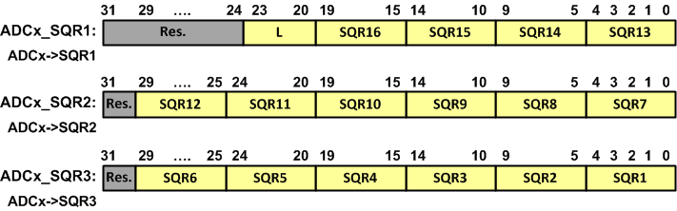
ADC_SQR (Sequence Registers)
Field | Description
SQRn | Nth conversion in the sequence
L | Regular channel sequence Length Total number of conversions is L + 1.

Slide 14
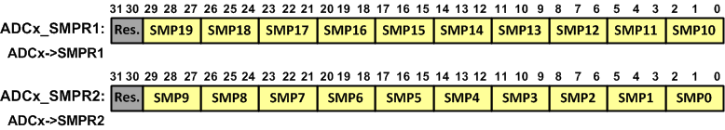
Sample Time
SMPn: Channel n Sample time selection
SMP | Sample time | SMP | Sample time
000 | 1.5 ADC clock cycles | 100 | 41.5 ADC clock cycles
001 | 7.5 ADC clock cycles | 101 | 55.5 ADC clock cycles
010 | 13.5 ADC clock cycles | 110 | 71.5 ADC clock cycles
011 | 28.5 ADC clock cycles | 111 | 239.5 ADC clock cycles

Slide 15

ADC_SR (Status Register)
Field | Description
STRT | Regular channel Start flag
JSTRT | Injected channel Start flag
JEOC | Injected channel End Of Conversion
EOC | Regular channel End Of Conversion (0: conversion not complete, 1: complete)
AWD | Analog WatchDog flag

Slide 16
Steps in Programming ADC
Enable the clock for ADC and GPIO
Configure the ADC pin as analog input
Turn on the ADC module
Initialize the ADCx_SMPR registers to proper values.
Wait 1 microsecond
start conversion by writing a one to the ADCON bit,
Monitor the EOC bit of ADCx_SR. When the EOC bit is HIGH, read ADCx_DR,
If you want to read the selected channel again, go back to step 6.

Slide 17
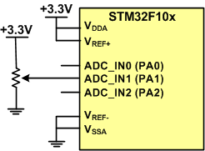
Example: This program gets data from ADC_IN1 (PA1) and sends the result through USART1
#include <stm32f10x.h>
#include <stdio.h>
/*definitions of usart and delay functions should be added here*/
int main( ) {
RCC->APB2ENR |= 0xFC|(1<<9)|(1<<14); // enable clocks for GPIO, ADC1 and usart1
GPIOA->CRL = 0x44444404; /* PA1(ADC_IN1) as analog input */
ADC1->CR2 = 1; /* ADON = 1 (power-up) */
ADC1->SMPR2 = 1<<3; /* SMP1 = 001 (set sample time for IN1 to 7.5 clocks) */
usart1_init(); /* initialize the usart1 */
delay_us(1); /* wait 1us to make sure the adc module is stable */
while(1) {
ADC1->SQR3 = 1; /* choose channel 1 as the input */
ADC1->CR2 = 1; /* ADON = 1 (start conversion) */
while((ADC1->SR&(1<<1)) == 0); /* wait until the EOC flag is set */
usart1_sendInt(ADC1->DR); /* read ADC1_DR and send its value through serial */
usart1_sendStr("\n\r"); /* go to new line */
}
}

Slide 18
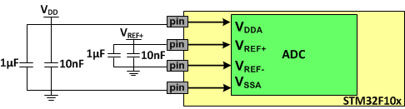
V_{ref+}, V_{ref-}, and V_{DDA}
Vref+
  It is connected to 3.3V in the Blue Pill.
  it cannot go beyond the VDD voltage
V_{DDA}
  It provides the voltage for analog ADC circuitry
V_{REF-}
  It is internally connected to GND if the chip does not have the pin.

Slide 19
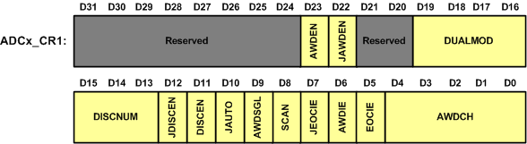
Enabling ADC Interrupts
EOCIE (EOC interrupt Enable),
AWDIE (AWD Interrupt Enable),
JEOCIE (JEOC Interrupt Enable)

Slide 20
Reading ADC using Interrupt
volatile uint16_t adcResult;
void ADC1_2_IRQHandler( ) {
adcResult= ADC1->DR; /* read conversion result */
}
int main ( ) {
RCC->APB2ENR |= 0xFC|(1<<9)|(1<<14); // enable clocks for GPIO, ADC1 & usart1
GPIOA->CRL = 0x44444404; /* PA1(ADC_IN1) as analog input */
ADC1->CR2 = 1; /* ADON = 1 (power-up) */
ADC1->SMPR2 = 7<<3; /* SMP1 = 111 (239.5 ADC clock cycles) */
delay_us(1); /* wait 1us to make sure the ADC module is stable */
usart1_init(); /* initialize the usart1 */
ADC1->CR1 = (1<<5); /* EOCIE = 1 */
ADC1->SQR3 = 1; /* choose channel 1 as the input */
ADC1->CR2 |= 1<<1; /* CONT = 1 (Convert continuously) */
ADC1->CR2 |= 1<<0; /* ADCON = 1 (start conversion) */
NVIC_EnableIRQ(ADC1_2_IRQn); /* enable ADC1_2 interrupt */
while(1) {
usart1_sendInt(adcResult); /* send the adc result through serial */
usart1_sendStr("\n\r"); /* go to new line */
delay_ms(10); /* wait 10ms */
}
}

Slide 21
Sensors
Sensor: Converts a physical signal (e.g. light, temperature, humidity, etc.) to an electrical signal (e.g. resistance, voltage, current, capacitance, etc)

Slide 22
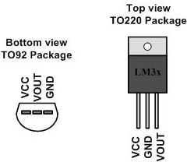
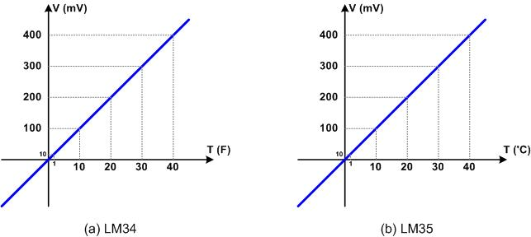
LM35 & LM34 (Temperature Sensors)
LM35 and LM34:
  convert temp. to voltage
  10mV for each degree

Slide 23
Example: Measuring temperature using LM35
int main( ) {
RCC->APB2ENR |= 0xFC|(1<<9)|(1<<14); /* enable clocks for GPIO, ADC1 clock, and usart1 */
GPIOA->CRL = 0x44444044; /* PA2(ADC_IN2) as analog input */
ADC1->CR2 = 1; /* ADON = 1 (power-up) */
ADC1->SMPR2 = 1<<6; /* SMPR2.SMP2 = 001 */
delay_us(1); /* wait 1us to make sure the adc module is stable */
usart1_init(); /* initialize the usart1 */
while(1) {
ADC1->SQR3 = 2; /* choose channel 2 as the input */
ADC1->CR2 = 1; /* ADON = 1 (start conversion) */
while((ADC1->SR&(1<<1)) == 0); /* wait until the EOC flag is set */
unsigned int temp = ADC1->DR*330/4096; /* read ADC1_DR and calc. temp. */
usart1_sendInt(temp); /* send temperature through serial */
usart1_sendStr("\n\r"); /* go to new line */
delay_ms(10); /* wait 10ms */
}
}

Slide 24
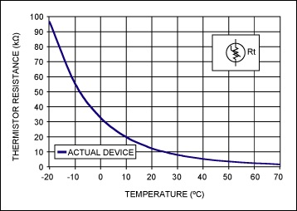
Thermistor (a temperature sensor)
Converts temperature to resistance
It is not linear

Slide 25
Signal conditioning
The output of some sensors (e.g. PT100) is in form of resistance
Some humidity sensor provide the result in form of Capacitance
We need to convert these signals to voltage, however, in order to send input to an ADC. This conversion is called signal conditioning.

