Slide 1
DC motor and PWM

Slide 2
Topics
Making Robots with Motors
DC motor
  Unidirectional control
  Bidirectional control
PWM
  generating waves with different duty cycles
  Controlling motor speed using PWM

Slide 3

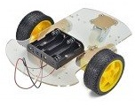
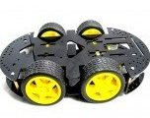
Some robots with 2 DC motors

Slide 4
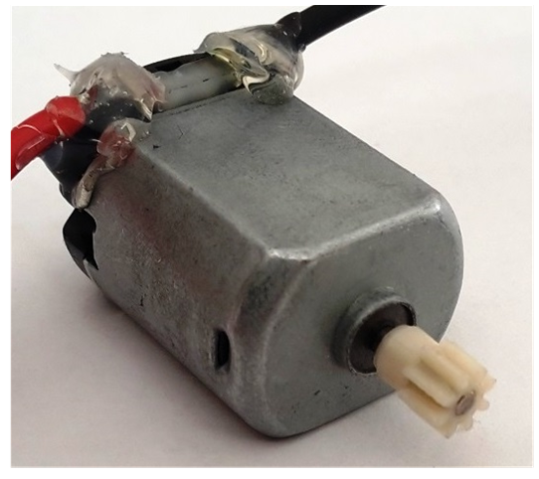

DC motor

Slide 5

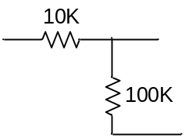
Unidirectional control
+12V
MCU
Analog Ground
M
VCC
Analog
Power
GND
TIP120
+3.3^{V}
Digital Ground

Slide 6
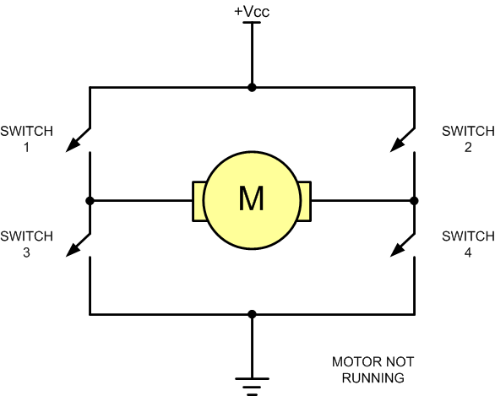
Bidirectional control

Slide 7
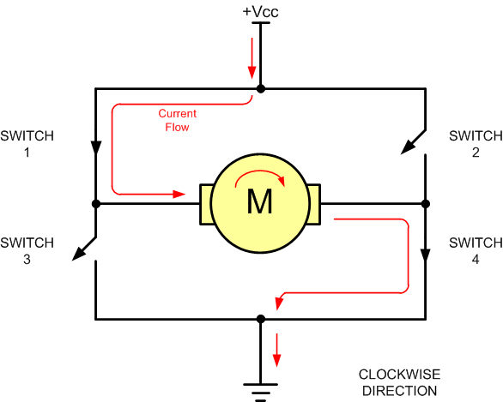
Bidirectional (clock wise)

Slide 8
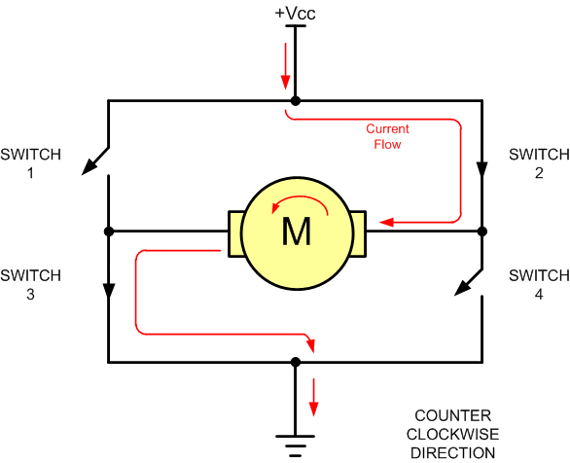
Bidirectional (counter clockwise)

Slide 9
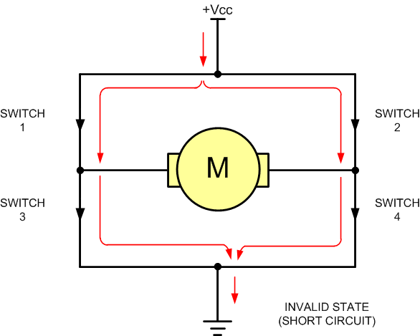
Bidirectional

Slide 10
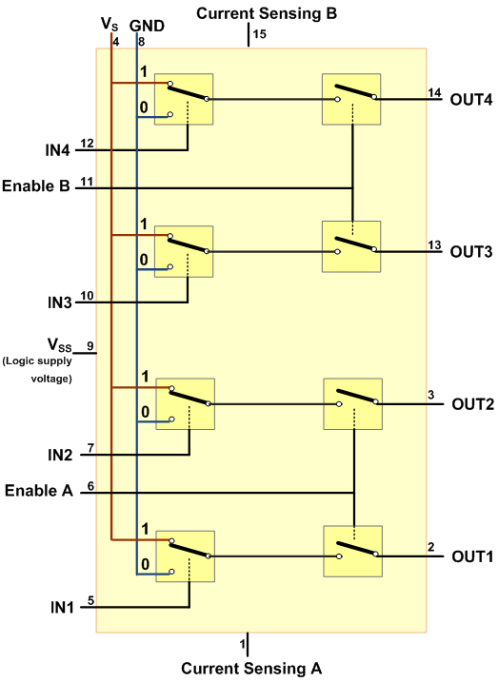
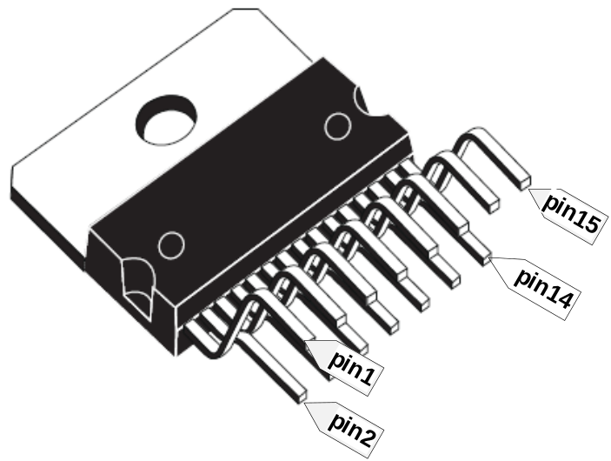
L298

Slide 11
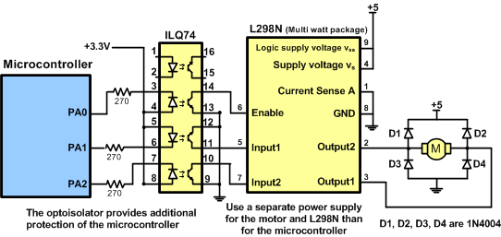
Using L298N

Slide 12
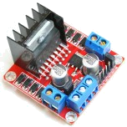
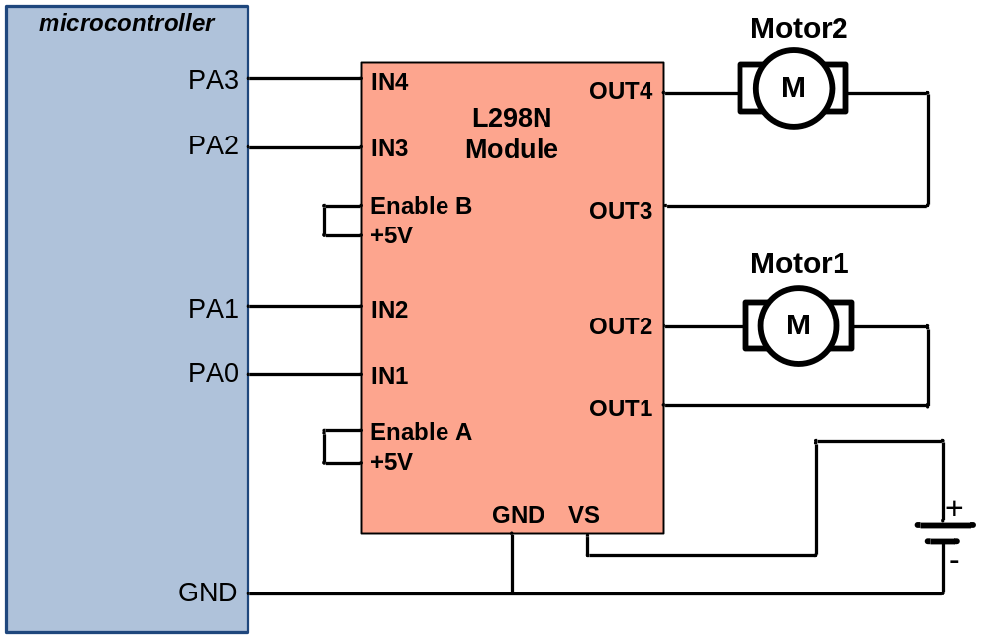
L298 module

Slide 13
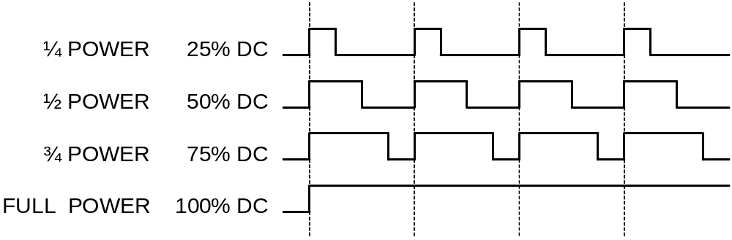
PWM and Duty Cycle

Slide 14
PWM in STM32F10x

Slide 15

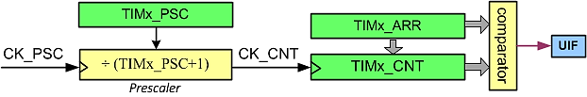
CNT, ARR, and PSC

Slide 16
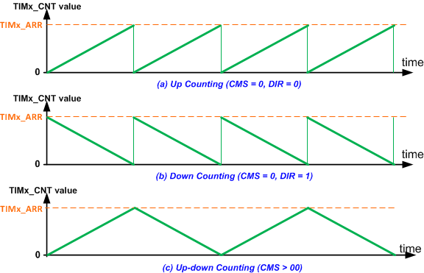
Counting Direction
CMS | DIR | Counting mode | Counting event (interrupt flag set)
00 | 0 | Counting up | When the counter reaches ARR
00 | 1 | Counting down | When the counter reaches 0
01 | X | Count up and down | When the counter reaches 0 and ARR
10 | X | Count up and down | When the counter reaches 0 and ARR
11 | X | Count up and down | When the counter reaches 0 and ARR

Slide 17
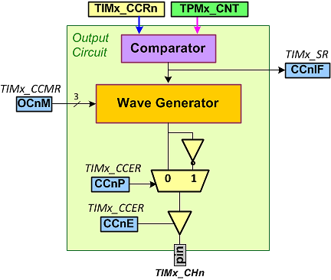
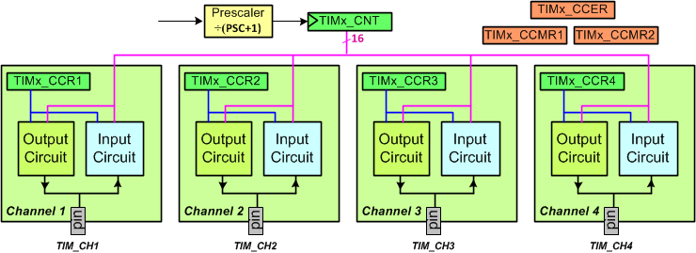
Timer channels

Slide 18
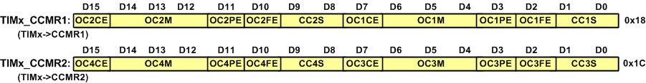
CCMR1 and CCMR2
OCnM: Output Compare n Mode
OCnPE: Output Compare n Preload Enable.
  0: TIMx_CCRn is not buffered,
  1: It is buffered.
CCnS: Compare/Capture n Selection
  00: output compare,
  otherwise: input capture
OCnM | Mode
000 | Frozen | Compare match has no effect on the GPIO pin
001 | Active on match | The output activates when CNT is equal to CCRn.
010 | Inactive on match | The output becomes inactive when CNT=CCRn.
011 | Toggle on match | The output toggles when CNT is equal to CCRn.
100 | Force inactive | It forces the GPIO pin to inactive level.
101 | Force active | It forces the GPIO pin to active level.
110 | PWM 1 | The output is active when CNT is less than CCRn.
111 | PWM 2 (inverted) | The output is inactive when CNT is less than CCRn.

Slide 19
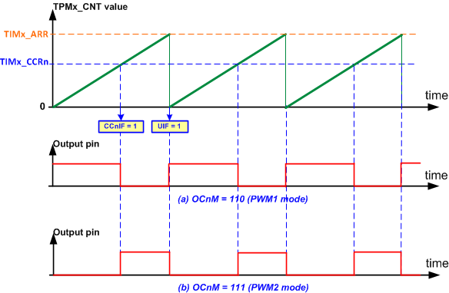
PWM in Up-Counting Mode

Slide 20
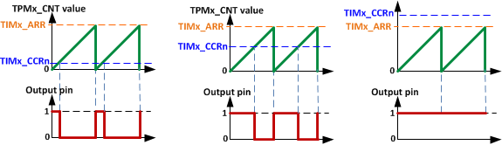
PWM1

Slide 21
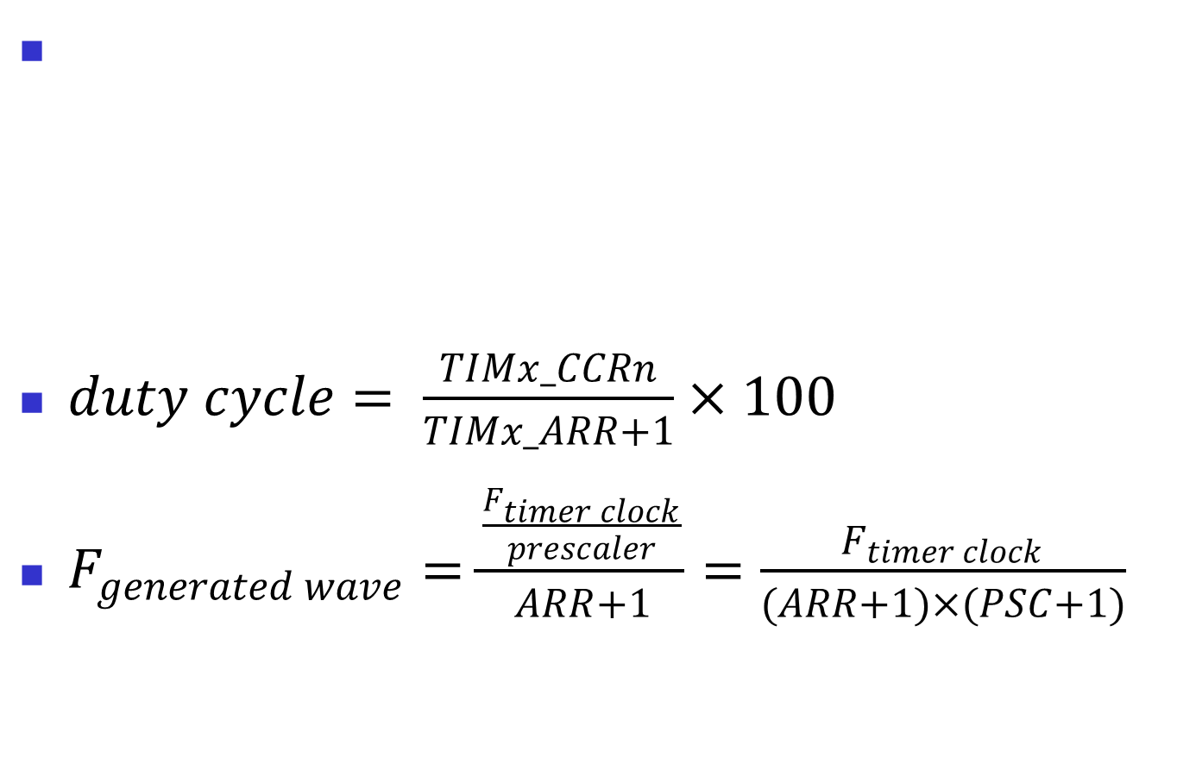
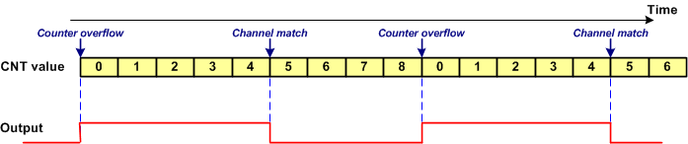
Duty cycle & Frequency
ARR = 8, CCRn= 5, OCnM = 110 (PWM1)

Slide 22
Example
Find the frequency (F) and pulse width (DC, duty cycle) of a PWM if TIMx_ARR=999 and TIMx_CCRn=250. Assume OCnM = 110 (PWM1), no prescaler, and TIMx clock frequency of 72MHz.
Solution:
Frequency=72M/(999+1)=72KHz=72000Hz.
The Duty Cycle is [TIMx_CCR/(TIMx_ARR +1)] × 100 = (250/1000) × 100 = 25%.

Slide 23
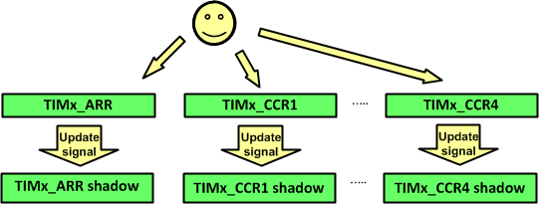
Shadow registers and Preloading
ARPE: Auto-reload Preload Enable
1: ARR is buffered

Slide 24
TIMx_EGR (Event Generating Register)
If the UG (update generation) bit of TIMx_EGR is set, an update signal is generated and then hardware clears the UG bit automatically.

Slide 25
Example: generating a 100Hz wave with D.C. of 30%
#include <stm32f10x.h>
int main( ) {
RCC->APB2ENR |= 0xFC; /* enable GPIO clocks */
RCC->APB1ENR |= (1<<0); /* enable TIM2 clock */
GPIOA->CRL = 0x4444444B; /* PA0: alternate func. output */
TIM2->CCER = 0x1 << 0; /* CC1P = 0, CC1E = 1 */
TIM2->CCMR1 = 0x0068; /* OC1M=PWM1, OC1PE=1 */
TIM2->CR1 = 0x80; /* Auto reload preload enable */
TIM2->PSC = 720-1; /* prescaler = 720 */
TIM2->ARR = 1000-1; /* ARR = 999 */
TIM2->CCR1 = 300; /* duty cycle = (300/1000)*100 */
TIM2->EGR = 1; /* UG = 1 (generate update) */
TIM2->CR1 |= 0x01; /* timer enable (CEN = 1) */
while(1) { }
}

Slide 26
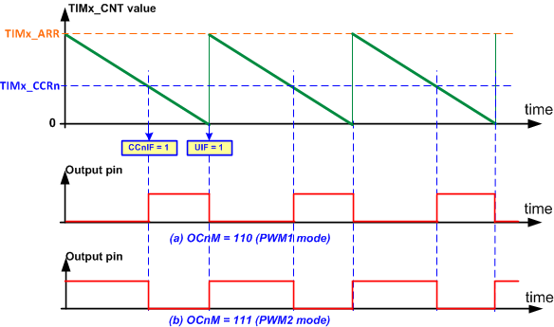
PWM in Down-Counting Mode

Slide 27
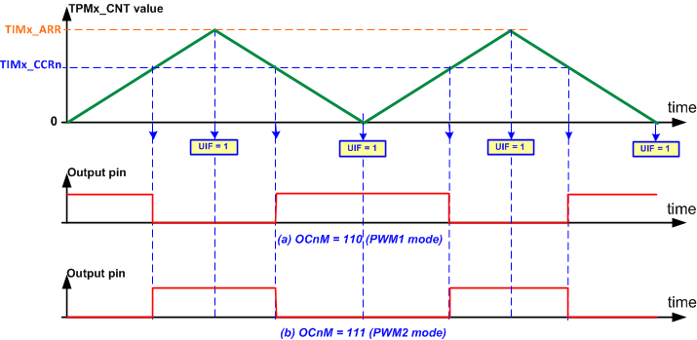
Up-down Counting (Center-aligned)

Slide 28
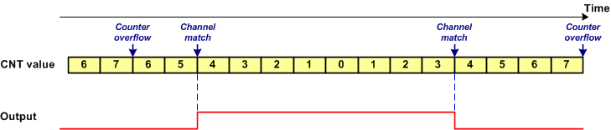
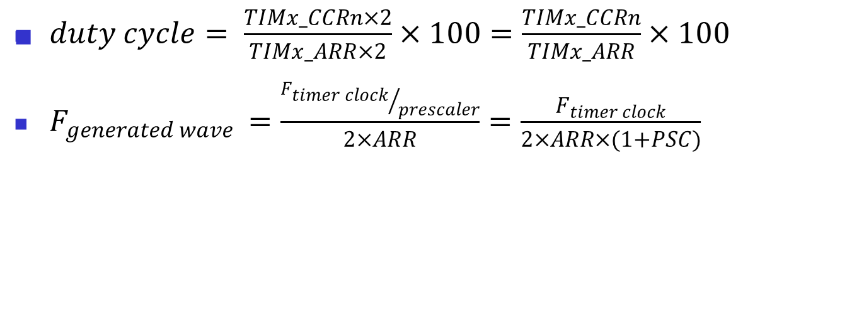
Duty Cycle and frequency

Slide 29
Example: Generating a wave with frequency of 1kHz and duty cycle of 70%
#include <stm32f10x.h>
int main( ) {
RCC->APB2ENR |= 0xFC; /* enable GPIO clocks */
RCC->APB1ENR |= (1<<1); /* enable TIM3 clock */
GPIOA->CRL = 0xB4444444; /* PA7: alternate func. output */
TIM3->CCER = 0x1 << 4; /* CC2P = 0, CC2E = 1 */
TIM3->CCMR1 = 0x6800; /* OC2M=PWM1, OC2PE=1 */
TIM3->CR1 = 0xA0; // Auto reload preload enable, up down counting mode
TIM3->PSC = 0; /* prescaler = 1 */
TIM3->ARR = 32000; /* ARR = 32000 */
TIM3->CCR2 = 25200; /* duty cycle = (25200/32000)*100 */
TIM3->EGR = 1; /* UG = 1 (generate update) */
TIM3->CR1 |= 0x01; /* timer enable (CEN = 1) */
while(1) { }
}

Slide 30
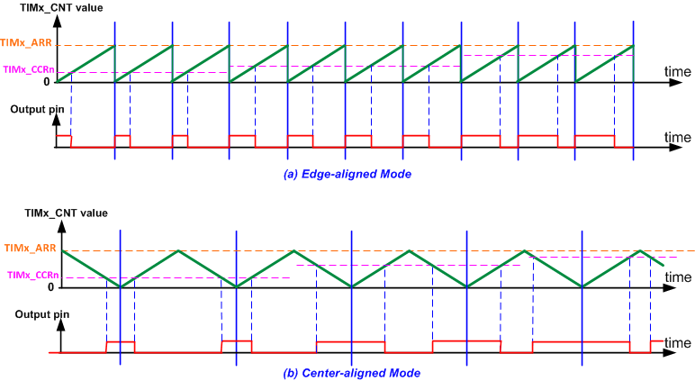
Edge-aligned vs. Center-aligned

Slide 31
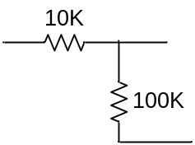
Unidirectional Speed Control
+12V
AVR
MCU
Analog Ground
M
VCC
VCC
Analog
Power
GND
GND
OC0A
TIMx_CHn
TIP120
+3.3V
Digital Ground

Slide 32
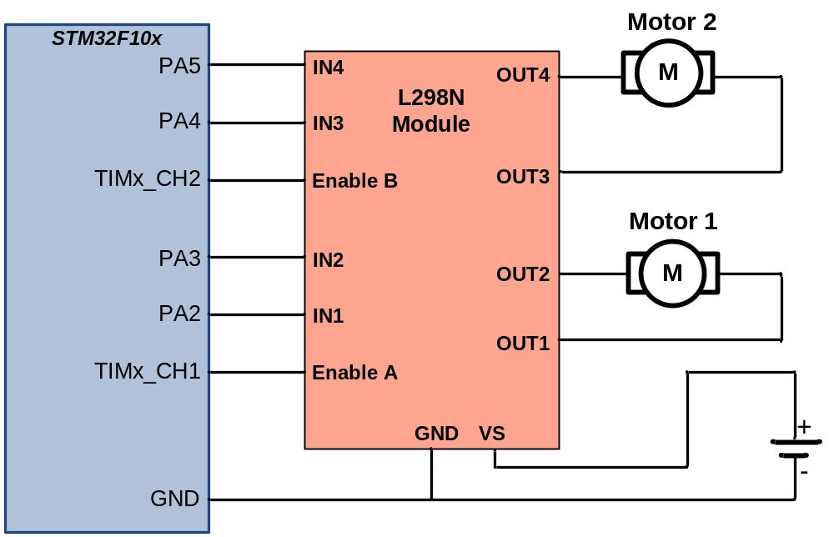
Bidirectional Speed Control

