Slide 1

I2C and RTC
Chapter 16
Sepehr Naimi
www.NicerLand.com

Slide 2
I2C History
IIC: Inter-Integrated Circuit
Philips (NXP)
1982
Aim: connecting many devices (around 128 devices) to the MCU using two wires

Slide 3
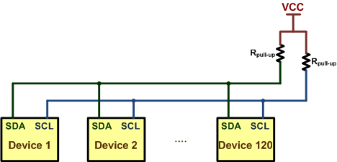
Connecting devices using I2C
SDA: Serial Data
SCL: Serial Clock
Open-collector devices (Wire AND)
SDA
SCL

Slide 4
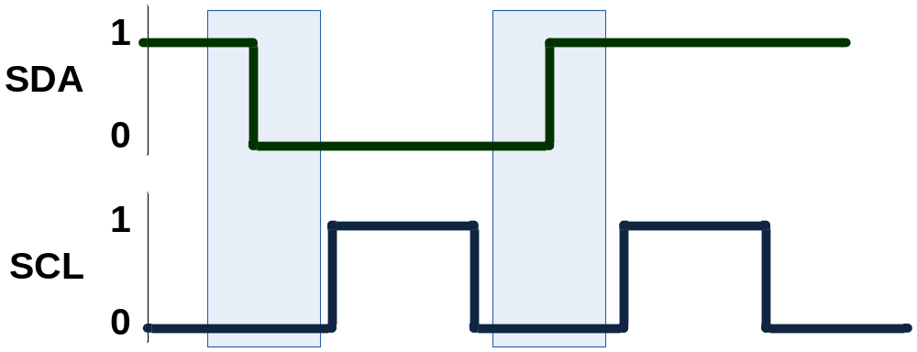
Sending bits of data
The SDA values changes when SCL is low.
The receiver reads SDA on the falling edge of SCL.

Slide 5
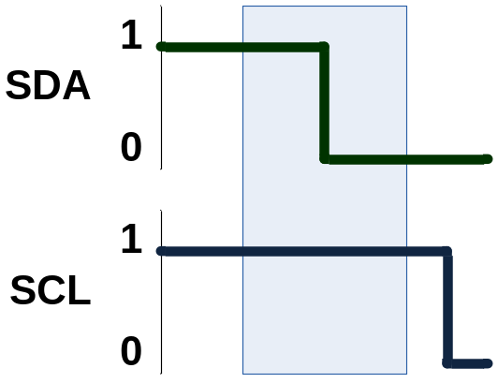
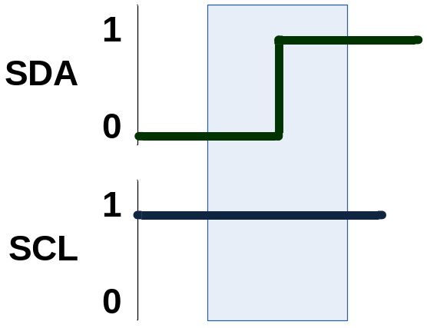
Start and Stop conditions
Start
Stop

Slide 6
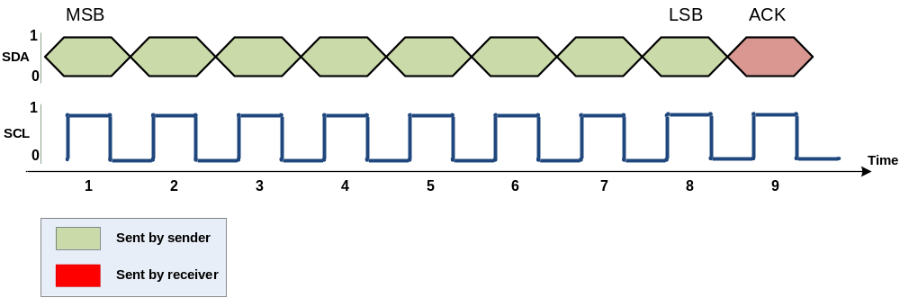
Packet Format
Each packet is 9 bits long.
First 8 bits are put on SDA by the transmitter
The 9th bit is an acknowledge by the receiver
  NACK (leave high) or ACK (pull down)

Slide 7
Master vs. Slave
Master
  Begins the communication
  Chooses the slave
  Makes clock
  Sends or receives data
Slave
  Responds to the master
  Each slave has a unique 7-bit address

Slide 8
Master vs. Slave (Cont.)
There might be more than 1 master on an I2C bus
Each device can be both Master and Slave

Slide 9
Steps of a communication
Start
Address
Send or Receive (Write or read)
Acknowledge
Send/receive a byte of data
Acknowledge
Stop

Slide 10
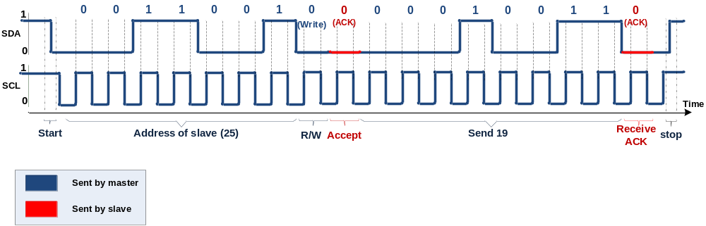
Sending a byte
Sending 19 to device 25.

Slide 11
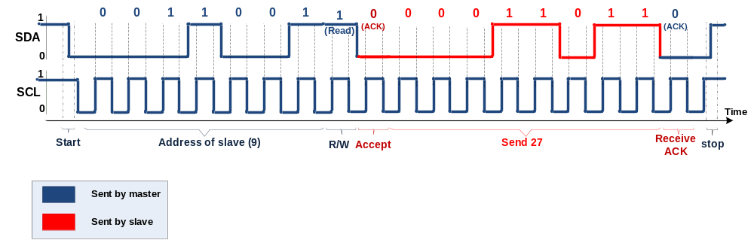
Receiving a byte from Device 9

Slide 12

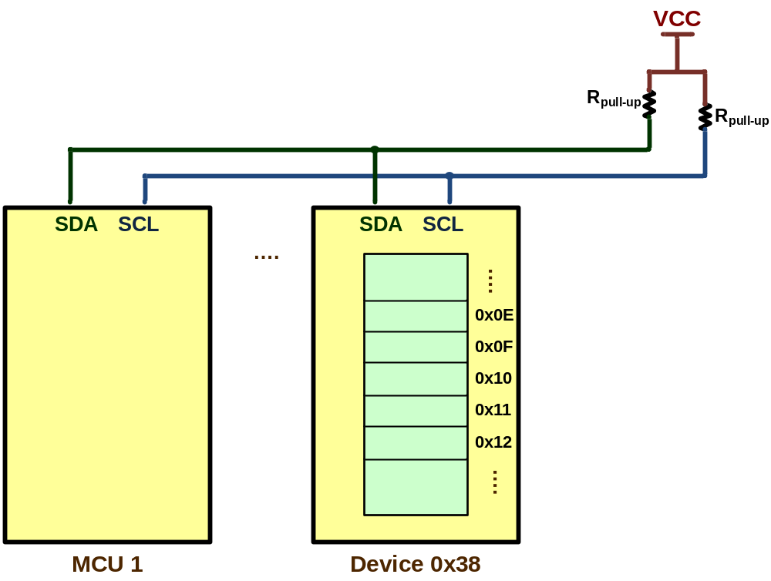
Multi-byte Burst Write
Master can send multiple bytes of data to slaves.
  E.g. To store data in memories with I2C interface, first the address and then data is sent.
0x38
0x0F
0x05
0x16
0x0B
0x38
0x0F
0x05
0x16
0x0B

Slide 13
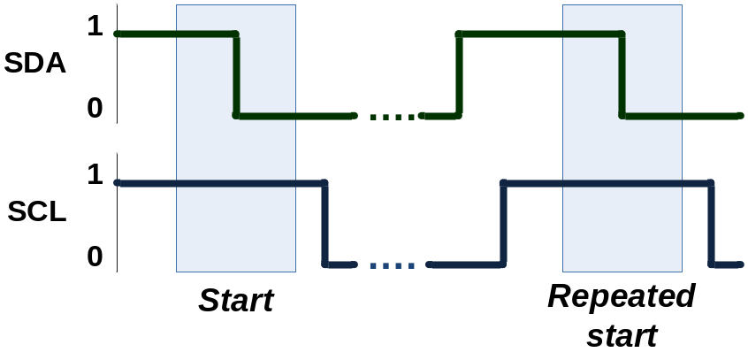
Repeated start
A new Start condition before the Stop condition

Slide 14

Repeated-Start and Multi-byte Burst Read
Reading from location 0x0F of memory:
  Send the address of memory for write
  Write the address of memory location to be read (0x0F)
  Make a repeated-start and send the address of memory for read
  Get data and send Ack. as long as, you want to get the next byte

Slide 15
I2C in STM32F10x

Slide 16
Field | Bit | Descriptions
SWRST | 15 | Software Reset
ALERT | 13 | SMBus alert (It is used in SMBus.)
PEC | 12 | Packet Error Checking
POS | 11 | PEC Position
ACK | 10 | Acknowledge enable (0: No Ack, 1: ACK) The bit is set/cleared by software to send ACK/NACK. Hardware clears the bit after sending ACK.
STOP | 9 | Stop generation If software sets the bit, the I2C hardware generates a Stop condition and switches to slave mode (The MSL bit of I2C_SR2 is cleared.)
START | 8 | Start generation When software sets the bit, the I2C interface generates a Start condition and switches to master mode (MSL is set). If it is already in master mode, setting the START bit generates a repeated start.
NO STRETCH | 7 | No clock stretching in slave mode (0: clock stretching enabled, 1: disabled) Software can set the bit to disable clock stretching.
ENGC | 6 | General Call Enable (0: General call disabled, 1: enabled (Addr. 0 is ACKed) )
ENPEC | 5 | PEC enable (0: PEC calculation disabled, 1: PEC calculation enabled)
ENARP | 4 | ARP enable (It is used in SMBus.)
SMBTYPE | 3 | SMB Type (It is used in SMBus.)
SMBUS | 1 | SMB Bus (0: I2C mode, 1: SMBus mode)
PE | 0 | Peripheral Enable (0: peripheral disable, 1: enable)

Slide 17
I2C_CR2 (Control Register 2)
Field | Bit | Descriptions
LAST | 12 | DMA Last Transfer
DMAEN | 11 | DMA request Enable (0: disabled, 1: enabled)
ITBUFEN | 10 | Buffer Interrupt Enable (0: Interrupt disabled, 1: enabled) If ITBUFEN is set, an interrupt is generated when TxE or RxNE flags of I2C_SR1 are set.
ITEVTEN | 9 | Event Interrupt Enable (0: Interrupt disabled, 1: enabled) If ITEVTEN is set, an interrupt is generated when any of the event flags (SB, ADDR, ADD10, STOPF, or BTF) are set.
ITERREN | 8 | Error Interrupt Enable (0: Interrupt disabled, 1: enabled) If ITERREN is set, an interrupt is generated when any of the error flags (BERR, ARLO, AF, OVR, PECERR, TIMEOUT, or SMBALERT) are set.
FREQ | 5-0 | PCLK (Peripheral Clock) Frequency

Slide 18
I2Cx_CCR (Clock Control Register)
Field | Bit | Descriptions
F/S | 15 | Master mode selection (0: Standard mode, 1: Fast mode)
DUTY | 14 | SCL clock duty cycle in Fast mode
CCR | 11-0 | Clock Control in master mode
I2C grade | Baud rate
Standard | 100Kbps
Fast | Up to 400Kbps
Fast plus | Up to 1Mbps
High Speed | Up to 3.2Mbps
F/S | DUTY | Duty cycle for SCL | t_{low} | t_{high} | T_{I2C} (=t_{low}+t_{high}) | Baud rate (1/T_{I2C})
0 (Standard) | X | 50% | CCR × T_{PCLK} | CCR × T_{PCLK} | 2×CCR×T_{PCLK} | F_{PCLK}/(2×CCR)
1 (Fast) | 0 | 33.3% | 2×CCR×T_{PCLK} | CCR×T_{PCLK} | 3×CCR×T_{PCLK} | F_{PCLK}/(3×CCR)
1 (Fast) | 1 | 36% | 16×CCR×T_{PCLK} | 9×CCR×T_{PCLK} | 25×CCR×T_{PCLK} | F_{PCLK}/(25×CCR)

Slide 19
I2C_TRISE (T_{Rise})
Using the I2C_TRISE, we mention the amount of time that the rise time might take.
  In Standard mode
    I2C_TRISE is usually set to (PCLK/1M) + 1
    E.g.: PCLK = 32M ➔ TRISE = 32 + 1 = 33
  In Fast mode
    I2C_TRISE = 0.3 × (PCLK/1M) + 1
    E.g.: PCLK = 40M ➔ TRISE = (0.3 × 40) +1 = 13

Slide 20
Example
Assuming PCLK1 is 36MHz. Find I2C_CR2, I2C_CCR and I2C_TRISE for speed of 100Kbps.
Solution:
PCLK1 is 36MHz. So, FREQ should be set to 36 (100100 in binary)
I2C_CR2 | Res. | LAST | DMAEN | ITBUFEN | ITEVTEN | ITERREN | Res. | FREQ
 | 000 | 0 | 0 | 0 | 0 | 0 | 00 | 100100
I2C_CR2 = 0x0024
100Kbps is standard. baud rate = PCLK/(2×CCR) ➔ 100K = 36M/(2×CCR) ➔ CCR = 180. So, F/S = 0 and CCR = 000010110100. DUTY can be 0 or 1.
I2C_CCR | F/S | DUTY | Res. | CCR
 | 0 | X | 00 | 0000 1011 0100
I2C_CCR = 0x00B4
I2C_TRISE = (PCLK/1M) + 1 = 36 + 1 = 37.

Slide 21

I2Cx_OAR1 (Own Address Register)

Slide 22
I2C_DR (Data Register)

Slide 23
I2Cx_SR1 (Status Register)
Field | Bit | Descriptions
SMBALERT | 15 | SMB Alert (Not used in I2C)
TIMEOUT | 14 | Time out (0: No timeout, 1: SCL remained LOW for 25ms)
PECERR | 12 | PEC Error in reception
OVR | 11 | Overrun/Underrun (0: No overrun/underrun, 1: overrun or underrun) The flag might rise when NOSTRETCH=1. See the reference manual.
AF | 10 | Acknowledge Failure (0: No Acknowledge failure, 1: Acknowledge failure)
ARLO | 9 | Arbitration lost in master mode (0: no arbitration lost, 1: arbitration lost)
BERR | 8 | Bus Error (0: no bus error, 1: bus error) As discussed earlier, when SCL is high, SDA should not change. Otherwise, it is considered as STOP or START conditions. While transferring data, if the value of SDA changes when SCL is high, the BERR flag sets.
TxE | 7 | Transmit Empty (0: Transmit not empty, 1: Empty) The flag is set by hardware when it is waiting for us to write data to the I2C_DR register.
RxNE | 6 | Receive Not Empty The flag is set when a new byte of data is in I2C_DR waiting to be read.
STOPF | 4 | Stop detection in slave mode (0: No Stop condition, 1: Stop condition)
ADD10 | 3 | 10-bit header sent (Used in 10-bit address mode)
BTF | 2 | Byte transfer finished (0: transfer not done, 1: transfer successfully finished)
ADDR | 1 | Address sent (master mode)/matched (slave mode) In slave mode, if the received address matches with I2C_OAR, the flag sets. In master mode, when the address is sent, the flag sets. To clear the flag, read I2C_SR1 and then I2C_SR2.
SB | 0 | Start bit (0: No start generated, 1: start condition generated) In master mode, the flag sets as soon as a Start condition is generated. To clear the flag, read I2C_SR1 and then write to I2C_DR.

Slide 24
I2Cx_SR2 (Status Register 2)
Field | Bit | Descriptions
PEC | 15-8 | Packet Error Checking (For more information, see the manual.)
DUALF | 7 | Dual Flag (It is used when dual address is enabled. See the manual.)
SMBHOST | 6 | Used in SMBus. (For more information, see the manual.)
SMBDEFAULT | 5 | Used in SMBus. (For more information, see the manual.)
GENCALL | 4 | General call detected (0: no general call, 1: General call address received)
TRA | 2 | Transmitter/receiver (0: receiver, 1: transmitter) In slave mode, the flag shows if the device is in receiver or transmitter mode. The hardware sets the flag according to the R/W signal.
BUSY | 1 | Bus Busy (0: no communication on the bus, 1: communication on the bus) The flag indicates that a communication is in progress. Hardware sets the flag when SCL or SDA become low. The flag clears when a stop condition is detected.
MSL | 0 | Master/Slave (0: Slave, 1: Master) The hardware sets the flag when the I2C module is in master mode. The flag is set when a stop condition or arbitration lost is detected.

Slide 25
Configuring the I2C
We need to take the following steps to configure the I2C:
  Enable the clock to I2C module and the GPIO using APB1ENR and APB2ENR,
  Configure I2C pins as alternate function open-drain output,
  Initialize the FREQ field of CR2 with the PCLK frequency,
  Initialize CCR to make proper baud rate in master mode,
  Initialize the TRISE register,
  Enable the I2C module by setting the PE bit of CCR1.

Slide 26
Sending data in master mode
Check the busy flag of SR2 to make sure the bus is not busy.
Set the START bit of CR1 to make a start condition.
Monitor the SB bit of SR1 until the start condition is generated.
Put the slave address in the data register (DR). Bits 1 to 7 should contain the slave address and the bit 0 is R/W. To send data the R/W needs to be 0.
Monitor the status registers. If the address is sent successfully the ADDR flag sets and you can continue the progress. If the ARLO (Arbitration Lost) is set, you should wait until the bus becomes free and you should repeat steps 1 to 5.
Load the data register with the data to be sent.
Monitor the TxE flag. The flag is set when an ACK is received.
Repeat steps 6 and 7 if you have more bytes to send. Otherwise, set the STOP bit of CR1 to make a stop condition.

Slide 27
Receiving Data
Receiving data is similar to sending. To receive data in master mode we should do the followings:
  Check the busy flag of SR2 to make sure the bus is not busy.
  Set the START bit of CR1 to make a start condition.
  Monitor the SB bit of SR1 until the start condition is generated.
  Put the slave address in the data register (DR). Bits 1 to 7 should contain the slave address and the bit 0 is R/W. To receive data, the R/W needs to be 1.
  Monitor the status registers. If the address is sent successfully the ADDR flag sets and you can continue the progress. If the ARLO (Arbitration Lost) is set, you should wait until the bus becomes free and you should repeat steps 1 to 5.
  If you want to send an ACK in response, set the ACK bit of CR1.
  Monitor the RxNE flag. The flag is set when a byte is received. Then, read the data register to get the received byte.
  Repeat steps 6 and 7 if you want to receive more bytes. Otherwise, set the STOP bit of CR1 to make a stop condition.

Slide 28
Program: Sending 0x0E and 0 to slave 0x68
#include <stm32f10x.h>
void i2c_init(void);
void i2c_waitForReady(void);
void i2c_sendStart(void);
uint8_t i2c_sendAddrForWrite(uint8_t addr);
uint8_t i2c_sendData(uint8_t data);
void i2c_sendStop(void);
int main( ) {
i2c_init();
do{
i2c_waitForReady();
i2c_sendStart();
}while(i2c_sendAddrForWrite(0x68) != 0);
i2c_sendData(0x0E);
i2c_sendData(0);
i2c_sendStop();
while(1);
}
void i2c_init( ) {
RCC->APB2ENR |= (0xFC); /* enable clocks for GPIOs */
RCC->APB1ENR |= (1<<21); /* enable clock for I2C1 */
GPIOB->CRL |= 0xFF000000; /* configure PA6 and PA7 as alt. func. open drain */
I2C1->CR2 = 0x0020;
I2C1->CCR = 0x00B4;
I2C1->TRISE = 37;
I2C1->CR1 = 1; /* PE = 1 */
}
void i2c_waitForReady( ) {
while((I2C1->SR2&(1<<1)) != 0); /* check bus busy */
}
void i2c_sendStart( ) {
I2C1->CR1 |= (1<<8); /* start */
while((I2C1->SR1&(1<<0)) == 0); /* wait for SB */
int stat = I2C1->SR2;
}
void i2c_sendStop( ) {
I2C1->CR1 |= (1<<9); /* stop */
while((I2C1->SR2&(1<<0)) != 0); /* wait for becoming slave */
}
uint8_t i2c_sendAddr(uint8_t addr) {
I2C1->DR = addr;
int stat;
do{
stat = I2C1->SR1;
if((stat&(1<<9)) != 0) /* arbitration lost */
return 1;
if((stat&(1<<1)) != 0) /* address sent */
{
stat = I2C1->SR2; /* read SR2 to clear ADDR flag */
return 0;
}
}while(1);
}
uint8_t i2c_sendAddrForRead(uint8_t addr) {
return i2c_sendAddr((addr<<1) + 1); /* addr+Read(1) */
}
uint8_t i2c_sendAddrForWrite(uint8_t addr) {
return i2c_sendAddr((addr<<1)); /* addr+Write(0) */
}
uint8_t i2c_sendData(uint8_t data) {
I2C1->DR = data;
int stat1;
do{
stat1 = I2C1->SR1;
if((stat1&(1<<7)) != 0) /* TxE = 1 */
return 0;
} while(1);
}
uint8_t i2c_readData(uint8_t ack) {
if(ack!= 0)
I2C1->CR1 |= 1<<10;
else
I2C1->CR1 &= ~(1<<10);
while((I2C1->SR1&(1<<6)) == 0); /* waiting for RxNE */
return I2C1->DR;
}

Slide 29
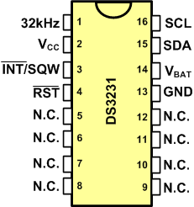
DS3231
RTC (Real-time clock)
Keeps time and date

Slide 30
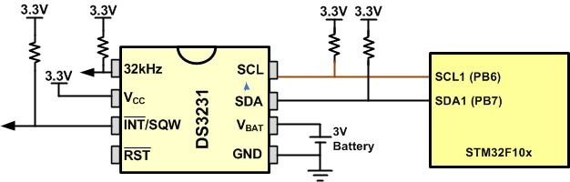
Connecting DS3231 to the MCU

Slide 31
DS3231 address map
Addr. | Bit7 | Bit6 | Bit5 | Bit4 | Bit3 | Bit2 | Bit1 | Bit0 | Function | Range
00H | 0 | 10 Seconds |  |  | Seconds |  |  |  | Seconds | 00-59
01H | 0 | 10 Minutes |  |  | Minutes |  |  |  | Minutes | 00-59
02H | 0 | 12/24 | PM/AM 20 hour | 10hour | Hours |  |  |  | Hours | 1-12+AM/PM 0-23
03H | 0 | 0 | 0 | 0 | 0 | Day |  |  | Day | 1-7
04H | 0 | 0 | 10 Date |  | Date |  |  |  | Date | 01-31
05H | Century | 0 | 0 | 10Month | Month |  |  |  | Month Century | 1-12+Century
06H | 10 Year |  |  |  | Year |  |  |  | Year | 00-99
07H | A1M1 | 10 Seconds |  |  | Seconds |  |  |  | Alarm 1 Seconds | 00-59
08H | A1M2 | 10 Minutes |  |  | Minutes |  |  |  | Alarm 1 Minutes | 00-59
09H | A1M3 | 12/24 | AM/PM | 10 Hour | Hour |  |  |  | Alarm 1 Hours | 1-12 00-23
 |  |  | 20 Hour
0AH | A1M4 | DY/DT | 10 Date |  | Day |  |  |  | Alarm 1 Day | 1-7
 |  |  |  |  | Date |  |  |  | Alarm 1 Date | 01-31
0BH | A2M2 | 10 Minutes |  |  | Minutes |  |  |  | Alarm 2 Minutes | 00-59
0CH | A2M3 | 12/24 | AM/PM | 10 Hour | Hour |  |  |  | Alarm 2 Hours | 1-12 00-23
 |  |  | 10 Hour
0DH | A2M4 | DY/DT | 10 Date |  | Day |  |  |  | Alarm 2 Day | 1-7
 |  |  |  |  | Date |  |  |  | Alarm 2 Date | 01-31
0EH | EOSC# | BBSQW | CONV | RS2 | RS1 | INTCN | A2IE | A1IE | Control | -
0FH | OSF | 0 | 0 | 0 | EN32kHz | BSY | A2F | A1F | Control/Status | -
10H | SIGN | DATA | DATA | DATA | DATA | DATA | DATA | DATA | Aging Offset | -
11H | SIGN | DATA | DATA | DATA | DATA | DATA | DATA | DATA | MSB of Temp | -
12H | DATA | DATA | 0 | 0 | 0 | 0 | 0 | 0 | LSB of Temp | -
19 bytes
BCD format is used
Addresses 0x00 to 0x06 give time and date.

Slide 32
Register Pointer in DS3231
In DS3231 there is a register pointer that specifies the byte that will be accessed in the next read or write command.
After each read or write operation, the content of the register pointer is automatically incremented. It is useful in multi-byte read or write.
Register pointer:

Slide 33
Writing to DS3231
Transmit START condition
Transmit the address of DS3231 (1001101) followed by 0 to indicate a write operation
Transmit the address of location you want to access (it sets the value of Register Pointer)
Transmit one or more bytes of data
Transmit STOP condition

Slide 34
Reading from DS3231
Transmit START condition
Transmit the address of DS1307 (1001101) followed by 1 to indicate a read operation
Receive one or more bytes of date
Transmit STOP condition
  Note: the register pointer indicates which address will be read (you should set it before reading)

Slide 35
Example: Setting Time and Date
/* The program sets time and date to 15/9/2019 19:14:35 */
#include <stm32f10x.h>
void i2c_init(void);
void i2c_waitForReady(void);
void i2c_sendStart(void);
uint8_t i2c_sendAddrForWrite(uint8_t addr);
uint8_t i2c_sendData(uint8_t data);
void i2c_sendStop(void);
int main( ) {
i2c_init();
do{
i2c_waitForReady(); /* wait while the bus is busy */
i2c_sendStart(); /* generate a start condition */
/* send slave addr. 0x68 for write. repeat from beginning if arbitration lost */
}while(i2c_sendAddrForWrite(0x68) != 0);
i2c_sendData(0x0); /* set addr. pointer to 0 */
i2c_sendData(0x35); /* second */
i2c_sendData(0x14); /* min */
i2c_sendData(0x19); /* hour */
i2c_sendData(0x07); /* day of week */
i2c_sendData(0x15); /* day of month */
i2c_sendData(0x09); /* month */
i2c_sendData(0x19); /* year */
i2c_sendStop(); /* generate a stop condition */
while(1);
}
/* Copy all the I2C functions to here */

Slide 36
Example: Reading Time and Date and sending via USART1
#include <stm32f10x.h>
#include <stdio.h>
void i2c_init(void);
void i2c_waitForReady(void);
void i2c_sendStart(void);
void i2c_sendStop(void);
uint8_t i2c_sendAddrForRead(uint8_t addr);
uint8_t i2c_sendAddrForWrite(uint8_t addr);
void getTime(uint8_t *year, uint8_t *month, uint8_t *day, uint8_t *hour, uint8_t *min, uint8_t *sec);
void usart1_init(void);
void usart1_sendByte(unsigned char c);
void usart1_sendStr(char *str);
void delay_ms(uint16_t t);
int main()
{
char str[30];
uint8_t year, month, day, hour, min, sec;
RCC->APB2ENR |= (0xFC)|(1<<14); /* enable clocks for GPIOs and usart1 */
i2c_init();
usart1_init();
usart1_sendStr("\n\rDate and Time");
while(1) {
getTime(&year, &month, &day, &hour,&min,&sec);
sprintf(str,"\n\r%d/%d/%d %d:%d:%d",day,month,year,hour,min,sec);
usart1_sendStr(str);
delay_ms(1000);
}
}
/* The function gets a BCD number and converts it to binary */
uint8_t bcd2int(uint8_t n){
return ((n&0xF0)>>4)*10 + (n&0x0F);
}
void getTime(uint8_t *year, uint8_t *month, uint8_t *day, uint8_t *hour,
uint8_t *min, uint8_t *sec) {
do{
i2c_waitForReady(); /* wait while the bus is busy */
i2c_sendStart(); /* generate start condition */
}while(i2c_sendAddrForWrite(0x68) != 0); /* send addr. 0x68 for write; repeat if arbitration lost */
i2c_sendData(0x00); /* set register pointer to 0 */
i2c_sendStop(); /* generate stop condition */
do{
i2c_waitForReady(); /* wait while the bus is busy */
i2c_sendStart(); /* generate start condition */
}while(i2c_sendAddrForRead(0x68) != 0); /* send addr. 0x68 for read; repeat if arbitration lost */
*sec = bcd2int(i2c_readData(0x01)); /* read sec */
*min = bcd2int(i2c_readData(0x01)); /* read min */
*hour = bcd2int(i2c_readData(0x01)); /* read hour */
i2c_readData(0x01); /* read day of week */
*day = bcd2int(i2c_readData(0x01)); /* read day of month */
*month = bcd2int(i2c_readData(0x01)); /* read month */
*year = bcd2int(i2c_readData(0x00)); /* read year (the last read) */
i2c_sendStop(); /* generate stop */
}
void delay_ms(uint16_t t)
{
volatile unsigned long l = 0;
for(uint16_t i = 0; i < t; i++)
for(l = 0; l < 6000; l++)
{
}
}
/* Copy the I2C functions from Program 16-1 to here. */
/* Copy the USART1 functions from Program 11-1 to here. */

Slide 37
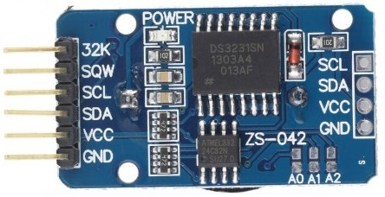
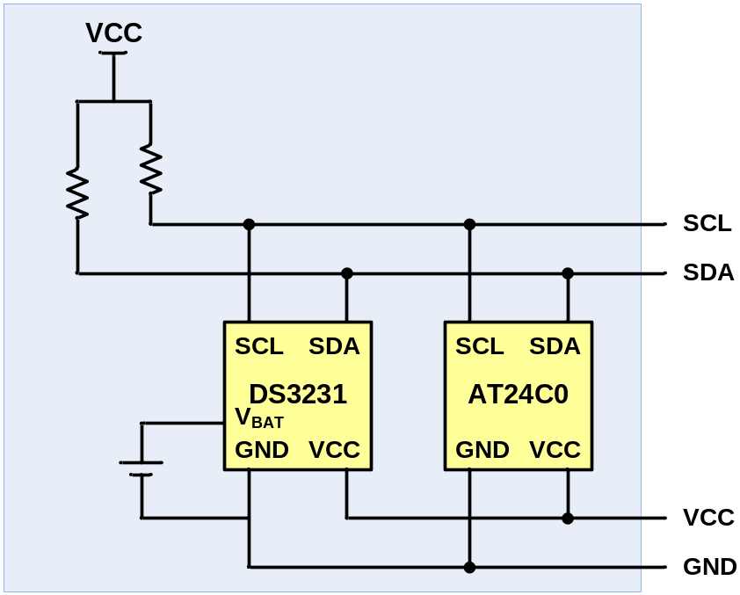
DS3231 module
It contains:
  DS3231
  A backup battery
  An AT24C0 EEPROM

Slide 38
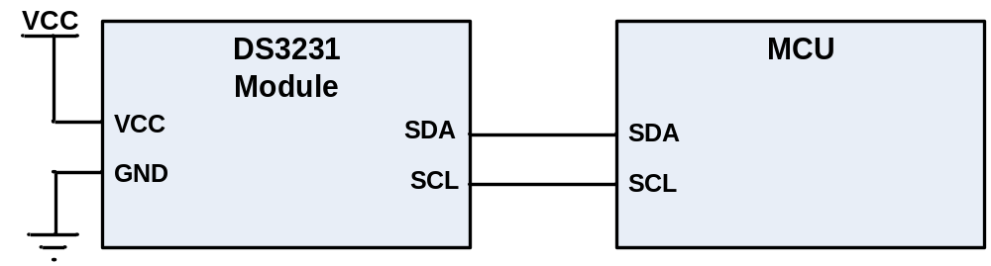
Connecting DS3231 to the MCU

